Slide 1
US Collegiate Sports
John Little
&
Yeva Kramarova

Slide 2
Introduction
US Collegiate Sports Dataset
This data set contains the comprehensive information on collegiate sports programs across various institutions in the United States from years 2015-2019. It includes data on student enrollment, sports participation, revenue, and expenditures, categorized by gender and sport.
We chose it because we’re both interested in sports

Slide 3
Dataset Description
This dataset includes the total number of male and female students enrolled in each institution, providing insights into the gender distribution of the student body. Participation data is broken down by gender and sport, allowing for analysis of gender representation in different sports. Revenue and expenditures for men's and women's sports are detailed, enabling financial analysis of sports programs. Institutions are classified by type and sector, which helps in comparing different categories of schools (e.g., NCAA Division I, II, III). The data set contains 132,327 rows and 28 columns with various data types. A complete listing is shown in Table 1.

Slide 4
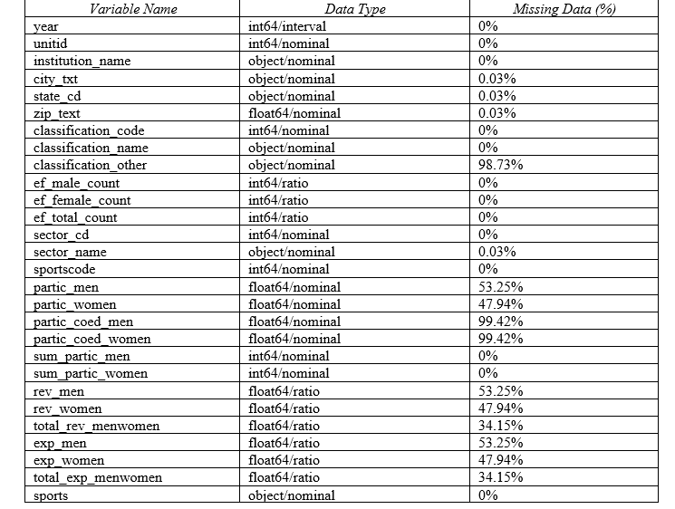
Table 1: Data Types and Missing Data

Slide 5
Data Cleanup Process
Dropped 3 variables that had an unusable amount of missing/blank data
Noticed that some of the sports did not have participation by both genders and were left blank (football, for example). Replaced these pieces of missing data with 0’s to reflect no participation.
For the missing categorical data, we replaced those with ‘unknown’ so that they did not mess up the data
Checked for complete data cleanup

Slide 6
Dataset Summary Statistics
This section will dive deeper into the statistical measurements of the dataset such as count, mean, standard deviation, min, 25th, 50th, 75th, max.

Slide 7
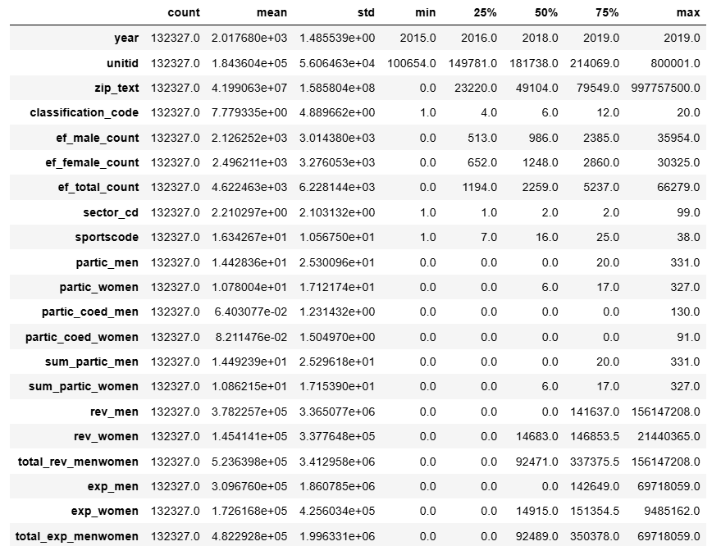
Table 2: Summary Statistics for US Collegiate Sports

Slide 8
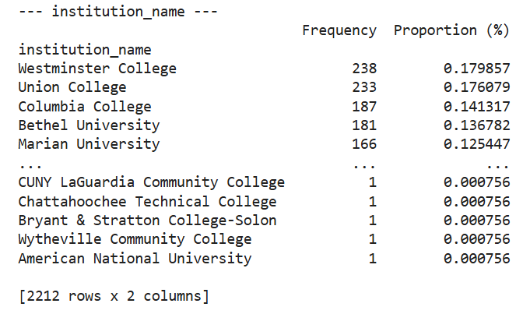
Table 3: Proportions for US Collegiate Sports (Institution)

Slide 9
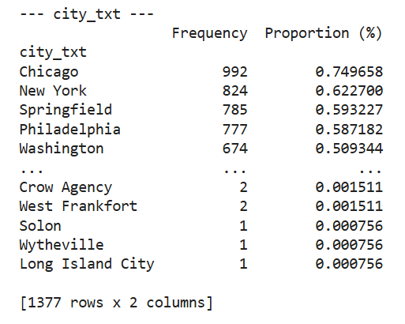
Table 3: Proportions for US Collegiate Sports (City)

Slide 10
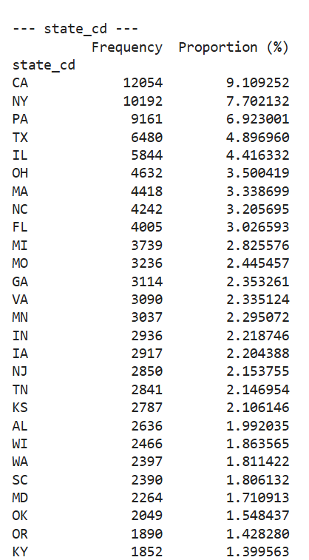
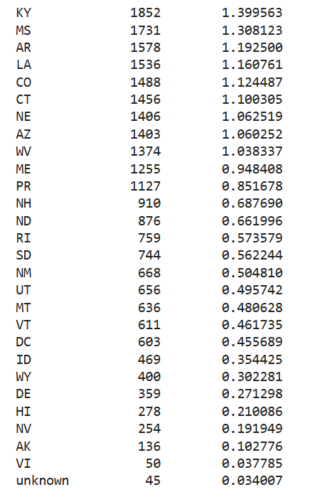
Table 3: Proportions for US Collegiate Sports (State)

Slide 11
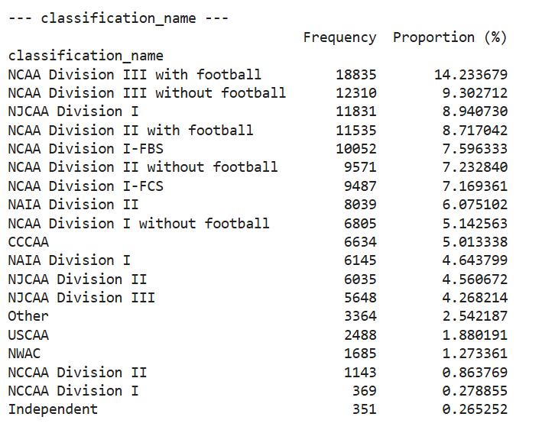
Table 3: Proportions for US Collegiate Sports (Sport Classification)

Slide 12
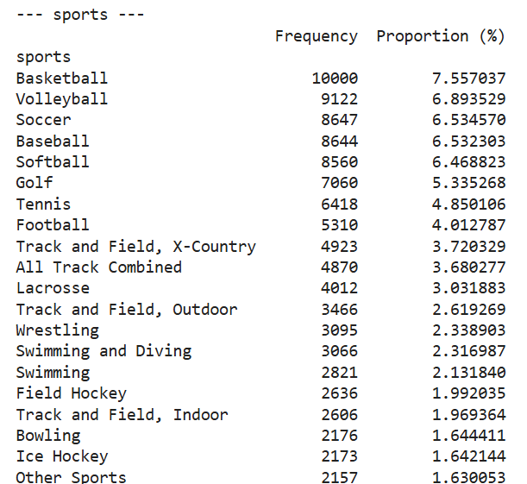
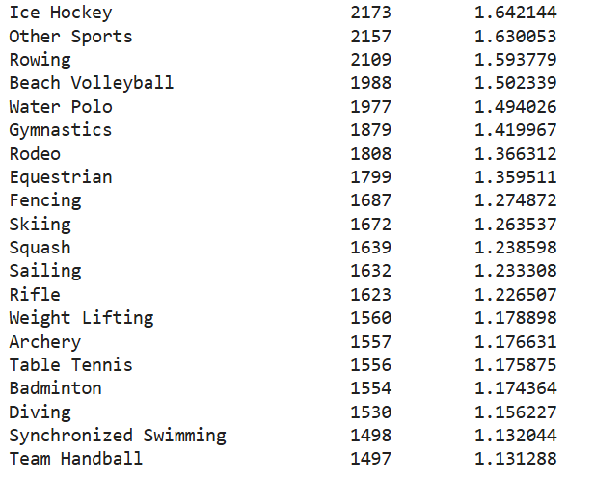
Table 3: Proportions for US Collegiate Sports (Sports)

Slide 13
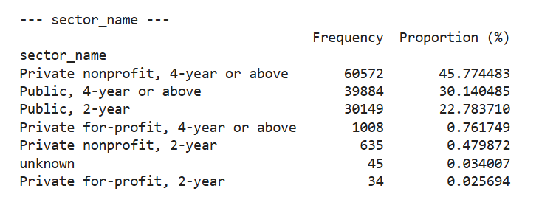
Table 3: Proportions for US Collegiate Sports (Sector)

Slide 14
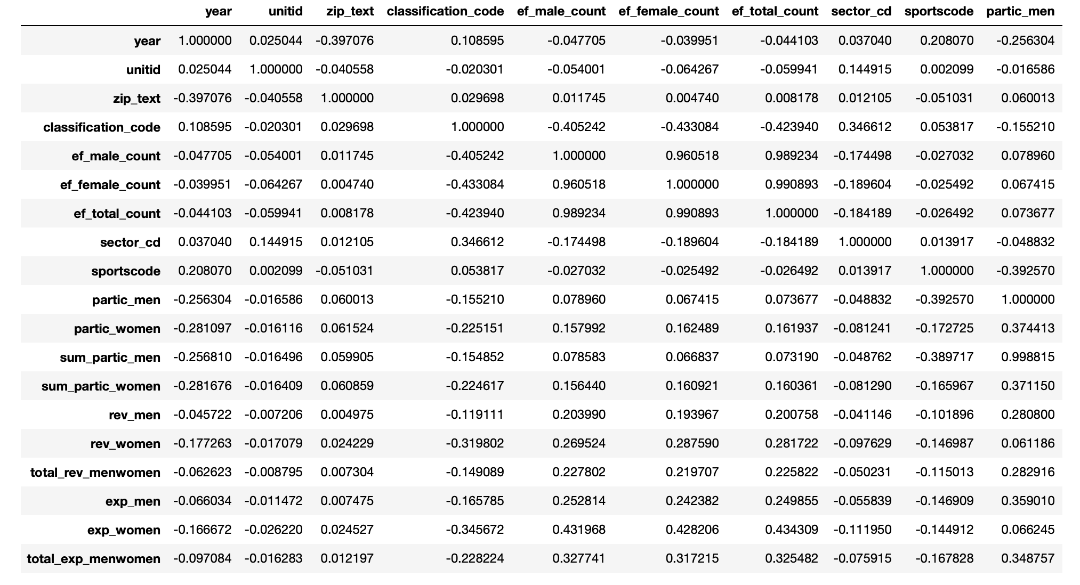
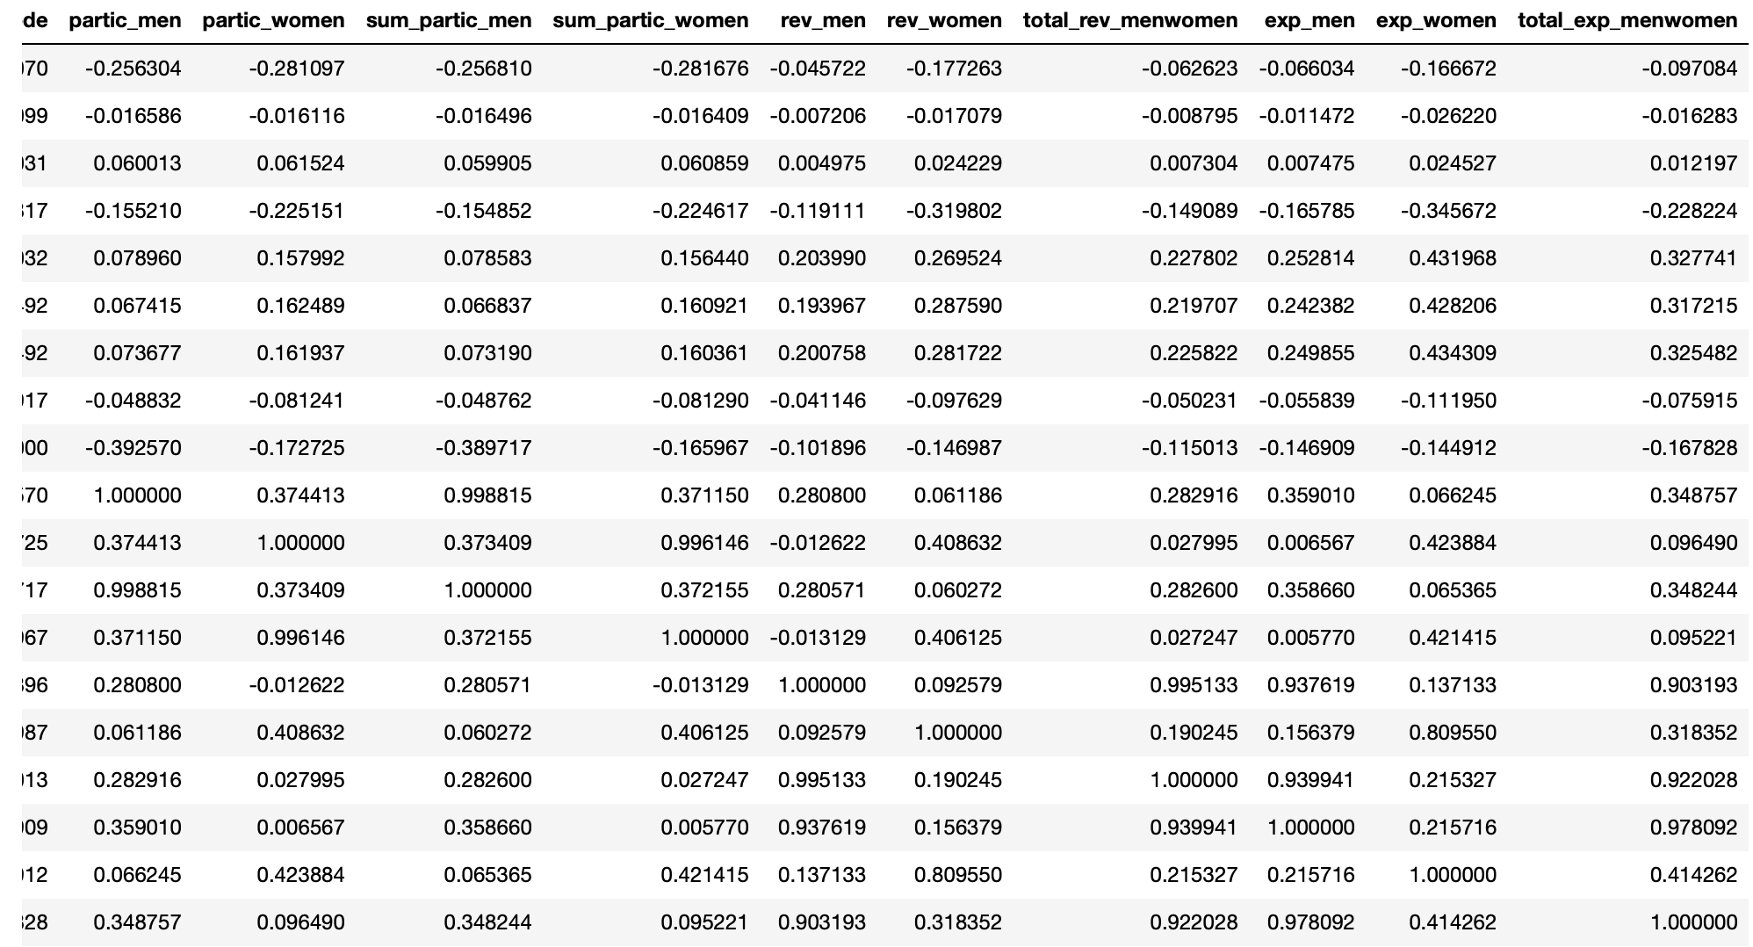
Table 4a: Correlation Table

Slide 15
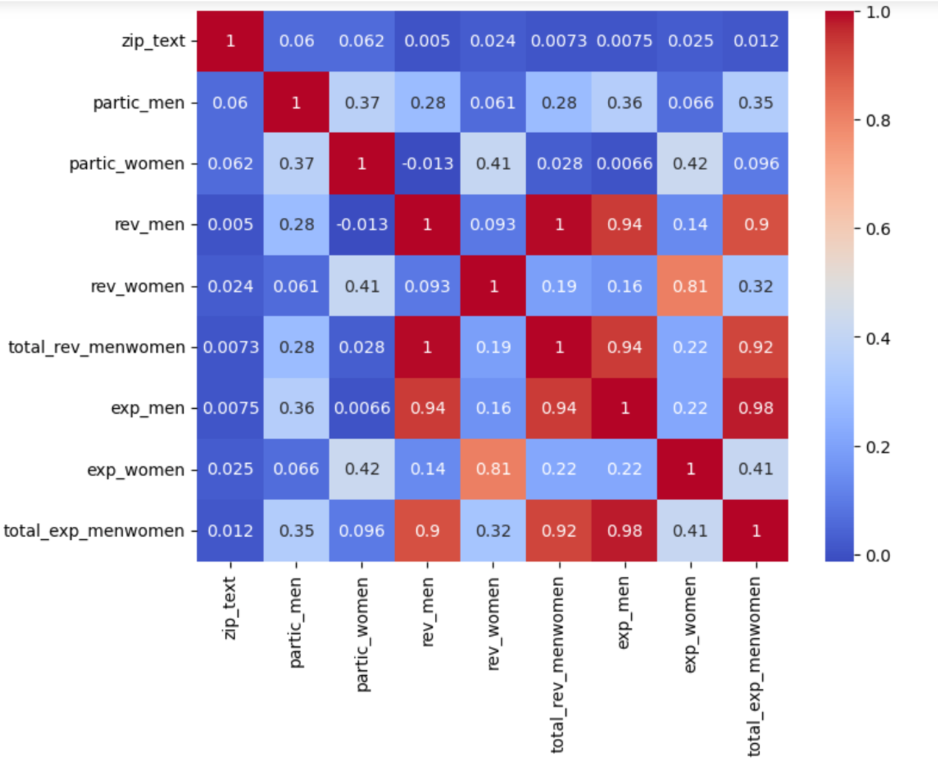
Table 4b: Correlation Heatmap

Slide 16

Dataset Graphical Exploration

Slide 17
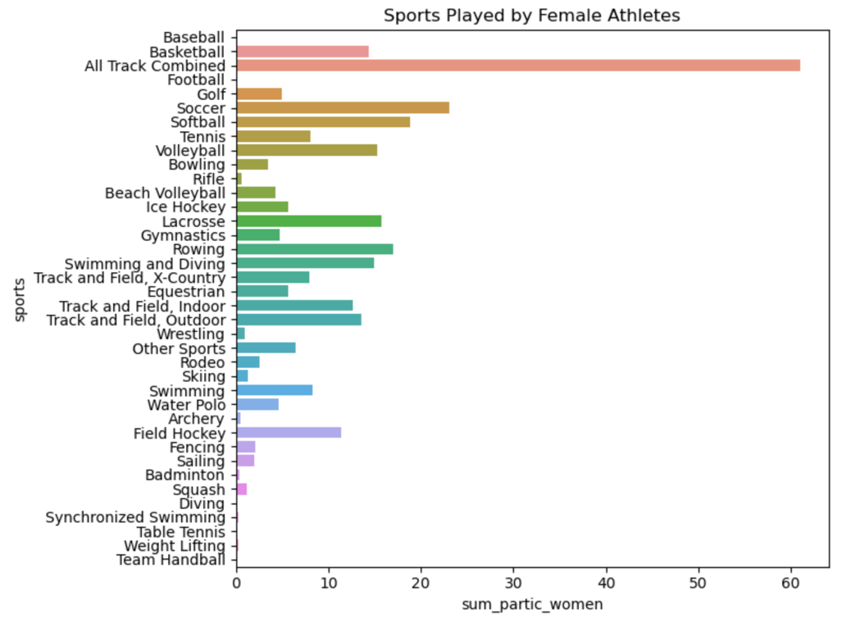
The following chart shows the distribution of the sports played by female athletes.
Figure 1: Sports Distribution in Female Athletes

Slide 18
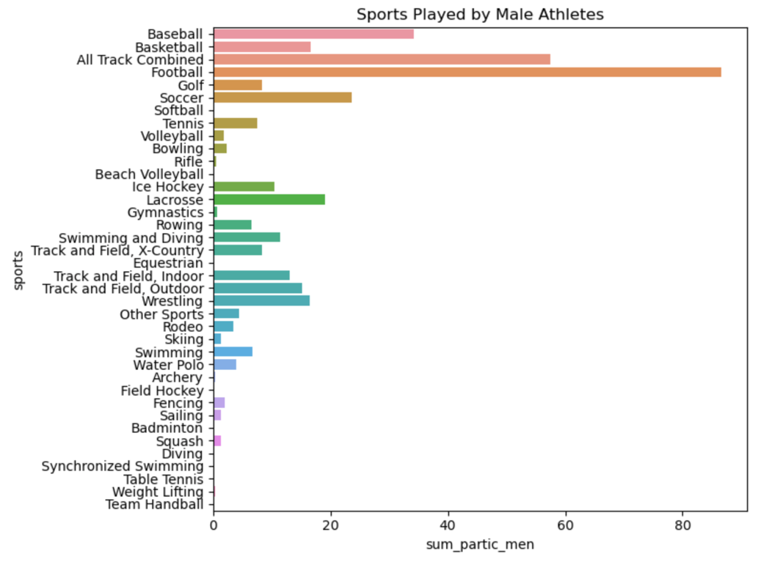
The following chart shows the distribution of the sports played by Male athletes.
Figure 2: Sports Distribution in Male Athletes

Slide 19
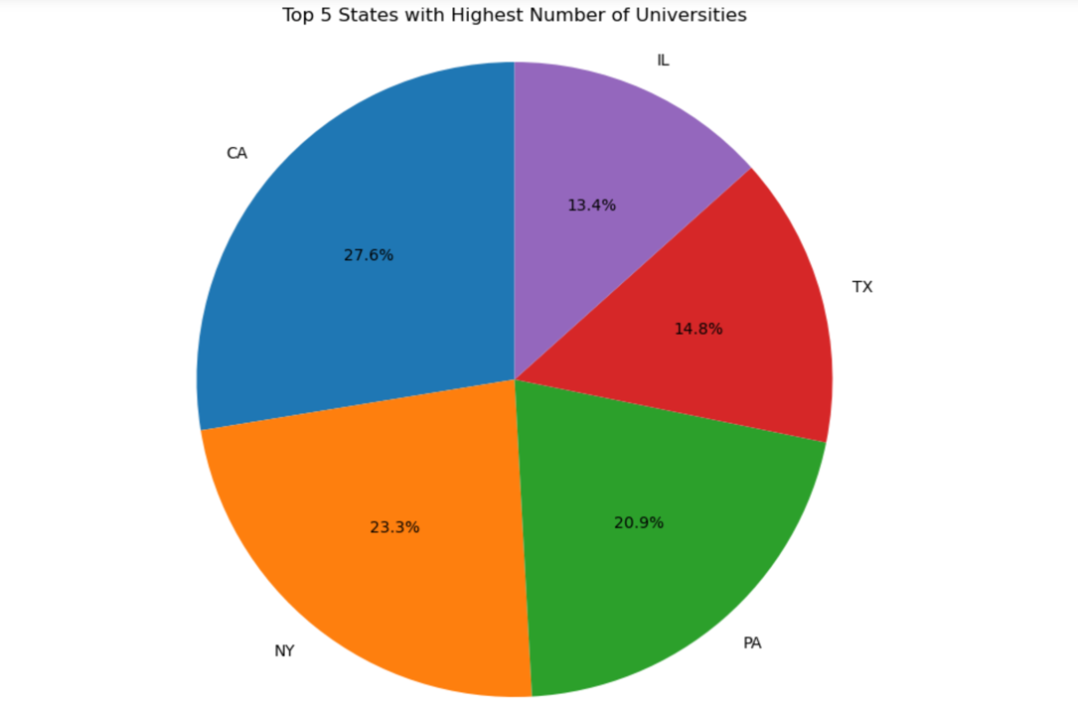
The pie chart in the Figure 3 shows which states have the highest number of universities, you can group the data by the state_cd column, which represents the state abbreviations, and then count the number of institutions per state.
Figure 3: Top 5 States by University Count

Slide 20
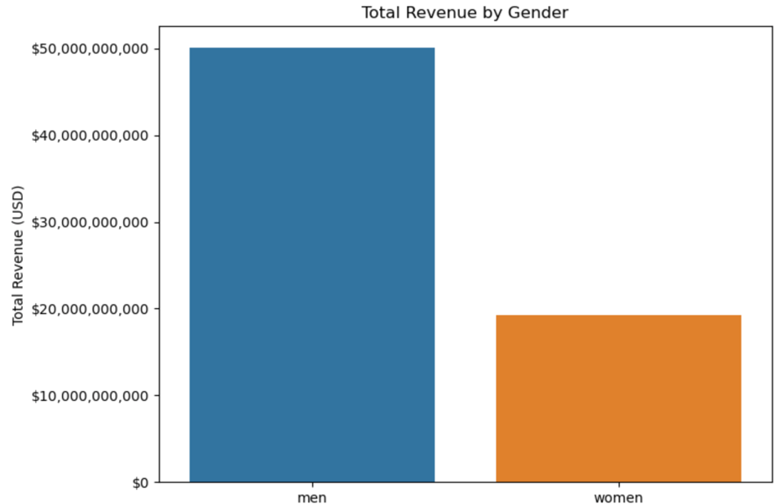
The Figure 4 is a bar plot showing the total revenue generated by men and women, and it formats the Y-axis to display the values in US dollars with a dollar sign and commas (e.g., $1,000,000) for easier readability.
Figure 4: Total Revenue by Gender

Slide 21
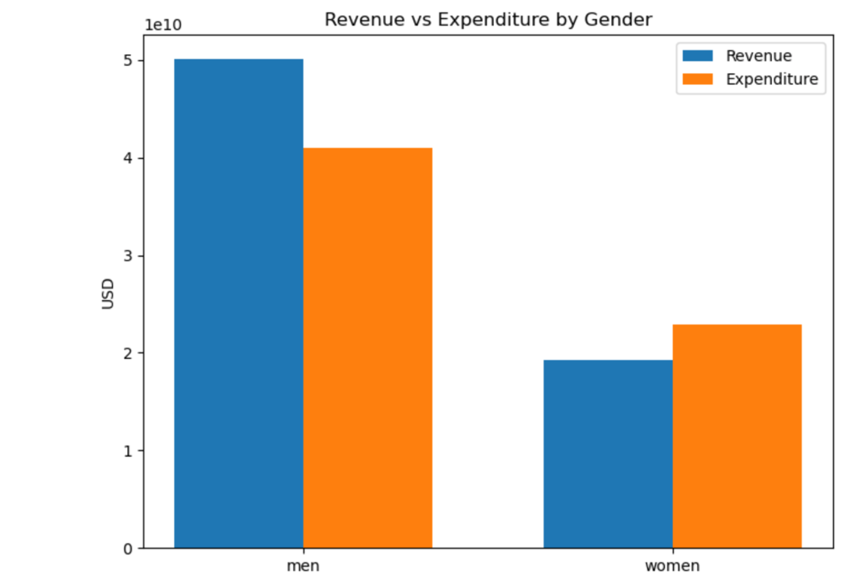
Figure 5 generates a grouped bar chart comparing revenue and expenditure for men and women. It displays two bars for each gender: one for total revenue and one for total expenditure, with the X-axis showing "men" and "women," and the Y-axis representing the amounts in USD.
Figure 5: Revenue and Expenditure by Gender Comparison

Slide 22
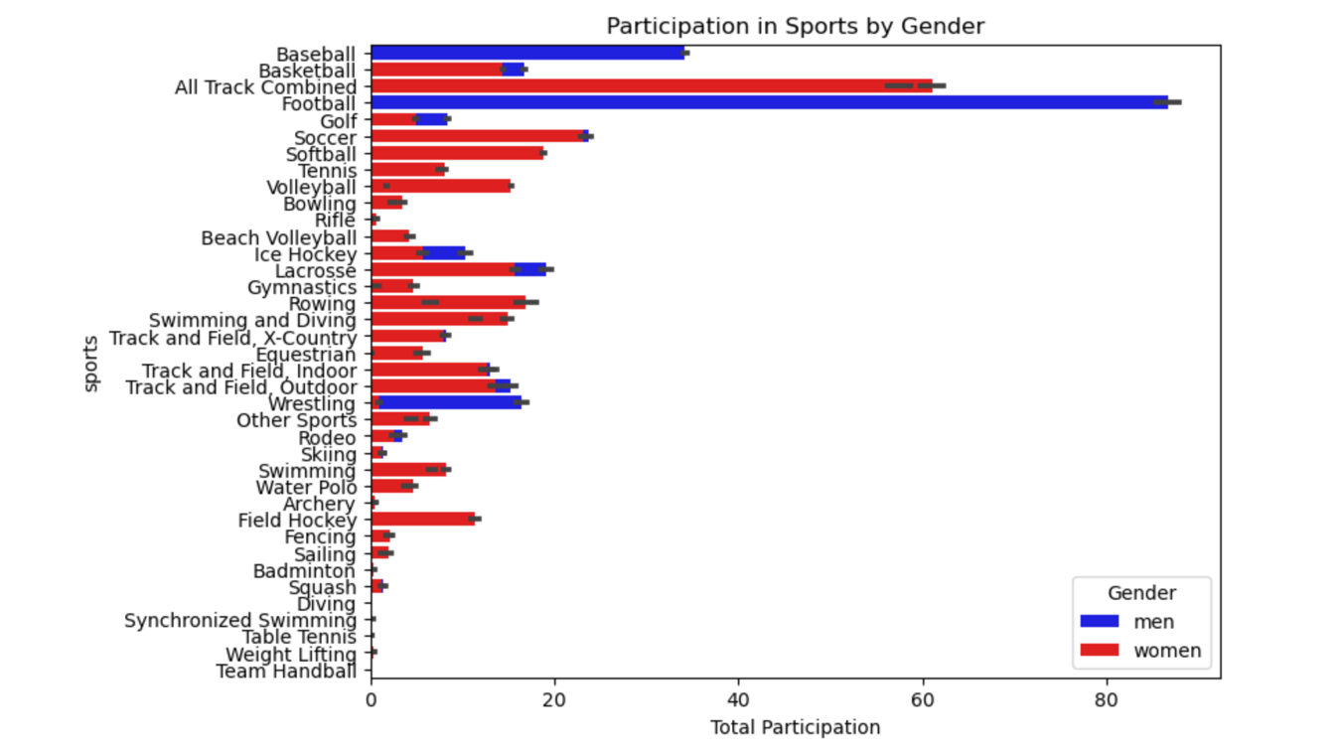
The Figure 6 is a stacked bar plot showing the total participation in sports by both men and women, where men's participation is represented in blue and women's participation is represented in red.
Figure 6: Gender Sports Participation

Slide 23
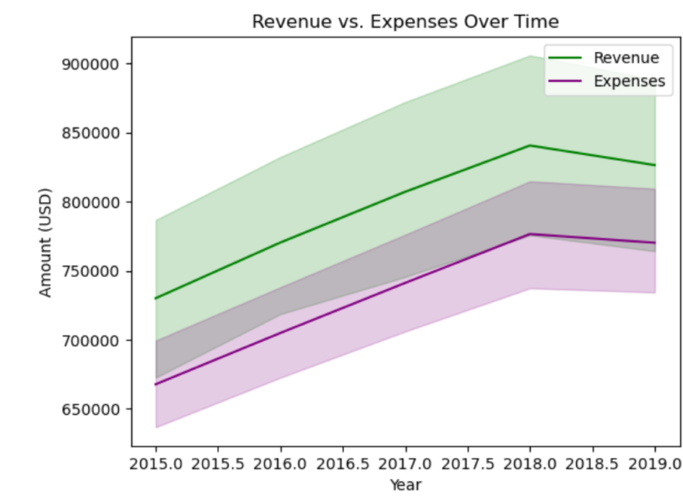
Figure 7 is a double line plot that compare total revenue and total expenses over time.
Figure 7: Revenue vs Expenses Over Time in all the US

Slide 24
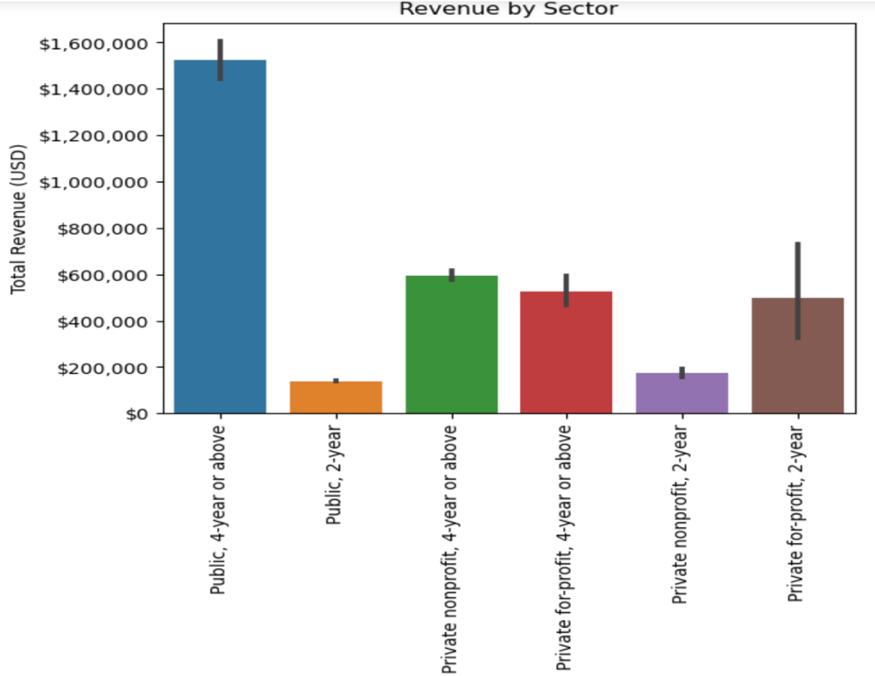
Figure 8 creates a bar plot that shows the total revenue for men and women by different sectors (e.g., public, private, etc.).
Figure 8: Revenue by Sector

Slide 25
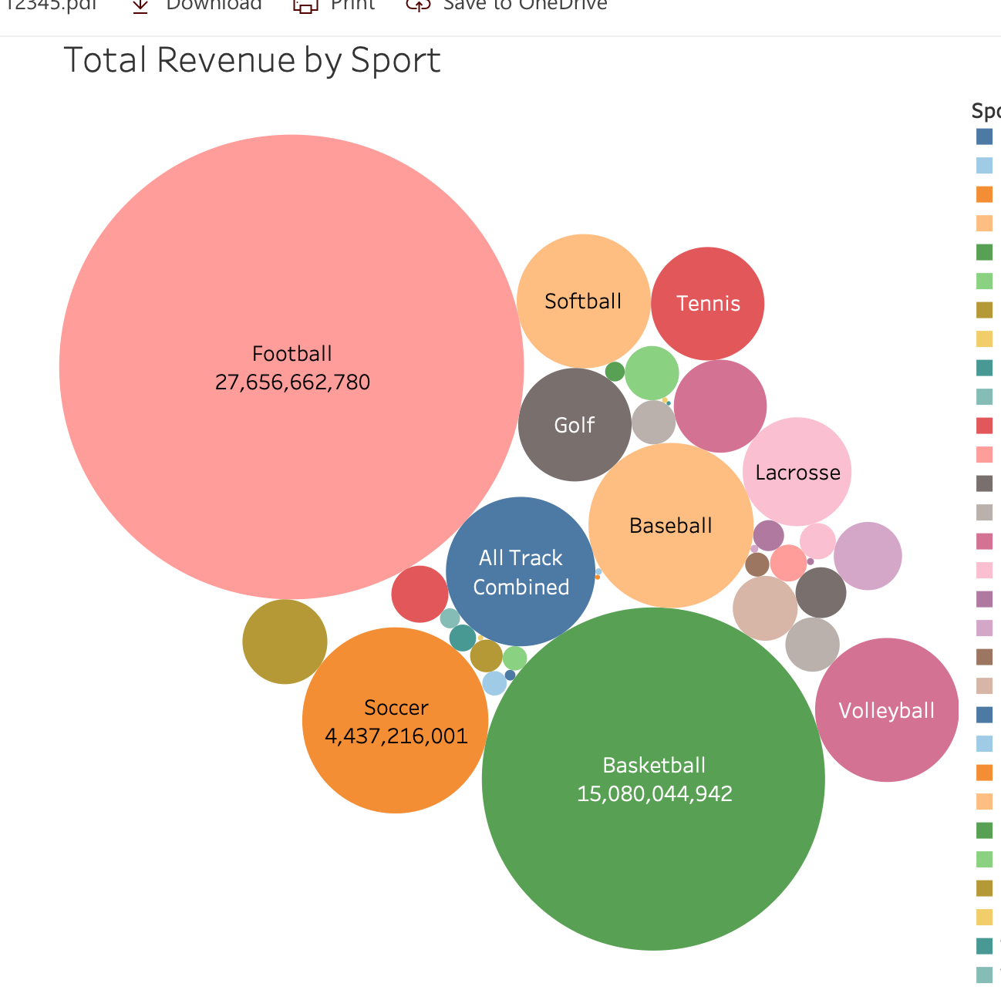
Figure 9 creates a packed bubble plot that shows which sports bring in the most revenue
Figure 9: Total Revenue by Sport

Slide 26
Summary of Findings (part 1)
The heatmap indicates that there is a very strong correlation between the total expenses for any given sport and the total revenue. What this means is that when schools spend more on an athletic program. It typically earns more money back.
Based on Figure 1, track is the most popular female sport.
Based on Figure 2, football is the most popular male sport.
Based on Figure 3, California is the state with the most colleges/universities.
Based on Figure 4, men’s sports appear to bring in a lot more revenue (without considering expenses).
Based on Figure 5, men’s collegiate sports revenue is higher than its expenses. For women, the opposite is true.

Slide 27
Summary of Findings (part 2)
Based on Figure 6, it looks like a similar number of men and women participate in soccer.
Based on Figure 7, US collegiate sports produced the highest revenue in 2018 (at least within this range of years).
Based on Figure 8, public 4-year schools have a much higher total revenue.
Based on Figure 9, football brings in the most revenue, which is also almost double that of basketball in collegiate sports.

