Slide 1
Swift UI
Intro to swift ui world

Slide 2
Swift UI definition
Swift UI is the way for creating UI elements using Swift language in Xcode that provides a variety of using multiple items in a declarative way
Swift UI came to iOS and Xcode to have the possibility to use a modern declarative way of development of the UI and to have the possibility to renew UIKit
Apple’s definition: SwiftUI is a modern way to declare user interfaces for any Apple platform. Create beautiful, dynamic apps faster than ever before.

Slide 3
Elements definition
SwiftUI uses commonly the same components from the view perspective but different into code declaration.
Main components that SwiftUI is using are:
View
Text
TextField
VStack, HStack, ZStack
Spacer
Shapes (Rectangle, Circle, Ellipse …)
ScrollView
Divider
List
Button
ActionSheet
DatePicker
Slider

Slide 4
Opaque Types
var body: some View
var body: View
A function or method with an opaque return type hides its return value’s type information. Instead of providing a concrete type as the function’s return type, the return value is described in terms of the protocols it supports. Hiding type information is useful at boundaries between a module and code that calls into the module, because the underlying type of the return value can remain private. Unlike returning a value whose type is a protocol type, opaque types preserve type identity—the compiler has access to the type information, but clients of the module don’t.
https://docs.swift.org/swift-book/LanguageGuide/OpaqueTypes.html

Slide 5
View animations
Animation in SwiftUI realized by AnyTransition struct
Custom animation can be done by extension to the class mentioned above.
Example:
extension AnyTransition {
static var moveAndFade: AnyTransition {
.asymmetric(
insertion: .move(edge: .leading).combined(with: .opacity),
removal: .scale.combined(with: .opacity)
)
}
}

Slide 6
How to define animation
Define peace of the code what you want to animate by withAnimation
keyword
Button("Present rectangle") {
withAnimation { showInformationLabel.toggle() }
}
Define the actual view you want to animate with the type of animation that needs to be applied and type of animation to be used
Rectangle()
.foregroundColor(.red)
.frame(width: 40, height: 40, alignment: .center)
.transition(.moveAndFade)
extension AnyTransition {
static var moveAndFade: AnyTransition {
.asymmetric(
insertion: .move(edge: .leading).combined(with: .opacity),
removal: .scale.combined(with: .opacity)
)
}
}

Slide 7
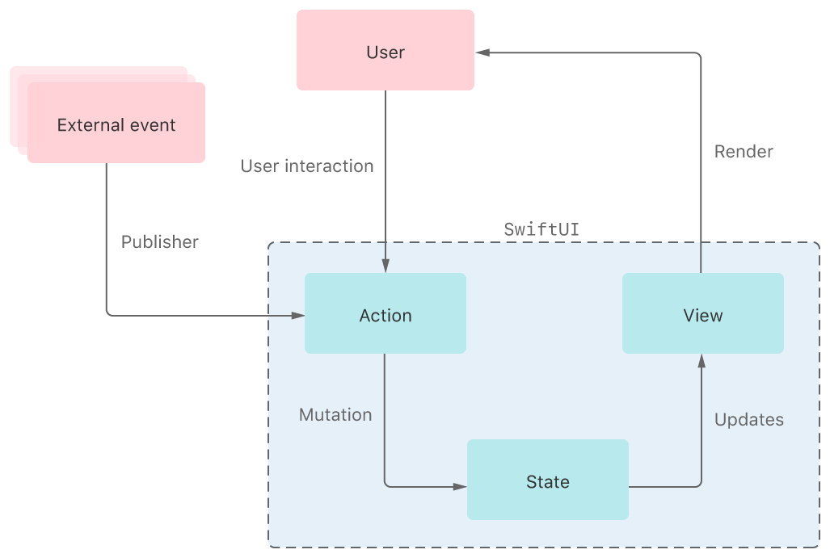
State and Data Flow

Slide 8
View states sharing
To define the current state of view in SwiftUI there are 4 propery wrappers that are used:
@State, @Binding
@StateObject
@ObservedObject
@EnvironmentObject

Slide 9
What kind of wrapper to select?
The decision about the property wrapper should be decided mindfully.
@State – a wrapper that is used for simple properties which the view should handle such as some view hiding or transitions for navigation. This property almost always should be private and needs to belong for one view
@StateObject – the wrapper that belongs to a separated object that should not be shared among other views and belongs only to one view. With the help of this observable almost always we defining the main state for the particular view
@ObservedObject – represents the observable that could be shared between multiple views and is responsible for he complex representation of some entity in the app
@EnvironmentObject – gives the ability to define the object across full apps and to be able to use it as shared data from any place in the app

Slide 10
Lists and Navigation
Creating components that refers to the multiple elements are performed with elements:
List – to create similar view to table view
ForEach – takes a list of elements with section separation and control. Comonly is used under List parent to define scrollable area
ScrollView – takes views that can be extended to be able to scroll items if they are out of the screen
NavigationView and NavigationLink – elements that represents navigation in the app. Commonly are similar to UINavigationViewController but are less responsible for the presentation and defining only the routing

Slide 11
Layouting
SwiftUI layout is different from UIKit.
Main elements for positioning:
.padding
.size, .frame, .position
Spacing
Alignment
GeometryReader
VStack, HStack, ZStack

Slide 12

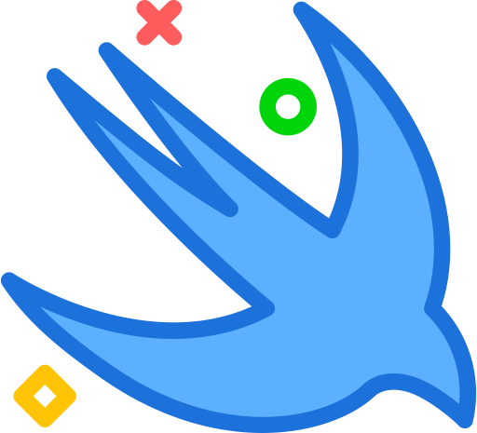
SwiftUI vs UIKit and UIKit + SwiftUI

Slide 13
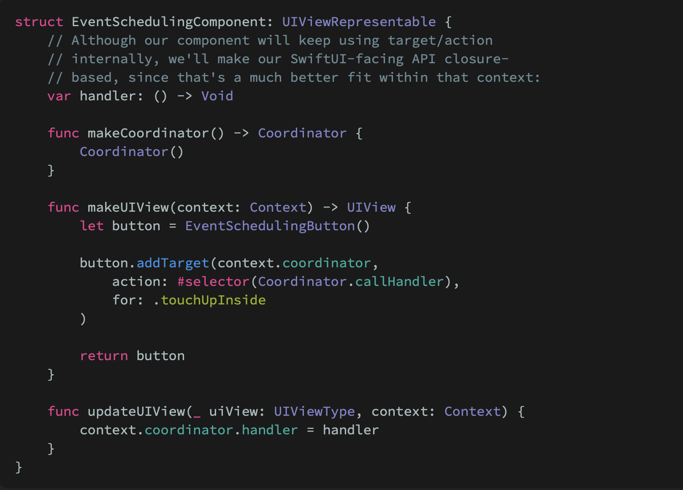
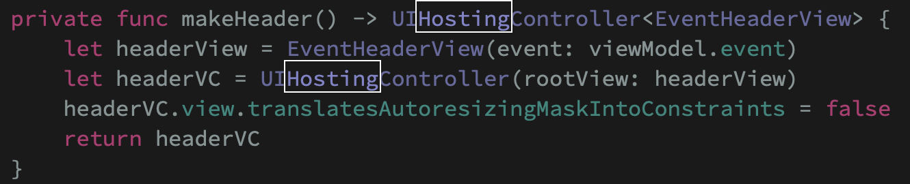
SwiftUI + UIKit combining
6

Slide 14
SwiftUI and CoreData
Define managed object context under App class that is the main for the app
Use environment varibale where you need to get any data from core data
@Environment(\.managedObjectContext) private var viewContext

Slide 15
Resources:
https://developer.apple.com/tutorials/swiftui
https://developer.apple.com/xcode/swiftui/
https://www.hackingwithswift.com/100/swiftui
https://docs.swift.org/swift-book/LanguageGuide/OpaqueTypes.html
https://www.hackingwithswift.com/quick-start/swiftui/whats-the-difference-between-observedobject-state-and-environmentobject
https://www.swiftbysundell.com/articles/swiftui-and-uikit-interoperability-part-2/

Slide 16
Thank you for the attention

