Slide 1

F#

Slide 2
Demo
Type Provider

Slide 3
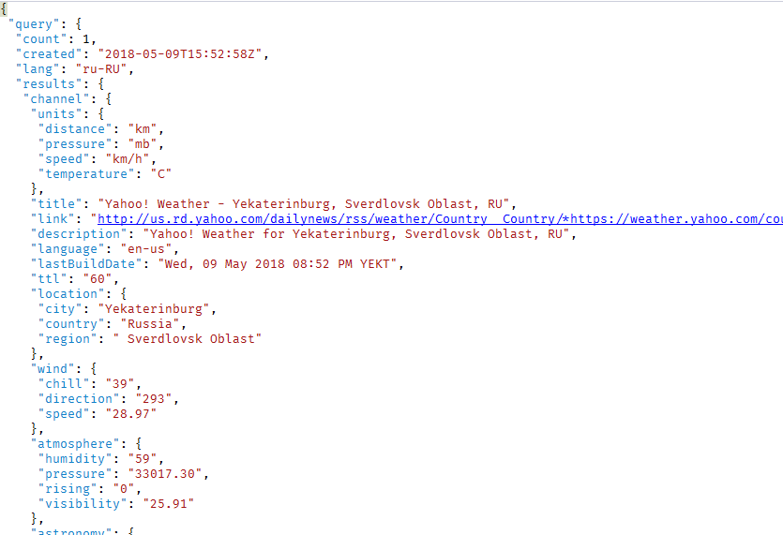

Slide 4
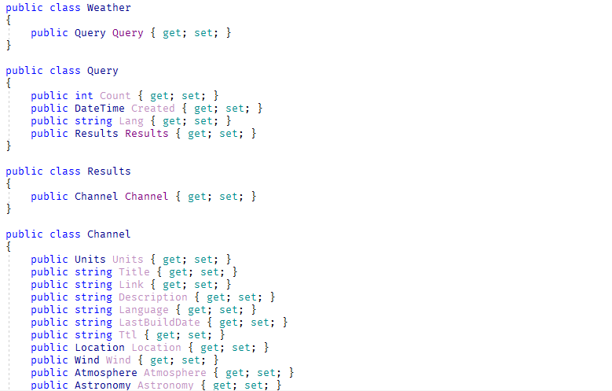

Slide 5
type Weather = JsonProvider<"../weather.json">

Slide 6
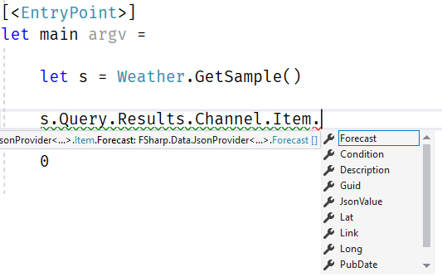

Slide 7
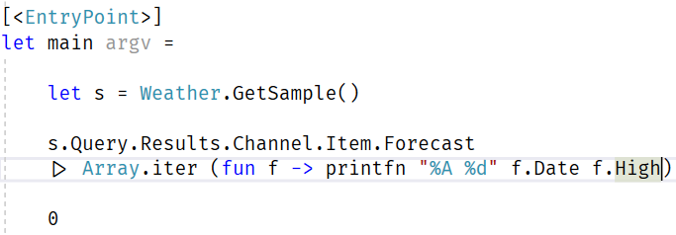

Slide 8
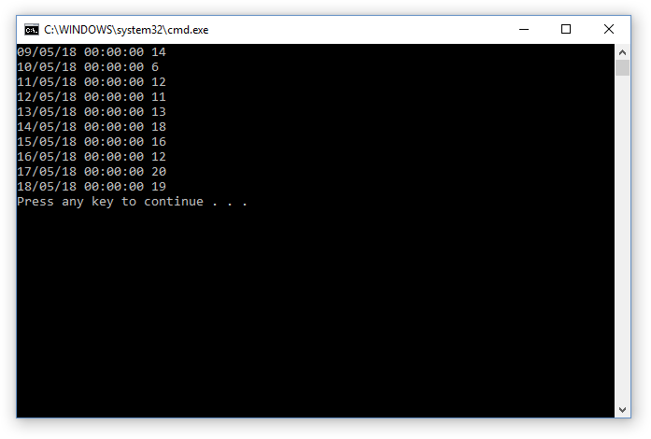

Slide 9
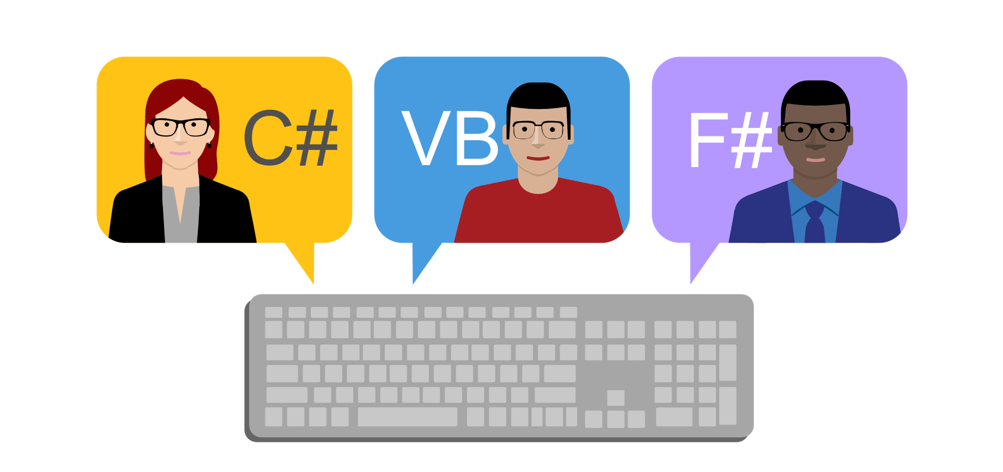

Slide 10
Что пишет Microsoft?
F# (pronounced "F sharp") is a cross-platform, open-source, functional programming language for .NET. It also includes object-oriented and imperative programming.

Slide 11
Про синтаксис
Отступы вместо скобок
f(a, b, c) f a b c
|> - pipe operator
f3 (f2 (f1 x))
x |> f1 |> f2 |> f3
f a b c
c |> f a b

Slide 12
#1
Type Providers

Slide 13
Type Provider
type Weather = JsonProvider<"../weather.json">
Создаёт типы на основе информации, полученной компилятором из источника данных

Slide 14
Type Provider
Примеры:
JSON
XML
CSV
SQL
…
R

Slide 15
#2
Discriminated Unions

Slide 16
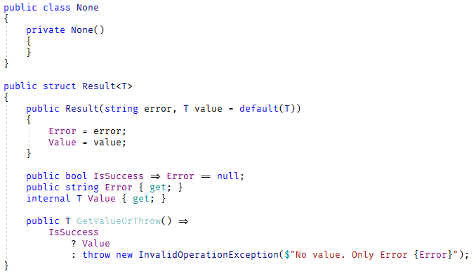
Result.cs

Slide 17
Result.cs – что не так?
Нужен тип None
Дублирование ☹
Нужны вспомогательные методы
public static Result<None> Ok()
public static Result<T> Ok<T>(T value)
public static Result<T> Fail<T>(string e)
Можно написать
var fail = Result.Fail<int>("epic fail");
var value = fail.GetValueOrThrow();

Slide 18
Discriminated Union
type Result<'a> =
| Ok of 'a
| Fail of string
let ok = Ok 42
let fail = Fail "epic fail"

Slide 19
Demo
Discriminated Union

Slide 20
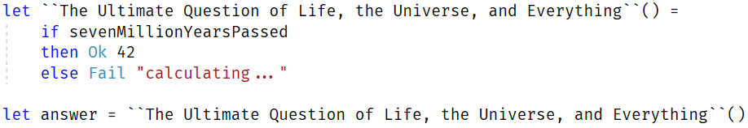

Slide 21


Slide 22


Slide 23


Slide 24
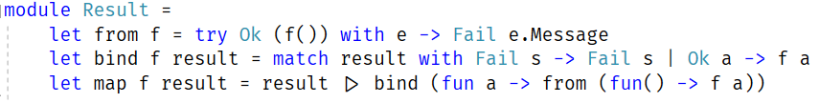

Slide 25
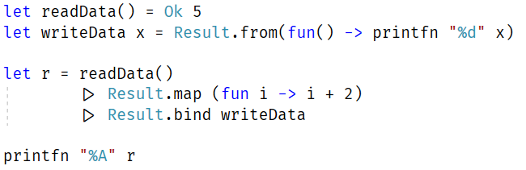

Slide 26


Slide 27
#3
Computation Expressions

Slide 28
Что общего?
yield return 1;
await Task.Run(1000);
var squares = from item in items
select item * item;

Slide 29
Computation Expression: seq
let f() = seq {
yield 1
yield 2
yield 3
}

Slide 30
Computation Expression: async
let f() = async {
do! Async.Sleep 1000
}

Slide 31
Computation Expression: async
let fetchUrlAsync url = async {
let req = WebRequest.Create(Uri(url))
use! resp = req.AsyncGetResponse()
use stream = resp.GetResponseStream()
use reader = new IO.StreamReader(stream)
let! html = reader.ReadToEndAsync() |> Async.AwaitTask
printfn "finished downloading %s" url
return html
}

Slide 32
Computation Expression: query
let items = [1;2;3]
let squares = query {
for item in items do
select (item * item)
}

Slide 33
Custom Computation Expression: result
let readFromDb id =
if id < 8
then Ok (id + 2)
else Fail (sprintf "Value %d is not available" id)
let calculate() = result {
let x = 3
let! y = readFromDb x
let! z = readFromDb (x + y)
return x + y + z
}

Slide 34
#4
Records

Slide 35
Immutable class
class Song {
public Song(string author, string name) {
Author = author;
Name = name;
}
public string Author { get; }
public string Name { get; }
}

Slide 36
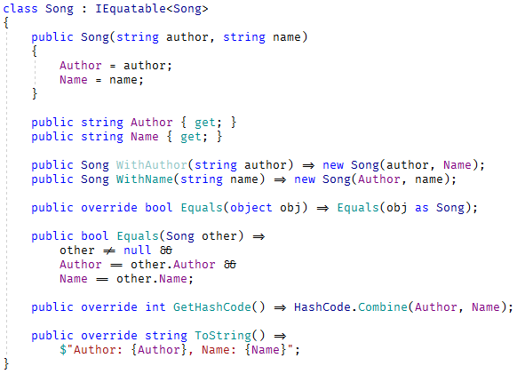
Immutable class

Slide 37
Record
type Song = { Author: string; Name: string }
let song1 = { Author="Queen"; Name="Bohemian Rhapsody" }
let song2 = { Author="Queen"; Name="Bohemian Rhapsody" }
printfn "%b" (song1=song2) // true
let song3 = { song2 with Name="We Are the Champions" }
let { Name=name } = song3 // name = song3.Name
printfn "%s" name // "We Are the Champions"

Slide 38






Инструменты
ionide.io

Slide 39

Где учить?
- из презентации
Don Syme
fsharpforfunandprofit.com
fsharp.org/learn.html

Slide 40

Вопросы?
github.com/yevgeniyredko/shpora-2018-fsharp
email: r.e.s.1997@gmail.com
github/telegram/twitter/fb/vk: @yevgeniyredko

