Slide 1

F#

Slide 2
Demo

Slide 3
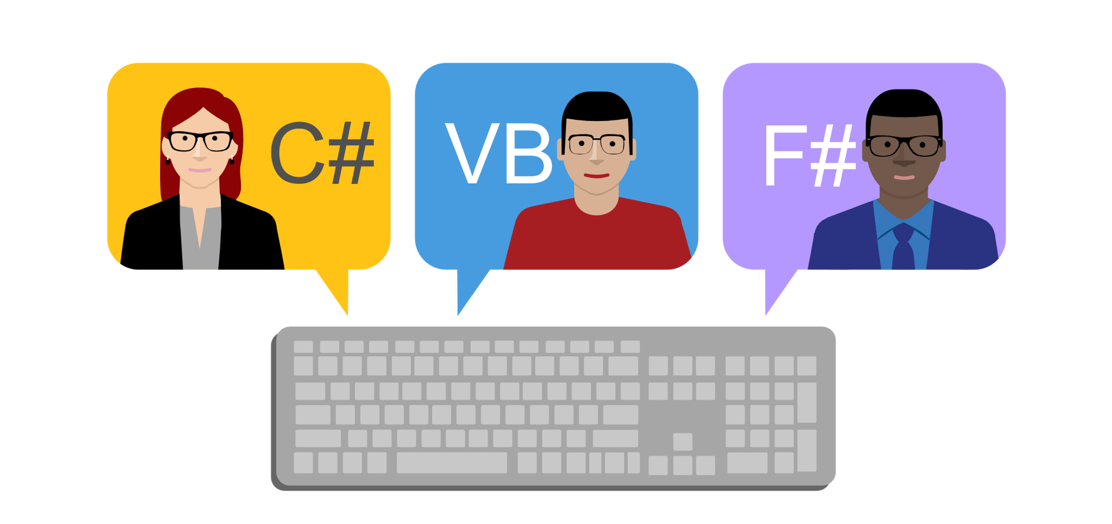

Slide 4
Что пишет Microsoft?
F# (pronounced "F sharp") is a cross-platform, open-source, functional programming language for .NET. It also includes object-oriented and imperative programming.

Slide 6
Где учить?
- из презентации
Don Syme
fsharpforfunandprofit.com

Slide 7
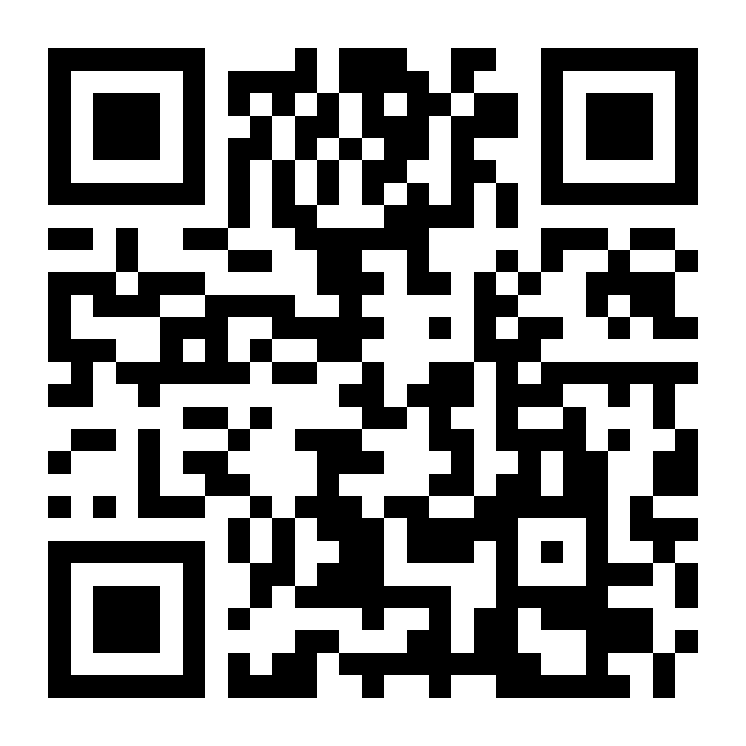
Вопросы?
github.com/yevgeniyredko/shpora-2018-fsharp

