Slide 1

F#

Slide 2
Demo
Type Provider

Slide 3
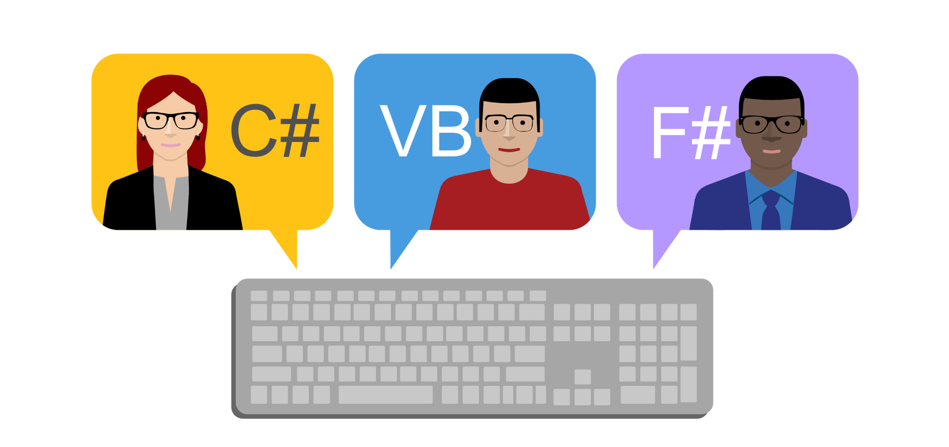

Slide 4
Что пишет Microsoft?
F# (pronounced "F sharp") is a cross-platform, open-source, functional programming language for .NET. It also includes object-oriented and imperative programming.

Slide 5
Про синтаксис
Отступы вместо скобок
f(a, b, c) f a b c
|> - pipe operator
f3 (f2 (f1 x))
x |> f1 |> f2 |> f3
f a b c
c |> f a b

Slide 6
#1
Type Providers

Slide 7
Type Provider
type Weather = JsonProvider<"../weather.json">
Создаёт типы на основе информации, полученной компилятором из источника данных

Slide 8
Type Provider
Примеры:
JSON
XML
CSV
SQL
…
R

Slide 9
#2
Discriminated Unions

Slide 10
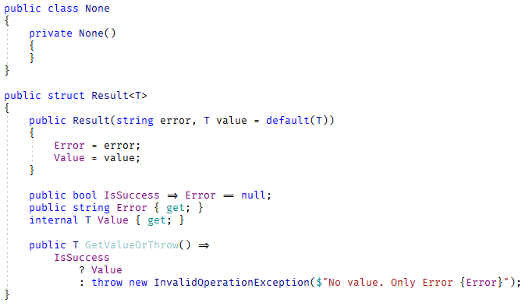
Result.cs

Slide 11
Result.cs – что не так?
Нужен тип None
Дублирование ☹
Нужны вспомогательные методы
public static Result<None> Ok()
public static Result<T> Ok<T>(T value)
public static Result<T> Fail<T>(string e)
Можно написать
var fail = Result.Fail<int>("epic fail");
var value = fail.GetValueOrThrow();

Slide 12
Discriminated Union
type Result<'a> =
| Ok of 'a
| Fail of string
let ok = Ok 42
let fail = Fail "epic fail"

Slide 13
Demo
Discriminated Union

Slide 14
#3
Computation Expressions

Slide 15
Что общего?
yield return 1;
await Task.Run(1000);
var squares = from item in items
select item * item;

Slide 16
Computation Expression: seq
let f() = seq {
yield 1
yield 2
yield 3
}

Slide 17
Computation Expression: async
let f() = async {
do! Async.Sleep 1000
}

Slide 18
Computation Expression: async
let fetchUrlAsync url = async {
let req = WebRequest.Create(Uri(url))
use! resp = req.AsyncGetResponse()
use stream = resp.GetResponseStream()
use reader = new IO.StreamReader(stream)
let! html = reader.ReadToEndAsync() |> Async.AwaitTask
printfn "finished downloading %s" url
return html
}

Slide 19
Computation Expression: query
let items = [1;2;3]
let squares = query {
for item in items do
select (item * item)
}

Slide 20
Custom Computation Expression: result
let readFromDb id =
if id < 8
then Ok (id + 2)
else Fail (sprintf "Value %d is not available" id)
let calculate() = result {
let x = 3
let! y = readFromDb x
let! z = readFromDb (x + y)
return x + y + z
}

Slide 21
#4
Records

Slide 22
Immutable class
class Song {
public Song(string author, string name) {
Author = author;
Name = name;
}
public string Author { get; }
public string Name { get; }
}

Slide 23
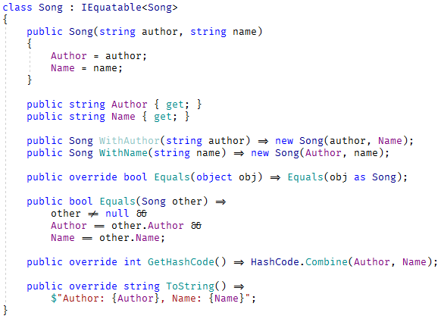
Immutable class

Slide 24
Record
type Song = { Author: string; Name: string }
let song1 = { Author="Queen"; Name="Bohemian Rhapsody" }
let song2 = { Author="Queen"; Name="Bohemian Rhapsody" }
printfn "%b" (song1=song2) // true
let song3 = { song2 with Name="We Are the Champions" }
let { Name=name } = song3 // name = song3.Name
printfn "%s" name // "We Are the Champions"

Slide 25






Инструменты
ionide.io

Slide 26

Где учить?
- из презентации
Don Syme
fsharpforfunandprofit.com
fsharp.org/learn.html

Slide 27

Вопросы?
github.com/yevgeniyredko/shpora-2018-fsharp
email: r.e.s.1997@gmail.com
github/telegram/twitter/fb/vk: @yevgeniyredko

