Slide 1

Beyond the frame.
PPT MASTER THEMES / LANDSCAPE STUDY
A field guide to light,
landscape and attention.

Slide 2
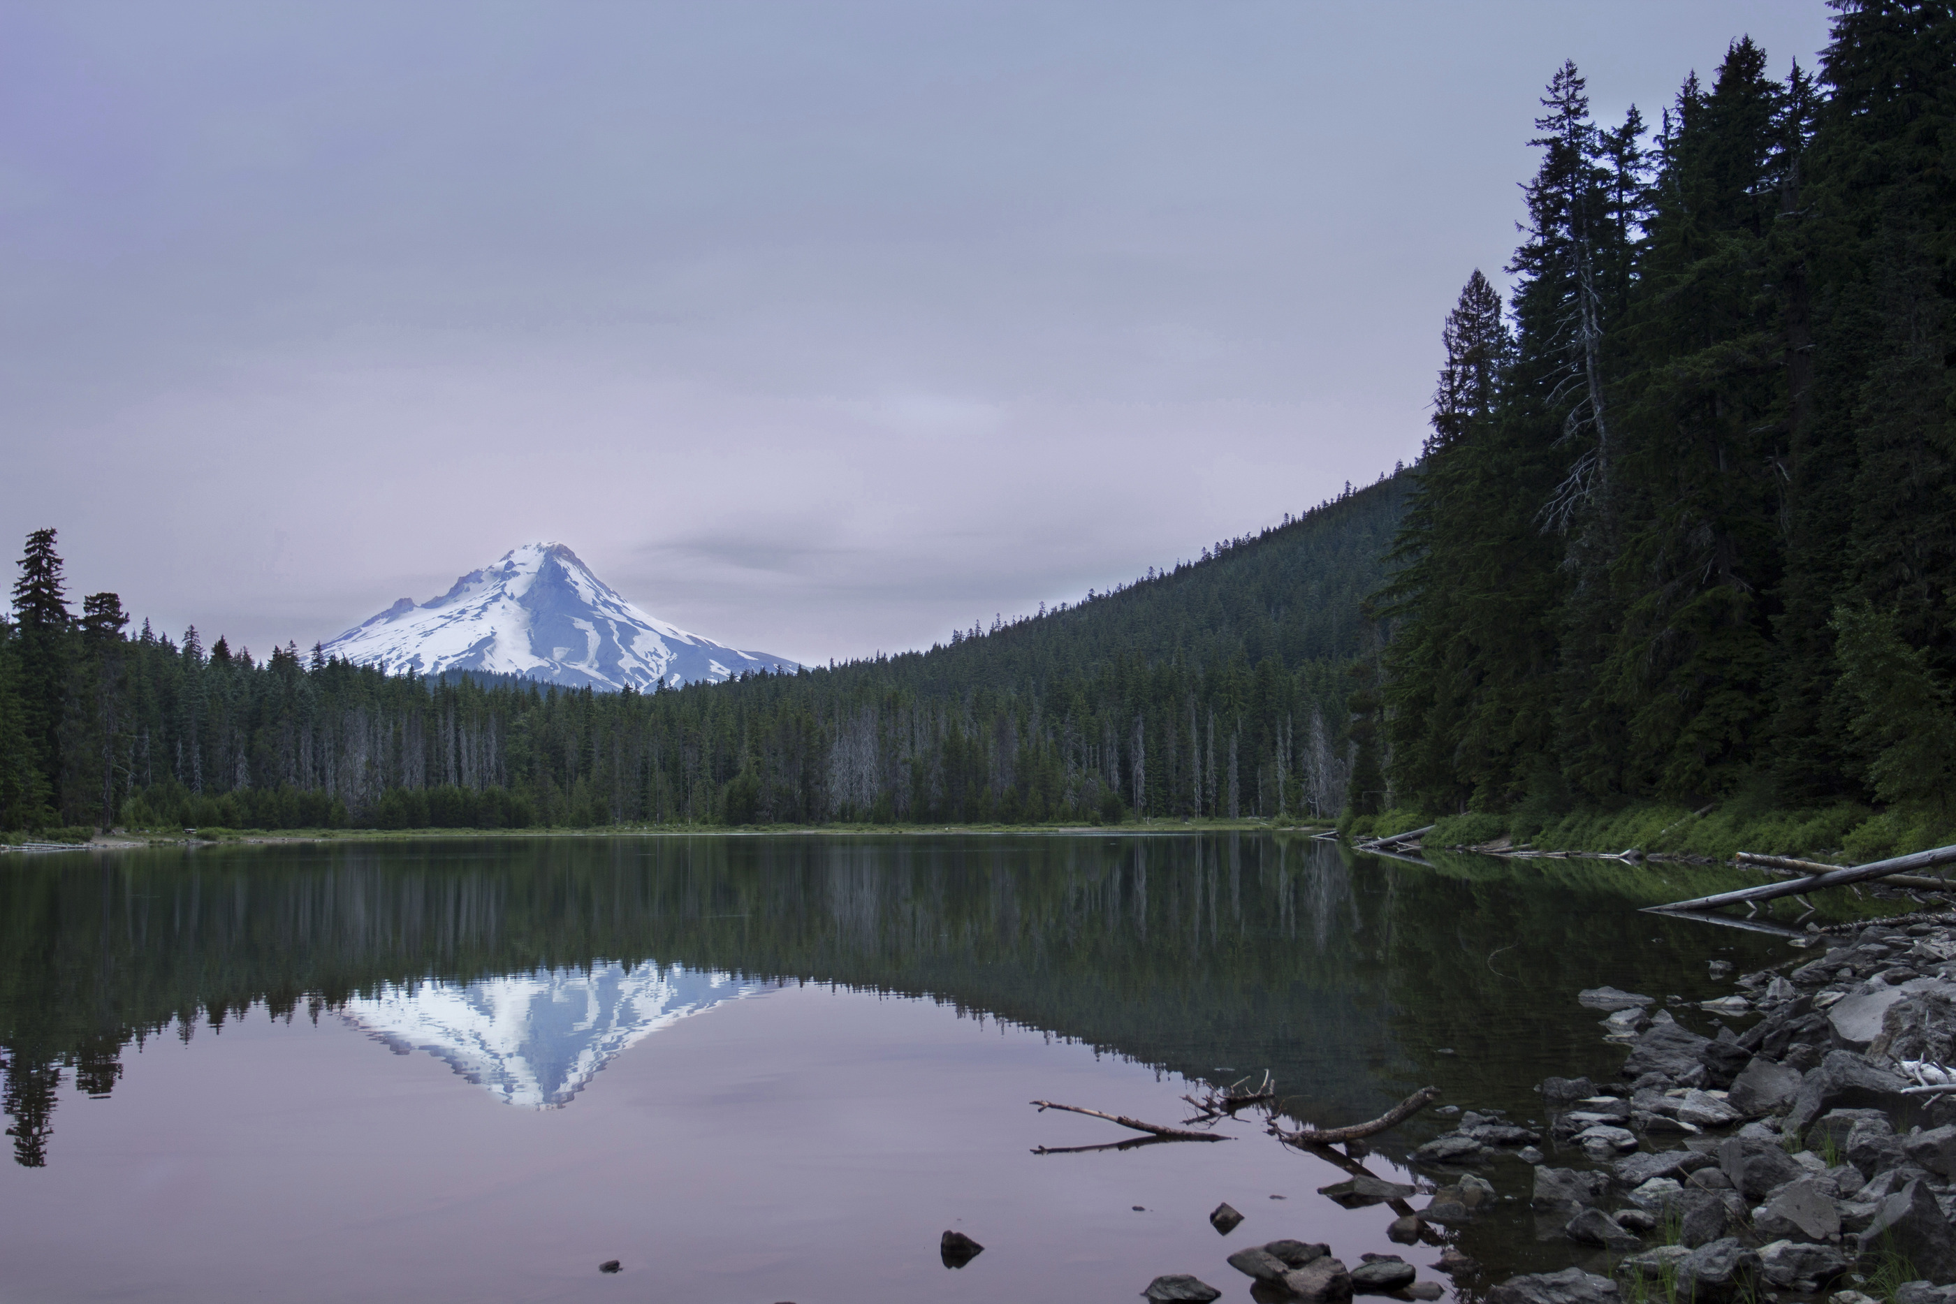
Look closer.
Ask better questions.
02
Every place has a story.
Start by learning how to see it.

Slide 3
Ideas become richer when worlds meet.
01 / THE LEARNING EXPERIENCE
Research gives you a position.
Listening gives you another perspective.
A question is a starting point.
Before a committee meets, delegates study
a topic, examine sources and work out what
a particular position means in practice.
The task is to make an argument that others
can understand, question and build upon.
In conversation, a prepared idea becomes
something more demanding. Other people
bring different priorities and experiences.
Listening closely makes it possible to see
where disagreement begins — and where
there may be room for a shared response.
Good preparation makes that exchange
more thoughtful. It also makes the limits
of an argument easier to recognise.
Field observation offers another way in.
A place can prompt questions that a briefing
paper cannot anticipate: who uses a space,
which stories are visible, and what remains
outside the frame? Notes help turn a first
impression into a question worth exploring.
Keep the two ways of learning connected.
Return to the discussion with a detail, an
observation or a question from the field.
Then ask how it changes the way you read
the issue, rather than treating a visit as
a separate item on an itinerary.
The result is a habit of moving between
evidence and experience — with enough
curiosity to revise an initial view.
The best questions travel with you.
So does the habit of looking closer.

Slide 4
A notebook is a way of noticing.
02 / A PRACTICE OF ATTENTION
Give observations somewhere to become ideas.
Begin with what is actually in front of you. Describe
a space, a sound, a gesture or a material before
trying to explain it. Precise details give later
reflection something more reliable than a general
impression to work with.
Separate observation from interpretation. What did
you see? What do you think it might mean? What
would you need to ask before drawing a conclusion?
Keeping those questions distinct makes a notebook
more useful when you return to it.
A short entry can be enough: one detail, one question
and one possible connection. Leave room for an
answer that complicates the first impression.
Later, share a note with someone else. Their reading
may reveal something you did not notice yourself.
TRY THIS
01 Notice a detail.
02 Describe it plainly.
03 Ask what is missing.
04 Make a connection.
Keep a distinction
between what you saw
and what you inferred.
Observe first. Interpret carefully.
Stay open to a different reading.

Slide 5
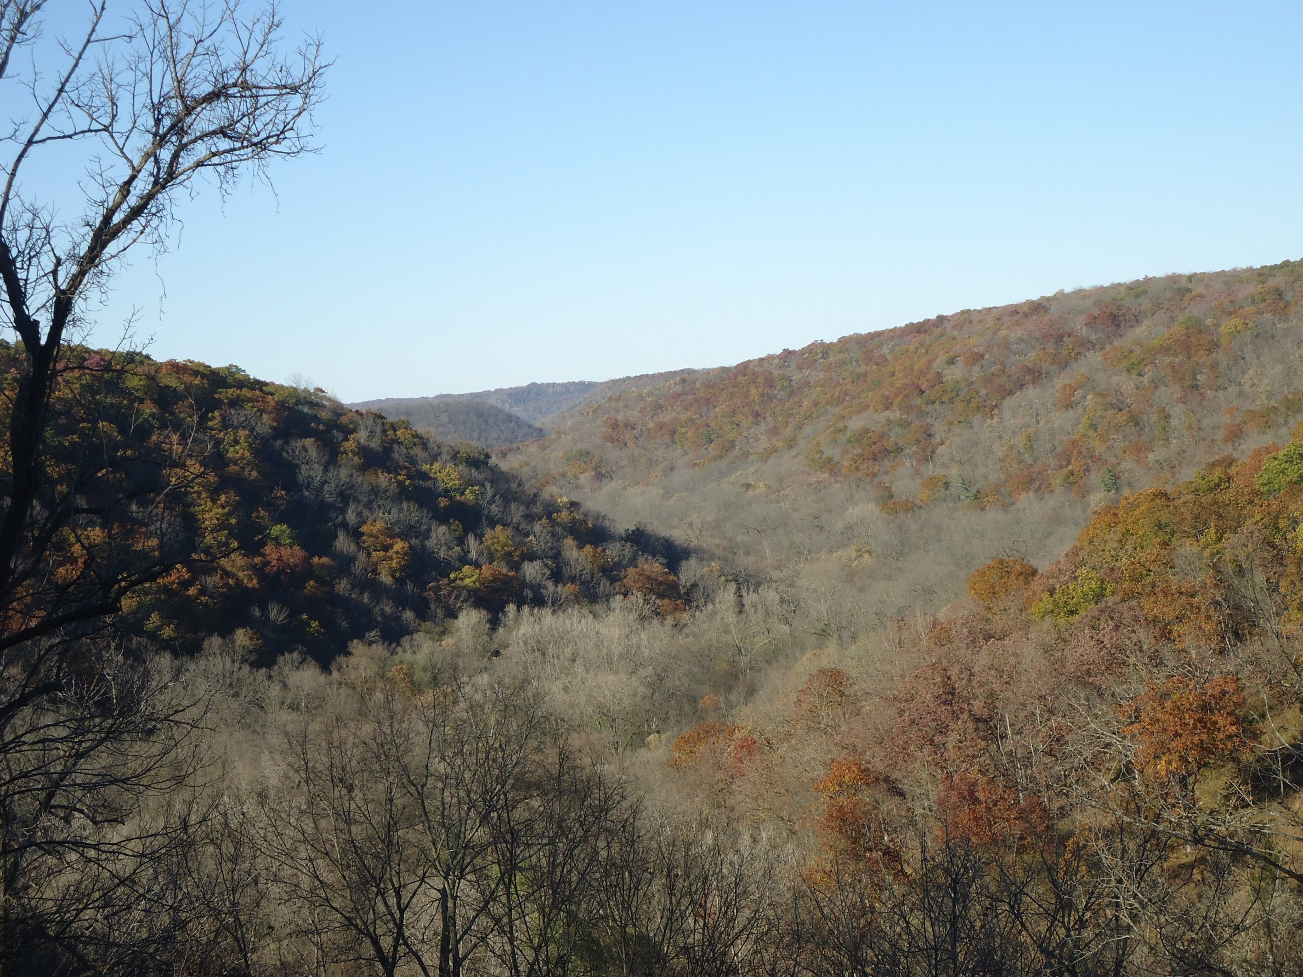
Learning begins with attention.
03 / IN THE FIELD
A shared scene. Several ways of seeing.
A photograph establishes a setting.
A field note records a detail. Together,
they can turn a passing impression into
a question worth taking back to a group.
Look for relationships within the scene,
not just a subject at its centre.
What belongs in the frame?
What would a closer view reveal?
What might someone else notice?
The purpose is not to collect answers
as quickly as possible. It is to make
better observations along the way.
PHOTO: ARCHBOB / CC0 1.0 / CROP FOR LAYOUT DEMONSTRATION

Slide 6

Follow the water.
04 / NATURE, UP CLOSE
A quiet detail can
open a wider story.
Water moves through the frame.
A rock, a branch and a current
create different points of entry.
Look before naming the scene.
Notice light and arrangement.
Follow an edge or a reflection.
Leave room for a closer view
to change what first seemed
important in the landscape.
PHOTO: MARTIN EKLUND / CC0
FULL-HEIGHT PHOTOGRAPHIC CROP

Slide 7
Let the landscape open the story.
05 / A WIDER PERSPECTIVE

Slide 8
A single photograph can hold a whole opening.
The eye crosses the fold before the next paragraph begins.
Pause with the setting. Then move from the wider view
to the details that make a place worth understanding.
BONNIE MORELAND / CC0 1.0 / ONE SHARED CROP ACROSS BOTH PAGES

Slide 9
Give an idea a path forward.
06 / FROM QUESTION TO CONTRIBUTION
Four moves that turn preparation into participation.
​
01
Prepare
Research the issue and test your sources.
Bring a clear position and a useful question.
​
02
Exchange
Listen to other perspectives and explain your own.
Make the differences understandable.
​
03
Build
Identify common ground and work on shared wording.
Turn a discussion into something others can examine.
​
04
Reflect
Review what changed and what remains unresolved.
Carry those questions into the next conversation.

Slide 10
See the shape of the experience.
07 / A CLEARER OVERVIEW
A compact reading table keeps the details accessible.
​
STAGE
FOCUS
OUTPUT
Before
Research and preparation
Position paper
In committee
Discussion and negotiation
Draft resolution
In the field
Observation and questions
Field notes
Afterwards
Review and reflection
Personal reflection
ILLUSTRATIVE CONTENT FOR LAYOUT REVIEW — NOT A CONFIRMED PROGRAMME.
Structure makes detail easier to find.
White space makes it easier to read.

Slide 11

Many ways of seeing.
Water, shorelines and horizons.
Three landscapes offer different scales of attention.
PHOTOS: BONNIE MORELAND / HOMMIE09 / MARTIN EKLUND. CC0 1.0.

Slide 12
Read.
Pause. Notice.
08 / THE RHYTHM OF READING
A page has more
than one speed.
Give each a place.
A headline opens the conversation. A paragraph
holds it. A short statement offers a place to pause.
The shift in scale gives each voice a different role.
Keep the edges familiar while changing the pace.
An offset beginning can create tension without
making the next line difficult to find.
Aa
Repetition makes a pattern.
Variation gives it meaning.
A quiet margin is part of the composition.
It gives the next idea somewhere to arrive.
Colour can join this rhythm.
The page should also work without it.
The grid remains underneath.
It connects the large and the small,
the close reading and the quick glance.

Slide 13
The margin has something to say.
09 / THE SECOND VOICE
A good note belongs beside the thought it supports.
It may define a term, locate a source or ask a useful
question. Its smaller scale creates a second voice
without interrupting the main line of the argument.
The reader can stay with the article or step aside.
Both routes remain easy to follow.
01 / CONTEXT
A note can hold a definition,
a source or a qualification.
Place it beside the passage
that gives it meaning.
Leave space for the thought
that changes the first one.
Return to the same text measure after the pause.
That familiar width tells the reader where to continue.
The large statement creates a change of tempo;
the repeated column restores the underlying beat.
The margin remains a conversation, not a container
for everything that would not fit in the main text.
02 / RETURN
A repeated label helps
readers recognise the role.
A new vertical position
connects the note to its
own passage.
EDITORIAL METHOD / ILLUSTRATIVE COPY

Slide 14
A way in.
10 / CHOOSE A WAY IN
01 / The wider view
Start with a place and its context.
02 / The small detail
Look for what a quick glance misses.
03 / The shared question
Bring another perspective into view.
Three entry points.
One connected story.
A visual index offers different ways into the same subject.
Keep labels brief, repeat their rhythm, and make the next
step clear. Add real page references in the final document.

Slide 15

A world, in fragments.
BY COLUMN, TOP TO BOTTOM: lake / autumn; waterfall / sunrise;
waves / dunes. CC0 1.0 photographs; full credits in the website source list.
Independent landscapes, not one location or event sequence.

Slide 16
Let the eye wander.
11 / WIDE. CLOSE. CLOSER.
02 / A SMALL DETAIL
A closer view changes
the scale of attention.
01 / THE SETTING
Begin with the wider scene.
03 / A DIFFERENT SCALE
Move from water to land to horizon.
Different image sizes create a route,
while the shared edges hold it together.
CC0 1.0 LANDSCAPES
SOURCES LISTED ON THE WEBSITE
LAYOUT DEMONSTRATION

Slide 17
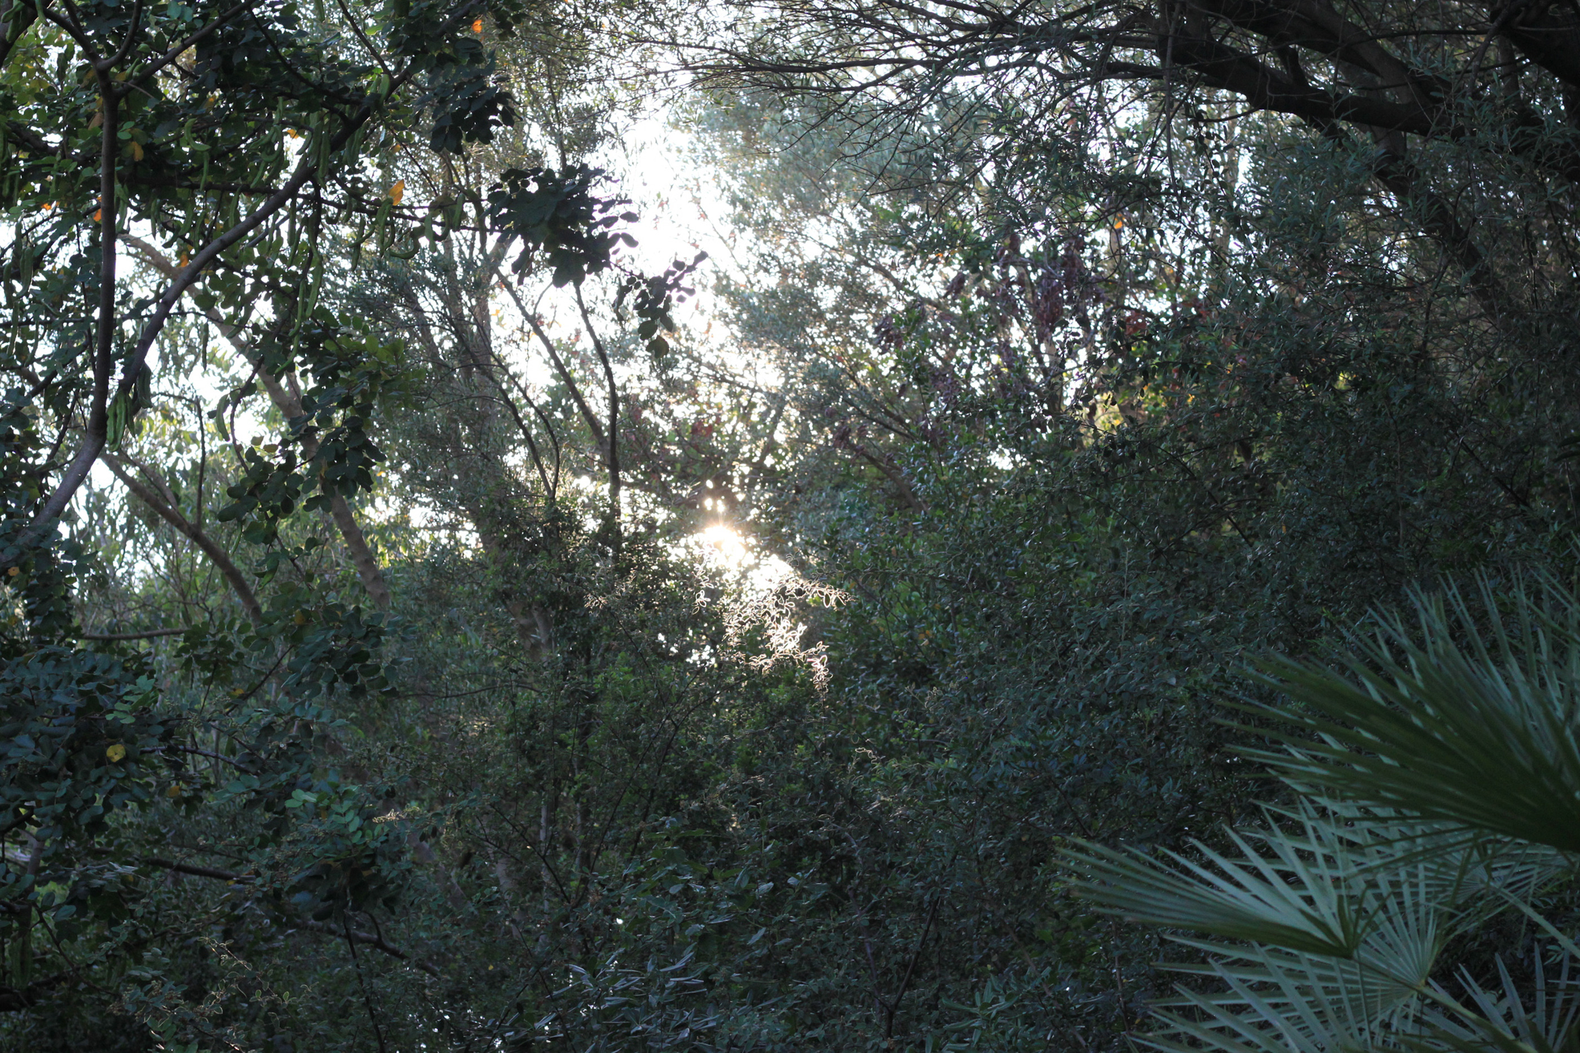
One frame. Many worlds.
A panoramic anchor, followed by six supporting views.
Read the smaller frames from left to right, then top to bottom.
CC0 landscapes from different places; full credits in the source list.

Slide 18
Across the frame.
12 /
PHOTO
ESSAY
A short headline crosses the edge of the photograph.
A quiet reading plane keeps the words together.
Let the photograph keep its subject. Let the type
keep its voice. The overlap connects the two.
PHOTO: BONNIE
MORELAND / CC0
Photograph, reading plate
and headline remain
separate objects.

Slide 19
A frame for the natural world.
13 / SPACE AND COUNTERWEIGHT
A quiet circle
changes the balance.
The photograph
keeps the detail.
A larger field connects two separate image scales.
The geometry is editorial atmosphere, not a logo,
a measured area or a claim about the subject.

Slide 20
Different page jobs.
One coherent system.
14 / MAKE THE CLAIM READABLE
The expanded catalogue contains 24 layouts.
Each family answers a different reading need.
LAYOUT COUNT
This catalogue, edition 02.
No programme outcomes.
​
WHAT TO READ
Photo layouts set
place and sequence.
Information layouts help
compare, locate
and explain.
Reading layouts carry
arguments and pauses.
NUMBER OF LAYOUTS
Photography
13
Information
6
Reading
5
SOURCE: THE 24 ENTRIES IN THIS DEMONSTRATION CATALOGUE.
COUNTS DESCRIBE THE LIBRARY; THEY ARE NOT A PAGE-MIX TARGET.
Choose the form from the reader’s task.
The catalogue is a repertoire, not a required sequence.

Slide 21
First notice.
Then interpret.
15 / TWO RELATED WAYS OF THINKING
Observation
Interpretation
THE QUESTION
What is actually in front of me?
Describe what can be seen or heard.
THE QUESTION
What could this detail mean?
Explain the reasoning, not just the answer.
THE RECORD
Write a precise detail.
Keep the original context visible.
THE RECORD
Offer a possible explanation.
Name the assumptions it depends on.
THE NEXT MOVE
Ask whether someone else
would notice the same thing.
THE NEXT MOVE
Look for evidence that could
change the first interpretation.
A QUALITATIVE COMPARISON / THE TWO COLUMNS DO NOT IMPLY NUMERICAL SCORES.

Slide 22
Before. During.
Beyond.
16 / THE SHAPE OF A JOURNEY
01
PREPARE
Read about the place. Find a question worth carrying.
Identify what you know and what you need to ask.
Keep a short record of the starting point.
02
ENCOUNTER
Listen, observe and compare different perspectives.
Record the detail that challenges your first reading.
Let the experience make the question more precise.
03
RETURN
Revisit the notes and explain what changed.
Connect an observation to a clearer argument.
Carry the unanswered questions into the next conversation.
ORDERED PHASES / EQUAL ROW HEIGHT DOES NOT REPRESENT EQUAL DURATION.

Slide 23
Less rush.
More attention.
17 / A MOMENT OF SPACE
A quieter page can still
make a strong impression.
Not every thought
needs a picture.
Use scale to create a clear entrance.
Let a smaller voice answer it.
Then leave enough space for the
reader to connect the two.
The pause is part of the story.

Slide 24
Take the questions with you.
The journey continues in the way you see the world.
CC0 PHOTOGRAPHY
Bonnie Moreland / Archbob / Martin Eklund
Bautsch / SpessiG / Hommie09
Alabama Extension / Bruce Dupree
SOURCES AND LICENSE
Source list included with the examples:
photo-sources.json and image-credits.html
Also available on the website.

