Slide 1
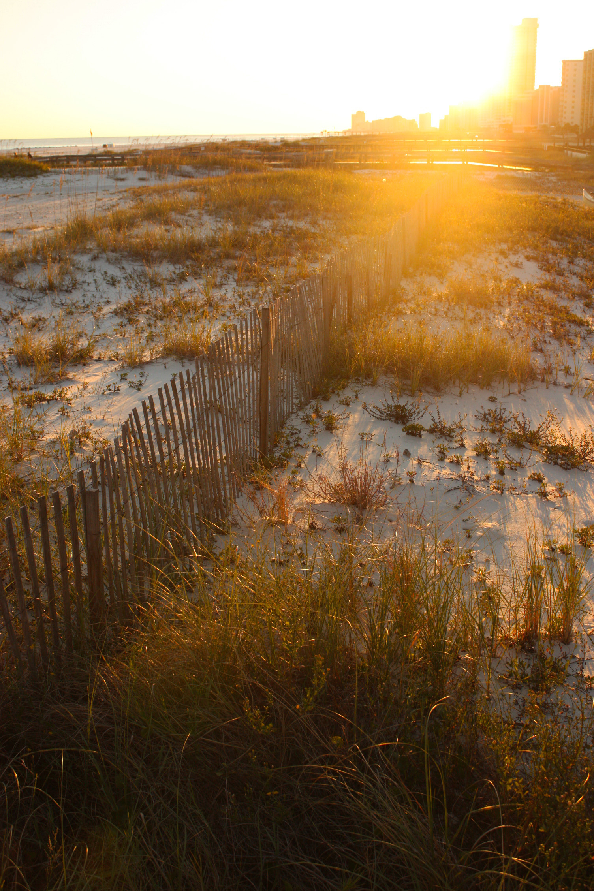
Beyond the frame.
THE FIELD JOURNAL / LANDSCAPE STUDY
A field guide to light,
landscape and attention.

Slide 2
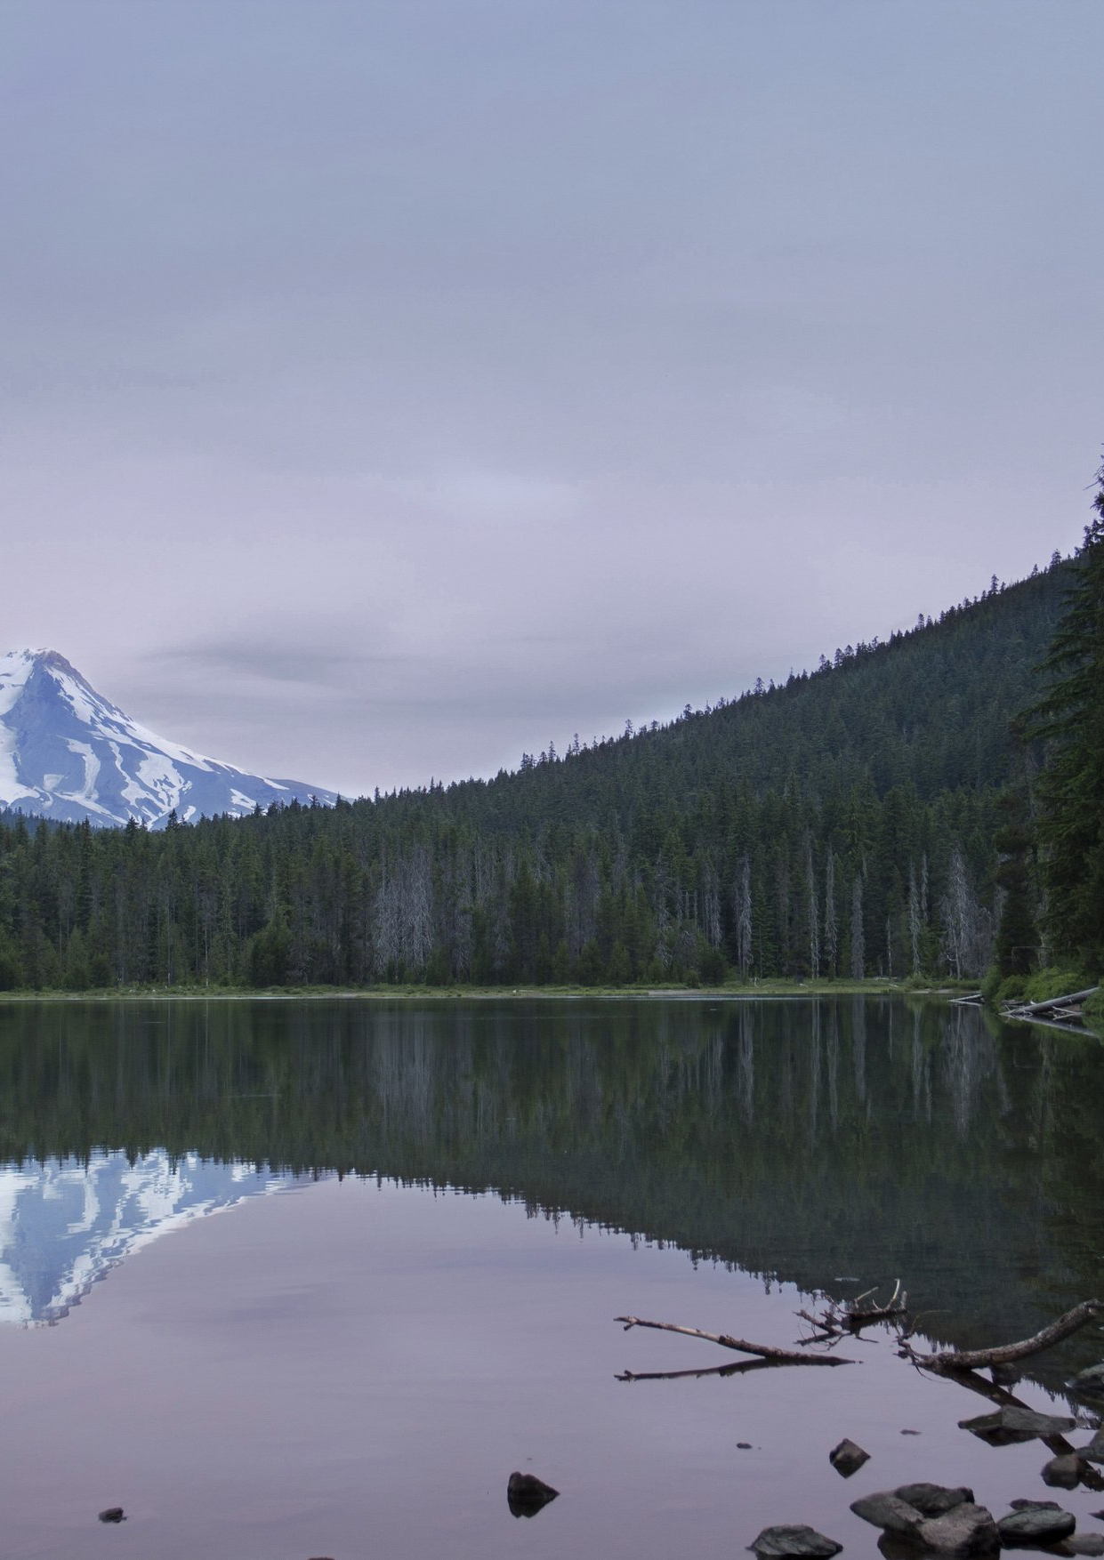
Look closer.
Ask better questions.
02
Every place has a story.
Start by learning how to see it.

Slide 3
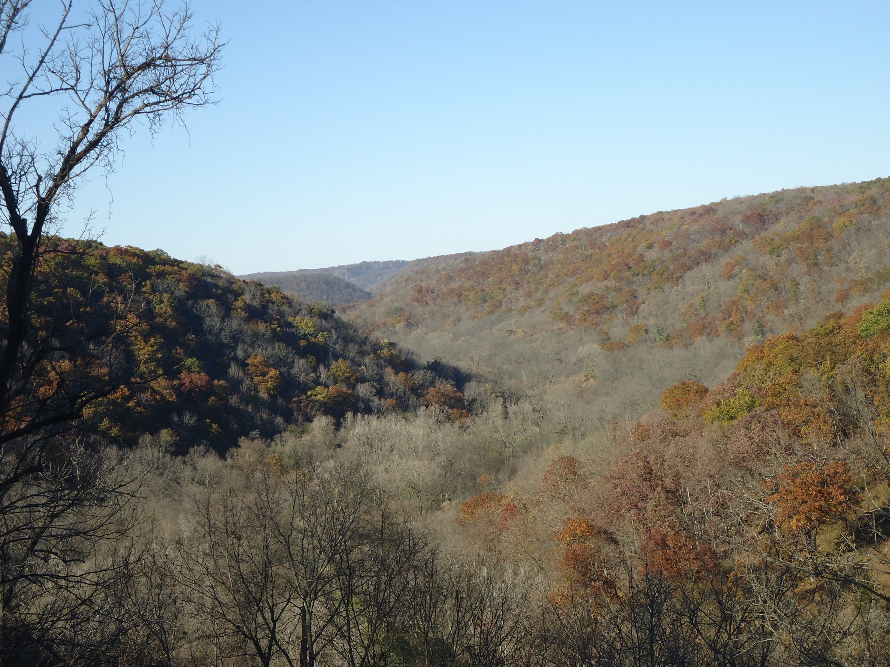
Learning begins with attention.
03 / IN THE FIELD
A shared scene. Several ways of seeing.
A photograph establishes a setting.
A field note records a detail. Together,
they can turn a passing impression into
a question worth taking back to a group.
Look for relationships within the scene,
not just a subject at its centre.
What belongs in the frame?
What would a closer view reveal?
What might someone else notice?
The purpose is not to collect answers
as quickly as possible. It is to make
better observations along the way.
PHOTO: ARCHBOB / CC0 1.0 / CROP FOR LAYOUT DEMONSTRATION

Slide 4
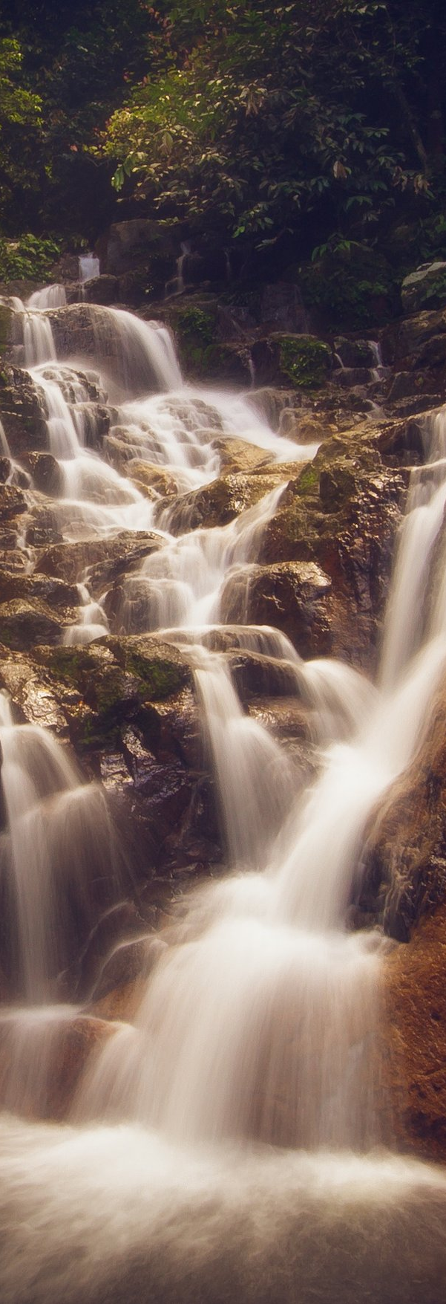
Follow the water.
04 / NATURE, UP CLOSE
A quiet detail can
open a wider story.
Water moves through the frame.
A rock, a branch and a current
create different points of entry.
Look before naming the scene.
Notice light and arrangement.
Follow an edge or a reflection.
Leave room for a closer view
to change what first seemed
important in the landscape.
PHOTO: MARTIN EKLUND / CC0
FULL-HEIGHT PHOTOGRAPHIC CROP

Slide 5

Let the landscape open the story.
05 / A WIDER PERSPECTIVE

Slide 6
A single photograph can hold a whole opening.
The eye crosses the fold before the next paragraph begins.
Pause with the setting. Then move from the wider view
to the details that make a place worth understanding.
BONNIE MORELAND / CC0 1.0 / ONE SHARED CROP ACROSS BOTH PAGES

Slide 7
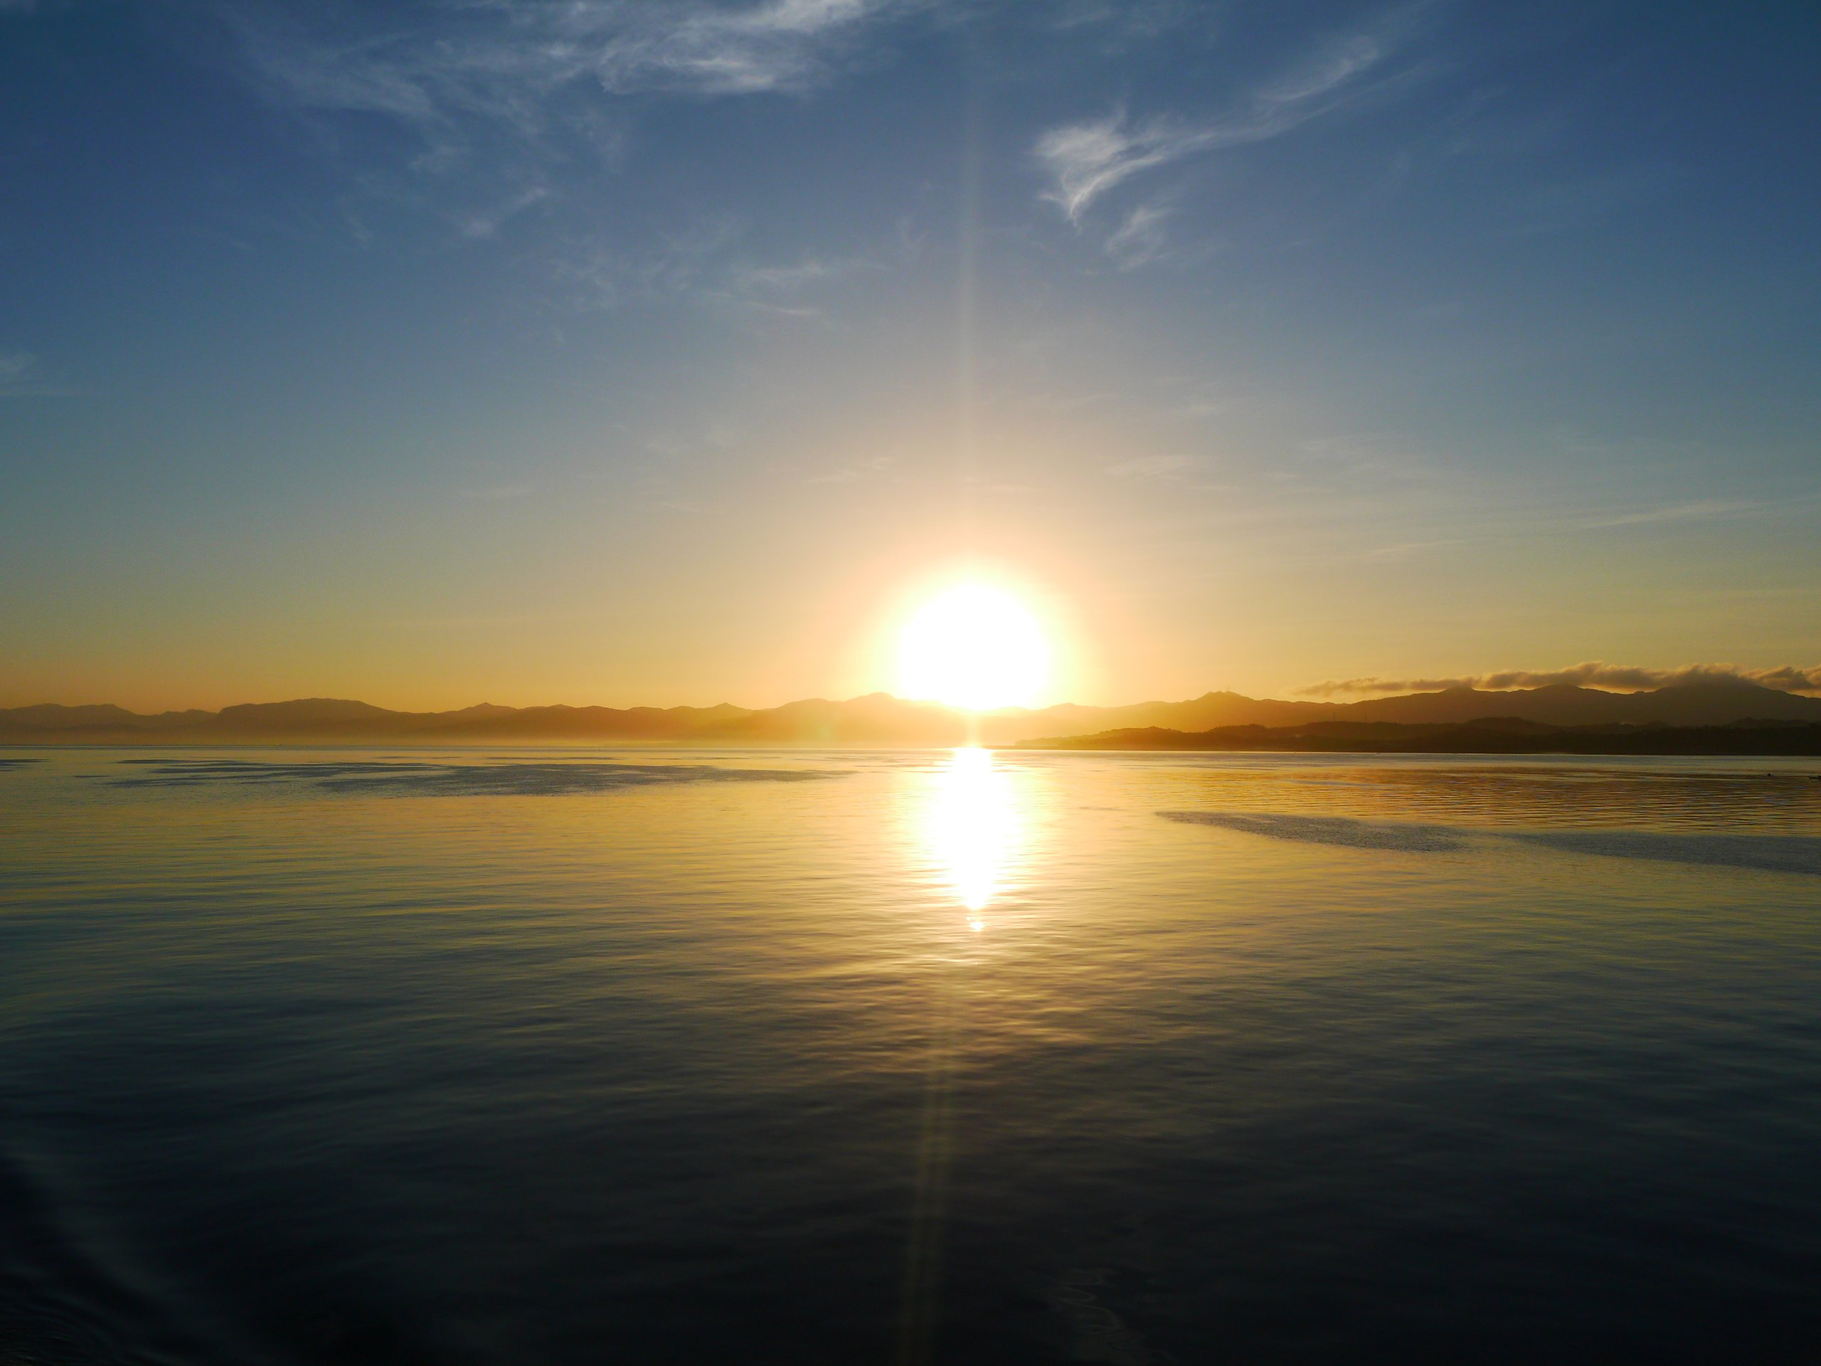

Many ways of seeing.
Water, shorelines and horizons.
Three landscapes offer different scales of attention.
PHOTOS: BONNIE MORELAND / HOMMIE09 / MARTIN EKLUND. CC0 1.0.

Slide 8
A way in.
10 / CHOOSE A WAY IN
01 / The wider view
Start with a place and its context.
02 / The small detail
Look for what a quick glance misses.
03 / The shared question
Bring another perspective into view.
Three entry points.
One connected story.
A visual index offers different ways into the same subject.
Keep labels brief, repeat their rhythm, and make the next
step clear. Add real page references in the final document.

Slide 9
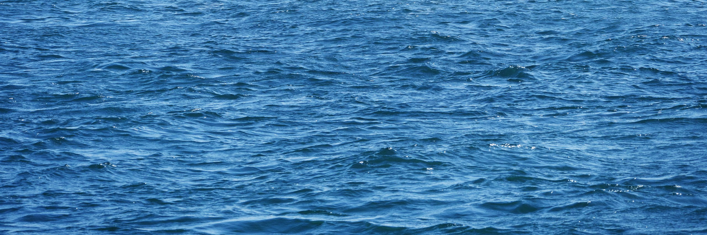
A world, in fragments.
BY COLUMN, TOP TO BOTTOM: lake / autumn; waterfall / sunrise;
waves / dunes. CC0 1.0 photographs; full credits in the website source list.
Independent landscapes, not one location or event sequence.

Slide 10
Let the eye wander.
11 / WIDE. CLOSE. CLOSER.
02 / A SMALL DETAIL
A closer view changes
the scale of attention.
01 / THE SETTING
Begin with the wider scene.
03 / A DIFFERENT SCALE
Move from water to land to horizon.
Different image sizes create a route,
while translucent bridges link the frames.
CC0 1.0 LANDSCAPES
SOURCES LISTED ON THE WEBSITE

Slide 11
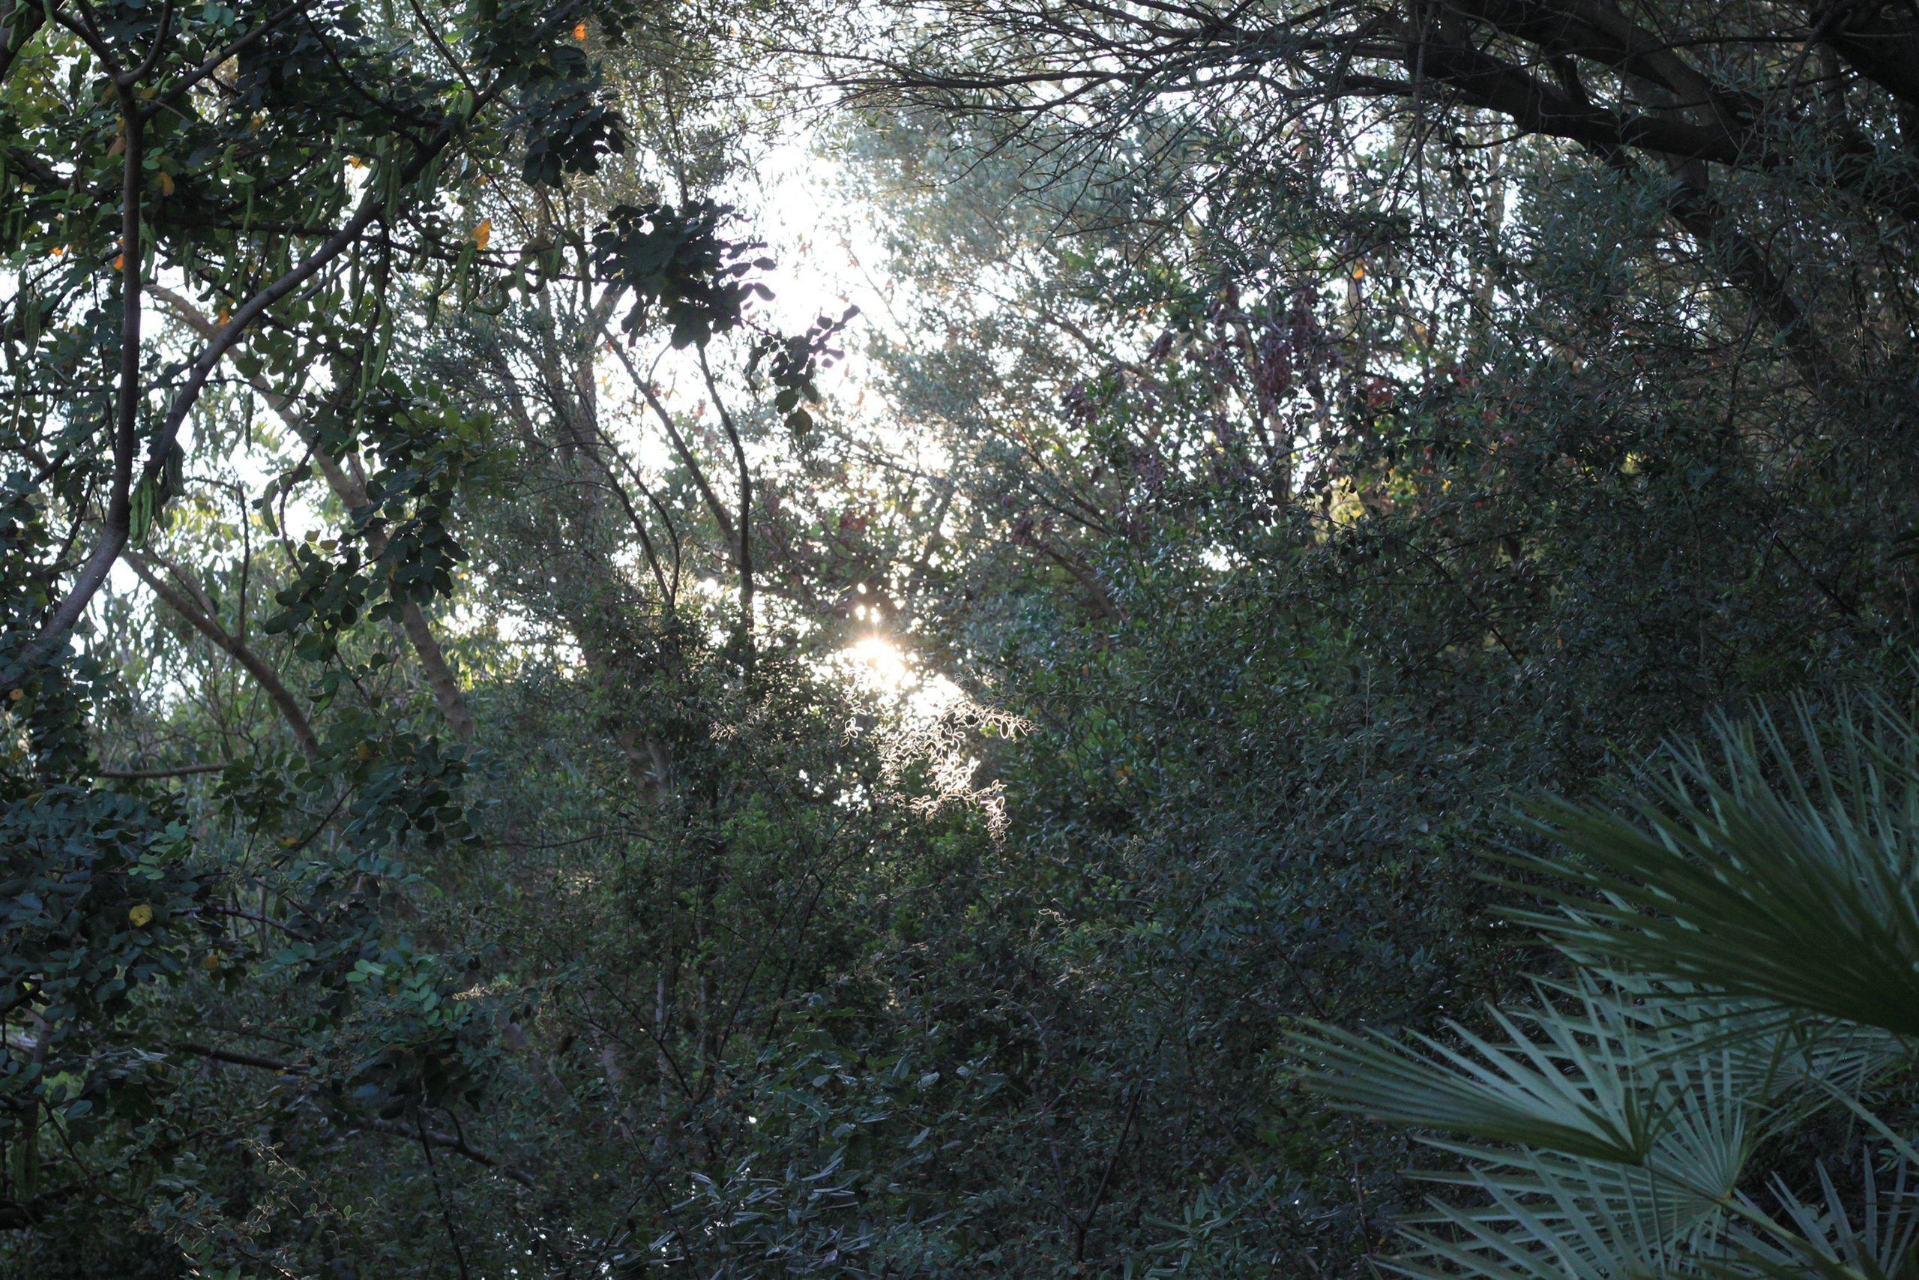
One frame. Many worlds.
A panoramic anchor, followed by six supporting views.
Read the smaller frames from left to right, then top to bottom.
CC0 landscapes from different places; full credits in the source list.

Slide 12
Across the frame.
12 / ACROSS THE EDGE
A reading plane can cross the boundary between
margin and photograph when both sides remain
deliberate. The image keeps its subject; the text
keeps a calm surface.
Keep the photograph, panel and type as separate
objects so crop and copy can be adjusted later.
LAYER ORDER
01 Photograph
02 Interlocking glazes
03 Reading panel
04 Headline and prose
PHOTO: BONNIE MORELAND / CC0

Slide 13
A frame for the natural world.
13 / SPACE AND COUNTERWEIGHT
A simple geometric shape can
connect two photographs without
pretending to be a chart or a logo.
Use it as a counterweight: large,
quiet and subordinate to the
images and the text.
A dominant view sets the place.
A smaller frame holds a second
texture, while translucent geometry
bridges the two scales.

Slide 14

The ocean keeps its own time.
05 / OPEN WATER
05
Currents, weather and light keep a record
that only patience can read.
PHOTO: BAUTSCH / CC0 1.0 / FULL-BLEED PANORAMA

Slide 15
FOUR CITIES · ACROSS THE SERIES · EDITORIAL RHYTHM · PERSPECTIVES
15+
PHOTOGRAPHIC STUDIES
29
A4 LAYOUT ARCHETYPES
06
ALIGNMENT TRACKS
04
MASONRY COLUMNS
FOUR-COLUMN HERO METRICS + CANTED OFF-AXIS MASONRY SEAM · CC0 LANDSCAPES

Slide 16

The wild is not a place.
It is a way of looking.
07 / ATTENTION AS PRACTICE
FIELD NOTE 07
Attention is the first instrument.
PHOTO: SPESSIG / CC0 1.0 / CONTRAST SCRIM OVER FOREST

Slide 17
Three ways to look.
08 / THREE DISTANCES
01 / WATER
Follow the current.
02 / STILLNESS
Let the surface settle.
03 / SEASON
Wait for the turn.
PHOTOS: MARTIN EKLUND / BONNIE MORELAND / ARCHBOB — CC0 1.0

Slide 18
Where the land ends.
FIELD REPORT 10 / THE COAST
10
A shoreline is a record of what
the water leaves behind.
PHOTO: HOMMIE09 / CC0 1.0 / CONTINUOUS SPREAD — LEFT

Slide 19
THE COAST / CONTINUED
A coastline is
never finished.
The line between water and land
is never fixed. Tide, weather and
time redraw it daily, leaving a
record that is read in layers.
Begin at the edge, then look back.
Look for the small evidence: a
strand line, a changed edge, a
surface that holds the sky. The
coast asks for patience, not
certainty. Return at another hour.
PHOTO: HOMMIE09 / CC0 1.0 / CONTINUOUS SPREAD — RIGHT

Slide 20
The forest remembers every footstep.
FIELD NOTE 11 / THE FOREST
A NOTE ON ATTENTION
What we notice becomes part of the place.
PHOTO: SPESSIG / CC0 1.0 / CONTINUOUS SPREAD — LEFT

Slide 21
THE FOREST / CONTINUED
11
Every path
is a question
asked slowly.
Walk slowly. Let the edge of the
path stay visible. A forest is not
a backdrop; it is a set of small
decisions about light, growth
and decay. Stay long enough for
the noise to settle.
Sound arrives before detail: water,
wind, a branch moving. Follow it.
Then look for what the eye missed
on the first pass — a broken stem,
a change in the canopy, a path
that was not there last season.
PHOTO: SPESSIG / CC0 1.0 / CONTINUOUS SPREAD — RIGHT

Slide 22
The season turns.
FEATURE 12 / SEASONAL LIGHT
12
Colour is a temporary agreement
between light, water and time.
PHOTO: ARCHBOB / CC0 1.0 / FULL-BLEED SEASONAL STUDY

Slide 23
A quiet surface.
13 / STILL WATER
A lake holds the sky
long enough to study it.
Wind, light and depth change the
surface before the eye can settle.
What looks still is usually a
balance of small movements.
Read the water from the edge
inward: the strand line, the
reflection, the place where the
bottom disappears. Each is a
different kind of evidence.
Return at another hour. The same
view will ask a different question.
The surface is a
temporary agreement
between wind and light.
Stillness is
a form
of attention.
PHOTO: BONNIE MORELAND / CC0 1.0
LAKE MOUNTAIN LANDSCAPE
PHOTOGRAPHIC PANEL STUDY
CC0 1.0 / FULL-BLEED PHOTOGRAPH + READING PANEL

Slide 24
Take the questions with you.
The journey continues in the way you see the world.
CC0 PHOTOGRAPHY
Bonnie Moreland / Archbob / Martin Eklund
Bautsch / SpessiG / Hommie09
Alabama Extension / Bruce Dupree
SOURCES AND LICENSE
Source list included with the examples:
photo-sources.json and image-credits.html
Also available on the website.

