Slide 1
NANYANG TECHNOLOGICAL UNIVERSITY
TextLens
A Translation App Integrated with Scene Text Editing
Goh Yew Kiang
Bachelor of Computing in Computer Science · College of Computing and Data Science · 2026
FINAL YEAR PROJECT · CCDS25-0235

Slide 2
Agenda
01
Motivation & Background
02
Project Objectives & Scope
03
Architecture & Pipeline
04
Implementation & UI Demo
05
Testing & Evaluation
06
Results
07
Conclusion & Future Work
08
Q & A

Slide 3
Motivation & Background
Why build a real-time on-device scene translation app?
PROBLEM
SOLUTION
The Problem
TextLens
— Apps like Google Translate & Apple Translate offer AR translation but depend on cloud
✓ Fully on-device pipeline — OCR + translation without any internet
— Proprietary internals — hard to reproduce or study offline behaviour
✓ Renders translated text back into the scene
— Privacy risk: camera frames sent to remote servers
✓ Motion-gated processing: OCR only on stable frames
— No internet = no translation in many real-world settings

Slide 4
Project Objectives & Scope
Five core goals driving the design of TextLens
Recognize scene text from a live camera feed using on-device ML Kit OCR
Real-Time OCR
Translate detected text without internet via on-device neural MT models
Offline Translation
Replace original text in the scene with translated content via inpainting
Scene Text Editing
Use OpenCV frame differencing to trigger OCR only on stable frames
Motion-Stable Framing
Auto-route Latin, Chinese, Japanese and Korean to the correct OCR & NMT model
Multi-Language Support

Slide 5



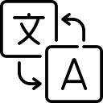

How TextLens Works
Five steps from camera to translated scene fully on-device
1
2
3
4
5
Launch App
Select target language
Point Camera
30 fps live preview
OCR Triggered
On stable frames only
Translate + Inpaint
NMT + OpenCV
Overlay Live
Tap to freeze

Slide 6
Architecture & Processing Pipeline
Three-layer modular design · end-to-end data flow
UI LAYER
APPLICATION CONTROL LAYER
ON-DEVICE PROCESSING LAYER
Camera Preview
MainActivity
OcrService (ML Kit + OpenCV)
Language Selector
→
OCR Coordinator
→
TranslationService (NMT)
Freeze-Frame Mode
Tracking Controller
TrackingEngine (Affine)
Status Indicator
Frame State Mgmt
SceneTextReplacer (Inpaint)
Camera
Motion
OCR
LangID
Translate
Inpaint
Overlay
→
→
→
→
→
→
CameraX
OpenCV
ML Kit
ML Kit
ML Kit
OpenCV
OpenCV

Slide 7
Implementation: OCR & Motion Detection
Stable-frame gating reduces wasted compute
Motion-Stability Gate
ML KIT OCR OUTPUT
1
Convert frame to grayscale
Text Blocks
Logical groupings of lines
2
Compute absolute difference vs. previous frame
Bounding Boxes
Pixel coordinates per text line
Corner Points
4-point polygon per text region
3
Mean pixel diff < threshold → frame is stable
Script Support
Latin, Chinese, Japanese, Korean
4
Submit stable frame to ML Kit OCR analyzer
Language Hint
Informs which OCR model to select
5
Cache results; skip OCR while camera is moving
Confidence
Used to filter low-quality detections

Slide 8
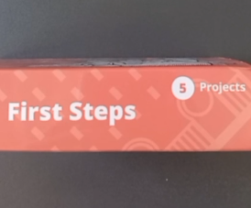

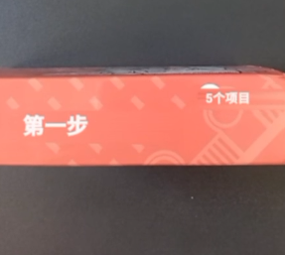
Implementation: Scene Text Replacement
Inpainting the original text, re-rendering the translation
1
Detect & Extract
2
OpenCV Inpainting
3
Re-render Translation
OCR returns a 4-point bounding polygon per text region. The region is cropped from the live camera frame for processing.
A binary mask covers the detected text area. OpenCV reconstructs the background texture from neighbouring pixels, removing the original text.
Translated text is drawn back at the original location with auto-scaled font, maintaining spatial layout and scene coherence.
→
→
original text region
bounding polygon
masked area
background reconstruction
translated text drawn
auto-scaled font

Slide 9
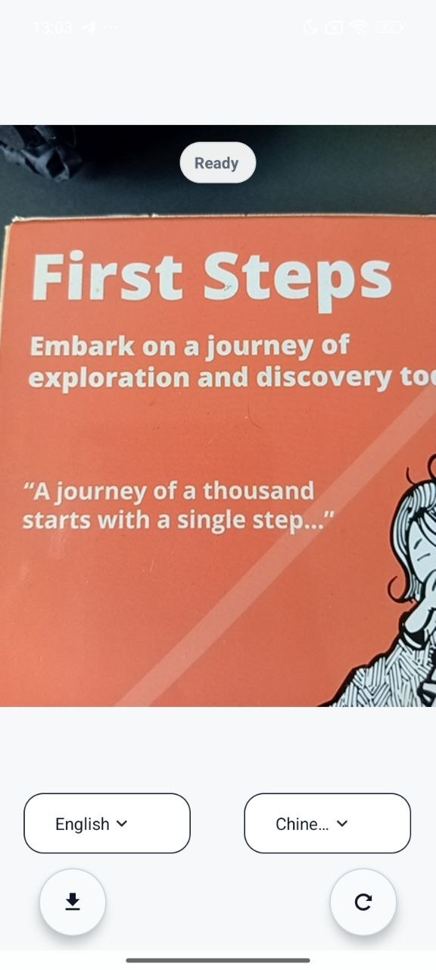
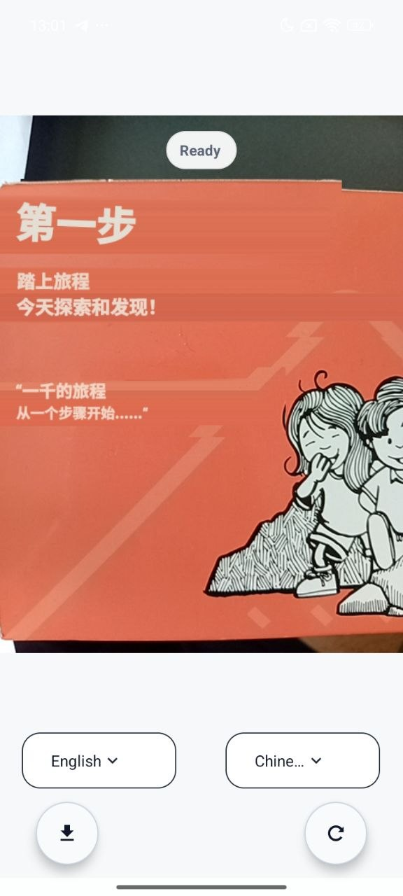
UI Showcase: Before & After
ORIGINAL
TRANSLATED
[ Insert screenshot ]
[ Insert screenshot ]
Original camera frame
Inpainted + translated output

Slide 10

LIVE DEMO
820 ms
End-to-end latency
TextLens in Action
[ Insert screen recording ]
WATCH FOR
92.1%
OCR detection precision
Motion gate
Overlay pauses when phone moves — OCR only on stable frames
Inpainting
Original text erased, background reconstructed by OpenCV
4.2 / 5
Translation quality score
Tap to freeze
Translation locks in place so you can read at your own pace
▶
26 fps
Overlay render rate
DEMO SEQUENCE
Menu → Chinese → point at image → stable → overlay → tap freeze → screenshot option
Fully On-Device · No Internet Required

Slide 11
Testing & Evaluation Methodology
Multi-level testing and five performance dimensions
UNIT TESTING
INTEGRATION TESTING
END-TO-END TESTING
Language code mapping
Translation cache logic
UI model-download state
Camera → OCR → Translation → Overlay chain
Motion stability → OCR trigger
Full workflow: launch → scan → OCR → translate → freeze-frame → save → return
Evaluation Metrics
OCR Detection
Precision = TP/(TP+FP) · Recall = TP/(TP+FN)
OCR Recognition
CER = (S+D+I)/N — character-level error rate (lower = better)
Language Routing
Accuracy = Correct classifications / Total segments
Translation Quality
Manual 1–5 scale (5 = perfect meaning & grammar)
Latency
Total = OCR time + Translation time + Render time

Slide 12
Results: OCR & Language Performance
Strong accuracy on printed scene text under indoor conditions
92.1%
86.8%
5.9%
95%
Detection Precision
Detection Recall
Char Error Rate
Lang Routing
LANGUAGE ROUTING ACCURACY
REMAINING ERROR CAUSES
Latin-based
96%
Small font sizes → Missed detections
Chinese
95%
Motion blur → Recognition errors (CER↑)
Low contrast → Both detection & recognition
Japanese
94%
Mixed-language text → Routing errors
Korean
93%
Partial occlusion → Incomplete bounding boxes

Slide 13
Results: System Performance
Translation quality, latency, throughput and tracking stability
4.2/5.0
820 ms
91%
26 fps
Translation Quality
End-to-End Latency
Tracking Success
Overlay Render
Latency Breakdown (ms)
THROUGHPUT & LATENCY
Camera frame rate
30 fps
Overlay render rate
26 fps
OCR refresh interval
1.6 s
Tracking avg. duration
3.5 s
Latency — small scene
~873 ms
Latency — dense scene
~5,958 ms

Slide 14
Conclusion & Future Work
What TextLens demonstrates — and where it can go next
Real-time on-device scene text translation on Android — no cloud needed.
Future Work
Feasibility Proven
Parallel / batch translation to cut dense-scene latency
92.1% precision · 5.9% CER · 4.2/5 translation score · 820 ms end-to-end.
Strong Performance
Advanced OCR for low-light, curved and stylised text
Motion-gated OCR + affine tracking + inpainting + NMT in a single mobile app.
AR-quality text replacement via surface geometry estimation
Novel Pipeline
Improved tracking with homography or learning-based methods
26 fps overlay, 91% tracking success, fully offline after one-time model download.
Practical Usability
Leverage diffusion models to improve scene replacement

Slide 15
Thank You
Questions & Discussion
92.1%
5.9%
4.2/5
820ms
OCR Precision
Char Error Rate
Translation Score
E2E Latency
Goh Yew Kiang · CCDS25-0235 · Nanyang Technological University · 2026
github.com/yewkiang123/TranslatorApp

