Slide 1
Probing VLM Robustness with Controlled Synthetic Data
A controlled evaluation of BLIP and a custom VQA model under image and text perturbations
Ye Wu and Victoria Chiang
Rice University · COMP 646 Final Project
5-minute project brief
01

Slide 2
Motivation: Accuracy Is Not Reliability
VLMs can perform well on benchmarks but fail under small input changes.
Robustness matters when image/text changes preserve the correct answer.
Controlled synthetic data isolates specific reasoning failures.
Focus: attribute binding, counting, and perturbation robustness.
Core Question
When the answer should stay the same, do model outputs stay stable?
Which task fails: existence, counting, spatial, or comparison?
02

Slide 3
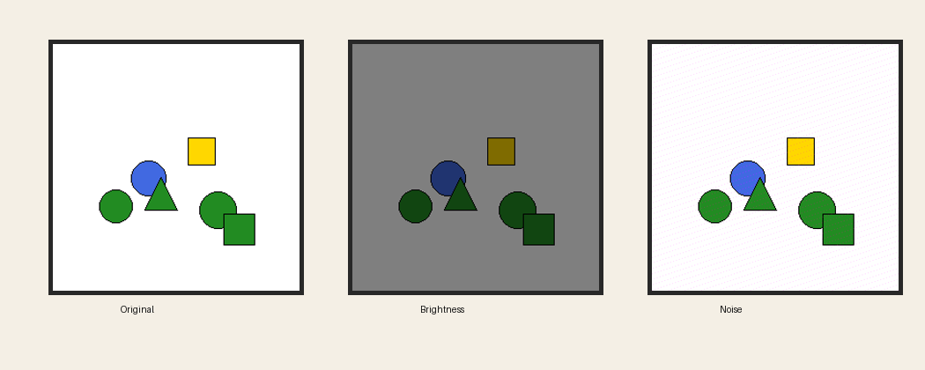
Controlled Synthetic VQA Setup
Dataset and Perturbations
3000 training-pool examples; 20% validation split.
600 held-out test examples.
Queries: existence, counting, spatial relationship, comparison.
Perturbations: brightness factor 0.5, noise std 20, text rephrasing.
03

Slide 4
Models Compared
BLIP VQA Base
Custom Dual-Head VQA
Checkpoint: Salesforce/blip-vqa-base
Pretrained VQA baseline
Inference only
Generates short text answers
ResNet-18 image encoder
Bidirectional GRU text encoder
Query-type embedding + fusion MLP
Yes/no head + counting head
Perturbation augmentation
04

Slide 5
Evaluation Protocol
Original
Brightness
Noise
Text Rephrasing
Metrics
Exact-match accuracy · robustness degradation · per-task breakdown · paired McNemar test · qualitative robustness failures
Same 600 test examples are used for both BLIP and the custom model.
05

Slide 6
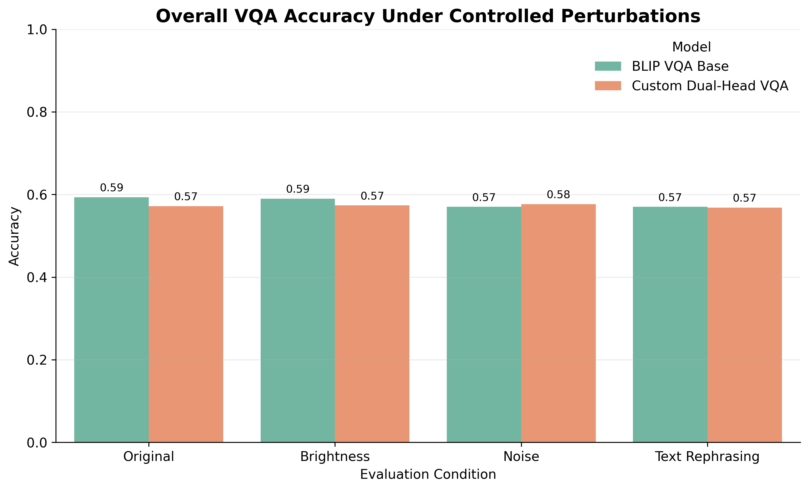
Quantitative Results
Key Findings
BLIP clean: 0.593; Custom clean: 0.572.
Under noise, Custom slightly exceeds BLIP: 0.577 vs 0.570.
Custom improves counting through its count head.
McNemar tests: no significant overall difference at 0.05.
06

Slide 7
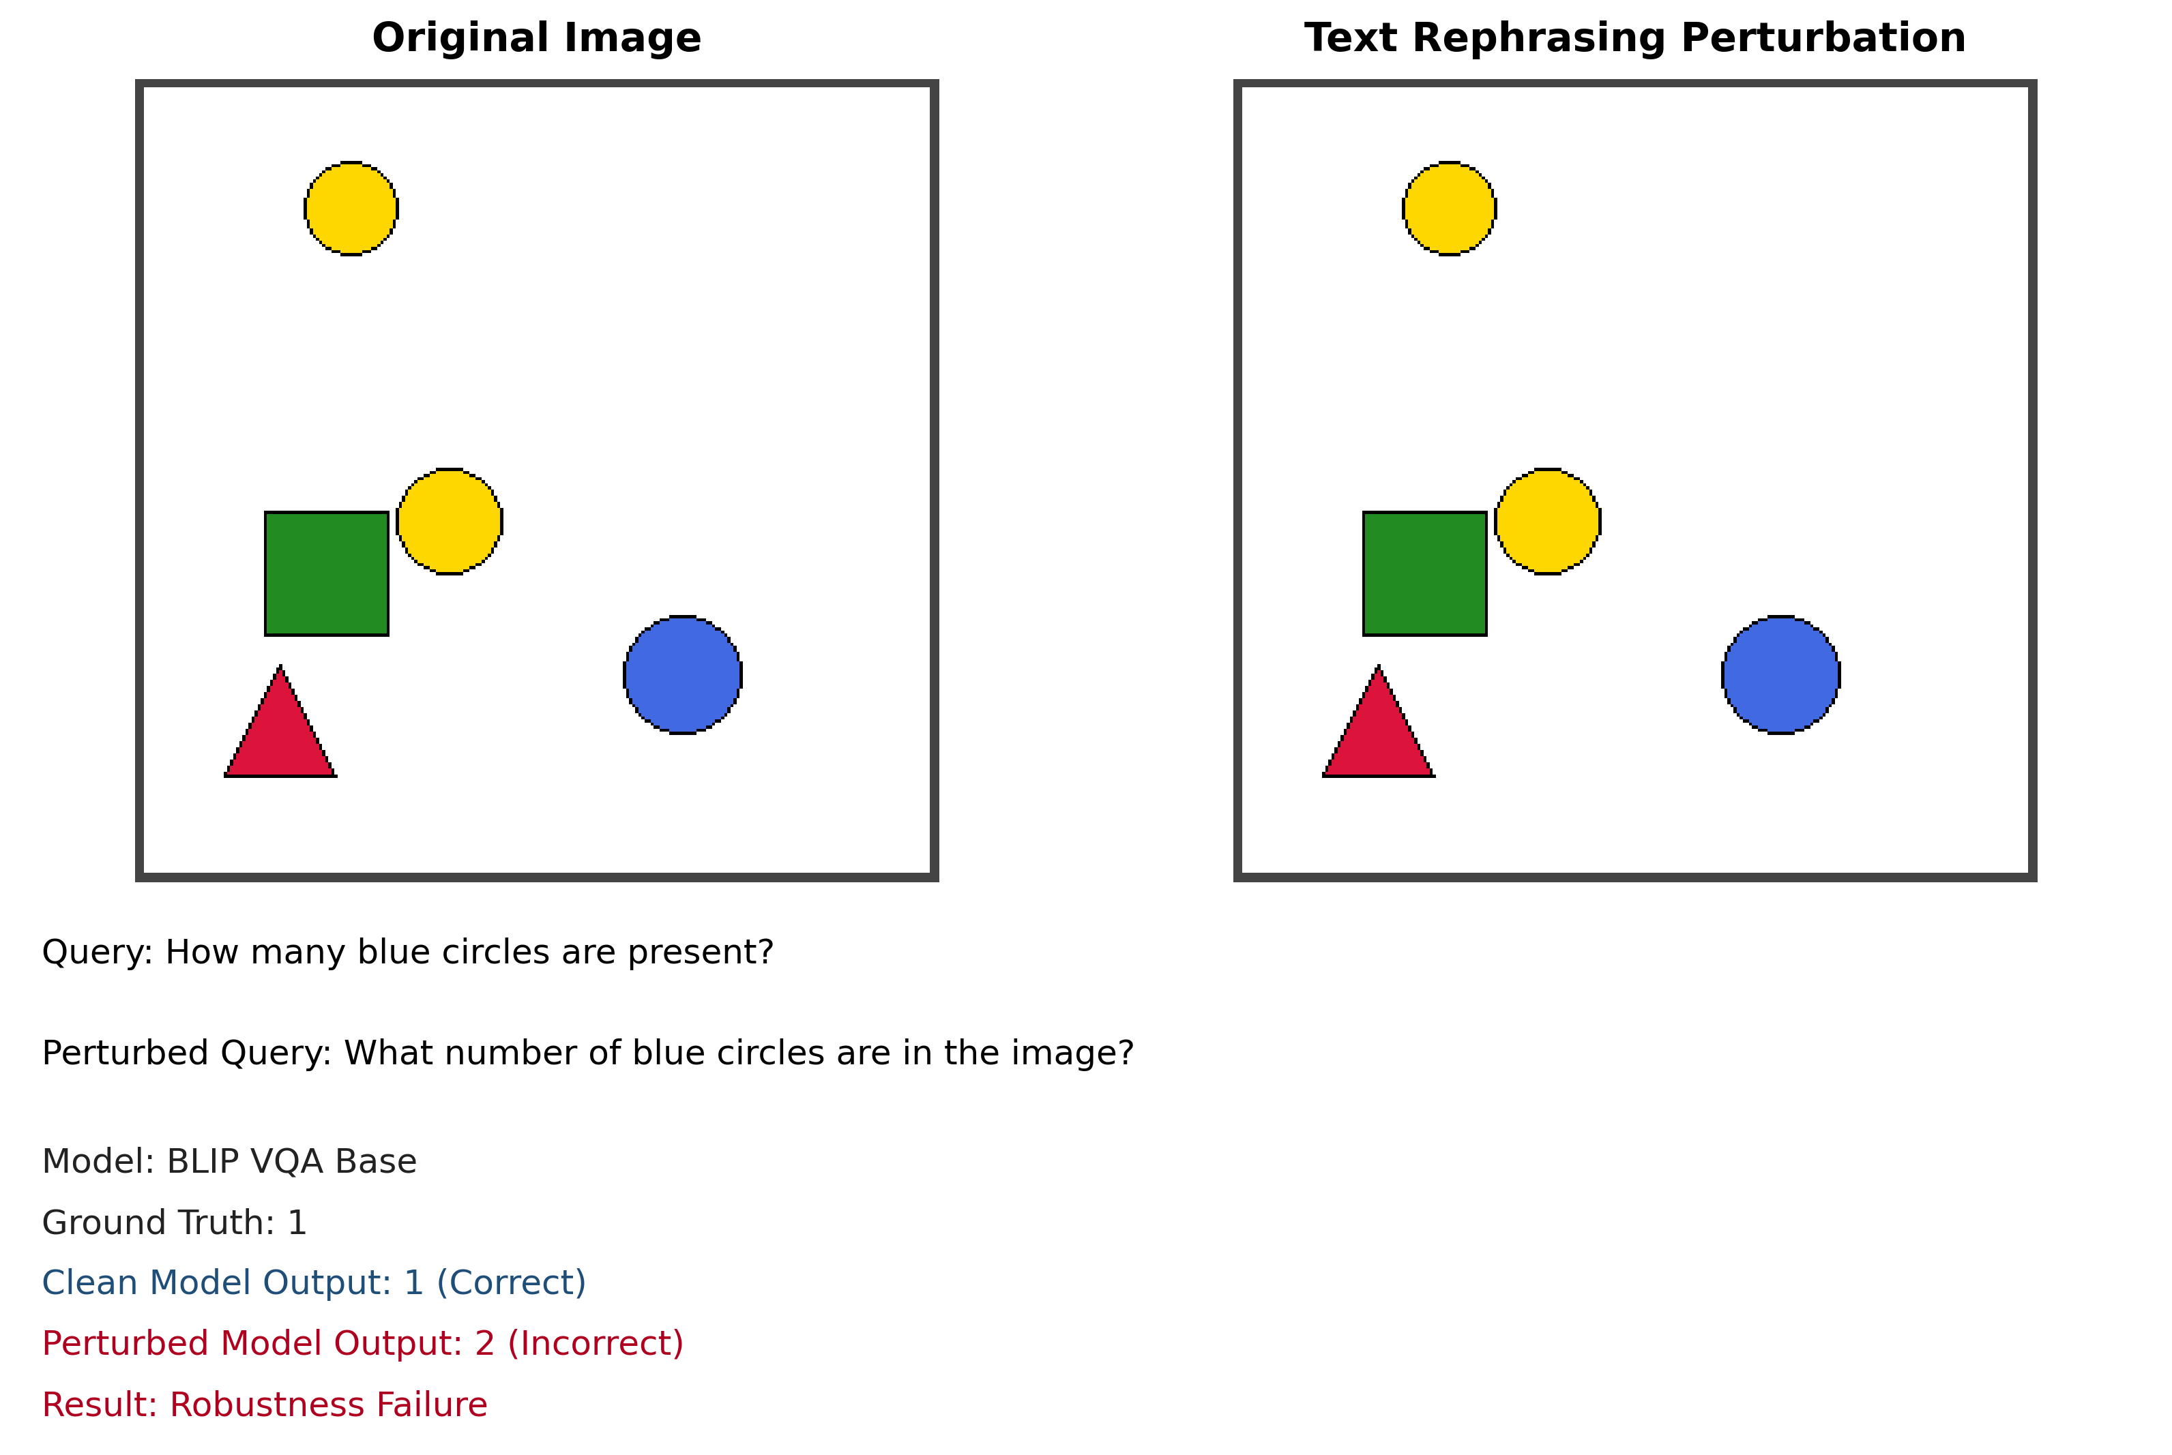
Takeaways
What We Learned
BLIP is slightly stronger on clean inputs, but the custom model is competitive.
Per-task analysis reveals complementary strengths.
Counting remains a key bottleneck for pretrained VQA.
Qualitative failures show why visual inspection matters.
Controlled synthetic evaluation helps diagnose VLM reliability.
07

