Slide 1


What affects the SAT participation rate between 2017-2018 in U.S.?
Identify target states for SAT growth
Notes:
competition between SAT and ACT (number for reference)
goal is to identify target states to expand growth
mention that some states require ACT as final exams, restriction due to government policy / regulation , so that there are some markets that we don’t touch on

Slide 2
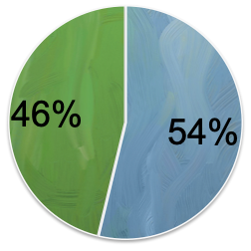
2.22m
1.91m
ACT
SAT
Source:
https://reports.collegeboard.org/pdf/2019-total-group-sat-suite-assessments-annual-report.pdf
2018 ACT & SAT no. of test takers

Slide 3
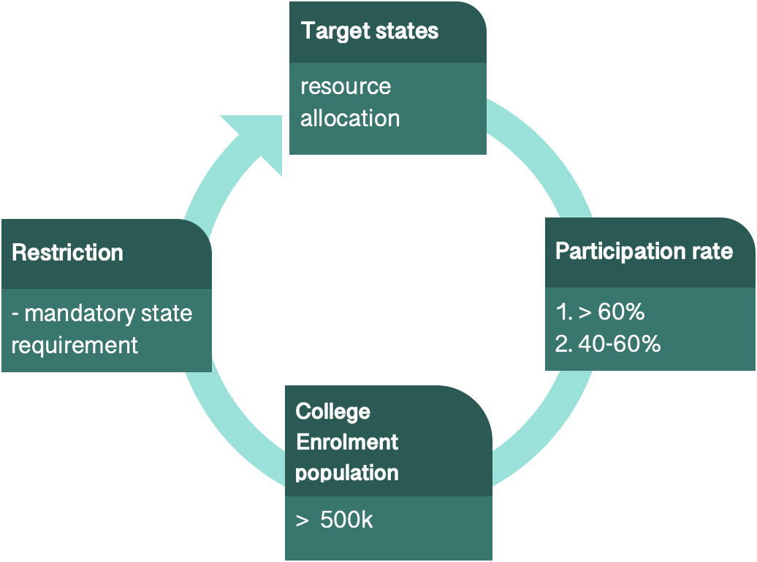
Criteria to identify target states

Slide 4
Data Insights

Slide 5
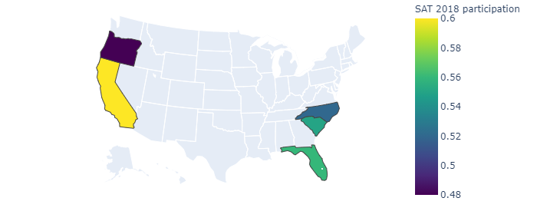
States with SAT rates between 40% and 60%
Notes:
Uplifting the brand through marketing

Slide 6
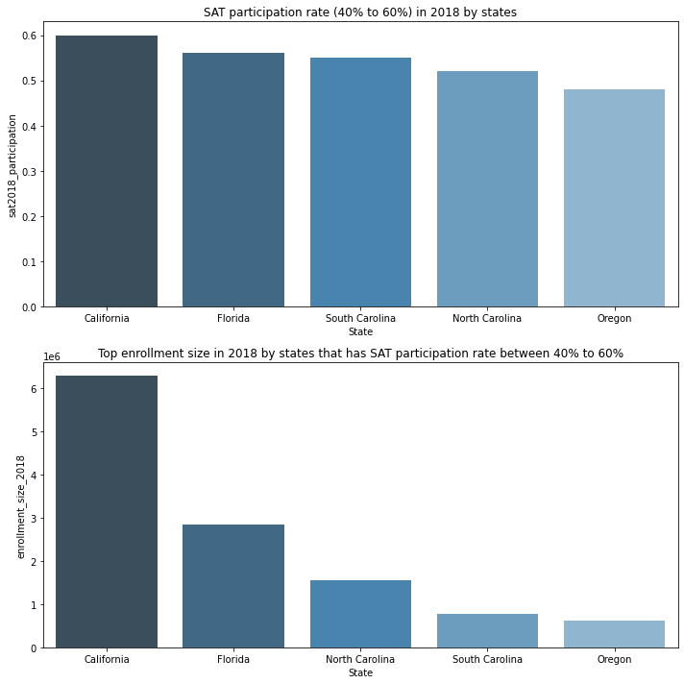
https://nces.ed.gov/programs/digest/d19/tables/dt19_203.20.asp
Breakdown of States with participation between 40% to 60% and more than 500,000 enrollment population
Notes:
Primary data source is from sat 2017 and sat 2018 internal data

Slide 7
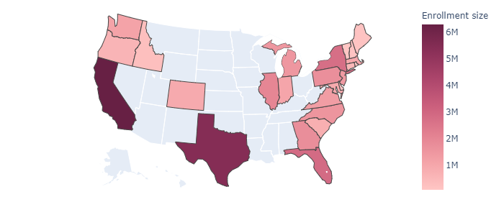
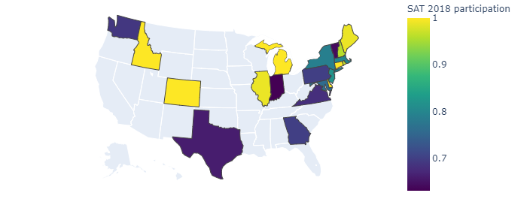
States with SAT participation above 60%
Notes:
60% to 90% we look to maintain the branding
Above 90% we leverage on branding that we already have

Slide 8
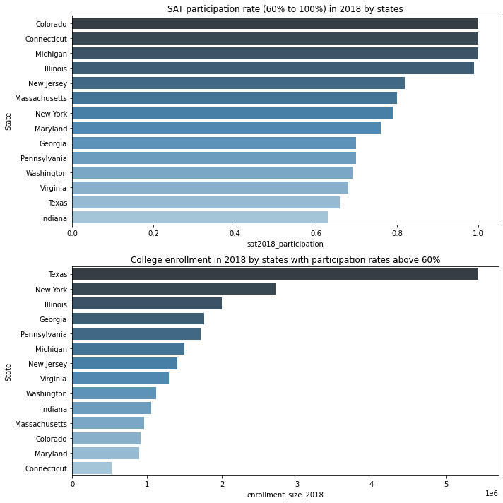
https://nces.ed.gov/programs/digest/d19/tables/dt19_203.20.asp
Breakdown of States with participation >60% and more than 500,000 enrollment population

Slide 9
https://nces.ed.gov/programs/digest/d19/tables/dt19_203.20.asp
States to Target

Slide 10
Business Ideas

Slide 11

6 million
Lobby California

Slide 12

NEW JERSEY
82%
NEW YORK
79%
GEORGIA
70%
Lobby States close to 100% SAT participation

Slide 13

SAT 56% ACT 89%
HAWAII
SAT 66% ACT 41%
TEXAS
SAT 56% ACT 66%
FLORIDA
Lobby States with no preference (yet)

Slide 14
Recommendations

Slide 15
COLORADO
→ 56000
5500
in 2016
in 2017
Made mandatory in 2018
source:https://www.testive.com/colorado-sat-change-2017/
Case Study: Colorado State

Slide 16
ILLINOIS
→ 100%
9%
in 2017
Made mandatory in 2018
source:https://www2.illinois.gov/services/ISBE/sat
Case Study: Illinois State

Slide 17
NEW YORK
→ 79%
67%
in 2017
in 2018
source:https://reports.collegeboard.org/pdf/2018-new-york-sat-suite-assessments-annual-report.pdf
Recommend SAT to New York State

Slide 18
NEW YORK
100% =
43,000 more test takers
Better branding across the US East Coast
in 2019
source:https://reports.collegeboard.org/pdf/2018-new-york-sat-suite-assessments-annual-report.pdf
Recommend SAT to New York State

Slide 19
Q & A

