Slide 1
VE281 Data Structures and Algorithms
Comparison Sort
Learning Objectives:
Know the difference between comparison sort and non-comparison sort
Know the procedures of merge sort and quick sort
Know the master theorem
Know different characteristics of sorting algorithms, such as time complexity, stability, etc.

Slide 2
Outline
Sorting Basics
Merge Sort
Quick Sort
Comparison Sort Summary

Slide 3
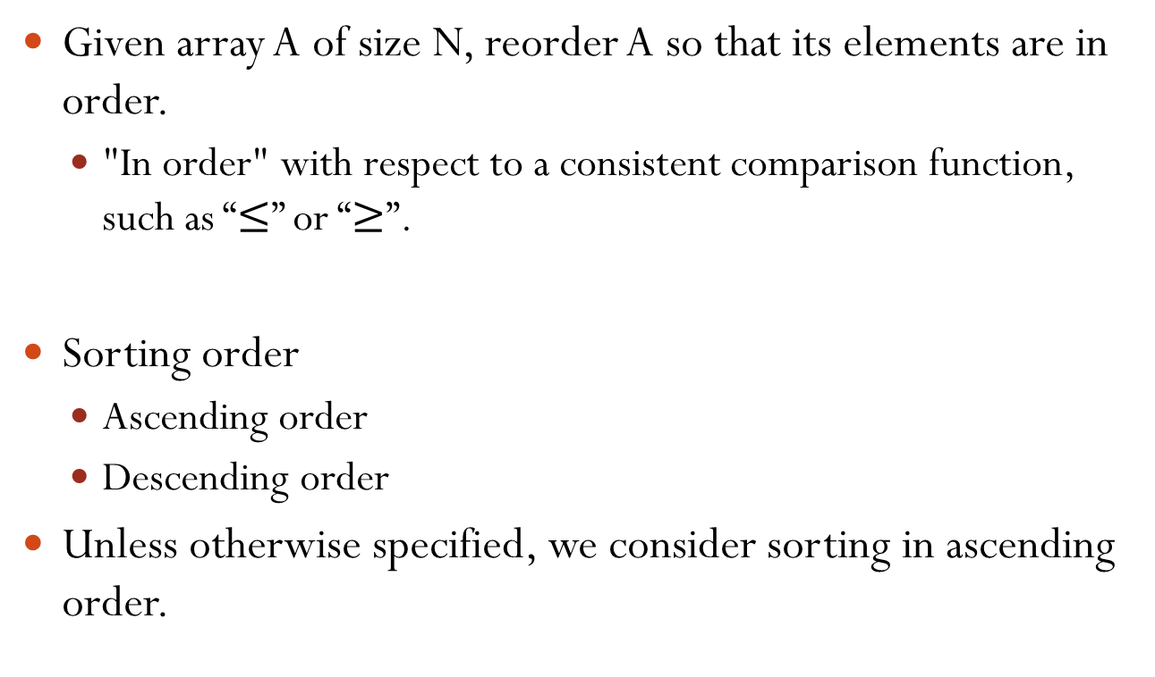
Sorting
Given array A of size N, reorder A so that its elements are in order.
"In order" with respect to a consistent comparison function, such as “$≤$” or “$≥$”.
Sorting order
Ascending order
Descending order
Unless otherwise specified, we consider sorting in ascending order.
Notes:
Comparison function:
For integer/double
For string: lexicographic order. boy < car < cat < catch

Slide 4
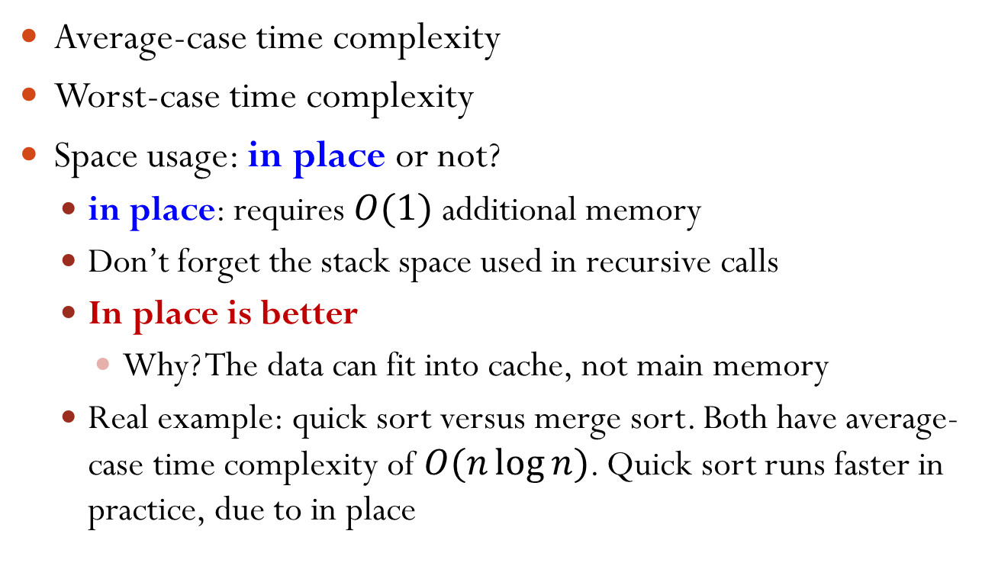
Characteristics of Sorting Algorithms
Average-case time complexity
Worst-case time complexity
Space usage: in place or not?
in place: requires $O(1)$ additional memory
Don’t forget the stack space used in recursive calls
In place is better
Why? The data can fit into cache, not main memory
Real example: quick sort versus merge sort. Both have average-case time complexity of $O(n\log{n})$. Quick sort runs faster in practice, due to in place
Notes:
Space usage affects the constant factor, because the memory access takes time. Modern computers are based on memory hierarchy. The top is small cache, but extremely fast. If O(1) additional space, it can be fit inside the cache and then, the program is fast; otherwise, it cannot be fit inside the cache, which needs to read the secondary memory, which takes time.

Slide 5
Characteristics of Sorting Algorithms
Stability: whether the algorithm maintains the relative order of records with equal keys
Usually there is a secondary key whose ordering you want to keep. Stable sort is thus useful for sorting over multiple keys
Example: sort complex numbers a+bi
Ordering rule: first compare a; when there is a tie, compare b
One sorting method: first sort b, then sort a
(4, b), (3, e), (3, b), (5, b)
(3, e), (3, b), (4, b), (5, b)
Sort on the first number
Stable!
Sort on b
3+5i, 2+6i, 3+4i, 5+2i
5+2i, 3+4i, 3+5i, 2+6i
… sort on a
2+6i, 3+4i, 3+5i, 5+2i
Stability is important!

Slide 6
Types of Sorting Algorithms
Sorting algorithms can be classified as comparison sort and non-comparison sort.
Comparison sort: each item is compared against others to determine its order.
Non-comparison sort: each item is put into predefined “bins” independent of the other items presented.
No comparison with other items needed.
It is also known as distribution-based sort.
Notes:
Non-comparison sort example: sort 100 numbers which are with limited choices {1, 2, 3, 4, 5}

Slide 7
Types of Sorting Algorithms
General types of comparison sort
Insertion-based: insertion sort
Selection-based: selection sort, heap sort
Exchange-based: bubble sort, quick sort
Merging-based: merge sort
Non-comparison sort: counting sort, bucket sort, radix sort
Notes:
Exchange-based: exchange two elements to restore their orders.

Slide 8

Insertion Sort
A[0] alone is a sorted array.
For i=1 to N-1
Insert A[i] into the appropriate location in the sorted array A[0], …, A[i-1], so that A[0], …, A[i] is sorted.
To do so, save A[i] in a temporary variable t, shift sorted elements greater than t right, and then insert t in the gap.
Time complexity?
In place?
Stable?
Yes, because elements are visited in order and equal elements are inserted after its equals.
$$O(N^{2})$$
Yes. O(1) additional memory.
Notes:
Example: Sort 3, 6, 5, 1, 4, 2
Each inner loop takes c x i operations, due to shift operations.
Worst case: reverse order 6, 5, 4, 3, 2, 1
Stability Example: (4, b), (3, e), (3, b).
(4, b); (3, e), (4, b); (3, e), (3, b), (4, b)

Slide 9
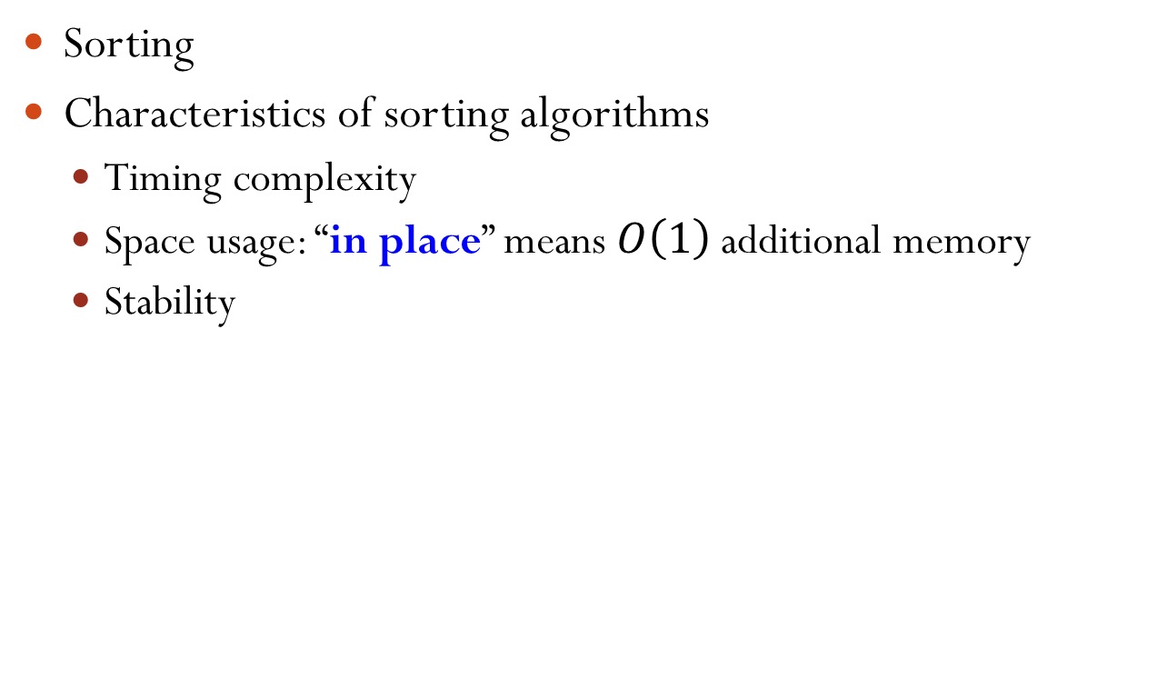
Insertion Sort Best Case Time Complexity
For i=1 to N-1
Insert A[i] into the appropriate location in the sorted array A[0], …, A[i-1], so that A[0], …, A[i] is sorted.
The best case time complexity is $O(N)$.
It happens when the array is already sorted.
For other sorting algorithms we will talk, their best case time complexity is $Ω(N\log{N})$.
Notes:
Insertion sort is used in merge/quick sort once the array size is sufficiently small, because the constant for merge sort could be large.

Slide 10
Selection Sort
For i=0 to N-2
Find the smallest item in the array A[i], …, A[N-1]. Then, swap that item with A[i].
Finding the smallest item requires linear scan.
Notes:
Note: find the smallest and put at the beginning!! (but can also find the largest and put at the end.) Selection sort needs pairwise comparison.
Example: 3, 6, 5, 1, 4, 2
1, 6, 5, 3, 4, 2
1, 2, 5, 3, 4, 6
1, 2, 3, 5, 4, 6
1, 2, 3, 4, 5, 6
1, 2, 3, 4, 5, 6

Slide 11

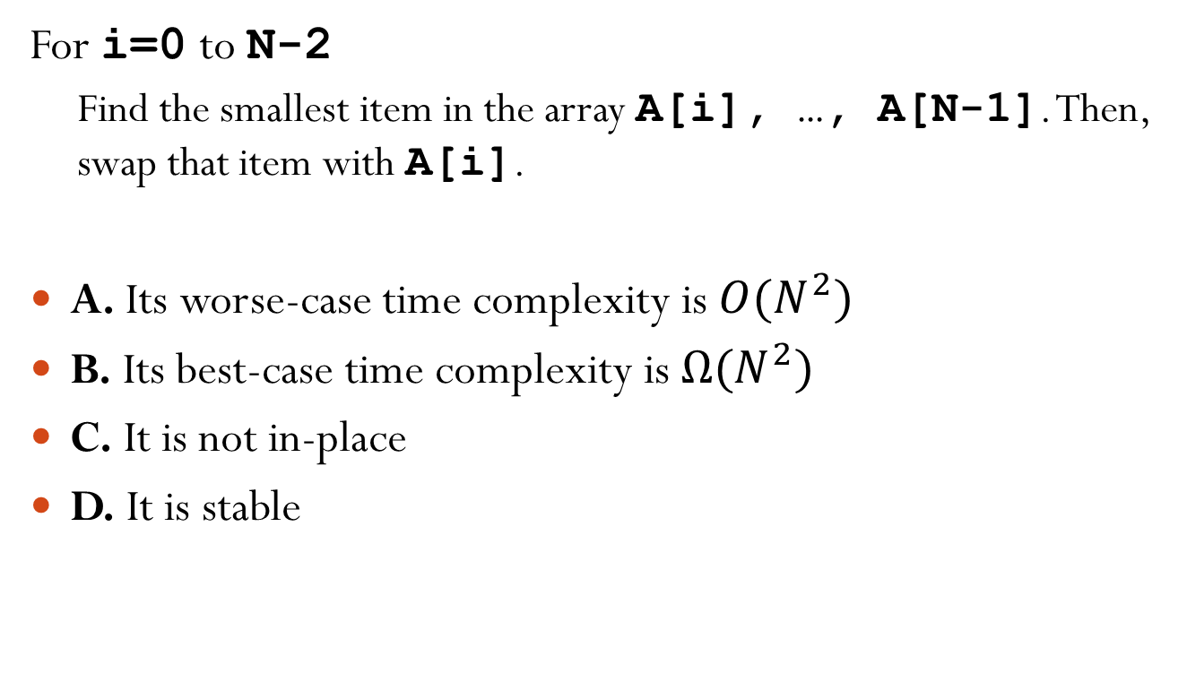
Which Statements Are Correct for Selection Sort?
For i=0 to N-2
Find the smallest item in the array A[i], …, A[N-1]. Then, swap that item with A[i].
A. Its worse-case time complexity is $O(N^{2})$
B. Its best-case time complexity is $Ω(N^{2})$
C. It is not in-place
D. It is stable
Notes:
Answer: A and B
C: It is in place.
D: not stable. Suppose when there are multiple smallest items, we pick the first one as min. (In implementation, it is like <=) Consider input as (3, e), (3, b), (2, a). After selection sort, it is (2, a), (3, b), (3, e).
Suppose when there are multiple smallest items, we pick the last one as min. (In implementation, it is like <=) Consider input as (3, e), (3, b). After selection sort, it is (3, b), (3, e).

Slide 12

Bubble Sort
For i=N-2 downto 0 For j=0 to i If A[j]>A[j+1] swap A[j] and A[j+1]
Compares two adjacent items and swap them to keep them in ascending order.
From the beginning to the end. The last item will be the largest.
Time complexity?
In place?
Stable?
Yes, because equal elements will not be swapped.
$$O(N^{2})$$
Yes.
Notes:
Example: 3, 6, 5, 1, 4, 2
i = 4: 3, 5, 1, 4, 2, 6
i = 3: 3, 1, 4, 2, 5, 6
i = 2: 1, 3, 2, 4, 5, 6
i = 1: 1, 2, 3, 4, 5, 6
i = 0: 1, 2, 3, 4, 5 ,6

Slide 13
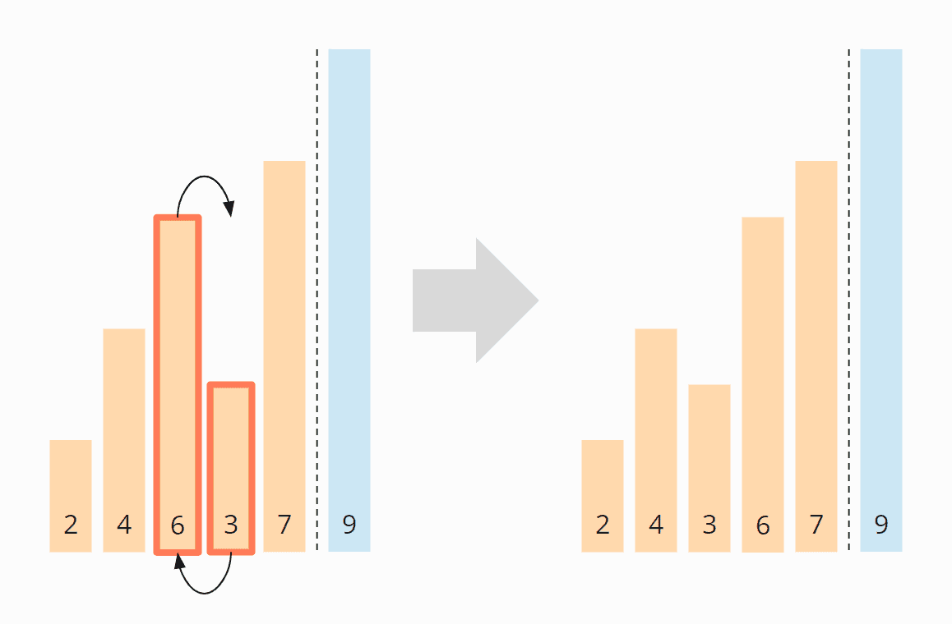
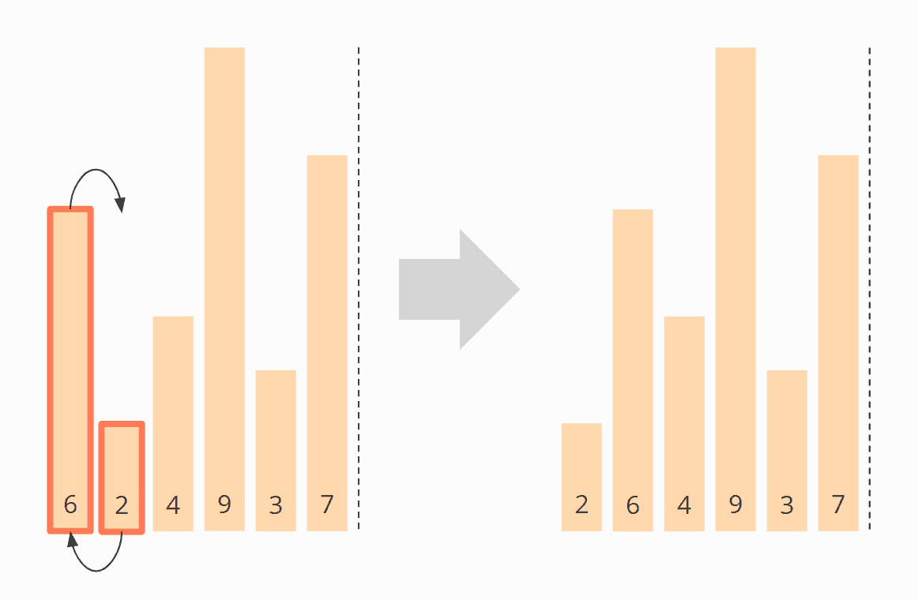
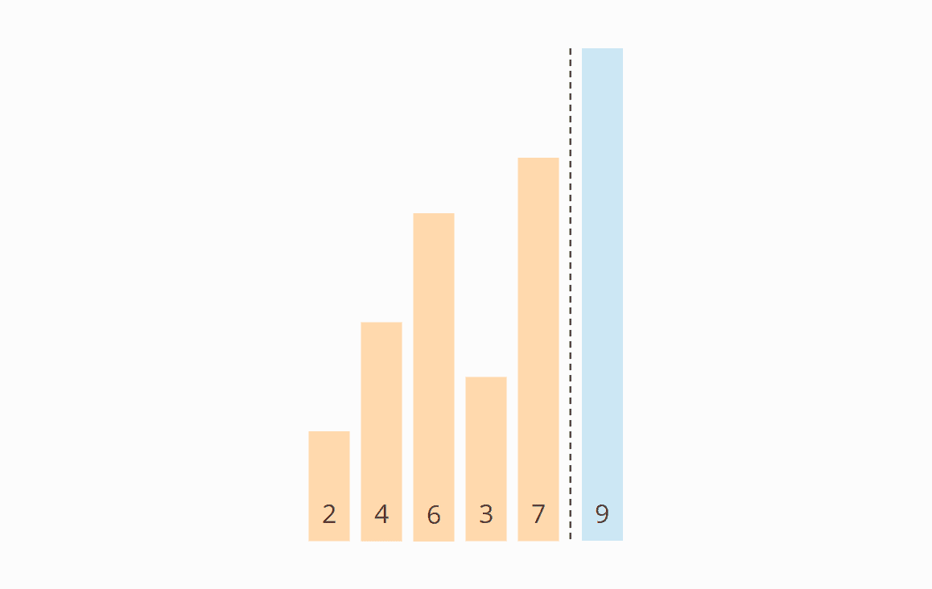
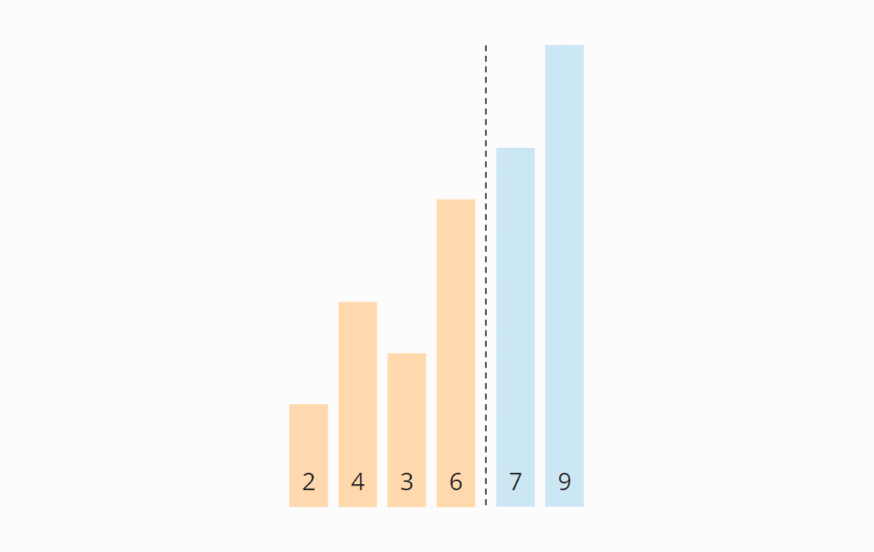
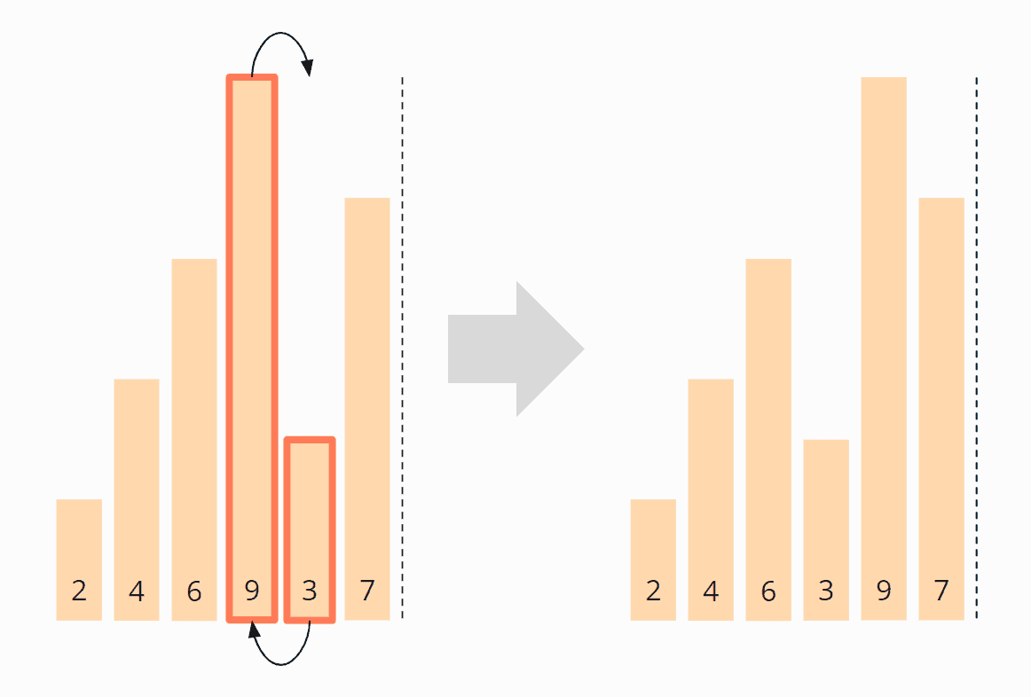
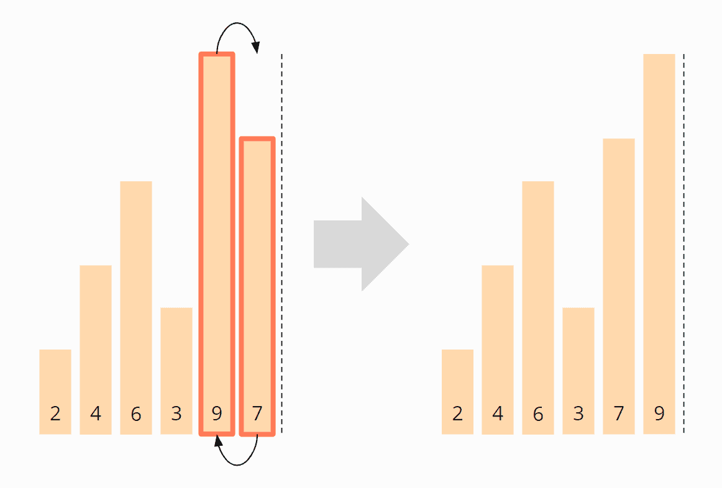
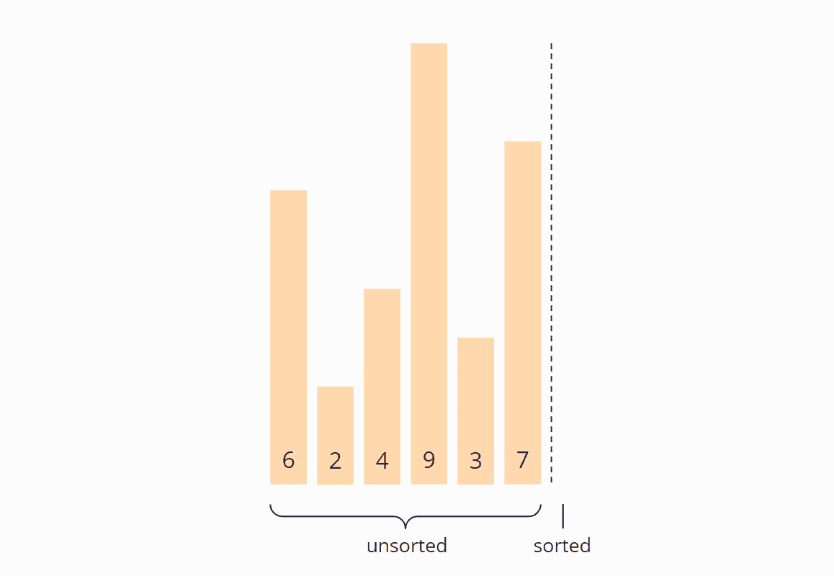
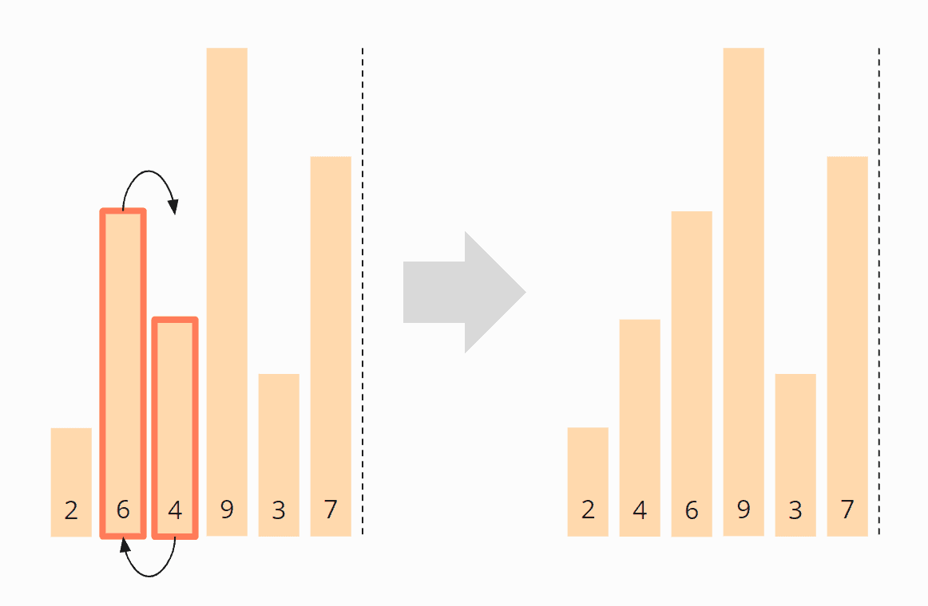
Animation

Slide 14
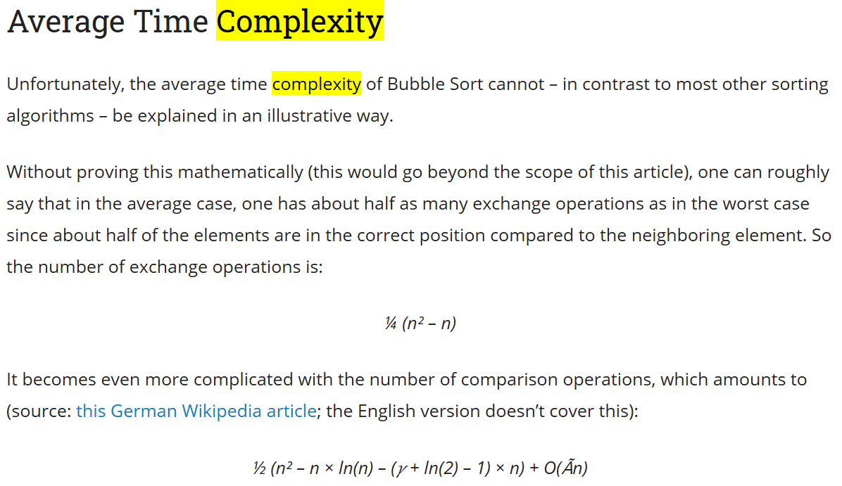
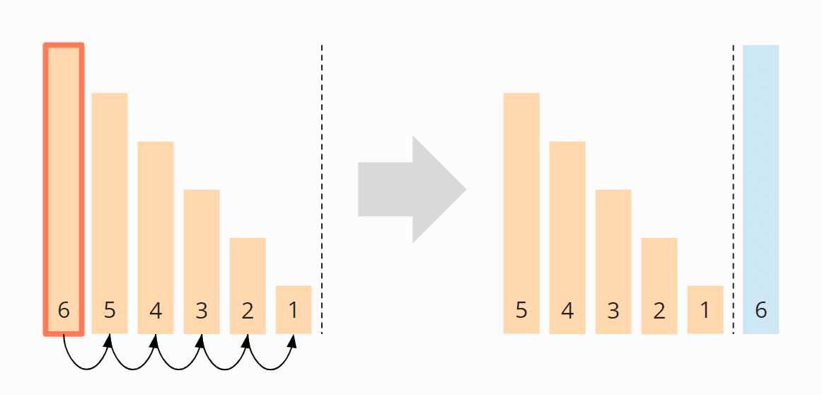
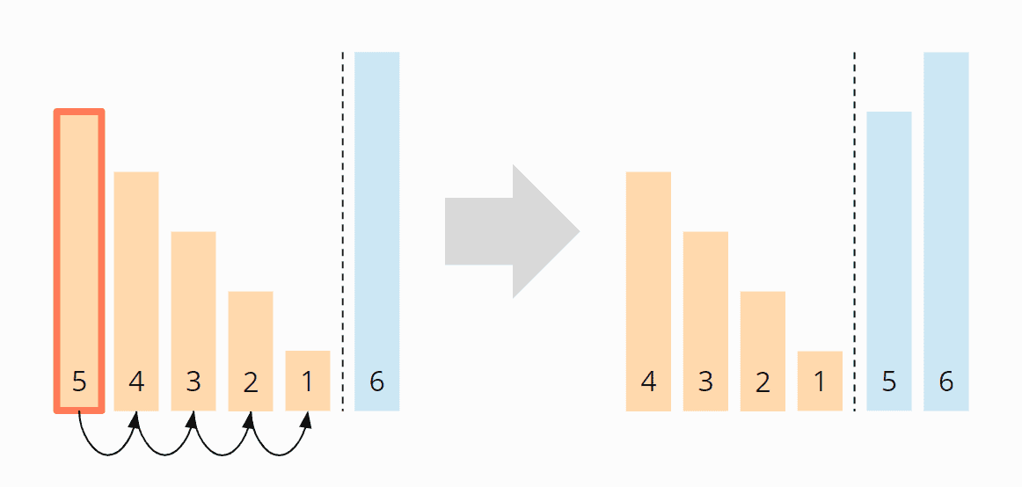
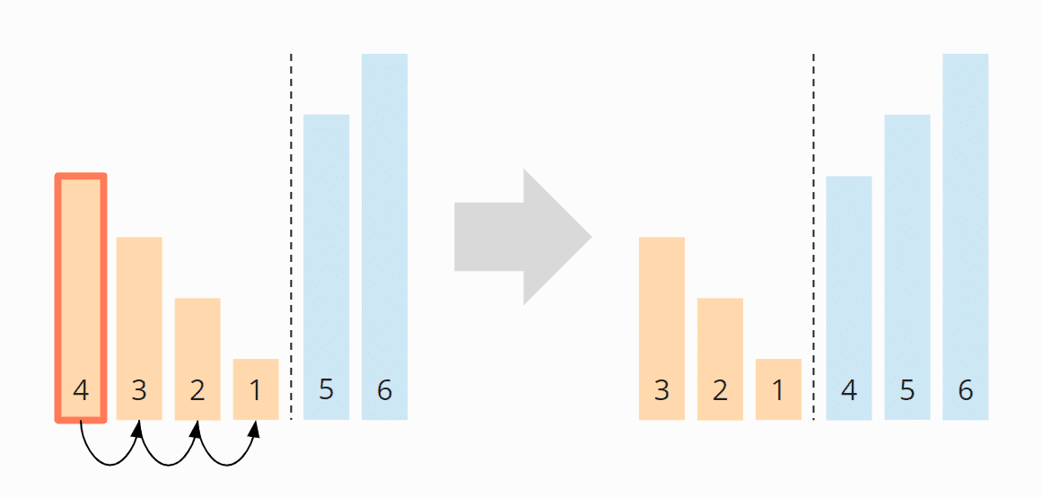
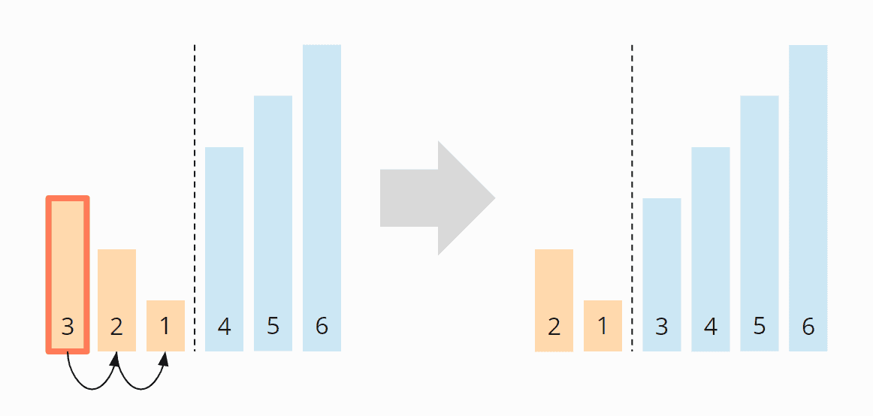
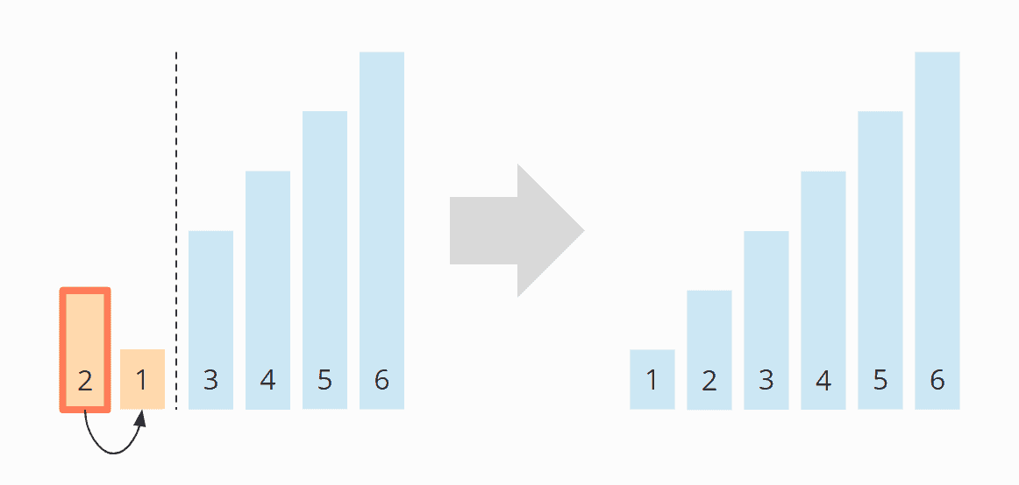
Worst-Case Complexity
So how many swaps are there??

Slide 15
Two Problems with Simple Sorts
They learn only one piece of information per comparison and hence might compare every pair of elements.
Contrast with binary search: learns N/2 pieces of information with first comparison.
They often move elements one place at a time (bubble sort and insertion sort), even if the element is “far” from its final place.
Contrast with selection sort, which moves each element exactly to its final place.
Fast sorts attack these two problems.
Two famous ones: merge sort and quick sort.
Notes:
They learn only one piece of information per comparison: the relative order between the two elements.
Finally, we need to compare almost all the pairs.

Slide 16
Short Break
5 min
Time for questions!
Try to keep your volume low so others can hear the question clearly!

Slide 17
Outline
Sorting Basics
Merge Sort
Quick Sort
Comparison Sort Summary

Slide 18
Merge Sort Algorithm
Spilt array into two (roughly) equal subarrays.
Merge sort each subarray recursively.
The two subarrays will be sorted.
Merge the two sorted subarrays into a sorted array.
[8, 3, 13, 6, 2, 14, 5, 9, 10]
[8, 3, 13, 6, 2]
[14, 5, 9, 10]
...
...
[2, 3, 6, 8, 13]
[5, 9, 10, 14]
[2, 3, 5, 6, 8, 9, 10, 13, 14]
Notes:
In case the array has odd number of elements, the middle element can be put either in the left sub-array or in the right sub-array.

Slide 19
Merge Sort Pseudo-code
void mergesort(int *a, int left, int right) { if (left >= right) return; int mid = (left+right)/2; mergesort(a, left, mid); mergesort(a, mid+1, right); merge(a, left, mid, right); }
Notes:
Original call is mergesort(a, 0, n-1)

Slide 20
Merge Two Sorted Arrays
For example, merge A = (2, 5, 6) and B = (1, 3, 8, 9, 10).
Compare the smallest element in the two arrays A and B and move the smaller one to an additional array C.
Repeat until one of the arrays becomes empty.
Then append the other array at the end of array C.

Slide 21
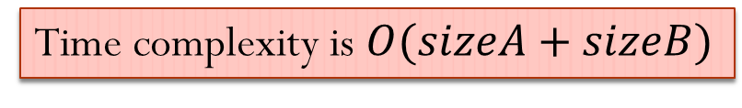
Merge Two Sorted Arrays Implementation
We actually do not “remove” element from arrays A and B.
We just keep a pointer indicating the smallest element in each array.
We “remove” element by incrementing that pointer.
i = j = k = 0; while(i < sizeA && j < sizeB) { if(A[i]<=B[j]) C[k++]=A[i++]; else C[k++]=B[j++]; } if(i == sizeA) append(C, B); else append(C, A);
Time complexity?
Time complexity is $O(sizeA+sizeB)$
Notes:
Hint: in terms of sizeA and sizeB.
Assume array A first becomes empty.

Slide 22

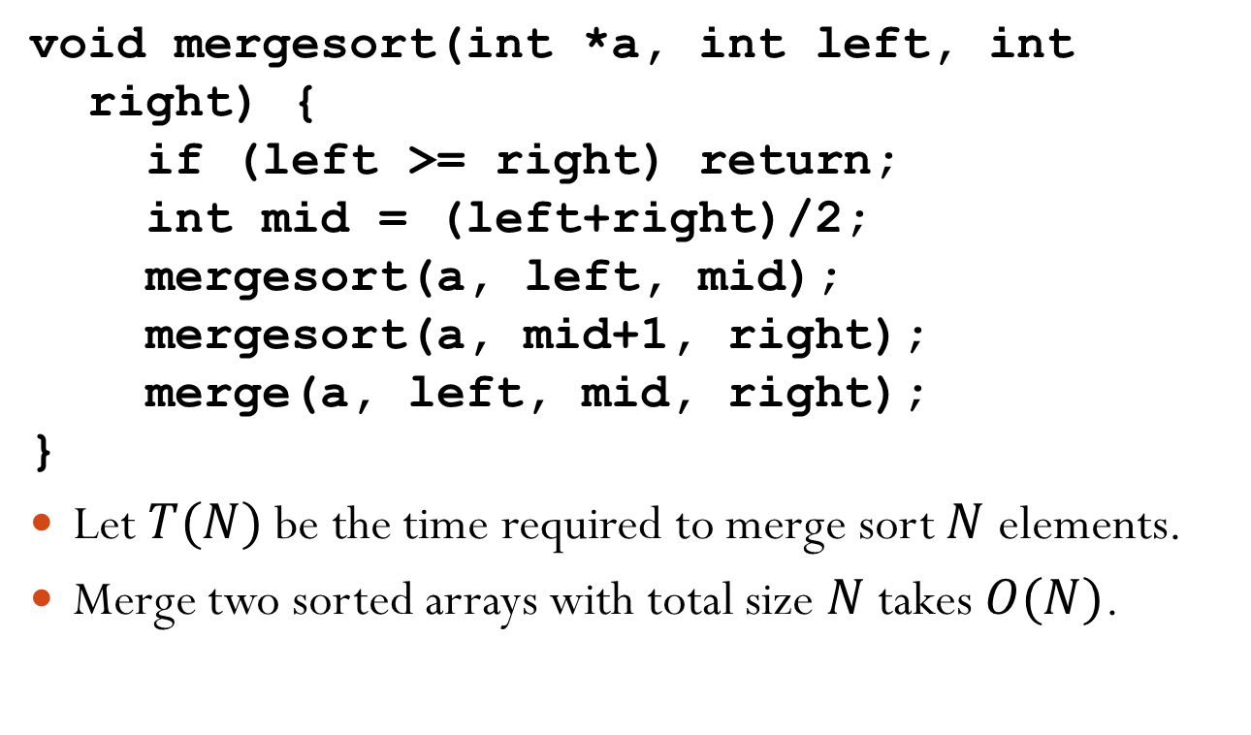
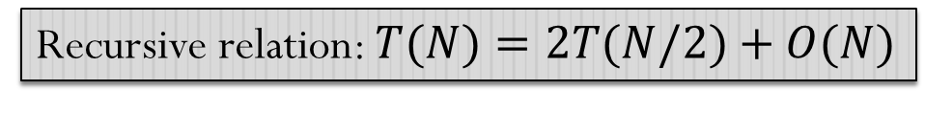


Merge Sort Time Complexity
void mergesort(int *a, int left, int right) { if (left >= right) return; int mid = (left+right)/2; mergesort(a, left, mid); mergesort(a, mid+1, right); merge(a, left, mid, right); }
Let $T(N)$ be the time required to merge sort $N$ elements.
Merge two sorted arrays with total size $N$ takes $O(N)$.
$$T(N/2)$$
$$T(N/2)$$
$$O(N)$$
Recursive relation: $T(N)=2T(N/2)+O(N)$
How to solve the recurrence?

Slide 23
Solve Recurrence: Master Method
A “black box” for solving recurrence.
However, there is an important assumption: all sub-problems have roughly equal sizes.
E.g., merge sort
Not apply to unbalanced division.

Slide 24
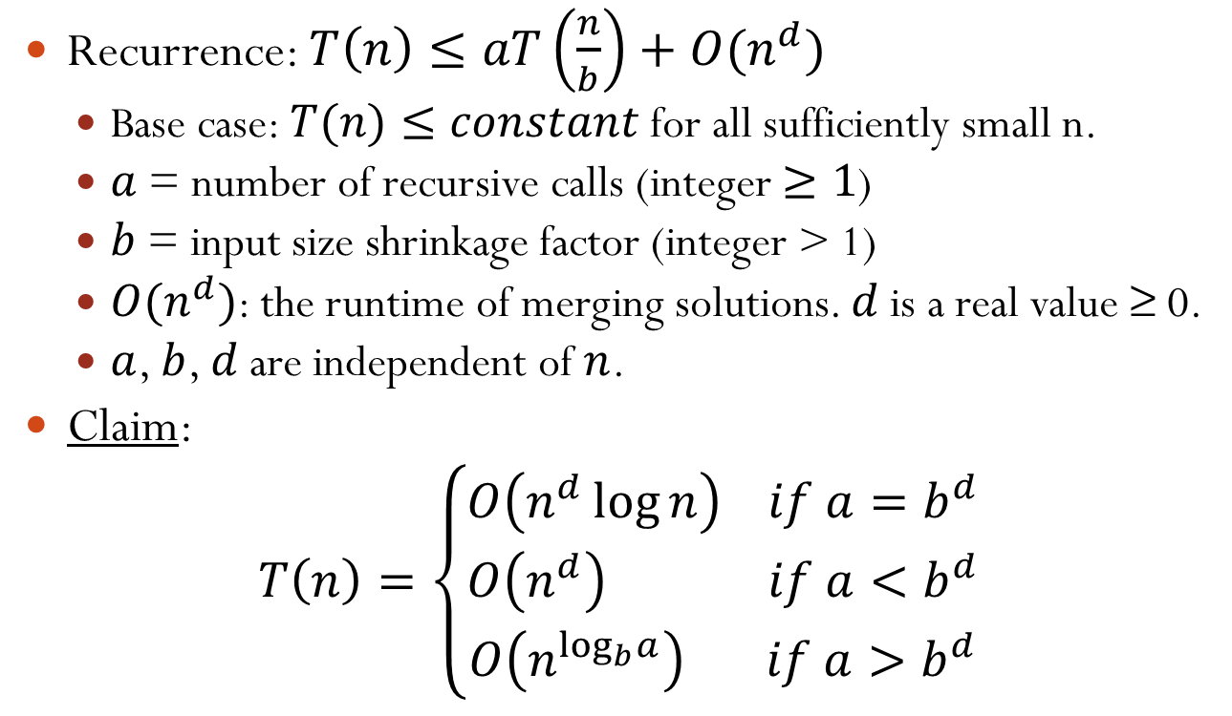
Solve Recurrence: Master Method
Recurrence: $T\left(n\right)≤aT\left(\frac{n}{b}\right)+O(n^{d})$
Base case: $T(n)≤constant$ for all sufficiently small n.
$a$ = number of recursive calls (integer $≥1$)
$b$ = input size shrinkage factor (integer > 1)
$O(n^{d})$: the runtime of merging solutions. $d$ is a real value ≥ 0.
$a$, $b$, $d$ are independent of $n$.
Claim:
$$T\left(n\right)=\left\{\begin{aligned}O\left(n^{d}\log{n}\right) if a=b^{d} \\ O\left(n^{d}\right) if a<b^{d} \\ O\left(n^{\log_{b}a}\right) if a>b^{d}\end{aligned}\right.$$
base doesn’t matter
base matters!
Notes:
In order to solve the original problem, you split it into a tasks, each with the size n/b. The additional combination step needs O(n^d) complexity.

Slide 25


Example of Merge Sort
$$T\left(n\right)≤aT\left(\frac{n}{b}\right)+O(n^{d})$$
$$T\left(n\right)=\left\{\begin{aligned}O\left(n^{d}\log{n}\right) if a=b^{d} \\ O\left(n^{d}\right) if a<b^{d} \\ O\left(n^{\log_{b}a}\right) if a>b^{d}\end{aligned}\right.$$
$a=2, b=2, d=1$
$T(n)=O(n\log{n})$
Recurrence:
Claim:
$$⇒b^{d}=a$$

Slide 26

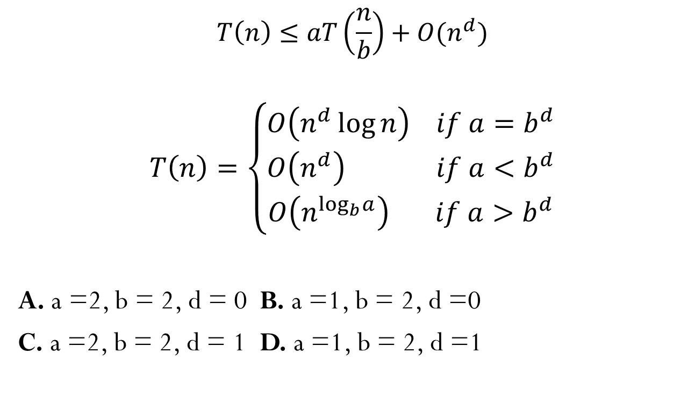
What are $a$, $b$, $d$ for Binary Search?
$$T\left(n\right)≤aT\left(\frac{n}{b}\right)+O(n^{d})$$
$$T\left(n\right)=\left\{\begin{aligned}O\left(n^{d}\log{n}\right) if a=b^{d} \\ O\left(n^{d}\right) if a<b^{d} \\ O\left(n^{\log_{b}a}\right) if a>b^{d}\end{aligned}\right.$$
A. a =2, b = 2, d = 0 B. a =1, b = 2, d =0
C. a =2, b = 2, d = 1 D. a =1, b = 2, d =1
Recurrence:
Claim:
Notes:
B. As a result, the complexity of binary search is O(log n).

Slide 27
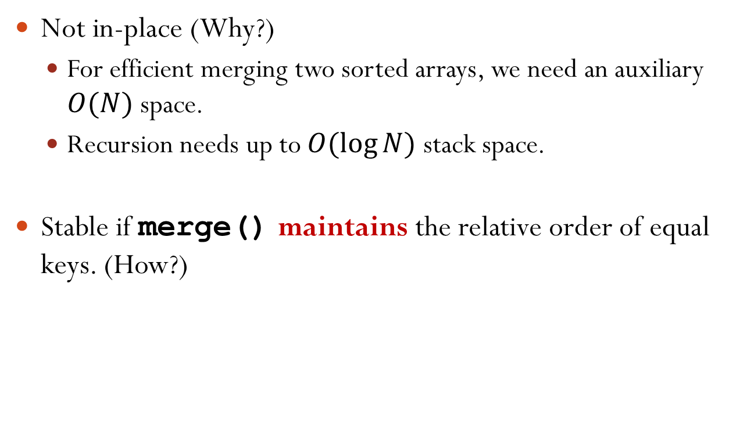
Merge Sort Characteristics
Not in-place (Why?)
For efficient merging two sorted arrays, we need an auxiliary $O(N)$ space.
Recursion needs up to $O(log⁡N)$ stack space.
Stable if merge() maintains the relative order of equal keys. (How?)
Notes:
maintains the relative order of equal keys: if there are two 3’s in the left sub-array and four 3’s in the right sub-array, then the two 3’s in the left sub-array is removed first.

Slide 28
Divide-and-Conquer Approach
Merge sort uses the divide-and-conquer approach.
Recursively breaking down a problem into two or more sub-problems of the same (or related) type, until these become simple enough to be solved directly.
For merge sort, split an array into two and sort them respectively.
The solutions to the sub-problems are then combined to give a solution to the original problem.
For merge sort, merge two sorted arrays.

Slide 29
Short Break
5 min
Time for questions!
Remember to keep your discussion among yourselves

Slide 30
Outline
Sorting Basics
Merge Sort
Quick Sort
Comparison Sort Summary

Slide 31
Quick Sort Algorithm
Another divide-and-conquer approach to sort
Choose an array element as pivot.
Put all elements $<$ pivot to the left of pivot.
Put all elements $≥$ pivot to the right of pivot.
Move pivot to its correct place in the array.
Sort left and right subarrays recursively (not including pivot).
void quicksort(int *a, int left, int right) { int pivotat; // index of the pivot if(left >= right) return; pivotat = partition(a, left, right); quicksort(a, left, pivotat-1); quicksort(a, pivotat+1, right); }
partition()
Notes:
Example: 2, 6, 5, 8, 4, 1, 9. Choose 6 as pivot. Result: 2, 5, 4, 1, _, 9, 8

Slide 32
Choice of Pivot
If your input is random, you can choose the first element.
But this is very bad for presorted input.
A better strategy: randomly pick an element from the array as pivot.
Claim: for any input, the average running time is $O(n\log{n})$.
Note: average is over random choice of pivots made by the algorithm, not on the input.

Slide 33
Partitioning the Array
Once pivot is chosen, swap pivot to the beginning of the array.
When another array B is available, scan original array A from left to right.
Put elements < pivot at the left end of B.
Put elements $≥$ pivot at the right end of B.
The pivot is put at the remaining position of B.
Copy B back to A.
A
6
2
8
5
11
10
4
1
9
7
3
2
5
4
1
3
6
7
9
10
11
B
8

Slide 34
In-Place Partitioning the Array
Once pivot is chosen, swap pivot to the beginning of the array.
Start counters i=1 and j=N-1.
Increment i until we find element A[i]>=pivot.
A[i] is the leftmost item $≥$ pivot.
Decrement j until we find element A[j]<pivot.
A[j] is the rightmost item $<$ pivot.
If i<j, swap A[i] with A[j]. Go back to step 3.
Otherwise, swap the first element (pivot) with A[j].
Notes:
We can actually do the partition without an extra array.
Observation #1: A[i] got in step 3 should be put on the right of A[j] got in step 4, so we swap them
Observation #2: If i > j, then all the elements <= j are smaller than the pivot and all the elements > j are greater than or equal to the pivot.
Step 5: i is the previous i and j is the previous j.

Slide 35
In-Place Partitioning the Array Example
i
j
Now, j < i, swap the first element (pivot) with A[j].
6
8
3
A
6
2
8
5
11
10
4
1
9
7
3
6
6
2
3
5
11
11
10
4
1
A
1
9
7
8
A
6
6
2
3
5
1
10
10
4
4
11
9
7
8
A
6
6
2
3
5
1
4
4
10
10
11
9
7
8
A
4
2
3
5
1
6
10
11
9
7
8

Slide 36
In-Place Partitioning the Array Time Complexity
Once pivot is chosen, swap pivot to the beginning of the array.
Start counters i=1 and j=N-1.
Increment i until we find element A[i]>=pivot.
Decrement j until we find element A[j]<pivot.
If i<j, swap A[i] with A[j]. Go back to step 3.
Otherwise, swap the first element (pivot) with A[j].
Scan the entire array no more than twice.
Time complexity is $O\left(N\right)$, where $N$ is the size of the array.

Slide 37
Quick Sort Time Complexity
void quicksort(int *a, int left, int right) { int pivotat; // index of the pivot if(left >= right) return; pivotat = partition(a, left, right); quicksort(a, left, pivotat-1); quicksort(a, pivotat+1, right); }
Let $T(N)$ be the time needed to sort $N$ elements.
$T(0)=c$, where $c$ is a constant.
Recursive relation: $T\left(N\right)=T\left(LeftSz\right)+T(RightSz)+O(N)$
$LeftSz+RightSz=N−1$
$$O(N)$$
$$T(LeftSz)$$
$$T(RightSz)$$
Notes:
Can we apply master theorem to solve the recurrence?

Slide 38
Quick Sort Worst Case Time Complexity
Recursive relation: $T(N)=T(LeftSz)+T(RightSz)+O(N)$
Worst case happens when each time the pivot is the smallest item or the largest item
$T\left(N\right)=T\left(N−1\right)+T\left(0\right)+O(N)$
$$≤T\left(N−1\right)+T\left(0\right)+dN$$
$$≤T\left(N−2\right)+2T\left(0\right)+d\left(N−1\right)+dN$$
$$⋯$$
$$≤T\left(0\right)+NT\left(0\right)+d+2d+⋯+d\left(N−1\right)+dN$$
$$=O(N^{2})$$
Notes:
Intuitively, the worst case happens when the partition is extremely unbalanced. This corresponds to the pivot is the smallest item or the largest item.
T(N-1) \le T(N-2) + T(0) + d(N-1)

Slide 39
Quick Sort Best Case Time Complexity
Recursive realtaion: $T(N)=T(LeftSz)+T(RightSz)+O(N)$
Best case happens when each time the pivot divides the array into two equal-sized ones.
$T(N)=T((N−1)/2)+T((N−1)/2)+O(N)$
The recursive relation is similar to that of merge sort.
$T\left(N\right)=O(N\log{N})$
Notes:
The recursive relation similar to merge sort: because the array is split into two.

Slide 40
Quick Sort Average Time Complexity
Average time complexity of quick sort can be proved to be $O(N log⁡N)$.
Assume randomly pick an element from the array as pivot.
Note: average is over random choice of pivots made by the algorithm, not on the input.
The claim holds for any input.
Notes:
Now the question is what the average case time complexity is. Is it close to the worst case time complexity O(n^2) or the best case time complexity O(n logn)?

Slide 41

Quick Sort Other Characteristics
In-place?
In-place partitioning.
Worst case needs $O(N)$ stack space. (Why?)
Average case needs $O\left(\log{N}\right)$ stack space.
“Weakly” in-place.
Not stable. (Why?)
Remedy?
(4, b), (3, e), (3, b), (5, b)
(4, b,1), (3, e,2), (3, b,3), (5, b,4)
Notes:
Not stable: due to random choice of pivot.

Slide 42
Quick Sort Summary
Like merge sort, quick sort is a divide-and-conquer algorithm.
Merge sort: easy division, complex combination.
Quick sort: complex division (partition with pivot step), easy combination.
Insertion sort runs faster than quick sort for small arrays.
Terminate quick sort when array size is below a threshold. Do insertion sort on subarrays.

Slide 43
Outline
Sorting Basics
Merge Sort
Quick Sort
Comparison Sort Summary

Slide 44
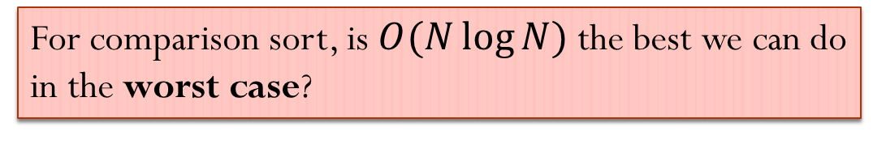
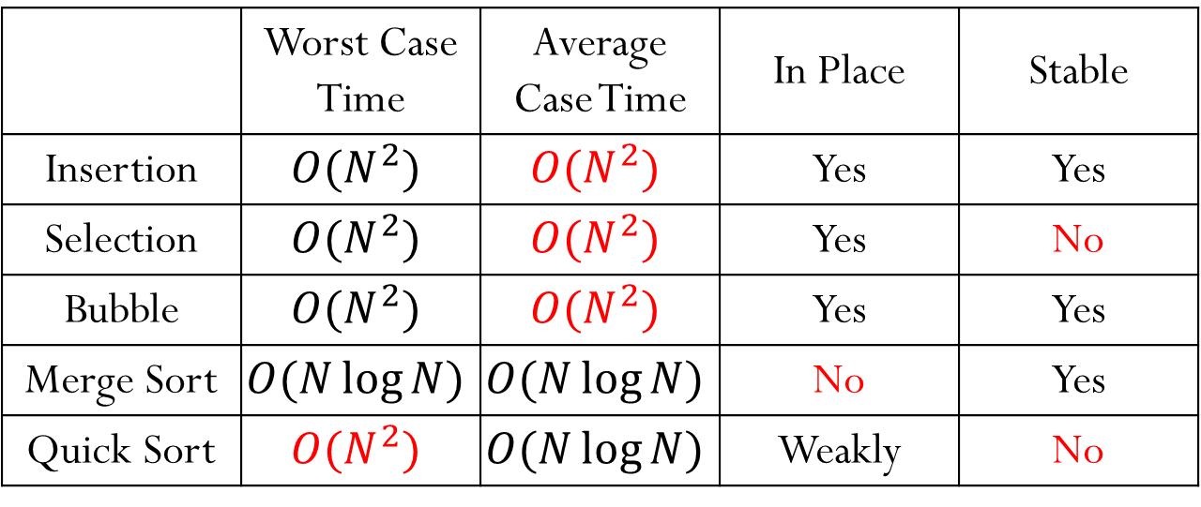
Comparison Sorts Summary
 | Worst Case Time | Average Case Time | In Place | Stable
Insertion | $$O(N^{2})$$ | $$O(N^{2})$$ | Yes | Yes
Selection | $$O(N^{2})$$ | $$O(N^{2})$$ | Yes | No
Bubble | $$O(N^{2})$$ | $$O(N^{2})$$ | Yes | Yes
Merge Sort | $$O(N\log{N})$$ | $$O(N\log{N})$$ | No | Yes
Quick Sort | $$O(N^{2})$$ | $$O(N\log{N})$$ | Weakly | No
For comparison sort, is $O(N\log{N})$ the best we can do in the worst case?

Slide 45

Comparison Sorts Worst Case Time Complexity
Theorem: A sorting algorithm that is based on pairwise comparisons must use $Ω(N\log{N})$ operations to sort in the worst case.

Slide 46
That’s All for Today!
3 min Q&A before you leave!

