Slide 1
VE281 Data Structures and Algorithms
Universal Hashing and Bloom Filter
Learning Objectives:
Know what is Universal Hashing
Know what Bloom filter is and how it works
Know the advantages and disadvantages of Bloom filter

Slide 2
Universal Hashing
Collision is bad!
For x ≠ y, h(x) = h(y)
Given any fixed hashing scheme, an adversary can create a sequence of inputs that maximizes collisions
Remedy?
The idea of randomization
Similar to quickSort and randomSelect

Slide 3
Universal Hashing
A scheme to produce hashing functions
h = u(p)
We talked about by creating hash function by taking the mod of prime numbers (p)
Foil adversaries by randomly picking p!

Slide 4
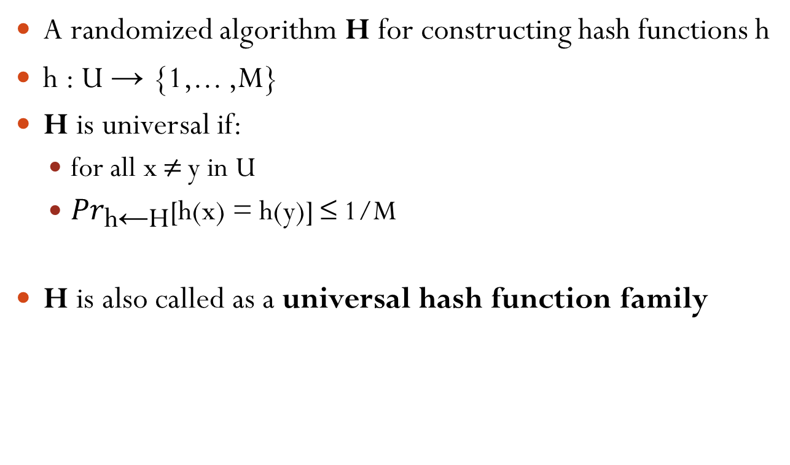
Definition of Universal Hashing
A randomized algorithm H for constructing hash functions h
h : U → {1,... ,M}
H is universal if:
for all x ≠ y in U
${Pr}_{\text{h}\text{←}\text{H}}\text{[}\text{h}\text{(}\text{x}\text{) = }\text{h}\text{(}\text{y}\text{)] ≤ 1/}\text{M}$
H is also called as a universal hash function family

Slide 5
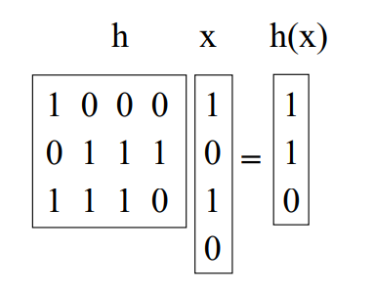
Other Universal Hash Function Families
The Matrix method
Keys: u-bits long
Table size: M=2^{b}
h: b-by-u 0/1 matrix
H: h(x) = h∙x

Slide 6
Proof of Universal

Slide 7
Short break

Slide 8
Bloom Filter
Invented by Burton Bloom in 1970
Supports fast insert and find
Comparison to hash tables:
Pros: more space efficient
Cons:
Can’t store an associated object
No deletion (There are variations support deletion, but this operation is complicated)
Small false positive probability: may say x has been inserted even if it hasn’t been
But no false negative (x is inserted, but says not inserted)

Slide 9
Bloom Filter Applications
When to use bloom filter?
If the false positive is not a concern, no associated objects, no deletion, and you look for space efficiency
Original application: spell checker
40 years ago, space is a big concern, it’s OK to tolerate some error
Canonical application: list of forbidden passwords
Don’t care about the false positive issue
Modern applications: network routers
Limited memory, need to be fast
Applications include keeping track of blocked IP address, keeping track of contents of caches, etc.
Notes:
Spell checker: correct words are in the bloom filter, while incorrect words are not
Forbidden passwords: passwords that are too weak, too easy to guess, or too common. What does it mean by having 0.1% false positive rate? Once out of a thousand, a strong password is thought weak.

Slide 10
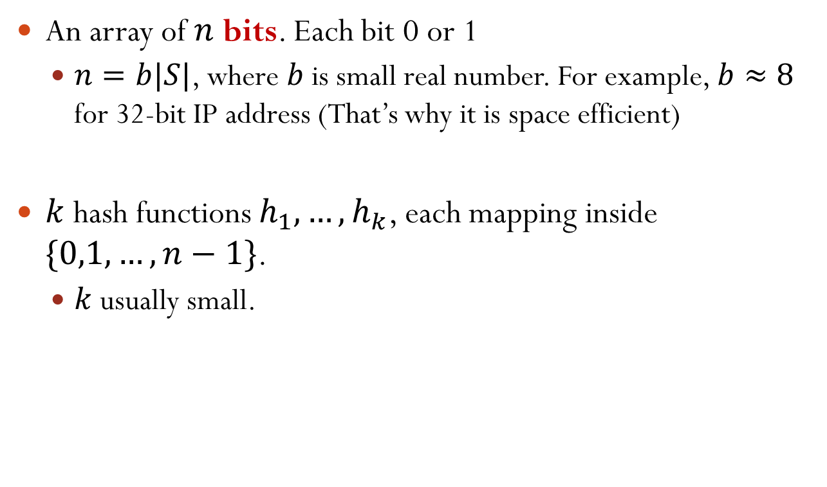
Bloom Filter Implementation: Components
An array of $n$ bits. Each bit 0 or 1
$n=b|S|$, where $b$ is small real number. For example, $b≈8$ for 32-bit IP address (That’s why it is space efficient)
$k$ hash functions $h_{1},…, h_{k}$, each mapping inside $\{0,1,…,n−1\}$.
$k$ usually small.
Notes:
b is a value close to 8. For general hash table, the size in bits is 32 c S.

Slide 11
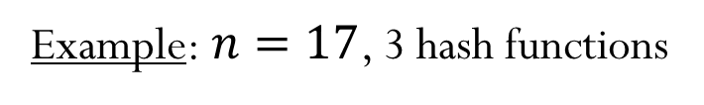





Bloom Filter Insert
Initially, the array is all-zero.
Insert $x$: For $i=1,2,…,k$, set $A\left[h_{i}\left(x\right)\right]=1$
No matter whether the bit is 0 or 1 before
Example: $n=17$, 3 hash functions
$$h_{1}\left(x\right)=7,h_{2}\left(x\right)=3,h_{3}\left(x\right)=12$$
$$h_{1}\left(y\right)=11,h_{2}\left(y\right)=14,h_{3}\left(y\right)=7$$
$$x$$
$$y$$
1
1
1
1
1
0
1
2
3
4
5
6
7
8
9
10
11
12
13
14
15
16

Slide 12



Bloom Filter Find
Find $x$: return true if and only if $A\left[h_{i}\left(x\right)\right]=1,∀i=1,…,k$
No false negative: if $x$ was inserted, find($x$) guaranteed to return true
False positive possible: consider $h_{1}\left(w\right)=11,h_{2}\left(w\right)=12,h_{3}\left(w\right)=7$ in the above example
$$x$$
$$y$$
1
1
1
1
1
0
1
2
3
4
5
6
7
8
9
10
11
12
13
14
15
16
Suppose $h_{1}\left(x\right)=7,h_{2}\left(x\right)=3,h_{3}\left(x\right)=12$. Find $x$?
Yes!
Suppose $h_{1}\left(z\right)=3,h_{2}\left(z\right)=11,h_{3}\left(z\right)=5$. Find $z$?
No!

Slide 13
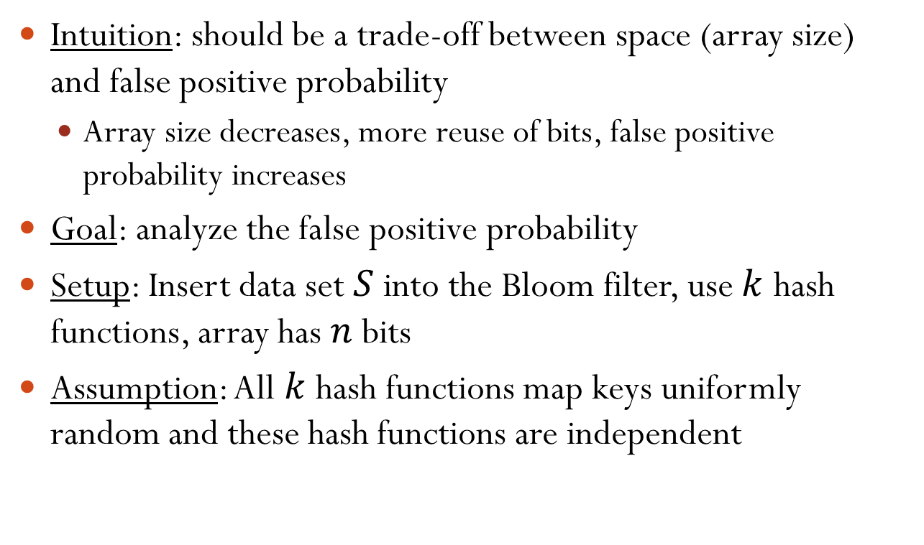
Heuristic Analysis of Error Probability
Intuition: should be a trade-off between space (array size) and false positive probability
Array size decreases, more reuse of bits, false positive probability increases
Goal: analyze the false positive probability
Setup: Insert data set $S$ into the Bloom filter, use $k$ hash functions, array has $n$ bits
Assumption: All $k$ hash functions map keys uniformly random and these hash functions are independent

Slide 14
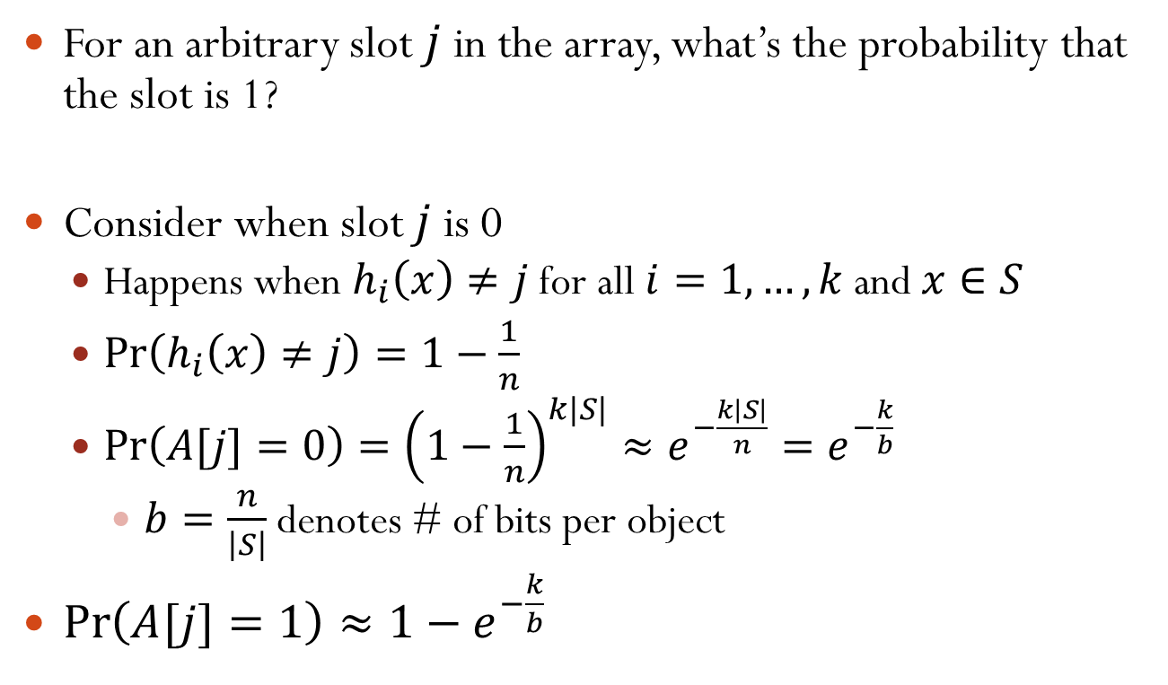
Probability of a Slot Being 1
For an arbitrary slot $j$ in the array, what’s the probability that the slot is 1?
Consider when slot $j$ is 0
Happens when $h_{i}\left(x\right)≠j$ for all $i=1,…,k$ and $x∈S$
$\operatorname{Pr}\left(h_{i}\left(x\right)≠j\right)=1−\frac{1}{n}$
$\operatorname{Pr}\left(A[j]=0\right)={\left(1−\frac{1}{n}\right)}^{k|S|}≈e^{−\frac{k\left|S\right|}{n}}=e^{−\frac{k}{b}}$
$b=\frac{n}{\left|S\right|}$ denotes # of bits per object
$\operatorname{Pr}\left(A[j]=1\right)≈1−e^{−\frac{k}{b}}$
Notes:
lim n->+inf (1-1/n)^{-n} = e

Slide 15
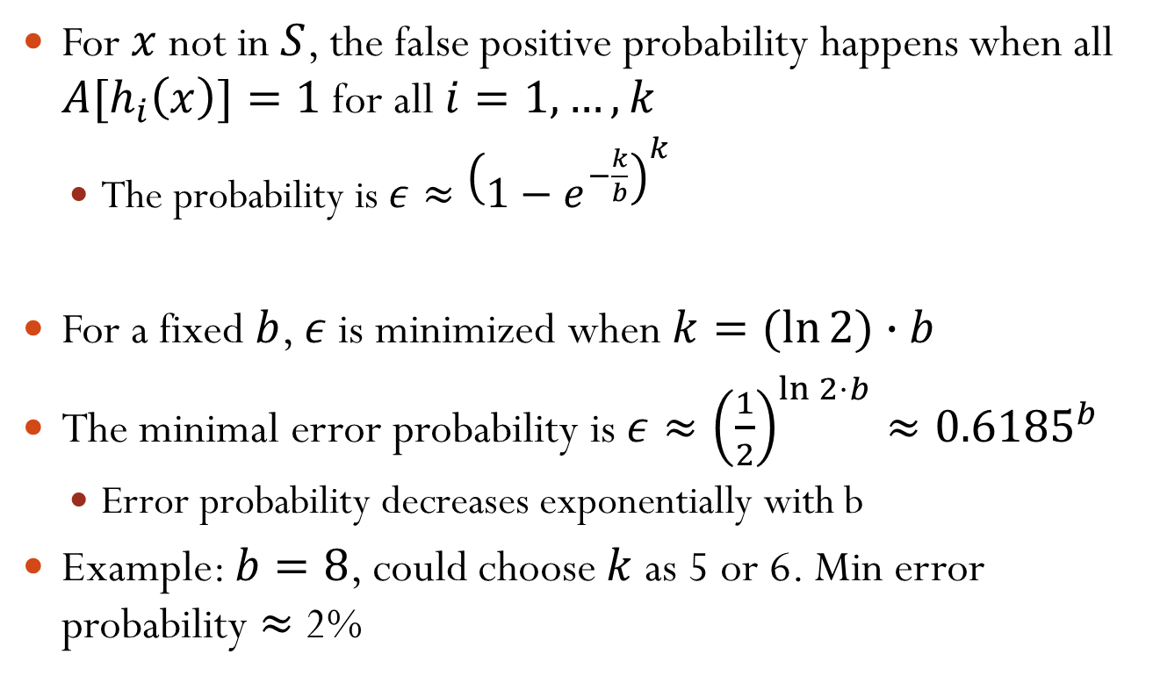
False Positive Probability
For $x$ not in $S$, the false positive probability happens when all ${A[h}_{i}\left(x\right)]=1$ for all $i=1,…,k$
The probability is $ε≈{\left(1−e^{−\frac{k}{b}}\right)}^{k}$
For a fixed $b$, $ε$ is minimized when $k=(ln{2)}∙b$
The minimal error probability is $ε≈{\left(\frac{1}{2}\right)}^{\ln{2}⋅b}≈{0.6185}^{b}$
Error probability decreases exponentially with b
Example: $b=8$, could choose $k$ as 5 or 6. Min error probability $≈$ 2%
Notes:
Error probability decreases exponentially with b: agree with our analysis on the trade-off between error probability and space

