Slide 1
VE281 Data Structures and Algorithms
k-d Trees
Learning Objectives:
Know what a k-d tree is and its difference over basic binary search tree
Know how to implement search, insertion, and removal for a k-d tree

Slide 2
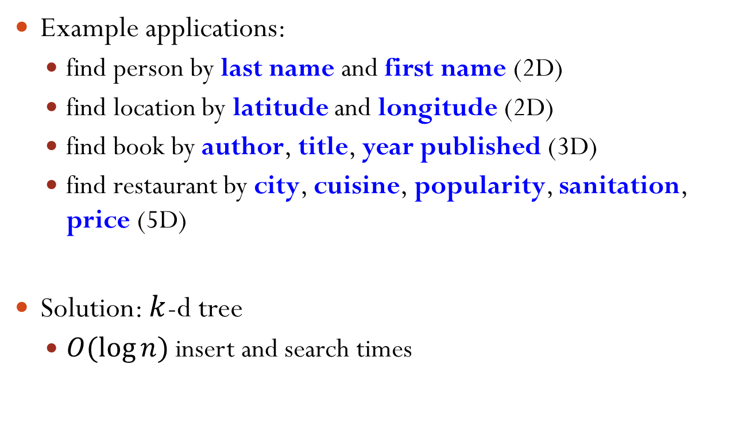
Multidimensional Search
Example applications:
find person by last name and first name (2D)
find location by latitude and longitude (2D)
find book by author, title, year published (3D)
find restaurant by city, cuisine, popularity, sanitation, price (5D)
Solution: $k$-d tree
$O(log⁡n)$ insert and search times

Slide 3

$k$-d Tree
A k-d tree is a binary search tree
At each level, keys from a different search dimension is used as the discriminator
Nodes on the left subtree of a node have keys with value < the node’s key value along this dimension
Nodes on the right subtree have keys with value ≥ the node’s key value along this dimension
We cycle through the dimensions as we go down the tree
For example, given keys consisting of x- and y-coordinates, level 0 discriminates by the x-coordinate, level 1 by the y-coordinate, level 2 again by the x-coordinate, etc.
Notes:
Right subtree could have keys that are equal to the key of the root for the current dimension.
Dimension starts from 0.

Slide 4
Example
k-d tree for points in a 2-D plane
dimension
y
B
E
x
A
G
H
C
y
I
B
A
E
F
G
x
D
C
D
y
F
H
I
J
x
J
x

Slide 5
k-d Tree Insert
If new item’s key is equal to the root’s key, return;
If new item has a key smaller than that of root’s along the dimension of the current level, recursive call on left subtree
Else, recursive call on the right subtree
In recursive call, cyclically increment the dimension
void insert(node *&root, Item item, int dim) { if(root == NULL) { root = new node(item); return; }
if(item.key == root->item.key) // equal in all return; // dimensions if(item.key[dim] < root->item.key[dim]) insert(root->left, item, (dim+1)%numDim); else insert(root->right, item, (dim+1)%numDim); }
dim refers to the dimension of the root

Slide 6
Insert Example
Insert H
Initial function call: insert(A, H, 0) // 0 indicates dimension x
y
B
E
dimen.
x
G
A
H
A
C
y
B
C
E
F
G
x
D
D
F
H
x
Notes:
insert(B, H, 1); insert(D, H, 0)

Slide 7
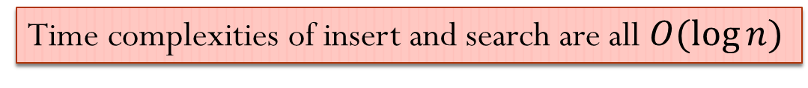
k-d Tree Search
Search works similarly to insert
In recursive call, cyclically increment the dimension
node *search(node *root, Key k, int dim) { if(root == NULL) return NULL; if(k == root->item.key) return root; if(k[dim] < root->item.key[dim]) return search(root->left, k, (dim+1)%numDim); else return search(root->right, k, (dim+1)%numDim); }
Time complexities of insert and search are all $O(\log{n})$

Slide 8
k-d Tree Remove
If the node is a leaf, simply remove it (e.g., remove (50,50))
If the node has only one child, can we do the same thing as BST (i.e., connect the node’s parent to the node’s child)?
Consider remove (60, 80)
Answer: No!
dimension
35, 60
x
35, 60
20, 45
60, 80
y
20, 45
80, 40
X
10, 35
80, 40
x
10, 35
50, 50
90, 60
50, 50
90, 60
y
Notes:
Wrong! Because we change the dimension to compare with.

Slide 9
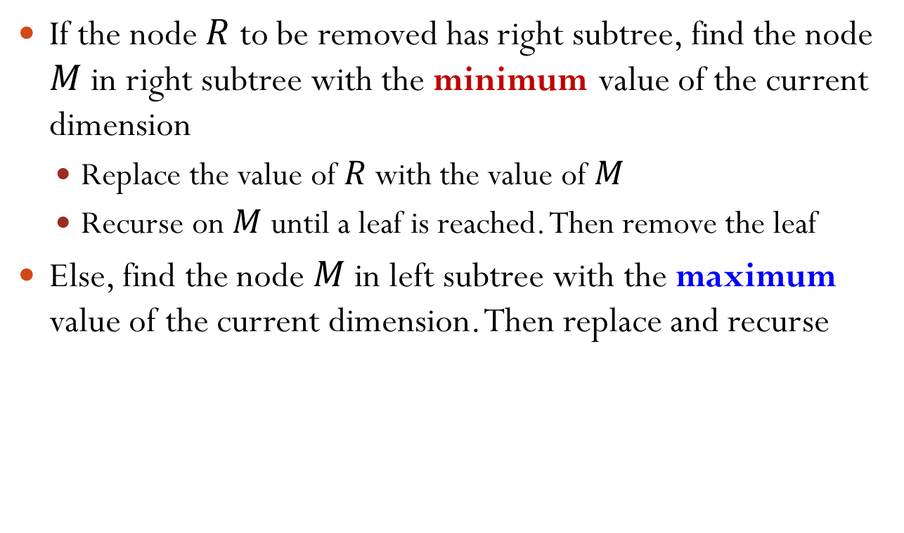
k-d Tree Removal of Non-leaf Node
If the node $R$ to be removed has right subtree, find the node $M$ in right subtree with the minimum value of the current dimension
Replace the value of $R$ with the value of $M$
Recurse on $M$ until a leaf is reached. Then remove the leaf
Else, find the node $M$ in left subtree with the maximum value of the current dimension. Then replace and recurse

Slide 10
k-d Tree Removal Example
delete
35, 60
x
50, 30
20, 45
60, 80
y
20, 45
60, 80
10, 35
80, 40
x
10, 35
80, 40
min x
50, 30
90, 60
y
delete
50, 30
90, 60
60, 20
x
60, 20
70, 10
y
70, 10

Slide 11
k-d Tree Removal Example
50, 30
x
50, 30
20, 45
60, 80
y
20, 45
60, 80
10, 35
80, 40
x
10, 35
80, 40
delete
50, 30
90, 60
y
60, 20
90, 60
60, 20
max y
x
60, 20
delete
70, 10
y
70, 10

Slide 12
k-d Tree Removal Example
50, 30
x
50, 30
20, 45
60, 80
y
20, 45
60, 80
10, 35
80, 40
x
10, 35
80, 40
60, 20
90, 60
y
60, 20
90, 60
60, 20
delete
x
70, 10
min x
70, 10
y
delete
70, 10
Leaf!
X

Slide 13
k-d Tree Removal Example: Summary
delete
35, 60
x
50, 30
20, 45
60, 80
y
20, 45
60, 80
10, 35
80, 40
x
10, 35
80, 40
50, 30
90, 60
y
60, 20
90, 60
60, 20
x
70, 10
70, 10
y

Slide 14
Find Minimum Value in a Dimension
Different from the basic BST, because it may not be the left-most descendent.
35, 60
x
Find the node with minimum
value in dimension y
20, 45
80, 30
y
10, 40
50, 20
90, 60
x

Slide 15
Find Min-Y
35, 60
20, 45
60, 80
10, 35
80, 40
90, 120
50, 30
90, 60
60, 20
70, 10

Slide 16
Find Minimum Value in a Dimension
node *findMin(node *root, int dimCmp, int dim) { // dimCmp: dimension for comparison if(!root) return NULL; node *min = findMin(root->left, dimCmp, (dim+1)%numDim); if(dimCmp != dim) { rightMin = findMin(root->right, dimCmp, (dim+1)%numDim); min = minNode(min, rightMin, dimCmp); } return minNode(min, root, dimCmp); }
minNode takes two nodes and a dimension as input, and returns the node with the smaller value in that dimension
Notes:
Find the node with minimum y in the following tree
Function call: findMin(root, 1, 0)
35,60 x
/ \
20,45 80,30 y
/ / \
10,40 50,20 90,60 x
If dimCmp = min, there is no need to get rightMin, since it will definitely be larger than min.

Slide 17
Time Complexity of Removal
Stop condition of FindMin
A node whose current discriminator is the target dimension
A node without a left child (no left subtree)
Why?
If the node has a life child, the left child < the node

Slide 18

Visual Explanation
dimension
y
B
E
x
A
G
H
C
y
I
B
A
E
F
G
x
D
C
D
y
F
H
I
J
x
J
x

Slide 19
Complexity of FindMin
FindMin does not explore the right subtree
If the discriminator of the current level is the target dimension
Ignore both the node and the right subtree
dimension
y
B
E
x
A
G
H
C
y
I
B
A
E
F
G
x
D
C
D
y
F
H
I
J
x
J
x

Slide 20
A General Analysis
If there are M dimensions
Nodes are evenly distributed
Prune ½ of the tree in every M levels
Assume a total of L levels
The whole process touches (½)^{L/M} Nodes

Slide 21
Cascading FindMin
Key idea:
Only cascades to the right subtree
Never searches the same node twice in the same dimension
Blackboard!

Slide 22
Multidimensional Range Search
Example
Buy ticket for travel between certain dates and certain times
Look for apartments within certain price range, certain districts, and number of bedrooms
Find all restaurants near you
k-d tree supports efficient range search, which is similar to that of basic BST but more complex!

Slide 23
k-d Tree Range Search
void rangeSearch(node *root, int dim, Key searchRange[][2], Key treeRange[][2], List results)
Cycle through the dimensions as we go down the level
searchRange[][2] holds two values (min, max) per dimension
Define a hyper-cube
min of dimension j at searchRange[j][0], max at searchRange[j][1]
treeRange[][2] holds lower bound and upper bound per dimension for the tree rooted at root.
Need to be updated as we go down the levels
Need to check if a search range overlaps a subtree range

Slide 24
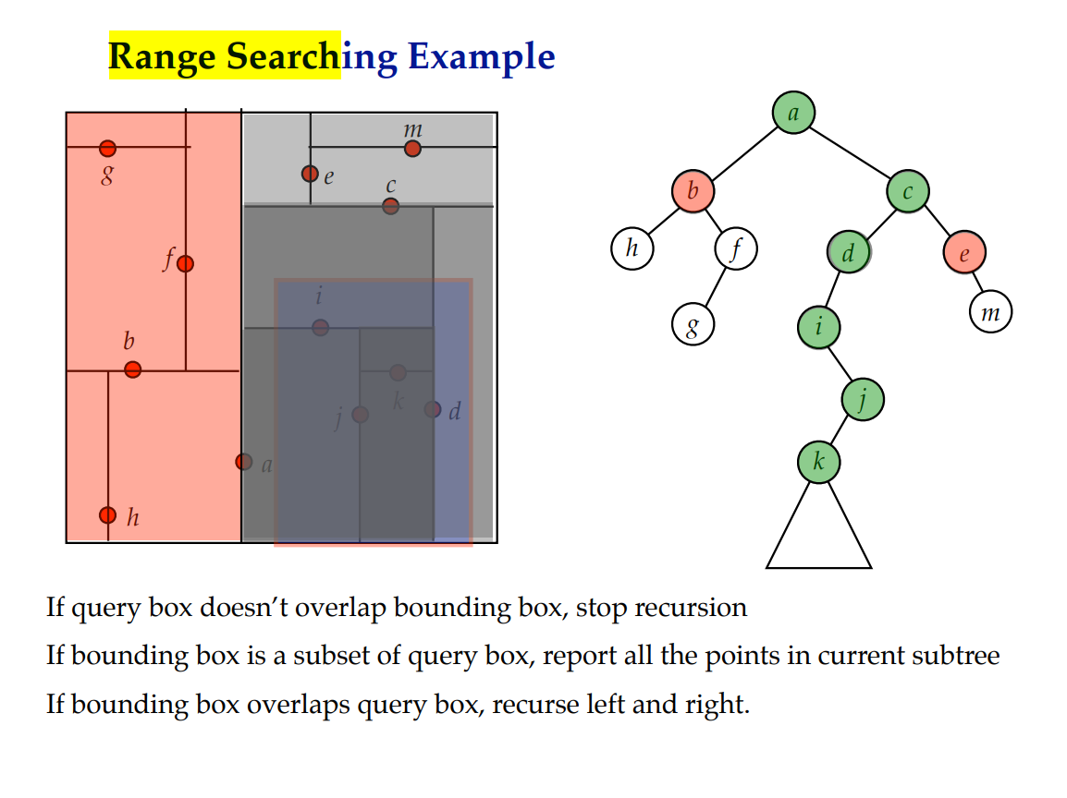

Slide 25
