Slide 1
VE281 Data Structures and Algorithms
Red-black Trees
Learning Objectives:
Know what a red-black tree is and its properties
Know how to do insertion for a red-black tree

Slide 2
Outline
Red-black Trees: Basics
Red-black Trees: Insertion

Slide 3
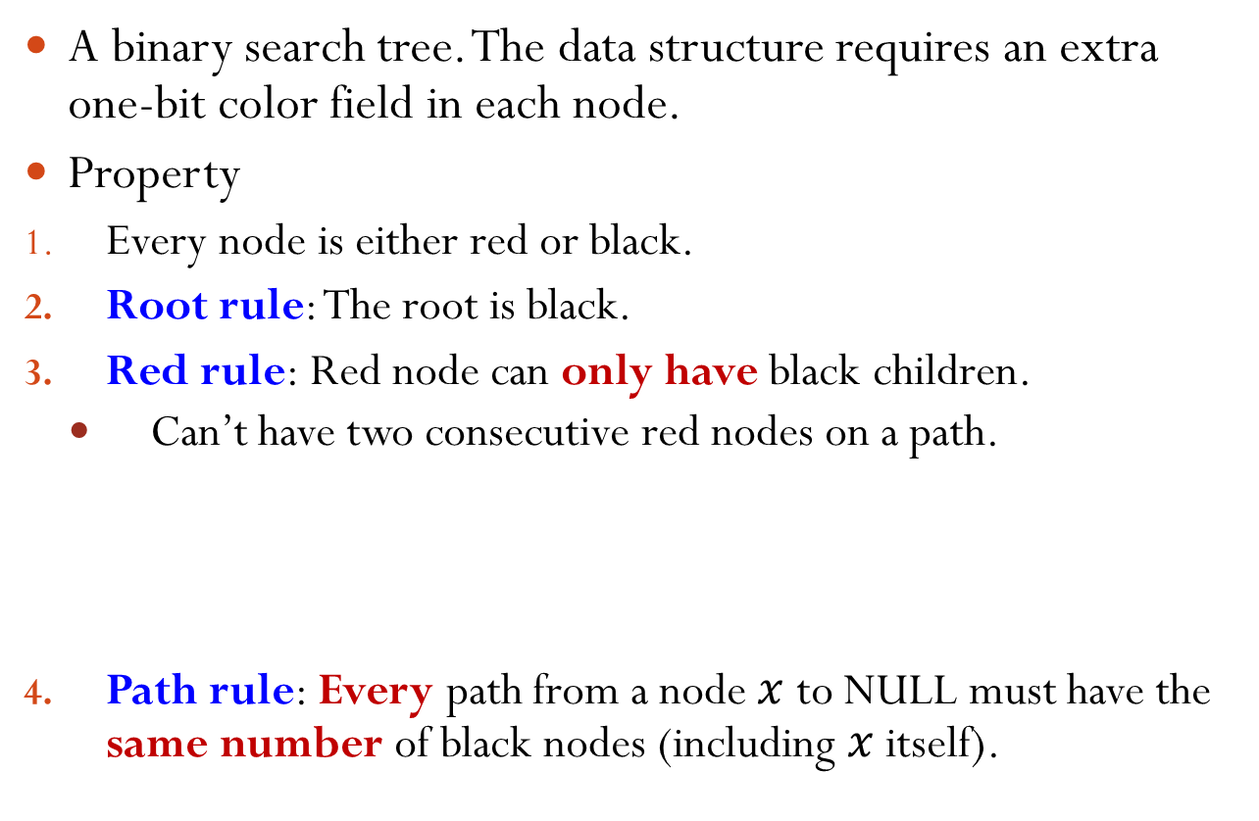
Red-Black Tree
A binary search tree. The data structure requires an extra one-bit color field in each node.
Property
Every node is either red or black.
Root rule: The root is black.
Red rule: Red node can only have black children.
Can’t have two consecutive red nodes on a path.
Path rule: Every path from a node $x$ to NULL must have the same number of black nodes (including $x$ itself).
✓
✗
✗

Slide 4
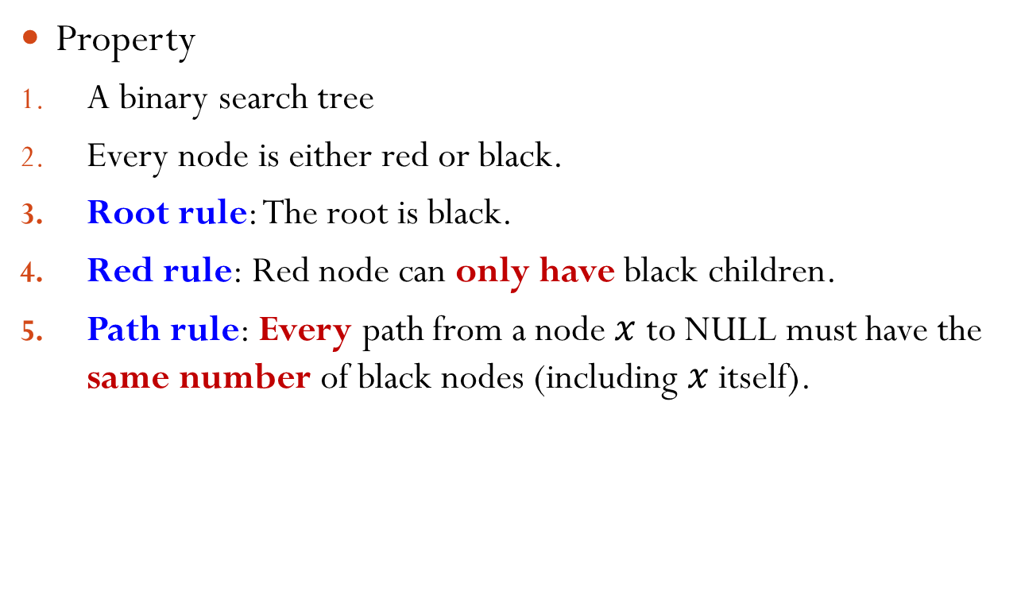
Red-Black Tree Example
Property
A binary search tree
Every node is either red or black.
Root rule: The root is black.
Red rule: Red node can only have black children.
Path rule: Every path from a node $x$ to NULL must have the same number of black nodes (including $x$ itself).
5
3
8
1
4
6
9
Notes:
The example satisfies all the rules.

Slide 5
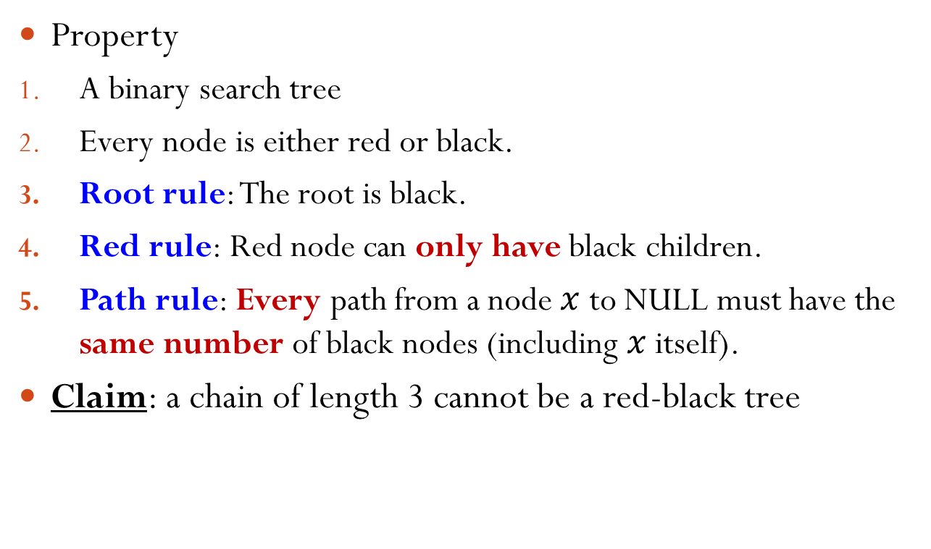
Counter Example
Property
A binary search tree
Every node is either red or black.
Root rule: The root is black.
Red rule: Red node can only have black children.
Path rule: Every path from a node $x$ to NULL must have the same number of black nodes (including $x$ itself).
Claim: a chain of length 3 cannot be a red-black tree
?
?
Notes:
The second node cannot be black; Otherwise, it violates the path rule. Thus, the second node must be red. The third node then must be black due to red rule. This eventually violates the path rule.

Slide 6

Black Height
Black height of a node $x$ is the number of black nodes on the path from $x$ to NULL, including $x$ itself.
5
2
1
3
8
1
1
1
1
4
6
0
9
0

Slide 7

Which Statements Are Correct?
A. It is possible for a red node to have a single child.
B. It is possible for a black node to have a single child.
C. It is possible for a node to have two children of different colors.
D. It is possible for a node to have two children and the node and its children are all of the same color.

Slide 8
Implication of the Rules
If a red node has at least one child, it must have two children and they must be black.
Why?
A red node’s child can only be black.
If has only one black child, then violate the path rule.
If a black node has only one child, that child must be a red leaf.
Why?
Can’t be black.
Must be a leaf.
5
3
8
1
4
6
Notes:
Must be a red leaf: if not black, then violate the path rule. If not a leaf, then it has children and the children must be black, which violates the path rule.

Slide 9
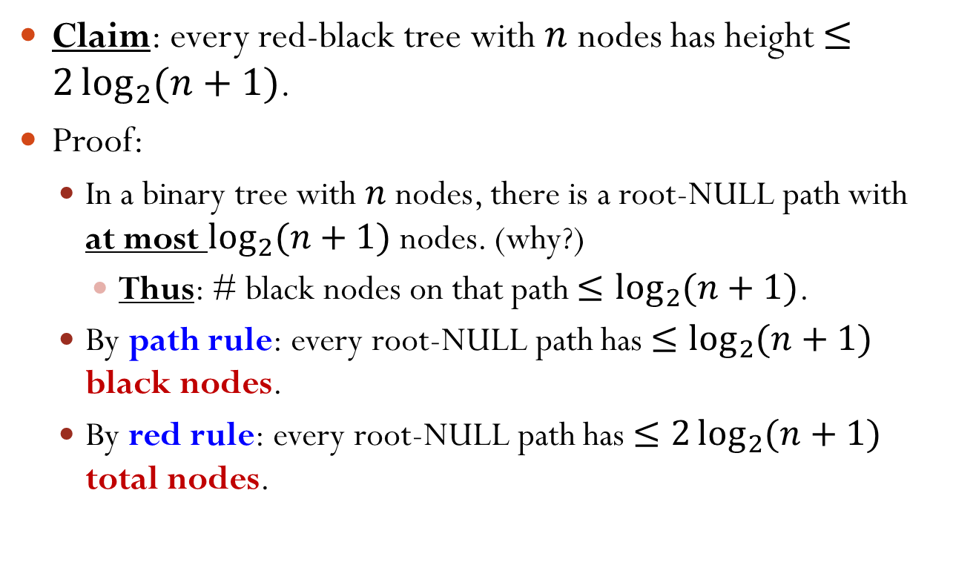
Height Guarantee
Claim: every red-black tree with $n$ nodes has height $≤2\log_{2}{(n+1)}$.
Proof:
In a binary tree with $n$ nodes, there is a root-NULL path with at most $\log_{2}{(n+1)}$ nodes. (why?)
Thus: # black nodes on that path $≤\log_{2}{(n+1)}$.
By path rule: every root-NULL path has $≤\log_{2}{(n+1)}$ black nodes.
By red rule: every root-NULL path has $≤2\log_{2}{(n+1)}$ total nodes.
Q.E.D.
Notes:
Otherwise, if every root-NULL path has more than log_2(n+1) nodes, then it at least contains a perfect binary tree of height log_2(n+1). Then, the number of nodes in the tree is larger than n.

Slide 10
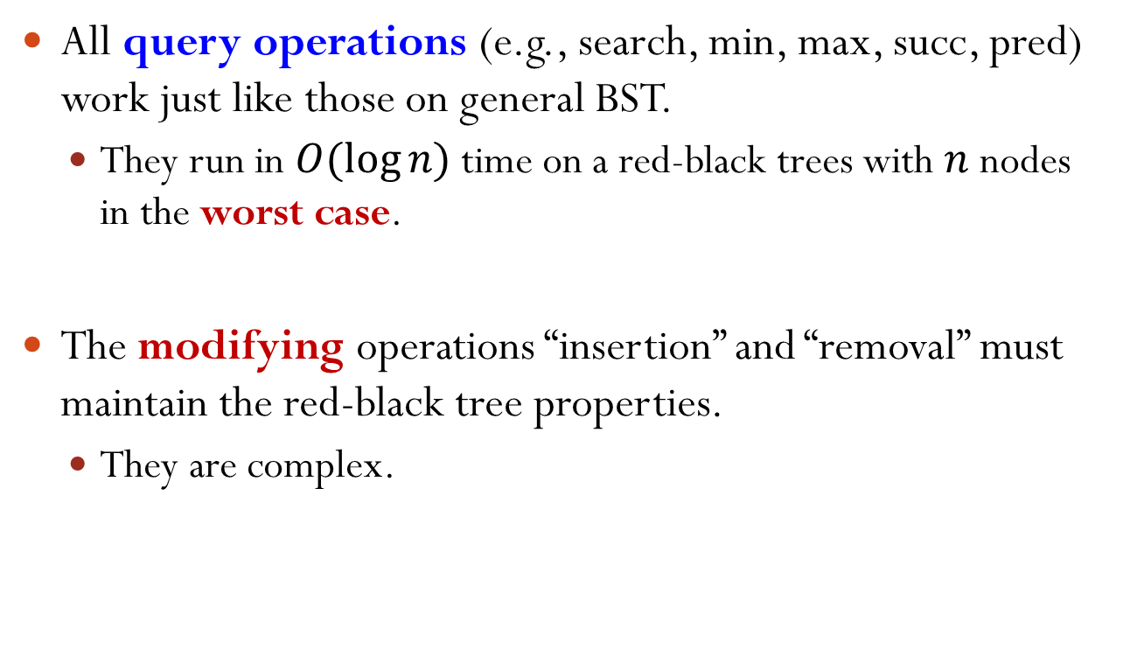
Operations on Red-Black Trees
All query operations (e.g., search, min, max, succ, pred) work just like those on general BST.
They run in $O(log⁡n)$ time on a red-black trees with $n$ nodes in the worst case.
The modifying operations “insertion” and “removal” must maintain the red-black tree properties.
They are complex.

Slide 11
Outline
Red-black Trees: Basics
Red-black Trees: Insertion

Slide 12
Insertion
5
New node is always a leaf.
However, it can’t be black!
Otherwise, violate path rule.
Therefore the new leaf must be red.
If parent is black, done (trivial case).
If parent is red, violate the red rule!
3
8
1
4
6
9
✗
7
5
3
8
8
We have to do some work…
1
4
6
9
6
9
2
✓
7
Notes:
We assume that the tree before insertion is a valid red-black tree.

Slide 13







Modification: Rotation
Maintain the binary search tree property.
Can be done in $O\left(1\right)$ time.
B
A
Right Rotation
B
A
Left Rotation
$$γ$$
$$α$$
$$β$$
$$γ$$
$$α$$
$$β$$

Slide 14
Modification: Recoloring
5
5
3
8
3
8
Recoloring
1
4
6
9
1
4
6
9
7
7

Slide 15
Invariants
Red Rule: Red nodes do not have Red children
Black Height Rule (Path Rule): Paths that stem from the same node have the same black heights.

Slide 16

Insertion: Sketch
Insert $x$ as a leaf.
Color $x$ red.
Only red rule may be violated.
Move the violation up the tree by recoloring/rotation.
At some point, the violation will be fixed.
Key idea:
We prioritize the maintenance of the Black Height Rule over the Red Rule

Slide 17
Violation at Leaf
Note: only red rule may be violated by inserting a (red) node as a leaf.
When violating, its parent is red and its grandparent is black.
Denote: the inserted node as “I”, its parent as “P”, its grandparent as “G”.
G
P
Q
I
Inserted
Notes:
Why parent red? Because otherwise it is not red rule violation.
Why grandparent black? Because otherwise it violates the red rule, but the tree before insertion is a valid red-black tree.

Slide 18
Which Statements Are Correct?
Suppose there is a violation at the leaf. Suppose the parent of the inserted node is “P”. Select all the correct statements.
A. P could be a non-leaf in the original tree.
B. P could have a sibling.
C. P could have no siblings.
D. P could have a sibling and that sibling must be a leaf node.
G
…
P
…
I
Inserted

Slide 19
Violation at Leaf
Note: only red rule may be violated by inserting a (red) node as a leaf.
When violating, its parent is red and its grandparent is black.
Denote: the inserted node as “I”, its parent as “P”, its grandparent as “G”.
Claim: in the old tree, “P” is a leaf, i.e., has no children.
G
P
Q
I
Inserted
Notes:
Why P is a leaf? Otherwise, P has a child, the child must be black. However, this violates the path rule.

Slide 20
Violation at Leaf
Assume: the parent “P” is the left child of the grandparent “G”.
The “right child” case is symmetric.
Denote: the right child of the grandparent to be Q.
Claim: Q is either a red leaf or a NULL.
Why?
G
P
Q
I
Inserted
Notes:
Why? Q is NULL is fine. If Q is not NULL, Q must be red (otherwise, violating path rule). If Q is red, then Q must be a leaf.

Slide 21
Violation at Leaf
Three cases:
1. Q is a red leaf. 2. Q is empty; I is P’s left child.
3. Q is empty; I is P’s right child.
G
G
P
Q
P
I
Inserted
I
Inserted
G
P
I
Inserted

Slide 22
Violation at Leaf
Case 1: Q is a red leaf.
G
G
Recoloring
P
Q
P
Q
I
Inserted
I
Inserted
May recurse, since G’s parent may be red.

Slide 23
Violation at Leaf
Case 2: Q is empty; I is P’s left child.
G
P
Right Rotation
P
I
G
I
Inserted
Recoloring
P
Done! All properties restored. (Why?)
I
G
Notes:
Recoloring: P from red to black and G from black to red

Slide 24
Violation at Leaf
Case 3: Q is empty; I is P’s right child.
G
G
Left Rotation
It’s Case 2!
P
I
I
Inserted
P
Right Rotation
I
Recoloring
I
P
G
P
G
Done! All properties restored.

Slide 25
Violation at Leaf: Summary
For Case 2 (Q is empty; I is P’s left child) and Case 3 (Q is empty; I is P’s right child), we’re done.
For Case 1 (Q is a red leaf), we may recurse.
Violation of red rule.
…
…
H
H
…
Recoloring
…
G
G
P
Q
P
Q
I
Inserted
I
Inserted

Slide 26
Violation at Internal Nodes
Caused by moving the violation up the tree.
When violating, its parent is red and its grandparent is black.
Assume: the parent “P” is the left child of the grandparent “G”. (The “right child” case is symmetric.)
Denote: the right child of the grandparent to be Q.
G
G
P
Q
P
Q
Violation
I
I
Notes:
When violating, its parent is red and its grandparent is black. This is the same as the leaf case.

Slide 27
Violation at Internal Nodes
Three Cases:
Q is a red node.
Claim:
α, β, γ, δ, ε are trees with black root.
α, β, γ, δ, ε have the same black height.
G
P
Q
Violation
I
γ
δ
ε
α
β
Notes:
alpha and beta black due to recoloring in the previous step. gamma, delta, and epsilon black due to red rule in the original red-black tree.
After recoloring, I becomes red, however, it is black before, with its child being red. Thus, the black height of beta is equal to the black height of gamma. It can also be proved that the black height of alpha is the same as the black height of beta.

Slide 28
Violation at Internal Nodes
Three Cases:
2. Q is a black node; I is P’s left child.
3. Q is a black node; I is P’s right child.
Claim for Case 2 and 3:
α, β, γ, Q are trees with black root.
α, β, γ, Q have the same black height.
G
Violation
P
Q
I
γ
α
β
G
P
Q
α
I
Violation
β
γ

Slide 29
Violation at Internal Nodes
Case 1: Q is a red node.
G
G
Violation
P
Q
P
Q
Recoloring
I
γ
δ
ε
I
γ
δ
ε
α
β
α
β
May recurse, since G’s parent may be red.

Slide 30
Violation at Internal Nodes
Case 2: Q is a black node; I is P’s left child.
G
P
Violation
P
Q
Right Rotation
I
G
I
γ
α
β
γ
Q
α
β
P
Recoloring
I
G
Done! All properties restored.
α
β
γ
Q
Notes:
Recoloring: P from red to black and G from black to red.
Why choose to recoloring this way instead of making I black? Because in this case, if P red, it may still violate the red rule; if P black, it violates the path rule.

Slide 31
Violation at Internal Nodes
Case 3: Q is a black node; I is P’s right child.
G
G
P
Q
Left Rotation
I
Q
α
I
P
γ
Violation
β
γ
α
β
It’s Case 2!

Slide 32
Violation at Internal Nodes: Case 3 (cont.)
G
I
I
Q
Right Rotation
P
G
P
γ
α
β
γ
Q
α
β
I
Recoloring
P
G
γ
Q
Done! All properties restored.
α
β
Notes:
Recoloring: I from red to black and G from black to red

Slide 33
Violation at Internal Nodes: Summary
For Case 2 (Q is a black node; I is P’s left child) and Case 3 (Q is a black node; I is P’s right child), we’re done.
For Case 1 (Q is a red node), we may recurse.
Violation of red rule.
…
…
H
H
…
…
G
G
Violation
P
Q
P
Q
Recoloring
I
γ
δ
ε
I
γ
δ
ε
α
β
α
β

Slide 34
Final Step: Violation Fix at the Root
By moving the violation up the tree …
… the root may become red.
Final step: set root to be black.
All red-black tree properties are now restored.
G
G
P
Q
Recoloring Root
P
Q
I
I
γ
δ
ε
γ
δ
ε
α
β
α
β
Notes:
In the previous step, P and Q are red and G is black, so we call recoloring and this leads to the graph at the left.

Slide 35
Example
Insert 1
Insert 8
Recoloring Root
1
1
1
8

Slide 36
Example (cont.)
Insert 2
1
Case 3 at leaf
1
8
Right Rotation
2
2
8
Left Rotation
2
2
Recoloring
1
8
1
8
Notes:
Note: Case 3.
However, it is the symmetric case of what we talked about. Thus, we do right rotation first and then left rotation.

Slide 37
Example (cont.)
Case 1 at leaf
2
Insert 7
2
Recoloring
1
8
1
8
7
7
Recoloring Root
2
1
8
7

Slide 38
Example (cont.)
Insert 3
2
Case 2 at leaf
2
1
8
Right Rotation
1
7
7
3
8
3
Recoloring
2
1
7
3
8

Slide 39
Example (cont.)
Insert 6
2
Case 1 at leaf
2
1
7
1
7
Recoloring
3
8
3
8
6
6
Notes:
It is case 1, because the other child of the grandparent is not empty.

Slide 40
Example (cont.)
Insert 4
2
Case 3 at leaf
2
1
7
1
7
3
8
3
8
Right Rotation
4
6
4
6
Left Rotation
2
2
1
7
1
7
Recoloring
4
8
4
8
3
6
3
6
Notes:
Note: case 3 at leaf.
However, it is the symmetric case of what we talked about. Thus, we do right rotation first and then left rotation.

Slide 41
Example (cont.)
Insert 5
Case 3 at internal node
2
Case 1 at leaf
2
7
1
7
1
Recoloring
4
8
4
8
3
6
3
6
5
5
Notes:
Note: Case 3 at internal node, because the other child of the grandparent is black and the direction of parent to child and grandparent to parent is opposite. (In this case: node 1 is the tree Q)

Slide 42
Example (cont.)
Case 3 at internal node
2
2
1
7
1
4
4
8
Right Rotation
7
3
3
6
6
8
5
5
Left Rotation
4
4
Recoloring
2
7
2
7
1
3
6
8
1
3
6
8
5
5
Notes:
However, it is the symmetric case of what we talked about. Thus, we do right rotation first and then left rotation.

Slide 43
Runtime Complexity
Number of rotations required
For case 1, only need to recolor, no rotation.
For case 2 or 3, perform 1 or 2 rotations and terminate.
Thus: # rotations = $O(1)$.
Number of recoloring required
Worst case: $O(\log{n})$
Runtime complexity is $O(\log{n})$.

Slide 44
Compared Against AVL Tree
Tree is less balanced
Bad for search
Good for insertion/deletion
What’s the best DS for
Database (lots of lookups, fewer modifications)?
Stock market transactions (lots of modifications)?

Slide 45
Deletion in RB Tree
What kind of a node is to be removed from RB Tree?
Single child or leaf nodes
What kind of a node could be a leaf node in an RB tree?
A red node?
A black node?
What kind of a node would have a single child in an RB tree?
A red node?
A black node?
Any grand children?
✓
✓
v
v
✗
v
v
v
v
✓
✓
✗

Slide 46
Deleting a Red Node
Simple?
Simple
Just remove it
No black height change
No red rule violations
v

Slide 47
Deleting a Black Node
Simple case:
Black node with a red child
Solution:
Delete
Recoloring
v
u
u
u

Slide 48
Deleting a Black Leaf
This is complicated!
Black height changes!
Reduced by 1
Fix: somehow retain the black height
Fix top: turn a red node to black!
Fix bottom: maintain the black path rule downward

Slide 49
Sibling Has Red Children
Sibling has red children:
Rotate and recolor
p
p
4
4
v
v
s
s
c
s
c
4
4
p
c
p
s

Slide 50
Sibling Has No Children
Sibling has red children:
Just and recolor the sibling
The end?
Nope. What if p was black! Then black height of p isn’t right!
p
p
v
v
s
s
c
p
p
s
s

Slide 51
Fix Double-Black
Consequences with recoloring the sibling:
Sibling now has the same black height!
So… Recurse
p
p
v
s
h-1
h-1
h
h-1

Slide 52
When Does Double-Black Stop
Until all the way to the root
Example: delete 1
5
5
5
2
7
2
7
2
7
1
3
6
8
3
6
8
3
6
8
5
5
5
2
7
2
7
2
7
3
6
8
3
6
8
3
6
8

Slide 53
Or When a Red Node Turns Black
6
6
6
2
8
2
8
2
8
0
4
7
9
0
4
7
9
0
4
7
9
-1
1
3
5
1
3
5
1
3
5
6
6
2
8
2
8
0
4
7
9
0
4
7
9
1
3
5
1
3
5

Slide 54
Deleting a Black Node
What does it mean?
Does the black height of the tree change?
What is the complexity? Why?

Slide 55
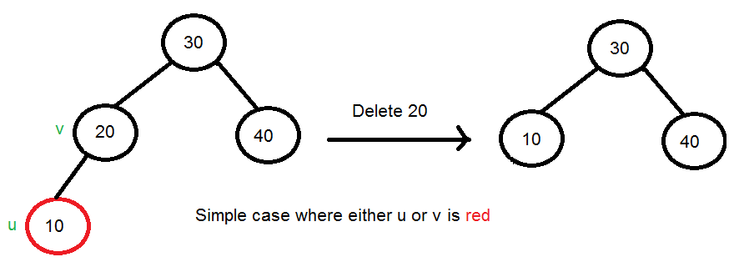
Deletion in RB Tree
Simple case: if either u or v is red

Slide 56
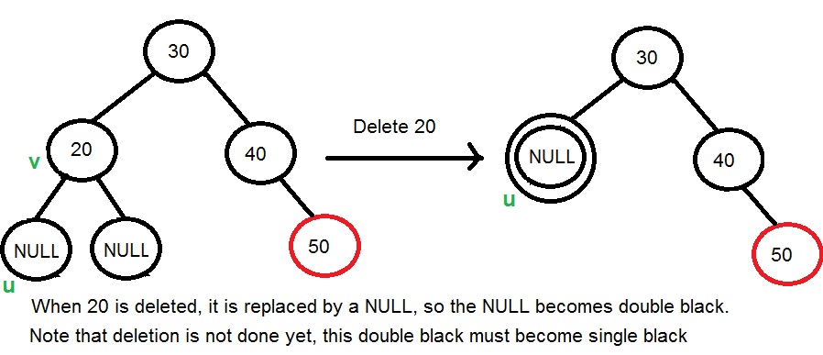
Deletion in RB Tree
Both u and v is black: convert double black to single black

Slide 57
Double Black
While the current node u is double black, and not the root. Let sibling of u be s. ….(a): If sibling s is black and at least one of sibling’s children is red, perform rotation(s). Let the red child of s be r. This case can be divided in four subcases depending upon positions of s and r. …………..(i) Left Left Case (s is left child of its parent and r is left child of s or both children of s are red). This is mirror of right right case shown in below diagram. …………..(ii) Left Right Case (s is left child of its parent and r is right child). This is mirror of right left case shown in below diagram. …………..(iii) Right Right Case (s is right child of its parent and r is right child of s or both children of s are red)

Slide 58
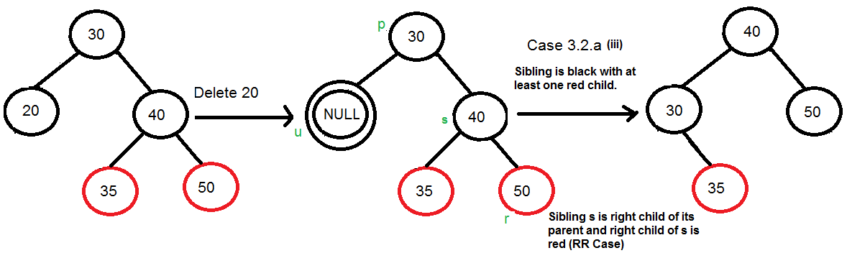

Slide 59
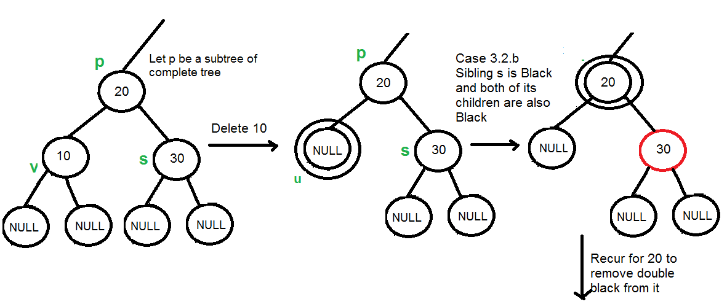
Double Black cont.
(b): If sibling is black and its both children are black, perform recoloring, and recur for the parent if parent is black.

Slide 60
Double Black cont.
…..(c): If sibling is red, perform a rotation to move old sibling up, recolor the old sibling and parent. The new sibling is always black (See the below diagram). This mainly converts the tree to black sibling case (by rotation) and leads to case (a) or (b). This case can be divided in two subcases. …………..(i) Left Case (s is left child of its parent). This is mirror of right right case shown in below diagram. We right rotate the parent p. …………..(iii) Right Case (s is right child of its parent). We left rotate the parent p.

Slide 61
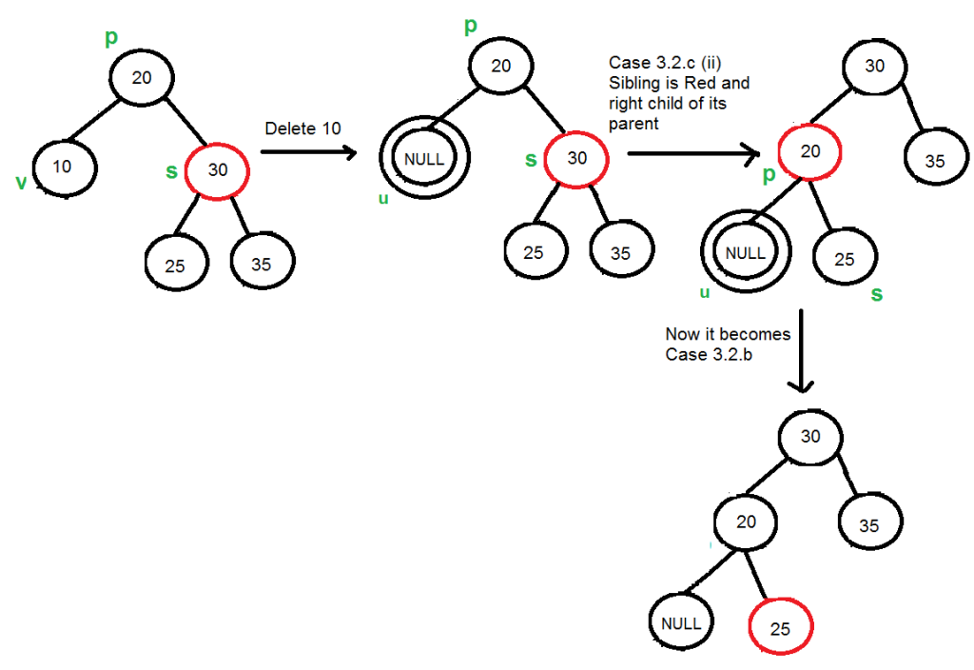

Slide 62
The Final Step
3.3) If u is root, make it single black and return (Black height of complete tree reduces by 1).

