Slide 1
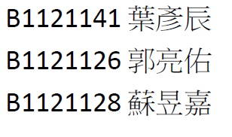
實驗六

Slide 2
實驗6-1

Slide 3
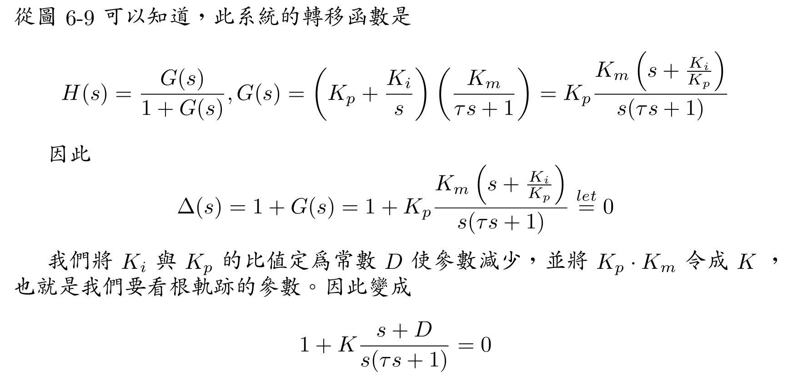
實驗6-3

Slide 4
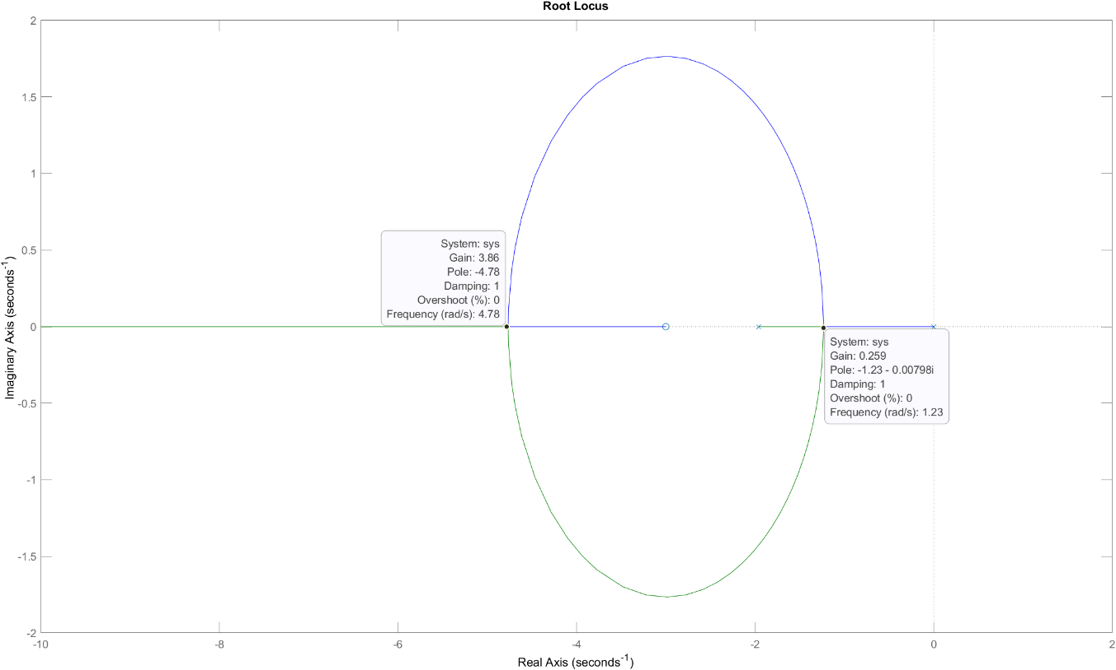
實驗6-3
s = tf('s');
tau = 0.51;
K_m = 307;
D = 3;
sys = (s + D) / (s * (tau *s + 1));
figure(1)
rlocus(sys)

Slide 5
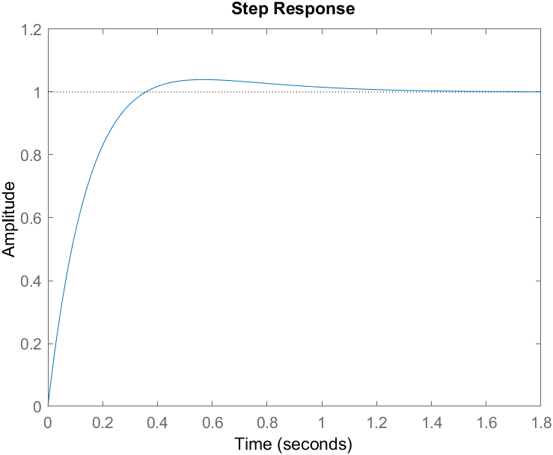
實驗6-3
s = tf('s');
tau = 0.51;
K_m = 307;
D = 3;
sys = (s + D) / (s * (tau *s + 1));
figure(2)
K = 3.86;
sys_cl = feedback(K * sys, 1);
step(sys_cl)

Slide 6
實驗6-3
k = 3.86 -> k_p = k / k_m = 3.86 / 307 =0.01257328990228013
-> k_i = k_p * D = 0.03771986970684039

Slide 7
問題討論

