Slide 1
RNAseq preliminary analysis
Ye Yuan
For 1st sample batch, AGC#5407

Slide 2
Section 1: number of reads mapped to each gene

Slide 3
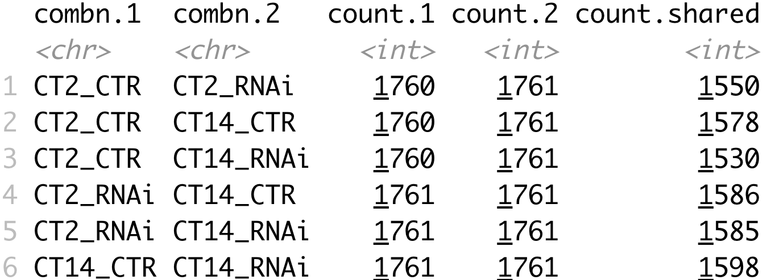
Section 1 input data summary
For each sample:
alignment was performed using classic fruit fly genome (dm6, 2014)
for each gene, number of reads mapped to it was counted
top 10% genes in terms of number of reads were selected
1st row in words:
1760 genes are among top 10% for CT2 CONTROL sample
1761 genes are among top 10% for CT2 RNAi sample
Among those genes, 1550 are shared.
1550/1760 ~ 88%
Notes:
Actually, “NA” is considered in this summary. Real shared should be -1!!!

Slide 4
Pairwise fold change plots
What
Consider one pair of samples, for instance CT2_CONTROL vs CT14_CONTROL
What are the top genes that show the largest fold change?
Meaningful pairs
CT2 CTR vs CT14 CTR
CT2 CTR vs CT2 RNAi
CT14 CTR vs CT14 RNAi
CT2 RNAi vs CT14 RNAi
In the next slides, red dots are ”significant” genes. However, this is drawn arbitrarily by me because we do not have replicates.

Slide 5
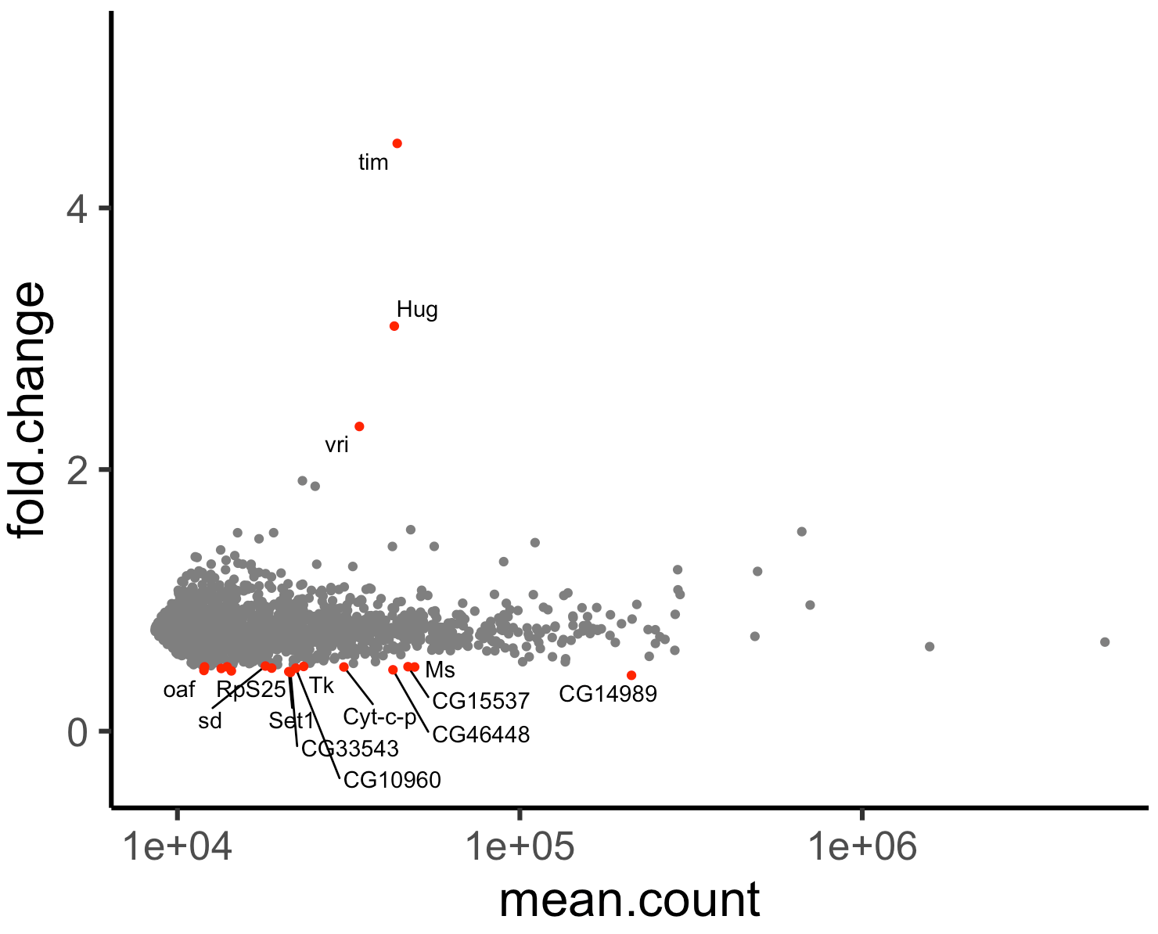
CT2 CTR vs CT14 CTR
Very few…
Should be due to strong filtering (only analyzed top 10% expressed genes)
--- will change this soon, with the normalization discussed
CT14 / CT2 for y-axis

Slide 6
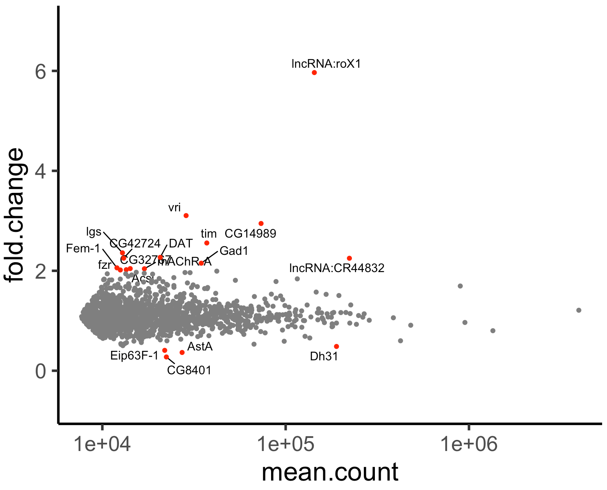
CT2 RNAi vs CT14 RNAi
CT14 / CT2 for y-axis

Slide 7
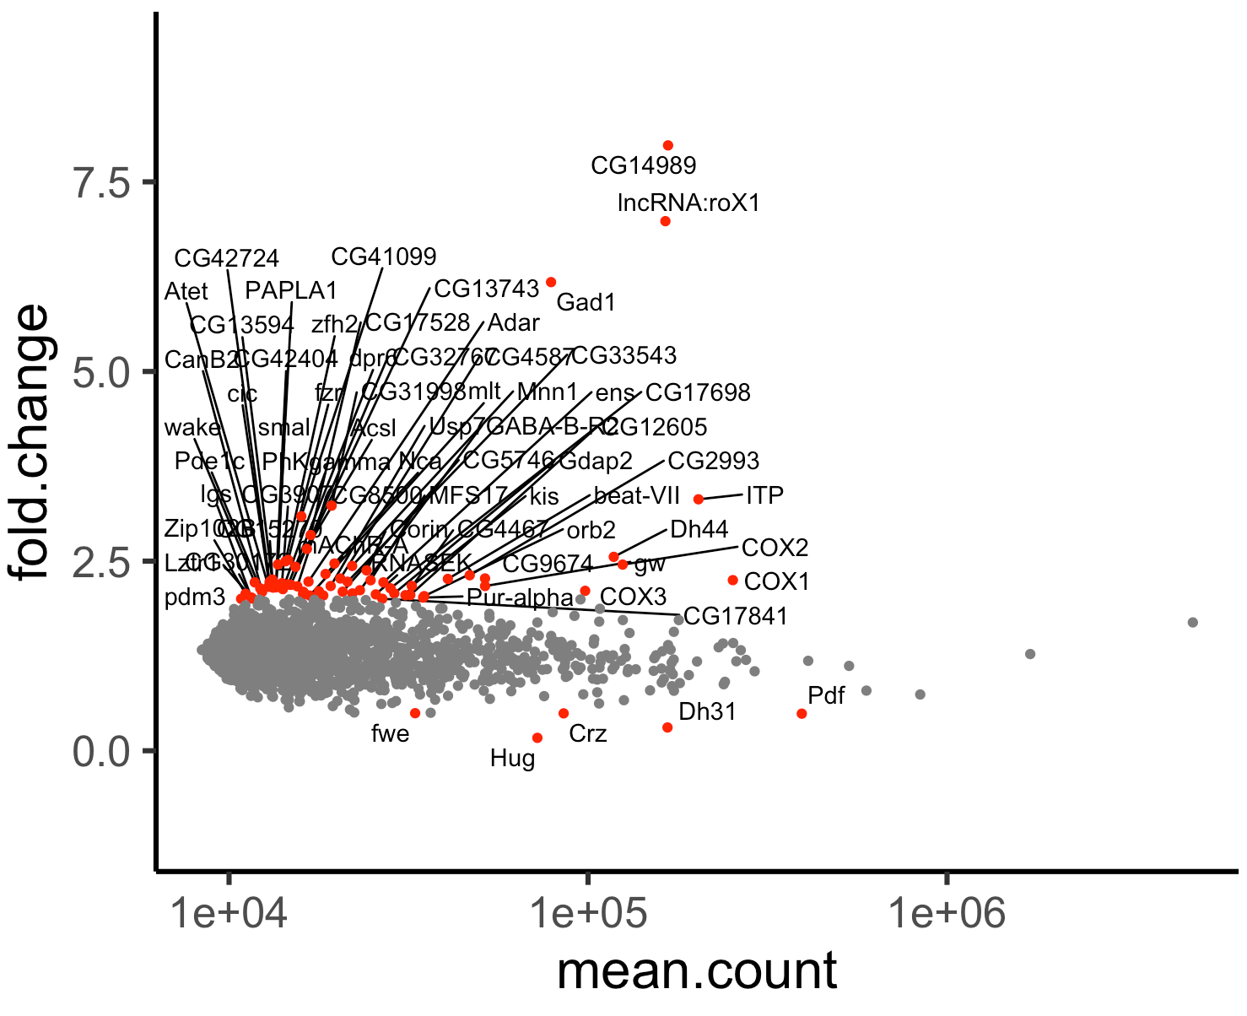
CT2 CTR vs CT2 RNAi
CTR / RNAi for y axis
Because of the threshold I chose, this plot specifically looks messy.

Slide 8
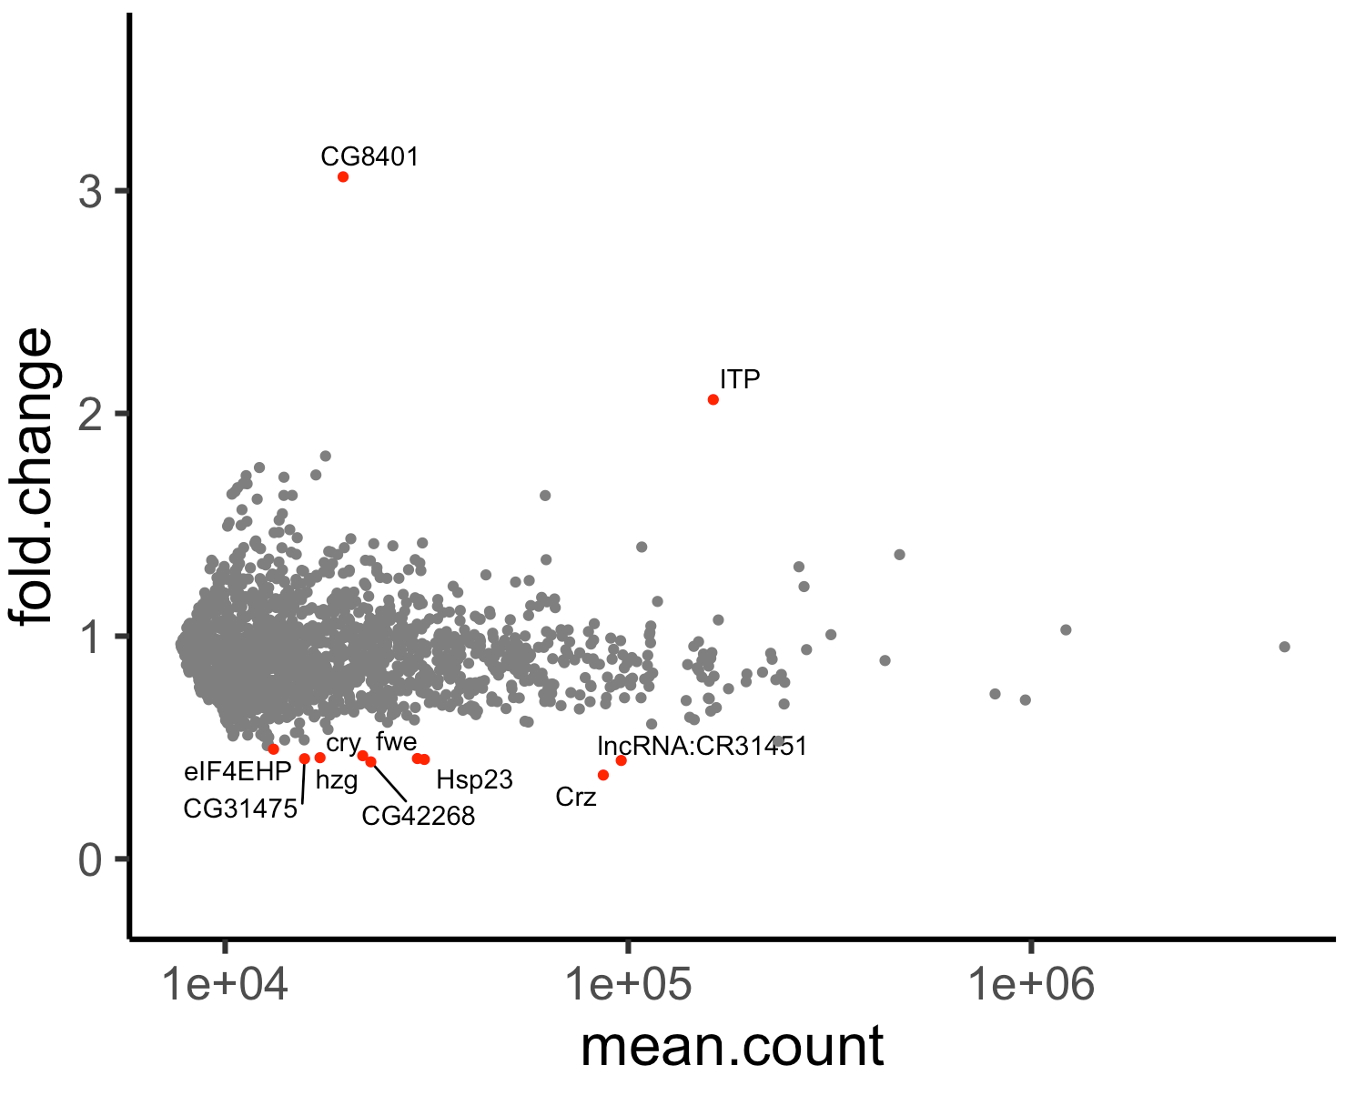
CT14 CTR vs CT14 RNAi
CTR / RNAi for y axis

Slide 9
Top 30 genes with largest number of reads
What
For each sample, simply look at the 30 genes with the largest number of reads

Slide 10
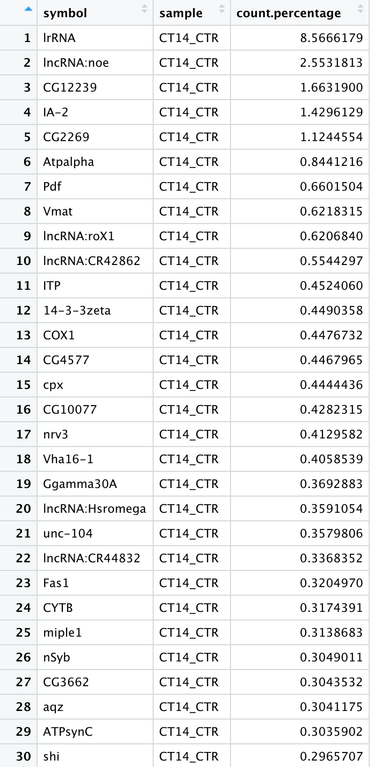
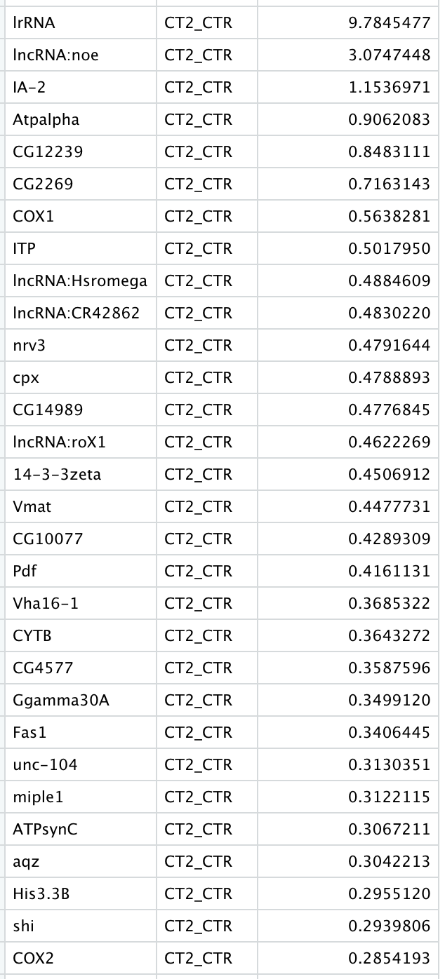

Slide 11
