Slide 1



From Random to Explicit via Subspace Designs With Applications to Local Properties and Matroids
Yeyuan Chen
Michigan
Joshua Brakensiek Manik Dhar Zihan Zhang
UCB MIT OSU

Slide 2
Subspace Designs: GX13, GK16
Applications of subspace designs in coding theory:
Prior work using SD to construct good list-decodable codes: Sri25,CZ25
Large-alphabet local properties generalized from code properties (list-decoding, list-recovery) (LMS25)
Contribution of this paper: Find an equivalence between SD and Local Properties
Applications:
List-decoding and List-recovery (This paper and BCDZ26b)
Conditional graph birigidity test in P
Near-optimal Proximity Gap of random punctured RS codes (GG26)
Bipartite Matching in NC (CGGRT26)

Slide 3

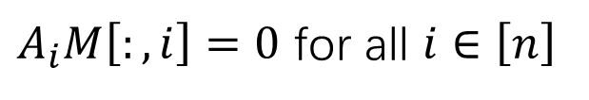





Local Properties (Levi-Mosheiff-Shagrithaya, FOCS25)
$$P=(A_{1},A_{2},…,A_{n}∈𝔽^{a×b})$$
A linear subspace $U⊆𝔽^{n}$ contains $P$ iff there exists a non-zero matrix $M∈𝔽^{b}⊗U$ with the following form:
$$n$$
$$M\left[:,i\right]$$
$$b$$
$$M\left[j,:\right]∈U$$
$$M$$
$A_{i}M\left[:,i\right]=0$ for all $i∈\left[n\right]$
Think $P$ as a sequence of coordinate-wise linear tests on columns
Think $U$ as uniform linear tests on rows
Includes a variety of code properties like list-decoding, list-recovery

Slide 4
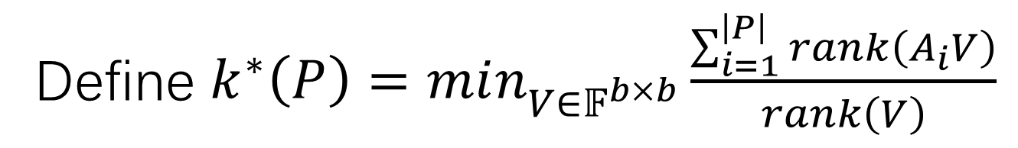
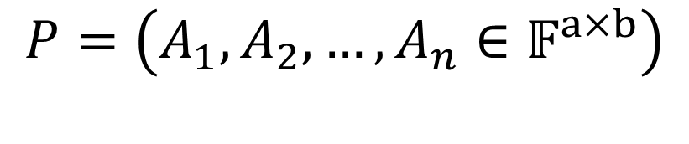

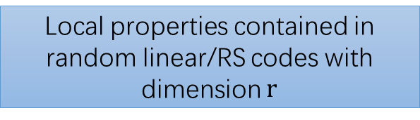
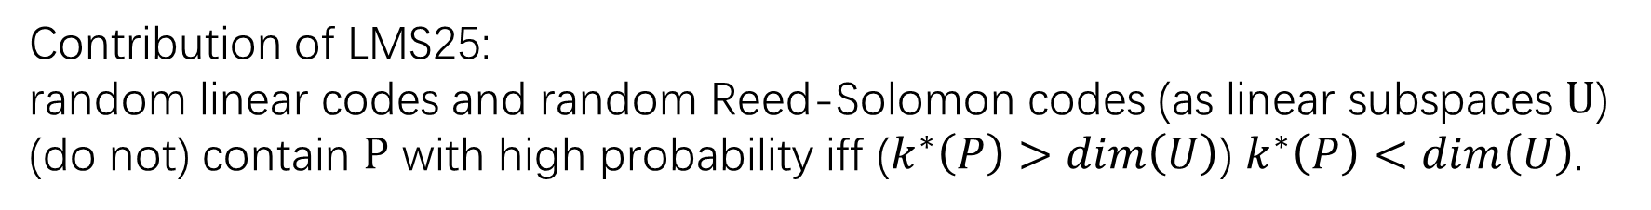
$$P=\left(A_{1},A_{2},…,A_{n}∈𝔽^{a×b}\right)$$
Define $k^{∗}\left(P\right)=min_{V∈𝔽^{b×b}}\frac{\sum_{i=1}^{\left|P\right|}{rank\left(A_{i}V\right)}}{rank\left(V\right)}$
Contribution of LMS25:
random linear codes and random Reed-Solomon codes (as linear subspaces $U$)
(do not) contain $P$ with high probability iff ($k^{∗}\left(P\right)>dim\left(U\right)$) $k^{∗}\left(P\right)<dim\left(U\right)$.
Local properties contained in random linear/RS codes with dimension $r$
Local properties with
$$k^{∗}\left(P\right)<r$$
LMS25

Slide 5
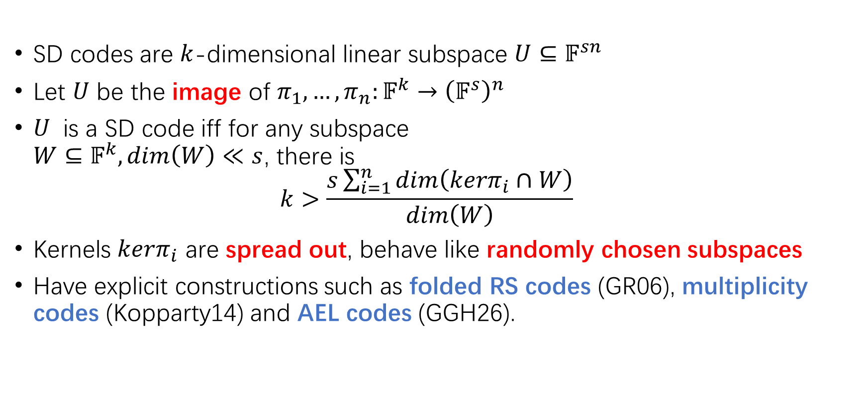
Subspace Design Codes (GX13, GK16)
SD codes are $k$-dimensional linear subspace $U⊆𝔽^{sn}$
Let $U$ be the image of $π_{1},…,π_{n}:𝔽^{k}→{\left(𝔽^{s}\right)}^{n}$
$U$ is a SD code iff for any subspace $W⊆𝔽^{k},dim\left(W\right)≪s$, there is $k>\frac{s\sum_{i=1}^{n}{dim\left(kerπ_{i}∩W\right)}}{dim\left(W\right)}$
Kernels $kerπ_{i}$ are spread out, behave like randomly chosen subspaces
Have explicit constructions such as folded RS codes (GR06), multiplicity codes (Kopparty14) and AEL codes (GGH26).

Slide 6
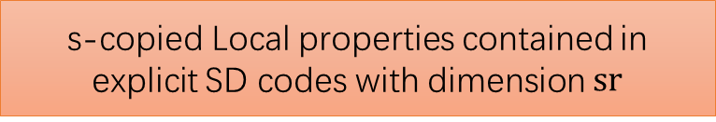


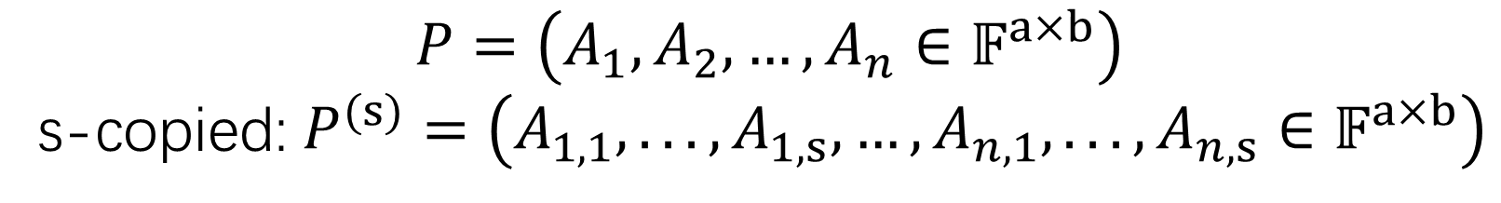
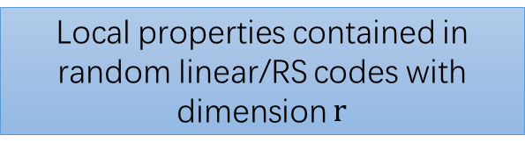
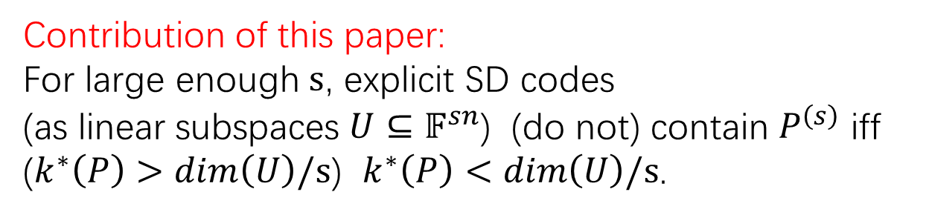

$$P=\left(A_{1},A_{2},…,A_{n}∈𝔽^{a×b}\right)$$
s-copied:$P^{(s)}=\left(A_{1,1},...,A_{1,s},…,A_{n,1},...,A_{n,s}∈𝔽^{a×b}\right)$
$$k^{∗}\left(P\right)=min_{V∈𝔽^{b×b}}\frac{\sum_{i=1}^{\left|P\right|}{rank\left(A_{i}V\right)}}{rank\left(V\right)}$$
$$sk^{∗}\left(P\right)=k^{∗}(P^{(s)})$$
Contribution of this paper:
For large enough $s$, explicit SD codes
(as linear subspaces $U⊆𝔽^{sn}$) (do not) contain $P^{\left(s\right)}$ iff
($k^{∗}\left(P\right)>dim\left(U\right)/s$) $k^{∗}\left(P\right)<dim\left(U\right)/s$.
Local properties contained in random linear/RS codes with dimension $r$
LMS25
Local properties with
$$k^{∗}\left(P\right)<r$$
This work
s-copied Local properties contained in explicit SD codes with dimension $sr$

Slide 7
Applications in explicit constructions (in coding theory)
In terms of list-recoverability, explicit SD codes are no worse than random linear codes and random RS codes (directly by this work), thus gives the derandomization of random linear/RS codes. (random linear/RS to SD)
After BCDZ26b computed the nearly-optimal list-recoverability of SD codes, the equivalence in this work transfers the same result to random linear/RS codes. (SD to random linear/RS)
In GG26, the authors first show that SD codes have optimal proximity gap, and then use this work to get the same result to random linear/RS codes. (SD to random linear/RS)

Slide 8

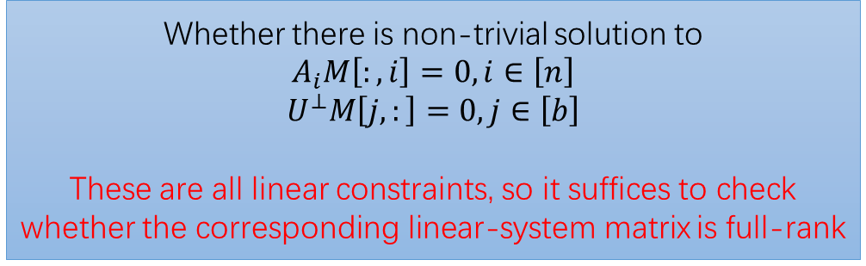

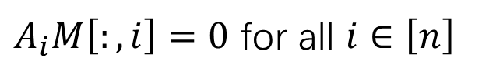

Applications in algorithm design (derandomization)
Given $P$ and $U$, there is a deterministic polytime algorithm to decide whether $U$ contains $P$
$$n$$
$$M\left[:,i\right]$$
$$b$$
$$M\left[j,:\right]∈U$$
$A_{i}M\left[:,i\right]=0$ for all $i∈\left[n\right]$
Whether there is non-trivial solution to
$$A_{i}M\left[:,i\right]=0,i∈\left[n\right]$$
$$U^{⊥}M\left[j,:\right]=0,j∈\left[b\right]$$
These are all linear constraints, so it suffices to check whether the corresponding linear-system matrix is full-rank
Ber84, Csa76: Computing rank is in uniform $NC^{2}$
This task is in uniform $NC^{2}$ (Observed in CGGRT26)

Slide 9
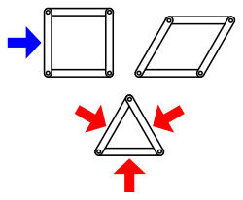
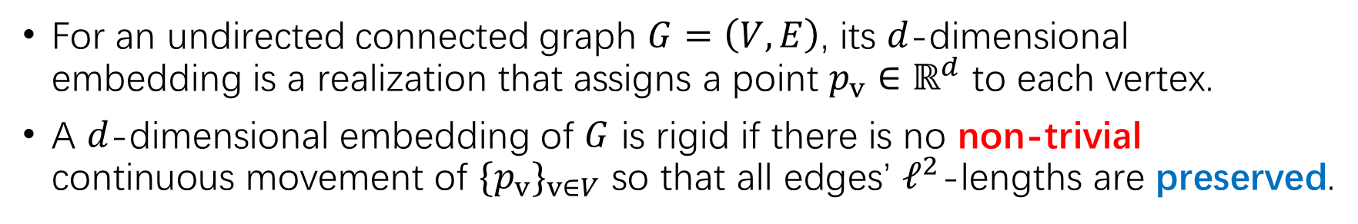

Graph rigidity
For an undirected connected graph $G=\left(V,E\right)$, its $d$-dimensional embedding is a realization that assigns a point $p_{v}∈ℝ^{d}$ to each vertex.
A $d$-dimensional embedding of $G$ is rigid if there is no non-trivial continuous movement of ${\{p}_{v}\}_{v∈V}$ so that all edges’ $ℓ^{2}$-lengths are preserved.
$G=\left(V,E\right)$ is $d$-rigid iff it has a rigid $d$-dimensional embedding
Task: Given $G=\left(V,E\right)$, decide whether it is $d$-rigid
$d=2$: Known as Laman graphs (classic)
$d=3$: Grand open problem in math. (posed by Maxwell 1864)

Slide 10
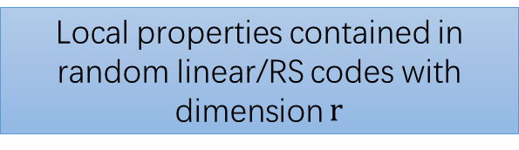
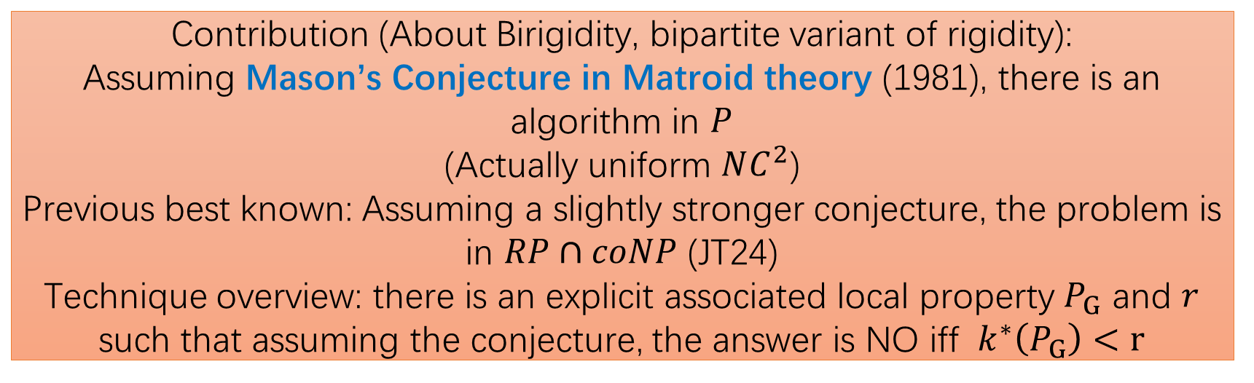
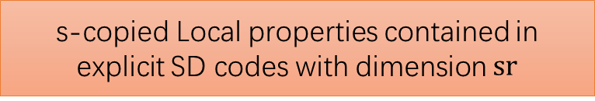

Contribution (About Birigidity, bipartite variant of rigidity):
Assuming Mason’s Conjecture in Matroid theory (1981), there is an algorithm in $P$ (Actually uniform $NC^{2}$)
Previous best known: Assuming a slightly stronger conjecture, the problem is in $RP∩coNP$ (JT24)
Technique overview: there is an explicit associated local property $P_{G}$ and $r$ such that assuming the conjecture, the answer is NO iff ${ k}^{∗}\left(P_{G}\right)<r$
Local properties contained in random linear/RS codes with dimension $r$
LMS25
Local properties with
$$k^{∗}\left(P\right)<r$$
This work
s-copied Local properties contained in explicit SD codes with dimension $sr$
Given $P_{G}$and $U$ (the explicit SD code), , there is a polytime algorithm to decide whether $U$ contains $P_{G}$

Slide 11
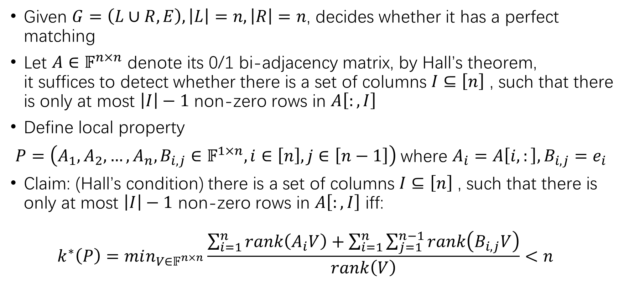
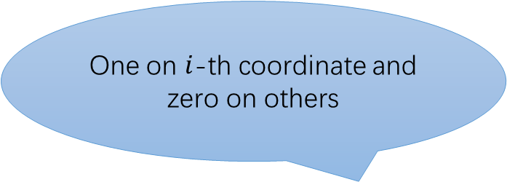

Bipartite Matching in $NC^{2}$ (By CGGRT26)
$$A_{1}$$ $$A_{i}$$ $$A_{n}$$
Given $G=\left(L∪R,E\right),\left|L\right|=n,\left|R\right|=n$, decides whether it has a perfect matching
Let $A∈𝔽^{n×n}$ denote its 0/1 bi-adjacency matrix, by Hall’s theorem, it suffices to detect whether there is a set of columns $I⊆\left[n\right]$ , such that there is only at most $\left|I\right|−1$ non-zero rows in $A\left[:,I\right]$
Define local property
$P=\left(A_{1},A_{2},…,A_{n},B_{i,j}∈𝔽^{1×n},i∈\left[n\right],j∈\left[n−1\right]\right)$where $A_{i}=A\left[i,:\right],B_{i,j}=e_{i}$
Claim: (Hall’s condition) there is a set of columns $I⊆\left[n\right]$ , such that there is only at most $\left|I\right|−1$ non-zero rows in $A\left[:,I\right]$ iff: $k^{∗}\left(P\right)=min_{V∈𝔽^{n×n}}\frac{\sum_{i=1}^{n}{rank\left(A_{i}V\right)}+\sum_{i=1}^{n}{\sum_{j=1}^{n−1}{rank\left(B_{i,j}V\right)}}}{rank\left(V\right)}<n$
One on $i$-th coordinate and zero on others

Slide 12
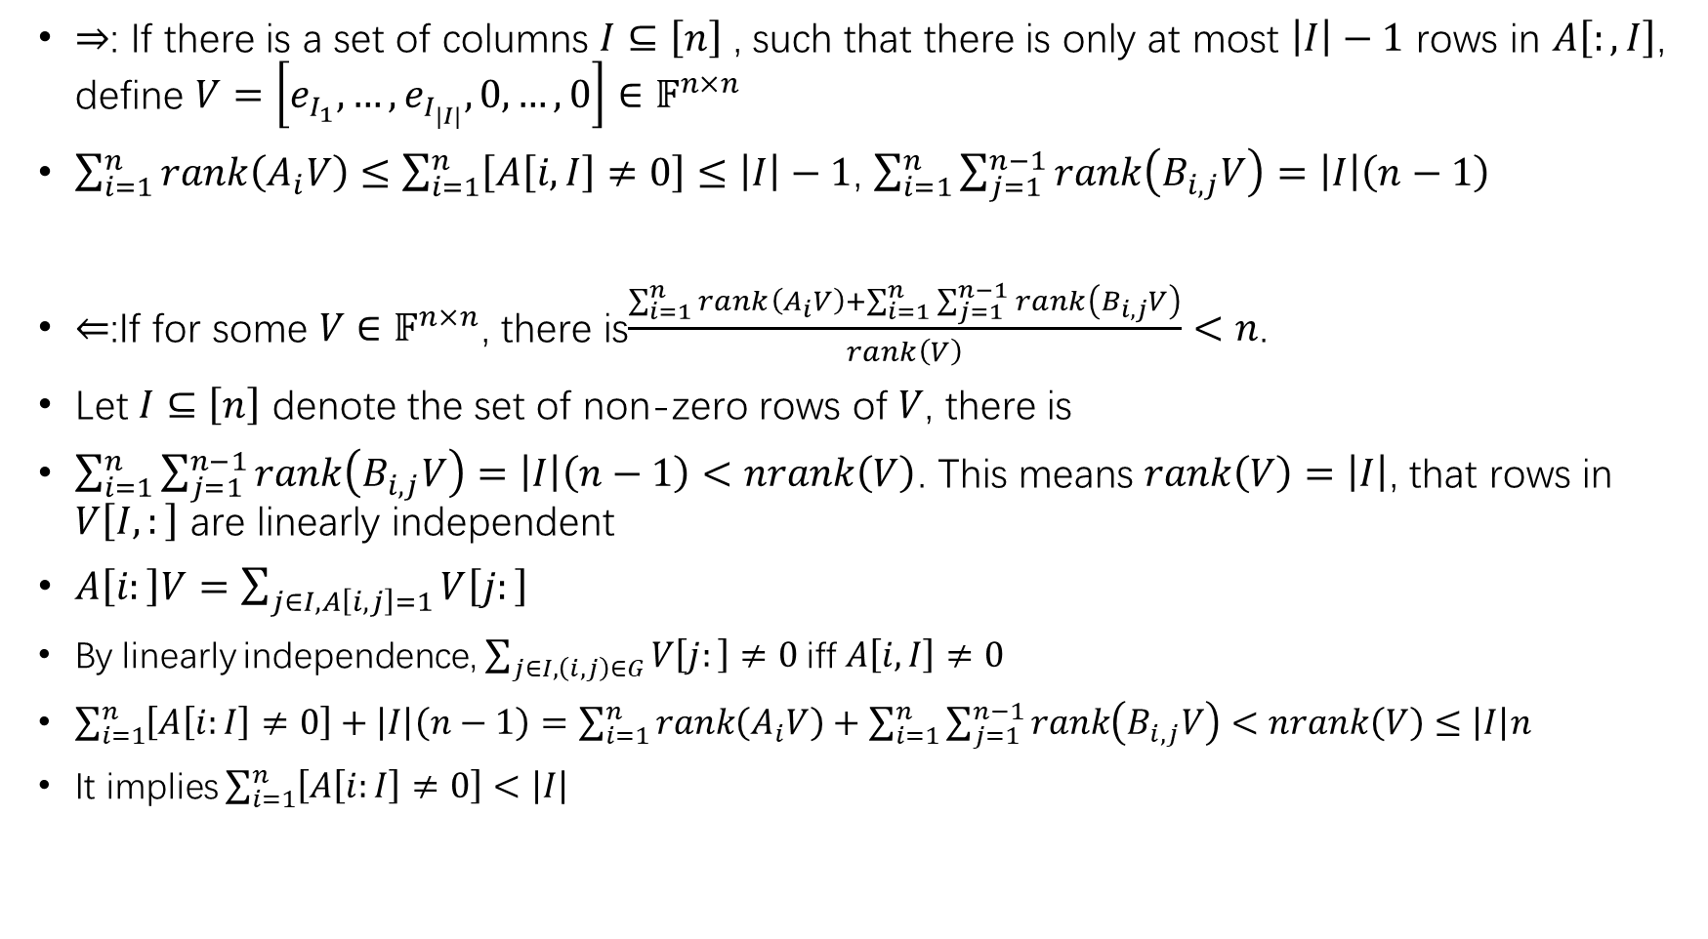
$⇒$: If there is a set of columns $I⊆\left[n\right]$ , such that there is only at most $\left|I\right|−1$ rows in $A\left[:,I\right]$, define $V=\left[e_{I_{1}},…,e_{I_{\left|I\right|}},0,…,0\right]∈𝔽^{n×n}$
$\sum_{i=1}^{n}{rank\left(A_{i}V\right)}≤\sum_{i=1}^{n}{\left[A\left[i,I\right]≠0\right]}≤\left|I\right|−1$, $\sum_{i=1}^{n}{\sum_{j=1}^{n−1}{rank\left(B_{i,j}V\right)=\left|I\right|\left(n−1\right)}}$
$⇐$:If for some $V∈𝔽^{n×n}$, there is$\frac{\sum_{i=1}^{n}{rank\left(A_{i}V\right)}+\sum_{i=1}^{n}{\sum_{j=1}^{n−1}{rank\left(B_{i,j}V\right)}}}{rank\left(V\right)}<n$.
Let $I⊆\left[n\right]$ denote the set of non-zero rows of $V$, there is
$\sum_{i=1}^{n}{\sum_{j=1}^{n−1}{rank\left(B_{i,j}V\right)=\left|I\right|\left(n−1\right)}}<nrank\left(V\right)$. This means $rank\left(V\right)=\left|I\right|$, that rows in $V\left[I,:\right]$ are linearly independent
$A\left[i:\right]V=\sum_{j∈I,A\left[i,j\right]=1}{V\left[j:\right]}$
By linearly independence, $\sum_{j∈I,\left(i,j\right)∈G}{V\left[j:\right]}≠0$iff $A\left[i,I\right]≠0$
$\sum_{i=1}^{n}{\left[A\left[i:I\right]≠0\right]+\left|I\right|\left(n−1\right)=\sum_{i=1}^{n}{rank\left(A_{i}V\right)}+\sum_{i=1}^{n}{\sum_{j=1}^{n−1}{rank\left(B_{i,j}V\right)}}<nrank\left(V\right)≤\left|I\right|n}$
It implies $\sum_{i=1}^{n}{\left[A\left[i:I\right]≠0\right]}<\left|I\right|$

Slide 13
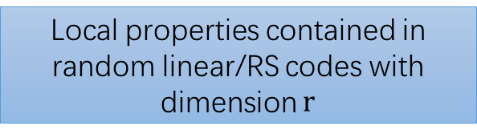
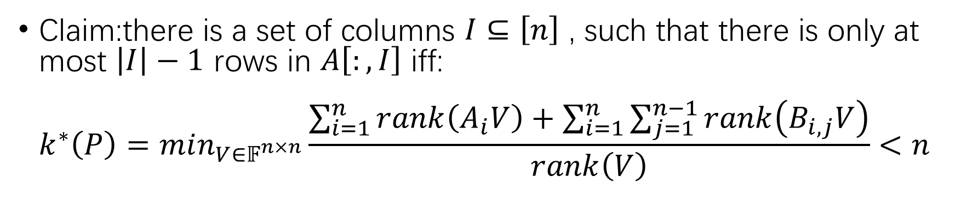

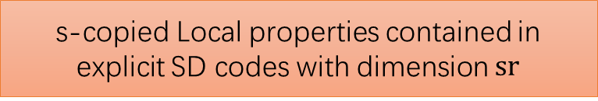

Claim:there is a set of columns $I⊆\left[n\right]$ , such that there is only at most $\left|I\right|−1$ rows in $A\left[:,I\right]$ iff: $k^{∗}\left(P\right)=min_{V∈𝔽^{n×n}}\frac{\sum_{i=1}^{n}{rank\left(A_{i}V\right)}+\sum_{i=1}^{n}{\sum_{j=1}^{n−1}{rank\left(B_{i,j}V\right)}}}{rank\left(V\right)}<n$
Local properties contained in random linear/RS codes with dimension $r$
LMS25
Local properties with
$$k^{∗}\left(P\right)<r$$
This work
s-copied Local properties contained in explicit SD codes with dimension $sr$
Given $P$ and $U$ (the explicit SD code), there is a deterministic polytime uniform $NC^{2}$ algorithm to decide whether $U$ contains $P$

