Slide 1

Explicit Folded Reed-Solomon and Multiplicity Codes
Achieve Relaxed Generalized Singleton Bounds
Yeyuan Chen
Zihan Zhang

Slide 2
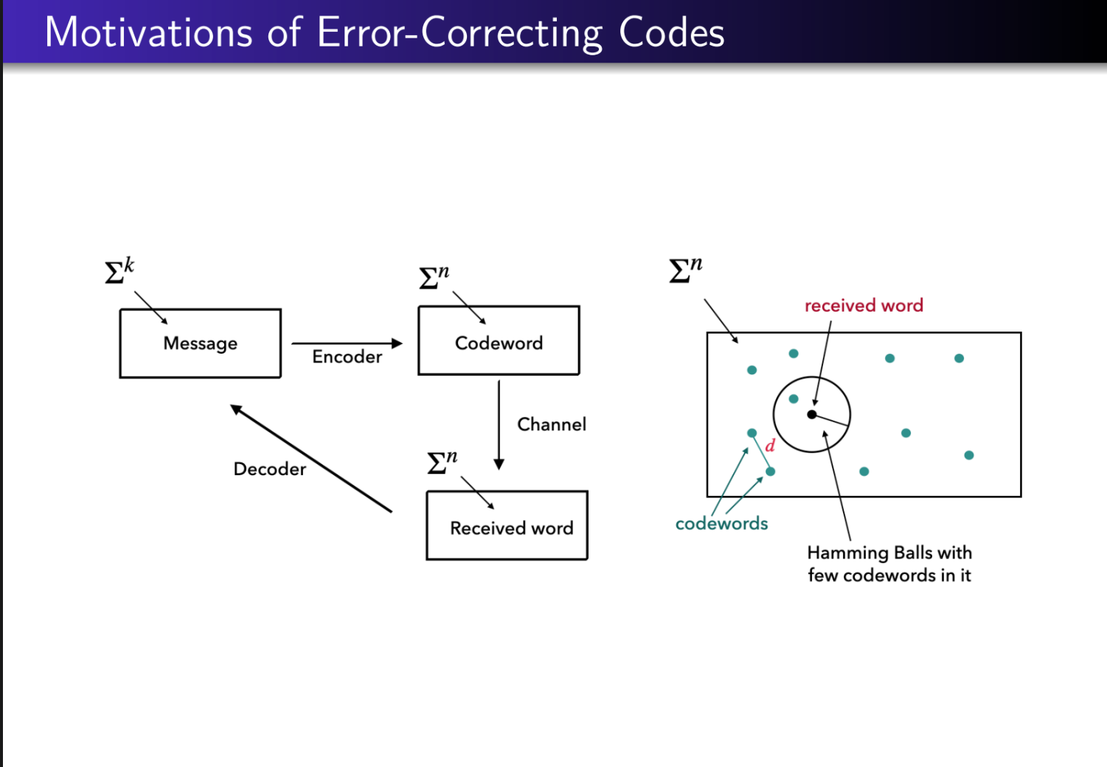

Slide 3
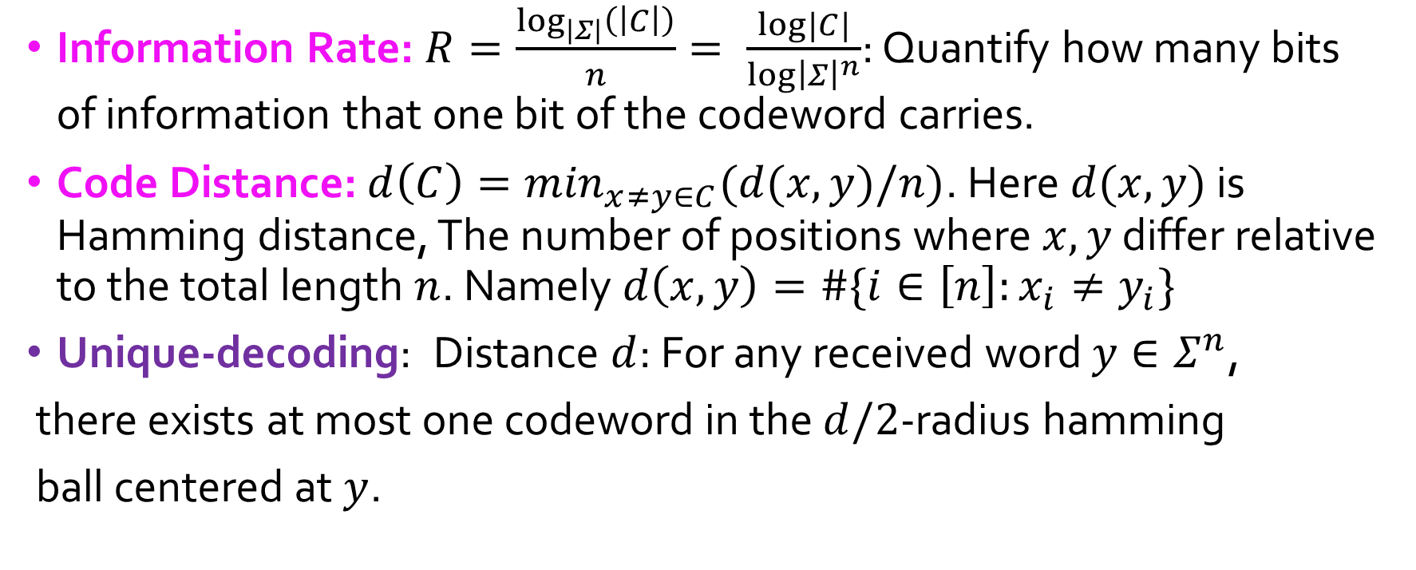

A code $C$ over an alphabet set $Σ$ is a subset of $n$-length strings $C⊆Σ^{n}$
Information Rate: $R=\frac{\log_{\left|Σ\right|}\left(\left|C\right|\right)}{n}= \frac{log|C|}{log{\left|Σ\right|}^{n}}$: Quantify how many bits of information that one bit of the codeword carries.
Code Distance: $d\left(C\right)=\min_{x≠y∈C}(d(x,y)/n)$. Here $d(x,y)$ is Hamming distance, The number of positions where $x,y$ differ relative to the total length $n$. Namely $d\left(x,y\right)=\#\{i∈\left[n\right]:x_{i}≠y_{i}\}$
Unique-decoding: Distance $d$: For any received word $y∈Σ^{n}$,
there exists at most one codeword in the $d/2$-radius hamming
ball centered at $y$.

Slide 4
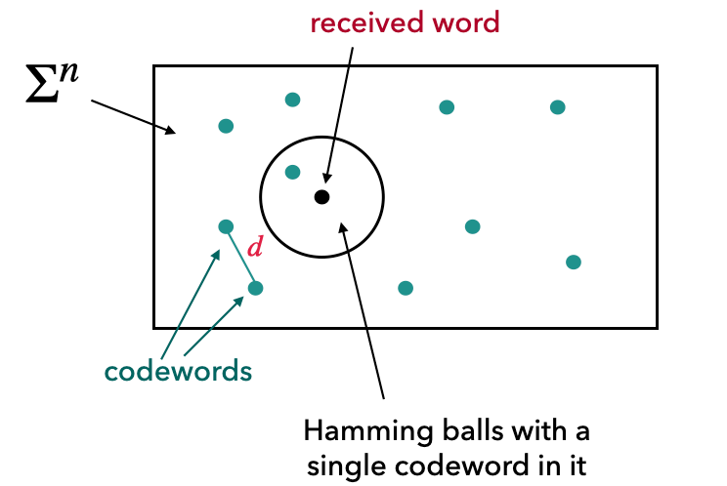

Trade-off: Singleton Bound(1964): $d≤1−R$

Slide 5
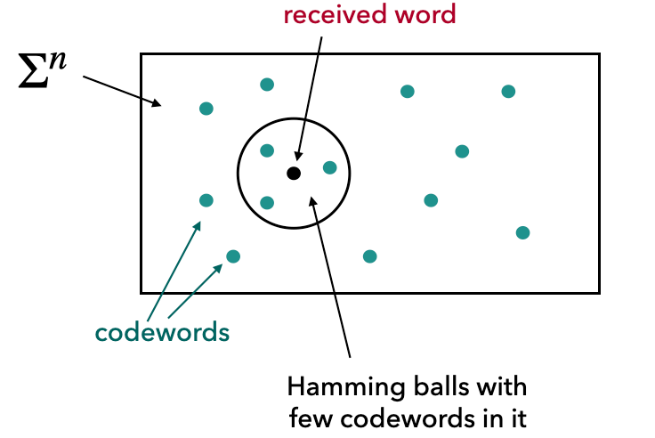
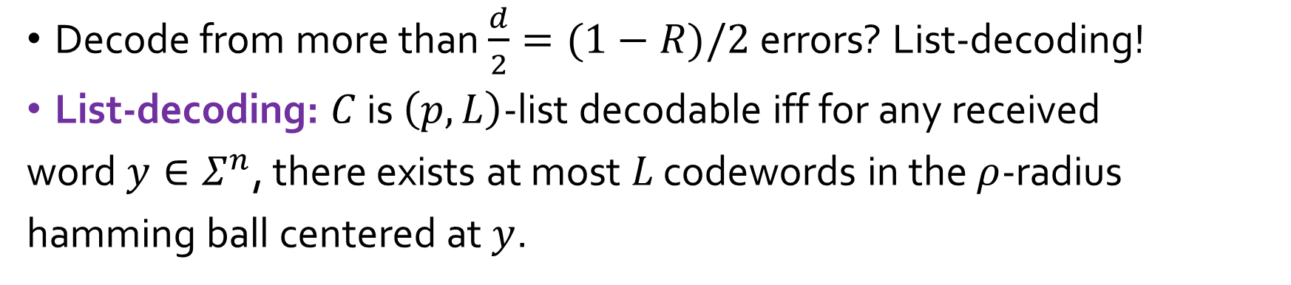
Decode from more than $\frac{d}{2}=(1−R)/2$ errors? List-decoding!
List-decoding: $C$ is $\left(p,L\right)$-list decodable iff for any received
word $y∈Σ^{n}$, there exists at most $L$ codewords in the $ρ$-radius
hamming ball centered at $y$.

Slide 6
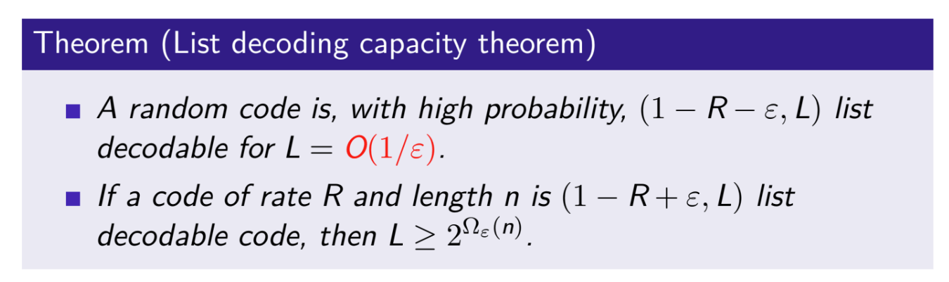
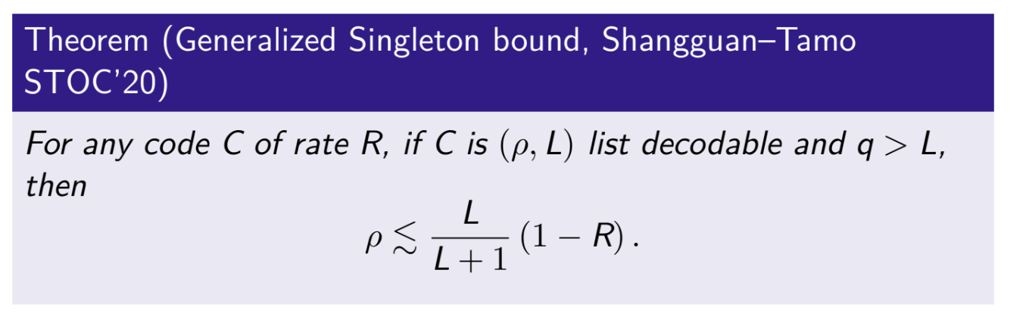
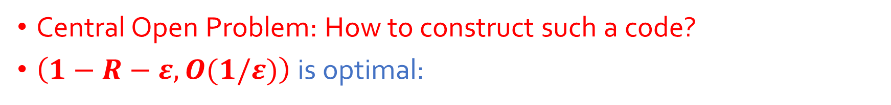
Central Open Problem: How to construct such a code?
$\left(1−R−ε,O(1/ε)\right)$ is optimal:
Fix $ρ=1−R−ε,$ the above bound implies $L>\frac{1−R−ε}{ε}$.

Slide 7
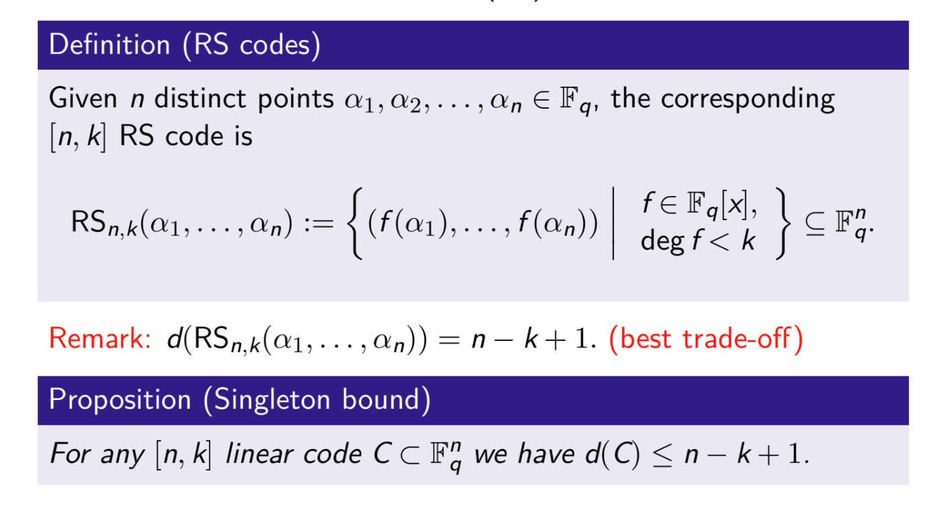

Slide 8
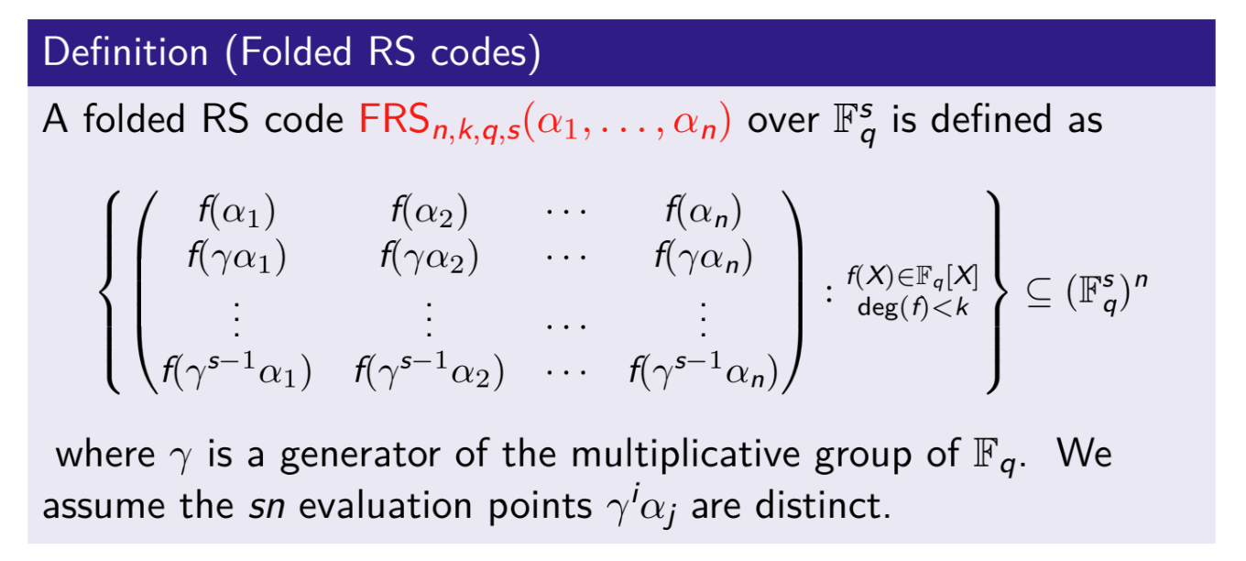

Slide 9
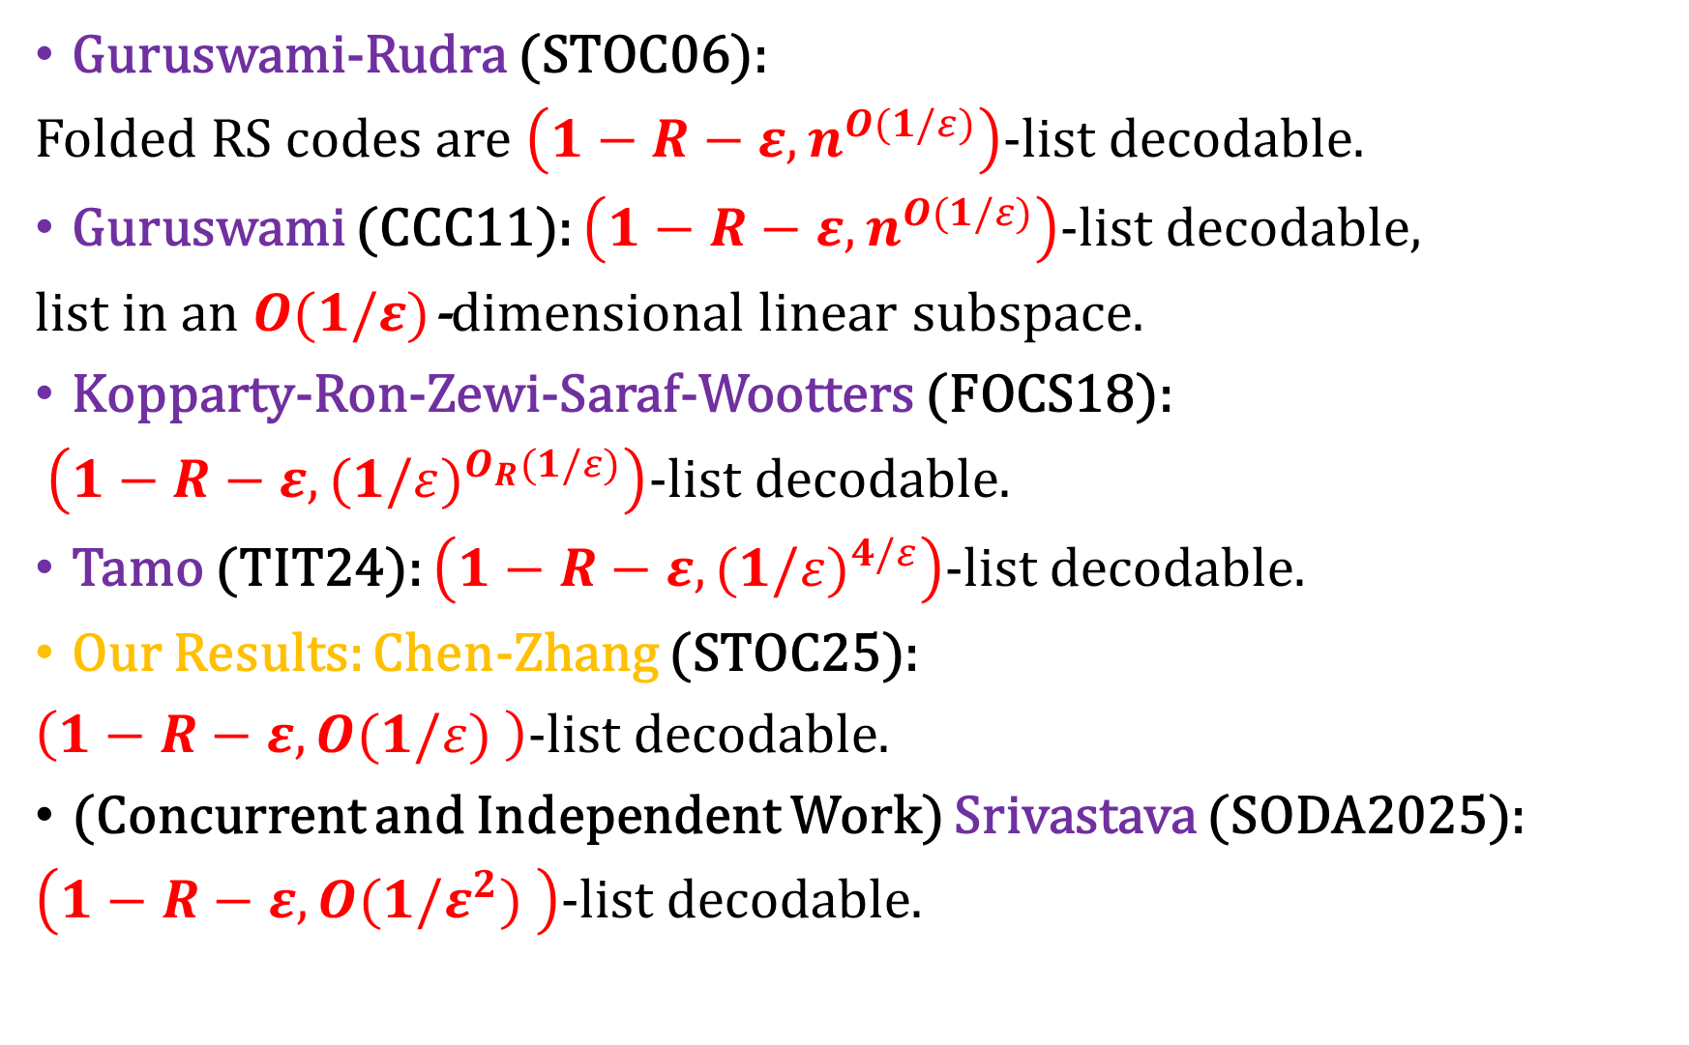
Guruswami-Rudra (STOC06):
Folded RS codes are $\left(1−R−ε,n^{O(1/ε)}\right)$-list decodable.
Guruswami (CCC11): $\left(1−R−ε,n^{O(1/ε)}\right)$-list decodable,
list in an $O(1/ε)$-dimensional linear subspace.
Kopparty-Ron-Zewi-Saraf-Wootters (FOCS18):
$\left(1−R−ε,{(1/ε)}^{O_{R}(1/ε)}\right)$-list decodable.
Tamo (TIT24): $\left(1−R−ε,{(1/ε)}^{4/ε}\right)$-list decodable.
Our Results: Chen-Zhang (STOC25):
$\left(1−R−ε,O(1/ε) \right)$-list decodable.
(Concurrent and Independent Work) Srivastava (SODA2025):
$\left(1−R−ε,O(1/ε^{2}) \right)$-list decodable.

Slide 10
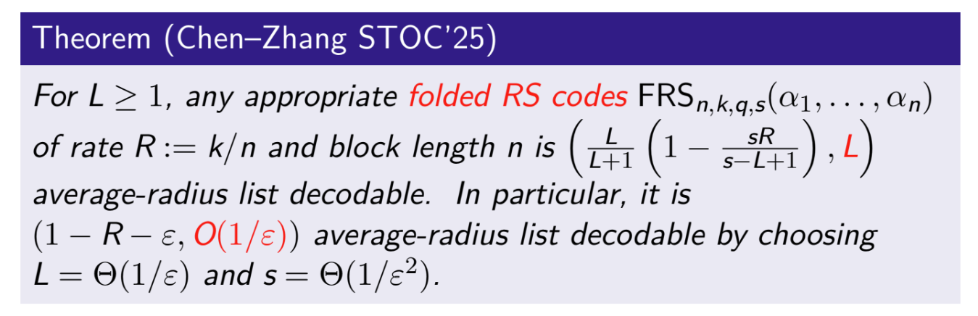

Slide 11
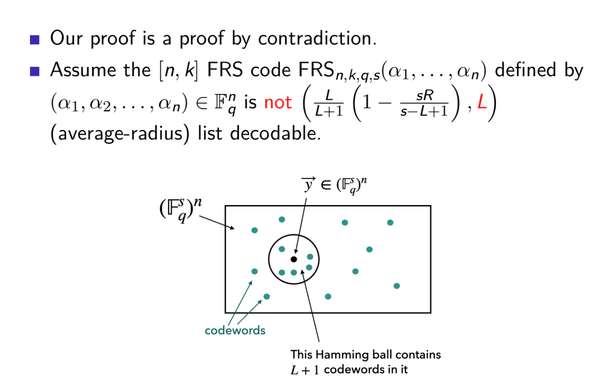

Slide 12
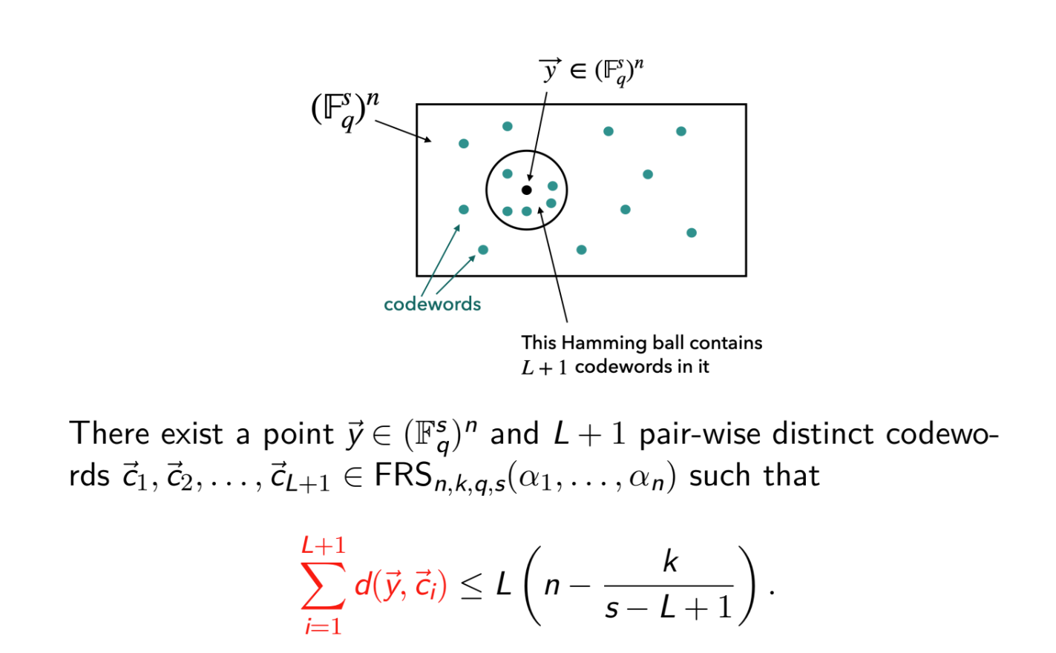

Slide 13
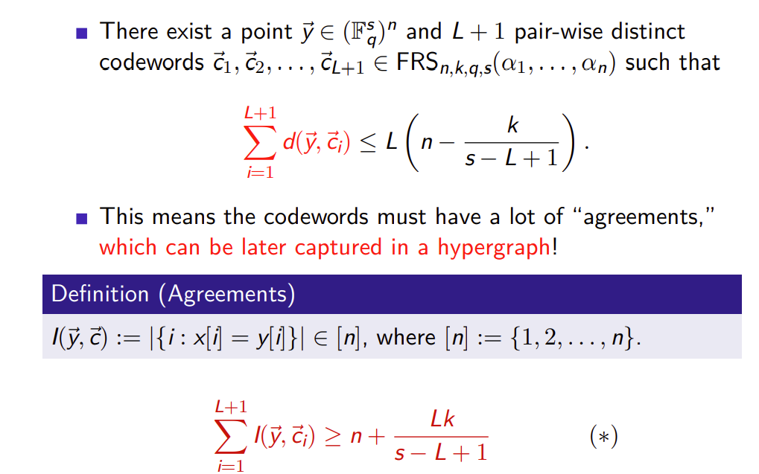

Slide 14
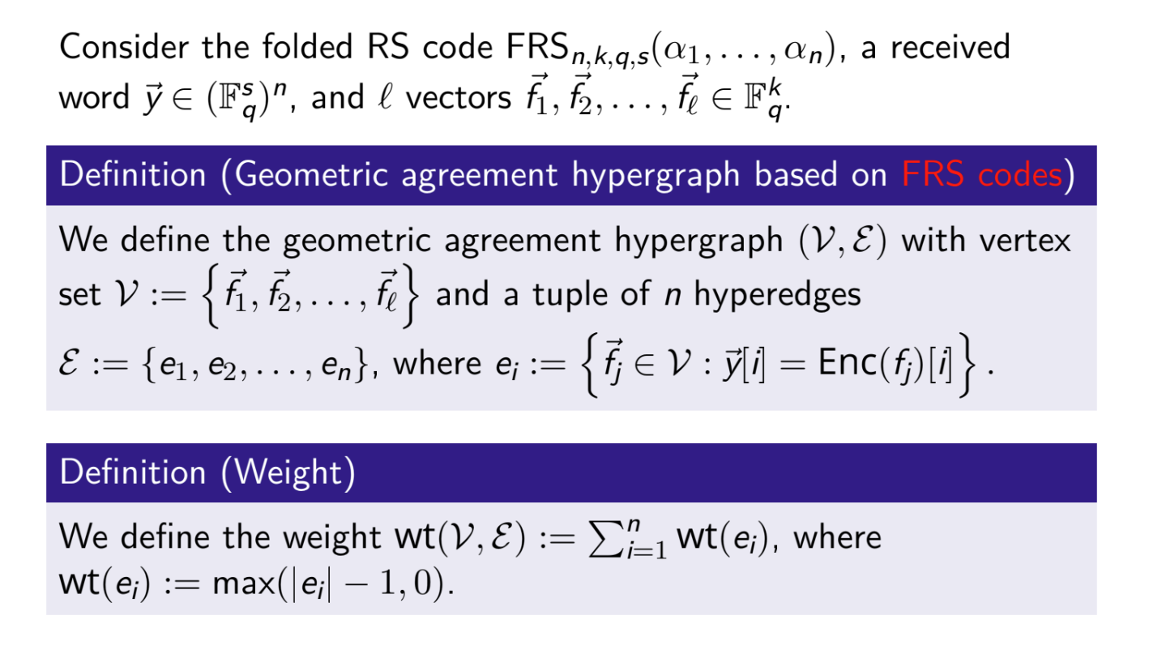
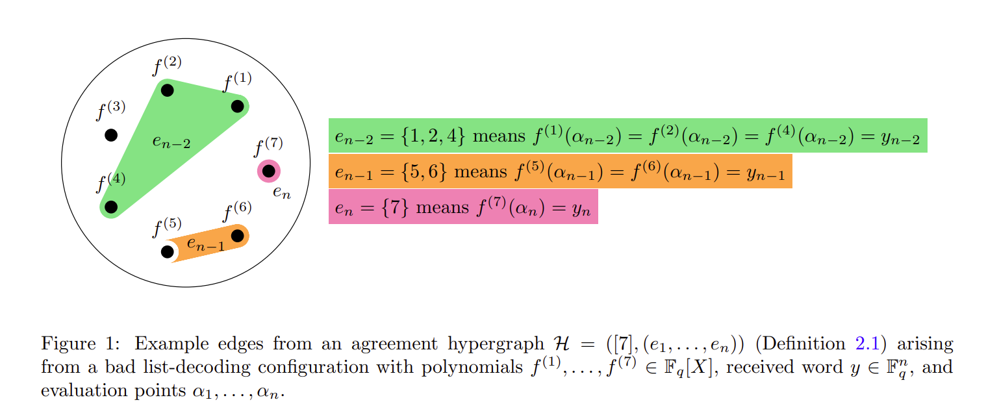

Slide 15
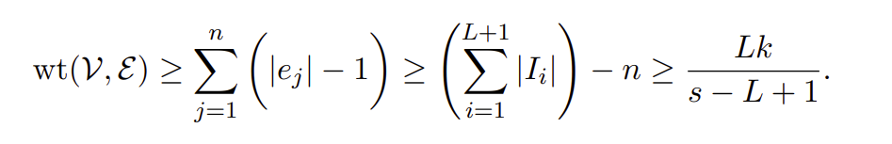
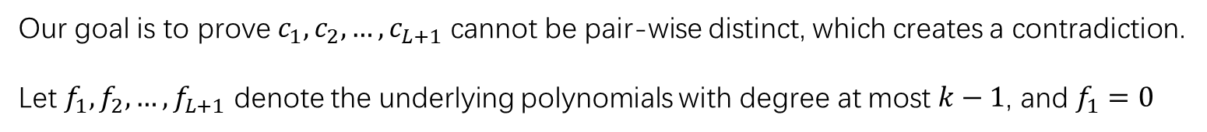
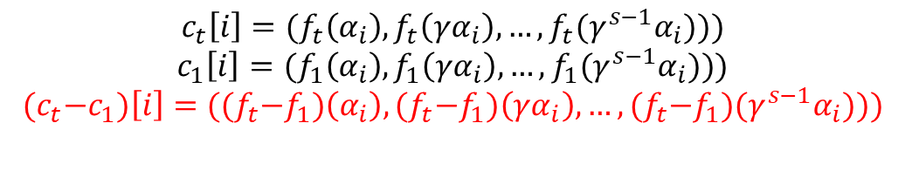
Weight Lower Bound
For a bad list certificate consisting of received word $y$ and codewords$,$ $c_{1},c_{2},…,c_{L+1}$, we can always transform it into
Another bad list certificate $y−c_{1},c_{1}−c_{1},c_{2}−c_{1},…,c_{L+1}−c_{1}$ without changing the pairwise distance. Therefore,
We can assume there is a bad list certificate with $c_{1}=0$
$$c_{t}\left[i\right]=(f_{t}\left(α_{i}\right),f_{t}\left(γα_{i}\right),…,f_{t}(γ^{s−1}α_{i})))$$
$$c_{1}\left[i\right]=(f_{1}\left(α_{i}\right),f_{1}\left(γα_{i}\right),…,f_{1}(γ^{s−1}α_{i})))$$
$${(c}_{t}−c_{1})\left[i\right]=({(f}_{t}−f_{1})\left(α_{i}\right),{(f}_{t}−f_{1})\left(γα_{i}\right),…,{(f}_{t}−f_{1})(γ^{s−1}α_{i})))$$
Our goal is to prove $c_{1},c_{2},…,c_{L+1}$ cannot be pair-wise distinct, which creates a contradiction.
Let $f_{1},f_{2},…,f_{L+1}$ denote the underlying polynomials with degree at most $k−1$, and $f_{1}=0$

Slide 16
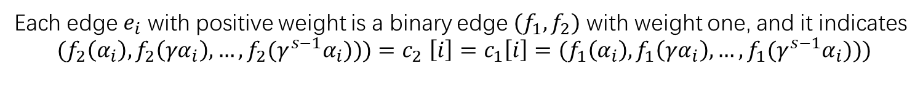

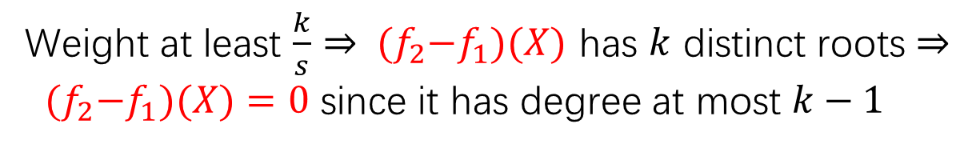
$$L=1$$
Each edge $e_{i}$ with positive weight is a binary edge ${(f}_{1},f_{2})$ with weight one, and it indicates
$$(f_{2}\left(α_{i}\right),f_{2}\left(γα_{i}\right),…,f_{2}(γ^{s−1}α_{i}))){=c}_{2}\left[i\right]=c_{1}\left[i\right]=(f_{1}\left(α_{i}\right),f_{1}\left(γα_{i}\right),…,f_{1}(γ^{s−1}α_{i})))$$
$α_{i},γα_{i},…,γ^{s−1}α_{i}$ are $s$ distinct roots of${ (f}_{2}−f_{1})(X)$
Weight at least $\frac{k}{s}⇒$ ${ (f}_{2}−f_{1})(X)$ has $k$ distinct roots $⇒$
${ (f}_{2}−f_{1})(X)=0$ since it has degree at most $k−1$
$c_{2}=c_{1}$, contradiction.

Slide 17
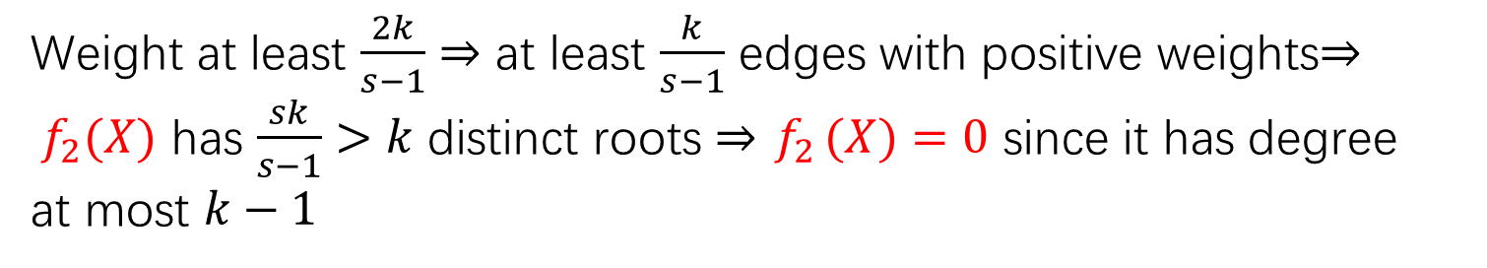
$$L=2$$
Simple case: The three polynomials are co-linear$f_{1}\left(X\right)=0,f_{2}\left(X\right),f_{3}\left(X\right)=af_{2}\left(X\right),a≠0,1$
Each edge $e_{i}$ with positive weight has weight at most two, and it gives $s$ distinct roots of${ f}_{2} (X)$
Weight at least $\frac{2k}{s−1}⇒$ at least $\frac{k}{s−1}$ edges with positive weights$⇒$
${ f}_{2}(X)$ has $\frac{sk}{s−1}>k$ distinct roots $⇒{ f}_{2}(X)=0$ since it has degree
at most $k−1$
hard case: The three polynomials are$f_{1}\left(X\right)=0,f_{2}\left(X\right),f_{3}\left(X\right)$ are two linearly-independent
Polynomials (when regarding them as length-$k$ coefficient vectors).

Slide 18
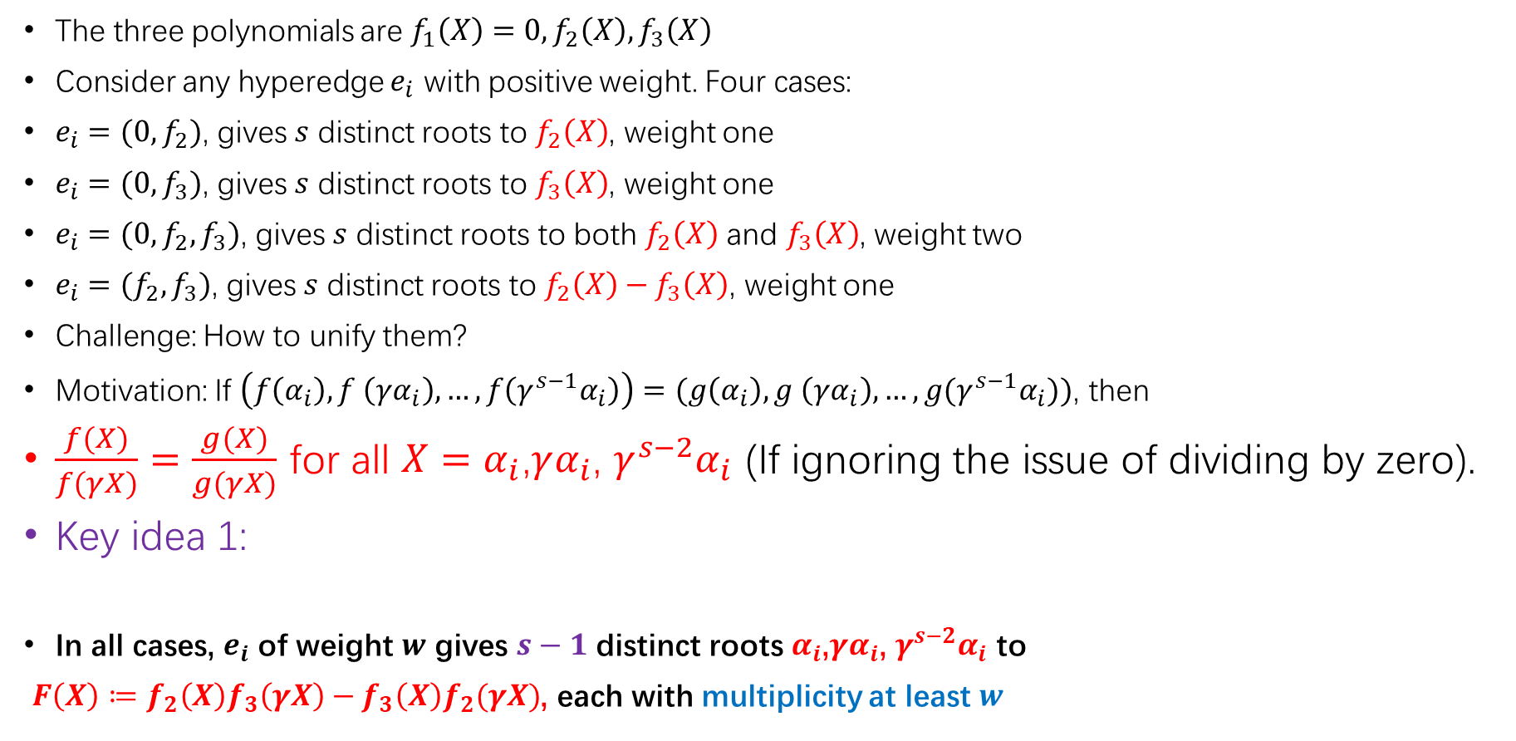
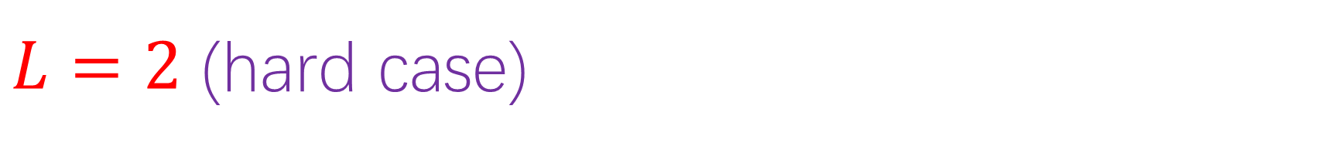
$L=2$ (hard case)
The three polynomials are$f_{1}\left(X\right)=0,f_{2}\left(X\right),f_{3}\left(X\right)$
Consider any hyperedge $e_{i}$ with positive weight. Four cases:
$e_{i}=(0,f_{2})$, gives $s$ distinct roots to $f_{2}\left(X\right)$, weight one
$e_{i}=(0,f_{3})$, gives $s$ distinct roots to $f_{3}\left(X\right)$, weight one
$e_{i}=(0,f_{2},f_{3})$, gives $s$ distinct roots to both $f_{2}\left(X\right)$ and $f_{3}\left(X\right)$, weight two
$e_{i}=(f_{2},f_{3})$, gives $s$ distinct roots to $f_{2}\left(X\right)−f_{3}\left(X\right)$, weight one
Challenge: How to unify them?
Motivation: If $\left(f\left(α_{i}\right),f \left(γα_{i}\right),…, f\left(γ^{s−1}α_{i}\right)\right)=(g\left(α_{i}\right),g \left(γα_{i}\right),…,g(γ^{s−1}α_{i}))$, then
$\frac{f(X)}{f(γX)}=\frac{g(X)}{g(γX)}$ for all $X=α_{i}$,$γα_{i}$, $γ^{s−2}α_{i}$ (If ignoring the issue of dividing by zero).
Key idea 1:
In all cases, $e_{i}$ of weight $w$ gives $s−1$ distinct roots $α_{i}$,$γα_{i}$, $γ^{s−2}α_{i}$ to
${F\left(X\right)≔f}_{2}\left(X\right)f_{3}\left(γX\right)−f_{3}\left(X\right)f_{2}(γX)$, each with multiplicity at least $w$

Slide 19
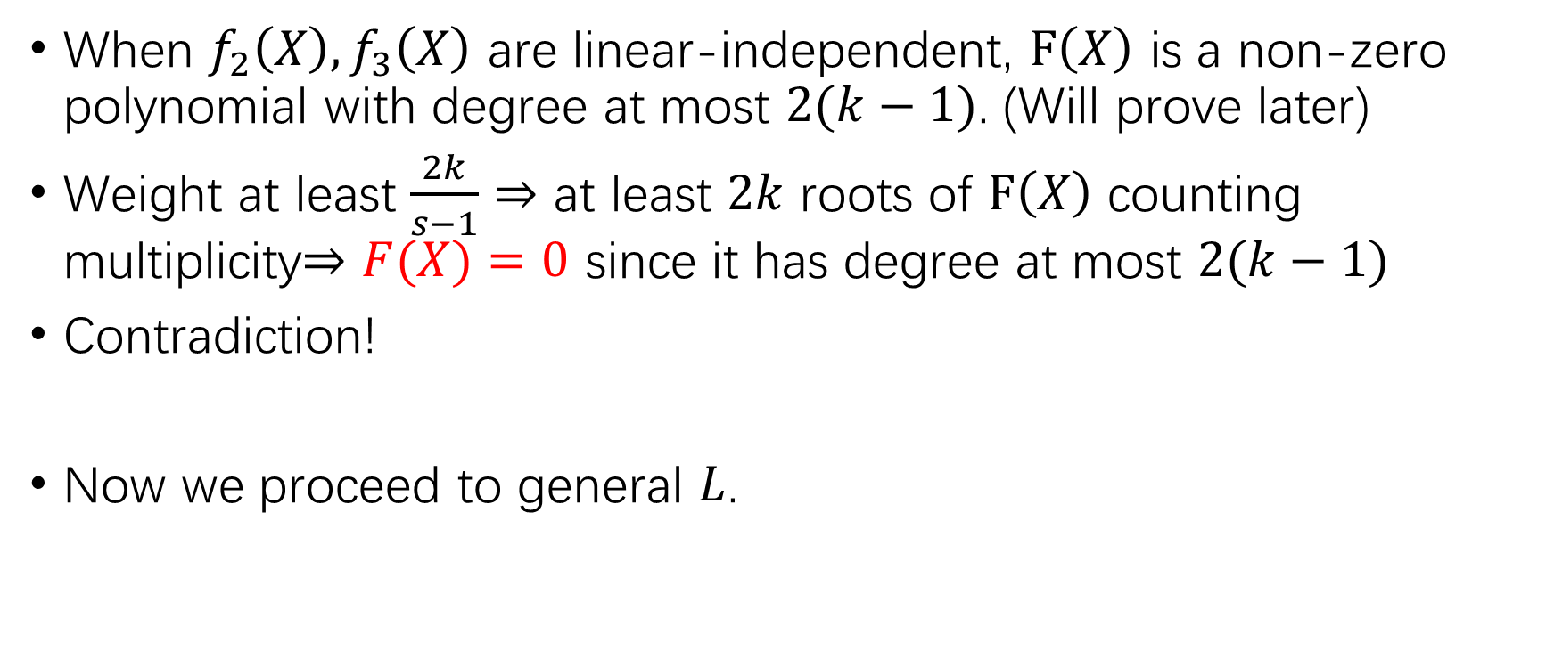
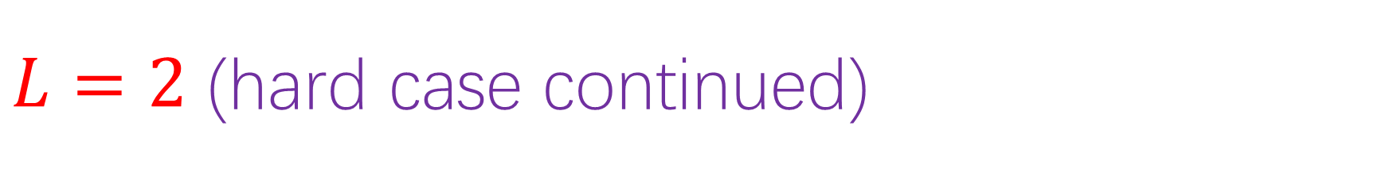
$L=2$ (hard case continued)
When $f_{2}\left(X\right),f_{3}\left(X\right)$ are linear-independent, $F\left(X\right)$ is a non-zero polynomial with degree at most $2(k−1)$. (Will prove later)
Weight at least $\frac{2k}{s−1}⇒$ at least $2k$ roots of $F\left(X\right)$ counting multiplicity$⇒F(X)=0$ since it has degree at most $2(k−1)$
Contradiction!
Now we proceed to general $L$.

Slide 20
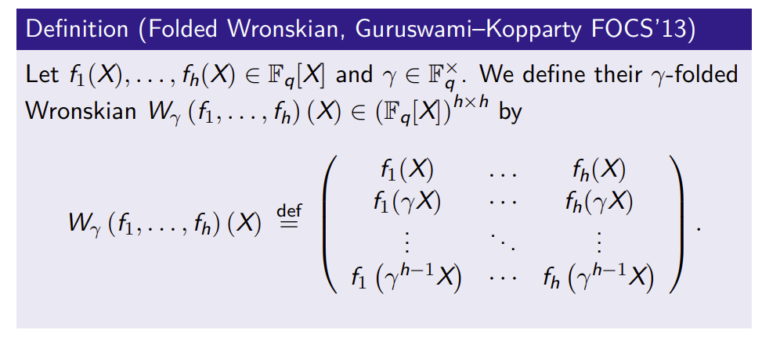
Folded Wronskian Matrix
Fact: If $f_{1},f_{2},…,f_{h}$ are linear-independent, then the Wronskian matrix has full rank
(regarded as matrix over the fractional functional field $F_{q}(X)$) (Will prove at the end of the talk)

Slide 21
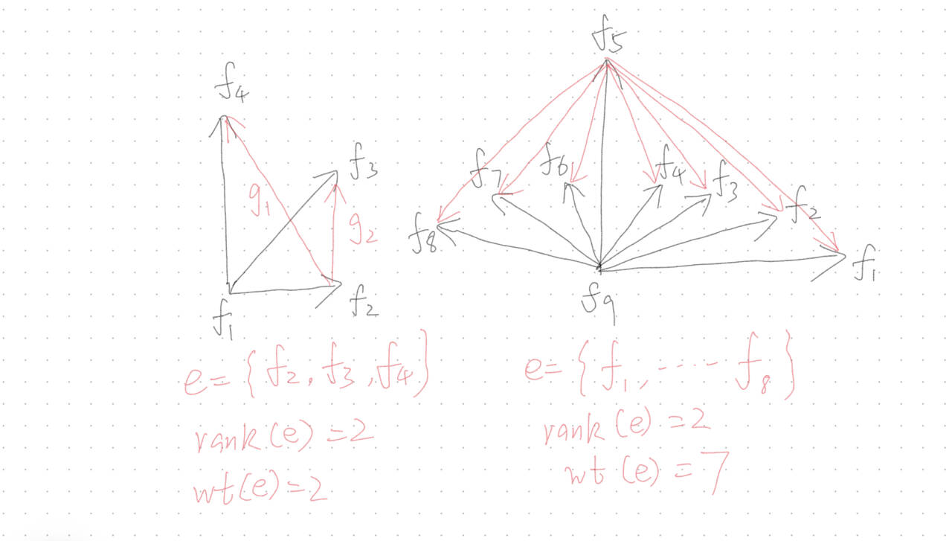

The polynomials are$f_{1}\left(X\right),f_{2}\left(X\right),f_{3}\left(X\right),…,$ $f_{L}\left(X\right),f_{L+1}\left(X\right)=0$.
Let $l≤L$ denote the dimension of $Span(f_{1}\left(X\right),f_{2}\left(X\right),f_{3}\left(X\right),…, f_{L}\left(X\right),f_{L+1}\left(X\right))$ (Regarded as coefficient vectors). Without loss of generality, let $f_{1}\left(X\right),f_{2}\left(X\right),…, f_{l}\left(X\right)$ be a basis.
Let $F(X)$ denote the determinant of folded Wronskian matrix of $f_{1}\left(X\right),f_{2}\left(X\right),…, f_{l}\left(X\right)$, we know $F(X)$ is a non-zero polynomial with degree at most $l(k−1)$.
Consider any hyperedge $e_{i}=(f_{i_{0}},f_{i_{2}},…,f_{i_{t}})$ with weight $t$. Let$g_{j}=f_{i_{j}}−f_{i_{0}}$, then we define the rank of $e_{i}$ as $rank(g_{1},…,g_{t})$.
In fact, it is equivalent to “rank of the star”:

Slide 22
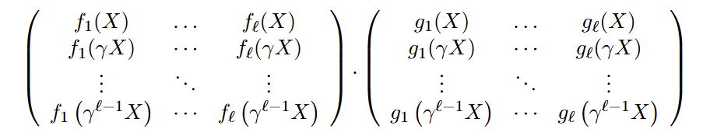
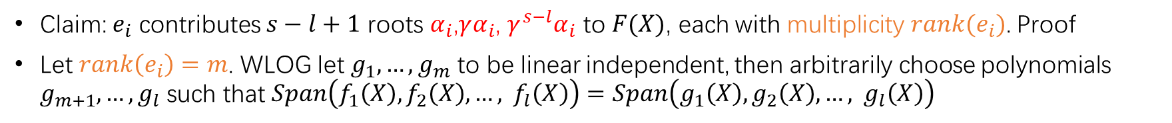
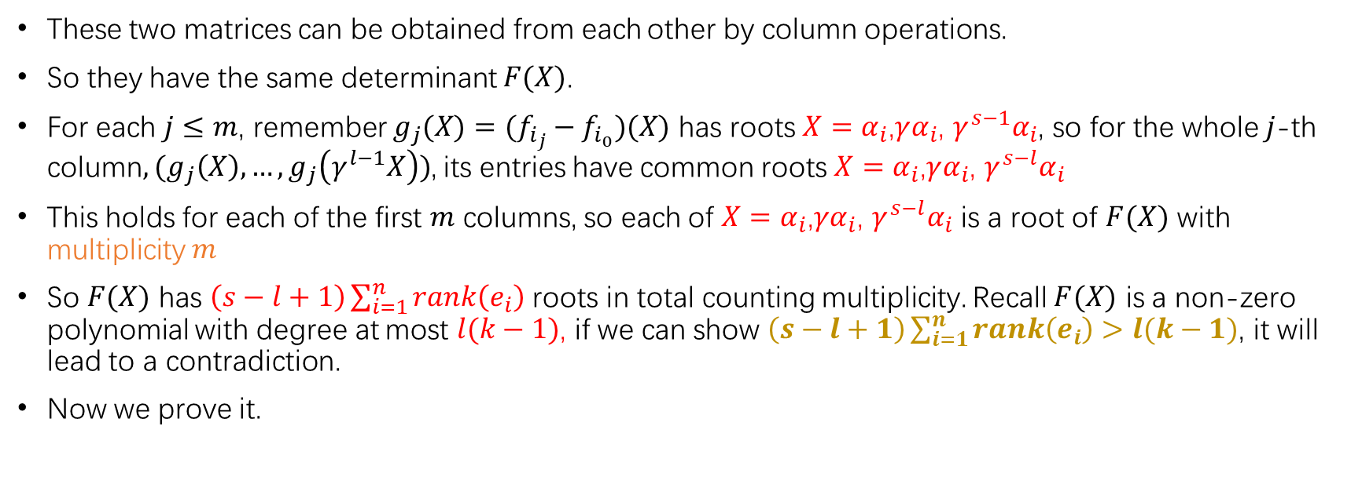
Claim: $e_{i}$ contributes $s−l+1$ roots $α_{i}$,$γα_{i}$, $γ^{s−l}α_{i}$ to $F(X)$, each with multiplicity $rank(e_{i})$. Proof
Let $rank\left(e_{i}\right)=m$. WLOG let $g_{1},…,g_{m}$ to be linear independent, then arbitrarily choose polynomials $g_{m+1},…,g_{l}$ such that $Span\left(f_{1}\left(X\right),f_{2}\left(X\right),…, f_{l}\left(X\right)\right)=Span\left(g_{1}\left(X\right),g_{2}\left(X\right),…, g_{l}\left(X\right)\right)$
These two matrices can be obtained from each other by column operations.
So they have the same determinant $F(X)$.
For each $j≤m$, remember $g_{j}(X)=(f_{i_{j}}−f_{i_{0}})(X)$ has roots $X=α_{i}$,$γα_{i}$, $γ^{s−1}α_{i}$, so for the whole $j$-th column$,{(g}_{j}\left(X\right),…,g_{j}\left(γ^{l−1}X\right))$, its entries have common roots $X=α_{i}$,$γα_{i}$, $γ^{s−l}α_{i}$
This holds for each of the first $m$ columns, so each of $X=α_{i}$,$γα_{i}$, $γ^{s−l}α_{i}$ is a root of $F(X)$ with multiplicity $m$
So $F(X)$ has $\left(s−l+1\right)\sum_{i=1}^{n}{rank\left(e_{i}\right)}$ roots in total counting multiplicity. Recall $F(X)$ is a non-zero polynomial with degree at most $l(k−1)$, if we can show $\left(s−l+1\right)\sum_{i=1}^{n}{rank\left(e_{i}\right)>l(k−1)}$, it will lead to a contradiction.
Now we prove it.

Slide 23
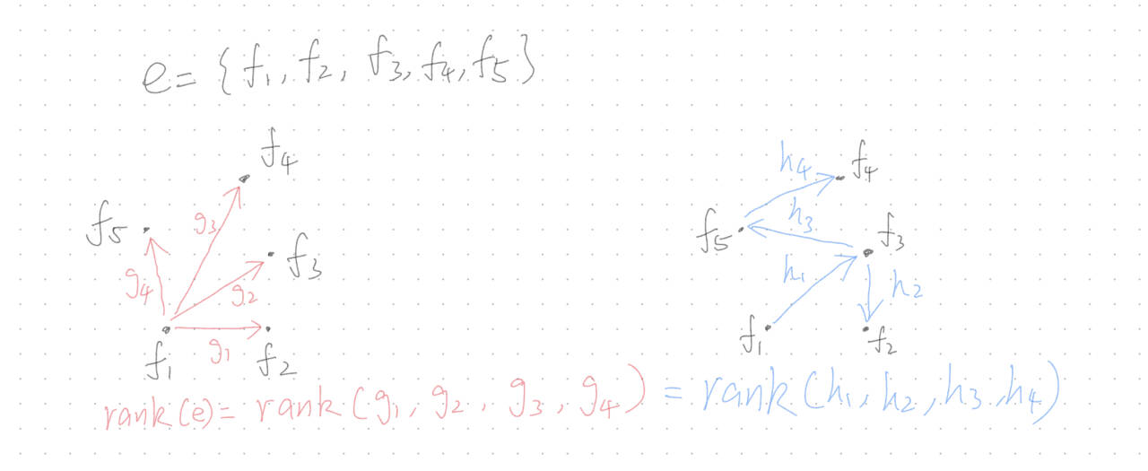
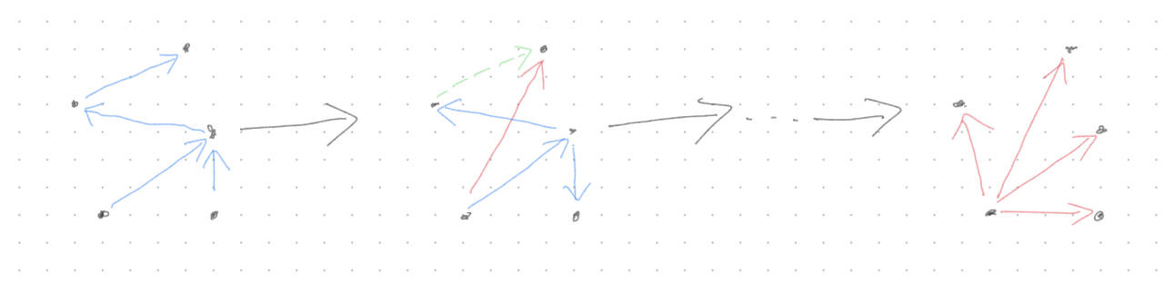

Rank of a hyperedge is independent from spanning trees
For any hyperedge $e_{i}$, the rank computed from any two spanning trees are equal. (Previously we use the star as the canonical tree).

Slide 24
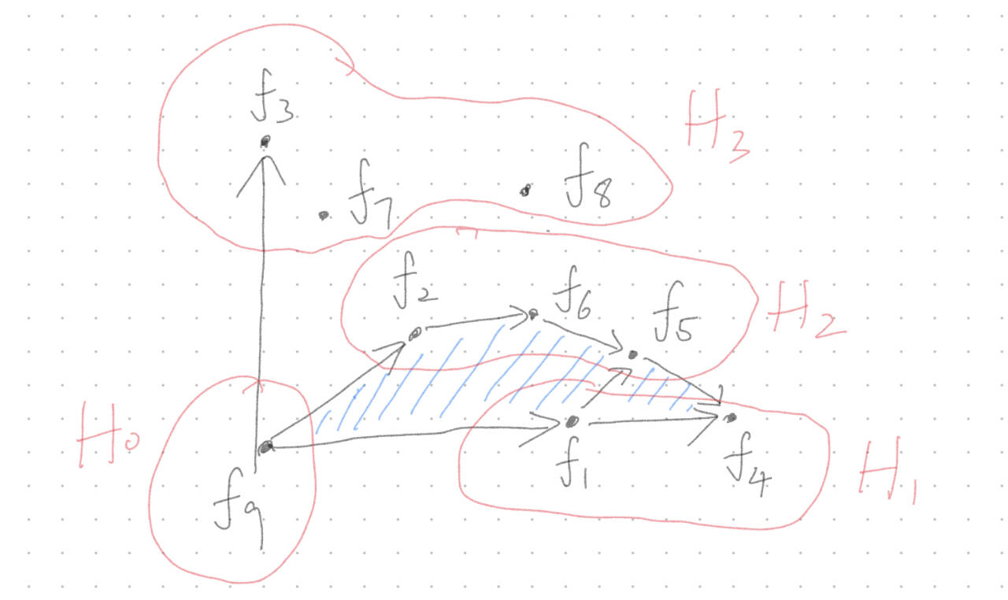
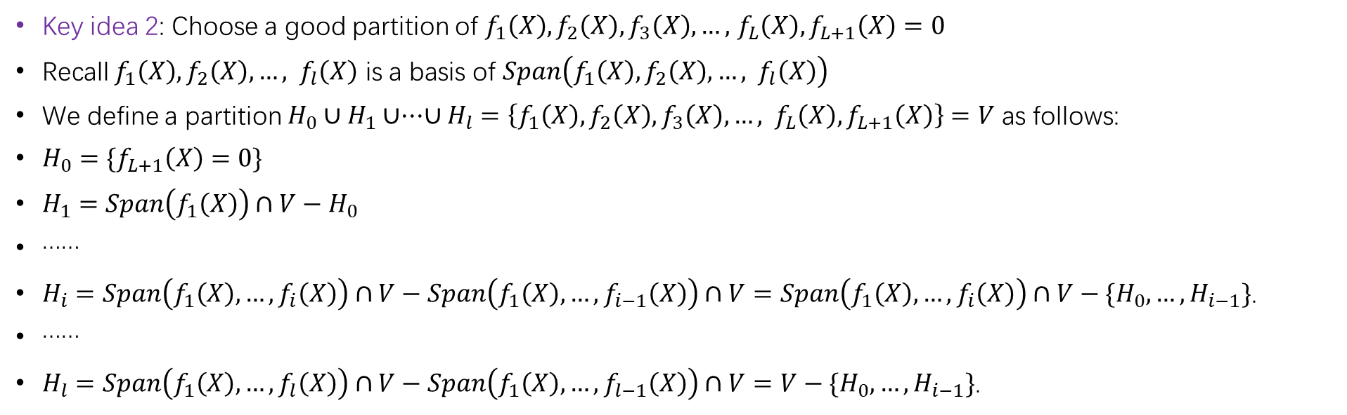
Key idea 2: Choose a good partition of $f_{1}\left(X\right),f_{2}\left(X\right),f_{3}\left(X\right),…,$ $f_{L}\left(X\right),f_{L+1}\left(X\right)=0$
Recall $f_{1}\left(X\right),f_{2}\left(X\right),…, f_{l}\left(X\right)$ is a basis of $Span\left(f_{1}\left(X\right),f_{2}\left(X\right),…, f_{l}\left(X\right)\right)$
We define a partition $H_{0}∪H_{1}∪···∪H_{l}=\left\{f_{1}\left(X\right),f_{2}\left(X\right),f_{3}\left(X\right),…, f_{L}\left(X\right),f_{L+1}\left(X\right)\right\}=V$ as follows:
$H_{0}=\{f_{L+1}\left(X\right)=0\}$
$H_{1}=Span\left(f_{1}\left(X\right)\right)∩V−H_{0}$
……
$H_{i}=Span\left(f_{1}\left(X\right),…,f_{i}\left(X\right)\right)∩V−Span\left(f_{1}\left(X\right),…,f_{i−1}\left(X\right)\right)∩V=Span\left(f_{1}\left(X\right),…,f_{i}\left(X\right)\right)∩V−\{H_{0},…,H_{i−1}\}$.
……
$H_{l}=Span\left(f_{1}\left(X\right),…,f_{l}\left(X\right)\right)∩V−Span\left(f_{1}\left(X\right),…,f_{l−1}\left(X\right)\right)∩V=V−\{H_{0},…,H_{i−1}\}$.

Slide 25
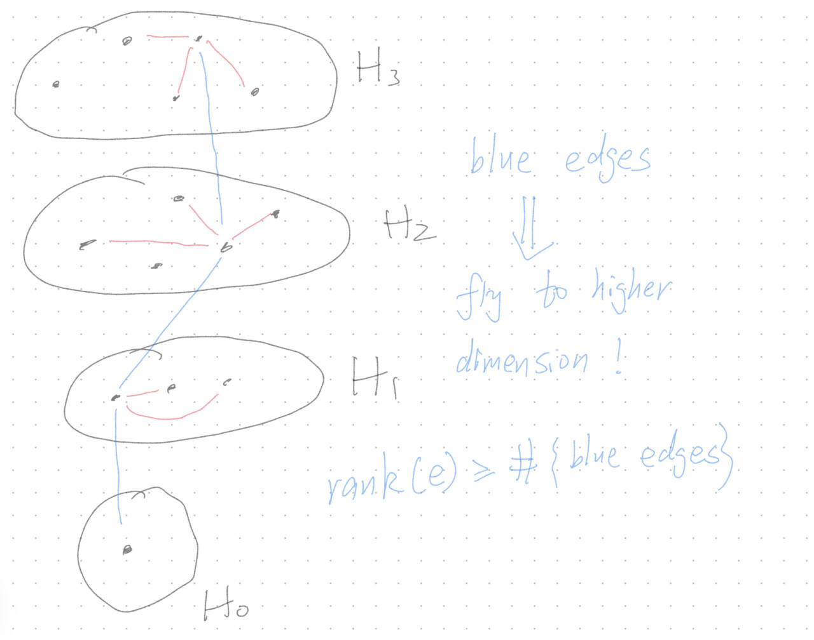
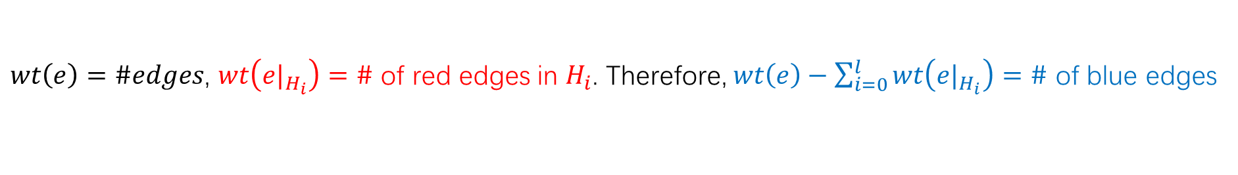
Claim: $rank\left(e\right)≥wt\left(e\right)−\sum_{i=0}^{l}{wt\left(e|_{H_{i}}\right)}$
$wt\left(e\right)=\#edges$, $wt\left(e|_{H_{i}}\right)=\#$ of red edges in $H_{i}$. Therefore, $wt\left(e\right)−\sum_{i=0}^{l}{wt\left(e|_{H_{i}}\right)}=\#$ of blue edges

Slide 26
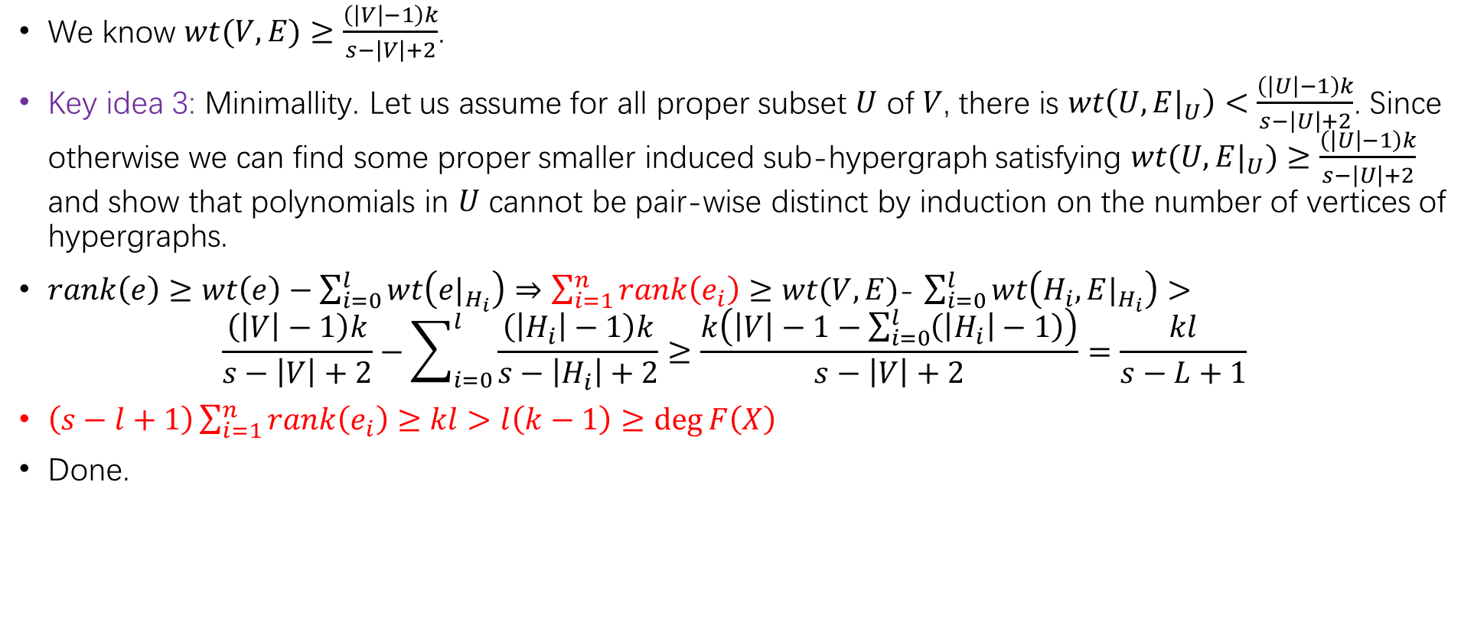
Put them all together
We know $wt(V,E)≥\frac{\left(\left|V\right|−1\right)k}{s−\left|V\right|+2}$.
Key idea 3: Minimallity. Let us assume for all proper subset $U$ of $V$, there is $wt\left(U,E|_{U}\right)<\frac{\left(\left|U\right|−1\right)k}{s−\left|U\right|+2}$. Since otherwise we can find some proper smaller induced sub-hypergraph satisfying $wt(U,E|_{U})≥\frac{\left(\left|U\right|−1\right)k}{s−\left|U\right|+2}$ and show that polynomials in $U$ cannot be pair-wise distinct by induction on the number of vertices of hypergraphs.
$rank\left(e\right)≥wt\left(e\right)−\sum_{i=0}^{l}{wt\left(e|_{H_{i}}\right)}⇒\sum_{i=1}^{n}{rank\left(e_{i}\right)}≥$ $wt(V,E)$- $\sum_{i=0}^{l}{wt\left(H_{i},E|_{H_{i}}\right)}>$
$$\frac{\left(\left|V\right|−1\right)k}{s−\left|V\right|+2}−\sum_{i=0}^{l}{\frac{\left(\left|H_{i}\right|−1\right)k}{s−\left|H_{i}\right|+2}}≥\frac{k\left(\left|V\right|−1−\sum_{i=0}^{l}{\left(\left|H_{i}\right|−1\right)}\right)}{s−\left|V\right|+2}=\frac{kl}{s−L+1}$$
$\left(s−l+1\right)\sum_{i=1}^{n}{rank\left(e_{i}\right)}≥kl>l\left(k−1\right)≥\deg{F\left(X\right)}$
Done.

Slide 27
Appendix
Fact: If $f_{1},f_{2},…,f_{h}$ are linear-independent, then the Wronskian matrix has full rank

Slide 28
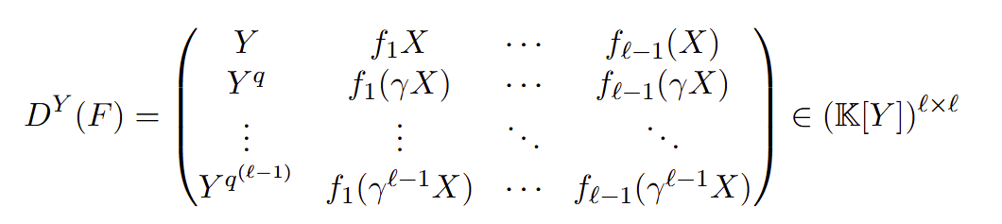
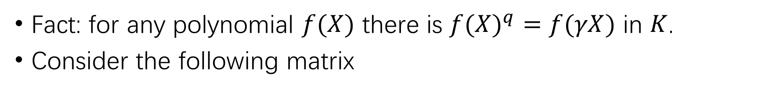
Proof:
https://www.cnblogs.com/Elegia/p/18738181/wronskian by Baitian Li
My easy proof: Induction on the size.
Fact: for any polynomial $f(X)$ there is ${f(X)}^{q}=f(γX)$ in $K$.
Consider the following matrix

Slide 29
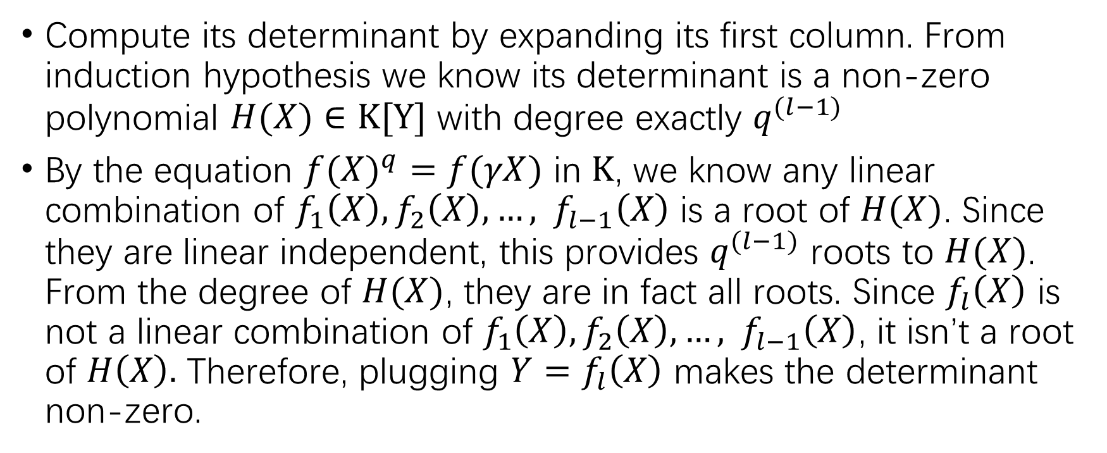
Compute its determinant by expanding its first column. From induction hypothesis we know its determinant is a non-zero polynomial $H(X)∈K[Y]$ with degree exactly $q^{(l−1)}$
By the equation ${f(X)}^{q}=f(γX)$ in $K$, we know any linear combination of $f_{1}\left(X\right),f_{2}\left(X\right),…, f_{l−1}\left(X\right)$ is a root of $H(X)$. Since they are linear independent, this provides $q^{(l−1)}$ roots to $H(X)$. From the degree of $H(X)$, they are in fact all roots. Since $f_{l}\left(X\right)$ is not a linear combination of $f_{1}\left(X\right),f_{2}\left(X\right),…, f_{l−1}\left(X\right)$, it isn’t a root of $H\left(X\right).$ Therefore, plugging $Y=f_{l}\left(X\right)$ makes the determinant non-zero.

