Slide 1


Explicit Folded Reed-Solomon and Multiplicity Codes
Achieve Relaxed Generalized Singleton Bounds
Yeyuan Chen
University of Michigan
Zihan Zhang
Ohio State University

Slide 2


A code over an alphabet $Σ$ is a subset $C⊆Σ^{n}$
Rate: $R=\frac{\log_{\left|Σ\right|}\left(\left|C\right|\right)}{n}= \frac{log|C|}{nlog\left|Σ\right|}$
Minimum (Relative) Distance: $δ\left(C\right)=\min_{x≠y∈C}(d(x,y)/n)$
Trade-off: Singleton Bound (1964): $δ≤1−R$

Slide 3
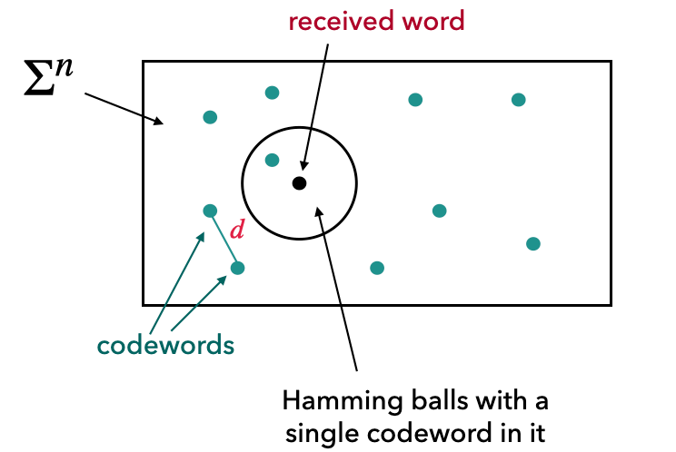
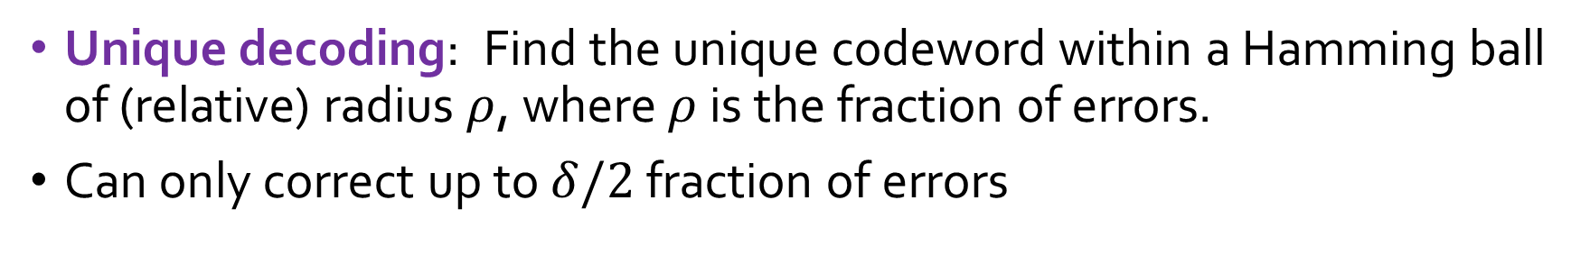
Unique decoding: Find the unique codeword within a Hamming ball of (relative) radius $ρ$, where $ρ$ is the fraction of errors.
Can only correct up to $δ/2$ fraction of errors

Slide 4
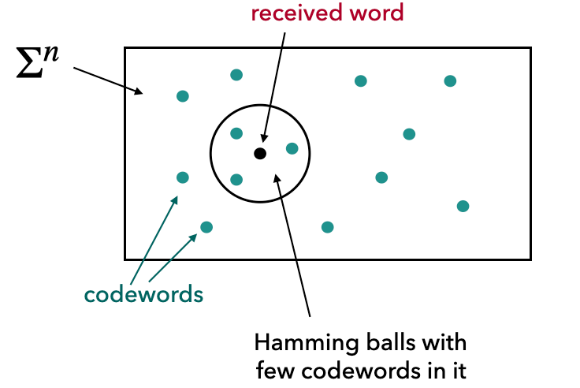
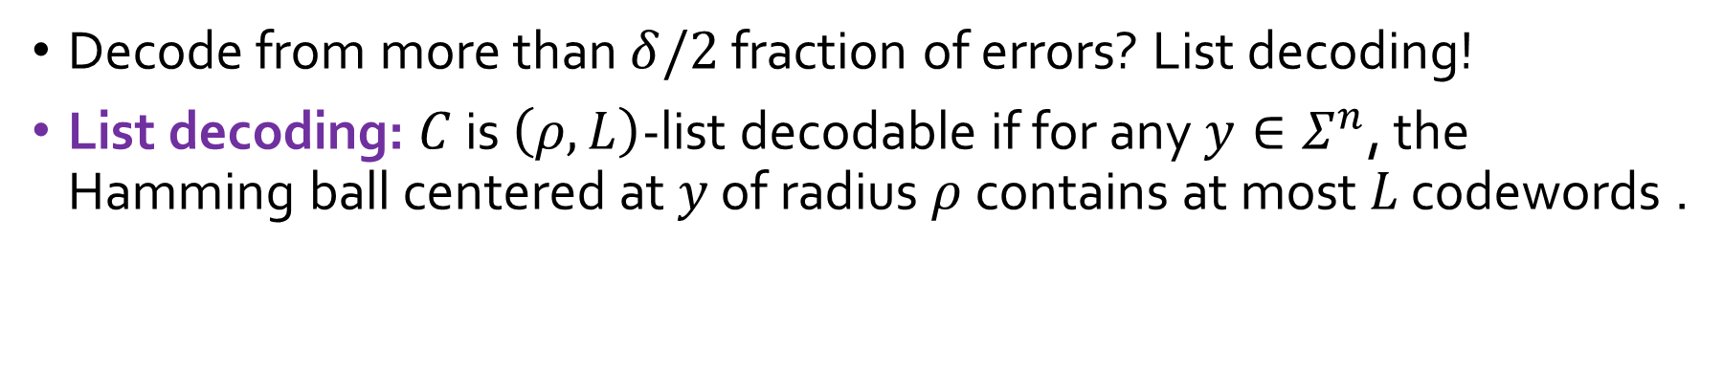
Decode from more than $δ/2$ fraction of errors? List decoding!
List decoding: $C$ is $\left(ρ,L\right)$-list decodable if for any $y∈Σ^{n}$, the Hamming ball centered at $y$ of radius $ρ$ contains at most $L$ codewords .

Slide 5
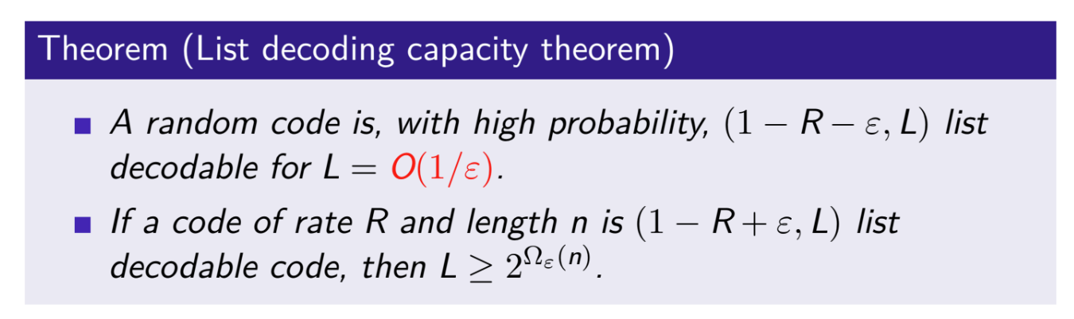
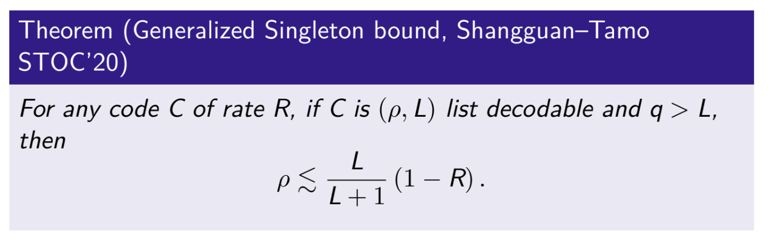
$\left(1−R−ε,O(1/ε)\right)$ is optimal:

Slide 6

Main Result 1
Question: Do there exist explicit $\left(1−R−ε,O(1/ε)\right)$ list decodable codes?
Answer: (Chen–Zhang ’25): Yes, explicit folded Reed-Solomon codes and multiplicity codes are $\left(1−R−ε,O(1/ε)\right)$ list decodable.

Slide 7
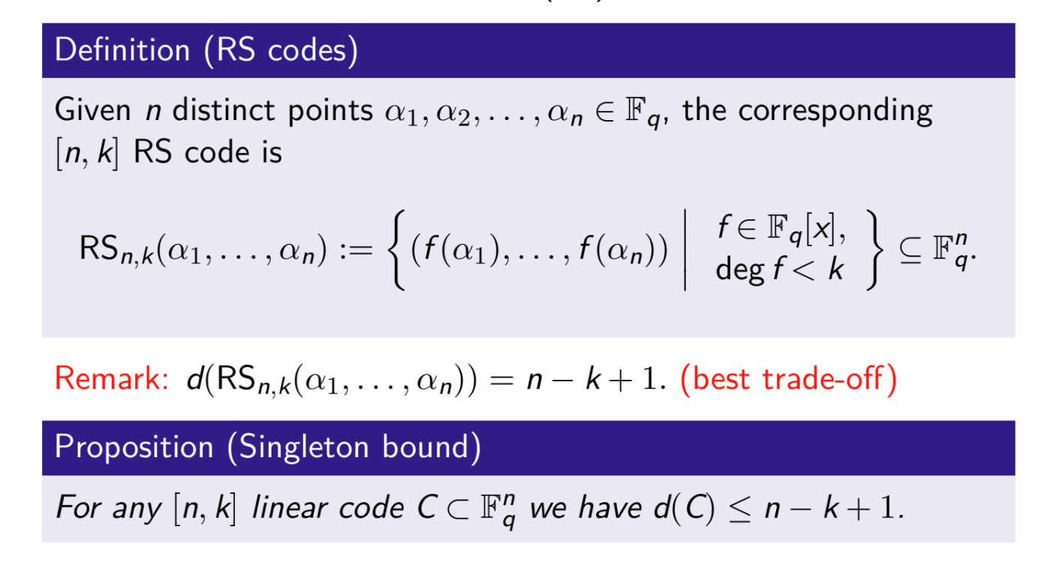

Slide 8
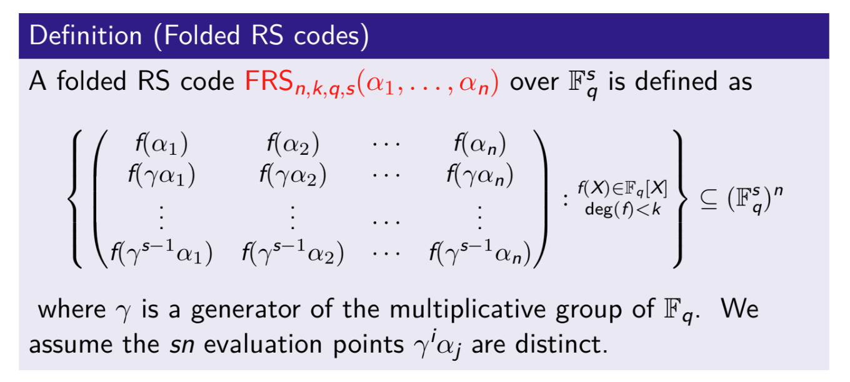

Slide 9
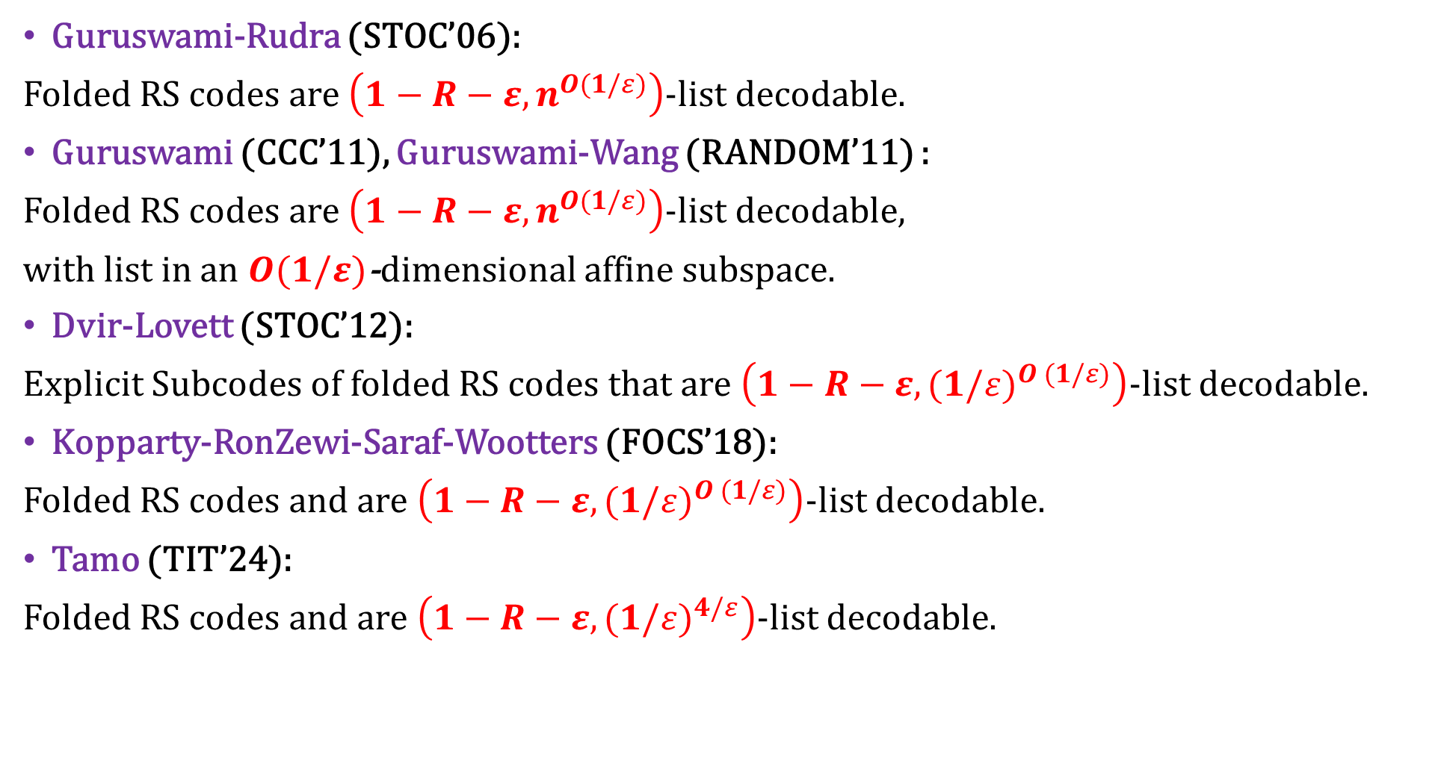
Guruswami-Rudra (STOC’06):
Folded RS codes are $\left(1−R−ε,n^{O(1/ε)}\right)$-list decodable.
Guruswami (CCC’11), Guruswami-Wang (RANDOM’11) :
Folded RS codes are $\left(1−R−ε,n^{O(1/ε)}\right)$-list decodable,
with list in an $O(1/ε)$-dimensional affine subspace.
Dvir-Lovett (STOC’12):
Explicit Subcodes of folded RS codes that are $\left(1−R−ε,{(1/ε)}^{O (1/ε)}\right)$-list decodable.
Kopparty-RonZewi-Saraf-Wootters (FOCS’18):
Folded RS codes and are $\left(1−R−ε,{(1/ε)}^{O (1/ε)}\right)$-list decodable.
Tamo (TIT’24):
Folded RS codes and are $\left(1−R−ε,{(1/ε)}^{4/ε}\right)$-list decodable.

Slide 10
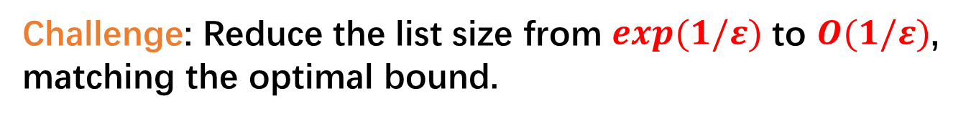
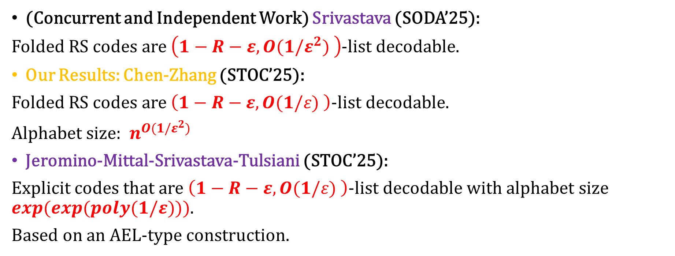
Challenge: Reduce the list size from $exp⁡(1/ε)$ to $O(1/ε)$,
matching the optimal bound.
(Concurrent and Independent Work) Srivastava (SODA’25):
Folded RS codes are $\left(1−R−ε,O(1/ε^{2}) \right)$-list decodable.
Our Results: Chen-Zhang (STOC’25):
Folded RS codes are $\left(1−R−ε,O(1/ε) \right)$-list decodable.
Alphabet size: $n^{O(1/ε^{2})}$
Jeromino-Mittal-Srivastava-Tulsiani (STOC’25):
Explicit codes that are $\left(1−R−ε,O(1/ε) \right)$-list decodable with alphabet size $exp⁡(exp⁡(poly(1/ε)))$.
Based on an AEL-type construction.

Slide 11
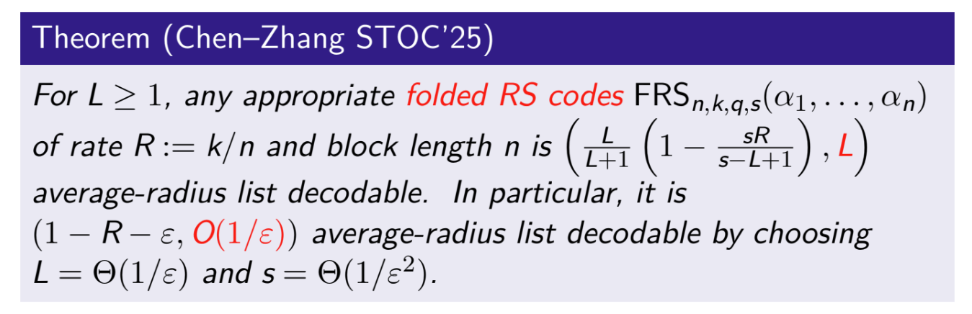

Slide 12
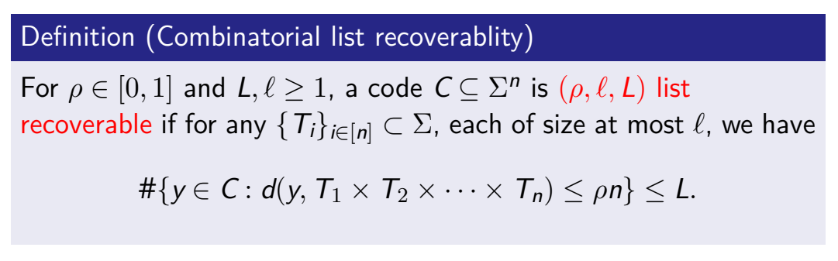
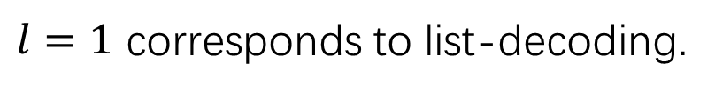
List Recovery
$l=1$ corresponds to list-decoding.
Application: equivalent to condenser (used to construct randomness extractor)
up to some parameter loss [GUV07], and more.

Slide 13
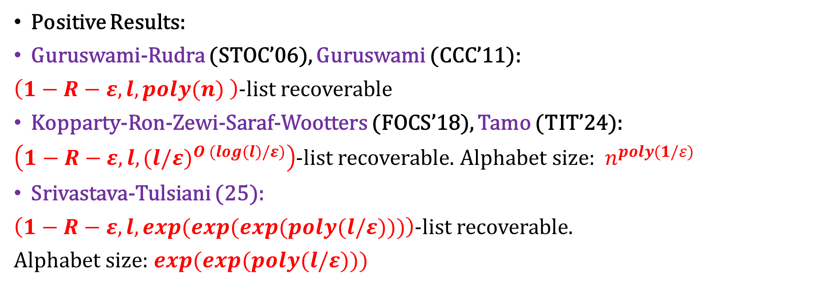
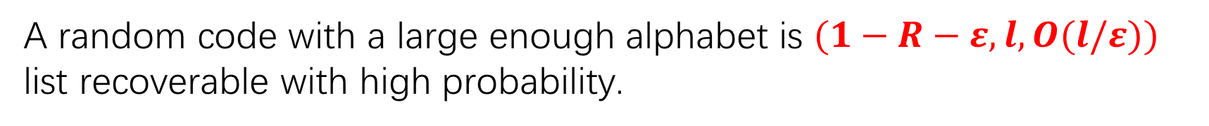
A random code with a large enough alphabet is $(1−R−ε, l,O(l/ε))$ list recoverable with high probability.
Central Open Problem: How to explicit construct such a code?
Positive Results:
Guruswami-Rudra (STOC’06), Guruswami (CCC’11):
$\left(1−R−ε,l,poly(n) \right)$-list recoverable
Kopparty-Ron-Zewi-Saraf-Wootters (FOCS’18), Tamo (TIT’24):
$\left(1−R−ε,{l,(l/ε)}^{O (log(l)/ε)}\right)$-list recoverable. Alphabet size: $n^{poly(1/ε)}$
Srivastava-Tulsiani (25):
$\left(1−R−ε,l,exp(exp(exp(poly(l/ε)))\right)$-list recoverable.
Alphabet size: $exp⁡(exp⁡(poly(l/ε)))$

Slide 14
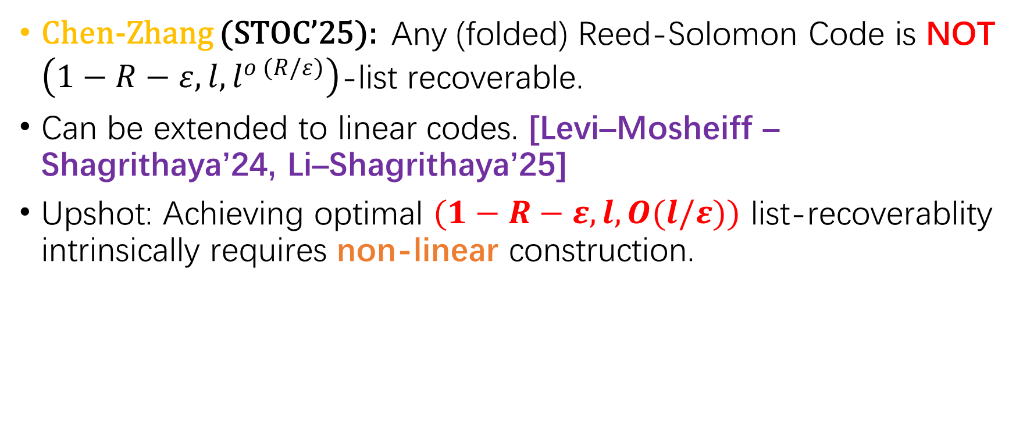
Main Result 2
Chen-Zhang (STOC’25): Any (folded) Reed-Solomon Code is NOT $\left(1−R−ε,{l,l}^{o (R/ε)}\right)$-list recoverable.
Can be extended to linear codes. [Levi–Mosheiff – Shagrithaya’24, Li–Shagrithaya’25]
Upshot: Achieving optimal $(1−R−ε, l,O(l/ε))$ list-recoverablity intrinsically requires non-linear construction.

Slide 15
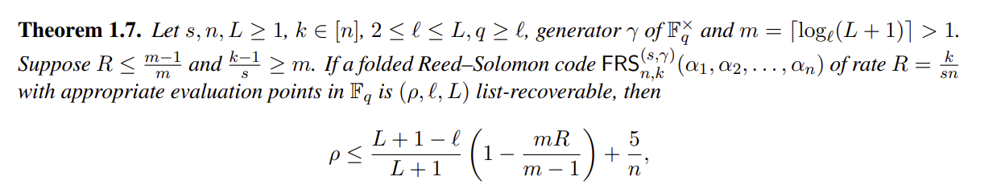
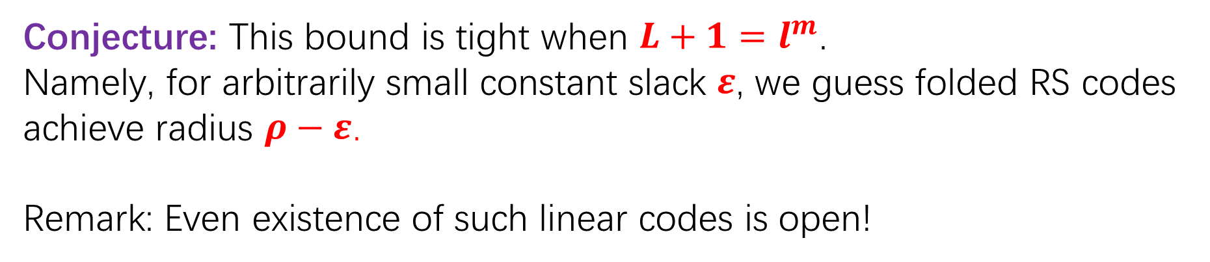

Conjecture: This bound is tight when $L+1=l^{m}$.
Namely, for arbitrarily small constant slack $ε$, we guess folded RS codes
achieve radius $ρ−ε$.
Remark: Even existence of such linear codes is open!
The smallest non-trivial case $l=2, L=3$ is confirmed in our paper.
Other cases are either open or corollaries of known list-decoding results

Slide 16
Proof Sketch of Main Result 1

Slide 17
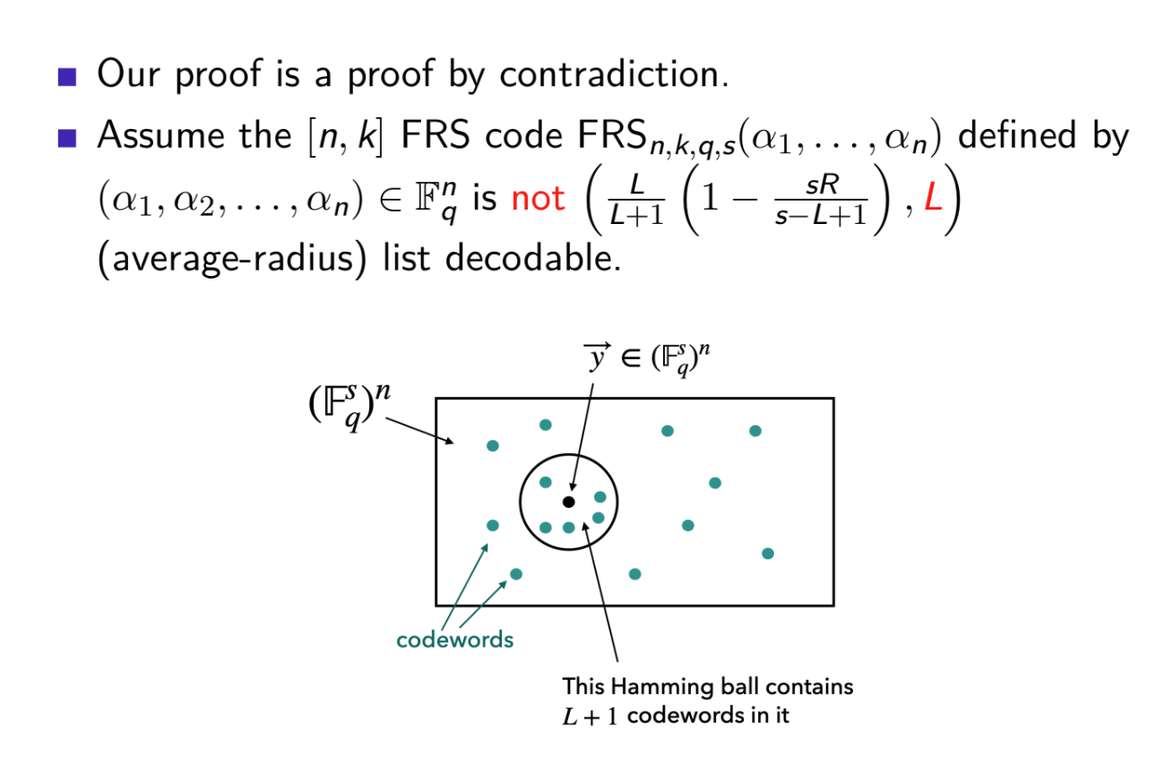

Slide 18
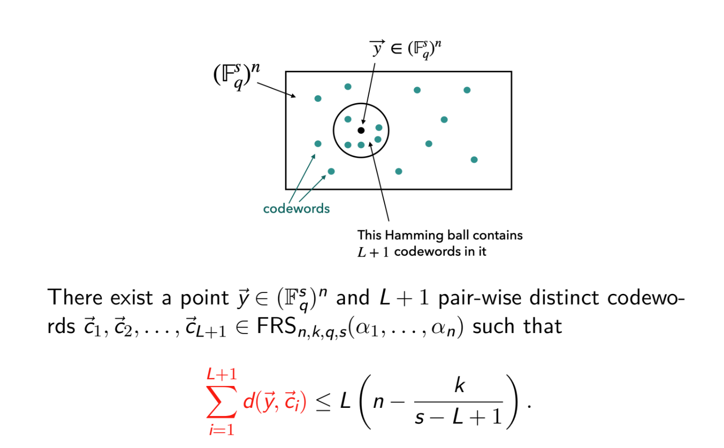

Slide 19
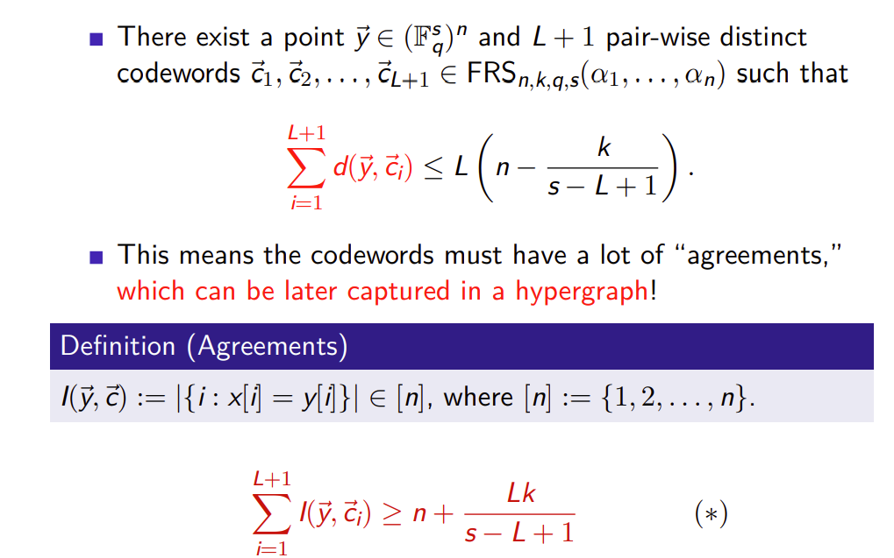

Slide 20
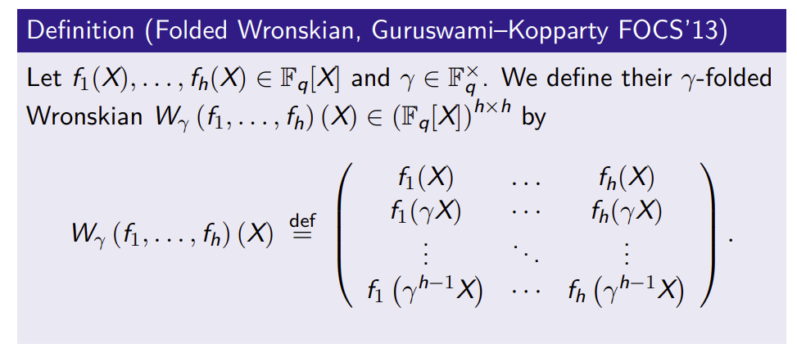
Folded Wronskian Matrix
Fact: If $f_{1},f_{2},…,f_{h}$ are linearly independent, then the determinant of their Wronskian matrix
is a non-zero polynomial with degree at most $h(k−1)$.

Slide 21
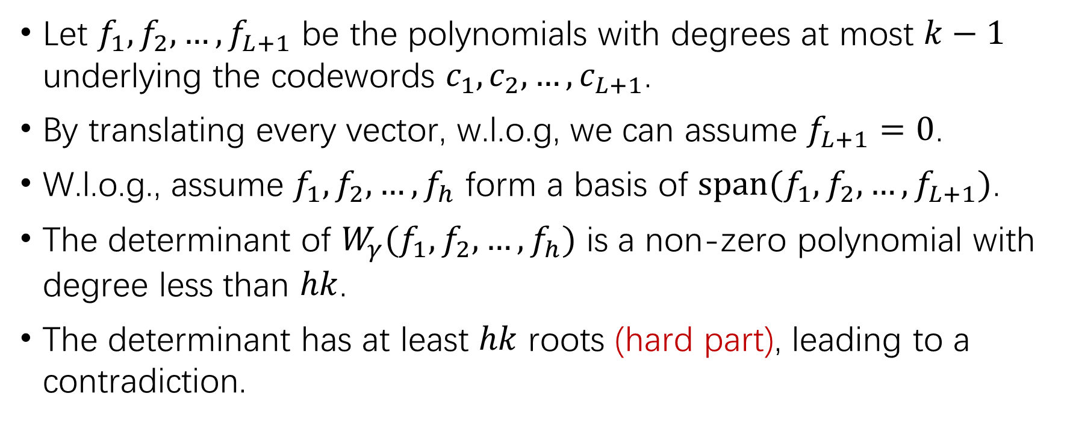
Proof Sketch
Let $f_{1},f_{2},…,f_{L+1}$ be the polynomials with degrees at most $k−1$ underlying the codewords $c_{1},c_{2},…,c_{L+1}$.
By translating every vector, w.l.o.g, we can assume $f_{L+1}=0$.
W.l.o.g., assume $f_{1},f_{2},…,f_{h}$ form a basis of $span{(f}_{1},f_{2},…,f_{L+1})$.
The determinant of $W_{γ}(f_{1},f_{2},…,f_{h})$ is a non-zero polynomial with degree less than $hk$.
The determinant has at least $hk$ roots (hard part), leading to a contradiction.

Slide 22
Thank You!

