Slide 1
Explicit Unique-neighbor Expanders
Yeyuan Chen
University of Michigan
Explicit two-sided unique-neighbor expanders Hsieh,McKenzie,Mohanty,Paredes STOC24
Unique-neighbor Expanders with Better Expansion Chen SODA25
for Polynomial-sized Sets
Explicit Two-Sided Vertex Expanders Beyond the Hsieh,Lin,Mohanty,O’Donnell,Zhang STOC25
Spectral Barrier

Slide 2


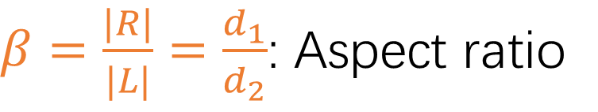
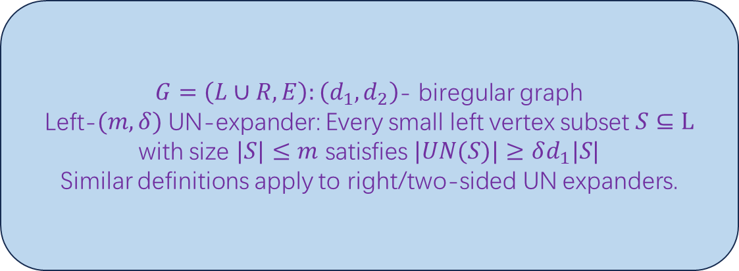
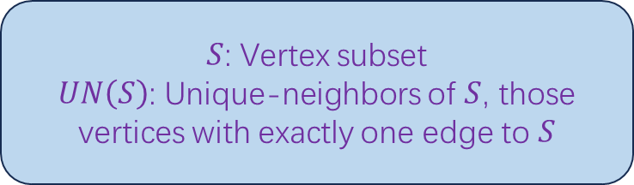
Unique-neighbor Expander
$S$: Vertex subset
$UN\left(S\right)$: Unique-neighbors of $S$, those vertices with exactly one edge to $S$
$$UN(S)$$
$$S$$
$G=\left(L∪R,E\right):\left(d_{1},d_{2}\right)$- biregular graph
Left-$(m,δ)$ UN-expander: Every small left vertex subset $S⊆L$ with size $|S|≤m$ satisfies $|UN(S)|≥δd_{1}|S|$
Similar definitions apply to right/two-sided UN expanders.
$β=\frac{|R|}{|L|}=\frac{d_{1}}{d_{2}}$: Aspect ratio

Slide 3










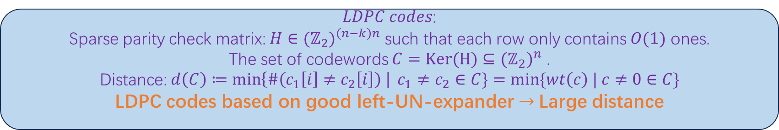














Motivation: One-sided
$LDPC codes$:
Sparse parity check matrix: $H∈{(ℤ_{2})}^{\left(n−k\right)n}$ such that each row only contains $O(1)$ ones.
The set of codewords $C=Ker(H)⊆{(ℤ_{2})}^{n}$ .
Distance: $d\left(C\right)≔\min\left\{\#\left(c_{1}\left[i\right]≠c_{2}\left[i\right]\right) \right| c_{1}≠c_{2}∈C\}=min⁡\{wt\left(c\right) | c≠0∈C\}$
LDPC codes based on good left-UN-expander$→$ Large distance
$$⋮$$
$$n$$
$$0$$
Fail
$$1$$
$$1$$
$$1$$
$$1$$
Fail
$$1$$
$$1$$
$$1$$
$$1$$
$$n−k$$
$$⋱$$
$$⋱$$
$$c$$
$$=0$$
$$n$$
$$1$$
$$n−k$$
$$⋱$$
$$1$$
$$0$$
Fail
$$0$$
$$⋮$$

Slide 4
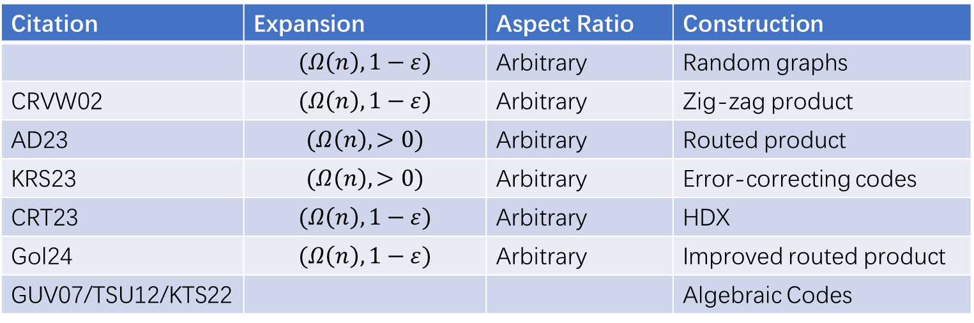
Existence & Construction: One-sided
Citation | Expansion | Aspect Ratio | Construction
 | $$(Ω\left(n\right),1−ε)$$ | Arbitrary | Random graphs
CRVW02 | $$(Ω\left(n\right),1−ε)$$ | Arbitrary | Zig-zag product
AD23 | $$(Ω\left(n\right),>0)$$ | Arbitrary | Routed product
KRS23 | $$(Ω\left(n\right),>0)$$ | Arbitrary | Error-correcting codes
CRT23 | $$(Ω\left(n\right),1−ε)$$ | Arbitrary | HDX
Gol24 | $$(Ω\left(n\right),1−ε)$$ | Arbitrary | Improved routed product
GUV07/TSU12/KTS22 |  |  | Algebraic Codes

Slide 5

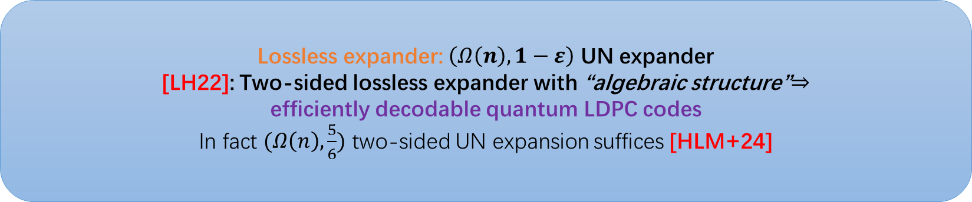

Motivation: Two-sided
Lossless expander: $\left(Ω\left(n\right),1−ε\right)$ UN expander
[LH22]: Two-sided lossless expander with “algebraic structure”$⇒$
efficiently decodable quantum LDPC codes
In fact $(Ω\left(n\right),\frac{5}{6})$ two-sided UN expansion suffices [HLM+24]
$Z$-Parity Checks
$X$-Parity Checks
Codeword

Slide 6
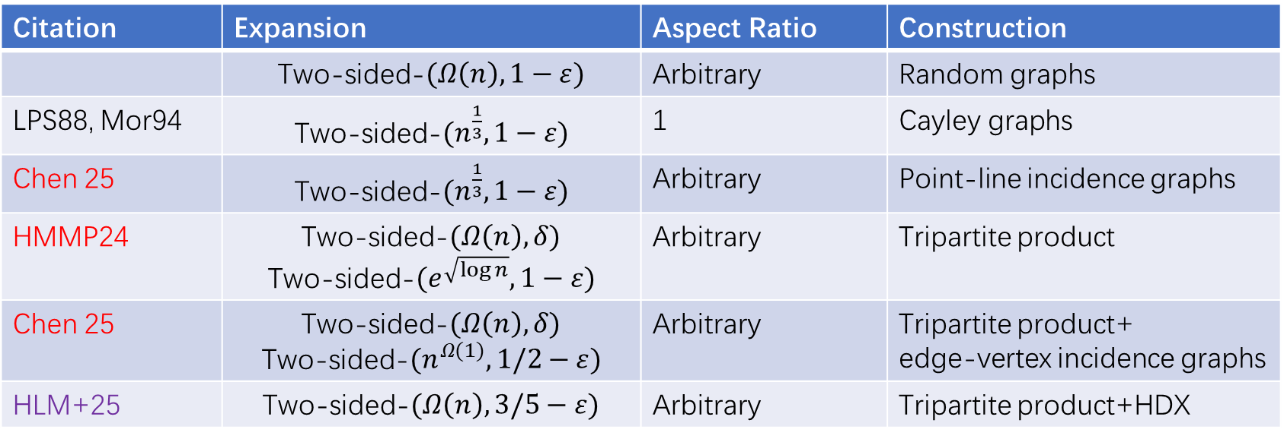
Existence & Construction: Two-sided
Citation | Expansion | Aspect Ratio | Construction
 | Two-sided-$(Ω\left(n\right),1−ε)$ | Arbitrary | Random graphs
LPS88, Mor94 | Two-sided-$(n^{\frac{1}{3}},1−ε)$ | 1 | Cayley graphs
Chen 25 | Two-sided-$(n^{\frac{1}{3}},1−ε)$ | Arbitrary | Point-line incidence graphs
HMMP24 | Two-sided-$(Ω\left(n\right),δ)$ Two-sided-$(e^{\sqrt{\log{n}}},1−ε)$ | Arbitrary | Tripartite product
Chen 25 | Two-sided-$(Ω\left(n\right),δ)$ Two-sided-$(n^{Ω(1)},1/2−ε)$ | Arbitrary | Tripartite product+ edge-vertex incidence graphs
HLM+25 | Two-sided-$(Ω\left(n\right),3/5−ε)$ | Arbitrary | Tripartite product+HDX

Slide 7


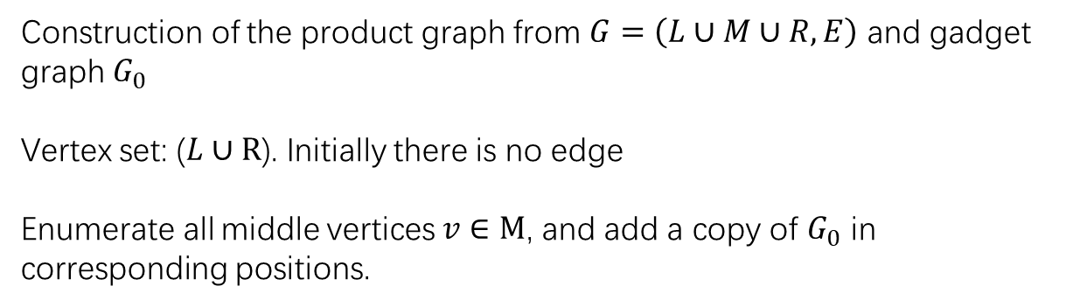

Tripartite Product (from HMMP24)
Construction of the product graph from $G=\left(L∪M∪R,E\right)$ and gadget graph $G_{0}$
Vertex set: ($L∪R$). Initially there is no edge
Enumerate all middle vertices $v∈M$, and add a copy of $G_{0}$ in corresponding positions.
Tripartite Product
$$G_{1}$$
$$G_{2}$$
$G_{1},G_{2}$: Base graphs
Gadget graph: constant size, can behave
like random graphs by bruteforce

Slide 8
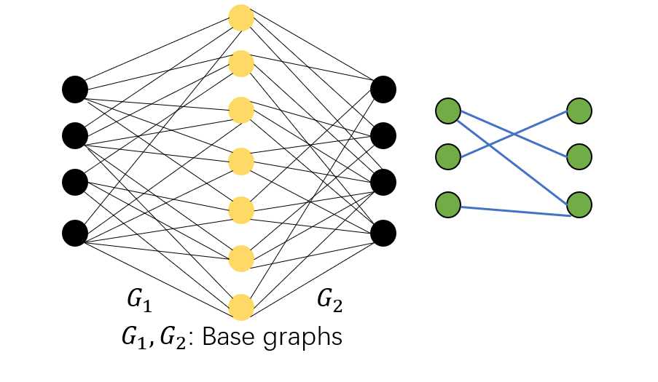
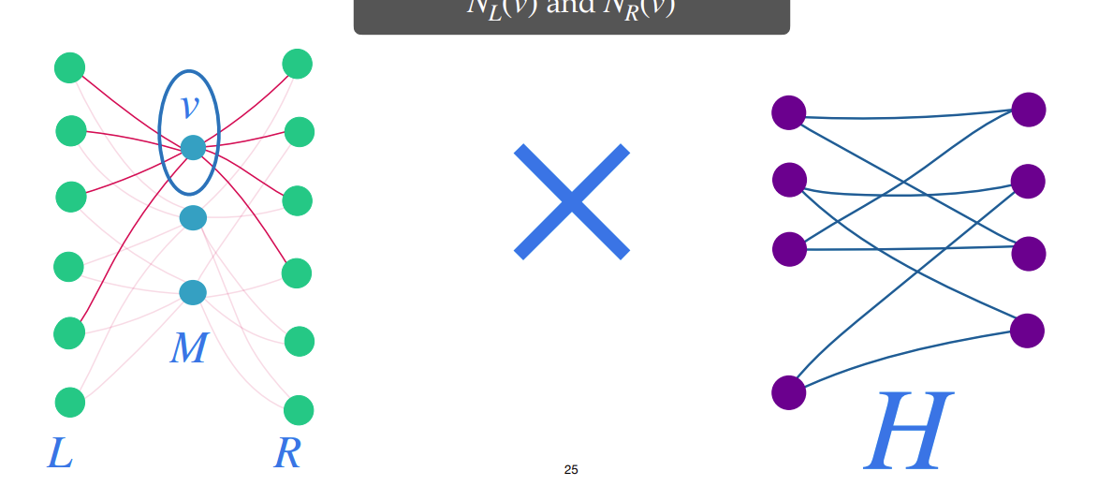
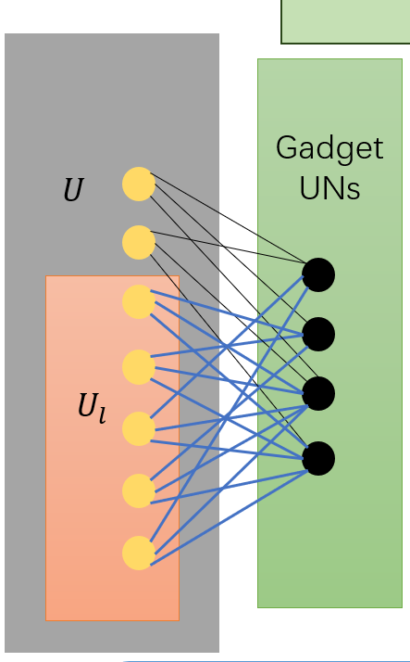
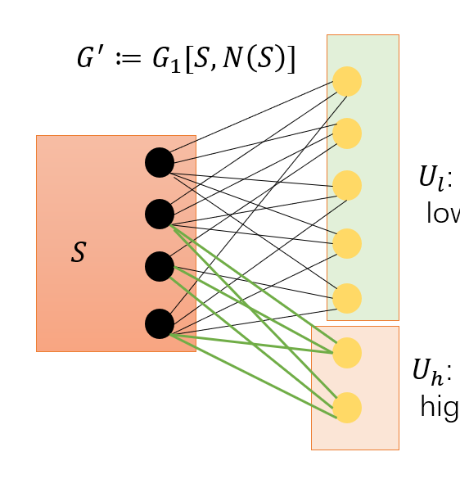
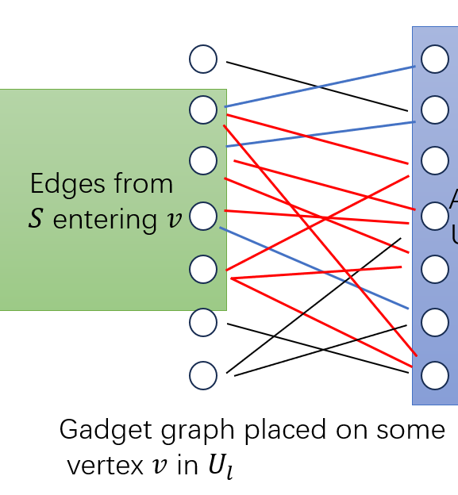
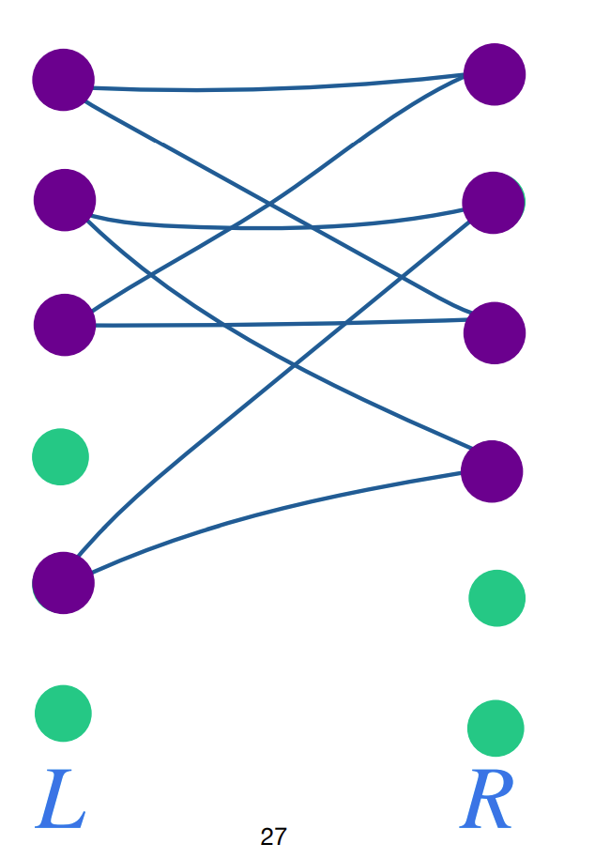
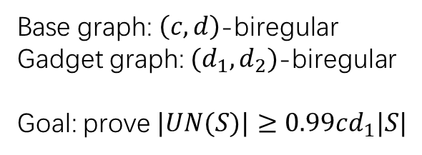
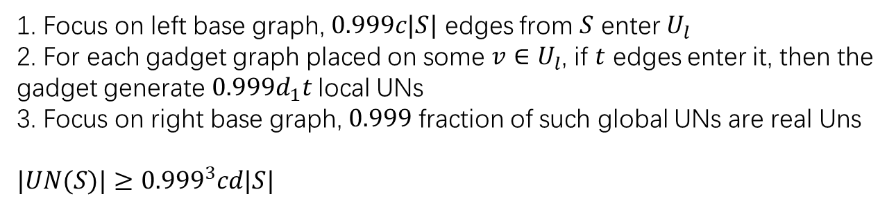
Framework
1. Focus on left base graph, $0.999c|S|$ edges from $S$ enter $U_{l}$
2. For each gadget graph placed on some $v∈U_{l}$, if $t$ edges enter it, then the gadget generate $0.999d_{1}t$ local UNs
3. Focus on right base graph, $0.999$ fraction of such global UNs are real Uns
$|UN(S)|≥{0.999}^{3}cd|S|$
Base graph: $\left(c,d\right)$-biregular
Gadget graph: $(d_{1},d_{2})$-biregular
Goal: prove $|UN(S)|≥0.99cd_{1}|S|$
Right side

Slide 9
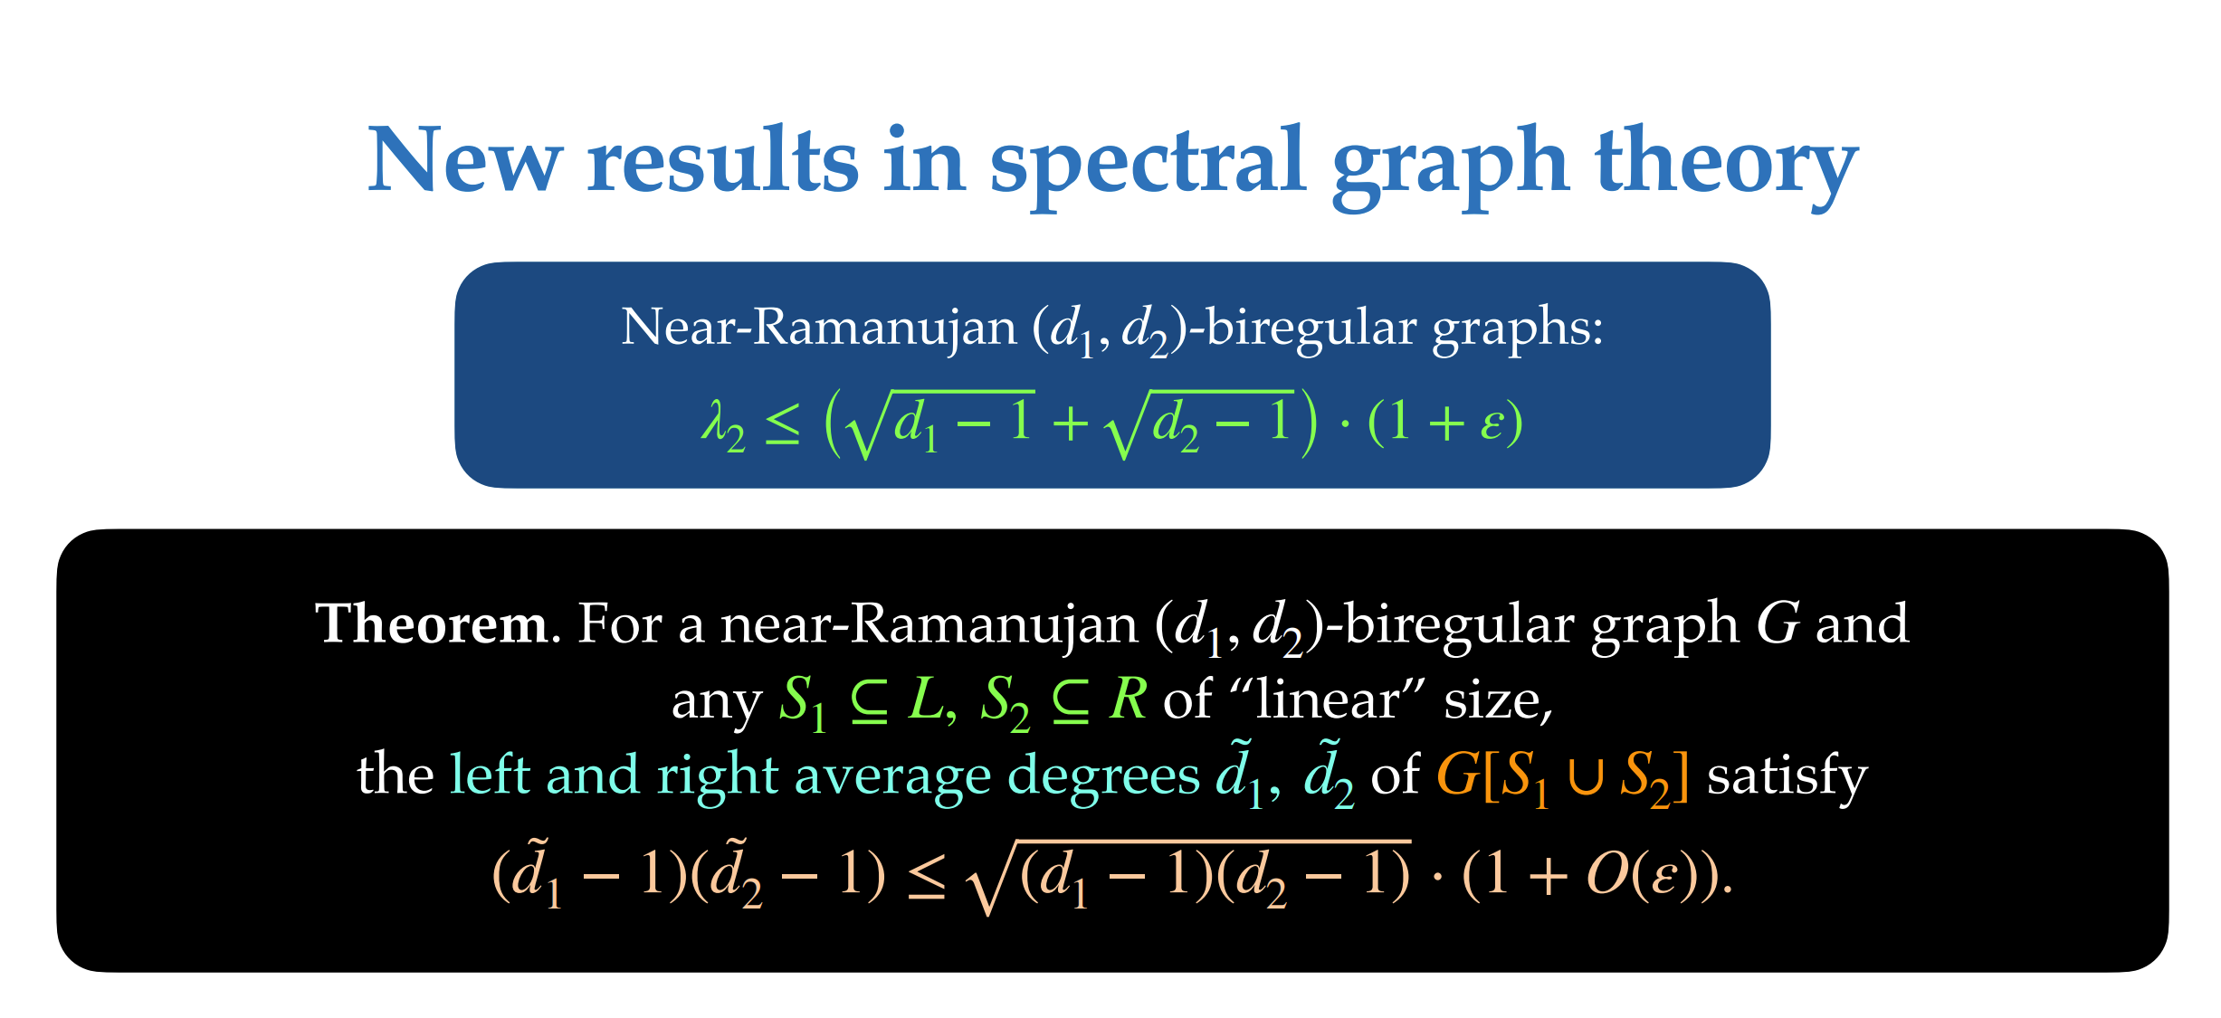

Slide 10
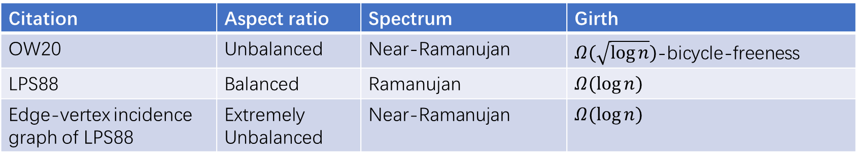
Base graphs
Citation | Aspect ratio | Spectrum | Girth
OW20 | Unbalanced | Near-Ramanujan | $Ω(\sqrt{\log{n}})$-bicycle-freeness
LPS88 | Balanced | Ramanujan | $$Ω(\log{n})$$
Edge-vertex incidence graph of LPS88 | Extremely Unbalanced | Near-Ramanujan | $$Ω(\log{n})$$

Slide 11
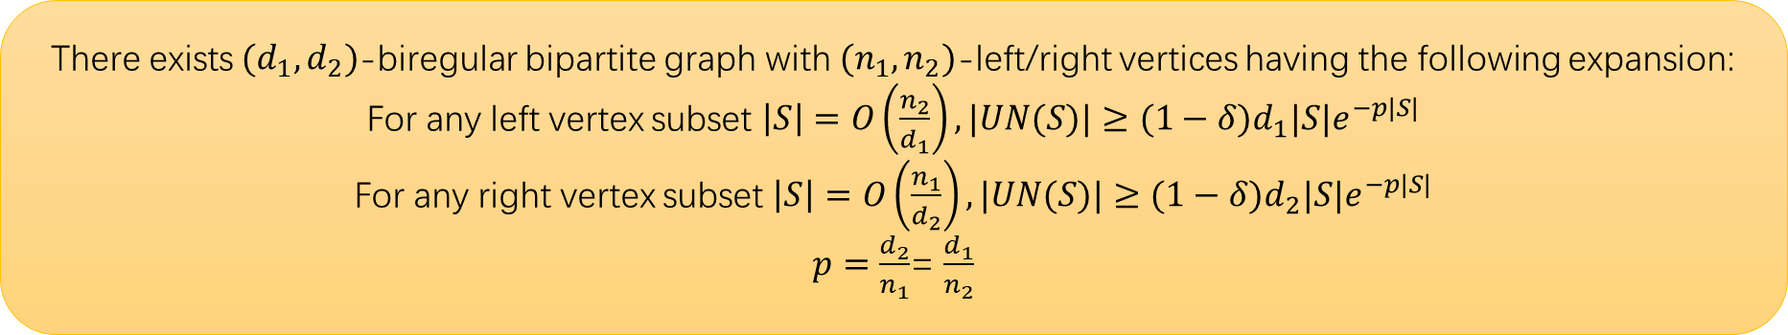

Gadget graphs
There exists $(d_{1},d_{2})$-biregular bipartite graph with $(n_{1},n_{2})$-left/right vertices having the following expansion:
For any left vertex subset $\left|S\right|=O\left(\frac{n_{2}}{d_{1}}\right), |UN(S)|≥(1−δ)d_{1}|S|e^{−p|S|}$
For any right vertex subset $\left|S\right|=O\left(\frac{n_{1}}{d_{2}}\right), |UN(S)|≥(1−δ)d_{2}|S|e^{−p|S|}$
$p=\frac{d_{2}}{n_{1}}$= $\frac{d_{1}}{n_{2}}$
HMMP24: $d=Θ(\sqrt{n})$
Chen25: All $ω(\log{n})≤d≤O(n)$

Slide 12
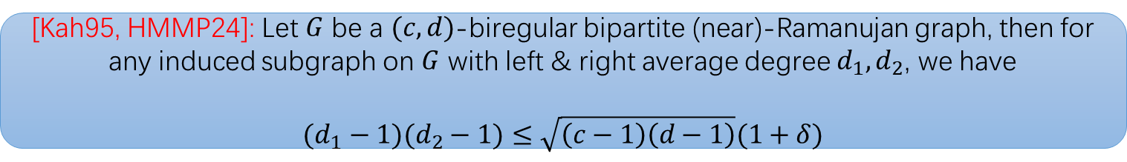

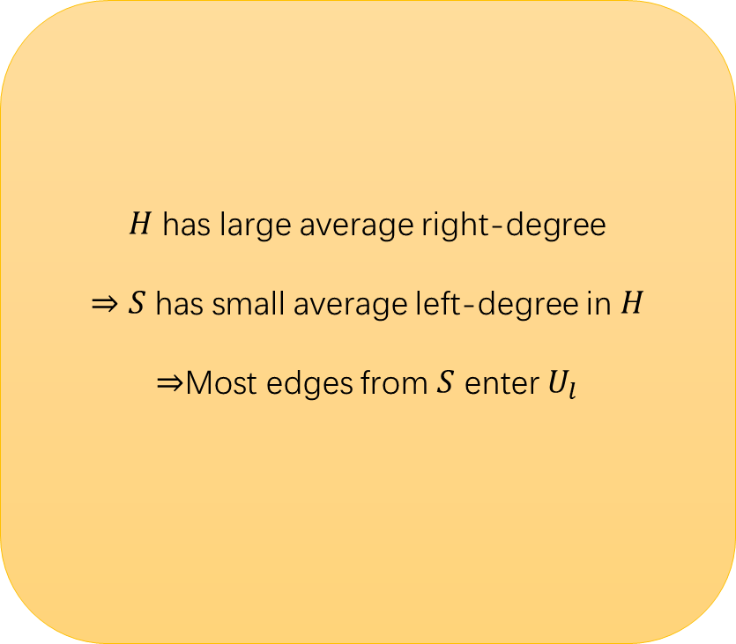




Left-middle expansion
$$G^{′}≔G_{1}[S,N\left(S\right)]$$
$$H≔G^{′}[S,U_{h}]$$
$H$ has large average right-degree
$⇒S$ has small average left-degree in $H$
$⇒$Most edges from $S$ enter $U_{l}$
$U_{l}$: middle neighbors with
low degree
$$S$$
$U_{h}$: middle neighbors with
high degree
[Kah95, HMMP24]: Let $G$ be a $(c,d)$-biregular bipartite (near)-Ramanujan graph, then for any induced subgraph on $G$ with left & right average degree $d_{1},d_{2}$, we have
$$(d_{1}−1)(d_{2}−1)≤\sqrt{\left(c−1\right)\left(d−1\right)}(1+δ)$$

Slide 13

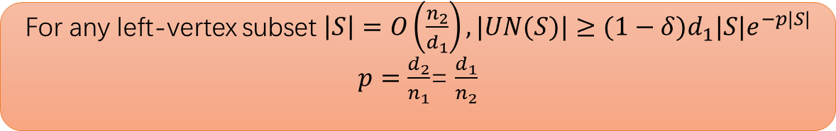

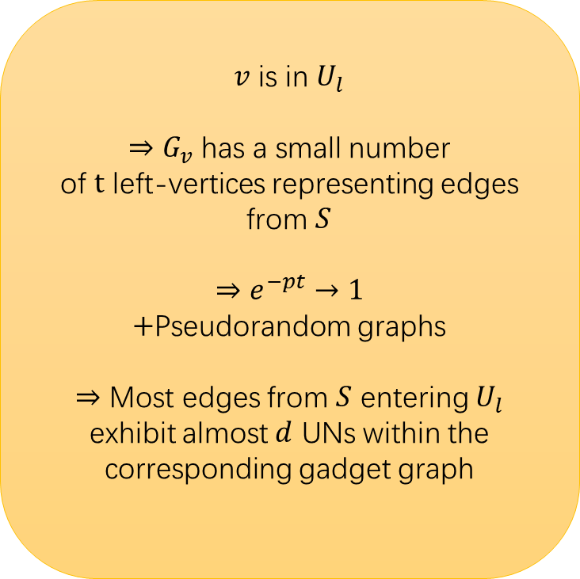
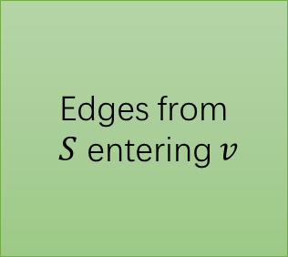
Middle expansion
$v$ is in $U_{l}$
$⇒G_{v}$ has a small number
of $t$ left-vertices representing edges from $S$
$$⇒e^{−pt}→1$$
$+$Pseudorandom graphs
$⇒$ Most edges from $S$ entering $U_{l}$ exhibit almost $d$ UNs within the corresponding gadget graph
Almost $td$ UNs in $G_{v}$
Edges from
$S$ entering $v$
Gadget graph placed on some
vertex $v$ in $U_{l}$
For any left-vertex subset $\left|S\right|=O\left(\frac{n_{2}}{d_{1}}\right), |UN(S)|≥(1−δ)d_{1}|S|e^{−p|S|}$
$p=\frac{d_{2}}{n_{1}}$= $\frac{d_{1}}{n_{2}}$

Slide 14

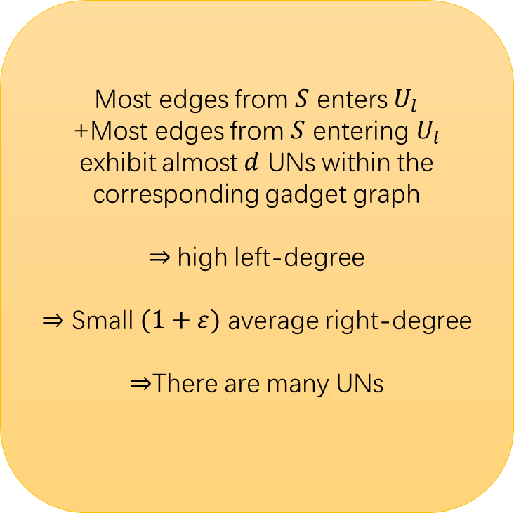

Middle-right expansion
Gadget UNs
Most edges from $S$ enters $U_{l}$
+Most edges from $S$ entering $U_{l}$ exhibit almost $d$ UNs within the corresponding gadget graph
$⇒$high left-degree
$⇒$ Small $(1+ε)$ average right-degree
$⇒$There are many UNs
$$U$$
$$U_{l}$$
[Kah95, HMMP24]: Let $G$ be a $(c,d)$-biregular bipartite (near)-Ramanujan graph, then for any induced subgraph on $G$ with left & right average degree $d_{1},d_{2}$, we have
$$(d_{1}−1)(d_{2}−1)≤\sqrt{\left(c−1\right)\left(d−1\right)}(1+δ)$$

Slide 15
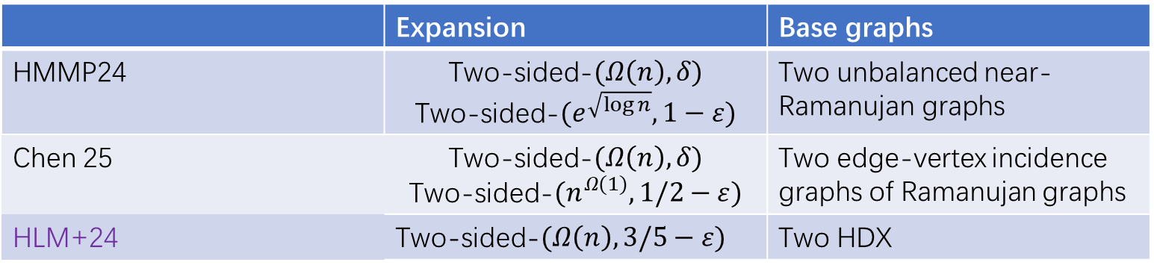
Constructions
 | Expansion | Base graphs
HMMP24 | Two-sided-$(Ω\left(n\right),δ)$ Two-sided-$(e^{\sqrt{\log{n}}},1−ε)$ | Two unbalanced near-Ramanujan graphs
Chen 25 | Two-sided-$(Ω\left(n\right),δ)$ Two-sided-$(n^{Ω(1)},1/2−ε)$ | Two edge-vertex incidence graphs of Ramanujan graphs
HLM+24 | Two-sided-$(Ω\left(n\right),3/5−ε)$ | Two HDX

Slide 16
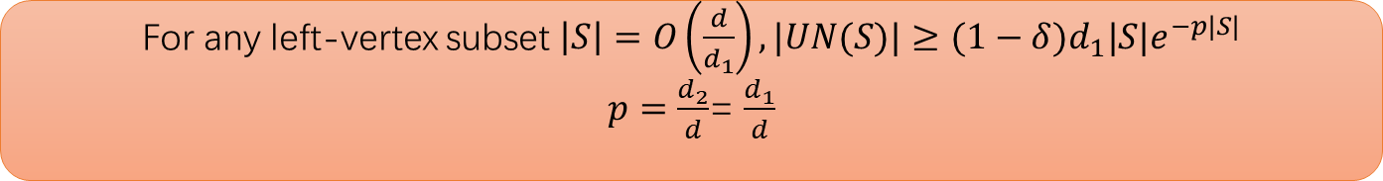
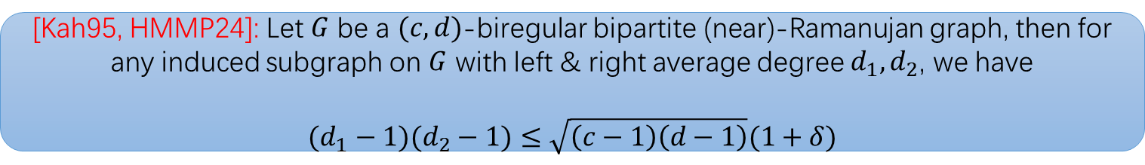
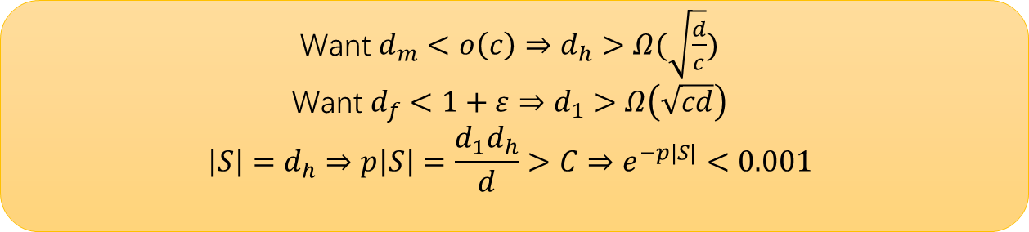
Barriers:
[Kah95, HMMP24]: Let $G$ be a $(c,d)$-biregular bipartite (near)-Ramanujan graph, then for any induced subgraph on $G$ with left & right average degree $d_{1},d_{2}$, we have
$$(d_{1}−1)(d_{2}−1)≤\sqrt{\left(c−1\right)\left(d−1\right)}(1+δ)$$
For any left-vertex subset $\left|S\right|=O\left(\frac{d}{d_{1}}\right), |UN(S)|≥(1−δ)d_{1}|S|e^{−p|S|}$
$p=\frac{d_{2}}{d}$= $\frac{d_{1}}{d}$
Want $d_{m}<o\left(c\right)⇒d_{h}>Ω(\sqrt{\frac{d}{c}})$
Want $d_{f}<1+ε⇒d_{1}>Ω\left(\sqrt{cd}\right)$
$$\left|S\right|=d_{h}⇒p\left|S\right|=\frac{d_{1}d_{h}}{d}>C⇒e^{−p|S|}<0.001$$

Slide 17
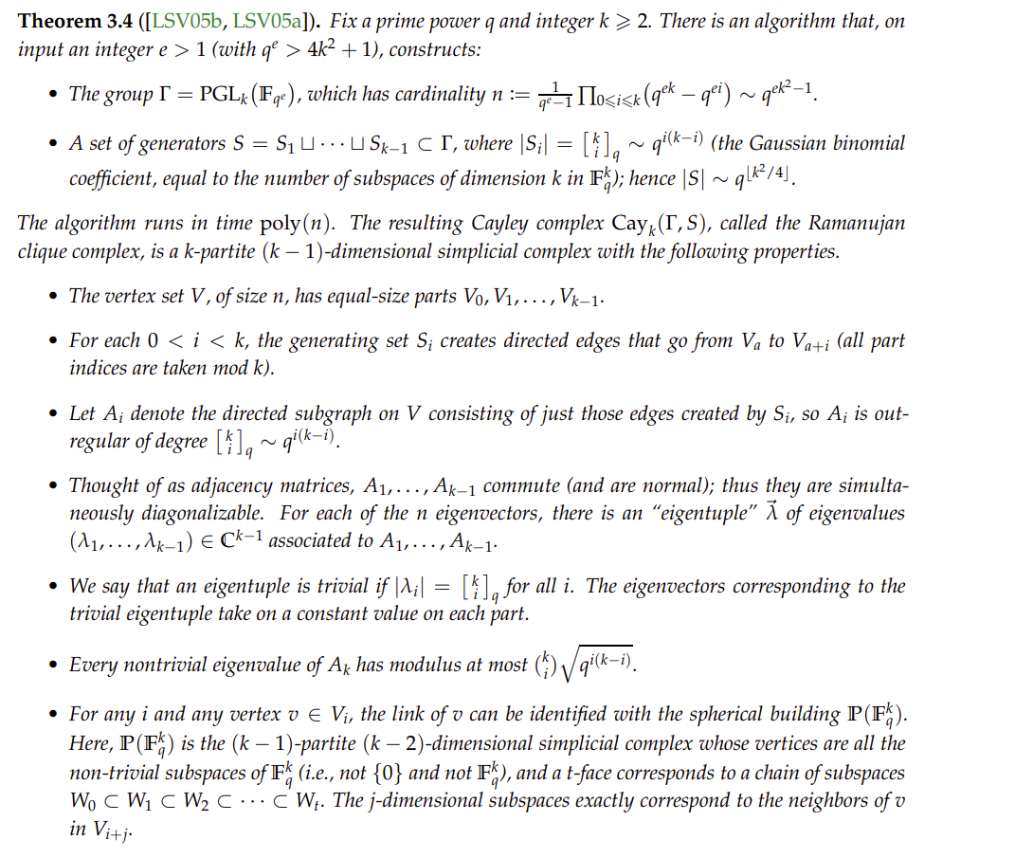
HDX: High-dimensional Expander

Slide 18
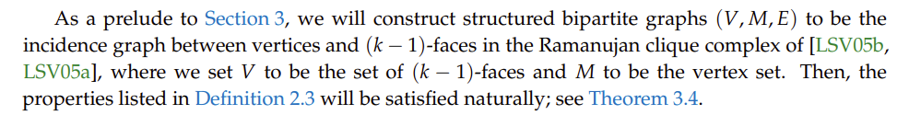
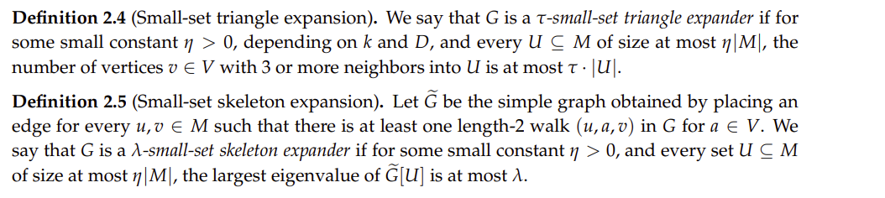

Slide 19
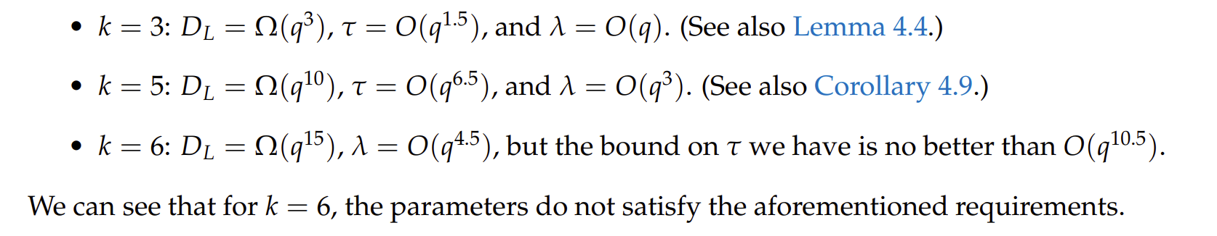
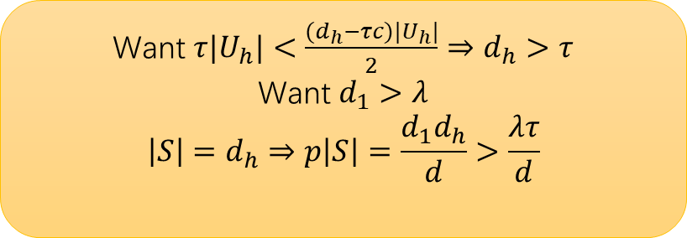

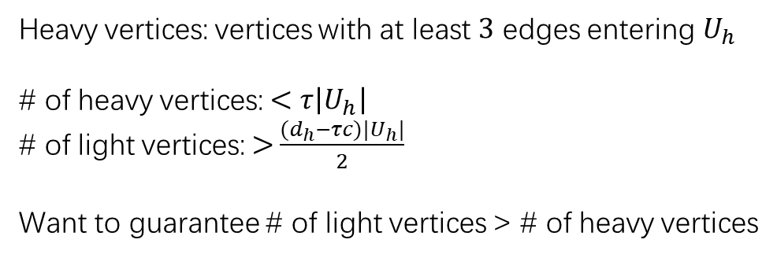
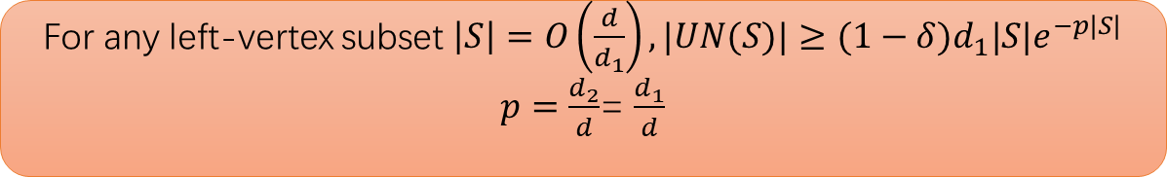
Heavy vertices: vertices with at least $3$ edges entering $U_{h}$
# of heavy vertices: $<τ\left|U_{h}\right|$
# of light vertices:$>$ $\frac{{(d}_{h}−τc)|U_{h}|}{2}$
Want to guarantee # of light vertices > # of heavy vertices
Want $τ|U_{h}|<\frac{{(d}_{h}−τc)|U_{h}|}{2}⇒d_{h}>τ$
Want $d_{1}>λ$
$$\left|S\right|=d_{h}⇒p\left|S\right|=\frac{d_{1}d_{h}}{d}>\frac{λτ}{d}$$
For any left-vertex subset $\left|S\right|=O\left(\frac{d}{d_{1}}\right), |UN(S)|≥(1−δ)d_{1}|S|e^{−p|S|}$
$p=\frac{d_{2}}{d}$= $\frac{d_{1}}{d}$
Expansion: $\frac{k−2}{k}0.99≈0.6$

