Slide 1
Unique-neighbor Expanders with Better Expansion for Polynomial-sized Sets
Yeyuan Chen
University of Michigan

Slide 2


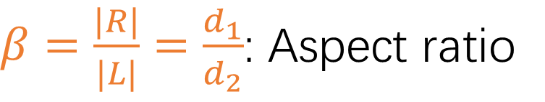
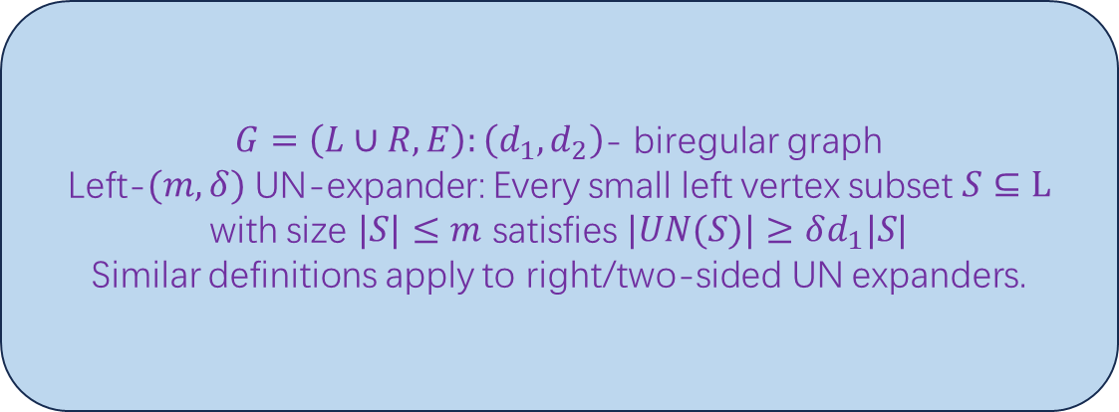
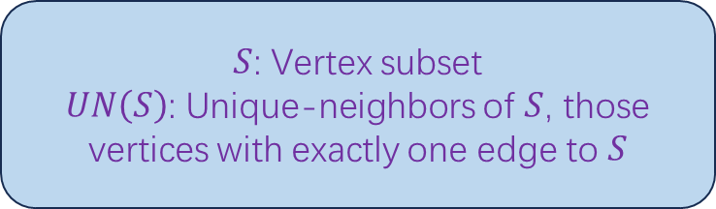
Unique-neighbor Expander
$S$: Vertex subset
$UN\left(S\right)$: Unique-neighbors of $S$, those vertices with exactly one edge to $S$
$$UN(S)$$
$$S$$
$G=\left(L∪R,E\right):\left(d_{1},d_{2}\right)$- biregular graph
Left-$(m,δ)$ UN-expander: Every small left vertex subset $S⊆L$ with size $|S|≤m$ satisfies $|UN(S)|≥δd_{1}|S|$
Similar definitions apply to right/two-sided UN expanders.
$β=\frac{|R|}{|L|}=\frac{d_{1}}{d_{2}}$: Aspect ratio

Slide 3










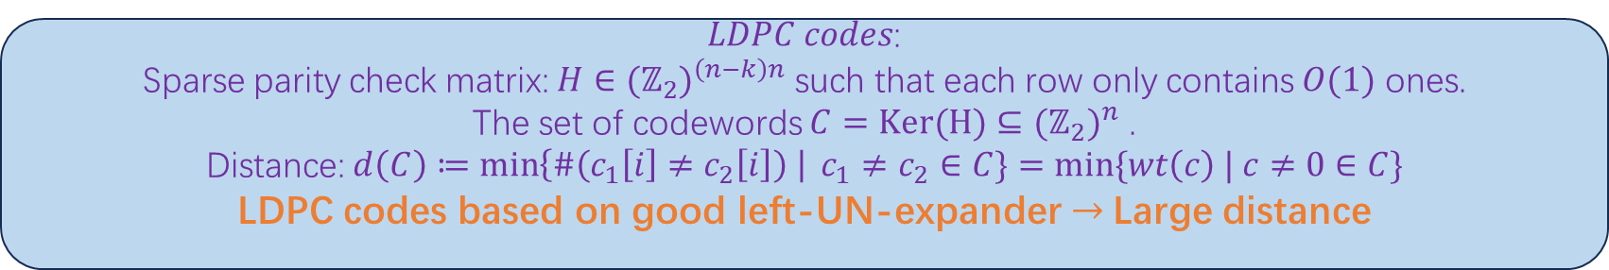














Motivation: One-sided
$LDPC codes$:
Sparse parity check matrix: $H∈{(ℤ_{2})}^{\left(n−k\right)n}$ such that each row only contains $O(1)$ ones.
The set of codewords $C=Ker(H)⊆{(ℤ_{2})}^{n}$ .
Distance: $d\left(C\right)≔\min\left\{\#\left(c_{1}\left[i\right]≠c_{2}\left[i\right]\right) \right| c_{1}≠c_{2}∈C\}=min⁡\{wt\left(c\right) | c≠0∈C\}$
LDPC codes based on good left-UN-expander$→$ Large distance
$$⋮$$
$$n$$
$$0$$
Fail
$$1$$
$$1$$
$$1$$
$$1$$
Fail
$$1$$
$$1$$
$$1$$
$$1$$
$$n−k$$
$$⋱$$
$$⋱$$
$$c$$
$$=0$$
$$n$$
$$1$$
$$n−k$$
$$⋱$$
$$1$$
$$0$$
Fail
$$0$$
$$⋮$$

Slide 4
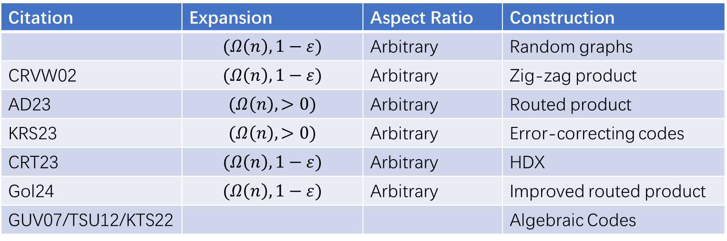
Existence & Construction: One-sided
Citation | Expansion | Aspect Ratio | Construction
 | $$(Ω\left(n\right),1−ε)$$ | Arbitrary | Random graphs
CRVW02 | $$(Ω\left(n\right),1−ε)$$ | Arbitrary | Zig-zag product
AD23 | $$(Ω\left(n\right),>0)$$ | Arbitrary | Routed product
KRS23 | $$(Ω\left(n\right),>0)$$ | Arbitrary | Error-correcting codes
CRT23 | $$(Ω\left(n\right),1−ε)$$ | Arbitrary | HDX
Gol24 | $$(Ω\left(n\right),1−ε)$$ | Arbitrary | Improved routed product
GUV07/TSU12/KTS22 |  |  | Algebraic Codes

Slide 5

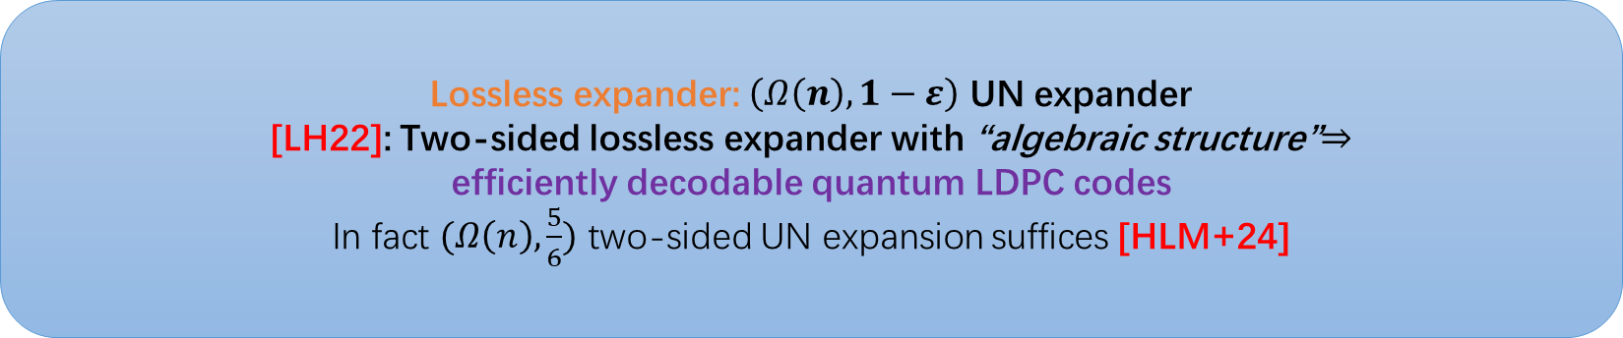

Motivation: Two-sided
Lossless expander: $\left(Ω\left(n\right),1−ε\right)$ UN expander
[LH22]: Two-sided lossless expander with “algebraic structure”$⇒$
efficiently decodable quantum LDPC codes
In fact $(Ω\left(n\right),\frac{5}{6})$ two-sided UN expansion suffices [HLM+24]
$Z$-Parity Checks
$X$-Parity Checks
Codeword

Slide 6
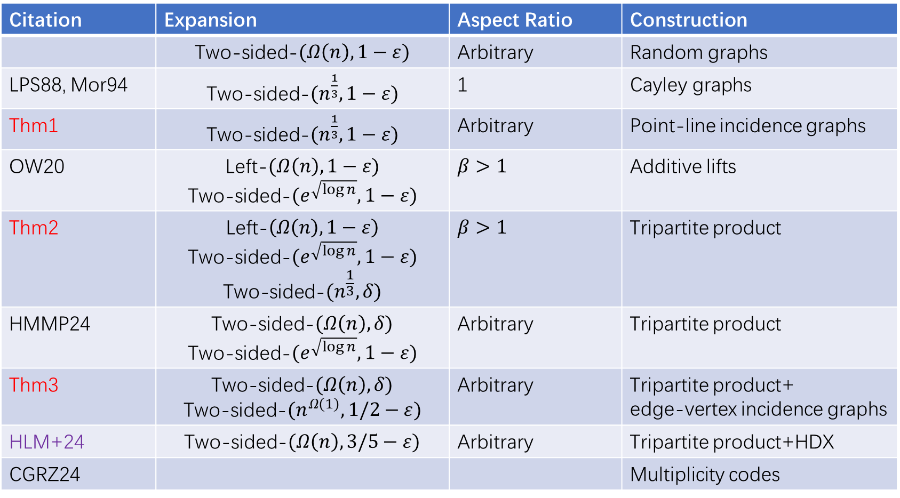
Existence & Construction: Two-sided
Citation | Expansion | Aspect Ratio | Construction
 | Two-sided-$(Ω\left(n\right),1−ε)$ | Arbitrary | Random graphs
LPS88, Mor94 | Two-sided-$(n^{\frac{1}{3}},1−ε)$ | 1 | Cayley graphs
Thm1 | Two-sided-$(n^{\frac{1}{3}},1−ε)$ | Arbitrary | Point-line incidence graphs
OW20 | Left-$(Ω\left(n\right),1−ε)$ Two-sided-$(e^{\sqrt{\log{n}}},1−ε)$ | $$β>1$$ | Additive lifts
Thm2 | $$\text{Left}\text{−}\left(Ω\left(n\right),1−ε\right)$$ Two-sided-$(e^{\sqrt{\log{n}}},1−ε)$ $$\text{Two}\text{−}\text{sided}\text{−}(n^{\frac{1}{3}},δ)$$ | $$β>1$$ | Tripartite product
HMMP24 | Two-sided-$(Ω\left(n\right),δ)$ Two-sided-$(e^{\sqrt{\log{n}}},1−ε)$ | Arbitrary | Tripartite product
Thm3 | Two-sided-$(Ω\left(n\right),δ)$ Two-sided-$(n^{Ω(1)},1/2−ε)$ | Arbitrary | Tripartite product+ edge-vertex incidence graphs
HLM+24 | Two-sided-$(Ω\left(n\right),3/5−ε)$ | Arbitrary | Tripartite product+HDX
CGRZ24 |  |  | Multiplicity codes

Slide 7
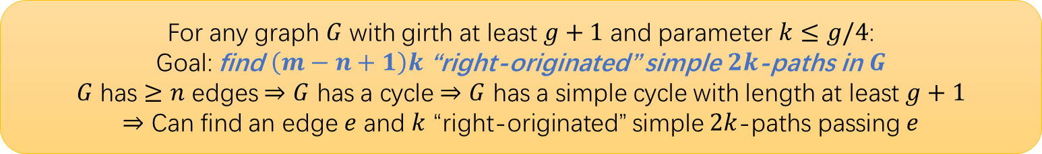
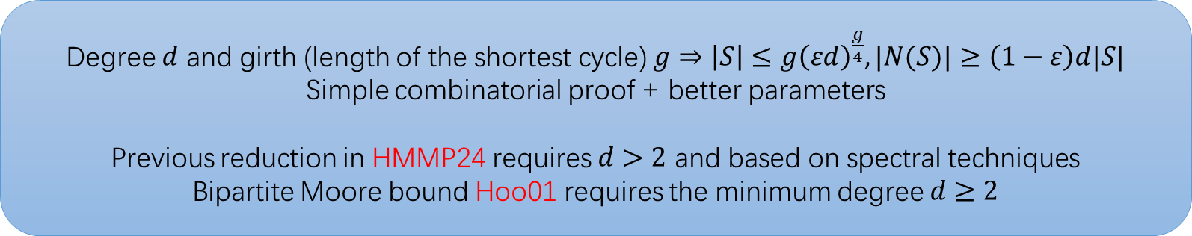



Combinatorial proof: large girth implies good expansion
Degree $d$ and girth (length of the shortest cycle) $g⇒\left|S\right|≤g{\left(εd\right)}^{\frac{g}{4}}, |N(S)|≥\left(1−ε\right)d|S|$
Simple combinatorial proof + better parameters
Previous reduction in HMMP24 requires $d>2$ and based on spectral techniques
Bipartite Moore bound Hoo01 requires the minimum degree $d≥2$
For any graph $G$ with girth at least $g+1$ and parameter $k≤g/4$:
Goal: find $\left(m−n+1\right)k$ “right-originated” simple $2k$-paths in $G$
$G$ has $≥n$ edges $⇒G$ has a cycle $⇒G$ has a simple cycle with length at least $g+1$
$⇒$ Can find an edge $e$ and $k$ “right-originated” simple $2k$-paths passing $e$
$$e$$
$13$-cycle
$12$-simple path

Slide 8
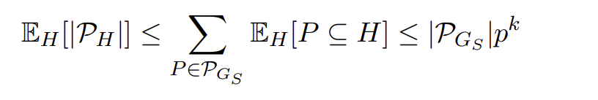
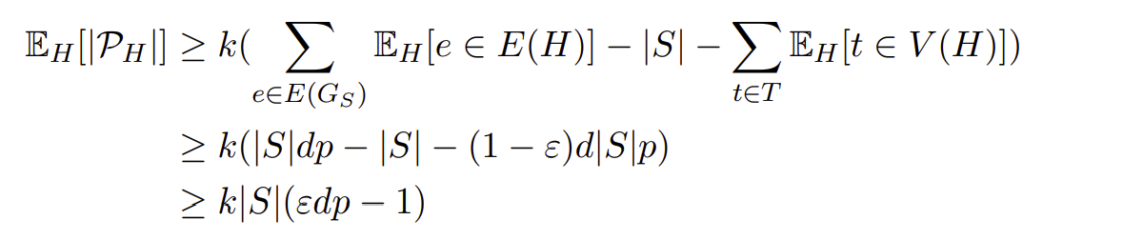

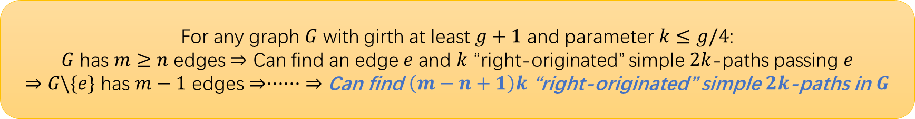



For any graph $G$ with girth at least $g+1$ and parameter $k≤g/4$:
$G$ has $m≥n$ edges $⇒$ Can find an edge $e$ and $k$ “right-originated” simple $2k$-paths passing $e$
$⇒$ $G\backslash \{e\}$ has $m−1$ edges $⇒······$ $⇒$ Can find $\left(m−n+1\right)k$ “right-originated” simple $2k$-paths in $G$
Proof: Suppose we have the graph $G_{S}=G[S,N(S)]$ with $|N(S)|≤\left(1−ε\right)d|S|$, we want to lower bound $|S|$
Let $p=\frac{1}{εd}$, we sample $R⊆N(S)$ such that each left vertex is selected with i.i.d probability $p$. Let $H=G[R,S]$
$$R$$
$$N(S)$$
$$S$$
Pigeon-hole principle from large girth

Slide 9



Tripartite Product (from HMMP24)
Tripartite Product
$$G_{1}$$
$$G_{2}$$
$G_{1},G_{2}$: Base graphs
Gadget graph: constant size, can behave
like random graphs by bruteforce

Slide 10
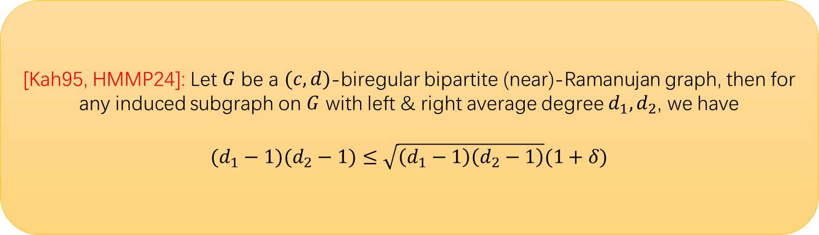
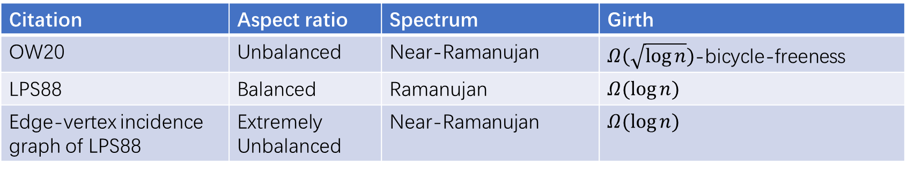
Base graphs
Citation | Aspect ratio | Spectrum | Girth
OW20 | Unbalanced | Near-Ramanujan | $Ω(\sqrt{\log{n}})$-bicycle-freeness
LPS88 | Balanced | Ramanujan | $$Ω(\log{n})$$
Edge-vertex incidence graph of LPS88 | Extremely Unbalanced | Near-Ramanujan | $$Ω(\log{n})$$
[Kah95, HMMP24]: Let $G$ be a $(c,d)$-biregular bipartite (near)-Ramanujan graph, then for any induced subgraph on $G$ with left & right average degree $d_{1},d_{2}$, we have
$$(d_{1}−1)(d_{2}−1)≤\sqrt{\left(d_{1}−1\right)\left(d_{2}−1\right)}(1+δ)$$

Slide 11
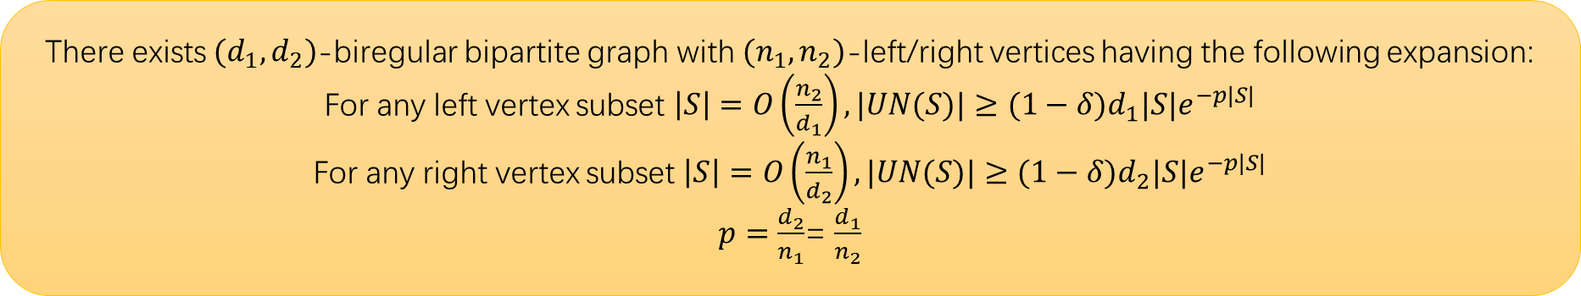

Gadget graphs
There exists $(d_{1},d_{2})$-biregular bipartite graph with $(n_{1},n_{2})$-left/right vertices having the following expansion:
For any left vertex subset $\left|S\right|=O\left(\frac{n_{2}}{d_{1}}\right), |UN(S)|≥(1−δ)d_{1}|S|e^{−p|S|}$
For any right vertex subset $\left|S\right|=O\left(\frac{n_{1}}{d_{2}}\right), |UN(S)|≥(1−δ)d_{2}|S|e^{−p|S|}$
$p=\frac{d_{2}}{n_{1}}$= $\frac{d_{1}}{n_{2}}$
HMMP24: $d=Θ(\sqrt{n})$
This work: All $ω(\log{n})≤d≤O(n)$

Slide 12
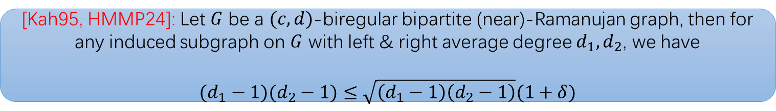

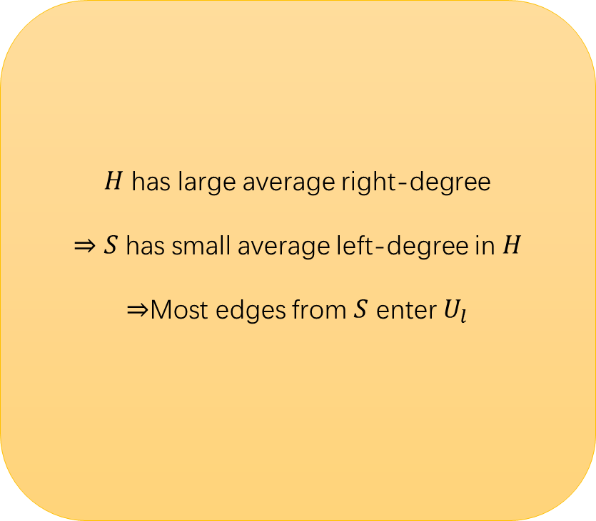




Left-middle expansion
$$G^{′}≔G_{1}[S,N\left(S\right)]$$
$$H≔G^{′}[S,U_{h}]$$
$H$ has large average right-degree
$⇒S$ has small average left-degree in $H$
$⇒$Most edges from $S$ enter $U_{l}$
$U_{l}$: middle neighbors with
low degree
$$S$$
$U_{h}$: middle neighbors with
high degree
[Kah95, HMMP24]: Let $G$ be a $(c,d)$-biregular bipartite (near)-Ramanujan graph, then for any induced subgraph on $G$ with left & right average degree $d_{1},d_{2}$, we have
$$(d_{1}−1)(d_{2}−1)≤\sqrt{\left(d_{1}−1\right)\left(d_{2}−1\right)}(1+δ)$$

Slide 13

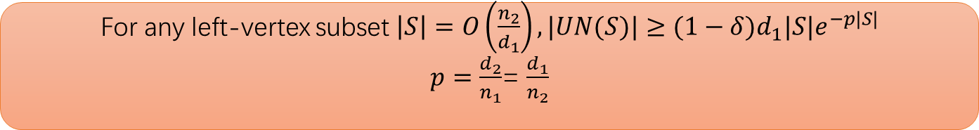

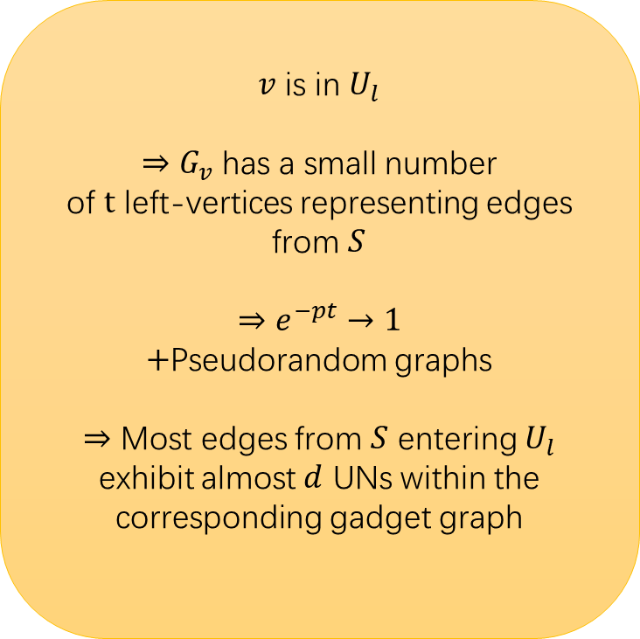
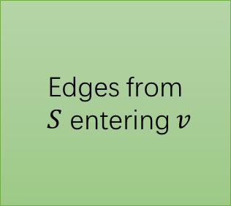
Middle expansion
$v$ is in $U_{l}$
$⇒G_{v}$ has a small number
of $t$ left-vertices representing edges from $S$
$$⇒e^{−pt}→1$$
$+$Pseudorandom graphs
$⇒$ Most edges from $S$ entering $U_{l}$ exhibit almost $d$ UNs within the corresponding gadget graph
Almost $td$ UNs in $G_{v}$
Edges from
$S$ entering $v$
Gadget graph placed on some
vertex $v$ in $U_{l}$
For any left-vertex subset $\left|S\right|=O\left(\frac{n_{2}}{d_{1}}\right), |UN(S)|≥(1−δ)d_{1}|S|e^{−p|S|}$
$p=\frac{d_{2}}{n_{1}}$= $\frac{d_{1}}{n_{2}}$

Slide 14

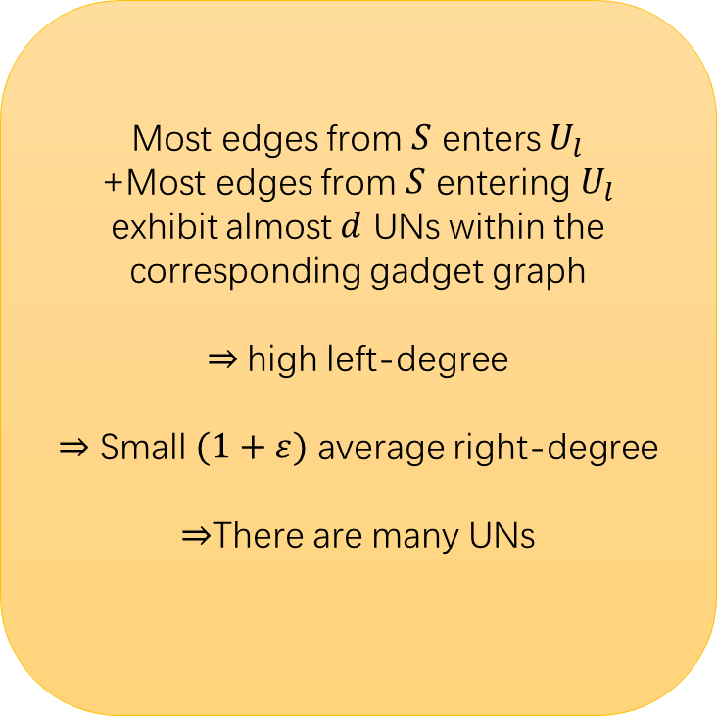

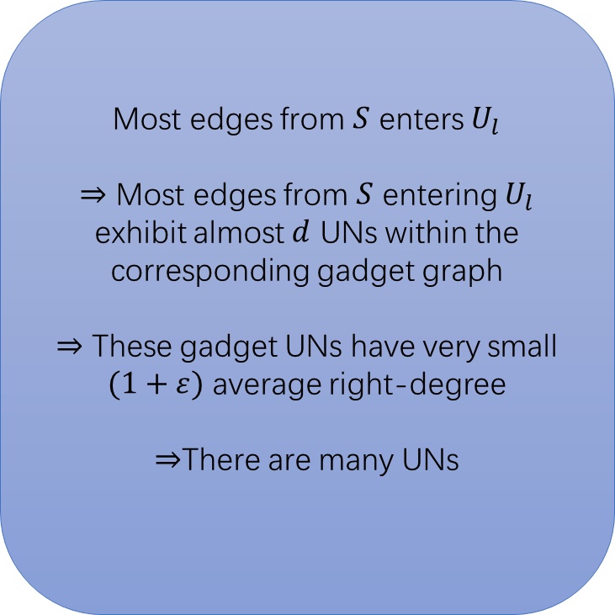
Middle-right expansion
Gadget UNs
Most edges from $S$ enters $U_{l}$
+Most edges from $S$ entering $U_{l}$ exhibit almost $d$ UNs within the corresponding gadget graph
$⇒$high left-degree
$⇒$ Small $(1+ε)$ average right-degree
$⇒$There are many UNs
Most edges from $S$ enters $U_{l}$
$⇒$ Most edges from $S$ entering $U_{l}$ exhibit almost $d$ UNs within the corresponding gadget graph
$⇒$ These gadget UNs have very small $(1+ε)$ average right-degree
$⇒$There are many UNs
$$U$$
$$U_{l}$$
[Kah95, HMMP24]: Let $G$ be a $(c,d)$-biregular bipartite (near)-Ramanujan graph, then for any induced subgraph on $G$ with left & right average degree $d_{1},d_{2}$, we have
$$(d_{1}−1)(d_{2}−1)≤\sqrt{\left(d_{1}−1\right)\left(d_{2}−1\right)}(1+δ)$$

Slide 15
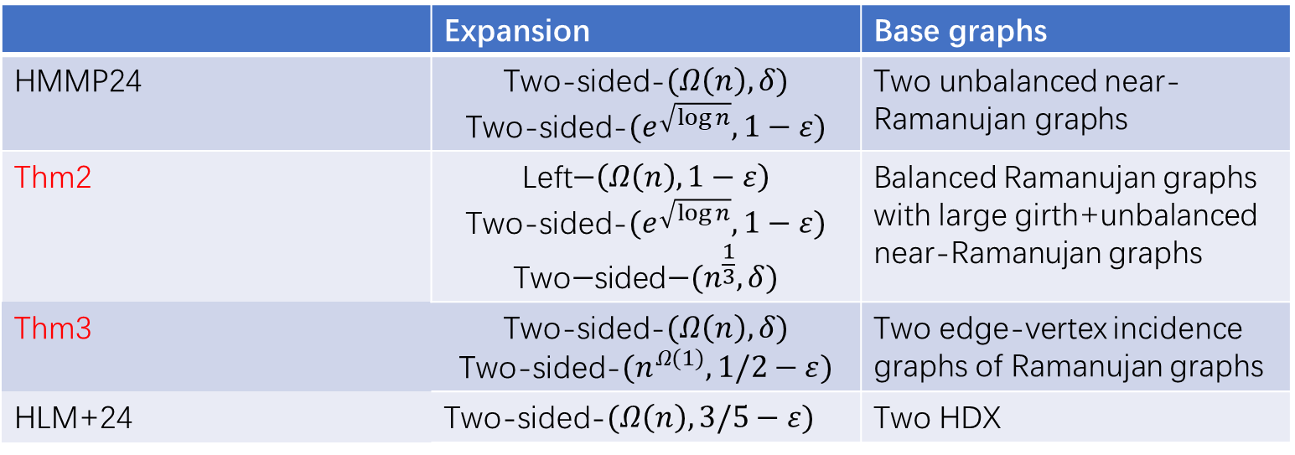
Constructions
 | Expansion | Base graphs
HMMP24 | Two-sided-$(Ω\left(n\right),δ)$ Two-sided-$(e^{\sqrt{\log{n}}},1−ε)$ | Two unbalanced near-Ramanujan graphs
Thm2 | $$\text{Left}\text{−}\left(Ω\left(n\right),1−ε\right)$$ Two-sided-$(e^{\sqrt{\log{n}}},1−ε)$ $$\text{Two}\text{−}\text{sided}\text{−}(n^{\frac{1}{3}},δ)$$ | Balanced Ramanujan graphs with large girth+unbalanced near-Ramanujan graphs
Thm3 | Two-sided-$(Ω\left(n\right),δ)$ Two-sided-$(n^{Ω(1)},1/2−ε)$ | Two edge-vertex incidence graphs of Ramanujan graphs
HLM+24 | Two-sided-$(Ω\left(n\right),3/5−ε)$ | Two HDX

