Slide 1
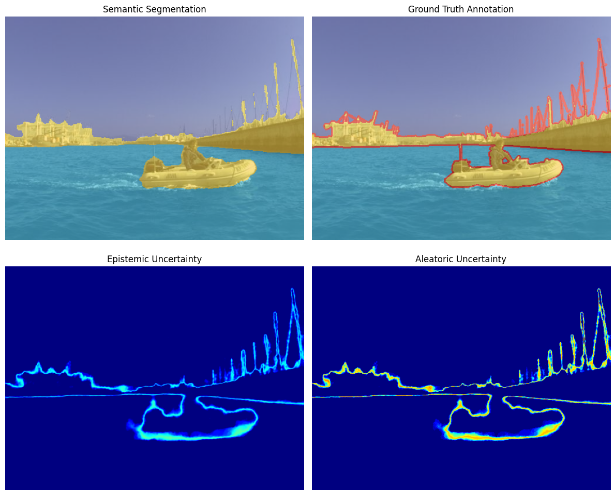
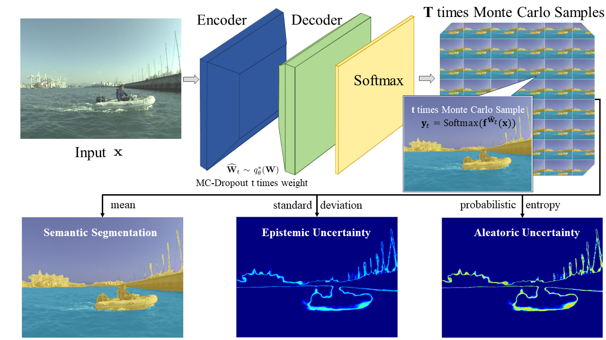

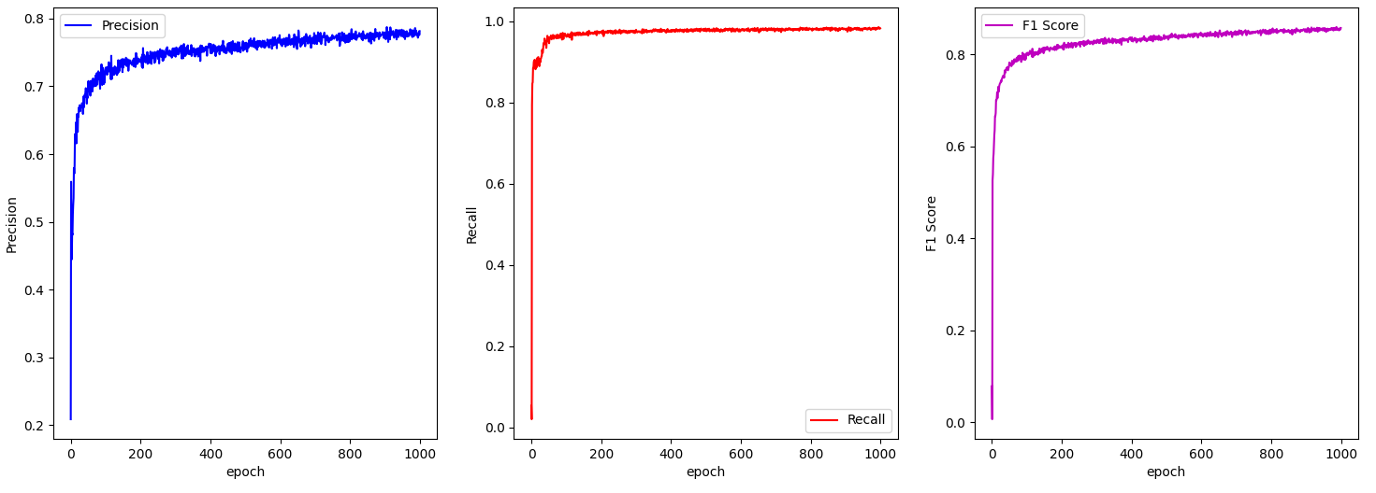

Bayesian Deep Learning Based Semantic Segmentation for Marine Environments
Zehao Ye
Department of Mechanical Engineering,
Faculty of Engineering Sciences, UCL
INTRODUCTION
Semantic Segmentation / Uncertainty Estimation
Aim:
Perform semantic segmentation and uncertainty estimations on images captured by USVs leverages Bayesian Deep Learning Approach.
Motivation:
Enhance robustness in perceiving complex maritime environments,
Address the scarcity of available maritime datasets.
Industrial relevance:
USV perception module
METHODOLOGY
Semantic Segmentation Algorithm:
Bayesian SegNet [1] Architecture
Bayesian Inference: Monte Carlo Dropout is utilized as the approximate Bayesian inference method, introducing stochasticity to the CNN.
SegNet Architecture: the encoder of SegNet is based on VGG16 with the fully connected layers removed, while the decoder mirrors the encoder. The final output is passed through a softmax function.
Comparison with other algorithm
Hint: Comparison based on MaSTr1325 dataset
Architecture | Pr (%) | Re (%) | F1 (%)
Bayesian SegNet | 81.2 | 97.8 | 87.8
SegNet | 79.9 | 87.5 | 81.3
PSPNet [3] | 82.1 | 50.8 | 62.8
U-Net [4] | 10.2 | 88.6 | 18.3
CONCLUSION
Performance:
The model performance is improved by a 1.3% increase in Precision and a 6.5% improvement in the F1 score over non-Bayesian baselines by reducing the effect of noisy data through the elimination of aleatoric uncertainty.
In terms of generalization capability, testing on the OASIs dataset shows that the F1 score is 39.77% higher than non-Bayesian baselines, which is attributed to the inference ability of the Bayesian approach.
Future Work:
Test generalization capability on other datasets
Adjust model threshold to achieve better segmentation
Further differentiate aleatoric and epistemic uncertainties
Monte Carlo Samples Softmax Results:
Semantic Segmentation – mean value
Epistemic Uncertainty - standard deviation
Aleatoric Uncertainty - probabilistic entropy
Maritime Dataset: MaSTr1325 dataset [2]
RESULTS
Model Training Progress:
Precision, Recall, and F1 Score are utilized as evaluation metrics of marine obstacle detection
REFERENCE
[1] A. Kendall et al., “Bayesian segnet: Model uncertainty in deep convolutional encoder-decoder architectures for scene understanding,” arXiv preprint arXiv:1511.02680, 2015.
[2] B. Bovcon et al., “The mastr1325 dataset for training deep usv obstacle detection models,” in 2019 IEEE/RSJ International Conference on Intelligent Robots and Systems (IROS), IEEE, 2019
[3] H. Zhao et al., “Pyramid scene parsing network,” in Proceedings of the IEEE conference on computer vision and pattern recognition, 2017.
[4] O. Ronneberger et al., “U-net: Convolutional networks for biomedical image segmentation,” in Medical image computing and computer-assisted intervention–MICCAI 2015: 18th international conference, Munich, Germany, Springer, 2015.
https://github.com/yezehao/BDL-based-semantic-segmentation
Notes:
Ensure sufficient contrast between your image and the ‘UCL’ cut out and banner
Make sure your image is at least 200 pixels per inch at the printed output size.
Always include an alt-tag description for any images used (right click on uploaded image > view alt text). Never mark the image as decorative as it won’t be read by a screen reader.

