Slide 1
MECH0064 Group Design Project Compact Continuum Manipulator Platform
Department of Mechanical Engineering
Faculty of Engineering Sciences
Supervisor: Dr Reza Haqshenas
Group members: Zehao Ye, Yuehan Zhang, Jiachen Wu, Dawei Xu, Yuantong Li, Yuhao Zhu
Date: 11th December 2023

Slide 2
Content
Background
Project Planning
Progress and Further Work
Manipulator Modelling
Electronic Components Control
Kinematics Algorithm
Integrated Simulation

Slide 3
Background - Objective
Develop a compact continuum robotic platform for precise manipulation of an ultrasonic transducer
Workspace: 30x30x30 cm cubic region, any position & orientation

Slide 4
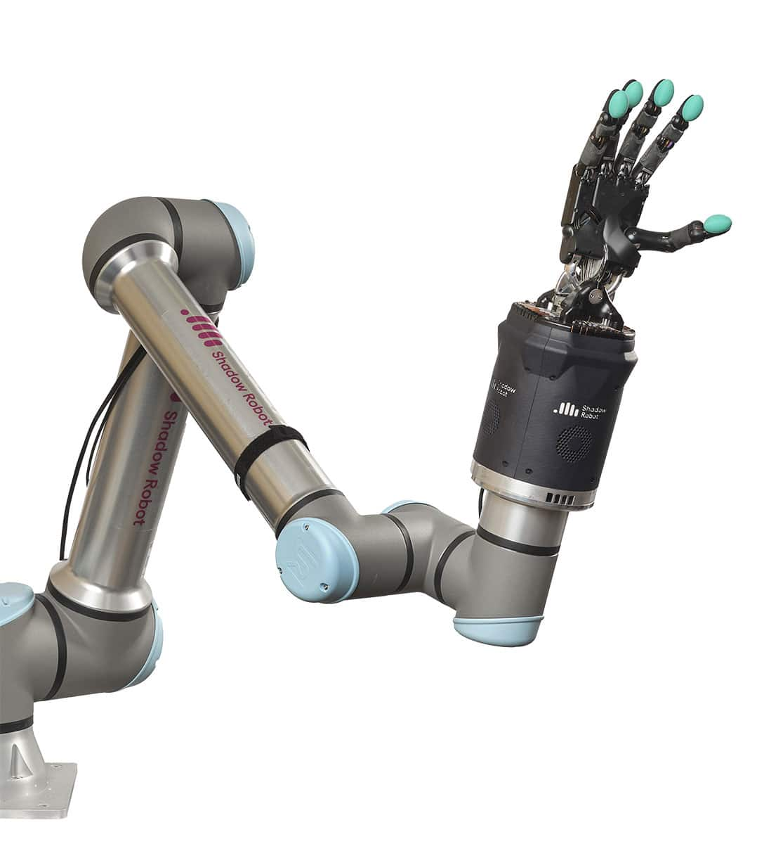
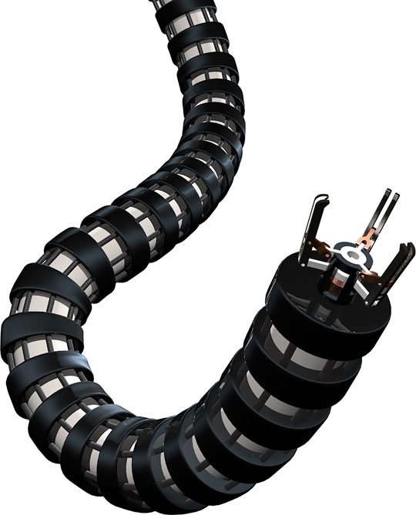
Background - Literature Review
Rigid-Joint Robots
Continuum Robots

Slide 5
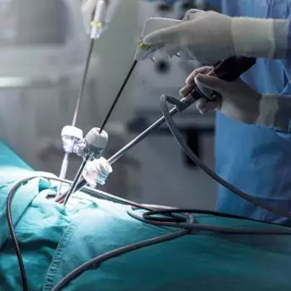
Background - Literature Review
Light-weight, flexible, adaptive to complex environments
Widely applied in:
- Surgical operations
- Search and rescue

Slide 6
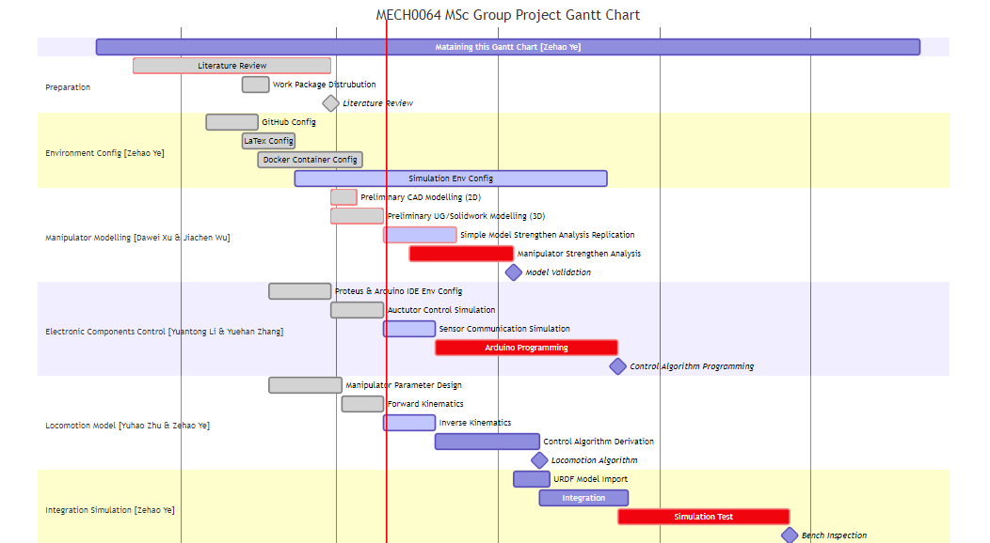
Project Planning
Gannt Chart

Slide 7
Work Packages
Manipulator Modelling – Stress Simulation
Electronic Components Control – Arduino Simulation
Kinematics Algorithm – Locomotion Simulation
Integrated Simulation

Slide 8
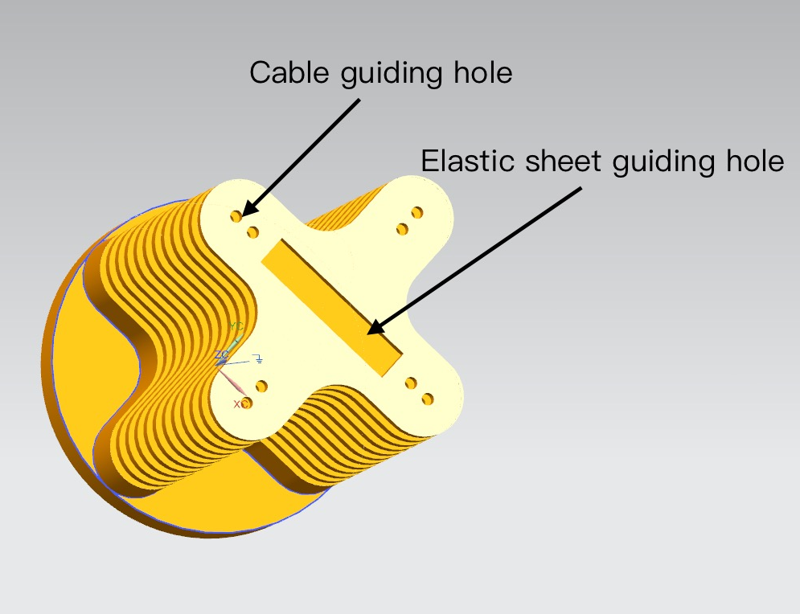
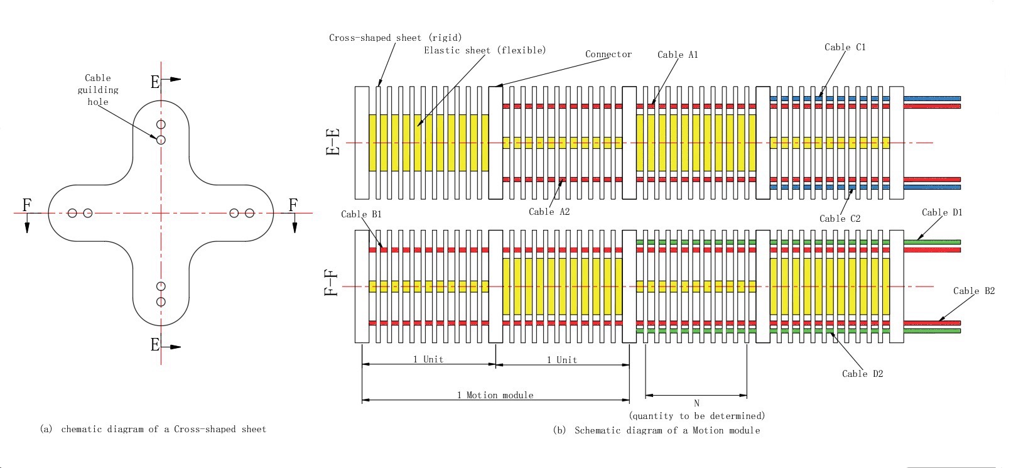
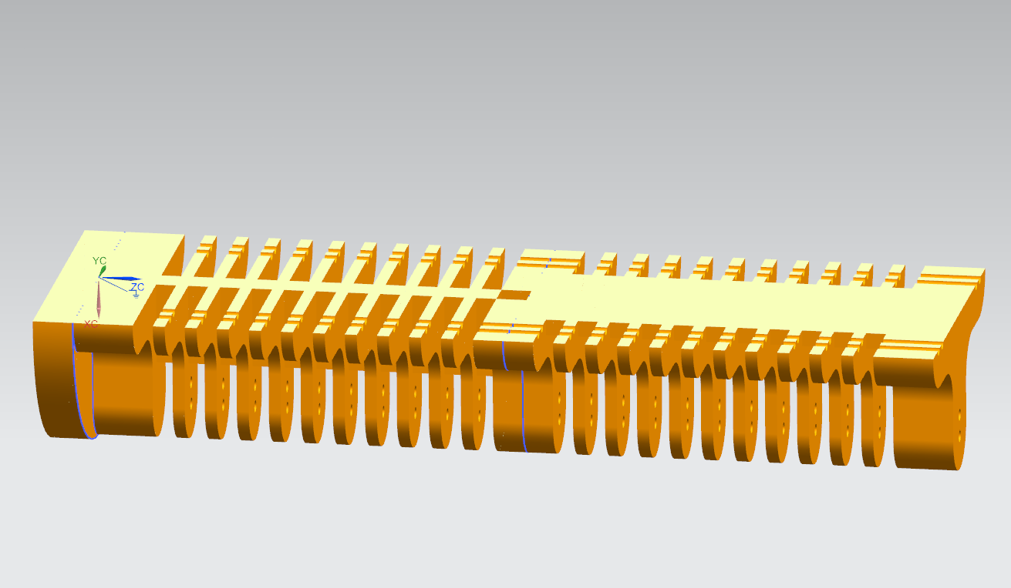
Manipulator Modelling

Slide 9
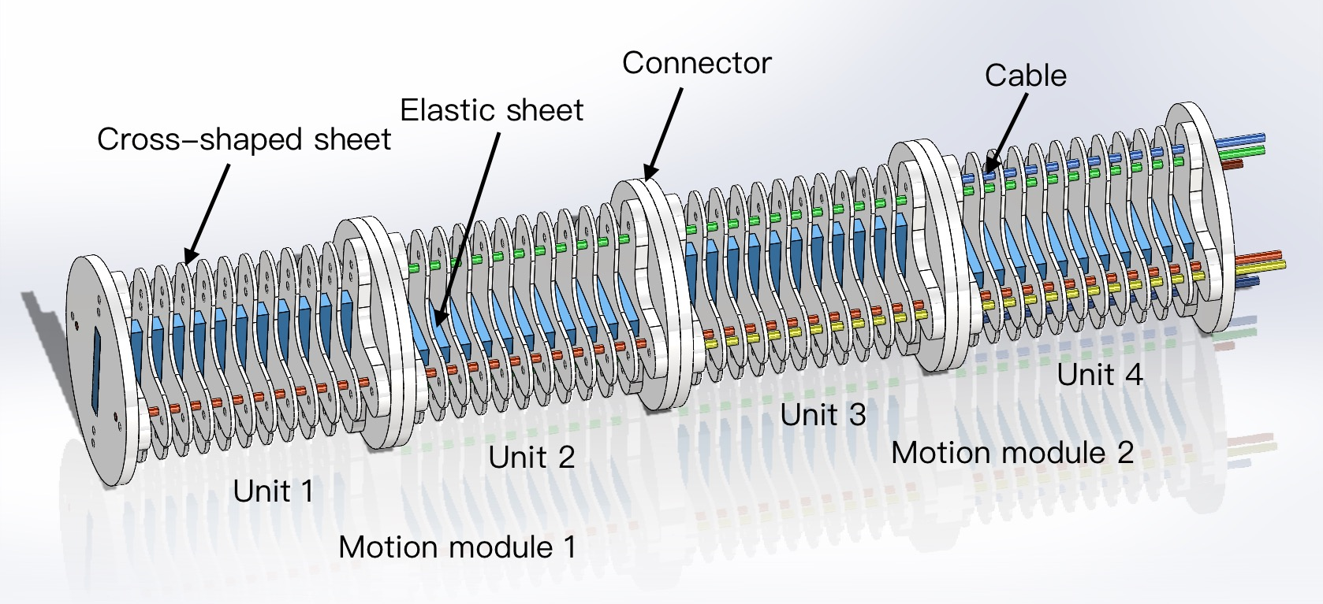
Manipulator Modelling
Project Progress:
Select structural models
Preliminary modelling
Future Works：
Strength calculation (Ansys)
Modify and complete the final model
Notes:
Thanks to my colleague’s introduction to the structure, now I will mainly focus on future works.
For the mechanical part, as we have finished the structural selection and initial 2D and 3D modelling. The next step is to do the stress and strain calculation, so we can determine the things like how many Cross-shaped sheets we are going to use in one unit, what the material of the elastic sheet will be, how the connector will be designed and so on.
For the strength simulation, we plan to use Ansys and take into account the weight of the transducer and the robotic arm. Then according to the specific data to modify and complete the final model.
In the next part, my colleague will talk about the electronic components control.

Slide 10
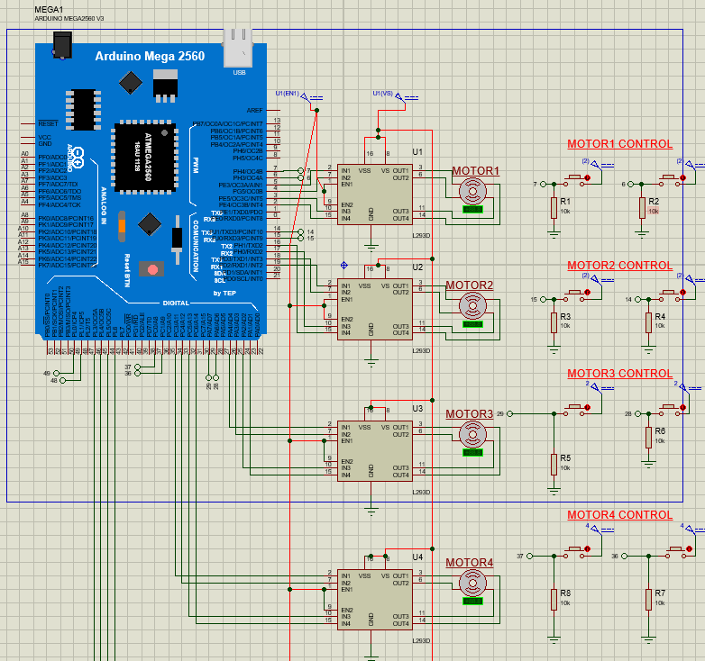
Electronic Components Control
Work package Progress
Cables are tensioned and released by stepper motors
Stepper motors are controlled by an Arduino board
Control system is simulated by Proteus
Future Work ( Accoding to Gannt Chart)
Apply kinetic formula to get input parametres of the system
Use screen and sensors to monitor the realtime data
Get feedbackes to construct a closed-loop system
Try to make the system remote controlable
Set up another (auto-guide) manipulate logic

Slide 11
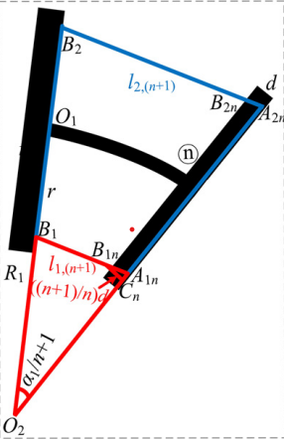
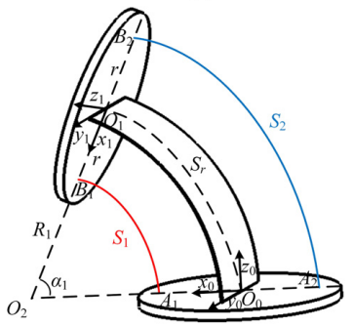
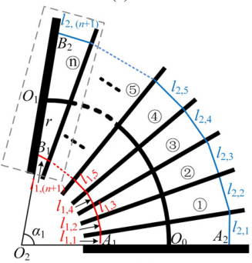
Kinematics Algorithm
Progress:
Build the kinematics model & choose number of sheets to make error-free.
Develop the forward kinematics algorithm
[1] P. Zhou, J. Yao, S. Zhang, C. Wei, H. Zhang, and S. Qi, “A bioinspired fishbone continuum robot with rigid-flexible-soft coupling structure,” Bioinspiration & Biomimetics, vol. 17, no. 6, pp. 066012–066012, Oct. 2022, doi: https://doi.org/10.1088/1748-3190/ac8c10.
‌

Slide 12
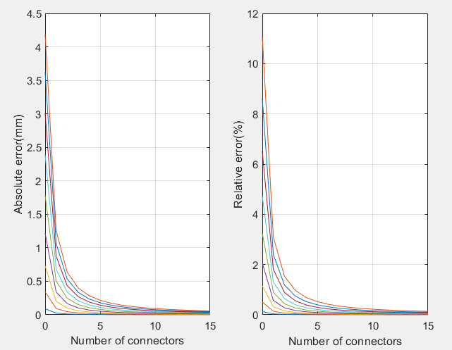
Kinematics Algorithm
Choose number of sheets to make error-free.
Develop the forward kinematics function.

Slide 13
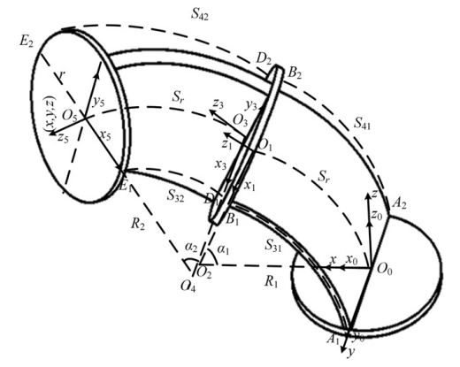
Kinematics Algorithm
Progress:
Develop the forward kinematics function.
[1] P. Zhou, J. Yao, S. Zhang, C. Wei, H. Zhang, and S. Qi, “A bioinspired fishbone continuum robot with rigid-flexible-soft coupling structure,” Bioinspiration & Biomimetics, vol. 17, no. 6, pp. 066012–066012, Oct. 2022, doi: https://doi.org/10.1088/1748-3190/ac8c10.
‌

Slide 14
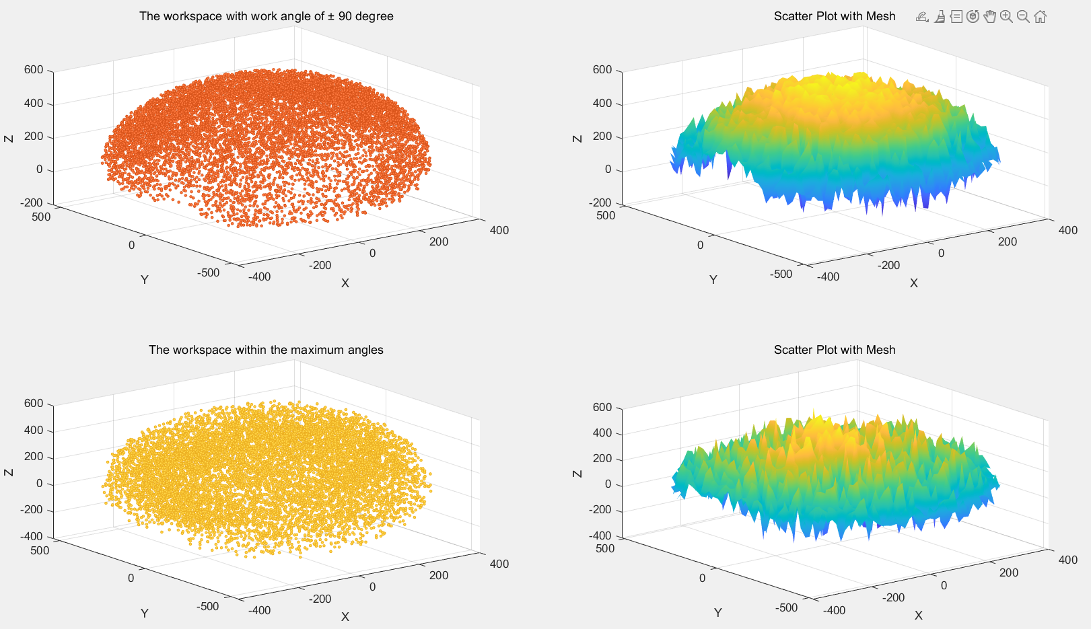
Kinematics Algorithm
Project progress:
Workspace derivation and locomotion simulation

Slide 15
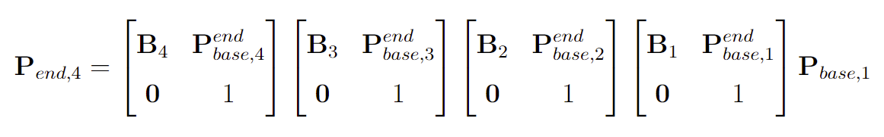
Kinematics Algorithm
Project progress:
Forward kinematics matrices
Further Work:
Inverse Kinematics Algorithm

Slide 16
Integrated Simulation
Aim:
Integrate Arduino simulation and locomotion simulation
Further Work:
ROS for communication
Gazebo for locomotion Simulation
rosserial_arduino for Arduino

Slide 17
The End

Slide 18
Q & A

