Slide 1


Vehicle Tracking
in Large Area
Supervisor: Ralph, Jason Presenter: Ye, Zehao Date: 13th December 2022

Slide 2
Agenda
Background
Project Planning
Project Progress
Summary

Slide 3
Background
Introduction
Objective
Context

Slide 4
Objectives

Slide 5
Context

Slide 6
Literature Review
R.C.Gonzalez, R.E.Woods, Digital Image Processing, 3rd Edition, Pearson / Prentice Hall, 2010.

Slide 7
Project Planning
Outline Requirement
Initial Design
Gannt Chart

Slide 8
Outline Requirement

Slide 9
Initial Design

Slide 10
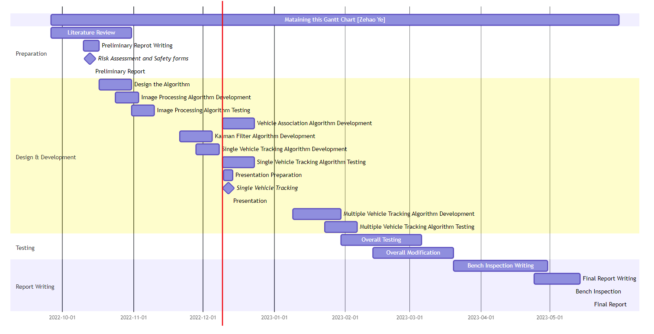
Gannt Chart

Slide 11
Project Progress
Current Progress
Result
Next Step

Slide 12
Current Progress

Slide 13
Result
Image Processing
Vehicle Association
Single Vehicle Tracking

