Slide 1


Vehicle Tracking
in Large Area
Supervisor: Ralph, Jason Presenter: Ye, Zehao Date: 13th December 2022

Slide 2
Content
Background
Project Planning
Project Progress
Next Step
Summary
0

Slide 3
Background
Objective
Context
Outline Requirement
Initial Design
1

Slide 4
Objective
Vehicle Tracking Algorithm
Multiple vehicle tracking
Long Distance Tracking
1.1

Slide 5
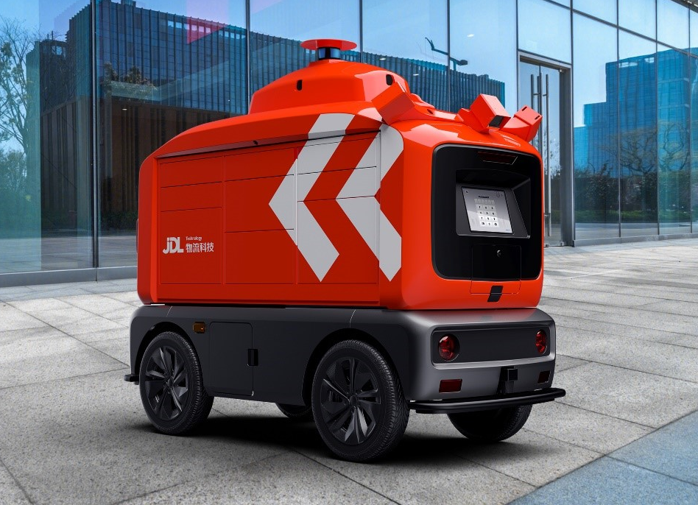
Context
Autonomous Delivery Vehicle
GPS-vehicle tracking
Logistics Network
1.2

Slide 6
Outline Requirement
Accurate Surveillance System
Smart City Management (project)
Control Theory about Kalman Filter (personal)
1.3

Slide 7
Initial Design
Image Processing
Single Vehicle Tracking
Multiple Vehicles Tracking
1.4

Slide 8
Project Planning
Gannt Chart
Application
2

Slide 9
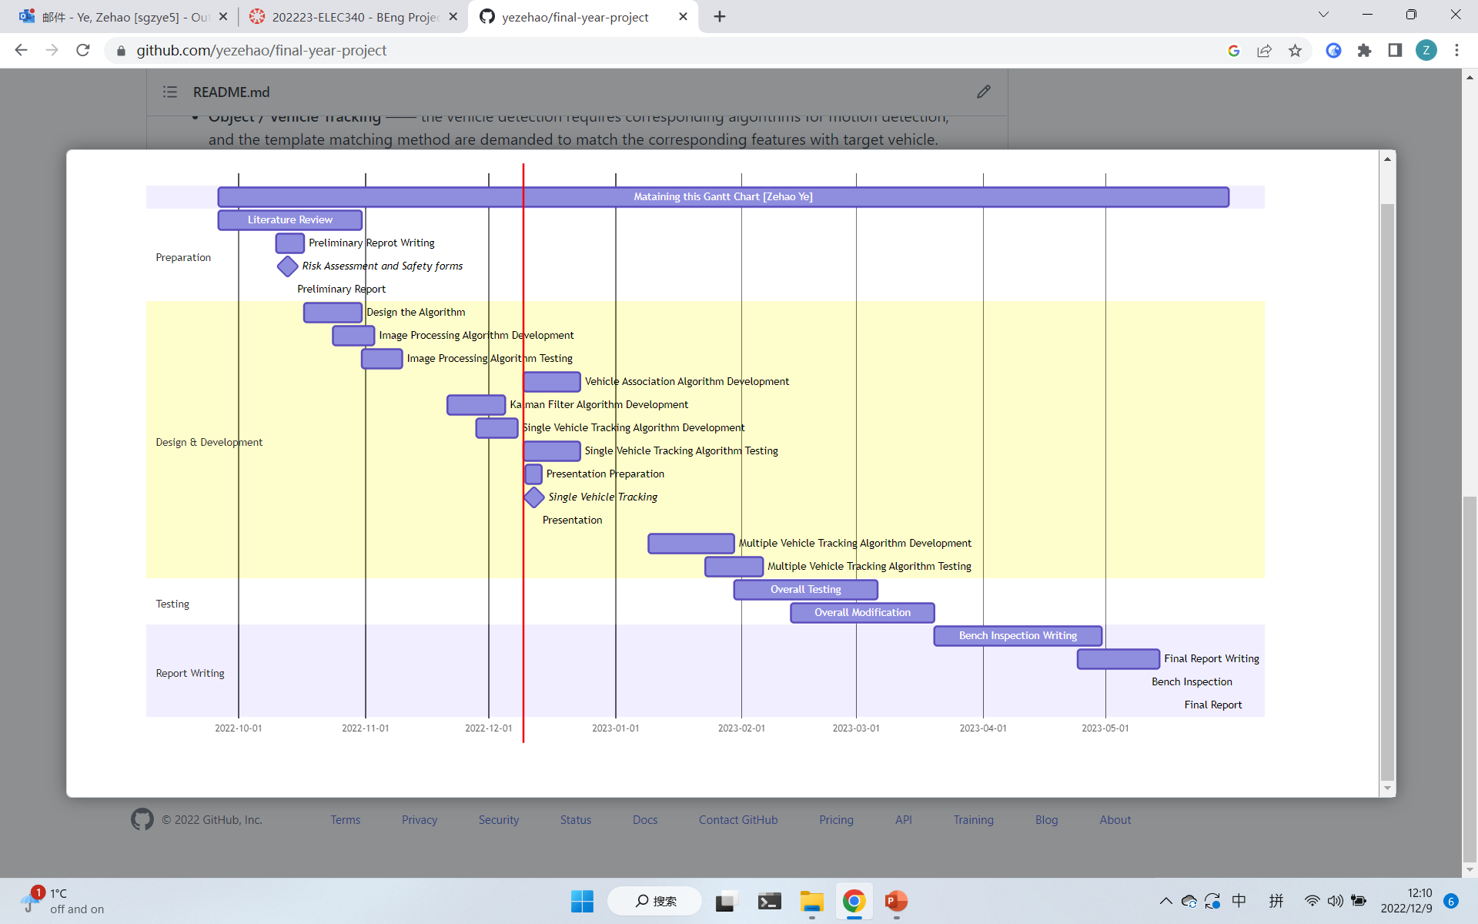
Gannt Chart
2.1

Slide 10
Application
Surveillance system
Extended Application
Wild animal tracking
Delivery vehicle tracking
2.2

Slide 11
Project Progress
Current Progress
Result
Next Step
3

Slide 12
Current Progress
3.1

Slide 13
Result
Image Processing
Single Vehicle Tracking
Without Kalman Filter
With Kalman Filter
3.2

Slide 14
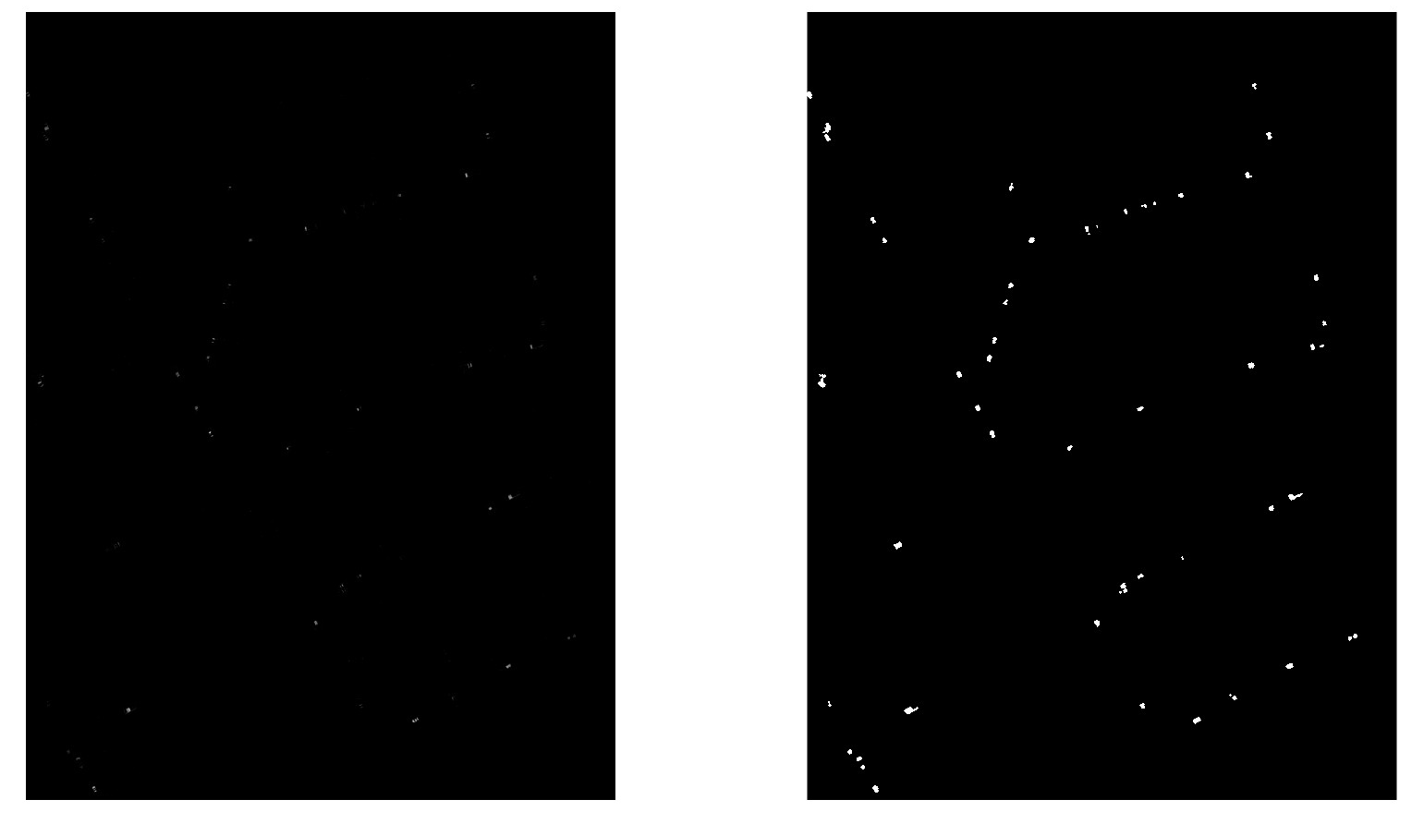
Image Processing
Motion Segmentation
Morphological Operation
video-display
3.2.1

Slide 15
Single Vehicle Tracking
Distance Base Association
Video Display
Kalman Filter
Video Display
3.2.2

Slide 16
Next Step
Optimize Single Vehicle Tracking Algorithm
3.3

Slide 17
Next Step
Single Vehicle Tracking Algorithm
Kalman Filter Parameter Adjustment
Single Vehicle Association
3.3

Slide 18
Summary
Outline
Progress
Further Planning
4

Slide 19
Reference
Image Processing Algorithm
R. C. Gonzalez, R. E. Woods, Digital Image Processing, 3rd Edition, Pearson / Prentice Hall, 2010.
Tracking Algorithm
Ralph, J.F. (2010). Target Tracking. In Encyclopedia of Aerospace Engineering (eds R. Blockley and W. Shyy). https://doi.org/10.1002/9780470686652.eae284

Slide 20
Q & A
Supervisor: Ralph, Jason Presenter: Ye, Zehao Date: 13th December 2022

Slide 21
Thank You
Supervisor: Ralph, Jason Presenter: Ye, Zehao Date: 13th December 2022

