Slide 1
CIS 700 Advanced Machine Learning Structured Machine Learning: Theory and Applications in Natural Language Processing
Dan Roth
Department of Computer and Information Science
University of Pennsylvania
What’s the class about
Motivation
How I plan to teach it
Requirements

Slide 2
A test
Linda read text with 2000 words
How many words had 7 characters and ended with an “ing”?
Write down a number A = …..
How many words had 7 characters and had an “n” in the 6th position?
Write down a number B = ……
Check if A > B (Yes/No)
This has nothing to do with the class
Related to Tversky & Kahneman Theory of Representatives and Small Sample decision making.
Can we use it as a basis for better NLP?

Slide 3
Before Introduction
Who are you?
ML Background
NLP Background
AI Background
Programming Background

Slide 4
A Story
(ENGLAND, June, 1989) - Christopher Robin is alive and well. He lives in England. He is the same person that you read about in the book, Winnie the Pooh. As a boy, Chris lived in a pretty home called Cotchfield Farm. When Chris was three years old, his father wrote a poem about him. The poem was printed in a magazine for others to read. Mr. Robin then wrote a book. He made up a fairy tale land where Chris lived. His friends were animals. There was a bear called Winnie the Pooh. There was also an owl and a young pig, called a piglet. All the animals were stuffed toys that Chris owned. Mr. Robin made them come to life with his words. The places in the story were all near Cotchfield Farm. Winnie the Pooh was written in 1925. Children still love to read about Christopher Robin and his animal friends. Most people don't know he is a real person who is grown now. He has written two books of his own. They tell what it is like to be famous.
1. Christopher Robin was born in England. 2. Winnie the Pooh is a title of a book.
3. Christopher Robin’s dad was a magician. 4. Christopher Robin must be at least 65 now.
This is an Inference Problem
Notes:
4
I would like to talk about it in the context of language understanding problems. This is the problem I would like to solve. You are given a short story, a document, a paragraph, which you would like to understand. My working definition for Comprehension here would be “ A process that….”
So, given some statement, I would like to know if they are true in this story or not….
This is a very difficult task…
What do we need to know in order to have a chance to do that? … Many things….;
If I would ask you “Where does Chris live?” you will not be satisfied with an answer – “Chris Lived in a Pretty home”
And, there are probably many other stand-alone tasks of this sort that we need to be able to address, if we want to have a chance to COMPREHEND this story, and answer questions with respect to it.
But comprehending this story, being able to determined the truth of these statements is probably a lot more than that – we need to be able to put these things,
(and what is “these” isnt’ so clear) together.
So, how do we address comprehension? Here is a somewhat cartoon-she view of what has happened in this area over the last 30 years or so?
talk about – I wish I could talk about.
Here is a challenge: write a program that responds correctly to these five questions. Many of us would love to be able to do it.
This is a very natural problem; a short paragraph on Christopher Robin that we all
Know and love, and a few questions about it; my six years old can answer these
Almost instantaneously, yes, we cannot write a program that answers more than, say, 2 out of five questions.
What is involved in being able to answer these? Clearly, there are many “small” local decisions that we need to make.
We need to recognize that there are two Chris’s here. A father an a son. We need to resolve co-reference. We need sometimes
To attach prepositions properly;
The key issue, is that it is not sufficient to solve these local problems – we need to figure out how to put them
Together in some coherent way.
And in this talk, I will focus on this. We describe some recent works that we have done in this direction - …..
What do we know – in the last few years there has been a lot of work – and a considerable success on what I call here ---
Here is a more concrete and easy example -----
There is an agreement today that learning/ statistics /information theory (you name it) is of prime importance to making
Progress in these tasks. The key reason, is that rather than working on these high level difficult tasks, we have moved
To work on well defined disambiguation problems that people felt are at the core of many problems.
And, as an outcome of work in NLP and Learning Theory, there is today a pretty good understanding for how to solve
All these problems – which are essentially the same problem.

Slide 5
Textual Entailment
A key problem in natural language understanding is to abstract over the inherent syntactic and semantic variability in natural language.
Is it true that…?
(Textual Entailment)
Eyeing the huge market potential, currently led by Google, Yahoo took over search company
Overture Services Inc. last year
⊆
Yahoo acquired Overture
Overture is a search company
Google is a search company
Google owns Overture
……….

Slide 6
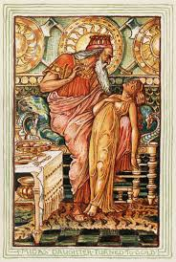
Why is it Difficult?
Midas: I hope that everything I touch becomes gold.
One cannot simply map natural language to a representation that gives rise to reasoning
Meaning
Variability
Ambiguity
Language

Slide 7






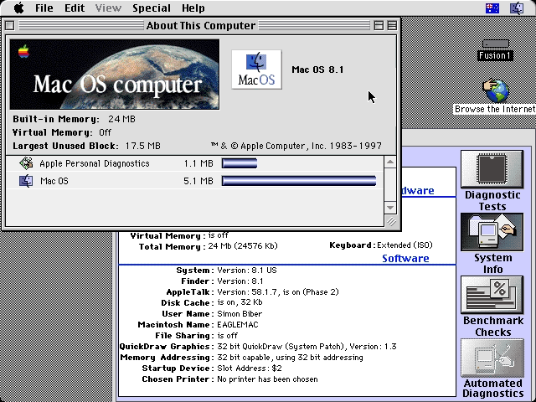
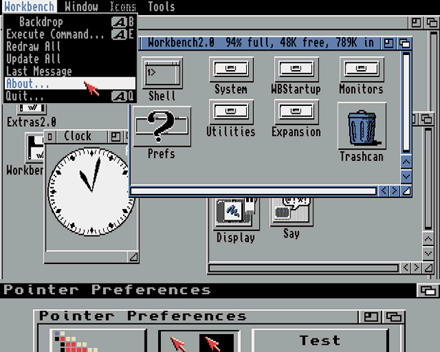
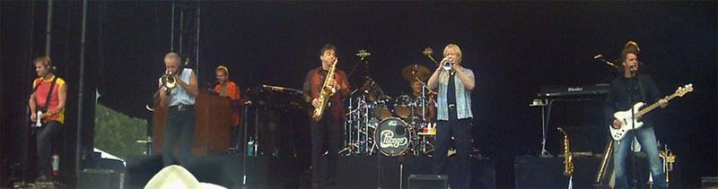
Ambiguity
It’s a version of Chicago – the standard classic Macintosh menu font, with that distinctive thick diagonal in the ”N”.
Chicago was used by default for Mac menus through MacOS 7.6, and OS 8 was released mid-1997..
Chicago VIII was one of the early 70s-era Chicago albums to catch my
ear, along with Chicago II.

Slide 8

Variability in Natural Language Expressions
Determine if Jim Carpenter works for the government
Jim Carpenter works for the U.S. Government.
The American government employed Jim Carpenter.
Jim Carpenter was fired by the US Government.
Jim Carpenter worked in a number of important positions. …. As a press liaison for the IRS, he made contacts in the white house.
Russian interior minister Yevgeny Topolov met yesterday with his US counterpart, Jim Carpenter.
Former US Secretary of Defense Jim Carpenter spoke today…
Conventional programming techniques cannot deal with the variability of expressing meaning nor with the
ambiguity of interpretation
Machine Learning is needed to support abstraction over the raw text, and deal with:
Identifying/Understanding Relations, Entities and Semantic Classes
Acquiring knowledge from external resources; representing knowledge
Identifying, disambiguating & tracking entities, events, etc.
Time, quantities, processes…
Notes:
8

Slide 9
Learning
The process of Abstraction has to be driven by statistical learning methods.
Over the last two decades or so it became clear that machine learning methods are necessary in order to support this process of abstraction.
But—

Slide 10
Classification: Ambiguity Resolution
Illinois’ bored of education [board]
Nissan Car and truck plant; plant and animal kingdom
(This Art) (can N) (will MD) (rust V) V,N,N
The dog bit the kid. He was taken to a veterinarian; a hospital
Tiger was in Washington for the PGA Tour
→ Finance; Banking; World News; Sports
Important or not important; love or hate

Slide 11
Classification
The goal is to learn a function f: X→ Y that maps observations in a domain to one of several categories.
Task: Decide which of {board ,bored } is more likely in the given context:
X: some representation of:
The Illinois’ _______ of education met yesterday…
Y: {board ,bored }
Typical learning protocol:
Observe a collection of labeled examples (x,y) 2 X £ Y
Use it to learn a function f:X→Y that is consistent with the observed examples, and (hopefully) performs well on new, previously unobserved examples.

Slide 12
Classification is Well Understood
Theoretically: generalization bounds (at least for linear models)
How many example does one need to see in order to guarantee good behavior on previously unobserved examples.
Algorithmically: good learning algorithms for linear representations.
Can deal with very high dimensionality (10⁶ features)
Very efficient in terms of computation and # of examples. On-line.
Key issues remaining:
Learning protocols: how to minimize interaction (supervision); how to map domain/task information to supervision; semi-supervised learning; active learning; ranking.
What are the features? No good theoretical understanding here.
Is it sufficient for making progress in NLP?

Slide 13
A Story
(ENGLAND, June, 1989) - Christopher Robin is alive and well. He lives in England. He is the same person that you read about in the book, Winnie the Pooh. As a boy, Chris lived in a pretty home called Cotchfield Farm. When Chris was three years old, his father wrote a poem about him. The poem was printed in a magazine for others to read. Mr. Robin then wrote a book. He made up a fairy tale land where Chris lived. His friends were animals. There was a bear called Winnie the Pooh. There was also an owl and a young pig, called a piglet. All the animals were stuffed toys that Chris owned. Mr. Robin made them come to life with his words. The places in the story were all near Cotchfield Farm. Winnie the Pooh was written in 1925. Children still love to read about Christopher Robin and his animal friends. Most people don't know he is a real person who is grown now. He has written two books of his own. They tell what it is like to be famous.
1. Christopher Robin was born in England. 2. Winnie the Pooh is a title of a book.
3. Christopher Robin’s dad was a magician. 4. Christopher Robin must be at least 65 now.
This is an Inference Problem
Notes:
13
I would like to talk about it in the context of language understanding problems. This is the problem I would like to solve. You are given a short story, a document, a paragraph, which you would like to understand. My working definition for Comprehension here would be “ A process that….”
So, given some statement, I would like to know if they are true in this story or not….
This is a very difficult task…
What do we need to know in order to have a chance to do that? … Many things….;
If I would ask you “Where does Chris live?” you will not be satisfied with an answer – “Chris Lived in a Pretty home”
And, there are probably many other stand-alone tasks of this sort that we need to be able to address, if we want to have a chance to COMPREHEND this story, and answer questions with respect to it.
But comprehending this story, being able to determined the truth of these statements is probably a lot more than that – we need to be able to put these things,
(and what is “these” isnt’ so clear) together.
So, how do we address comprehension? Here is a somewhat cartoon-she view of what has happened in this area over the last 30 years or so?
talk about – I wish I could talk about.
Here is a challenge: write a program that responds correctly to these five questions. Many of us would love to be able to do it.
This is a very natural problem; a short paragraph on Christopher Robin that we all
Know and love, and a few questions about it; my six years old can answer these
Almost instantaneously, yes, we cannot write a program that answers more than, say, 2 out of five questions.
What is involved in being able to answer these? Clearly, there are many “small” local decisions that we need to make.
We need to recognize that there are two Chris’s here. A father an a son. We need to resolve co-reference. We need sometimes
To attach prepositions properly;
The key issue, is that it is not sufficient to solve these local problems – we need to figure out how to put them
Together in some coherent way.
And in this talk, I will focus on this. We describe some recent works that we have done in this direction - …..
What do we know – in the last few years there has been a lot of work – and a considerable success on what I call here ---
Here is a more concrete and easy example -----
There is an agreement today that learning/ statistics /information theory (you name it) is of prime importance to making
Progress in these tasks. The key reason, is that rather than working on these high level difficult tasks, we have moved
To work on well defined disambiguation problems that people felt are at the core of many problems.
And, as an outcome of work in NLP and Learning Theory, there is today a pretty good understanding for how to solve
All these problems – which are essentially the same problem.

Slide 14
Joint Inference with General Constraint StructureEntities and Relations
Joint inference gives good improvement
other | 0.05
per | 0.85
loc | 0.10
other | 0.10
per | 0.60
loc | 0.30
other | 0.05
per | 0.50
loc | 0.45
other | 0.05
per | 0.85
loc | 0.10
other | 0.10
per | 0.60
loc | 0.30
other | 0.05
per | 0.50
loc | 0.45
other | 0.05
per | 0.50
loc | 0.45
Key Questions:
How to learn the model(s)?
What is the source of the knowledge?
How to guide the global inference?
Bernie’s wife, Jane, is a native of Brooklyn
E1 E2 E3
R₁₂
R₂₃
irrelevant | 0.05
spouse_of | 0.45
born_in | 0.50
irrelevant | 0.05
spouse_of | 0.45
born_in | 0.50
irrelevant | 0.05
spouse_of | 0.45
born_in | 0.50
irrelevant | 0.10
spouse_of | 0.05
born_in | 0.85
irrelevant | 0.10
spouse_of | 0.05
born_in | 0.85
Not all learning is from examples; communication-driven learning is essential.
Models could be learned separately/jointly; constraints may come up only at decision time.

Slide 15
Natural Language Understanding
Expectation is a knowledge intensive component
Natural language understanding decisions are global decisions that require
Making (local) predictions driven by different models trained in different ways, at different times/conditions/scenarios
The ability to put these predictions together coherently
Knowledge, that guides the decisions so they satisfy our expectations
Multiple forms of Inference; many boil down to determining best assignment to a collection of variables of interest
But not all…
Natural Language Interpretation is an Inference Process that is best thought of as a knowledge constrained optimization problem, done on top of multiple statistically learned models.
Notes:
15
Give examples for what’s not abductive reasoning
Focus on abductive reasoning
Show the formulation – talk about the boxes
Talk about multiple ways of training – decoupling – relate to abstraction
Examples: semantic parsing (do verb + Prep + commas together; lack of jointly annotated data)
Wikification – Relations (but also add geographical coherence; topical coherence; all interrelated signal that are acquired at different times, different contexts, etc.

Slide 16
Semantic Parsing
X :“What is the largest state that borders New York and Maryland ?"
Successful interpretation involves multiple decisions
What entities appear in the interpretation?
“New York” refers to a state or a city?
How to compose fragments together?
state(next_to()) >< next_to(state())
Y: largest( state( next_to( state(NY) AND next_to (state(MD))))
Notes:
16

Slide 17
Coherency in Semantic Role Labeling
son of a friend
it was kind of you
construction of the library
South of the site
Traveling by bus
book by Hemmingway
his son by his third wife
Predicate-arguments generated should be consistent across phenomena
The touchdown scored by Brady cemented the victory of the Patriots.
Verb | Nominalization | Preposition
Predicate: score A0: Brady (scorer) A1: The touchdown (points scored) | Predicate: win A0: the Patriots (winner) | Sense: 11(6) “the object of the preposition is the object of the underlying verb of the nominalization”
Linguistic Constraints:
A0: the Patriots ⇔ Sense(of): 11(6)
A0: Brady ⇔ Sense(by): 1(1)
Notes:
17

Slide 18
Learning and Inference
Natural Language Decisions are Structured
Global decisions in which several local decisions play a role but there are mutual dependencies on their outcome.
It is essential to make coherent decisions in a way that takes the interdependencies into account. Joint, Global Inference.
Unlike “standard” classification problems, in most interesting NLP problems there is a need to predict values for multiple interdependent variables.
These are typically called Structured Output Problems – and will be the focus of this class.

Slide 19
Statistics or Linguistics?
Statistical approaches were very successful in NLP
But, it has become clear that there is a need to move from strictly Data Driven approaches to Knowledge Driven approaches
Knowledge: Linguistics, Background world knowledge
How to incorporate Knowledge into Learning & Decision Making?
In many respects Structured Prediction addresses this question.
This also distinguishes it from the “standard” study of probabilistic models.

Slide 20
Hard Co-reference Problems
Knowledge representation ?
Requires knowledge Acquisition
The bee landed on the flower because it had/wanted pollen.
Lexical knowledge
John Doe robbed Jim Roy. He was arrested by the police.
The Subj of “rob” is more likely than the Obj of “rob” to be the Obj of “arrest”
Requires an inference framework that can make use of this knowledge
NL interpretation is an inference problem best modelled as a knowledge constrained optimization problem over multiple statistically learned models.

Slide 21
This Class
Problems
that will motivate us
Perspectives
we’ll develop
it’s not only the learning algorithm…
What we’ll do
and how

Slide 22
Some Examples
Part of Speech Tagging
This is a sequence labeling problem
The simplest example where (it seems that) the decision with respect to one word depends on the decision with respect to others.
Named Entity Recognition
This is a sequence segmentation problem
Not all segmentations are possible
There are dependencies among assignments of values to different segments.
Relation Extraction
Works_for (Jim, US-government) ; co-reference resolution
Semantic Role Labeling
Decisions here build on previous decisions (Pipeline Process)
Clear constraints among decisions

Slide 23
Semantic Role Labeling
How to express the constraints on the decisions?
How to “enforce” them?
Who did what to whom, when, where, why,…
I left my pearls to my daughter in my will .
[I]_{A0} left [my pearls]_{A1} [to my daughter]_{A2} [in my will]_{AM-LOC} .
A0 Leaver
A1 Things left
A2 Benefactor
AM-LOC Location
I left my pearls to my daughter in my will .
Overlapping arguments
If A2 is present, A1 must also be present.

Slide 24
Algorithmic Approach
I left my nice pearls to her
candidate arguments
I left my nice pearls to her
[ [ [ [ [
Identify argument candidates
Pruning [Xue&Palmer, EMNLP’04]
Argument Identifier
Binary classification (A-Perc)
Classify argument candidates
Argument Classifier
Multi-class classification (A-Perc)
Inference
Use the estimated probability distributions given by the argument classifier
Use structural and linguistic constraints
Infer the optimal global output
] ] ] ] ]
I left my nice pearls to her
[ [ [ [ [
] ] ] ] ]
I left my nice pearls to her
I left my nice pearls to her
Use the pipeline architecture’s simplicity while maintaining uncertainty: keep probability distributions over decisions & use global inference at decision time.
Page 24

Slide 25
A Lot More Problems
POS/Shallow Parsing/NER
SRL
Parsing/Dependency Parsing
Information Extraction/Relation Extraction
Co-Reference Resolution
Transliteration
Textual Entailment

Slide 26
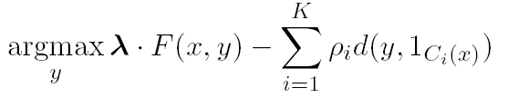
Computational Issues
A MODEL
The Inference Problem
How to solve/make decisions ?
The Learning Problem
How to train the model ?
Decouple?
Joint Learning
vs.
Joint Inference
Difficulty of Annotating Data
Indirect Supervision
Constraints Driven Learning
Semi-supervised Learning
Constraints Driven Learning

Slide 27
Perspective
Models
Generative/ Descriminative
Training
Supervised, Semi-Supervised, indirect supervision
Knowledge
Features
Models Structure
Declarative Information
Approach
Unify treatment
Demistify
Survey key ML techniques used in Structured NLP

Slide 28
This Course
Questions?
Structure
(Some) Lectures by me.
Flipped Structure
You will read stuff
Group discussions: of teaching material and projects
Assignments
Project: A group project; reports and presentations
Presentations: group paper presentations/tutorials (1-2 papers each)
4 critical surveys
Assignment 0 – Machine Learning Preparation.
Expectations
This is an advanced course. I view my role as guiding you through the material and helping you in your first steps as an researcher. I expect that your participation in class, reading assignments and presentations will reflect independence, mathematical rigor and critical thinking

Slide 29
Organization of Material
Dimension I: Models
On Line, Perceptron Based
Exponential Models (Logistic Regression, HMMs, CRFs)
SVMs
Constrained Conditional Models (ILP based formulations)
Neural Networks
(Markov Logic Networks?)
Dimension II: Learning & Inference Tasks
Basic sequential and Structured Prediction
Training Paradigms (Unsupervised & Semi Supervised; Indirect Supervision)
Latent Representations
Inference and Approximate Inference
Dimension III: Applications
There is a lot of overlaps, several things can belong to several categories. It will make it more interesting.

Slide 30
Projects
Project: Chosen by you
We can provide ideas
Small groups (2-3)
4 steps:
proposal,
intermediary report #1,
Intermediary report #2,
Final report and presentation.

Slide 31
Presentations/Tutorial Groups (Tentative)
EXP Models/CRF
Structured SVM
MLN
Optimization
Features
CCM
Structured Perceptron
Neural Networks
Inference
Latent Representations

Slide 32
Summary
Class will be taught (mostly) as a flipped seminar + a project
Tues/Thurs meetings might be replaced by Friday morning meetings, say.
Critical readings of papers + Projects + Presentation
Attendance is mandatory
If you want to drop the class, do it quickly – not to affect the projects.
Web site with all the information is already available .
On Thursday, I will hand you a Homework 0:
A ML prerequisites Exam (take home: 3 hours).

