Slide 1
CIS 700 Advanced Machine Learning for NLP Review 1: Supervised Learning, Binary Classifiers
Dan Roth
Department of Computer and Information Science
University of Pennsylvania
Augmented and modified by Vivek Srikumar

Slide 2
Supervised learning: General setting
Given: Training examples of the form <x, f(x)>
The function f is an unknown function
The input x is represented in a feature space
Typically x 2 {0,1}^{n} or x 2 <^{n}
For a training example x, f(x) is called the label
Goal: Find a good approximation for f
The label
Binary classification: f(x) 2 {-1,1}
Multiclass classification: f(x) 2 {1, 2, 3, ☹, K}
Regression: f(x) 2 <

Slide 3
Nature of applications
Humans can perform a task, but can’t describe how they do it
Eg: Object detection in images
Context Sensitive Spelling
The desired function is hard to obtain in closed form
Eg: Stock market
The subject argument of a verb

Slide 4
Binary classification
Spam filtering
Is an email spam or not?
Recommendation systems
Given user’s movie preferences, will she like a new movie?
Malware detection
Is an Android app malicious?
Time series prediction
Will the future value of a stock increase or decrease with respect to its current value?

Slide 5
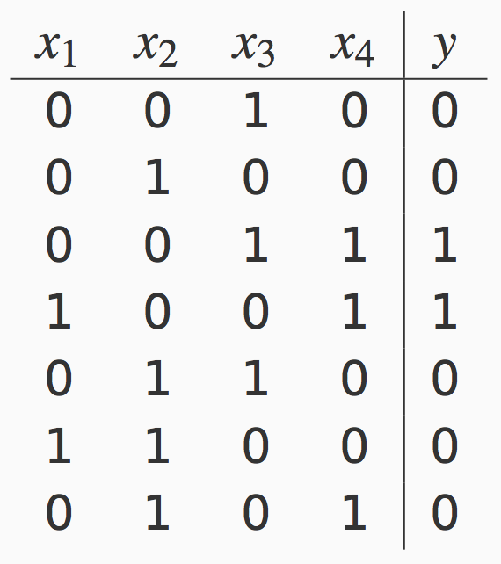
The fundamental problem: Machine learning is ill-posed!
x₁
Unknown function
x₂
x₃
y = f(x₁, x₂, x₃, x₄)
x₄
Can you learn this function?
What is it?

Slide 6
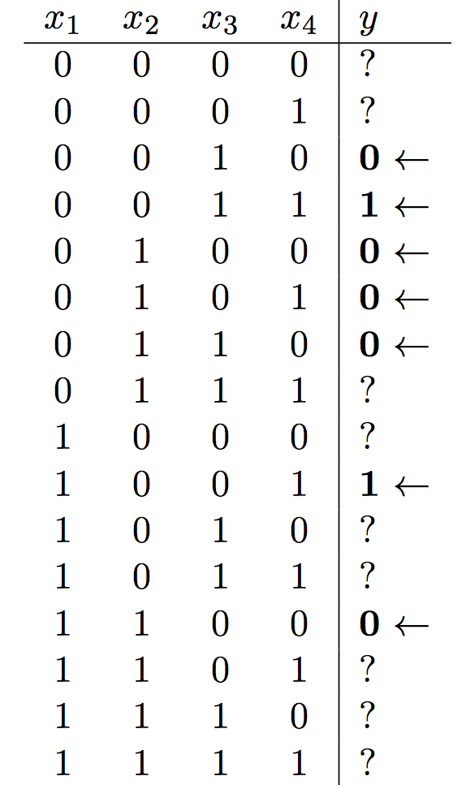
Is learning possible at all?
There are 2¹⁶ = 65536 possible Boolean functions over 4 inputs
Why? There are 16 possible outputs. Each way to fill these 16 slots is a different function, giving 2¹⁶ functions.
We have seen only 7 outputs
We cannot know what the rest are without seeing them
Think of an adversary filling in the labels every time you make a guess at the function

Slide 7
Solution: Restricted hypothesis space
A hypothesis space is the set of possible functions we consider
We were looking at the space of all Boolean functions
Choose a hypothesis space that is smaller than the space of all functions
Only simple conjunctions (with four variables, there are only 16 conjunctions without negations)
m-of-n rules: Pick a set of n variables. At least m of them must be true
Linear functions
How do we pick a hypothesis space?
Using some prior knowledge (or by guessing)
What if the hypothesis space is so small that nothing in it agrees with the data?
We need a hypothesis space that is flexible enough

Slide 8
Where are we?
Supervised learning: The general setting
Linear classifiers
The Perceptron algorithm
Learning as optimization
Support vector machines
Logistic Regression

Slide 9
Linear Classifiers
Input is a n dimensional vector x
Output is a label y 2 {-1, 1}
Linear threshold units classify an example x as
Classification rule= sgn(b+ w^{T}x) = sgn(b +∑w_{i} x_{i})
b + w^{T}x ¸ 0 ) Predict y = 1
b + w^{T}x < 0 ) Predict y = -1
For now

Slide 10
Linear Classifiers
Input is a n dimensional vector x
Output is a label y 2 {-1, 1}
Linear threshold units classify an example x as
Classification rule= sgn(b+ w^{T}x) = sgn(b +∑w_{i} x_{i})
b + w^{T}x ¸ 0 ) Predict y = 1
b + w^{T}x < 0 ) Predict y = -1
For now
Called the activation

Slide 11
The geometry of a linear classifier
sgn(b +w₁ x₁ + w₂x₂)
We only care about the sign, not the magnitude
b +w₁ x₁ + w₂x₂=0
+
+
+
+
+
+
+
+
[w₁ w₂]
x₁
-
-
-
-
-
-
-
In n dimensions,
a linear classifier
represents a hyperplane that separates the space into two half-spaces
-
-
-
-
-
-
-
-
-
-
-
x₂

Slide 12
Linear classifiers are an expressive hypothesis class
Many functions are linear
Conjunctions
y = x₁ Æ x₂ Æ x₃ y = sgn(-3 + x₁ + x₂ + x₃) W = (1,1,1); b = -3
At least m-of-n functions
We will see later in the class that many structured predictors are linear functions too
Often a good guess for a hypothesis space
Some functions are not linear
The XOR function
Non-trivial Boolean functions

Slide 13
XOR is not linearly separable
No line can be drawn to separate the two classes
-
-
-
-
-
-
-
+
+
+
-
-
-
-
+
+
-
-
-
-
-
+
+
+
-
-
x₁
-
-
-
-
-
-
-
+
-
-
+
+
+
-
-
-
+
-
-
+
-
-
+
+
-
-
x₂

Slide 14
Even these functions can be made linear
The trick: Change the representation
These points are not separable in 1-dimension by a line
What is a one-dimensional line, by the way?

Slide 15
Even these functions can be made linear
The trick: Use feature conjunctions
Transform points: Represent each point x in 2 dimensions by (x, x²)
Now the data is linearly separable in this space!
Exercise: How do you apply this for the XOR case?

Slide 16
Almost linearly separable data
sgn(b +w₁ x₁ + w₂x₂)
Training data is almost separable, except for some noise
How much noise do we allow for?
b +w₁ x₁ + w₂x₂=0
+
+
+
-
+
+
+
+
+
x₁
-
-
-
-
-
-
-
-
-
-
-
-
-
-
-
-
-
x₂

Slide 17
Training a linear classifier
Three cases to consider:
Training data is linearly separable
Simple conjunctions, general linear functions, etc
Training data is linearly inseparable
XOR, etc
Training data is almost linearly separable
Noise in the data
We could allow some the classifier to make some mistakes on the training data to account for these

Slide 18
Simplifying notation
We can stop writing b at each step because of the following notational sugar:
The prediction function is sgn(b + w^{T}x)
Rewrite x as [1, x] ! x’
Rewrite w as [b, w] ! w’
increases dimensionality by one
But we can write the prediction as sgn(w’^{T}x’)
We will not show b, and instead fold the bias term into the input by adding an extra feature
But remember that it is there

Slide 19
Where are we?
Supervised learning: The general setting
Linear classifiers
The Perceptron algorithm
Learning as optimization
Support vector machines
Logistic Regression

Slide 20
The Perceptron algorithm
Rosenblatt 1958
The goal is to find a separating hyperplane
For separable data, guaranteed to find one
An online algorithm
Processes one example at a time
Several variants exist (will discuss briefly at towards the end)

Slide 21
The algorithm
Given a training set D = {(x,y)}, x 2 <^{n}, y 2 {-1,1}
Initialize w = 0 2 <^{n}
For epoch = 1 … T:
For each training example (x, y) 2 D:
Predict y’ = sgn(w^{T}x)
If y ≠ y’, update w Ã w + y x
Return w
Prediction: sgn(w^{T}x)

Slide 22
The algorithm
Given a training set D = {(x,y)}
Initialize w = 0 2 <^{n}
For epoch = 1 … T:
For each training example (x, y) 2 D:
Predict y’ = sgn(w^{T}x)
If y ≠ y’, update w Ã w + y x
Return w
Prediction: sgn(w^{T}x)
T is a hyperparameter to the algorithm
In practice, good to shuffle D before the inner loop
Update only on an error.
Perceptron is an mistake-driven algorithm.

Slide 23
Geometry of the perceptron update
Predict
Update
After
w Ã w + y x
w_{old}
w_{new}
(x, +1)
(x, +1)
(x, +1)
Exercise: Verify for yourself that a similar picture can be drawn for negative examples too

Slide 24
Convergence
Convergence theorem
If there exist a set of weights that are consistent with the data (i.e. the data is linearly separable), the perceptron algorithm will converge.
How long?
Cycling theorem
If the training data is not linearly separable, then the learning algorithm will eventually repeat the same set of weights and enter an infinite loop

Slide 25
Margin
The margin of a hyperplane for a dataset is the distance between the hyperplane and the data point nearest to it.
-
-
+
+
+
-
+
+
-
-
-
-
+
+
+
-
-
-
-
-
-
-
-
-
-
Margin with respect to this hyperplane
-

Slide 26
Margin
The margin of a hyperplane for a dataset is the distance between the hyperplane and the data point nearest to it.
The margin of a data set (°) is the maximum margin possible for that dataset using any weight vector.
-
-
+
+
+
-
+
+
-
-
-
-
+
+
+
-
-
-
-
-
-
-
-
-
-
-
Margin of the data

Slide 27
The mistake bound theorem [Novikoff 1962]
Let D={(x_{i}, y_{i})} be a labeled dataset that is separable
Let || x_{i}|| · R for all examples.
Let ° be the margin of the dataset D.
Then, the perceptron algorithm will make at most R²/°² mistakes on the data.
Proof idea: We know that there is some true weight vector w*. Each perceptron update reduces the angle between w and w*.
Note: The theorem doesn’t depend on the number of examples we have.

Slide 28
Beyond the separable case
The good news
Perceptron makes no assumption about data distribution
Even adversarial
After a fixed number of mistakes, you are done. Don’t even need to see any more data
The bad news: Real world is not linearly separable
Can’t expect to never make mistakes again
What can we do: more features, try to be linearly separable if you can

Slide 29
Variants of the algorithm
So far: We return the final weight vector
Averaged perceptron
Remember every weight vector in your sequence of updates.
Weigh each weight vector as a function of the number of examples that survived this weight vector.
Make a prediction with the weighted average of the weight vectors.
Comes with strong theoretical guarantees about generalization.
Need to be smart about implementation.

Slide 30
Next steps
What is the perceptron doing?
Error-bound exists, but over training data
Is it minimizing a loss function? Can we say something about future errors?
More on different loss functions
Support vector machine
A look at regularization
Logistic Regression

