Slide 1
CIS 700 Advanced Machine Learning for NLP Review 2: Loss minimization, SVM and Logistic Regression
Dan Roth
Department of Computer and Information Science
University of Pennsylvania
Augmented and modified by Vivek Srikumar

Slide 2
Perceptron algorithm
Given a training set D = {(x,y)}, x 2 <^{n}, y 2 {-1,1}
Initialize w = 0 2 <^{n}
For epoch = 1 … T:
For each training example (x, y) 2 D:
Predict y’ = sgn(w^{T}x)
If y ≠ y’, update w Ã w + y x
Return w
Prediction: sgn(w^{T}x)
Or equivalently,
If y w^{T}x · 0, update w Ã w + y x

Slide 3
Where are we?
Supervised learning: The general setting
Linear classifiers
The Perceptron algorithm
Support vector machines
Learning as optimization
Logistic Regression

Slide 4
What is the Perceptron algorithm doing?
Mistake-bound on the training set
What about future examples? Can we say something about them?
Can we say anything about the future?

Slide 5
Recall: Margin
The margin of a hyperplane for a dataset is the distance between the hyperplane and the data point nearest to it.
-
-
+
+
+
-
+
+
-
-
-
-
+
+
+
-
-
-
-
-
-
-
-
-
-
Margin with respect to this hyperplane
-

Slide 6
Which line is a better choice? Why?
-
-
+
+
+
-
+
+
-
-
-
-
+
+
+
-
-
-
-
-
-
-
-
-
-
-
h₂
h₁
-
-
+
+
+
-
+
+
-
-
-
-
+
+
+
-
-
-
-
-
-
-
-
-
-
-

Slide 7
Which line is a better choice? Why?
+
-
-
+
+
+
-
+
+
-
-
-
-
+
+
+
-
-
-
-
A new example,
not from the
training set might be misclassified if the margin is smaller
-
-
-
-
-
-
-
h₂
h₁
+
-
-
+
+
+
-
+
+
-
-
-
-
+
+
+
-
-
-
-
-
-
-
-
-
-
-

Slide 8
Maximal margin and generalization
Larger margin gives better generalization
Note: learning is done on a training set
You can minimize your performance on the training data
But, you care about your performance on previousely unseen data
The notion of a margin is related to the notion of the expressivity of the hypothesis space
In this case, a hypothesis space of linear functions
Maximizing margin => fewer errors on future examples
This idea forms the basis of many learning algorithms
SVM, averaged perceptron, AdaBoost,…

Slide 9
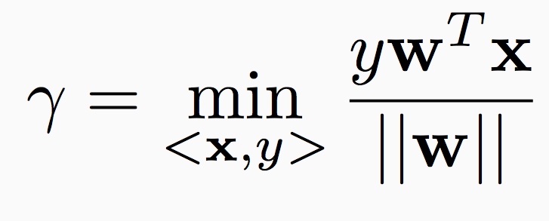
Maximizing margin
Margin = distance of the closest point from the hyperplane
We want max_{w} °

Slide 10
Recall: The geometry of a linear classifier
sgn(b +w₁ x₁ + w₂x₂)
b +w₁ x₁ + w₂x₂=0
+
+
+
+
+
+
+
+
[w₁ w₂]
x₁
-
-
-
-
-
-
-
-
-
We only care about the sign, not the magnitude
-
-
-
-
-
-
-
-
-
x₂

Slide 11
Maximizing margin
Margin = distance of the closest point from the hyperplane
We want max_{w} °
We only care about the sign of w in the end and not the magnitude
Set the activation of the closest point to be 1 and allow w to adjust itself
Sometimes called the functional margin
max_{w} ° is equivalent to min_{w} ||w||in this setting

Slide 12
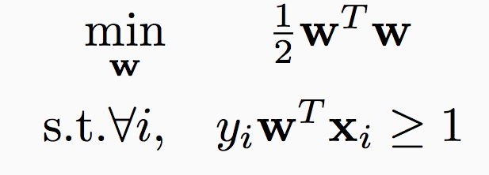
Max-margin classifiers
Learning a classifier:
min ||w|| such that the activation of the closest point is 1
Learning problem:
This is called the “hard” Support Vector Machine
We will look at solving this optimization problem later

Slide 13
What if the data is not separable?
Hard SVM

Slide 14
What if the data is not separable?
Hard SVM
This is a constrained optimization problem
If the data is not separable, there is no w that will classify the data
Infeasible problem, no solution!
Notes:
Think about why 1 not zero

Slide 15
Dealing with non-separable data
Key idea: Allow some examples to “break into the margin”
-
+
-
+
+
+
-
-
+
+
-
-
-
-
+
+
+
-
-
-
-
-
-
-
-
-
-
-
This separator has a large enough margin that it should generalize well. So, while computing margin, ignore the examples that make the margin smaller or the data inseparable.

Slide 16
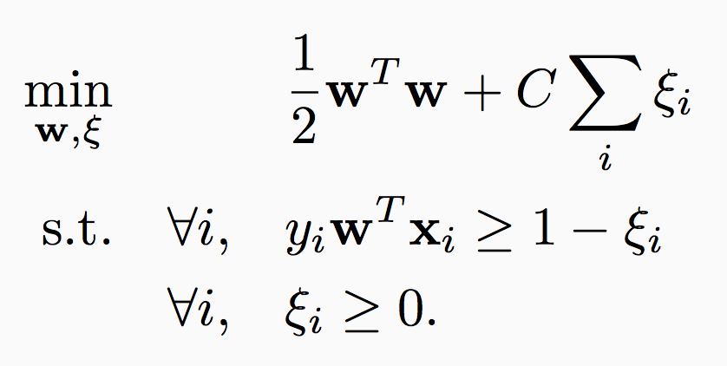
Soft SVM
Maximize margin
Hard SVM:
Introduce one slack variable »_{i} per example and require y_{i}w^{T}x_{i} ¸ 1 - »_{i} and »_{i} ¸ 0
New optimization problem for learning
Every example has an functional margin of at least 1

Slide 17
Soft SVM
Maximize margin
Hard SVM:
Introduce one slack variable »_{i} per example and require y_{i}w^{T}x_{i} ¸ 1 - »_{i} and »_{i} ¸ 0
Soft SVM learning:
Every example is at least at a distance 1 from the hyperplane
Maximize margin
Tradeoff between the two terms
Minimize total slack (i.e allow as few examples as possible to violate the margin)

Slide 18
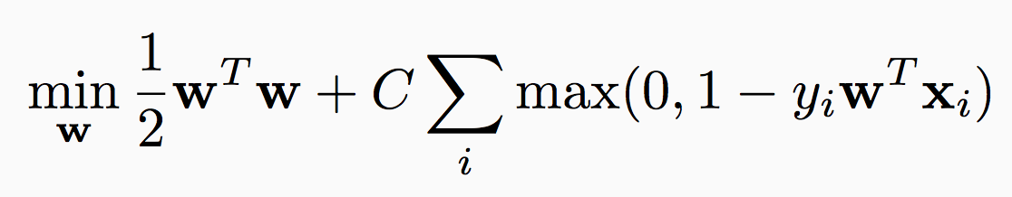
Soft SVM
Maximize margin
Tradeoff between the two terms
Eliminate the slack variables to rewrite this as
This form is more interpretable
Minimize total slack (i.e allow as few examples as possible to violate the margin)

Slide 19
Maximizing margin and minimizing loss
Three cases
An example is correctly classified: penalty = 0
An example is incorrectly classified: penalty = 1 – y_{i} w^{T}x_{i}
An example is correctly classified but within the margin: penalty = 1 – y_{i} w^{T}x_{i}
This is the hinge loss function
Maximize margin
Penalty for the prediction according to the weight vector

Slide 20
The Hinge Loss

Slide 21
SVM objective function
Regularization term:
Maximize the margin
Imposes a preference over the hypothesis space and pushes for better generalization
Can be replaced with other regularization terms which impose other preferences
Empirical Loss:
Hinge loss
Penalizes weight vectors that make mistakes
Can be replaced with other loss functions which impose other preferences
A hyper-parameter that controls the tradeoff between a large margin and a small hinge-loss

Slide 22
Where are we?
Supervised learning: The general setting
Linear classifiers
The Perceptron algorithm
Support vector machines
Learning as optimization
Logistic Regression

Slide 23
Computational Learning Theory
Studies theoretical issues about the importance of representation, sample complexity (how many examples are enough), computational complexity (how fast can I learn)
Led to algorithms such as support vector machine and boosting
No assumptions about the distribution of examples
But assume that both training and test examples come from the same distribution
Provides bounds that depend on the size of the hypothesis class

Slide 24
Learning as loss minimization
Collect some annotated data. More is generally better
Pick a hypothesis class
Eg: binominal, linear classifiers
Also, decide on how to impose a preference over hypotheses
Choose a loss function
Eg: negative log-likelihood
Decide on how to penalize incorrect decisions
Minimize the loss
Eg: Set derivative to zero, more complex algorithm

Slide 25
Learning as loss minimization: The setup
Examples <x, y> are created from some unknown distribution P
Identify a hypothesis class H
Define penalty for incorrect predictions:
The loss function L
Learning: Pick a function f 2 H to minimize expected loss
min_{H} E_{P}[L]
Use samples from P to estimate expectation:
The training set D = {<x, y>}
“Empirical risk minimization”
min_{f} _{2 H} ∑_{D} L(y, f(x))

Slide 26
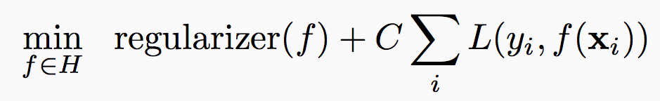
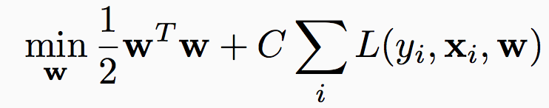
Regularized loss minimization: Logistic regression
Learning:
With linear classifiers:
What is a loss function?
Loss functions should penalize mistakes
We are minimizing average loss over the training data
What is the ideal loss function for classification?

Slide 27
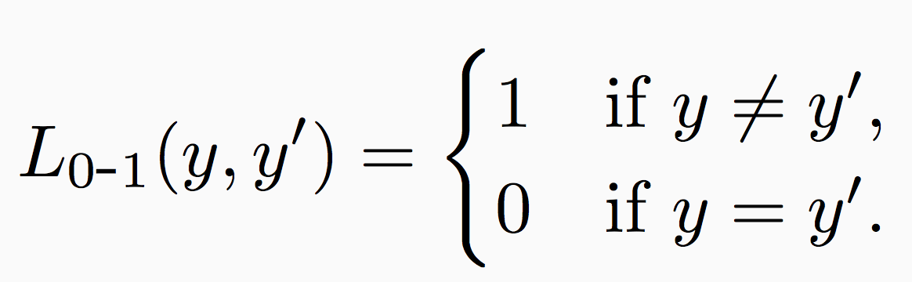
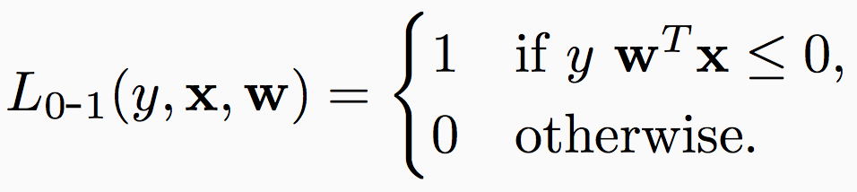
The 0-1 loss
Penalize classification mistakes between true label y and prediction y’
For linear classifiers, the prediction y’ = sgn(w^{T}x)
Mistake if y w^{T}x · 0
Minimizing 0-1 loss is intractable. Need surrogates

Slide 28
Loss functions
Typically plotted as a function of yw^{T}x
SVM

Slide 29
Support Vector Machines: Summary
SVM = linear classifier + regularization
Recall that perceptron did not have regularization
Ideally, we would like to minimize 0-1 loss, but can not
SVM minimizes hinge loss
Variants exist
Will not cover
Dual formulation, support vectors, kernels

Slide 30
Solving the SVM optimization problem
This function is convex in w

Slide 31
Convex functions
A function f is convex if for every u, v in the domain, and for every a 2 [0,1] we have
f(a u + (1-a) v) · a f(u) + (1-a) f(v)
The necessary condition for w* to be a minimum for a function f: df(w*)/dw = 0
For convex functions, this is both necessary and sufficient
f(u)
f(v)
u
v

Slide 32
Solving the SVM optimization problem
This function is convex in w
This is a quadratic optimization problem because the objective is quadratic
Earlier methods: Used techniques from Quadratic Programming
Very slow
No constraints, can use gradient descent
Still very slow!

Slide 33
Gradient descent for SVM
Gradient descent algorithm to minimize a function f(w):
Initialize solution w
Repeat
Find the gradient of f at w: r f
Set w Ã w – r r f
Gradient of the SVM objective requires summing over the entire training set
Slow
Does not really scale

Slide 34
Stochastic gradient descent for SVM
Given a training set D = {(x,y)}, x 2 <^{n}, y 2 {-1,1}
Initialize w = 0 2 <^{n}
For epoch = 1 … T:
For each training example (x, y) 2 D:
Treat (x,y) as a full dataset and take the derivative of the SVM objective at the current w to be r
w Ã w – r r
Return w
What is the gradient of the hinge loss with respect to w?
(The hinge loss is not a differentiable function!)

Slide 35
Stochastic sub-gradient descent for SVM
Given a training set D = {(x,y)}, x 2 <^{n}, y 2 {-1,1}
Initialize w = 0 2 <^{n}
For epoch = 1 … T:
For each training example (x, y) 2 D:
If y w^{T}x · 1,
then w Ã (1-r)w + r C y x
else w Ã (1-r) w
Return w
Prediction: sgn(w^{T}x)
Compare to the perceptron algorithm!
r: learning rate, many tweaks possible
Perceptron update:
If y w^{T}x · 0, update w Ã w + r y x

Slide 36
SVM summary from optimization perspective
Minimize regularized hinge loss
Solve using stochastic gradient descent
Very fast, run time does not depend on number of examples
Compare with Perceptron algorithm: Perceptron does not maximize margin width
Perceptron variants can force a margin
Convergence criterion is an issue; can be too aggressive in the beginning and get to a reasonably good solution fast; but convergence is slow for very accurate weight vector
Another successful optimization algorithm:
Dual coordinate descent, implemented in liblinear
Questions?

Slide 37
Where are we?
Supervised learning: The general setting
Linear classifiers
The Perceptron algorithm
Support vector machine
Learning as optimization
Logistic Regression

Slide 38
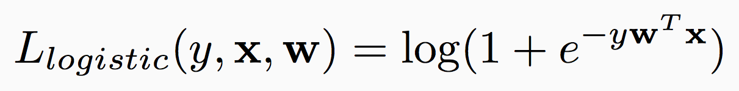
Regularized loss minimization: Logistic regression
Learning:
With linear classifiers:
SVM uses the hinge loss
Another loss function: The logistic loss

Slide 39
Loss functions
Typically plotted as a function of yw^{T}x
SVM
Logistic regression
Smooth, differentiable

Slide 40
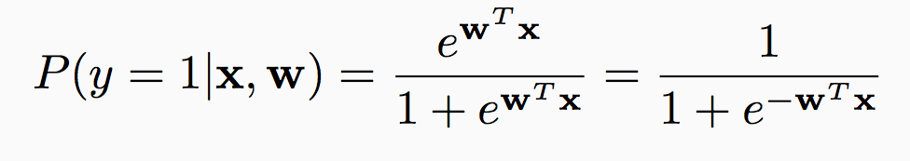
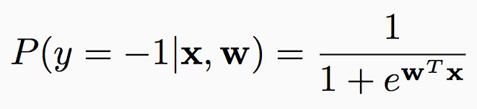
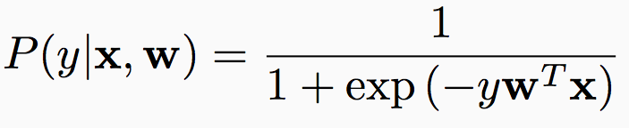
The probabilistic interpretation
Suppose we believe that the labels are generated using the following probability distribution:
Predict label = 1 if P(1 | x, w) > P(-1 | x, w)
Equivalent to predicting 1 if w^{T}x ¸ 0
Why?

Slide 41
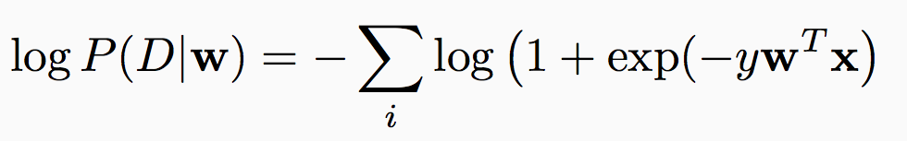
The probabilistic interpretation
Suppose we believe that the labels are generated using the following probability distribution:
What is the log-likelihood of seeing a dataset D = {<x_{i}, y_{i}>} given a weight vector w?

Slide 42
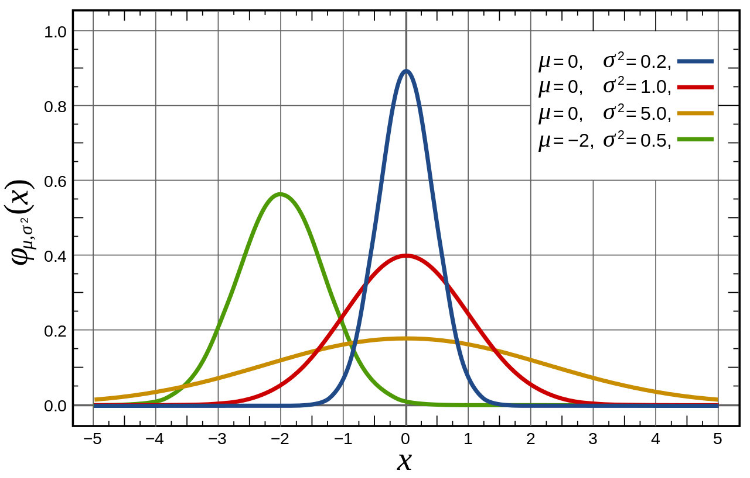
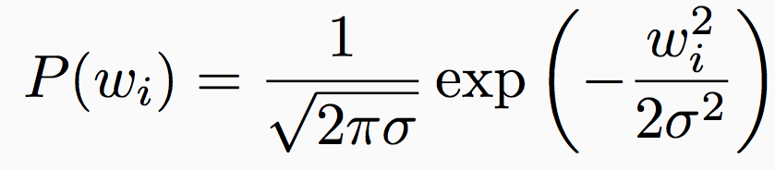
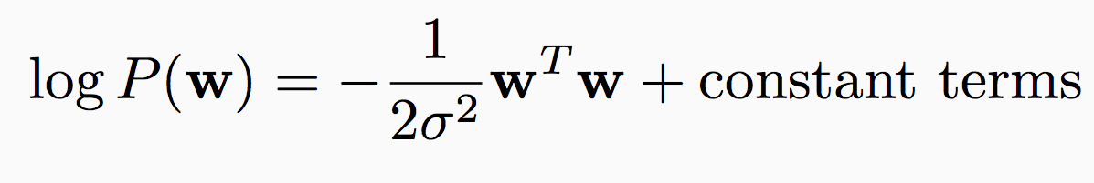
Prior distribution over the weight vectors
A prior balances the tradeoff between the likelihood of the data and existing belief about the parameters
Suppose each weight w_{i} is drawn independently from the normal distribution centered at zero with variance ¾²
Bias towards smaller weights
Probability of the entire weight vector:
Source: Wikipedia

Slide 43
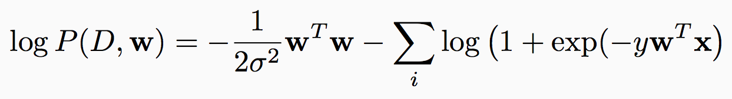
Regularized logistic regression
What is the probability of seeing a dataset D = {<x_{i}, y_{i}>} and a weight vector w?
P(w | D) / P(D, w) = P(D | w) P(w)
Learning: Find weight vector by maximizing the posterior distribution P(w | D)
Once again, regularized loss minimization! This is the Bayesian interpretation of regularization
Exercise: Derive the stochastic gradient descent algorithm for logistic regression.

Slide 44
Regularized loss minimization
Learning objective for both SVM, logistic regression:
loss over training data + regularizer
Different loss functions
Hinge loss vs. logistic loss
Same regularizer, but different interpretation
Margin vs prior
Hyper-parameter controls tradeoff between the loss and regularizer
Other regularizers/loss functions also possible
Questions?

Slide 45
Review of binary classification
Supervised learning: The general setting
Linear classifiers
The Perceptron algorithm
Support vector machine
Learning as optimization
Logistic Regression
Questions?

