Slide 1
CIS 700 Advanced Machine Learning for NLP Multiclass classification: Local and Global Views
Dan Roth
Department of Computer and Information Science
University of Pennsylvania
Augmented and modified by Vivek Srikumar

Slide 2
Admin Stuff
Class web page http://www.cis.upenn.edu/~danroth/Teaching/CIS-700-006/
Piazza
HW0 ???

Slide 3
Multiclass classification
Introduction
Combining binary classifiers
One-vs-all
All-vs-all
Error correcting codes
Training a single classifier
Multiclass SVM
Constraint classification

Slide 4
What is multiclass classification?
An input can belong to one of K classes
Training data: Input associated with class label (a number from 1 to K)
Prediction: Given a new input, predict the class label
Each input belongs to exactly one class. Not more, not less.
Otherwise, the problem is not multiclass classification
If an input can be assigned multiple labels (think tags for emails rather than folders), it is called multi-label classification

Slide 5
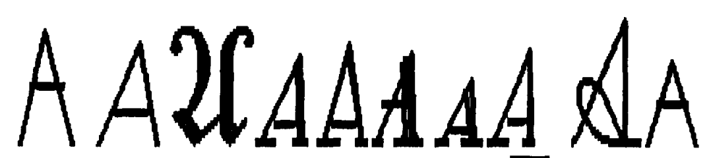




Example applications: Images
Input: hand-written character; Output: which character?
Input: a photograph of an object; Output: which of a set of categories of objects is it?
Eg: the Caltech 256 dataset
all map to the letter A
Car tire
Car tire
Duck
laptop

Slide 6
Example applications: Language
Input: a news article; Output: which section of the newspaper should it belong to?
Input: an email; Output: which folder should an email be placed into?
Input: an audio command given to a car; Output: which of a set of actions should be executed?

Slide 7
Where are we?
Introduction
Combining binary classifiers
One-vs-all
All-vs-all
Error correcting codes
Training a single classifier
Multiclass SVM
Constraint classification

Slide 8
Binary to multiclass
Can we use a binary classifier to construct a multiclass classifier?
Decompose the prediction into multiple binary decisions
How to decompose?
One-vs-all
All-vs-all
Error correcting codes

Slide 9
General setting
Input x 2 <^{n}
The inputs are represented by their feature vectors
Output y 2 {1, 2, ☹, K}
These classes represent domain-specific labels
Learning: Given a dataset D = {<x_{i}, y_{i}>}
Need to specify a learning algorithm that takes uses D to construct a function that can predict y given x
Goal: find a predictor that does well on the training data and has low generalization error
Prediction/Inference: Given an example x and the learned function (often also called the model)
Using the learned function, compute the class label for x

Slide 10
1. One-vs-all classification
Assumption: Each class individually separable from all the others
Learning: Given a dataset D = {<x_{i}, y_{i}>},
Note: x_{i} 2 <^{n}, y_{i} 2 {1, 2, ☹, K}
Decompose into K binary classification tasks
For class k, construct a binary classification task as:
Positive examples: Elements of D with label k
Negative examples: All other elements of D
Train K binary classifiers w₁, w₂, ☹ w_{K} using any learning algorithm we have seen
Prediction: “Winner Takes All”
argmax_{i} w_{i}^{T}x
Question: What is the dimensionality of each w_{i}?

Slide 11
Visualizing One-vs-all
From the full dataset, construct three binary classifiers, one for each class
w_{blue}^{T}x > 0 for blue inputs
w_{red}^{T}x > 0 for red inputs
w_{green}^{T}x > 0 for green inputs
Notation: Score for blue label
Winner Take All will predict the right answer. Only the correct label will have a positive score

Slide 12
One-vs-all may not always work
Black points are not separable with a single binary classifier
The decomposition will not work for these cases!
w_{blue}^{T}x > 0 for blue inputs
w_{red}^{T}x > 0 for red inputs
w_{green}^{T}x > 0 for green inputs
???

Slide 13
One-vs-all classification: Summary
Easy to learn
Use any binary classifier learning algorithm
Problems
No theoretical justification
Calibration issues
We are comparing scores produced by K classifiers trained independently. No reason for the scores to be in the same numerical range!
Might not always work
Yet, works fairly well in many cases, especially if the underlying binary classifiers are tuned, regularized

Slide 14
2. All-vs-all classification
Sometimes called one-vs-one
Assumption: Every pair of classes is separable
Learning: Given a dataset D = {<x_{i}, y_{i}>},
Note: x_{i} 2 <^{n}, y_{i} 2 {1, 2, ☹, K}
For every pair of labels (j, k), create a binary classifier with:
Positive examples: All examples with label j
Negative examples: All examples with label k
Train classifiers in all
Prediction: More complex, each label get K-1 votes
How to combine the votes? Many methods
Majority: Pick the label with maximum votes
Organize a tournament between the labels

Slide 15
All-vs-all classification
Every pair of labels is linearly separable here
When a pair of labels is considered, all others are ignored
Problems
O(K²) weight vectors to train and store
Size of training set for a pair of labels could be very small, leading to overfitting
Prediction is often ad-hoc and might be unstable
Eg: What if two classes get the same number of votes? For a tournament, what is the sequence in which the labels compete?

Slide 16
Summary: One-vs-All vs. All vs. All
Assume m examples, k class labels.
For simplicity, say, m/k in each.
One vs. All:
classifier f_{i}: m/k (+) and (k-1)m/k (-)
Decision:
Evaluate k linear classifiers and do Winner Takes All (WTA):
f(x) = argmax_{i} f_{i}(x) = argmax_{i} w_{i}^{T}x
All vs. All:
Classifier f_{ij}: m/k (+) and m/k (-)
More expressivity, but less examples to learn from.
Decision:
Evaluate k² linear classifiers; decision sometimes unstable.
What type of learning methods would prefer All vs. All (efficiency-wise)?
(Think about Dual/Primal)

Slide 17
A Challenge: One-vs-All vs. All vs. All
You are asked to implement a generic multiclass linear classification box.
Which method will you use, One vs All or All vs All?
Dual or Primal?
Are we going to use kernels or not?
Primal: algorithms are O(# of examples)
Dual: algorithms are O(# of examples)²
Why?
 | One vs All | All vs All
Primal | k m | k² m/k
Dual | k m² | k² (m/k)² = m²

Slide 18
Error Correcting Codes Decomposition
1-vs-all uses k classifiers for k labels; can you use only log₂ k?
Reduce the multi-class classification to random binary problems.
Choose a “code word” for each label.
K=8: all we need is 3 bits, three classifiers
Rows: An encoding of each class (k rows)
Columns: L dichotomies of the data, each corresponds to a new classification problem
Extreme cases:
1-vs-all: k rows, k columns
k rows log₂ k columns
Each training example is mapped to one example per column
(x,3) → {(x,P1), +; (x,P2), -; (x,P3), -; (x,P4), +}
To classify a new example x:
Evaluate hypothesis on the 4 binary problems
{(x,P1) , (x,P2), (x,P3), (x,P4),}
Choose label that is most consistent with the results.
Use Hamming distance (bit-wise distance)
Nice theoretical results as a function of the performance of the P_{i} s (depending on code & size)
Potential Problems?
Label | P1 | P2 | P3 | P4
1 | - | + | - | +
2 | - | + | + | -
3 | + | - | - | +
4 | + | - | + | +
k | - | + | - | -
Can you separate any dichotomy?
Notes:
However, a PROBLEM W/ DECOMPOSITION TECHNIQUES
Induced Binary problems are optimized INDEPENDENTLY
NO GLOBAL METRIC IS USED.
FOR EXAMPLE, in MC,
we don’t care about 1 vs rest performance
only about the FINAL MC Classification
TRANSISTION:
We can look at a simple example:

Slide 19
Decomposition methods: Summary
Questions?
General idea
Decompose the multiclass problem into many binary problems
We know how to train binary classifiers
Prediction depends on the decomposition
Constructs the multiclass label from the output of the binary classifiers
Learning optimizes local correctness
Each binary classifier does not need to be globally correct
That is, the classifiers do not need to agree with each other
E.g., two classifiers might think that a given example “belongs” to them.
The learning algorithm is not even aware of the prediction procedure!
Poor decomposition gives poor performance
Difficult local problems, can be “unnatural”
Eg. for ECOC, why should the binary problems be separable?
Not clear how to generalize multi-class to problems with a very large # of output variables.
Examples? What’s unique about these problems?

Slide 20
Where are we?
Introduction
Combining binary classifiers
One-vs-all
All-vs-all
Error correcting codes
Training a single classifier
Multiclass SVM
Constraint classification

Slide 21
Motivation
Decomposition methods
Do not account for how the final predictor will be used
Do not optimize any global measure of correctness
Goal: To train a multiclass classifier that is “global”

Slide 22
Recall: Margin for binary classifiers
The margin of a hyperplane for a dataset is the distance between the hyperplane and the data point nearest to it.
-
-
+
+
+
-
+
+
-
-
-
-
+
+
+
-
-
-
-
-
-
-
-
-
-
Margin with respect to this hyperplane
-

Slide 23
Multiclass margin
Defined as the score difference between the highest scoring label and the second one
Multiclass Margin
= w_{label}^{T}x

Slide 24
Multiclass SVM (Intuition)
Recall: Binary SVM
Maximize margin
Equivalently,
Minimize norm of weights such that the closest points to the hyperplane have a score §1
Multiclass SVM
Each label has a different weight vector (like one-vs-all)
Maximize multiclass margin
Equivalently,
Minimize total norm of the weights such that the true label is scored at least 1 more than the second best one

Slide 25
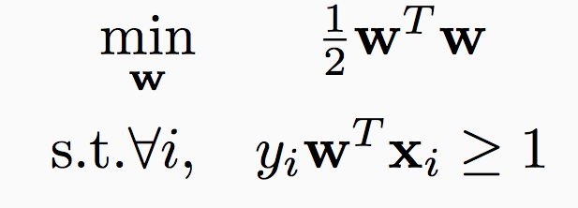
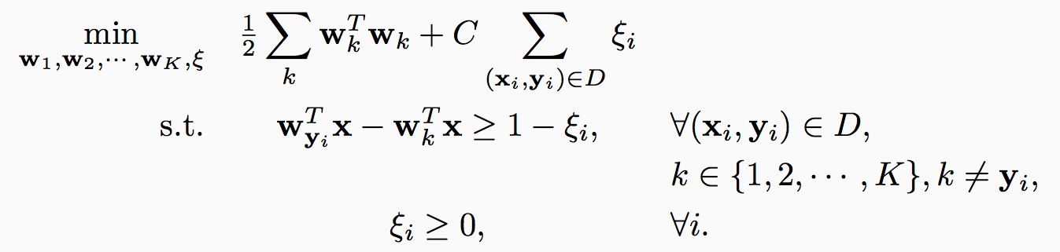
Multiclass SVM in the separable case
Recall hard binary SVM
Size of the weights. Effectively, regularizer
The score for the true label is higher than the score for any other label by 1

Slide 26
Multiclass SVM: General case
Total slack. Effectively, don’t allow too many examples to violate the margin constraint
Size of the weights. Effectively, regularizer
The score for the true label is higher than the score for any other label by 1
Slack variables. Not all examples need to satisfy the margin constraint.
Slack variables can only be positive

Slide 27
Multiclass SVM: General case
Total slack. Effectively, don’t allow too many examples to violate the margin constraint
Size of the weights. Effectively, regularizer
The score for the true label is higher than the score for any other label by
1 - »_{i}
Slack variables. Not all examples need to satisfy the margin constraint.
Slack variables can only be positive

Slide 28
Multiclass SVM
Generalizes binary SVM algorithm
If we have only two classes, this reduces to the binary (up to scale)
Comes with similar generalization guarantees as the binary SVM
Can be trained using different optimization methods
Stochastic sub-gradient descent can be generalized
Try as exercise

Slide 29
Multiclass SVM: Summary
Training:
Optimize the “global” SVM objective
Prediction:
Winner takes all
argmax_{i} w_{i}^{T}x
With K labels and inputs in <^{n}, we have nK weights in all
Same as one-vs-all
Why does it work?
Why is this the “right” definition of multiclass margin?
A theoretical justification, along with extensions to other algorithms beyond SVM is given by “Constraint Classification”
Applies also to multi-label problems, ranking problems, etc.
[Dav Zimak; with D. Roth and S. Har-Peled]

Slide 30
Where are we?
Introduction
Combining binary classifiers
One-vs-all
All-vs-all
Error correcting codes
Training a single classifier
Multiclass SVM
Constraint classification

Slide 31
One-vs-all again
Training:
Create K binary classifiers w₁, w₂, …, w_{K}
w_{i} separates class i from all others
Prediction: argmax_{i} w_{i}^{T}x
Observations:
At training time, we require w_{i}^{T}x to be positive for examples of class i.
Really, all we need is for w_{i}^{T}x to be larger than all other scores, not larger than zero

Slide 32
1 Vs All: Learning Architecture
k label nodes; n input features, nk weights.
Evaluation: Winner Take All
Training: Each set of n weights, corresponding to the i-th label, is trained
Independently, given its performance on example x, and
Independently of the performance of label j on x.
Hence: Local learning; only the final decision is global, (Winner Takes All (WTA)).
However, this architecture allows multiple learning algorithms; e.g., see the implementation in the SNoW Multi-class Classifier
Targets (each an LTU)
Weighted edges (weight vectors)
Features

Slide 33
Recall: Winnow’s Extensions
Positive
w⁺
Negative
w⁻
Winnow learns monotone Boolean functions
We extended to general Boolean functions via
“Balanced Winnow”
2 weights per variable;
Decision: using the “effective weight”,
the difference between w⁺ and w⁻
This is equivalent to the Winner take all decision
Learning: In principle, it is possible to use the 1-vs-all rule and update each set of n weights separately, but we suggested the “balanced” Update rule that takes into account how both sets of n weights predict on example x
Can this be generalized to the case of k labels, k >2?
We need a “global” learning approach

Slide 34
Extending Balanced
In a 1-vs-all training you have a target node that represents positive examples and target node that represents negative examples.
Typically, we train each node separately (mine/not-mine example).
Rather, given an example we could say: this is more a + example than a – example.
We compared the activation of the different target nodes (classifiers) on a given example. (This example is more class + than class -)
Can this be generalized to the case of k labels, k >2?
Notes:
Brief introduction to St. Out. problems
HIGHLIGHT THE DIFFERENCE BETWEEN LOCAL AND GLOBAL LEARNING!!!
Start w/ probably the simplest St. Out. problem: MULTICLASS!!!
where instead of viewing the label as a single integer, we can view it as a bit vector
ALONG WITH THE RESTIRCTION saying “EXACLTY ONE....”
Then, as we saw in the previous section, we can learn a collection of functions in two ways.
OvA attempts to have each function predict a single bit w/o looking at the rest! We call this LOCAL learning.
CC also learns the collection, but in a way the RESPECTS THE GLOB REST. LEARNS GLOBALLY all functions toghehter.
(LOOK AT SLIDE)!
Sequence tasks:
***** EX POS TAGGING,
TWO WAYS TO VIEW LABEL ::: Collection of word/pos pairs
::: Single label (WHOLE SENT TAG).
LEARN IN TWO WAYS ::: Fucnt to predict each POS tag sep.
::: Funct to predict whole tag seq at once.
Struct output:
arbitrary global constraints
**** LOCAL FUNCTIONS DON’T HAVE ACCESS TO THE GLOBAL CONSTRAINTS
--> NO CHANCE!!

Slide 35
Constraint Classification
The examples we give the learner are pairs (x,y), y 2 {1,…k}
The “black box learner” we described might be thought of as a function of x only but, actually, we made use of the labels y
How is y being used?
y decides what to do with the example x; that is, which of the k classifiers should take the example as a positive example (making it a negative to all the others).
How do we make decisions:
Let: f_{y}(x) = w_{y}^{T} ¢ x
Then, we predict using: y* = argmax_{y=1,…k} f_{y}(x)
Equivalently, we can say that we predict as follows:
Predict y iff
8 y’ 2 {1,…k}, y’:=y (w_{y}^{T} – w_{y’}^{T} ) ¢ x ¸ 0 (**)
So far, we did not say how we learn the k weight vectors w_{y} (y = 1,…k)
Can we train in a way that better fits the way we make decisions?
What does it mean?
Is it better in any well defined way?
Notes:
Brief introduction to St. Out. problems
HIGHLIGHT THE DIFFERENCE BETWEEN LOCAL AND GLOBAL LEARNING!!!
Start w/ probably the simplest St. Out. problem: MULTICLASS!!!
where instead of viewing the label as a single integer, we can view it as a bit vector
ALONG WITH THE RESTIRCTION saying “EXACLTY ONE....”
Then, as we saw in the previous section, we can learn a collection of functions in two ways.
OvA attempts to have each function predict a single bit w/o looking at the rest! We call this LOCAL learning.
CC also learns the collection, but in a way the RESPECTS THE GLOB REST. LEARNS GLOBALLY all functions toghehter.
(LOOK AT SLIDE)!
Sequence tasks:
***** EX POS TAGGING,
TWO WAYS TO VIEW LABEL ::: Collection of word/pos pairs
::: Single label (WHOLE SENT TAG).
LEARN IN TWO WAYS ::: Fucnt to predict each POS tag sep.
::: Funct to predict whole tag seq at once.
Struct output:
arbitrary global constraints
**** LOCAL FUNCTIONS DON’T HAVE ACCESS TO THE GLOBAL CONSTRAINTS
--> NO CHANCE!!

Slide 36
Linear Separability for Multiclass
We showed: if pairs of labels are separable (a reasonable assumption) than in some higher dimensional space, the problem is linearly separable.
We are learning k n-dimensional weight vectors, so we can concatenate the k weight vectors into
w= (w₁, w₂,…w_{k}) 2 R^{nk}
Key Construction: (Kesler Construction; Zimak’s Constraint Classification)
We will represent each example (x,y), as an nk-dimensional vector, x_{y}, with x embedded in the y-th part of it (y=1,2,…k) and the other coordinates are 0.
E.g., x_{y} = (0,x,0,0) ∈ R^{kn} (here k=4, y=2)
Now we can understand the n-dimensional decision rule:
Predict y iff 8 y’ 2 {1,…k}, y’:=y (w_{y}^{T} – w_{y’}^{T} ) ¢ x ¸ 0 (**)
In the nk-dimensional space.
Predict y iff 8 y’ 2 {1,…k}, y’:=y w^{T} ¢ (x_{y} – x_{y’}) ≡ w^{T} ¢ x_{yy’} ¸ 0
Conclusion: The set (x_{yy’} , + ) ≡ (x_{y} – x_{y’} , +) is linearly separable from the
set (-x_{yy’} , - ) using the linear separator w 2 R^{kn} ’
We solved the voroni diagram challenge.
Notice: This is just a representational trick. We did not say how to learn the weight vectors.
Notes:
Brief introduction to St. Out. problems
HIGHLIGHT THE DIFFERENCE BETWEEN LOCAL AND GLOBAL LEARNING!!!
Start w/ probably the simplest St. Out. problem: MULTICLASS!!!
where instead of viewing the label as a single integer, we can view it as a bit vector
ALONG WITH THE RESTIRCTION saying “EXACLTY ONE....”
Then, as we saw in the previous section, we can learn a collection of functions in two ways.
OvA attempts to have each function predict a single bit w/o looking at the rest! We call this LOCAL learning.
CC also learns the collection, but in a way the RESPECTS THE GLOB REST. LEARNS GLOBALLY all functions toghehter.
(LOOK AT SLIDE)!
Sequence tasks:
***** EX POS TAGGING,
TWO WAYS TO VIEW LABEL ::: Collection of word/pos pairs
::: Single label (WHOLE SENT TAG).
LEARN IN TWO WAYS ::: Fucnt to predict each POS tag sep.
::: Funct to predict whole tag seq at once.
Struct output:
arbitrary global constraints
**** LOCAL FUNCTIONS DON’T HAVE ACCESS TO THE GLOBAL CONSTRAINTS
--> NO CHANCE!!

Slide 37
Constraint Classification
Training:
Given a data set {(x,y)}, (m examples) with x 2 R^{n}, y 2 {1,2,…k}
create a binary classification task:
(x_{y} - x_{y’}, +), (x_{y’} – x_{y} -), for all y’ : = y (2m(k-1) examples)
Here x_{y} 2 R^{kn}
Use your favorite linear learning algorithm to train a binary classifier.
Prediction:
Given an nk dimensional weight vector w and a new example x, predict: argmax_{y} w^{T} x_{y}

Slide 38
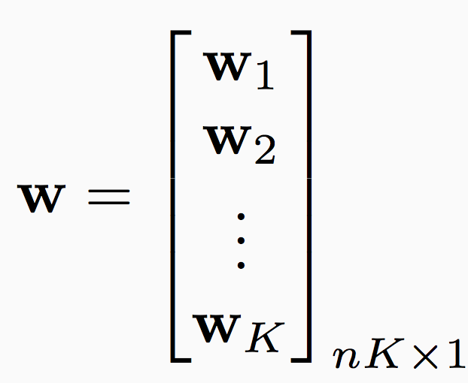
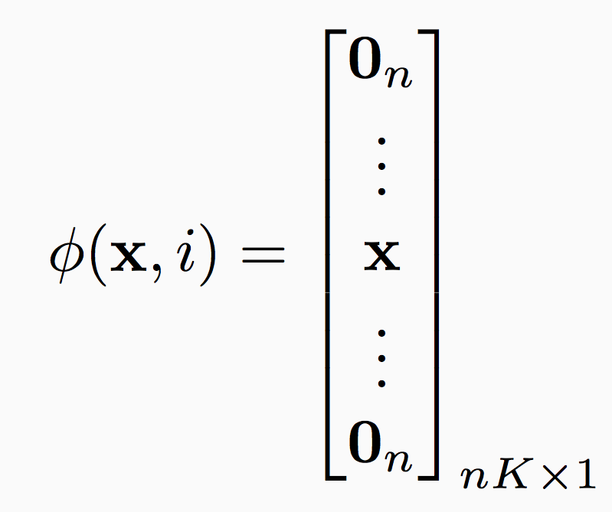
Linear Separability with multiple classes (1/3)
For examples with label i, we want w_{i}^{T}x > w_{j}^{T}x for all j
Rewrite inputs and weight vector
Stack all weight vectors into an
nK-dimensional vector
Define a feature vector for label i being associated to input x:
x in the i^{th} block, zeros
everywhere else

Slide 39
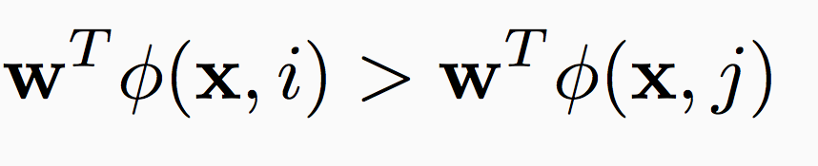
Linear Separability with multiple classes (2/3)
For examples with label i, we want w_{i}^{T}x > w_{j}^{T}x for all j
Equivalent requirement:
x in the i^{th} block, zeros
everywhere else
This is called the Kesler construction

Slide 40
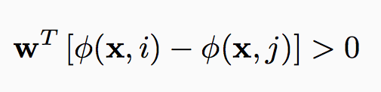


Linear Separability with multiple classes (3/3)
For examples with label i, we want w_{i}^{T}x > w_{j}^{T}x for all j
Equivalently, the following binary task in nK dimensions that should be linearly separable
Positive examples
Negative examples
i^{th} block
w
Example (x, i) in dataset, all other labels j

Slide 41
Constraint Classification
Training:
Given a data set {<x, y>}, create a binary classification task as
<Á(x, y) - Á(x, y’), +1>, <Á(x, y’) - Á(x, y), -1> for all y’ ≠ y
Use your favorite algorithm to train a binary classifier
Exercise: What do the perceptron update rules look like in terms of the Ás?
Prediction: Given a nK dimensional weight vector w and a new example x
argmax_{y} w^{T} Á(x, y)
Note: The binary classification task expresses preferences over label assignments
Approach extends training a ranker, can use partial preferences too, more on this later…

Slide 42
Perceptron in Kesler Construction
A perceptron update rule applied in the nk-dimensional space due to a mistake in w^{T} ¢ x_{ij} ¸ 0
Or, equivalently to (w_{i}^{T} – w_{j}^{T} ) ¢ x ¸ 0 (in the n-dimensional space)
Implies the following update:
Given example (x,i) (example x 2 R^{n}, labeled i)
8 (i,j), i,j = 1,…k, i := j (***)
If (w_{i}^{T} - w_{j}^{T} ) ¢ x < 0 (mistaken prediction;equivalent to w^{T} ¢ x_{ij} < 0 )
w_{i} ← w_{i} +x (promotion) and w_{j} ← w_{j} – x (demotion)
Note that this is a generalization of balanced Winnow rule.
Note that we promote w_{i} and demote (up to) k-1 weight vectors w_{j}
Notes:
Brief introduction to St. Out. problems
HIGHLIGHT THE DIFFERENCE BETWEEN LOCAL AND GLOBAL LEARNING!!!
Start w/ probably the simplest St. Out. problem: MULTICLASS!!!
where instead of viewing the label as a single integer, we can view it as a bit vector
ALONG WITH THE RESTIRCTION saying “EXACLTY ONE....”
Then, as we saw in the previous section, we can learn a collection of functions in two ways.
OvA attempts to have each function predict a single bit w/o looking at the rest! We call this LOCAL learning.
CC also learns the collection, but in a way the RESPECTS THE GLOB REST. LEARNS GLOBALLY all functions toghehter.
(LOOK AT SLIDE)!
Sequence tasks:
***** EX POS TAGGING,
TWO WAYS TO VIEW LABEL ::: Collection of word/pos pairs
::: Single label (WHOLE SENT TAG).
LEARN IN TWO WAYS ::: Fucnt to predict each POS tag sep.
::: Funct to predict whole tag seq at once.
Struct output:
arbitrary global constraints
**** LOCAL FUNCTIONS DON’T HAVE ACCESS TO THE GLOBAL CONSTRAINTS
--> NO CHANCE!!

Slide 43
Conservative update
The general scheme suggests:
Given example (x,i) (example x 2 R^{n}, labeled i)
8 (i,j), i,j = 1,…k, i := j (***)
If (w_{i}^{T} - w_{j}^{T} ) ¢ x < 0 (mistaken prediction; equivalent to w^{T} ¢ x_{ij} < 0 )
w_{i} ← w_{i} +x (promotion) and w_{j} ← w_{j} – x (demotion)
Promote w_{i} and demote (up to) k-1 weight vectors w_{j}
A conservative update: (LBJava’s implementation):
In case of a mistake: only the weights corresponding to the target node i and the closest node j are updated.
Let: j* = argmax_{j=1,…k} w_{j}^{T} ¢ x (highest activation among competing labels)
If (w_{i}^{T} – w_{j*}^{T} ) ¢ x < 0 (mistaken prediction)
w_{i} ← w_{i} +x (promotion) and w_{j*} ← w_{j*} – x (demotion)
Other weight vectors are not being updated.
Notes:
Brief introduction to St. Out. problems
HIGHLIGHT THE DIFFERENCE BETWEEN LOCAL AND GLOBAL LEARNING!!!
Start w/ probably the simplest St. Out. problem: MULTICLASS!!!
where instead of viewing the label as a single integer, we can view it as a bit vector
ALONG WITH THE RESTIRCTION saying “EXACLTY ONE....”
Then, as we saw in the previous section, we can learn a collection of functions in two ways.
OvA attempts to have each function predict a single bit w/o looking at the rest! We call this LOCAL learning.
CC also learns the collection, but in a way the RESPECTS THE GLOB REST. LEARNS GLOBALLY all functions toghehter.
(LOOK AT SLIDE)!
Sequence tasks:
***** EX POS TAGGING,
TWO WAYS TO VIEW LABEL ::: Collection of word/pos pairs
::: Single label (WHOLE SENT TAG).
LEARN IN TWO WAYS ::: Fucnt to predict each POS tag sep.
::: Funct to predict whole tag seq at once.
Struct output:
arbitrary global constraints
**** LOCAL FUNCTIONS DON’T HAVE ACCESS TO THE GLOBAL CONSTRAINTS
--> NO CHANCE!!

Slide 44
Significance
The hypothesis learned above is more expressive than when the OvA assumption is used.
Any linear learning algorithm can be used, and algorithmic-specific properties are maintained (e.g., attribute efficiency if using winnow.)
E.g., the multiclass support vector machine can be implemented by learning a hyperplane to separate P(S) with maximal margin.
As a byproduct of the linear separability observation, we get a natural notion of a margin in the multi-class case, inherited from the binary separability in the nk-dimensional space.
Given example x_{ij} 2 R^{nk}, margin(x_{ij},w) = min_{ij} w^{T} ¢ x_{ij}
Consequently, given x 2 R^{n}, labeled i
margin(x,w) = min_{j} (w_{i}^{T} - w_{j}^{T} ) ¢ x
Notes:
Brief introduction to St. Out. problems
HIGHLIGHT THE DIFFERENCE BETWEEN LOCAL AND GLOBAL LEARNING!!!
Start w/ probably the simplest St. Out. problem: MULTICLASS!!!
where instead of viewing the label as a single integer, we can view it as a bit vector
ALONG WITH THE RESTIRCTION saying “EXACLTY ONE....”
Then, as we saw in the previous section, we can learn a collection of functions in two ways.
OvA attempts to have each function predict a single bit w/o looking at the rest! We call this LOCAL learning.
CC also learns the collection, but in a way the RESPECTS THE GLOB REST. LEARNS GLOBALLY all functions toghehter.
(LOOK AT SLIDE)!
Sequence tasks:
***** EX POS TAGGING,
TWO WAYS TO VIEW LABEL ::: Collection of word/pos pairs
::: Single label (WHOLE SENT TAG).
LEARN IN TWO WAYS ::: Fucnt to predict each POS tag sep.
::: Funct to predict whole tag seq at once.
Struct output:
arbitrary global constraints
**** LOCAL FUNCTIONS DON’T HAVE ACCESS TO THE GLOBAL CONSTRAINTS
--> NO CHANCE!!

Slide 45
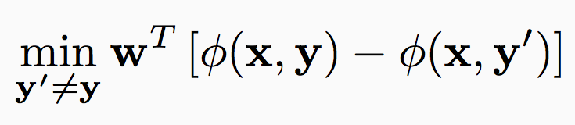
A second look at the multiclass margin
Defined as the score difference between the highest scoring label and the second one
Multiclass Margin
In terms of Kesler construction
Here y is the label that has the highest score

Slide 46
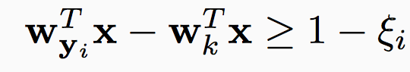
Discussion
What is the number of weights for multiclass SVM and constraint classification?
nK. Same as One-vs-all, much less than all-vs-all K(K-1)/2
But both still account for all pairwise label preferences
Multiclass SVM via the definition of the learning objective
Constraint classification by constructing a binary classification problem
Both come with theoretical guarantees for generalization
Important idea that is applicable when we move to arbitrary structures
Questions?

Slide 47
Constraint Classification
The scheme presented can be generalized to provide a uniform view for multiple types of problems: multi-class, multi-label, category-ranking
Reduces learning to a single binary learning task
Captures theoretical properties of binary algorithm
Experimentally verified
Naturally extends Perceptron, SVM, etc...
It is called “constraint classification” since it does it all by representing labels as a set of constraints or preferences among output labels.
Notes:
SPECIFICALLY, CC is a Framework for small output problems:
MC,ML,CAT, HIER..
Key to unifying these is to
learn a classifier to represent the CONSTRAINTS induced by the Mcat problem
TO reduce MCat to BIN, we
transform each input example to a --> set in higher dim space (pseudo)
each pseudo-example in the pseudo-space is responsible for maintaining a single constraint
Then, a SINGLE BINARY CLASSIFER CAN BE USED to learn these constraints.
Some NICE properties of this:
Can use any binary alg.
Many properties are inherited w/o much (or any) additional work

Slide 48
Multi-category with Constraint Classification
The unified formulation is clear from the following examples:
Multiclass
(x, A) ⇒ (x, (A>B, A>C, A>D) )
Multilabel
(x, (A, B)) ⇒ (x, ( (A>C, A>D, B>C, B>D) )
Label Ranking
(x, (5>4>3>2>1)) ⇒ (x, ( (5>4, 4>3, 3>2, 2>1) )
In all cases, we have examples (x,y) with y ∈ S_{k}
Where S_{k} : partial order over class labels {1,...,k}
defines “preference” relation ( > ) for class labeling
Consequently, the Constraint Classifier is: h: X → S_{k}
h(x) is a partial order
h(x) is consistent with y if (i<j) ∈ y ➔ (i<j) ∈h(x)
Just like in the multiclass we learn one w_{i} 2 R^{n} for each label, the same is done for multi-label and ranking. The weight vectors are updated according with the requirements from y 2 S_{k}
Research Question:
Can this be generalized, to general Boolean formulae on the labels?
What are natural examples?
Notes:
The TRANSFORMATIONS are very natural
GO THROUGH!!!
MC:
ML:
LR:
In general, we define a constraint example as one where the labels
partial order
defined by pairwise preferences.
CC classifier produces this order
Then we map the problem to the (PSEUDO) space
where each of the pairwise constraints can be maintained
and LEARN
TRANSITION: I describe this mapping for the linear case.

Slide 49
Training multiclass classifiers: Wrap-up
Label belongs to a set that has more than two elements
Methods
Decomposition into a collection of binary (local) decisions
One-vs-all
All-vs-all
Error correcting codes
Training a single (global) classifier
Multiclass SVM
Constraint classification
What if the size of the label space is huge?
What if there is an interesting structure on the label space?
Questions?

Slide 50
Next steps…
Build up to structured prediction
Multiclass is really a simple structure
But that framework we developed is really structured prediction
Different aspects of structured prediction
Deciding the structure, training, inference
The functions Á(x, y) will be more involved
The prediction step (inference; argmax ) will be more involved
Next: Sequence models

