Slide 1
CIS 700 Advanced Machine Learning Structured Machine Learning: Theory and Applications in Natural Language Processing
Shyam Upadhyay
Department of Computer and Information Science
University of Pennsylvania

Slide 2
Reminder
Google form for filling in preferences for paper presentation
Deadline 19th September
Fill in 4 papers, each from a different section.
No class on Thursday (reading assignment on MEMM, CRF)

Slide 3
Today’s Plan
Ingredients of Structured Prediction
Structured Prediction Formulation
Multiclass Classification
HMM Seq. Labeling
Dependency Parsing
Structured Perceptron

Slide 4


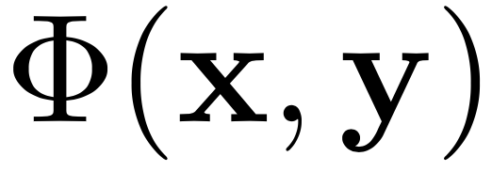
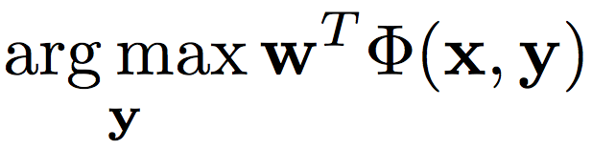
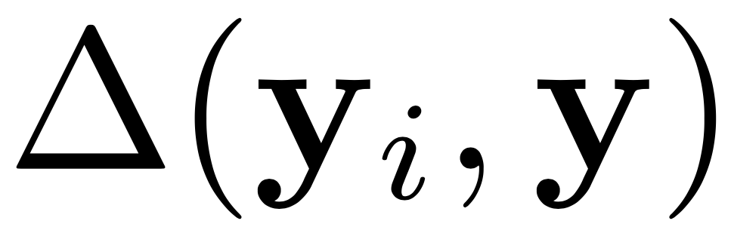
Ingredients of a Structured Prediction Problem
Input
Output
Feature Extractor
Inference
Inference , also called “Decoding”
Loss

Slide 5
Ingredients of a Structured Prediction Problem
Input
IInstance in SL
Output
IStructure in SL
Feature Extractor
AbstractFeatureGenerator in SL
Inference
Inference
Loss
AbstractInferenceSolver in SL

Slide 6
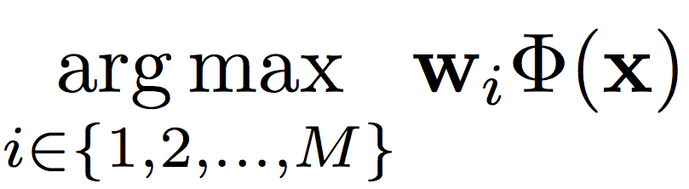
Multiclass Classification (Toy)
N training examples, and we need to predict the label from M different classes.
Winner takes all.
Maintain M different weight vectors.
Score a example using each of the weight vectors.
Predict the class whose score is highest.

Slide 7
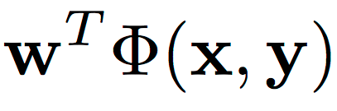
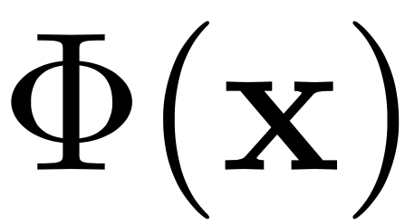
Questions
What is
What is
How to write the score function as ?
How to do inference?

Slide 8
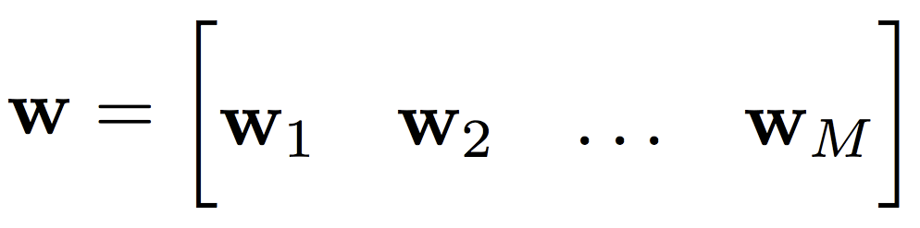
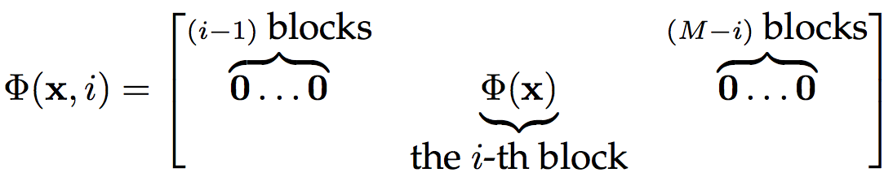

Solution
Confirm that

Slide 9
See it in Code

Slide 10
Short Quiz
How will you implement the error correcting code approach to multiclass classification?
How does definition of or change?
How does definition of weight vector change?
How does inference change?
Write binary classification as structured prediction
Try to avoid redundant weights.

Slide 11
Sequence Tagging
The cat sat on the mat .
Naïve approach
Local inference (actually works pretty well for POS tagging)
DT NN VBD IN DT NN .

Slide 12
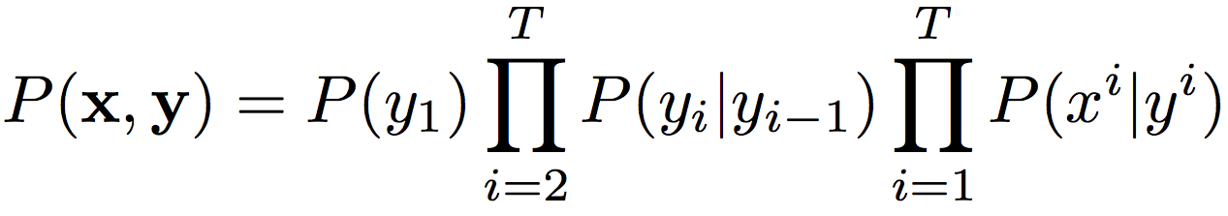
Sequence Tagging
HMM
Roth 1999, Collins 2002
How to write this as a structured prediction problem?

Slide 13
Questions
What is
What is
How to write the score function as ?
Should respect the model
How to do inference?

Slide 14
Solution – Weight Vector

Slide 15
Solution – Feature Vector
Confirm that

Slide 16
Inference in HMM
Greedy
Choose current position’s tag so that is maximizes the score so far.
Viterbi
Use Dynamic Programming to incrementally compute,
Sampling
MCMC
(HW) HMM with Greedy and MCMC.

Slide 17
See it in Code

Slide 18
Short Quiz – Naïve Bayes
Recall Naïve Bayes classification,
How to formulate this as structured prediction?
Assume there are only two classes.

Slide 19
Assume there are only two classes
(HW) Implement Naïve Bayes in Illinois-SL.

Slide 20
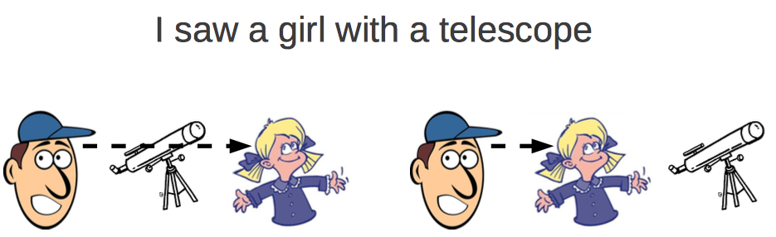
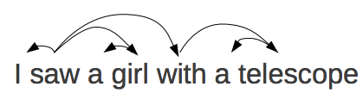
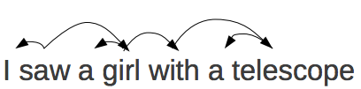
Dependency Parsing
Borrowed from Graham Neubig’s slides

Slide 21
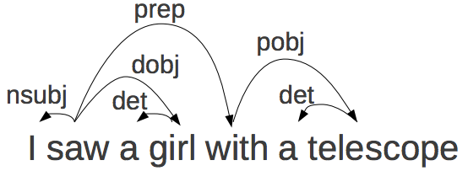
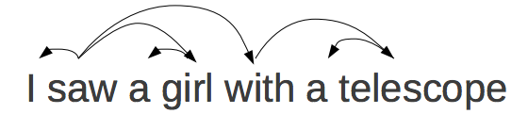
Typed and Untyped
Before we proceed, convince yourself that this is a (directed) tree.
Borrowed from Graham Neubig’s slides

Slide 22
Learning Problem
Setup
INPUT: A sentence with N words.
OUTPUT: A directed tree representing the dependency relations.
Given input x there are a fixed # of legal candidate trees.
Search Space
Find the highest scoring dependency tree, from the space of all dependency trees of N words.
How big is the search space?
Exponential # of candidates!

Slide 23
Questions
What is
What is
How to write the score function as ?
Unlike Multiclass, cannot learn a different model for each tree
How to do inference?

Slide 24

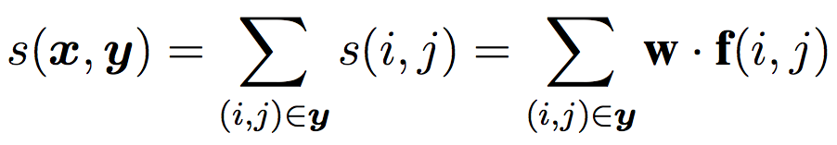
Decompose the Score
Learn a model to score edge (i,j) of a candidate tree
S[i][j] = score of word i having the word j as a parent.
Score of a dependency tree is sum of score of its edges.
Can you think of features for a edge?
Notes:
The notation s(i,j) here is somewhat misleading. You will have access to the input X. The correct notation should be s(i,j,x)

Slide 25

Finding Highest Scoring Tree
Cast as a directed maximum spanning tree problem.
Compute a matrix S of edge scores.
Chu-Liu-Edmonds Algorithm (black-box).
We can solve

Slide 26
Our First Structured Learning Algorithm
So far, we just identified what ingredients we needed.
How to learn a weight vector?
Structured Perceptron (Collins 2002)
Structured Version of Binary Perceptron
Mistake Driven, just like Perceptron
Virtually Identical

Slide 27




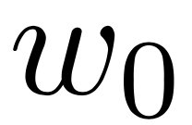
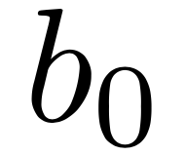

Binary Perceptron

Slide 28
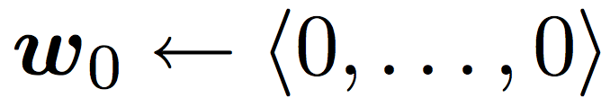


Structured Perceptron

Slide 29
Short Quiz
Why do we not have a bias term?
Do we see all possible structures during training?
AbstractInferenceSolver
Where was this used?
Learning requires inference over structures
Such inference can prove costly for large search spaces.
Think improvements.

Slide 30
Averaged Structured Perceptron
Remember we do not want to use only one weight vector.
Why?
Naïve way of averaging.
Maintain a list of weight vectors seen during training.
Maintain counts of how many examples each vector “survived”.
Compute weighted average at the end.
Drawbacks?
Better way?
I only want to maintain O(1) weight vectors and make updates only when necessary.

Slide 31
Averaging
Say we make the i^{th} update at time c_{i}
Weight vector after i^{th} update is w_{i}
The algorithm stops at time c_{T} and the last mistake was made at time c_{n}
What is the weighted average?

Slide 33
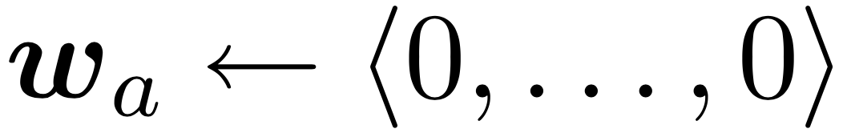
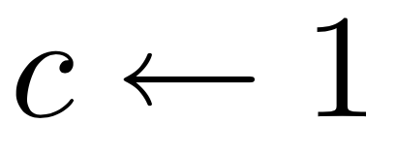



Averaged Structured Perceptron

Slide 34
What We Learned Today
Ingredients for Structured Prediction
Toy Formulations
Our First Learning Algorithm for Structured Prediction

Slide 35
HW for Today’s Lecture
Required Reading
Ming-Wei Chang’s Thesis Chapter 2 (most of today’s lecture)
Hal Daume’s Thesis Chapter 2 (structured perceptron)
M. Collins Discriminative Training for Hidden Markov Models: Theory and Experiments with Perceptron Algorithms EMNLP 2002.
Optional Reading
L. Huang, S. Fayong, Y. Guo Structured Perceptron with Inexact Search NAACL 2012.
Try implementation exercises given in the slides.

