Slide 1
TreeView: Peeking into deep neural networks via feature-space partitioning
Jayaraman J. Thiagarajan, Bhavya Kailkhura, Prasanna Sattigeri, Karthikeyan Natesan Ramamurthy

Slide 2
Abstract
With the advent of highly predictive but opaque deep learning models, it has become more important than ever to understand and explain the predictions of such models. Existing approaches define interpretability as the inverse of complexity and achieve interpretability at the cost of accuracy. This introduces a risk of producing interpretable but misleading explanations. As humans, we are prone to engage in this kind of behavior [1]. In this paper, we take a step in the direction of tackling the problem of interpretability without compromising the model accuracy. We propose to build a Treeview representation of the complex model via hierarchical partitioning of the feature space, which reveals the iterative rejection of unlikely class labels until the correct association is predicted

Slide 3
1. Interpretability in machine learning (skip) 2. Proposed approach
In this section, we describe the proposed approach in the context of understanding features learned by a deep neural network. We consider only fully connected networks although it is possible to conceive of extensions to other architectures. Figure 1(a) illustrates a simple fully connected deep network with a softmax layer for class prediction. Unraveling the mechanics of the hidden layer representations can provide interesting insights into the trained model. This is a main distinction of our approach compared to other existing methods that attempt to learn a simpler surrogate (e.g. linear models) to explain the predictions for individual examples.

Slide 4
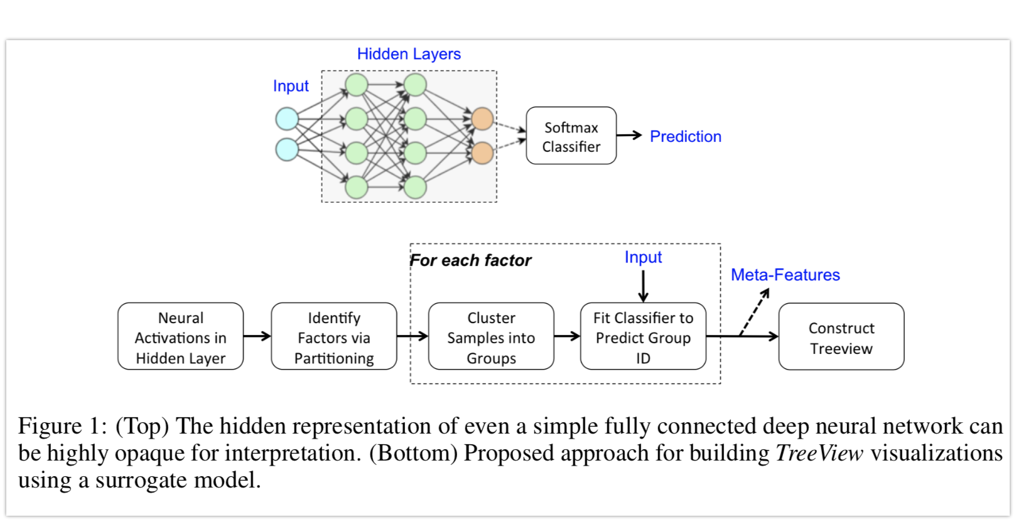
Figure 1(b) shows an overview of our approach. We decompose the feature space Y into K potentially overlapping factors?. Let us denote the feature dimensions corresponding to these factors using the sets {S1 , . . . , SK }. We obtain K different clusterings of samples, one for each of the subspaces of Y given by Si. We then construct a K−dimensional meta-feature for each sample as a collection of its K cluster labels?. The TreeView framework uses these meta-features used in a decision tree to create an easily interpretable visualization of the mechanics of the learned deep network.

Slide 5
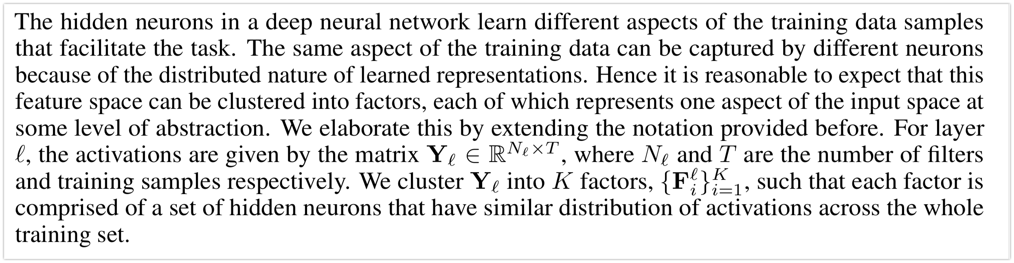
2.1 identifying factors
Actually the first time mentioning matrix notation: clustering of neurons

Slide 6
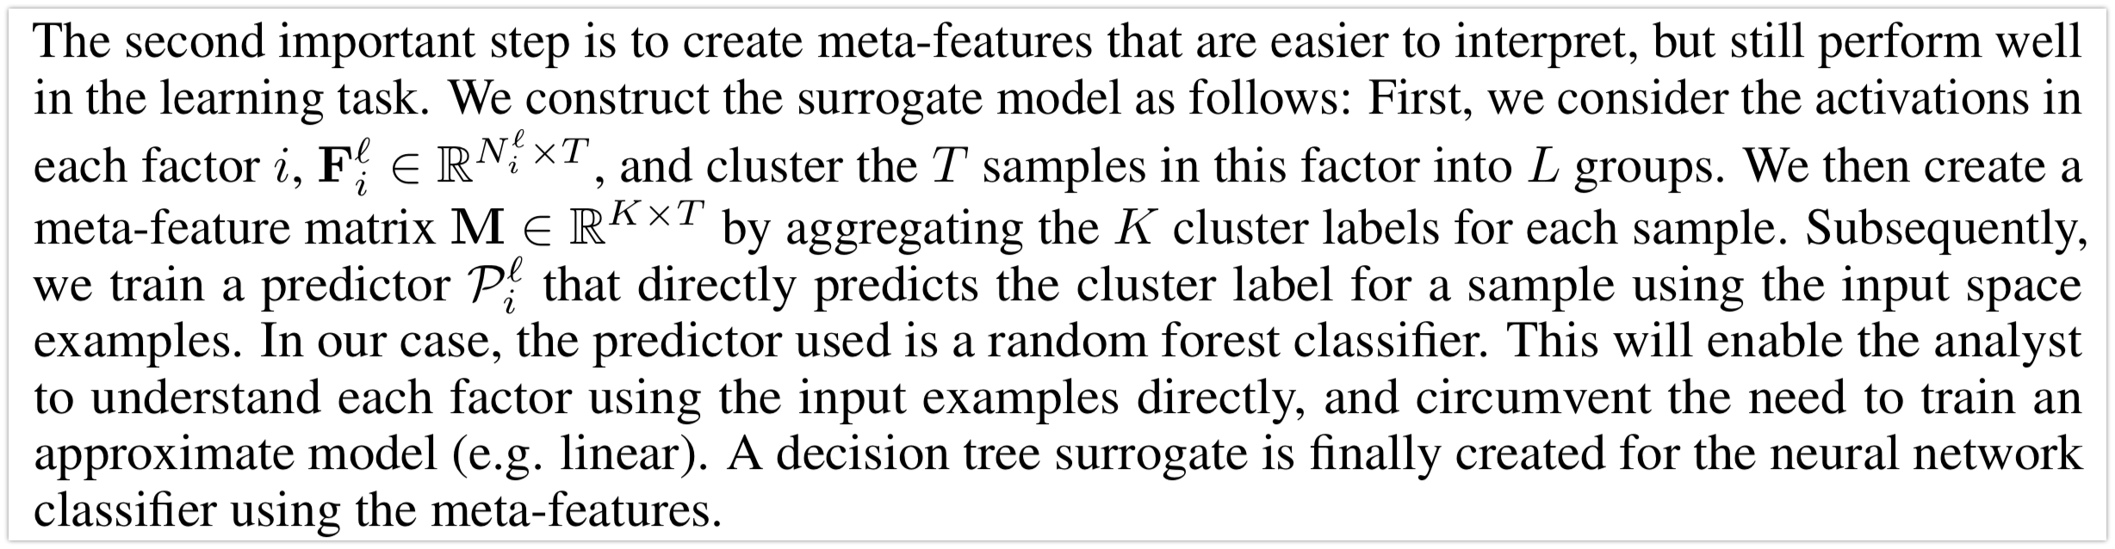
2.2 constructing meta-features
Actually the first time mentioning L: it is the categorical value for k th entry (L=2 in figure 2, 3)

Slide 7
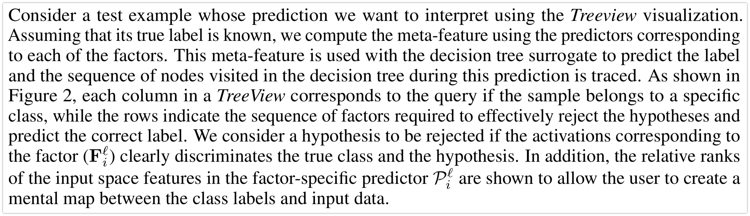
TreeView Design

Slide 8
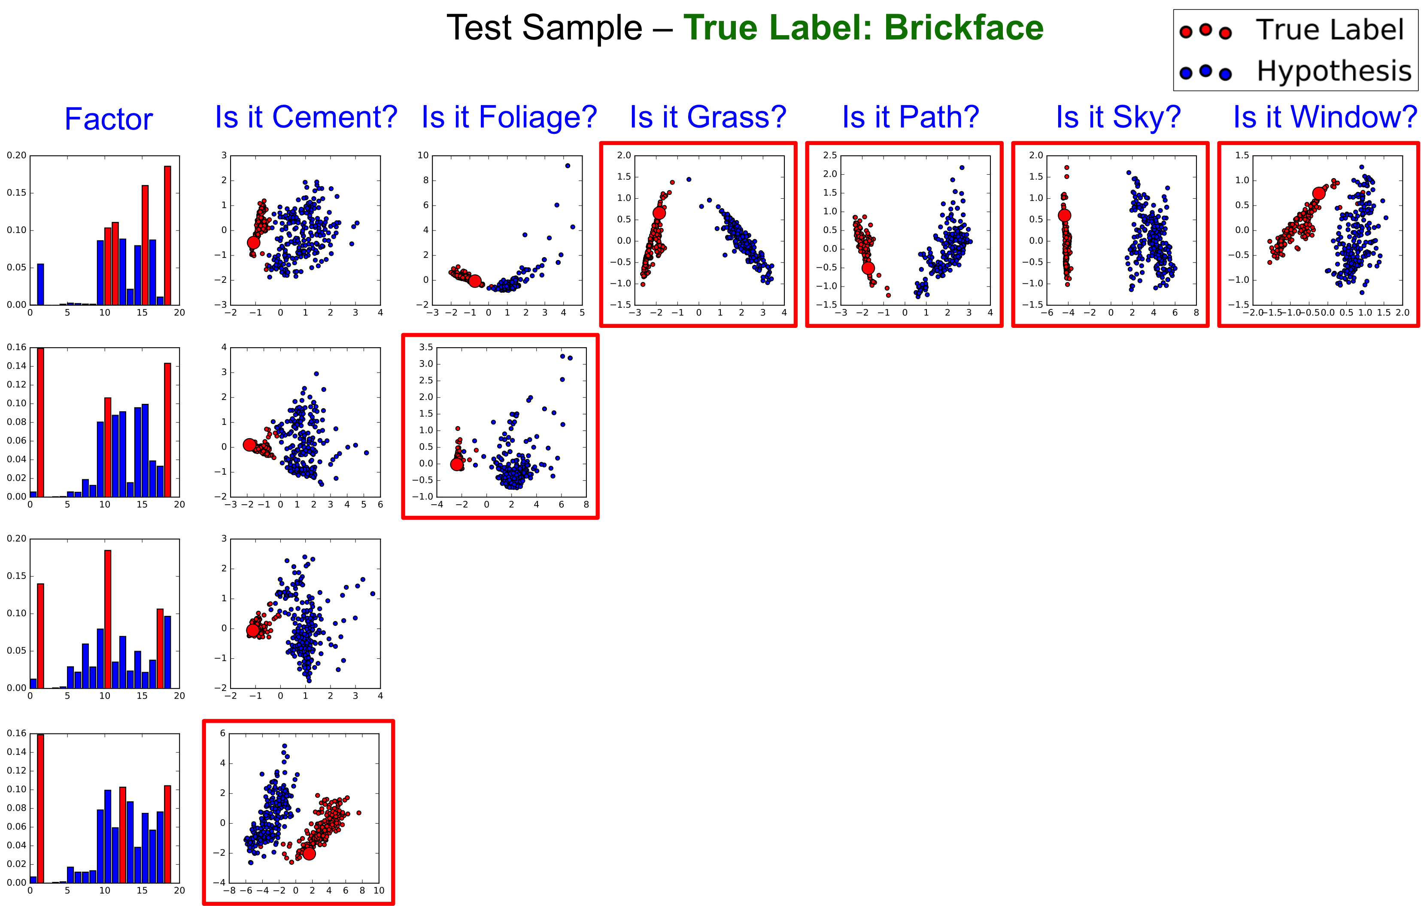
Figure 2: L =2, K =4
1
2
Figure 2 shows the TreeView visualization for a correctly classified example. While the root factor rejects the hypothesis for the classes Grass, Path, Sky, Window (indicated by a red bounded box) right away, a sequence of three more factors were required to reject the hypotheses for Cement. A fine-grained analysis of the high-ranked features from the input space (marked in red) can provide more insights into the connection between the input and label spaces, thereby enabling the analyst to validate their mental map between the spaces.
3

Slide 9
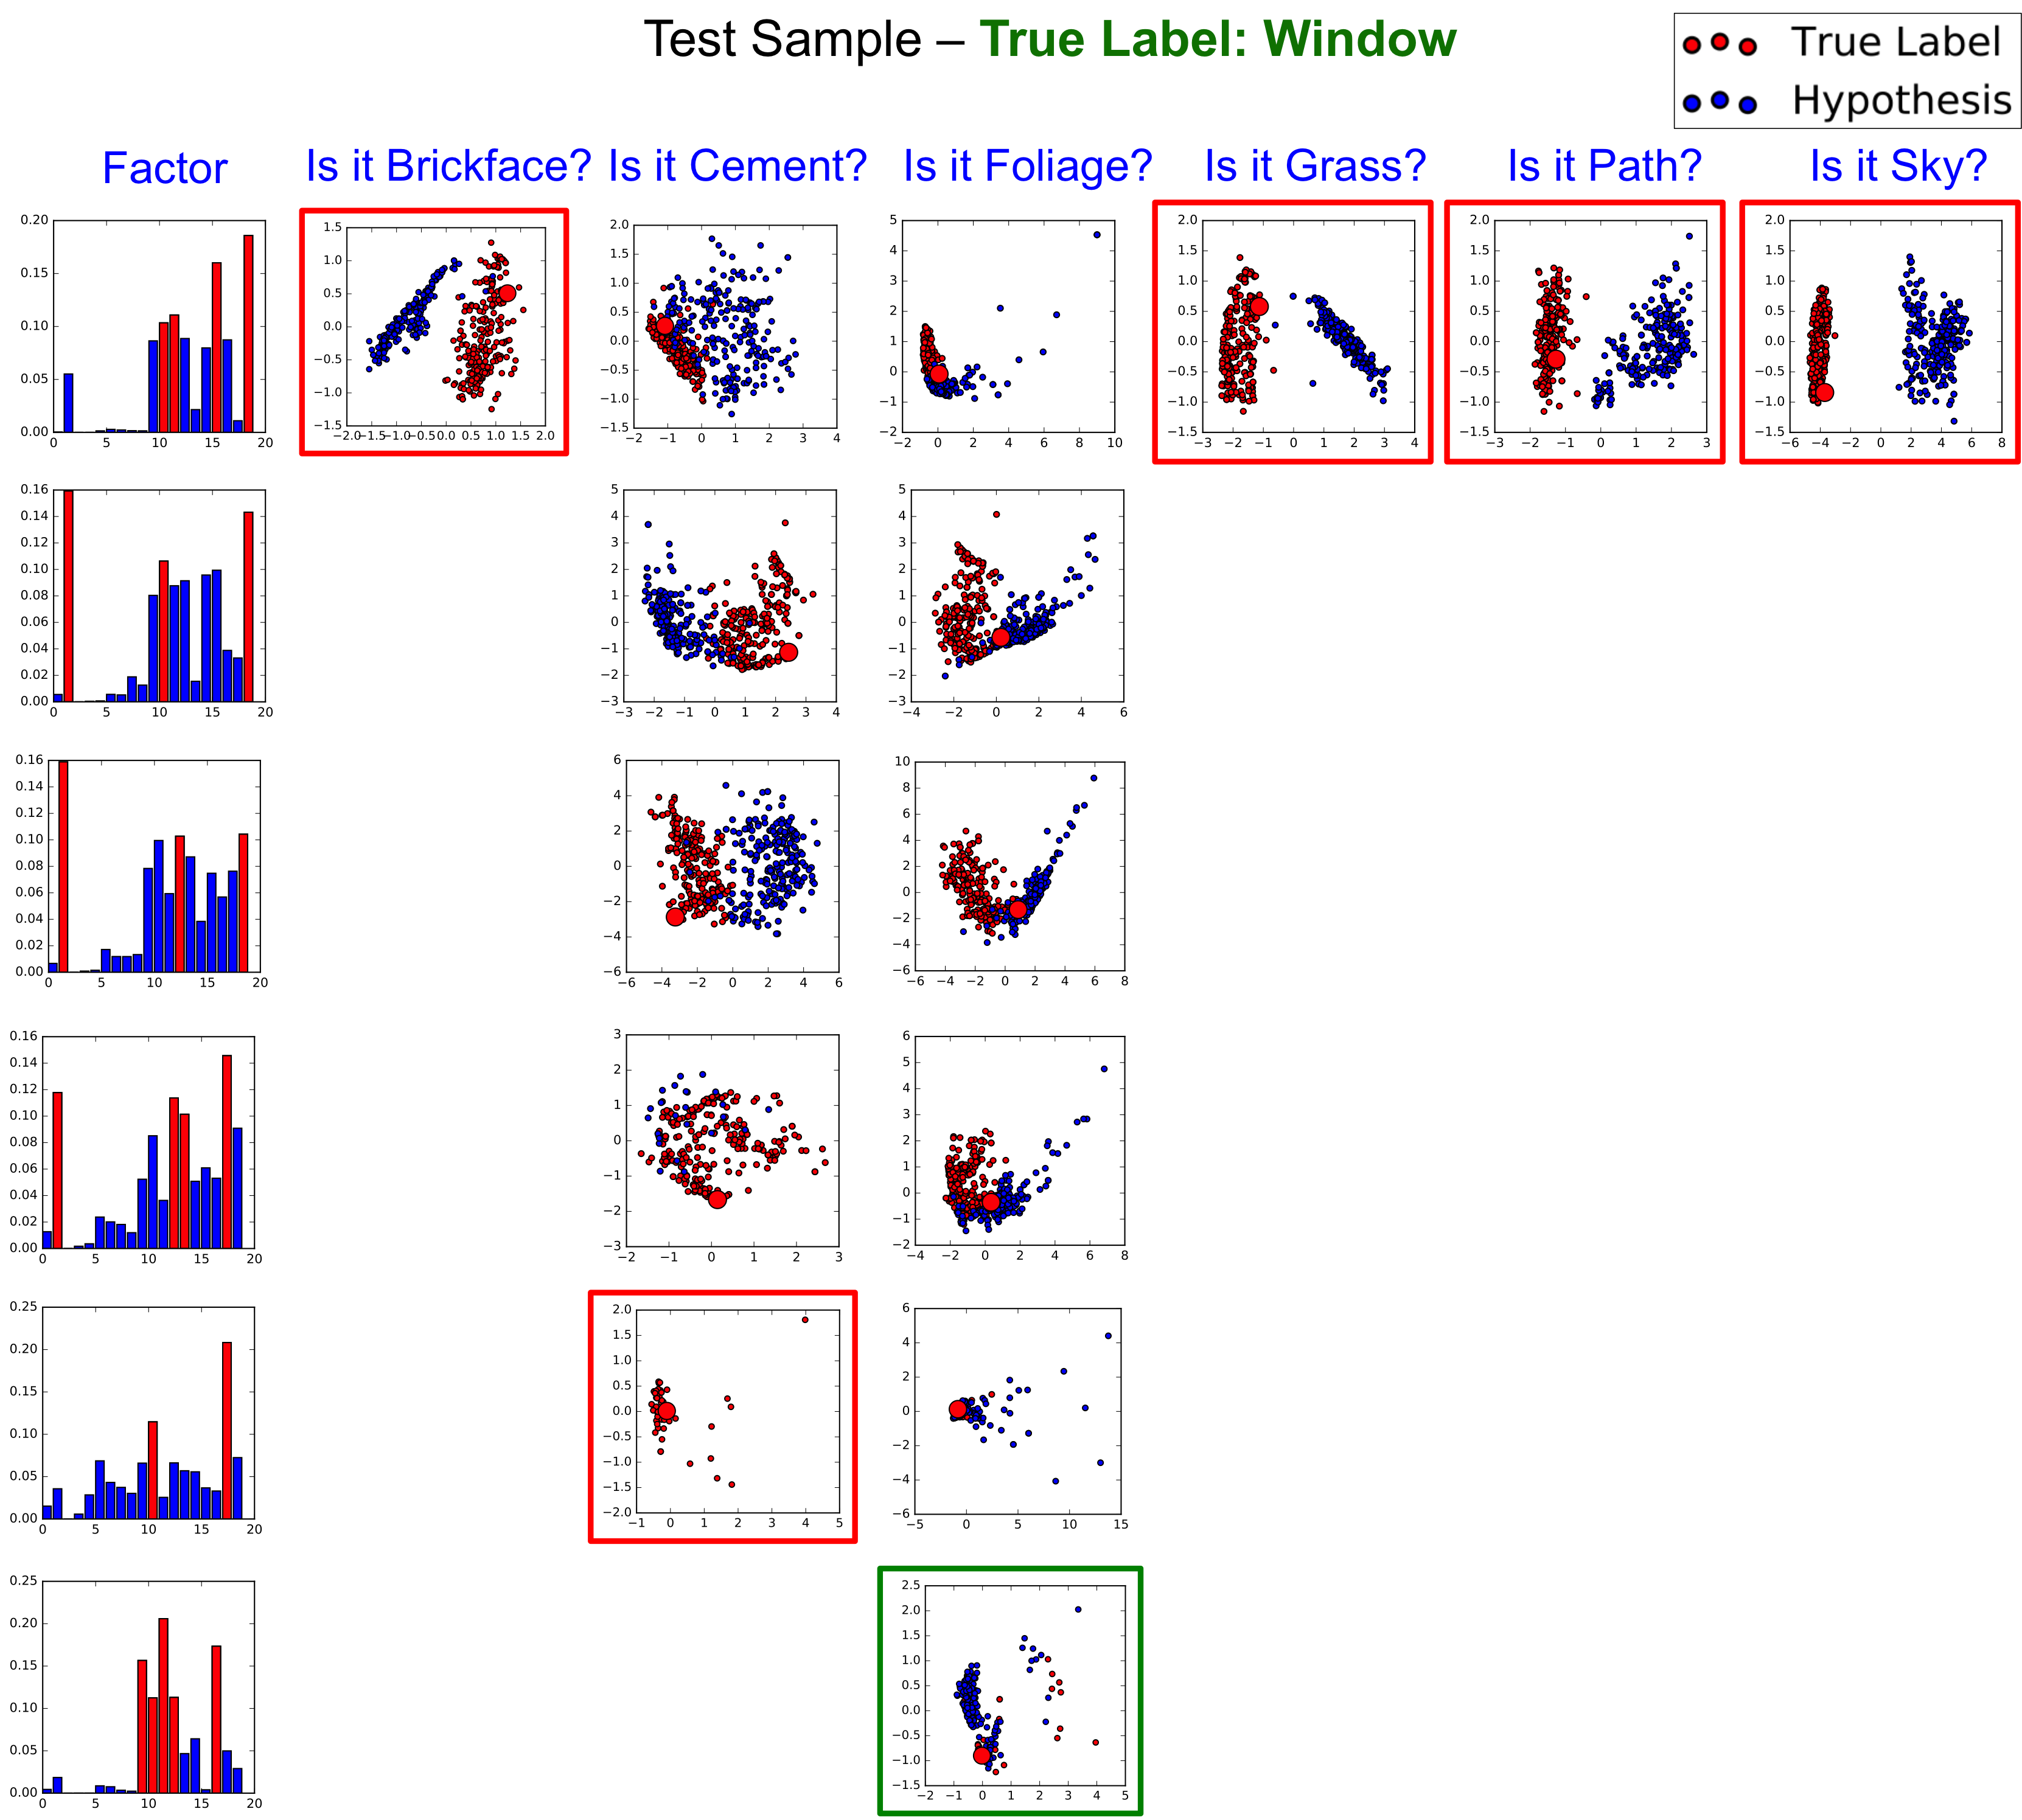
Figure 3: Treeview visualization for a sample which is wrongly classified by the neural network (L=2, K=6? )
1
2
In contrary, the negative example in Figure 3 illustrates a case where the factors identified by the network were unable to clearly discriminate between Foliage and the true class label Window. The Treeview visualization allows a convenient transition between factors, class labels, and the input data space, while staying relevant to the features inferred using the neural network.
3

