Slide 1
SoLID LASPD Segmentation Study
Zhihong Ye
12/22/2014

Slide 2
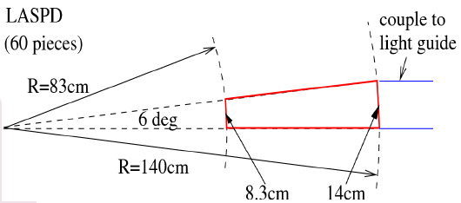
SoLID LASPD Segmentation
Assuming we need 60 pieces:
LASPD:
R_Min = 80.0 cm
R_Max = 135.0 cm
Z = -67. cm, right in front of EC
Thickness = 5mm or 1cm or 2cm or ...
Time Resolution ~ 100 ps
Photon Rejection ~ 10 : 1

Slide 3
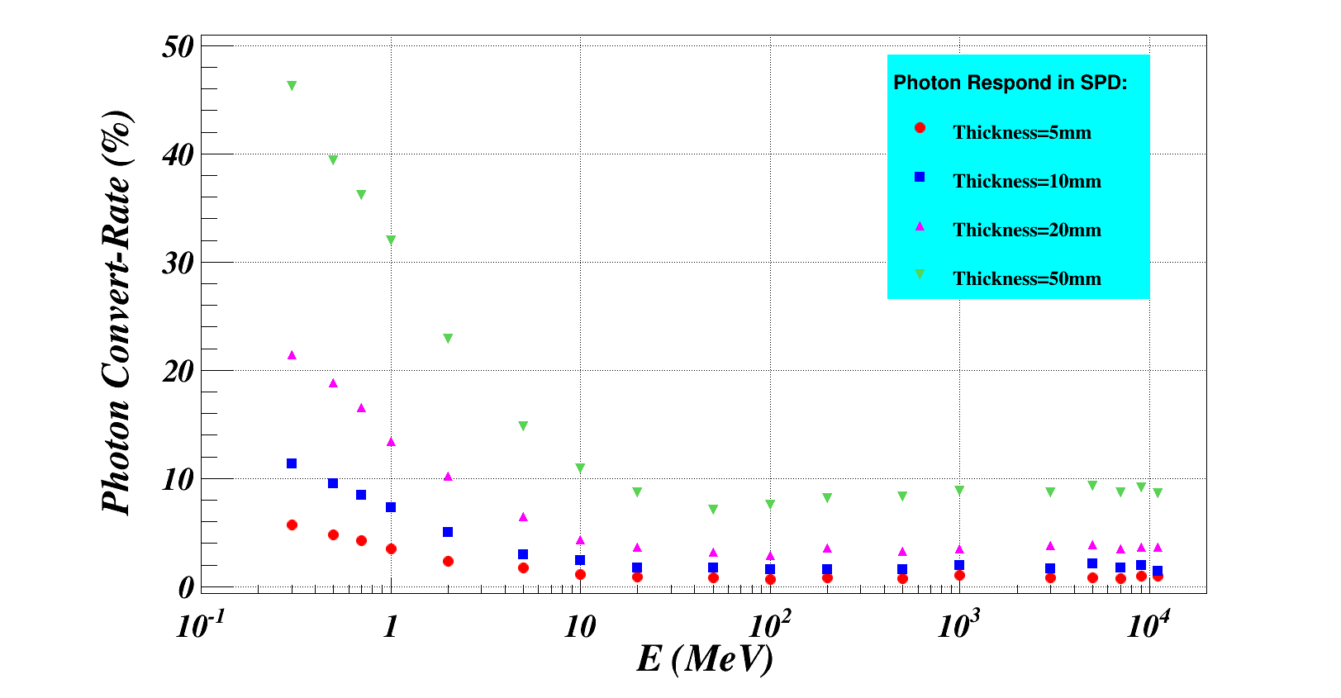
Photon Conversion
Send photons with fixed energy from 0.3 MeV to 11 GeV,
and for each setting, count how many photons can convert into electrons.

Slide 4
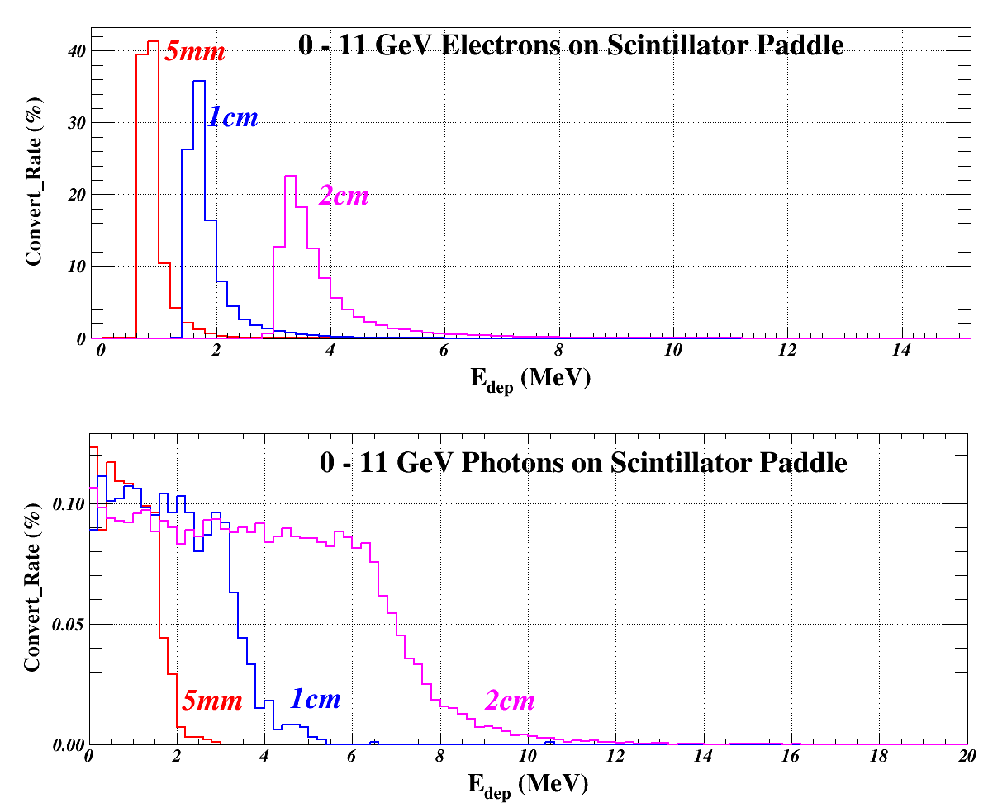
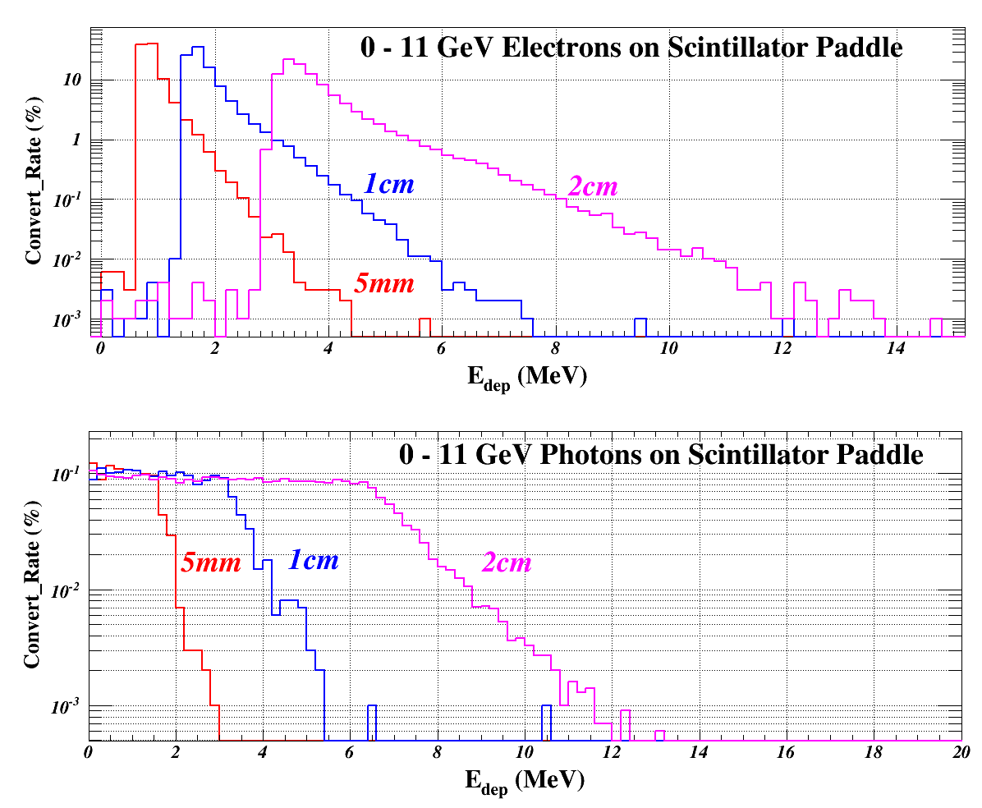
Energy Deposition
Quick Check where the MIP is for SPD with different thickness

Slide 5
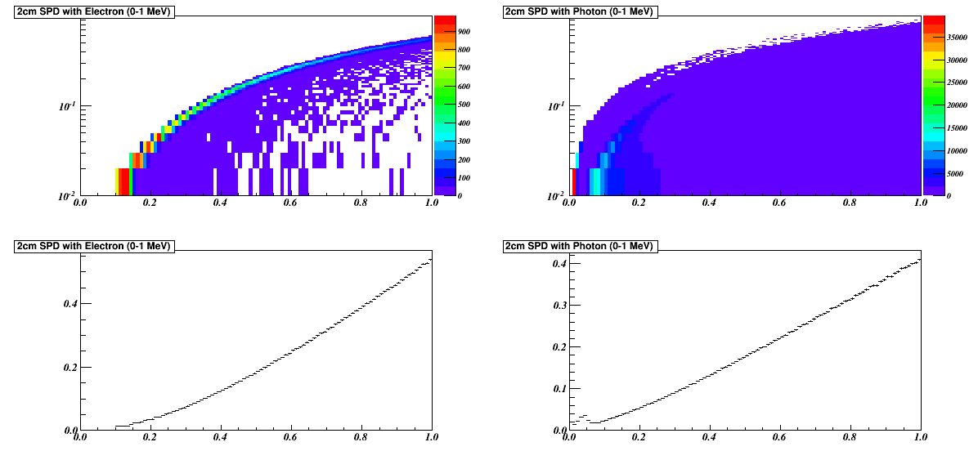
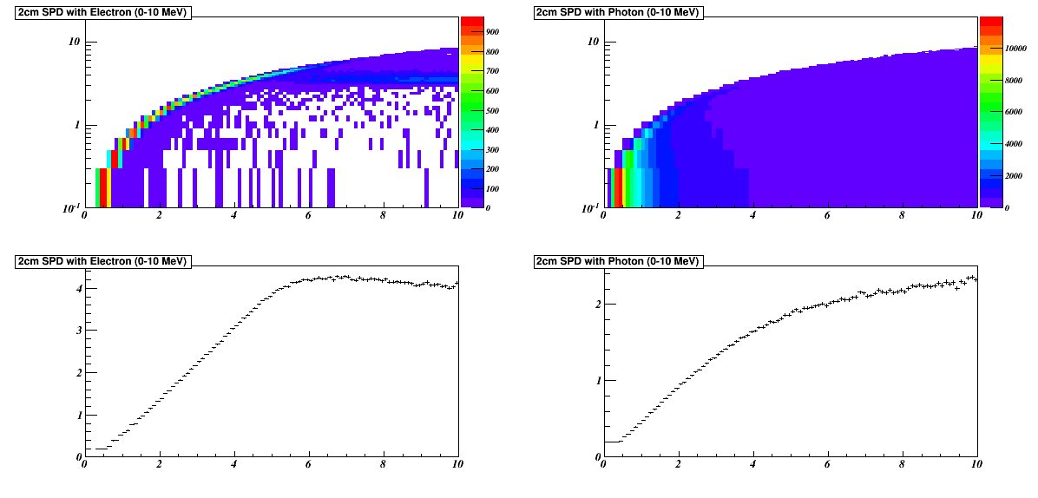
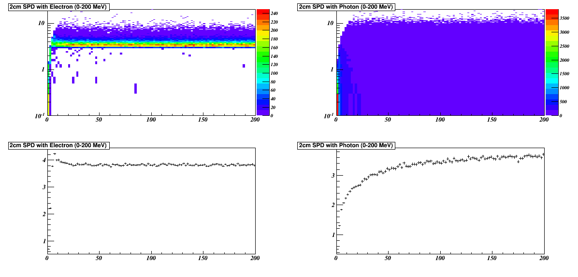
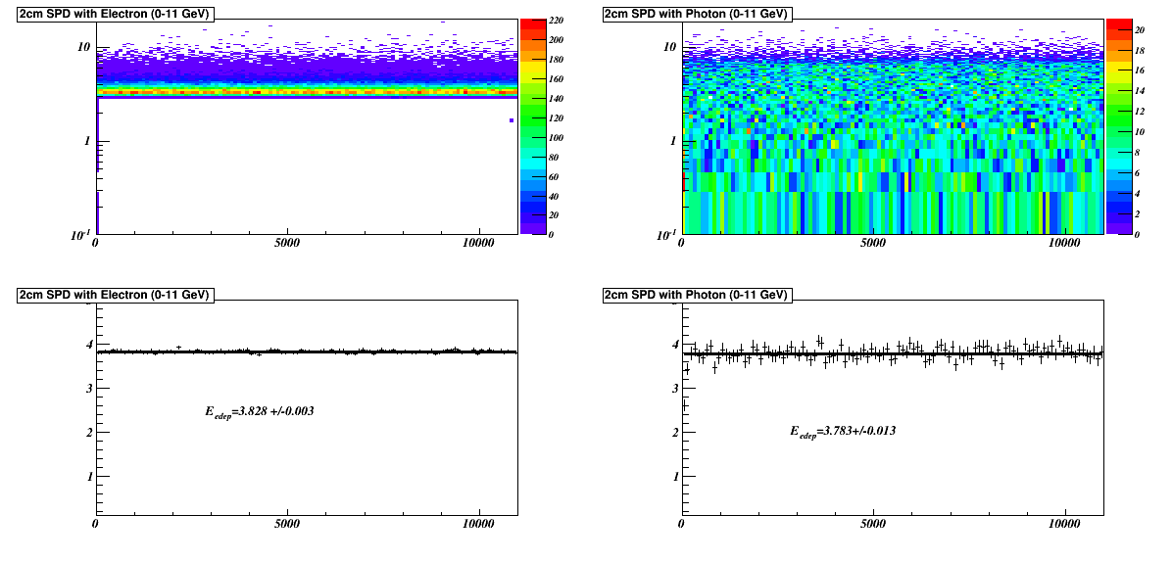
Energy Deposition
Electron
(0-1 MeV)
Photon
(0-1 MeV)
Electron
(0-10 MeV)
Photon
(0-10 MeV)
Electron
(0-200 MeV)
Photon
(0-200 MeV)
Electron
(0-11 GeV)
Photon
(0-11 GeV)

Slide 6
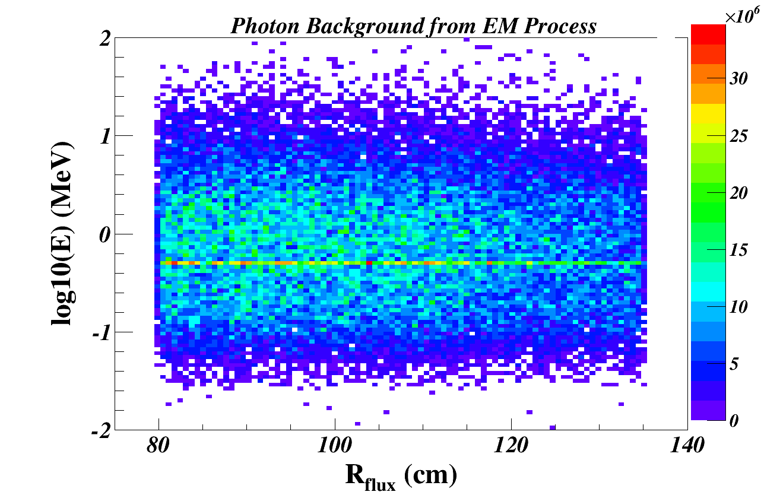
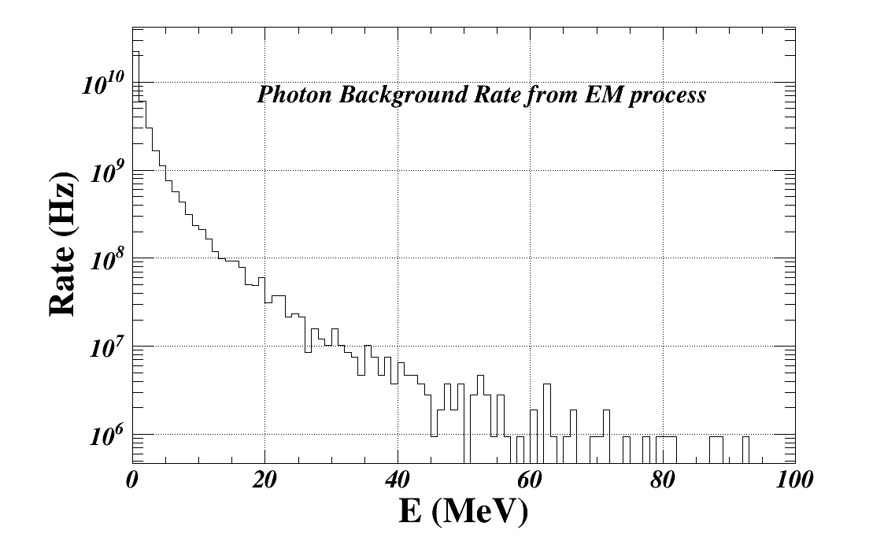
EM background
EM background is dominated by low energy photons and electrons are rare:
R (photon : electron) = 200 : 1
From the 2D plot, background particle energy is roughly independent of the radius

Slide 7
LASPD Segmentation Study Strategy
Study the conversion rate for a photon with certain energy in the SPD
Study the energy deposition of an electron (or photon after it converts into other particles) with certain energy in the SPD
With the pi0 background events generated from Wiser and propagating through GEMC, obtain the position and energy distribution on the SPD, with the rate.
For each photon from pi0 decay, consider two cases:
(1) its probability to become electrons.
Assuming its energy is 1GeV, from Slide#3, its probability is 4%, and its mean energy deposition from Slide#5 is 3.82 MeV (a MIP!) , so the chance to fire if it passes the half-MIP cut is:
if (3.82> 0.5*MIP), fire1 = 4% = 0.04; else, fire1 = 0;
(2) it does not convert into electrons but the energy-deposition-sum of background particles may pass the half-MIP cut.
Assuming for one photon passing through the SPD, there are 10K photons and 50 electrons passing through the *ENTIRE* plane. I randomly generate the energies of these particles from the 1D plot in slide#6, look for their energy-depositions from slide#5, and sum their values, e.g. EDep_Sum. Assuming there are N segments, the chance to fire the SPD is:
if(EDep_Sum/N > 0.5*MIP), fire2 = (1-4%)=0.96; else, fire2 = 0.0;
The “chance” that this photon fires the SPD is then given by:
Fire = (fire1+fire2)
(e) Loop through all events, e.g. , and calculate Rejection Factor:
Reject = Total / SUM(Fire)

Slide 8
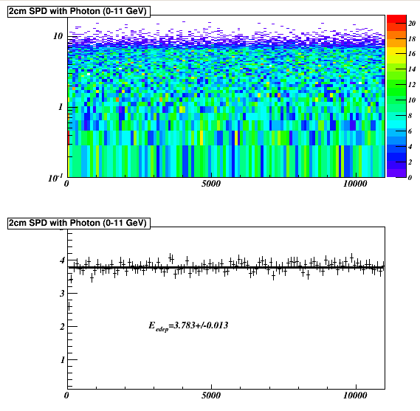
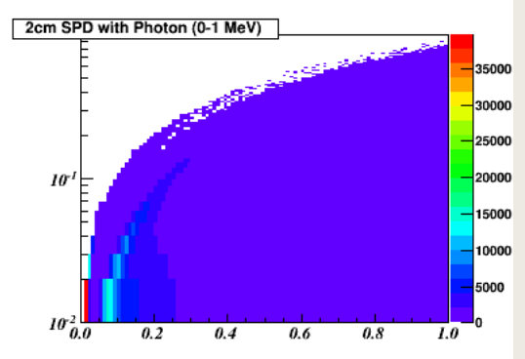
LASPD Segmentation Study Strategy
More details:
(1) Generate 100K pi0 events with Wiser
(2) Work on the virtual plane in front of the 2cm-thick LASPD
(3) For one photon with known energy (e.g. 2GeV), look for the conversion rate (5%)
(4) Look for its energy deposition by randomly picking from the 2-D plot (3.8 MeV)
(5) Now add the EM background which are mostly <10MeV photons
(6) Calculate how many photons+electrons hit on LASPD within 50ns:
e.g., on a 1-degree slice (1/360 total area), photon is about 1e8! (+several electrons)
(7) Generate 1e8 photons with random energy from the 2-D below
(8) Look for the energy deposition by randomly picking from the 2-D plot
(9) Add the energy deposition of these 1e8 photons together

Slide 9
Problem
For a 1-degree slice and within 50ns, I have:
total of energy deposition from electrons ~ 2MeV
total of energy deposition from photons ~ 2GeV!

