Slide 1
E12-10-006B:
Deep Exclusive π─ Production with Transversely Polarized ³He using SoLID
Co-Spokespersons:
Zafar Ahmed, University of Regina
Garth Huber, University of Regina
Zhihong Ye, Argonne National Laboratory

Slide 2
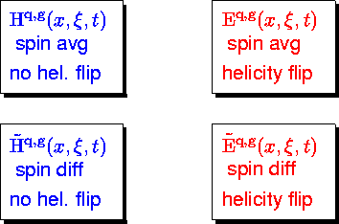


Leading Twist GPD Parameterization
GPDs are universal quantities and reflect nucleon structure independently of the probing reaction.
At leading twist–2, four quark chirality conserving GPDs for each quark, gluon type.
Because quark helicity is conserved in the hard scattering regime, the produced meson acts as a helicity filter.
Need a variety of Hard Exclusive Measurements to disentangle the different GPDs.
Deeply Virtual Compton Scattering:
Sensitive to all four GPDs.
Deep Exclusive Meson Production:
Vector mesons sensitive to spin–average H, E.
Pseudoscalar sensitive to spin–difference , .

Slide 3

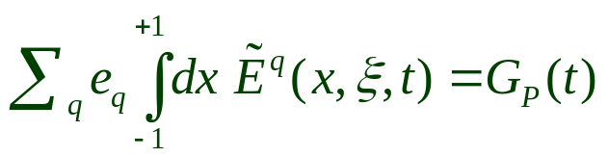

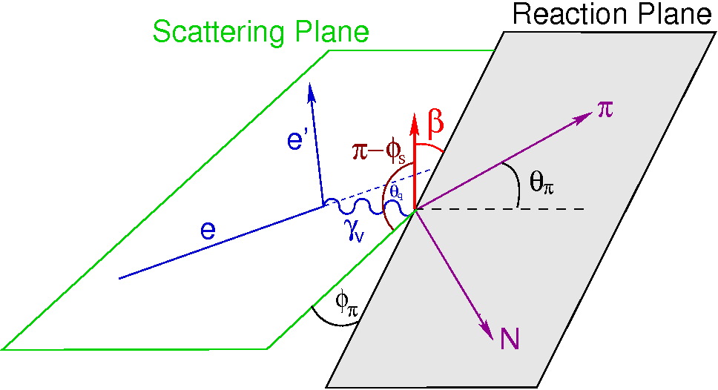
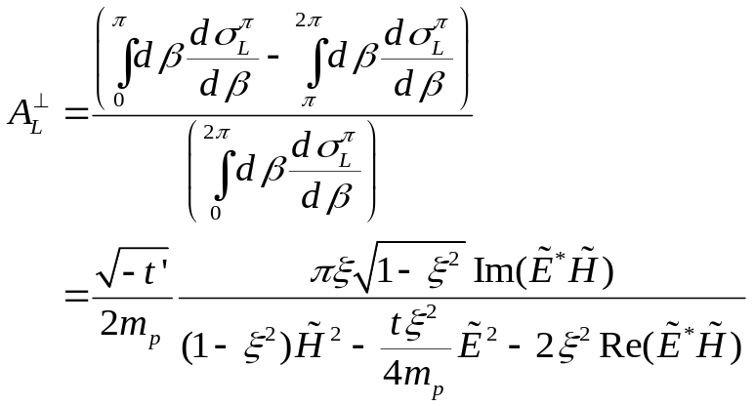
Exclusive π⁻ from Transversely Polarized Neutron
Probe GPD with DEMP
GPD is not related to any already known parton distribution.
G_{P}(t) is highly uncertain because it is negligible at the momentum transfer of β-decay.
Experimental measurements can provide new nucleon structure information unlikely to be available from any other source.
The most sensitive observable to probe is the transverse single-spin asymmetry in exclusive π production:
Fit sinβ=sin(φ-φ_{S}) dependence to extract asymmetry.
Theoretical calculations suggest higher twist corrections, which may be significant at low Q² for σ_{L}, likely cancel in A┴.
  May allow access to GPDs at Q²~4 GeV² while Q²>10 GeV² needed for σ_{L}.

Slide 4
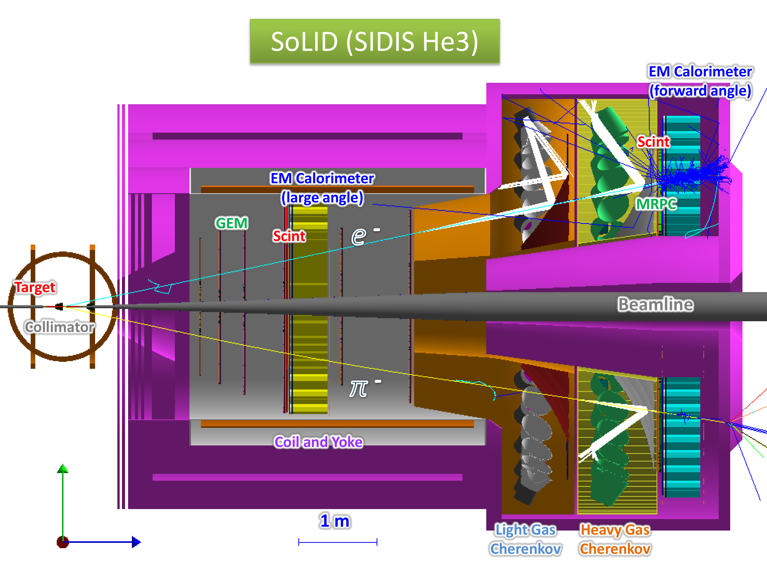
SoLID  Polarized ³He SIDIS Configuration
Run in parallel with E12-10-006: E₀ = 11.0 GeV (48 days)
Online Coincidence Trigger: Electron Trigger + Hadron Trigger (pions)
Offline Analysis: Identify (tag) protons and form triple-coincidence
No effect on SIDIS experiment as long as triple coincidence events are not vetoed in data acquisition.
Large-Angle :
Detect electrons and protons
Forward-Angle :
Detect electrons, pions, protons

Slide 5
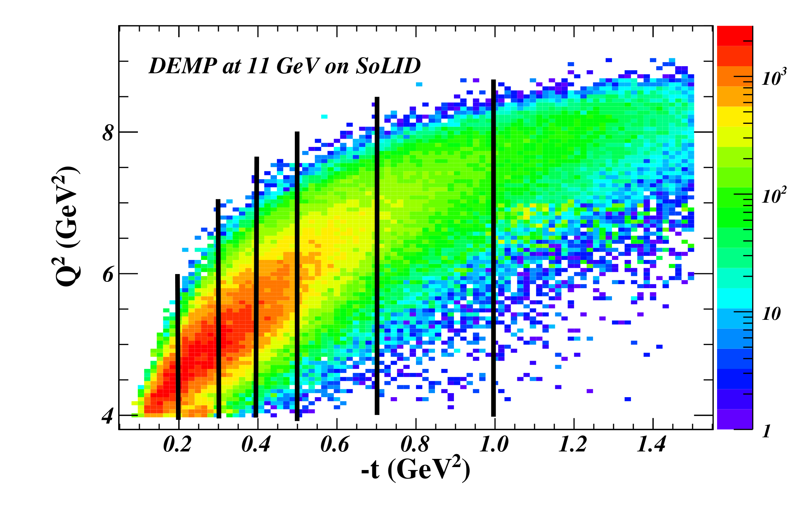
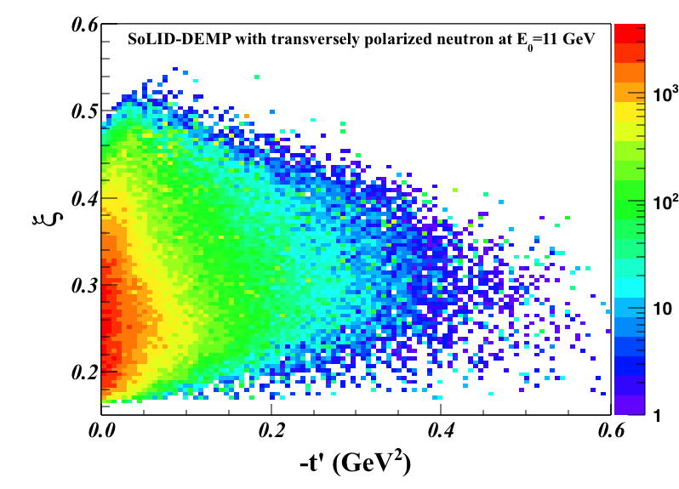
Kinematic Coverage
Q²>1 GeV² W>2 GeV | Q²>4 GeV² W>2 GeV
DEMP: n(e,e’π⁻p) Triple Coin (Hz)
4.95 | 0.40
SIDIS: n(e,e’π⁻)X Double Coin (Hz)
1425 | 35.8
Event generator based on data from HERMES, Halls B,C with VR Regge+DIS model used as constraint in unmeasured regions.
Data divided in 7 t-bins concentrating on the Q²>4 GeV² region of greatest physics interest.
Pioneering HERMES data at: ‹Q²›=2.38 GeV², ‹x_{B}›=0.13, ‹-t›=0.46 GeV², small skewness ξ<0.1.
With SoLID, we can measure the skewness dependence of the relevant GPDs over a fairly large range of ξ.

Slide 6
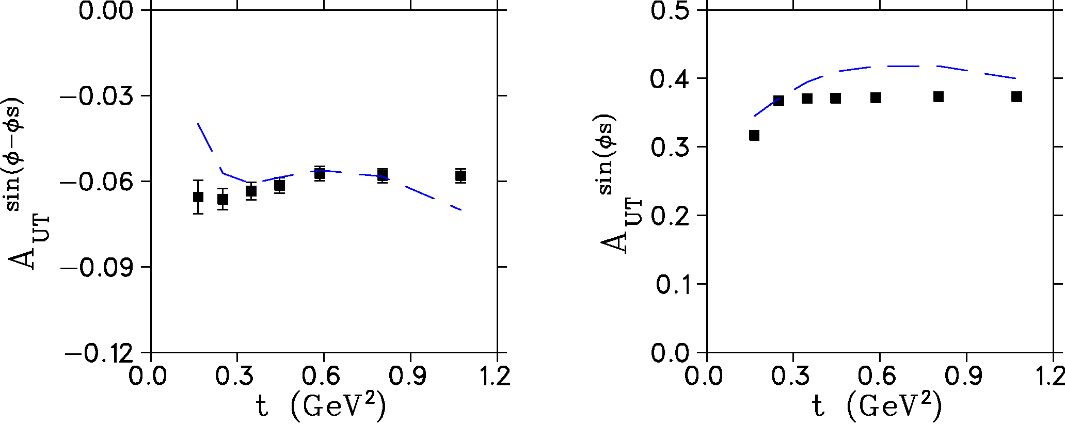

Exclusive π⁻ from Transversely Polarized Neutron
A wide -t coverage is needed to obtain a good understanding of the transverse single spin asymmetry, and the high luminosity capabilities of SoLID make it well-suited for this measurement.
Since an L-T separation is not possible with SoLID, the observed A_{UT}^{sin(φ-φS)} asymmetry will be diluted by the ratio of the longitudinal cross section to the unseparated cross section.
This was also true for the pioneering HERMES measurements, which provided a valuable constraint to models for the GPD.
A_{UT}^{sin(φS)} asymmetry can be extracted from the same data, providing powerful additional GPD model constraints.
Projected Uncertainties.
Includes all scattering, energy loss, resolution effects. Corresponds to when proton resolution is good enough to correct for Fermi momentum effects.
Projected “parasitic” E12-10-006 data. → analyze 2-track (e’ π⁻) data offline for recoil proton track.
Approved at SoLID Run Group Review (June 29/17) and encouraged “sharpening the physics case to make it a flagship experiment for the SoLID GPD program.”

Slide 8


Separated versus Unseparated Expts
Our reaction of interest is from the neutron in transversely polarized ³He.
It has not yet been possible to perform an experiment to measure A_{L}┴.
  Conflicting experimental requirements of transversely polarized target, high luminosity, L–T separation and closely controlled systematic uncertainties make this an exceptionally challenging observable to measure.
The most closely related measurement, of the transverse single-spin asymmetry in , without an L–T separation, was published by HERMES in 2010.
  Significant GPD information was obtained.
  Our proposed SoLID measurements will be a significant advance over the HERMES data in terms of kinematic coverage and statistical precision.

Slide 9
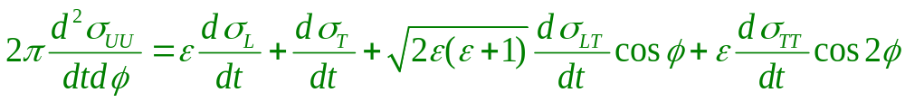
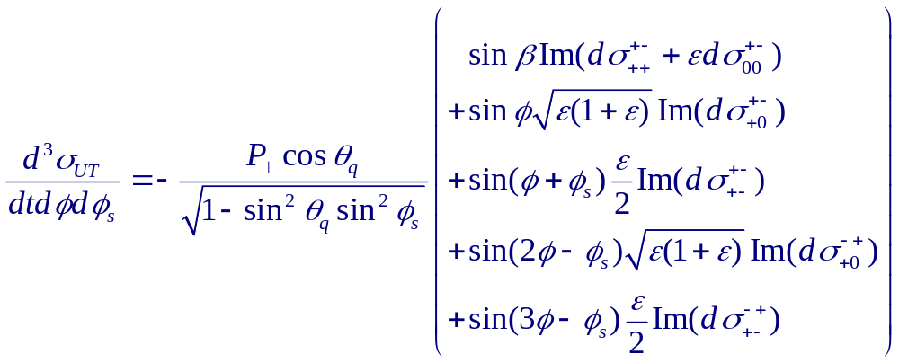
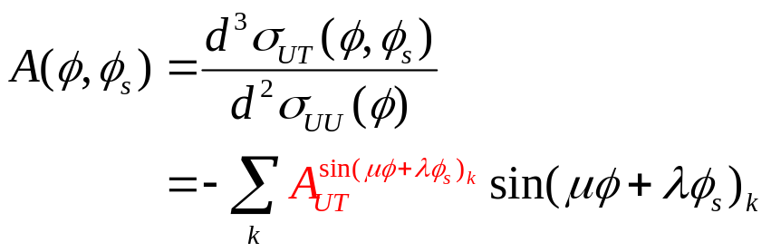
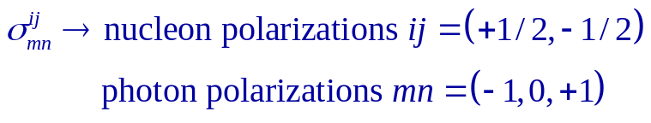
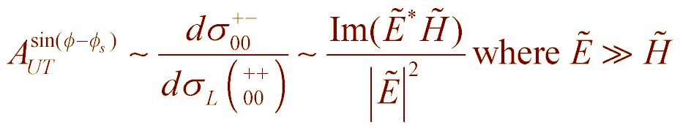
Transverse Target Single Spin Asymmetry in DEMP
Unpolarized
Cross section
Transversely polarized cross section has additional components
Note: Trento convention used for rest of talk
Gives rise to Asymmetry Moments
Unseparated sinβ=sin(φ-φ_{s}) Asymmetry Moment
Ref: M. Diehl, S. Sapeta, Eur.Phys.J. C41(2005)515.

Slide 10
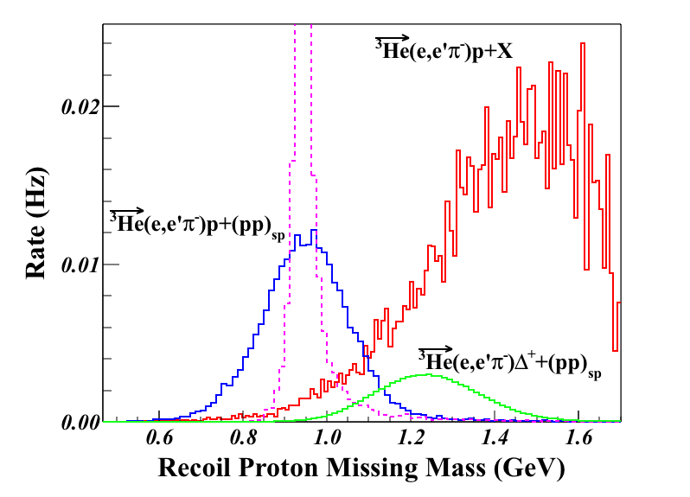
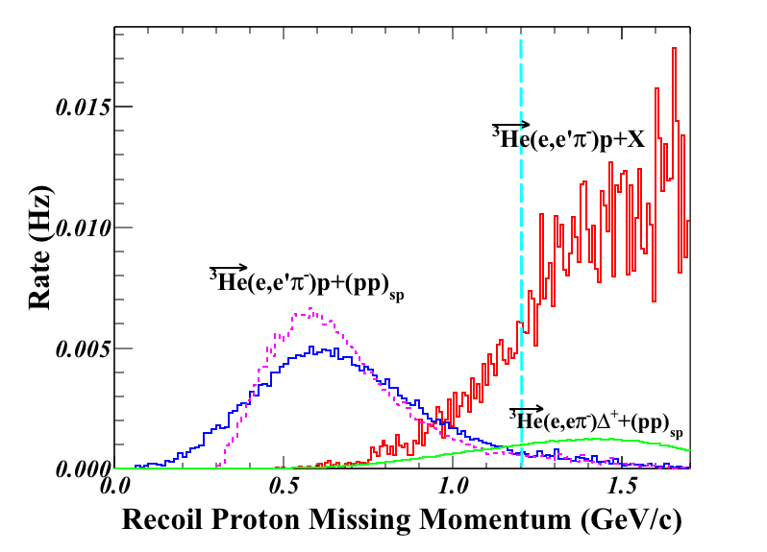
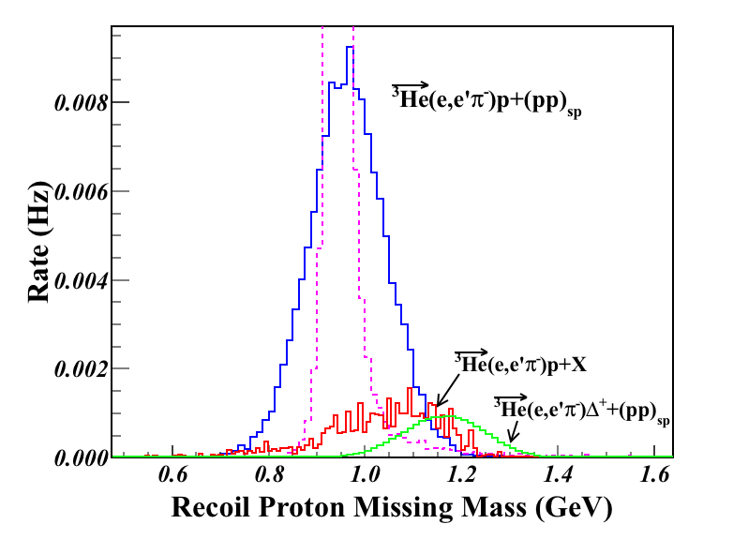
Example Cuts to Reduce Background
Two different background channels were simulated:
SoLID-SIDIS generator p(e,e’π–)X and n(e,e’π–)X, where we assume all X fragments contain a proton (over-estimate).
en→π–Δ⁺→π–π⁰p where the Δ⁺ (polarized) decays with l=1, m=0 angular distribution (more realistic).
Apply P_{miss}>1.2 GeV/c cut
Background remaining after P_{miss} cut
Scattering & radiation but no resolution smearing

Slide 11
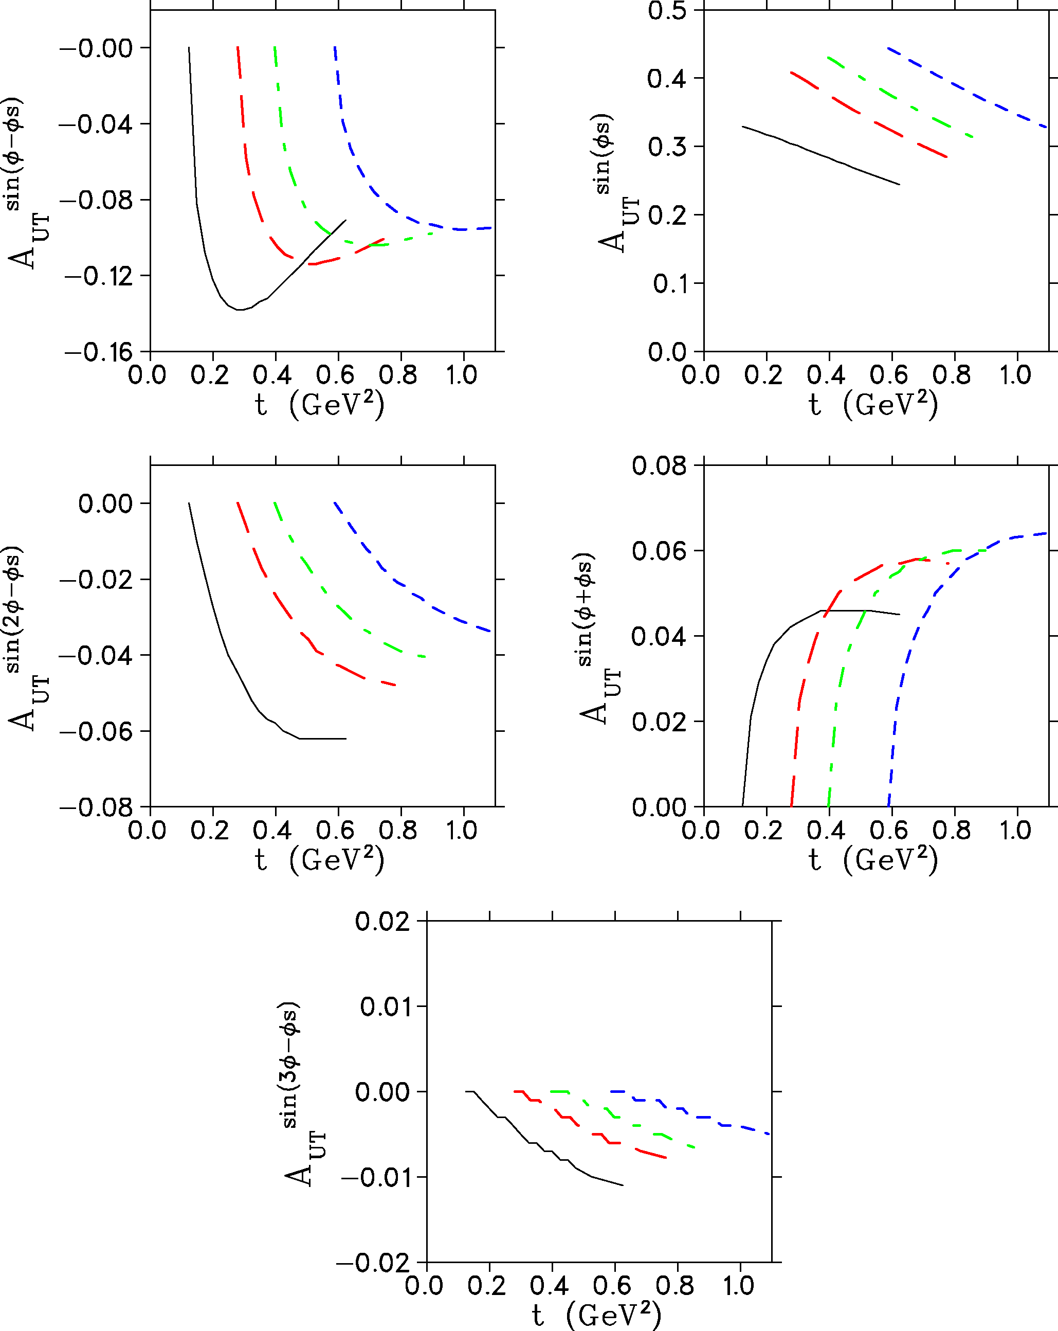
Asymmetry Moment Modeling
Event generator incorporates A_{UT} moments calculated by Goloskokov and Kroll for kinematics of this experiment.
GK handbag approach for π from neutron:
  Eur.Phys.J. C65(2010)137.
  Eur.Phys.J. A47(2011)112.
Simulated data for target polarization up and down are subjected to same Q²>4 GeV², W>2 GeV, 0.55<ε<0.75 cuts.
Q² | W
4.11 | 3.17
5.14 | 2.80
6.05 | 2.72
6.89 | 2.56

Slide 12
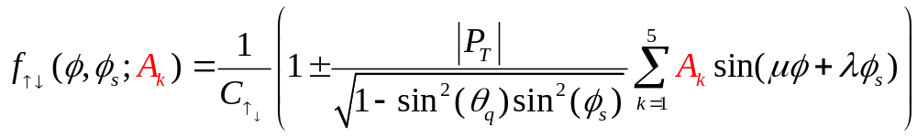
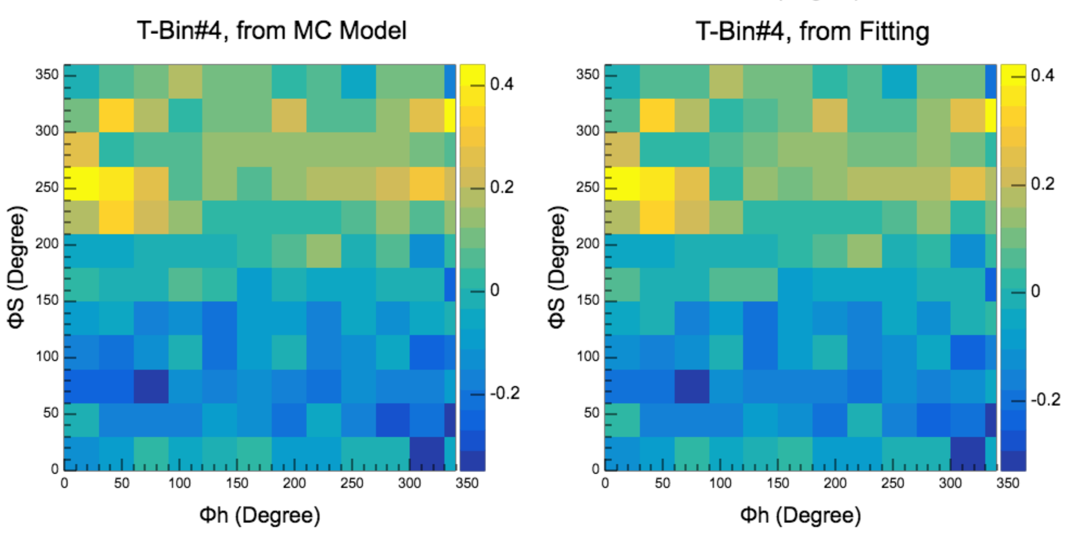
Unbinned Maximum Likelihood (UML) Method
Same method used by HERMES in their DEMP analysis [PLB 682(2010)345].
UML takes advantage of full statistics of the data, obtains much better results when statistics are limited.
The full set of azimuthal modulations A_{k} that minimize the likelihood function are defined as:
As an illustration, compare input (φ,φ_{s}) modulations to UML analysis output.
Projected Uncertainties.
Includes all scattering, energy loss, resolution effects. Corresponds to when proton resolution is good enough to correct for Fermi momentum effects.

Slide 13

Summary
A_{UT}^{sin(φ-φs)} transverse single-spin asymmetry in exclusive π production is particularly sensitive to the spin-flip GPD . Factorization studies indicate precocious scaling to set in at moderate Q²~2-4 GeV², while scaling is not expected until Q²>10 GeV² for absolute cross section.
A_{UT}^{sin(φs)} asymmetry can also be extracted from same data, providing powerful additional GPD-model constraints and insight into the role of transverse photon contributions at small –t, and over wide range of ξ.
High luminosity and good acceptance capabilities of SoLID make it well-suited for this measurement. It is the only feasible manner to access the wide –t range needed to fully understand the asymmetries.
We propose to analyze the E12-10-006 event files off-line to look for e-π⁻-p triple coincidence events. To be conservative, we assume the recoil proton is only identified, and its momentum is not used to further reduce SIDIS (and other) background.
We used a sophisticated UML analysis to extract the asymmetries from simulated data in a realistic manner, just as was used in the pioneering HERMES data. The projected data are expected to be a considerable advance over HERMES in kinematic coverage and statistical precision.
SoLID measurement is also important preparatory work for future EIC.

