Slide 1
E12-10-006B:
Deep Exclusive π─ Production with Transversely Polarized ³He using SoLID
Co-Spokespersons:
Zafar Ahmed, University of Regina
Garth Huber, University of Regina
Zhihong Ye, Argonne National Laboratory
SoLID Run Group Review, Jefferson Lab, June 29, 2017.

Slide 2
E12-10-006B Collaborators
J. Arrington, K. Hafidi, M. Hattawy, P. Reimer, S. Riordan, Z. Ye
Argonne National Laboratory
Z. Ahmed, G.R. Ambrose, S. Basnet, R.S. Evans, G.M. Huber, W. Li, D. Paudyal, Z. Papandreou
University of Regina
H. Gao, X. Li, T. Liu, C. Peng, W. Xiong, X.F. Yan, Z. Zhao
Duke University
A. Camsonne, J-P. Chen, S. Covrig-Dusa, D. Gaskell
  Jefferson Lab
T. Brecelj, M. Mihovilovic, S. Sirca, S. Stajner
Jozef Stefan Institute and University of Ljubljana
K. Aniol – California State University – Los Angeles
M Boer – Los Alamos National Laboratory
D. Dutta, L Ye – Mississippi State University
C.E. Hyde, F.R. Wesselmann – Old Dominion University
P. Markowitz – Florida International University
V. Sulkosky – University of Virginia
E. Voutier – Institut de Physique Nucleaire IN2P3/CNRS Orsay

Slide 3
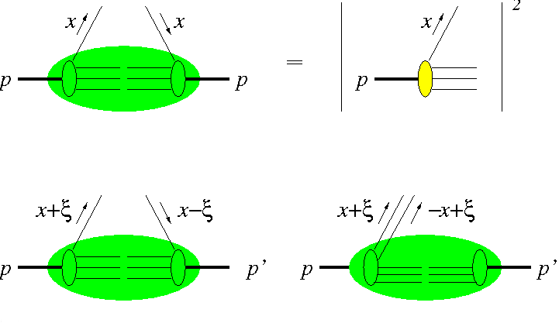


GPDs in Deep Exclusive Meson Production
PDFs : probability of finding a parton with longitudinal momentum fraction x and specified polarization in fast moving hadron.
GPDs : interference between partons with x+ξ and x-ξ, interrelating longitudinal and transverse momentum structure of partons within fast moving hadron.
A special kinematic regime is probed in
Deep Exclusive Meson Production,
where the initial hadron emits or gg pair.
No counterpart in usual PDFs.
Since GPDs correlate different parton configurations in the hadron at quantum mechanical level,
  GPDs determined in this regime carry information about and gg-components in the hadron wavefunction.

Slide 4
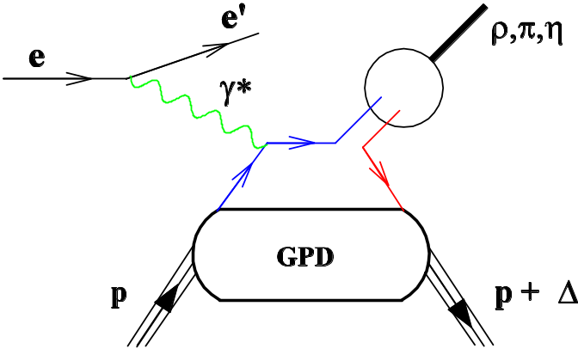
GPDs require Hard Exclusive Reactions
In order to access the physics contained in GPDs, one is restricted to the hard scattering regime.
Factorization property of hard reactions:
Hard probe creates a small size
and gluon configuration,
  interactions can be described by pQCD.
{
L
Factorization
Non-perturbative part describes how hadron reacts to this configuration, or how the probe is transformed into hadrons (parameterized by GPDs).
{
Hard Exclusive Meson Electroproduction first shown to be factorizable by Collins, Frankfurt & Strikman [PRD 56(1997)2982].
Factorization applies when the γ* is longitudinally polarized.
  corresponds to small size configuration compared to transversely polarized γ*.

Slide 5
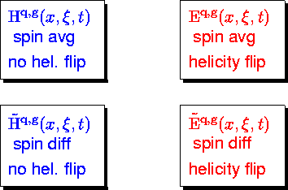




Generalized Parton Distributions (GPDs)
GPDs interrelate the longitudinal and transverse momentum structure of partons within a fast moving hadron.
GPDs are universal quantities and reflect nucleon structure independently of the probing reaction.
At leading twist–2, four quark chirality conserving GPDs for each quark, gluon type.
Because quark helicity is conserved in the hard scattering regime, the produced meson acts as helicity filter.
  Pseudoscalar mesons →
  Vector mesons → H E.
At twist–3, additional chiral–odd GPDs (H_{T} E_{T} ) offer a new way to access the transversity–dependent quark–content of the nucleon.

Slide 6
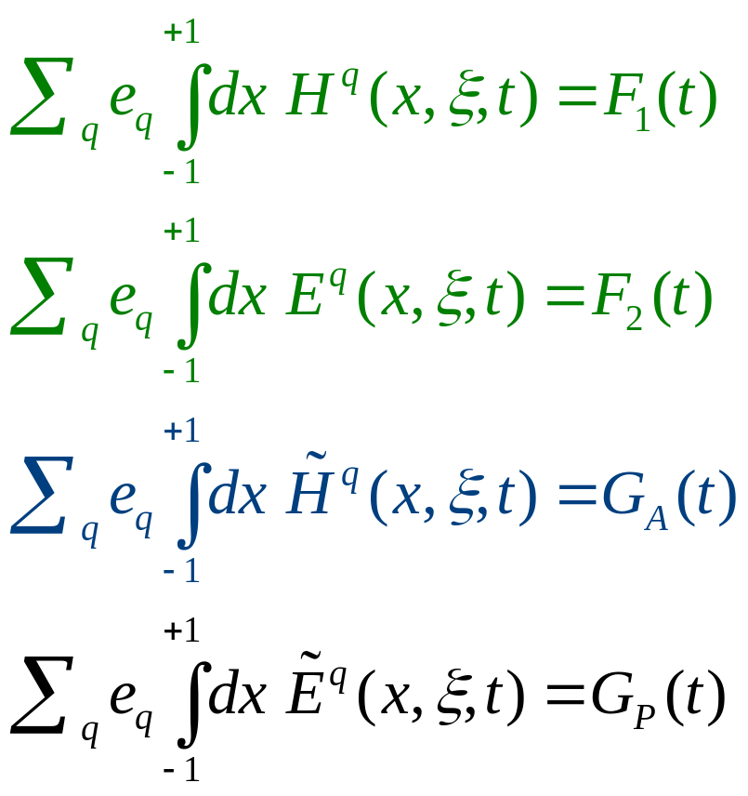
Links to other nucleon structure quantities
First moments of GPDs are related to nucleon elastic form factors through model-independent sum rules:
}
Dirac and Pauli elastic nucleon form factors.
t -dependence fairly well known.
Isovector axial form factor.
t –dep. poorly known.
Pseudoscalar form factor.
Very poorly known.

Slide 7
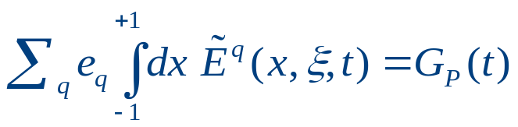

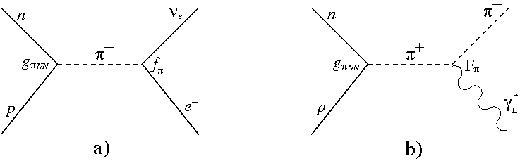
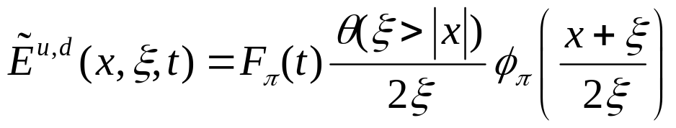
Spin-flip GPD E
~
G_{P}(t) is highly uncertain because it is negligible at the momentum transfer of β-decay.
Because of PCAC, G_{P}(t) alone receives contributions from J^{PG}=0⁻⁻ states.
  These are the quantum numbers of the pion, so contains an important pion pole contribution.
Pion pole contribution to G_{P}(t)
Pion pole contribution to meson electroproduction at low –t.
For this reason, a pion pole-dominated ansatz is typically assumed:
where F_{π} is the pion FF and φ_{π} the pion PDF.

Slide 8


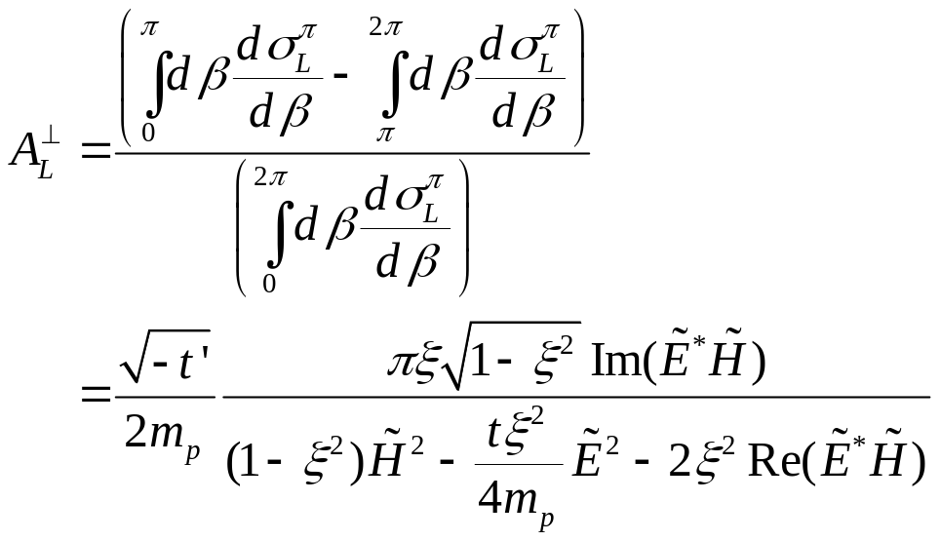
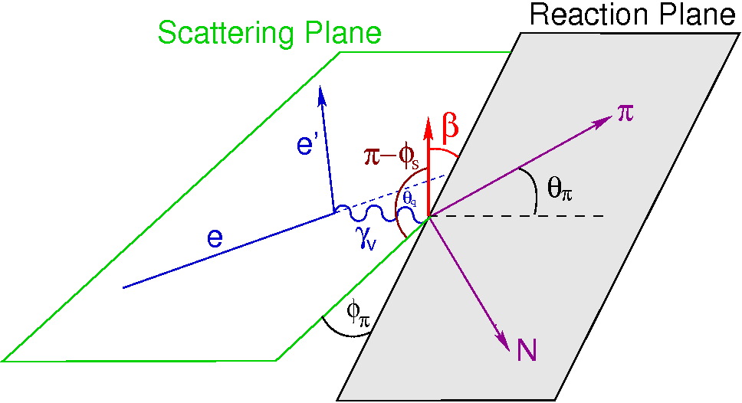
How to determine E
~
GPD not related to an already known parton distribution.
Experimental information on can provide new nucleon structure info unlikely to be available from any other source.
The most sensitive observable to probe is the transverse single-spin asymmetry in exclusive π production:
dσ_{π}^{L} = exclusive π cross section for longitudinal γ*
β =angle between transversely polarized target vector and the reaction plane.

Slide 9

Single Spin Asymmetry in Exclusive π Production
Frankfurt et al. have shown A_{L}┴ vanishes if is zero
[PRD 60(1999)014010].
  If ≠0, the asymmetry will produce a sinβ dependence.
They also argue that precocious factorization of the π production amplitude into three blocks is likely:
    overlap integral between γ, π wave functions.
    the hard interaction.
    the GPD.
  Higher order corrections, which may be significant at low Q² for σ_{L}, likely cancel in A_{L}┴.
A_{L}┴ expected to display precocious factorization at moderate Q²~2-4 GeV².

Slide 10
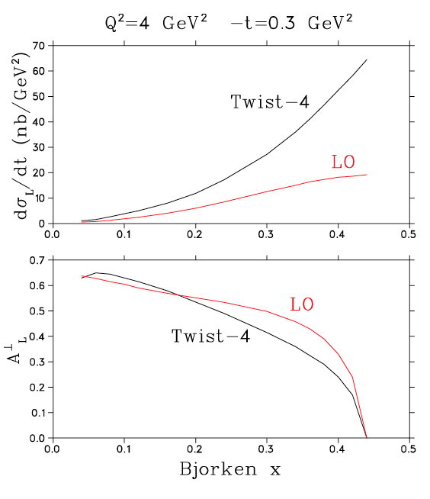
GPD information in A_{L}┴ may be particularly clean
A_{L}┴ is expected to display precocious factorization at only Q²~2-4 GeV²:
  At Q²=10 GeV², Twist–4 effects can be large, but cancel in A_{L}┴
  (Belitsky & Műller PLB 513(2001)349).
  At Q²=4 GeV², higher twist effects even larger in σ_{L}, but still cancel in the asymmetry
  (CIPANP 2003).
A_{L}┴=0 at parallel kinematic limit, where φ–φ_{s} is not well defined.
This relatively low value of Q² for the expected onset of precocious scaling is important, because it is experimentally accessible at Jefferson Lab.

Slide 11


Separated versus Unseparated Expts
Our reaction of interest is from the neutron in transversely polarized ³He.
It has not yet been possible to perform an experiment to measure A_{L}┴.
  Conflicting experimental requirements of transversely polarized target, high luminosity, L–T separation and closely controlled systematic uncertainties make this an exceptionally challenging observable to measure.
The most closely related measurement, of the transverse single-spin asymmetry in , without an L–T separation, was published by HERMES in 2010.
  Significant GPD information was obtained.
  Our proposed SoLID measurements will be a significant advance over the HERMES data in terms of kinematic coverage and statistical precision.

Slide 12
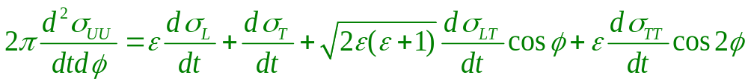
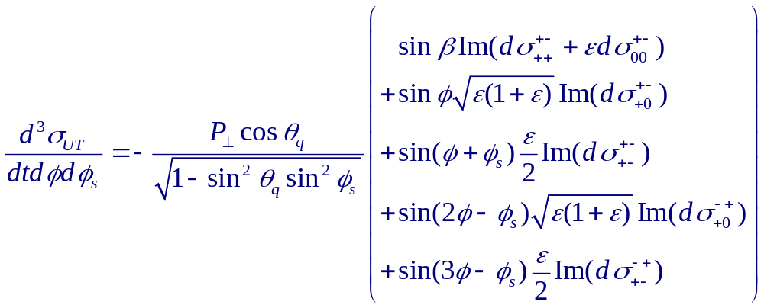
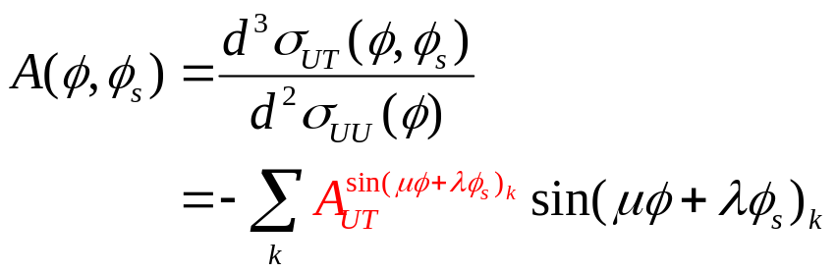
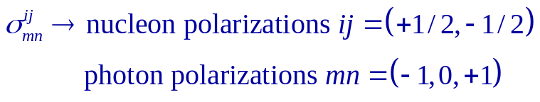
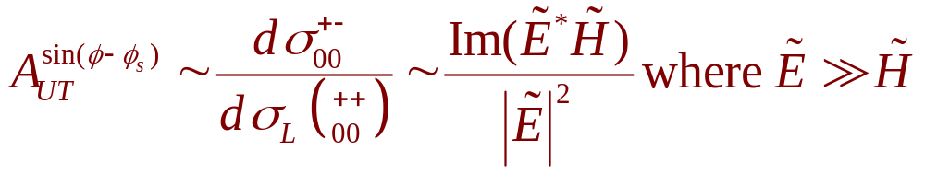
Transverse Target Single Spin Asymmetry in DEMP
Unpolarized
Cross section
Transversely polarized cross section has additional components
Note: Trento convention used for rest of talk
Gives rise to Asymmetry Moments
Unseparated sinβ=(φ-φ_{s}) Asymmetry Moment

Slide 13
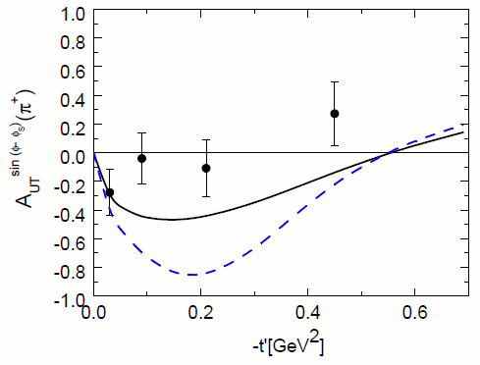

HERMES sin(β=φ-φ_{s}) Asymmetry Moment
Exclusive π⁺ production by scattering 27.6 GeV positrons or electrons from transverse polarized ¹H without L/T separation. [PLB 682(2010)345].
Analyzed in terms of 6 Fourier amplitudes for φ_{π},φ_{s}.
Asymmetry is diluted by ~50%.
‹x_{B}›=0.13, ‹Q²›=2.38 GeV², ‹-t›=0.46 GeV².
Full calculation, including transverse and longitudinal γ.
Longitudinal γ only.
Goloskokov and Kroll indicate the HERMES results have significant contributions from transverse photons, as well as from L and T interferences [Eur Phys.J. C65(2010)137].
Nonetheless, the HERMES data are consistent with GPD models based on the dominance of over at low –t.
  In fact, the sign crossing in the model curve at –t≈0.5 GeV² is due to the large contribution from demanded by the data.

Slide 14
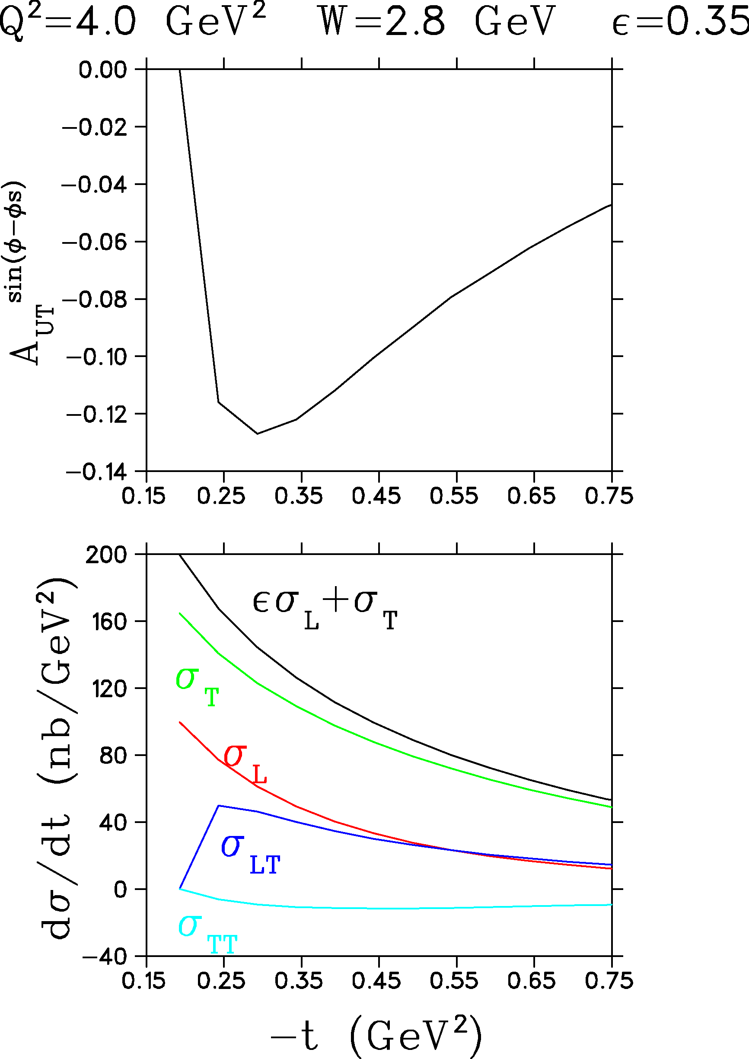
Asymmetry Dilution with SoLID
Calculation of cross section components and sin(β=φ-φ_{s}) asymmetry moment in handbag approach by Goloskokov & Kroll for our kinematics.
  Although their calculation tends to underestimate σ_{L} values measured by JLab Fπ–2, their model is in reasonable agreement with unseparated dσ/dt.
Similar level of A_{UT}^{sin(φ-φs)} asymmetry dilution as observed by HERMES is expected in SoLID measurement.
SoLID measurement at higher Q² than HERMES, will cover a wide range of –t with good statistical precision.

Slide 15
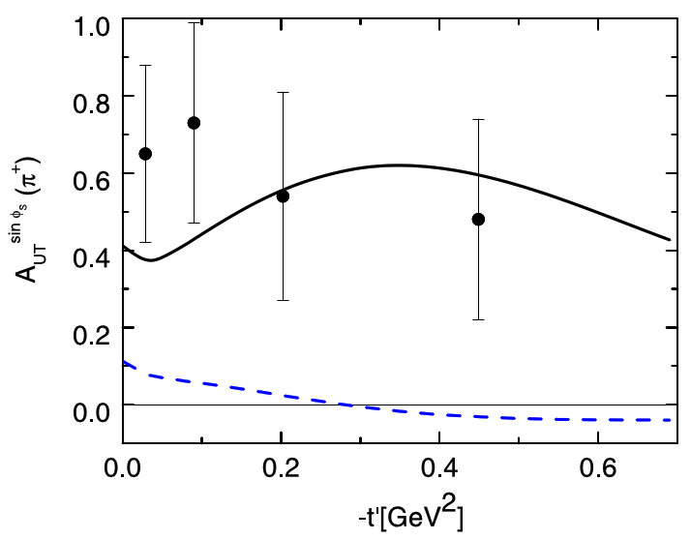
HERMES sin(φ_{s}) Asymmetry Moment
Full calculation, assuming dominance of H_{T}.
While most of the theoretical interest and the primary motivation of our experiment is the sin(φ-φ_{s}) asymmetry moment, there is growing interest in the sin(φ_{s}) moment, which may be interpretable in terms of the transversity GPDs.
No Twist-3 contribution.
In contrast to the sin(φ-φ_{s}) modulation, which has contributions from LL and TT interferences, the sin(φ_{S}) modulation measures only the LT interference.
The HERMES sin(φ_{S}) modulation is large and nonzero at –t’=0, giving the first clear signal for strong contributions from transversely polarized photons at rather large values of W and Q².
Goloskokov and Kroll calculation [Eur.Phys.J. C65(2010)137] assumes the transversity GPD H_{T} dominates and that the other three can be neglected.

Slide 16
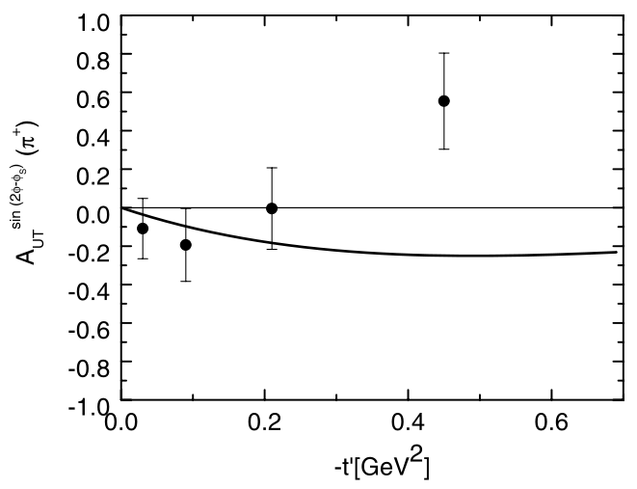
HERMES sin(2φ-φ_{s}) Asymmetry Moment
‹Q²›=2.38 GeV², ‹W›=3.99 GeV.
Experimental values and model calculation are both small.
Handbag approach calculation by Goloskokov & Kroll [Eur.Phys.J. C65(2010)137] .
sin(2φ-φ_{S}) modulation has additional LT interference amplitudes contributing that are not present in sin(φ_{s}).
  Improvement to calculation to reproduce sign change would require a more detailed modeling of these smaller amplitudes.
  This would also improve description of other amplitude moments. Different moments provide complementary amplitude term information in this sense.
The remaining sin(φ+φ_{s}), sin(2φ+φ_{s}), sin(3φ-φ_{s}) moments are only fed by TT interference and are even smaller.

Slide 17
Complementarity of Hall C and SoLID Expts
SHMS+HMS:
HMS detects scattered e’.
SHMS detects forward, high momentum π.
Expected small systematic uncertainties to give reliable L/T separations.
Good missing mass resolution to isolate exclusive final state.
Multiple SHMS angle settings to obtain complete azimuthal coverage up to 4º from q-vector.
It is not possible to have complete azimuthal coverage at larger –t, where A_{L}┴ is largest.
PR12-12-005 by GH, D. Dutta, D. Gaskell, W. Hersman based on next generation polarized ³He target (e.g. UNH).
SoLID:
Complete azimuthal coverage (for π) up to θ=24º.
High luminosity, particle ID and vertex resolution capabilities well matched to the experiment.
L/T separation is not possible, the sin(φ-φ_{s}) asymmetry moment is “diluted” by LL, TT contributions.
The measurement is valuable as it is the only practical way to obtain A_{UT}^{sin(φ-φs)} over a wide kinematic range.
We will also measure A_{UT}^{sin(φs)} and its companion moments, as was done by HERMES.
Provides vital GPD information not easily available in any other experiment prior to EIC.

Slide 18

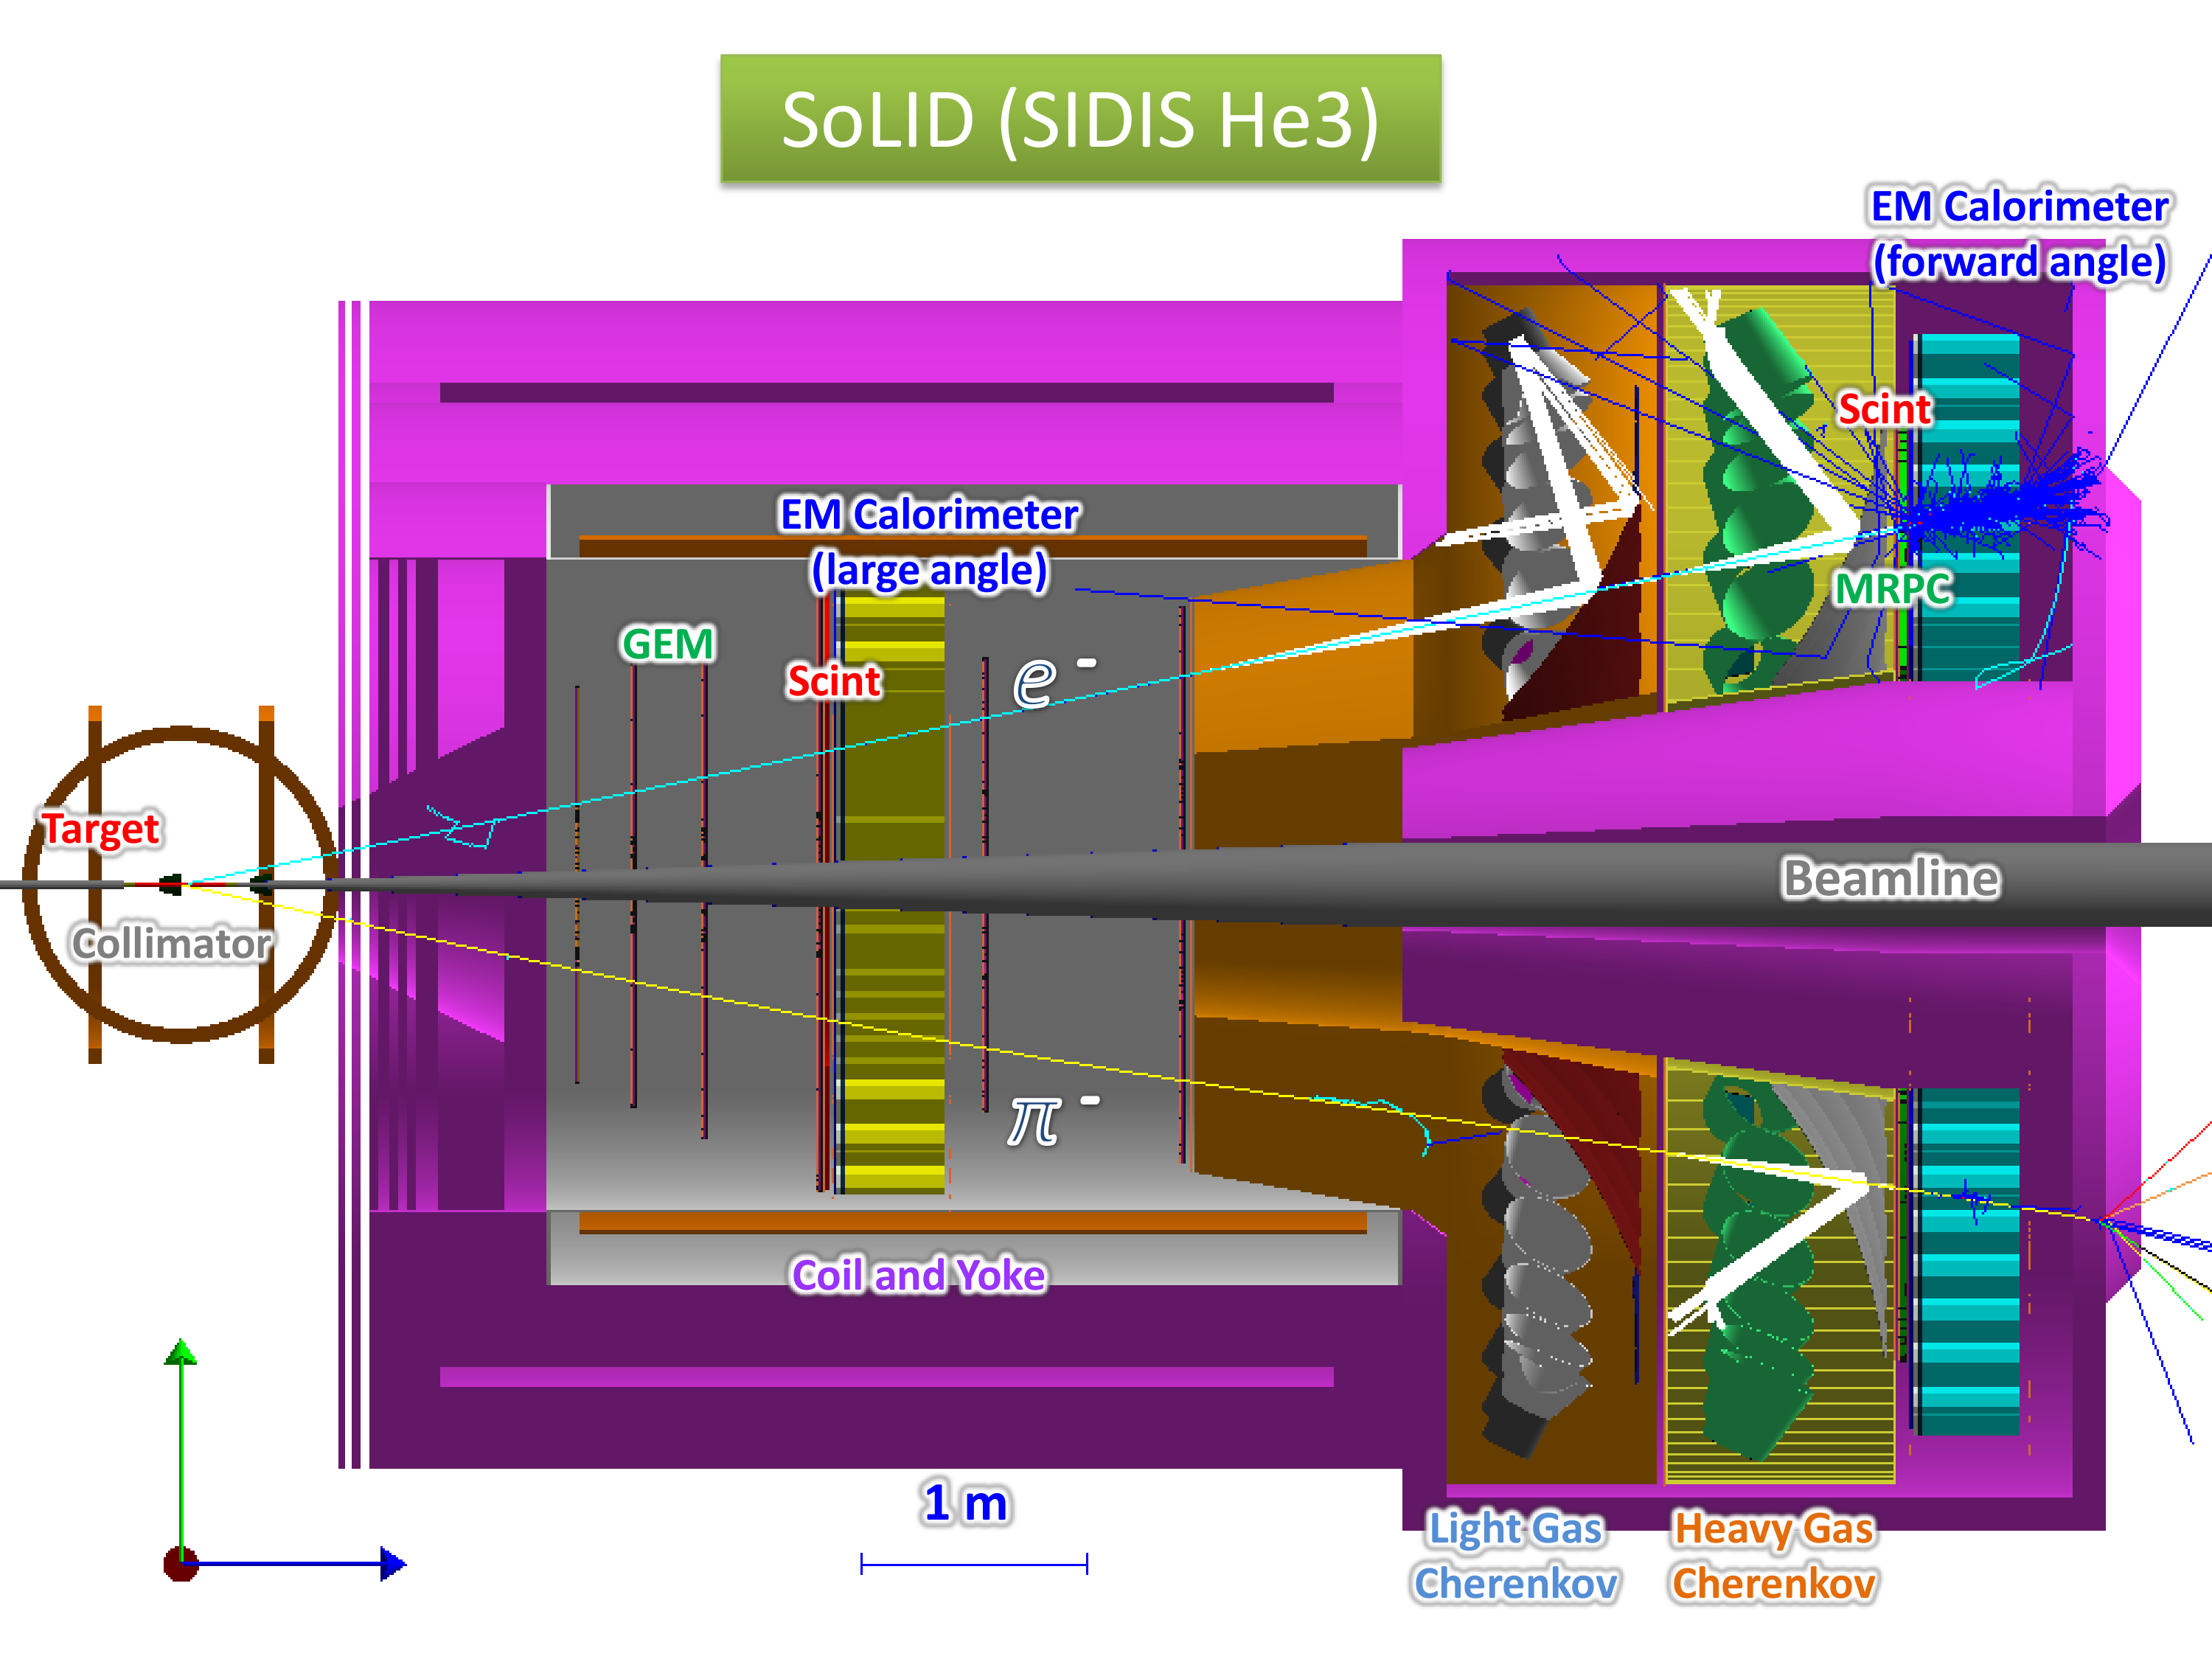
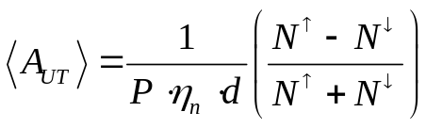
SoLID  Polarized ³He SIDIS Configuration
with transversely polarized ³He
Proton is tagged, but we do not assume the momentum information is very useful.
Run in parallel with E12-10-006:
E₀ = 11.0 GeV (48 days)
Luminosity = 10³⁶ cm⁻²s⁻¹ (per nucleon)
Target | ³He
Length | 40 cm
Polarization | ~60%
Dilution | ~90%
Effective Neutron | 86.5%
Uncertainty | ~3%

Slide 19
SoLID-SIDIS Detector Configuration
Large-Angle :
Detect electrons and protons
Forward-Angle :
Detect electrons, pions, protons
e/π Coverage: → Forward-Angle: 0<φ<2π, 8º<θ<14.8º, 1<P<7 GeV/c for e/π
→ Large-Angle: 0<φ<2π, 16º<θ<24º, 3.5<P<7 GeV/c for e only
Proton Coverage: → Same as e/π at FA and LA
Resolution: δP/P~2%, δθ~0.6 mrad, δφ~5 mrad
Coincidence Trigger: Electron Trigger + Hadron Trigger (pions)
Offline Analysis: Identify (tag) protons and form triple-coincidence

Slide 20
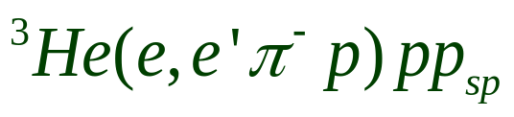
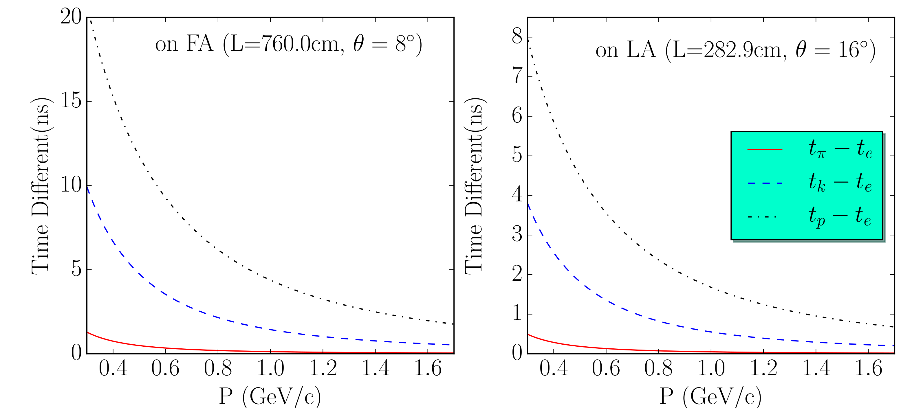
Recoil Particle Detection: Time of Flight
Need >5σ timing resolution to identify protons from other charged particles
Exisiting SoLID Timing Detectors:
  MRPC & FASPC at Forward-Angle: cover 8º~14.8º, >3 ns separation.
  LASPD at Large-Angle: cover 14º~24º, >1 ns separation.
The currently designed timing resolution is sufficient for proton identification using TOF.

Slide 21
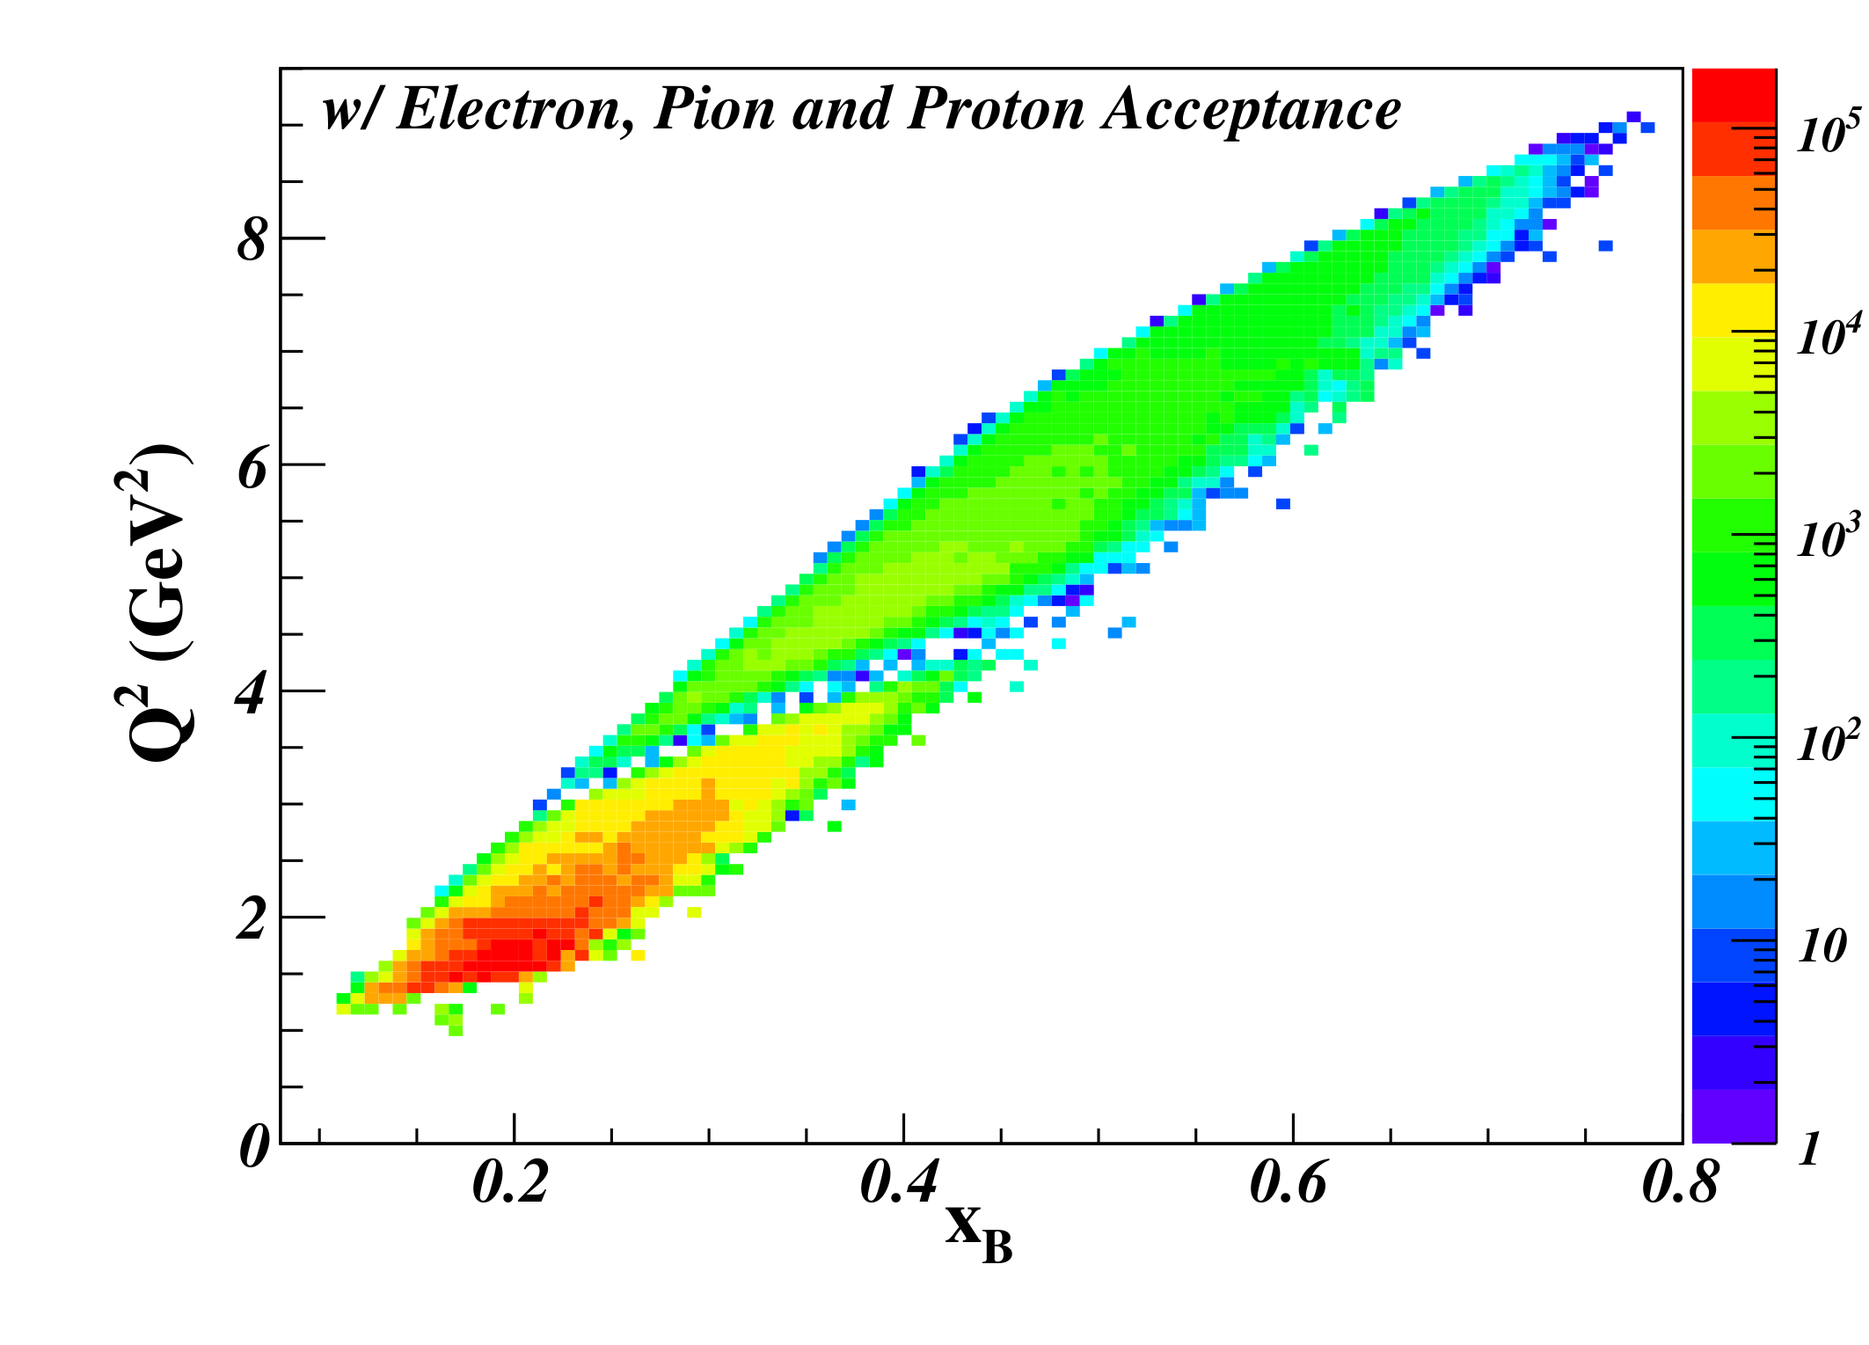
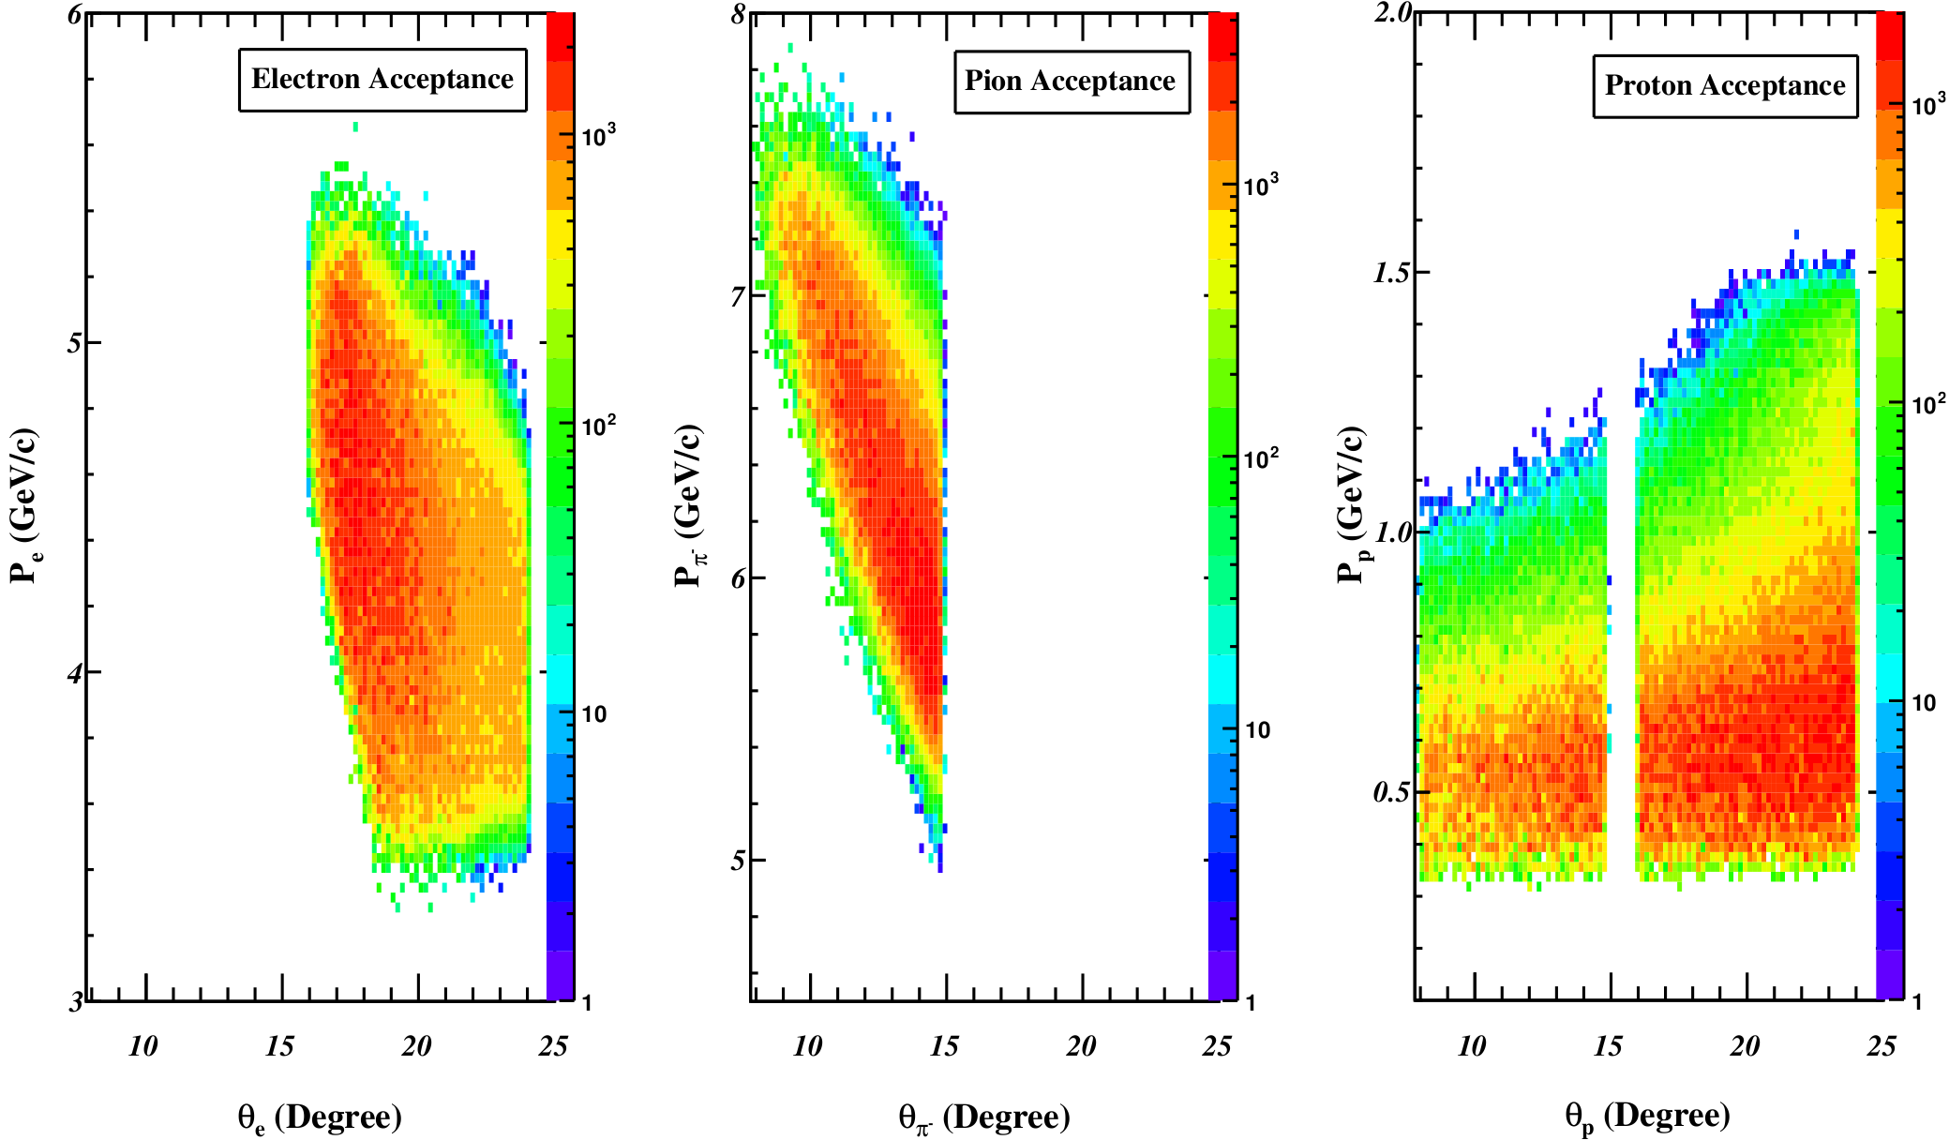
Acceptance and Projected Rates
Q²>1 GeV² W>2 GeV | Q²>4 GeV² W>2 GeV
DEMP: n(e,e’π⁻p) Triple Coin (Hz)
4.95 | 0.40
SIDIS: n(e,e’π⁻)X Double Coin (Hz)
1425 | 35.8
Event generator is based on data from HERMES, Halls B,C with VR Regge+DIS model used as a constraint in unmeasured regions.
Generator includes electron radiation, multiple scattering and ionization energy loss.
Every detected particle is smeared in (P,θ,φ) with resolution from SoLID tracking studies, and acceptance profiles from SoLID-SIDIS GEMC study applied.
Q²>4 GeV², W>2 GeV, 0.55<ε<0.75 cuts applied.

Slide 22
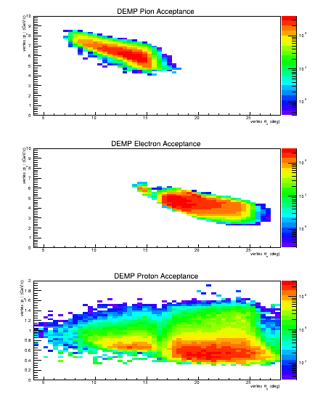
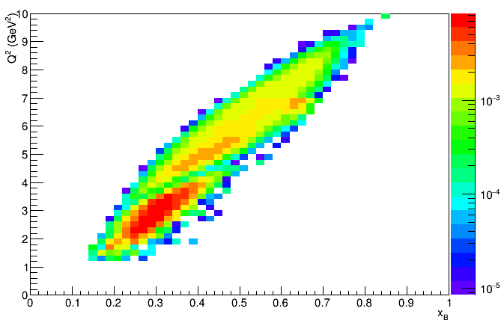
Similar Results from GEMC Simulations
As requested in last year’s TAC review, we performed a 2nd set of simulations to better model the lowest momentum recoil protons.
GEMC flux tree used to see if a particle hits a specific detector.
Good agreement with 1st set of simulations.
Detected proton momentum shifted upward slightly, ~300-350 MeV/c, partly due to change in plotting variables.

Slide 23
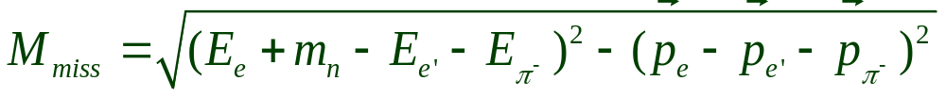
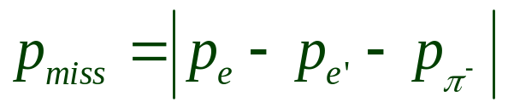
Missing Mass and Momentum
We have been very conservative in our estimations.
Although we will detect the recoil proton to separate the exclusive channel events, in this analysis we do not assume that the proton momentum resolution is sufficiently good to provide an additional constraint.
Thus, we compute the missing mass and momentum as if the proton were not detected:
Of course, in the actual analysis, we will try to reconstruct the proton momentum as accurately as possible.
If the resolution is sufficiently good, this would allow additional background discrimination, as well as the effect of Fermi momentum to be removed from the asymmetry moments on an event-by-event basis.

Slide 24
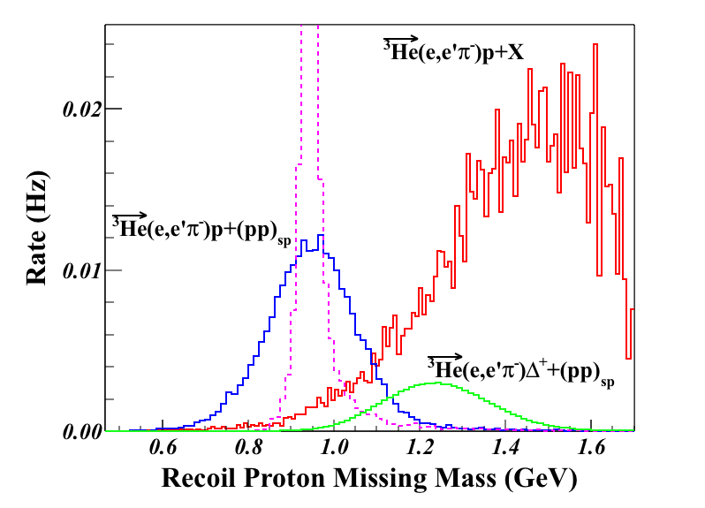
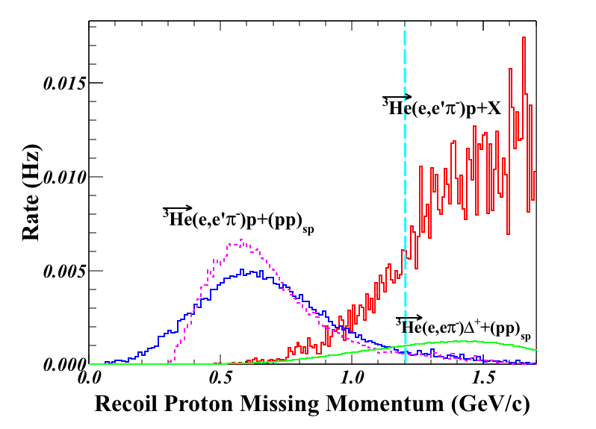
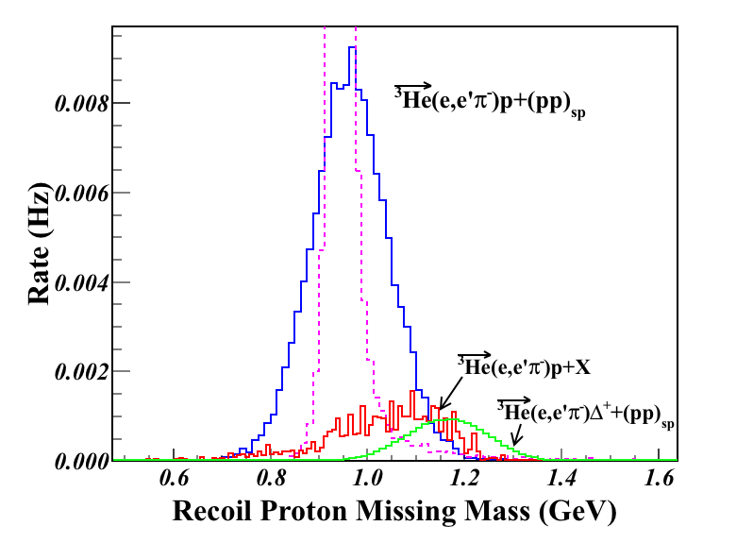
Example Cuts to Reduce Background
Two different background channels were simulated:
SoLID-SIDIS generator p(e,e’π–)X and n(e,e’π–)X where we assume all X fragments contain a proton (over-estimate).
en→π–Δ⁺→π–π⁰p where the Δ⁺ (polarized) decays with l=1, m=0 angular distribution (more realistic).
Apply P_{miss}>1.2 GeV/c cut
Background remaining after P_{miss} cut
Scattering & radiation but no resolution smearing

Slide 25
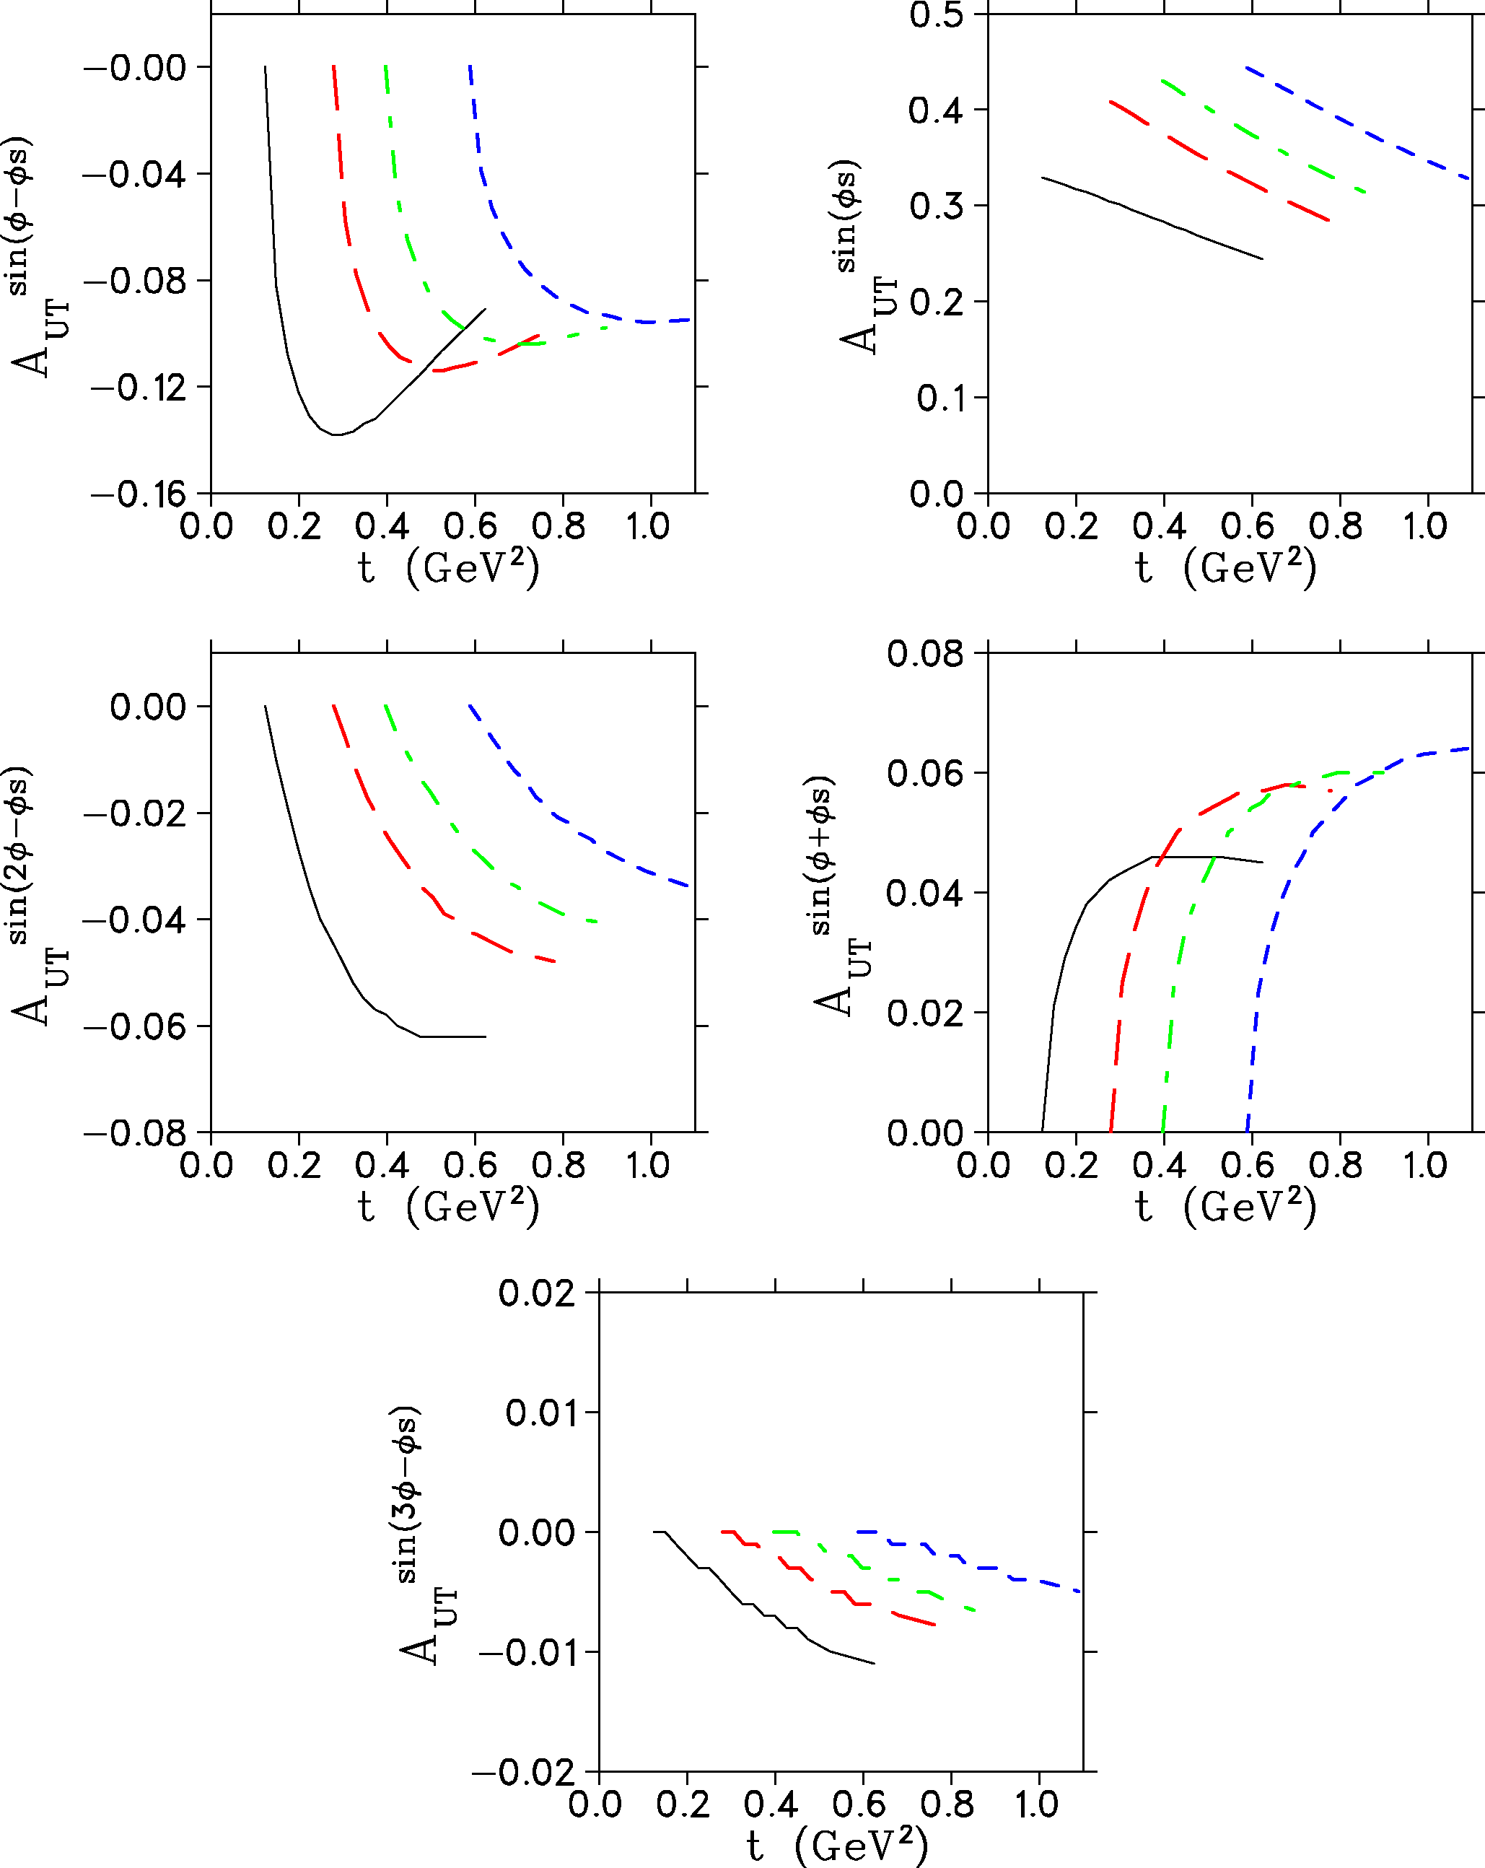
Asymmetry Moment Modeling
Event generator incorporates A_{UT} moments calculated by Goloskokov and Kroll for kinematics of this experiment.
GK handbag approach for π from neutron:
  Eur.Phys.J. C65 (2010) 137.
  Eur.Phys.J. A47 (2011) 112.
Simulated data for target polarization up and down are subjected to same Q²>4 GeV², W>2 GeV, 0.55<ε<0.75 cuts.
Q² | W
4.11 | 3.17
5.14 | 2.80
6.05 | 2.72
6.89 | 2.56

Slide 26
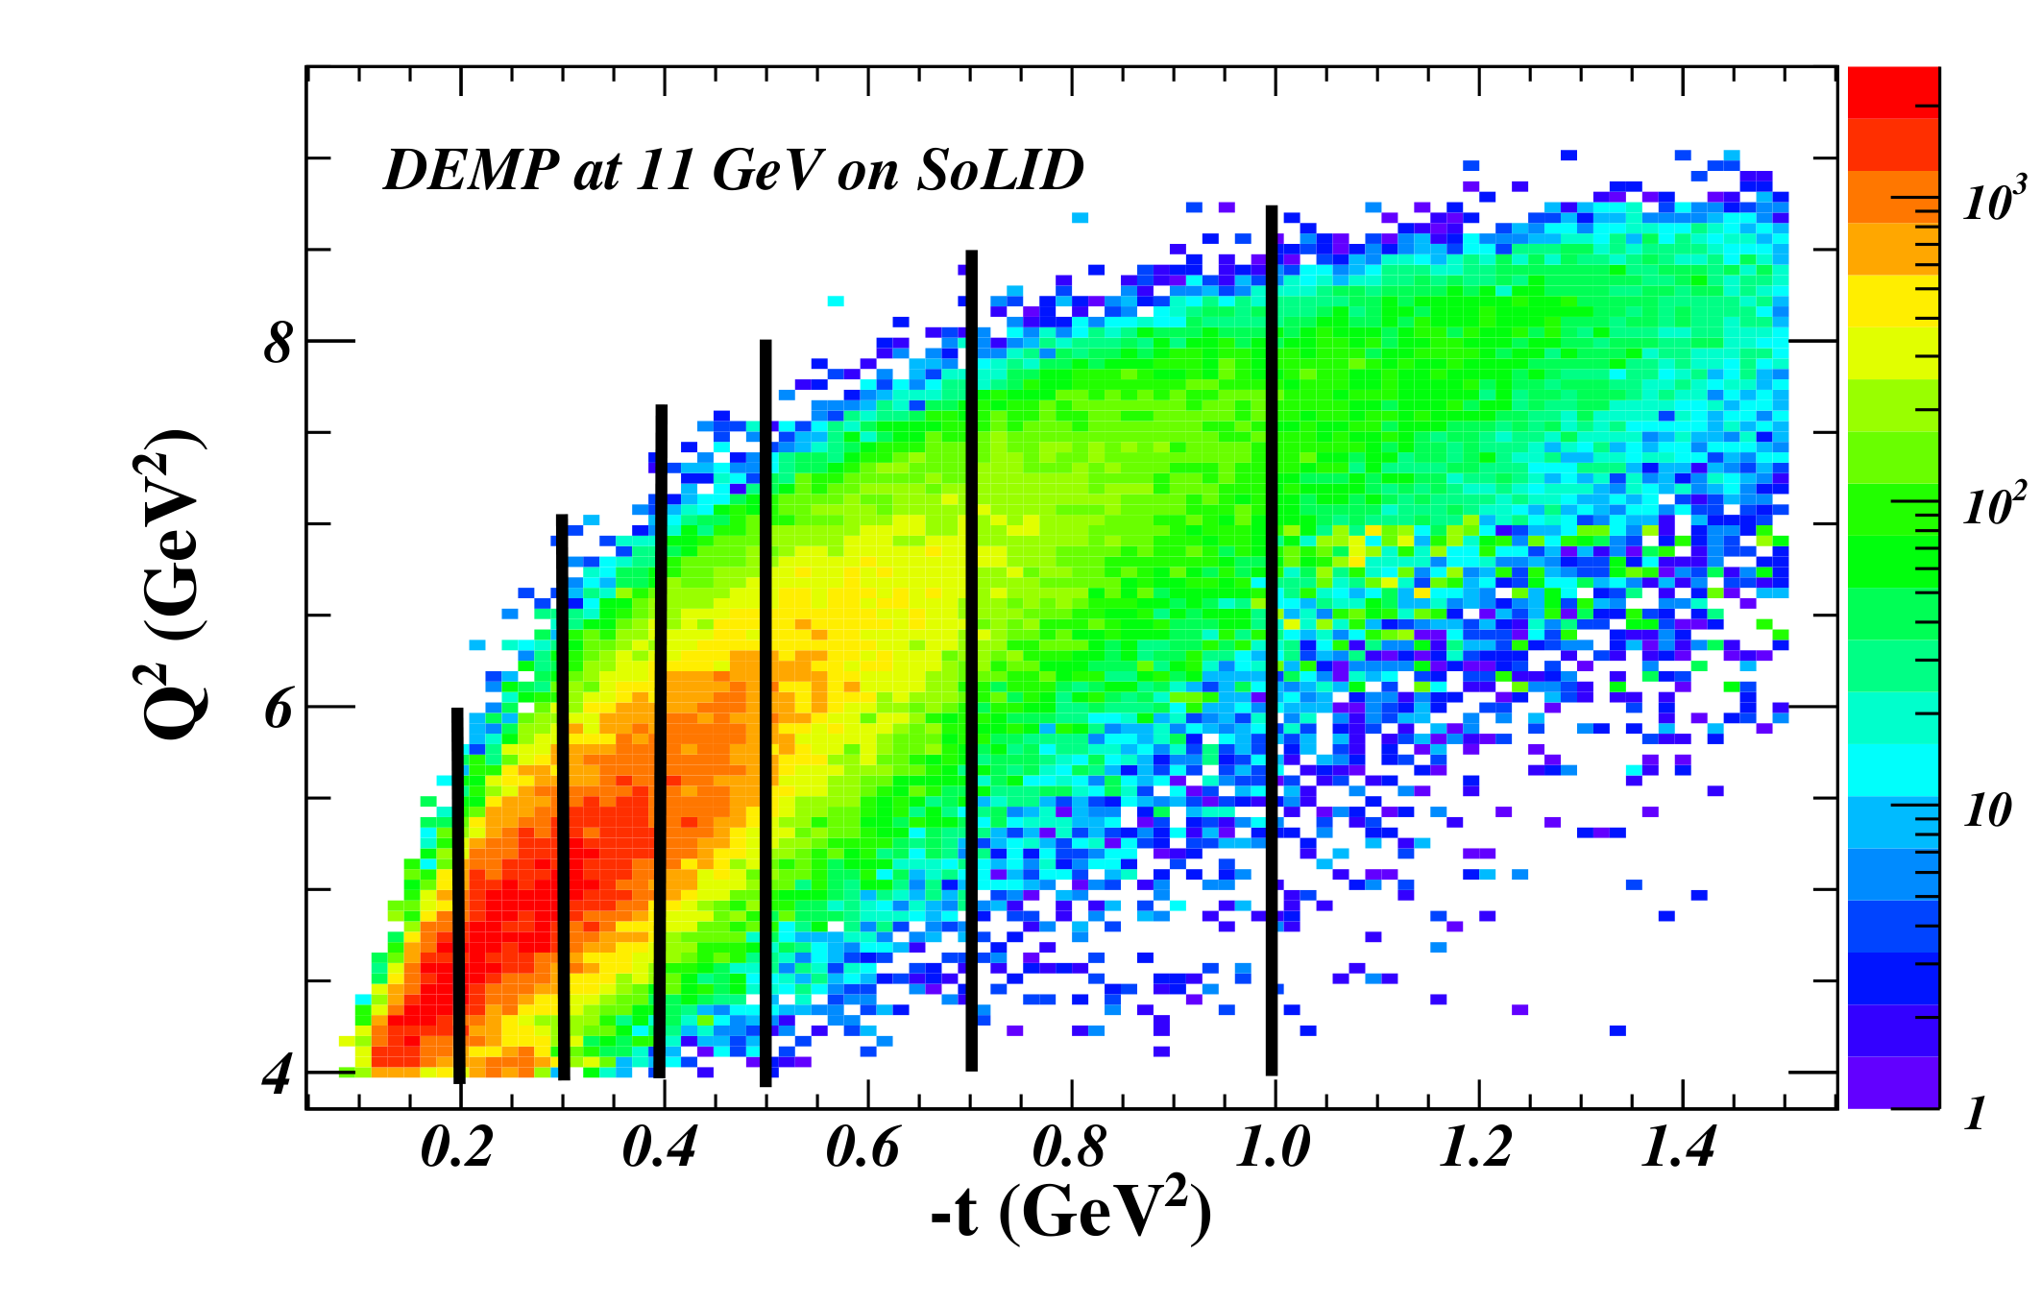
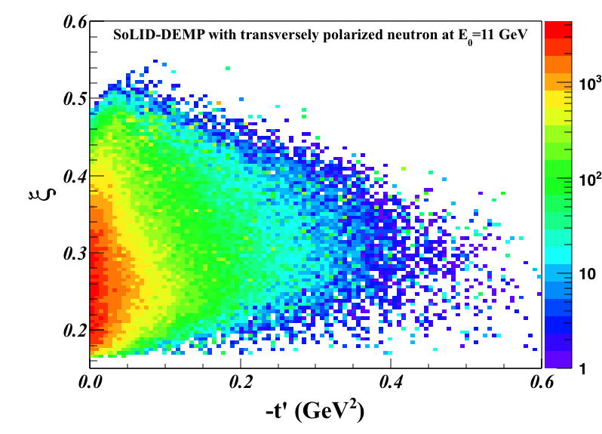
Kinematic Coverage and Binning
For this proposal, we binned the data in 7 t-bins.
In actual data analysis, we will consider alternate binning.
All JLab data cover a range of Q², x_{Bj} values.
  x_{Bj} fixes the skewness (ξ).
  Q² and x_{Bj} are correlated. In fact, we have an almost linear dependence of Q² on x_{Bj}.
The HERMES and COMPASS experiments are restricted kinematically to very small skewness (ξ<0.1).
With SoLID, we can measure the skewness dependence of the relevant GPDs over a fairly large range of ξ.

Slide 27
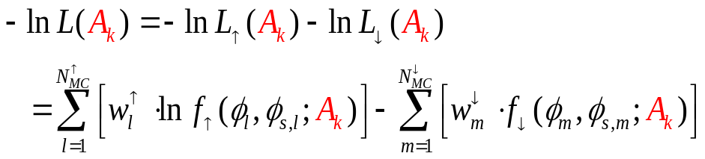
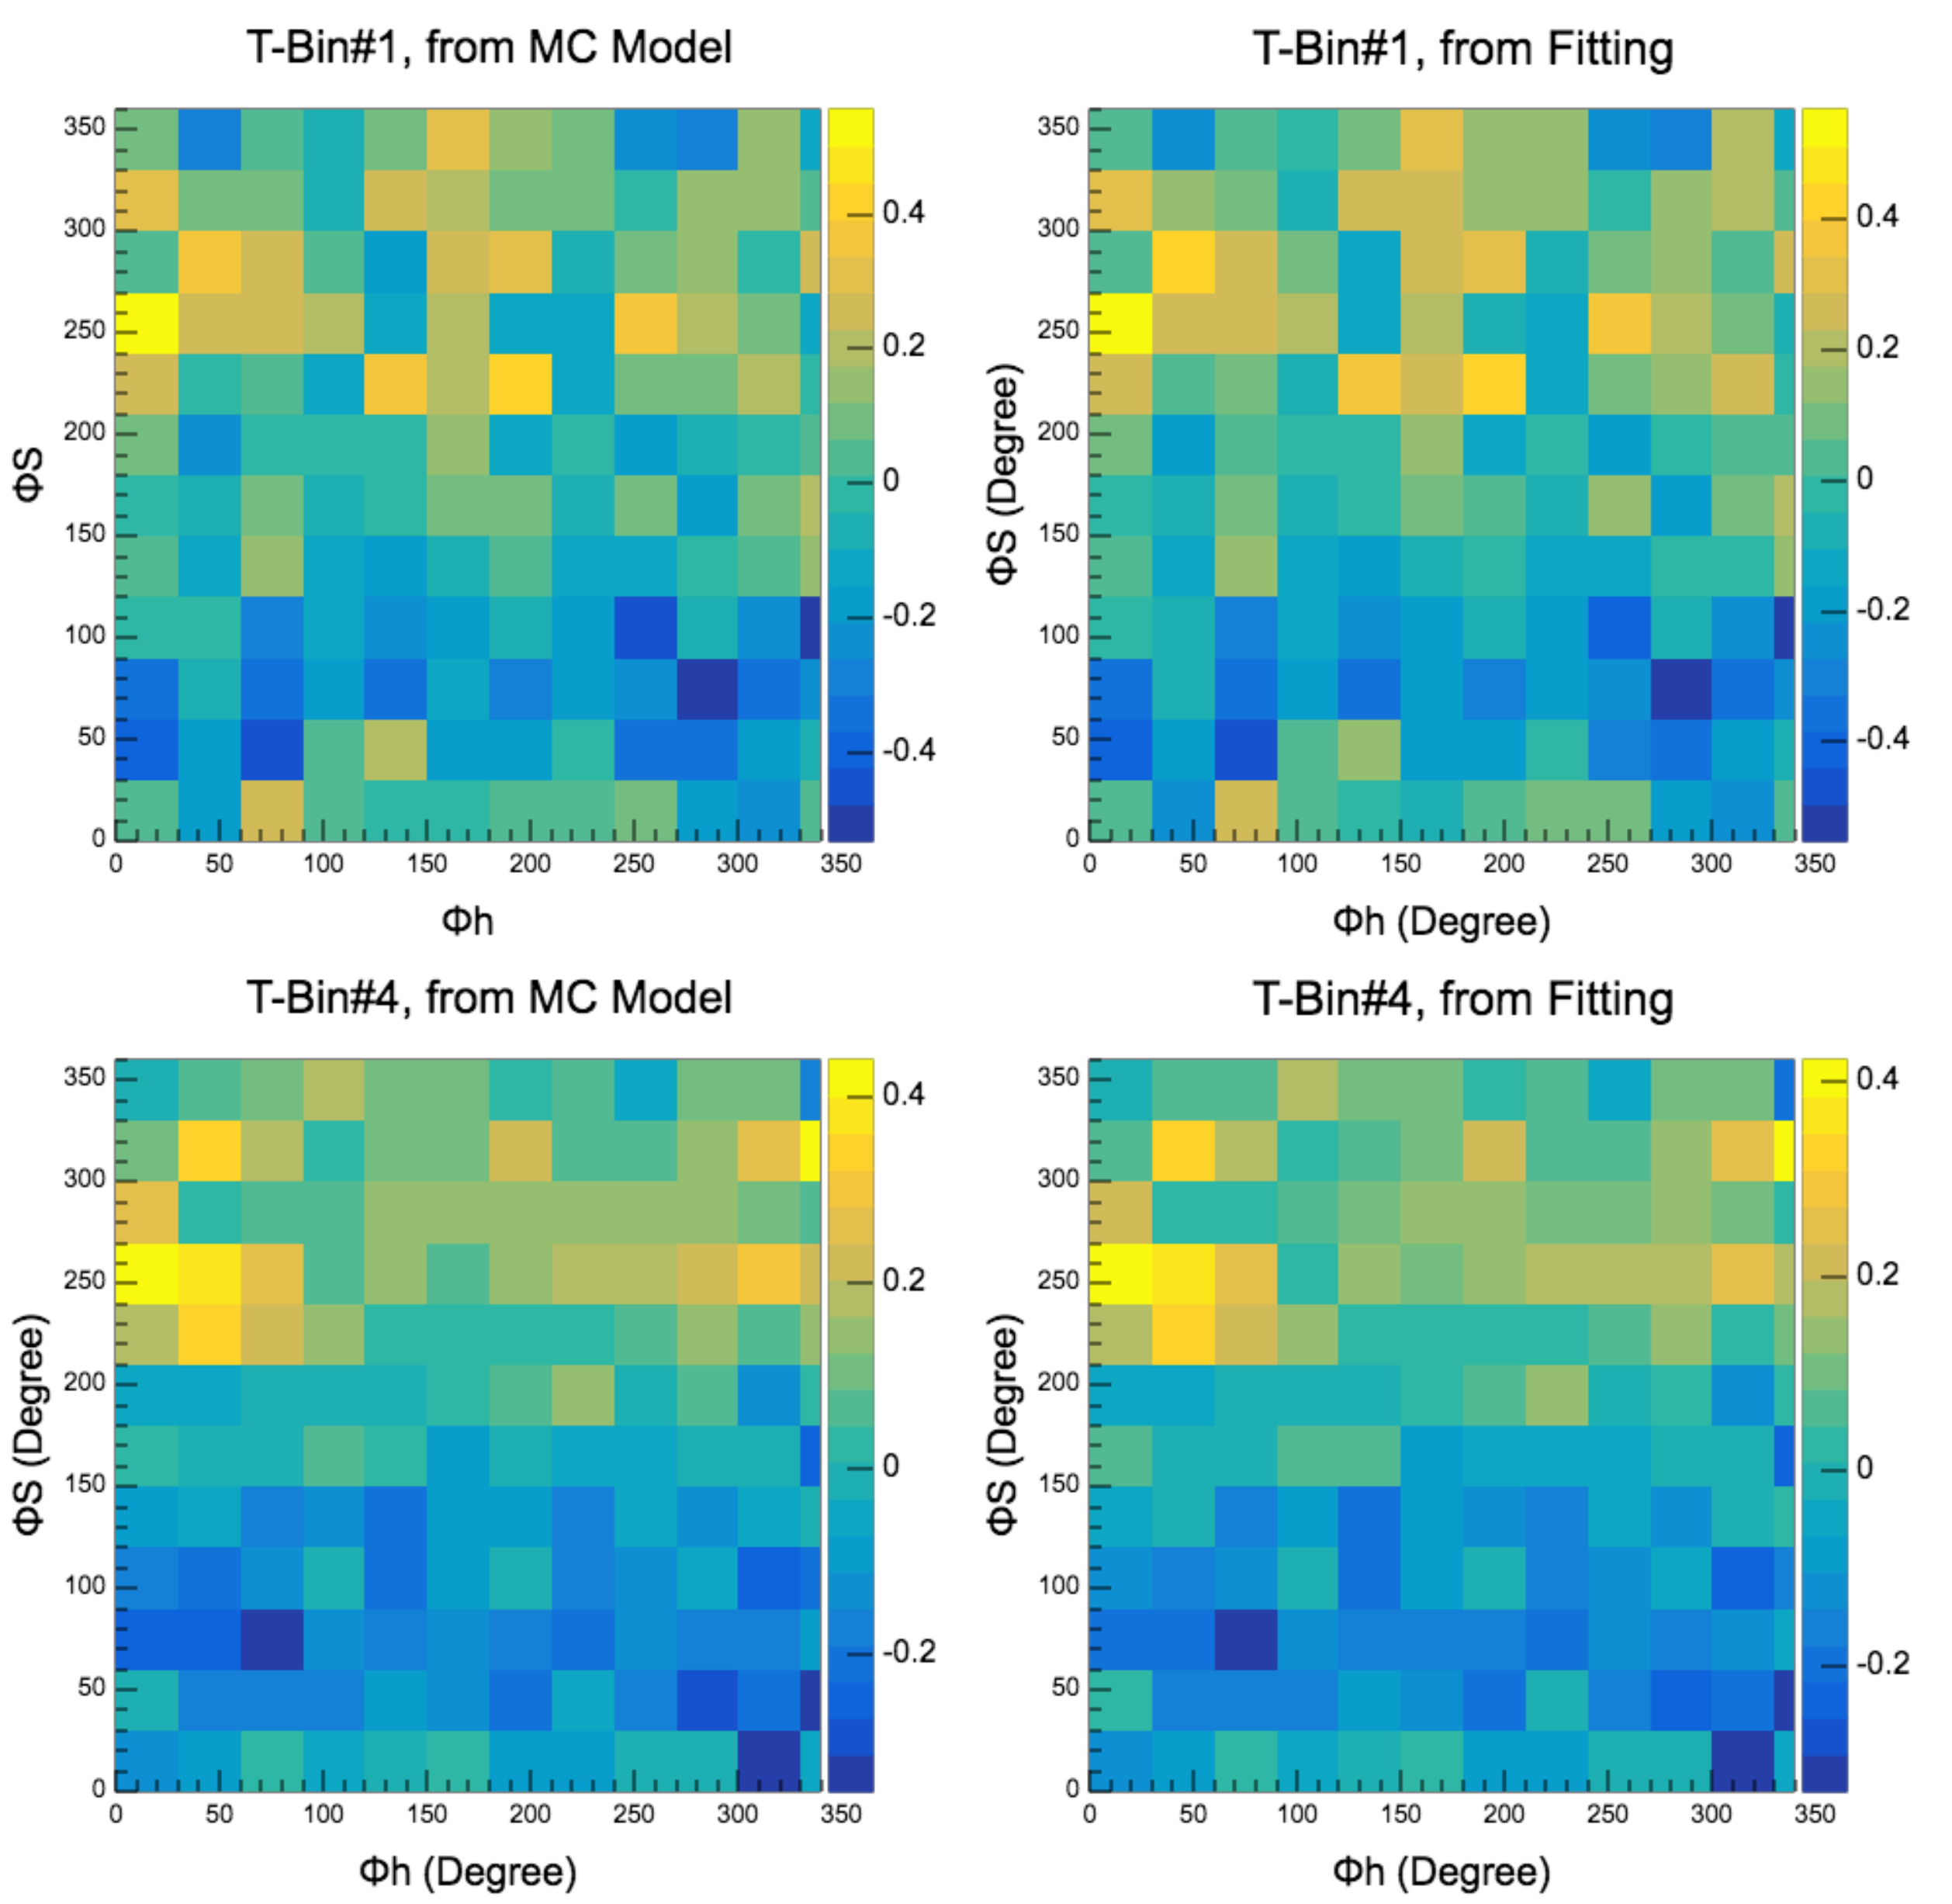
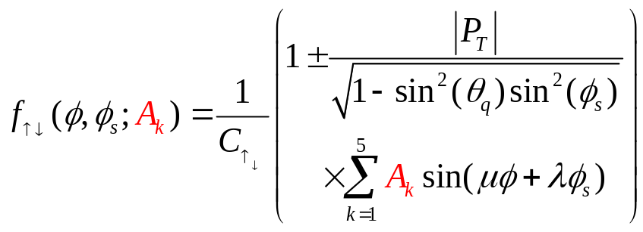
Unbinned Maximum Likelihood (UML) Method
Same method used by HERMES in their DEMP analysis [PLB 682(2010)345].
Instead of dividing the data into (φ,φ_{s}) bins to extract the asymmetry moments, UML takes advantage of full statistics of the data, obtains much better results when statistics are limited.
Construct probability density function
where A_{k} are the asymmetries that can minimize the likelihood function.
Minimize the negative log-likelihood function:
As an illustration, reconstruct the azimuthal modulations & compare:

Slide 28
Fermi Momentum Effects
As already mentioned, if the proton momentum resolution is sufficiently good, it will be possible to correct for Fermi momentum on an event-by-event basis. For the purposes of the proposal, we take the more conservative view that the resolution is not good enough, even though the removal of the Fermi momentum effect would simplify the physics interpretation of our data.
To estimate the impact of Fermi momentum, we ran the generator in a variety of configurations and repeated our analysis:
  Multiple scattering, energy loss, radiation effects ON/OFF.
  Fermi momentum ON/OFF.
The effect of Fermi momentum is about -0.02 on the sin(φ-φ_{s}) moment, and about -0.04 on the sin(φ_{s}) moment.
We hope this estimate of Fermi momentum effects at an early stage will encourage theorists to calculations for a timely and correct utilization of our proposed data, as suggested in last year’s Theory review.

Slide 29
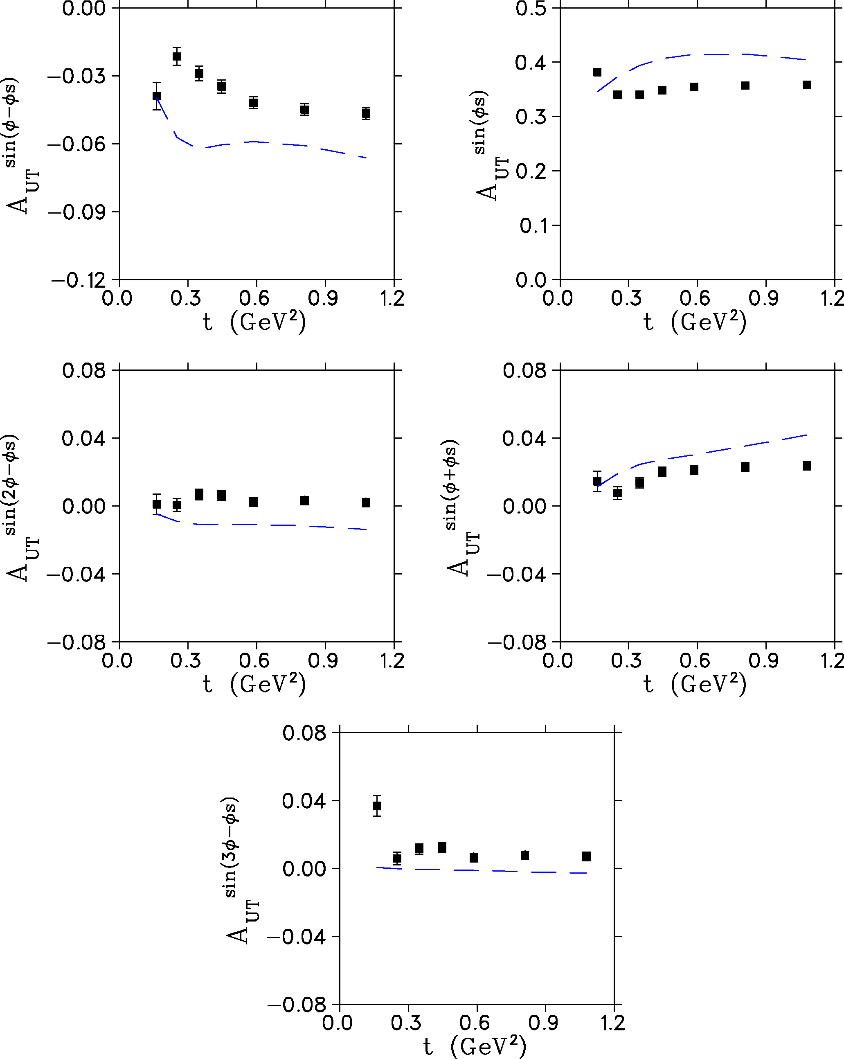
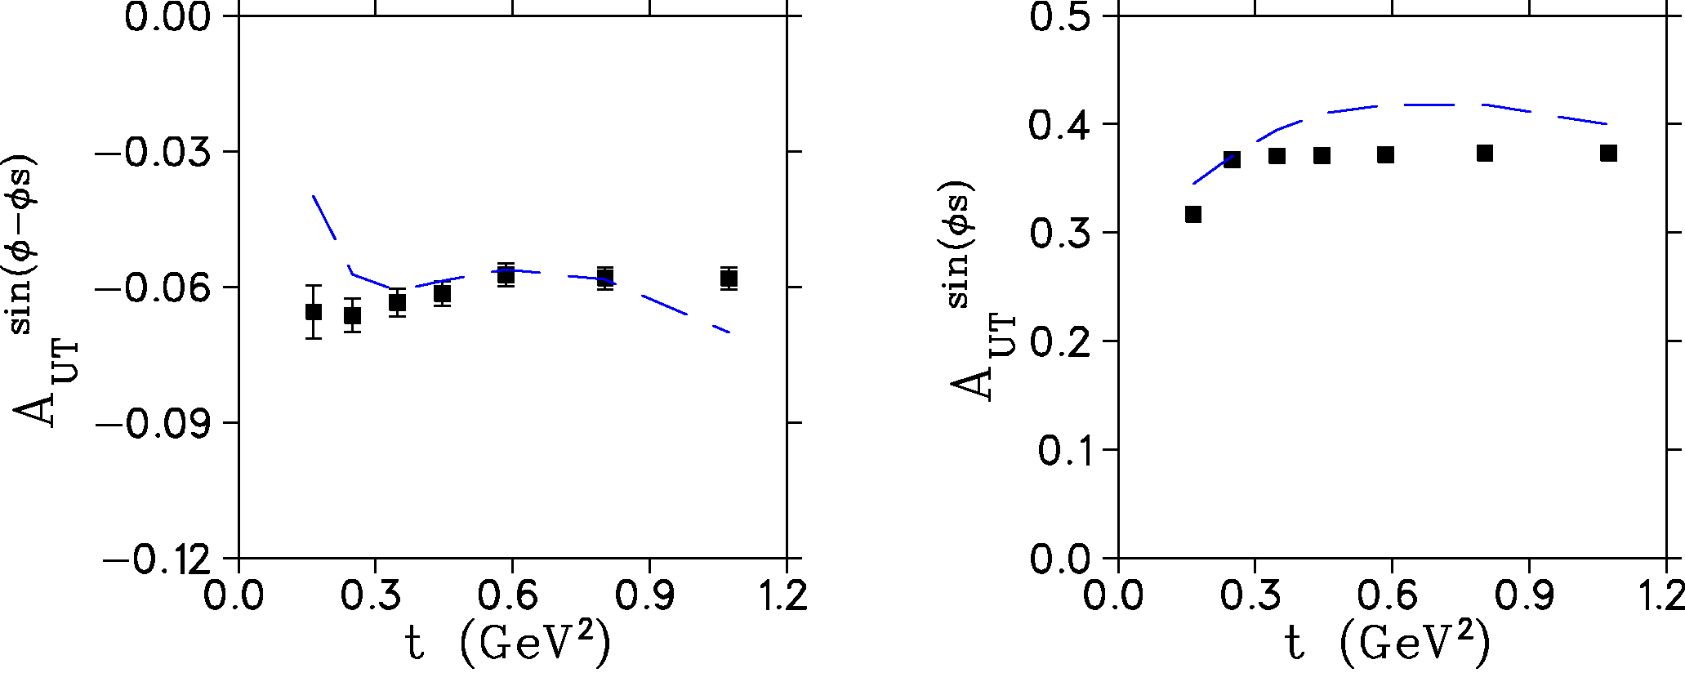
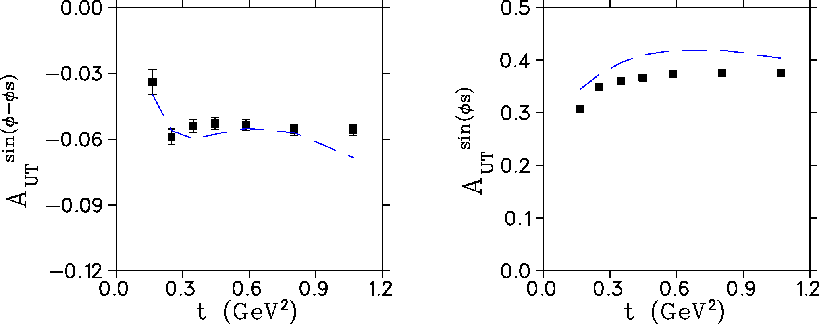
Projected Uncertainties
All effects on.
Includes all scattering, energy loss, resolution and Fermi momentum effects.
Only Fermi momentum off.
Includes all scattering, energy loss, resolution effects. Similar to where proton resolution is good enough to correct for Fermi momentum effects.
All effects off.
Agreement between input and output fit values is very good. Validates the UML procedure.
Average input asymmetry per bin.

Slide 30
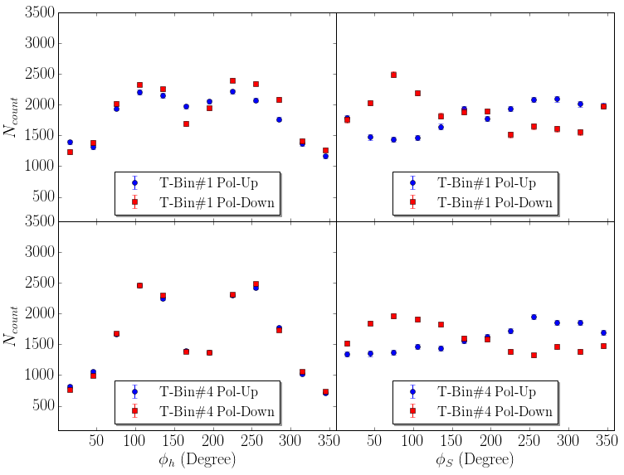
Acceptance Effects vs. (φ, φ_{s})
Expected yield as function of φ, φ_{s} for t-bins:
  #1 (0.05-0.20)
  #4 (0.40-0.50)
Acceptance fairly uniform in φ_{s}.
Some drop off on edges of φ distribution, since q is not aligned with the solenoid axis.
  Critical issue is that φ drop off is same for target pol. up, down.
UML analysis shows that sufficient statistics are obtained over full (φ,φ_{s}) plane to extract asymmetry moments with small errors.

Slide 31
Final State Interaction (FSI) Effects
To estimate FSI effects, we used an empirical (phase-shift) parameterization of π–N differential cross sections.
Based on this model, and the fact that there are only two proton spectators in the final state to interact with, we anticipate about 1% of events will suffer FSI interactions. The FSI fraction is weakly-dependent on Q², rising to about 1.2% for Q²>5 GeV² events. Of these, a large fraction of FSI events are scattered outside the triple-coincidence acceptance, reducing the FSI fraction to ~0.4%. This will be further reduced by analysis cuts such as P_{miss}<1.2 GeV/c.
Over the longer term, we will consult with theoretical groups for a more definitive FSI effect study.
  e.g. Del Dotto, Kaptari, Pace, Salme and Scopetta recent study of FSI effects in SIDIS from a transversely polarized ³He target [arXiv:1704.06182] showed that extracted Sivers and Collins asymmetries are basically independent of FSI. A similar calculation for DEMP, after this proposal is accepted, would be a natural extension of their work.

Slide 32

Summary
A_{UT}^{sin(φ-φs)} transverse single-spin asymmetry in exclusive π production is particularly sensitive to the spin-flip GPD . Factorization studies indicate precocious scaling to set in at moderate Q²~2-4 GeV², while scaling is not expected until Q²>10 GeV² for absolute cross section.
A_{UT}^{sin(φs)} asymmetry can also be extracted from same data, providing powerful additional GPD-model constraints and insight into the role of transverse photon contributions at small –t.
High luminosity and good acceptance capabilities of SoLID make it well-suited for this measurement. It is the only feasible manner to access the wide –t range needed to fully understand the asymmetries.
We propose to analyze the E12-10-006 event files off-line to look for e-π⁻-p triple coincidence events. To be conservative, we assume the recoil proton is only identified, and its momentum is not used to further reduce SIDIS (and other) background.
We used a sophisticated UML analysis to extract the asymmetries from simulated data in a realistic manner, just as was used in the pioneering HERMES data. The projected data are expected to be a considerable advance over HERMES in kinematic coverage and statistical precision.
SoLID measurement is also important preparatory work for future EIC.

Slide 34
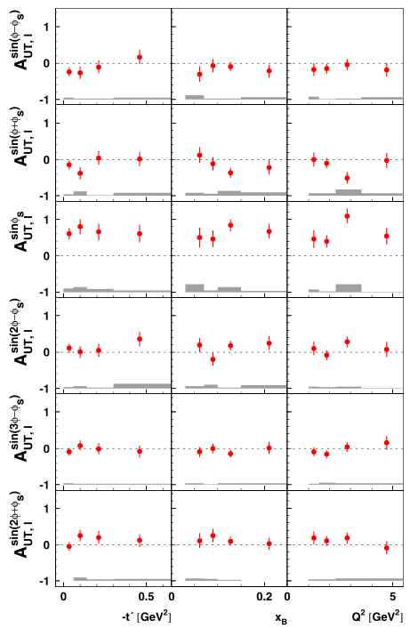

Slide 35
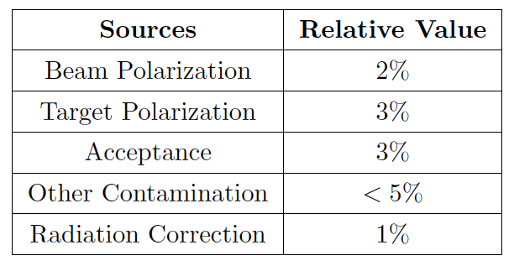
Systematic Uncertainties
Detector-wide, DEMP measurement shares the same systematic uncertainties with SIDIS experiments
Other sources of uncertainties are still under estimation.

Slide 36
Implications for Pion Form Factor Experiments
The study of A_{L}┴ is also important for the reliable extraction of F_{π} from p(e,e’π⁺)n data at high Q² [Frankfurt, Polyakov, Strikman, Vanderhaeghen PRL 84(2000)2589].
  Non-pion pole contributions need to be accounted for in some manner in order to reliably extract F_{π} from σ_{L} data at low -t.
  12 GeV Pion Form Factor experiment restricted to Q²=6 GeV² by need to keep non-pole contributions to an acceptable level (-t_{min}<0.2 GeV²).
  Hall C instrumentation and beam will allow Q²=8.5 GeV² F_{π} measurements if higher –t region is better understood.
A_{L}┴ is an interference between pseudoscalar and pseudovector contributions.
  Help constrain the non-pole contribution to p(e,e’π⁺)n.
  Assist the more reliable extraction of the pion form factor.
  Possibly extend the kinematic region for F_{π} measurements.

Slide 37
A_{L}┴ a Key GPD Measurement in Meson Sector
In Deep Exclusive Meson Electroproduction, factorization can only be applied to longitudinal photons.
JLab’s unique contribution to this field is in:
  ability to take measurements at multiple beam energies.
  unambiguous isolation of A_{L}┴ using Rosenbluth separation.
A JLab A_{L}┴ measurement could thus establish the applicability of the GPD formalism, and precocious scaling expectations, for other A┴ experiments,
A_{L}┴ is the ratio of two purely longitudinal quantities.
If the predicted precocious scaling is shown to not occur, then it may never be possible to experimentally determine GPDs via Deep Exclusive Meson Production.

