Slide 2



Benefits of Critical Thinking
Improved Problem-Solving
Better Decision-Making
Enhanced Communication
Clearer Expression of Ideas
Increased Creativity
Innovative Solutions
Higher Self-Reflection
More Informed Decisions

Slide 3
Product Overview Infographics
Jupiter
Venus
It’s a gas giant and the biggest planet
It has a beautiful name, but it’s hot
Mars
Neptune
Despite being red, Mars is a cold place
The farthest planet from the Sun
Mercury
Saturn
It’s the closest planet to the Sun
Yes, this is the ringed one
Your product

Slide 4



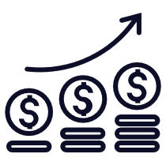


Add a Timeline Page
Add a main point
Add a main point
Add a main point
Add a main point
Elaborate on what you want to discuss.
Elaborate on what you want to discuss.
Elaborate on what you want to discuss.
Elaborate on what you want to discuss.

Slide 5
5 Secrets To Superior Supplier Quality Management
Create a cloud based integrated Information Technology (IT) storage.
Determine the necessary criterion for supplier quality management evaluation.
Acquire a Supplier Risk Scorecard System.
1
2
3
Create a collaborative working relationship and conduct audits.
Have suppliers take more responsibility for the quality of their supplies.
4
5

