Slide 1
Learn2Smile Learning Non-Verbal Interaction Through Observation
Will Feng, Anitha Kannan, Georgia Gkioxari, Larry Zitnick

Slide 2
Task
Robot face that reacts naturally to your facial expressions
E.g. it will smile when you smile; it will nod its head when you are talking
No explicit emotion labels used to train the model
i.e. the model doesn’t know the categorization of the user’s facial expressions
End-to-end training using only facial landmark keypoints
The model takes the user’s facial landmark keypoints as input, and produces the avatar’s landmark keypoints as output
Long-term sustained prediction

Slide 3
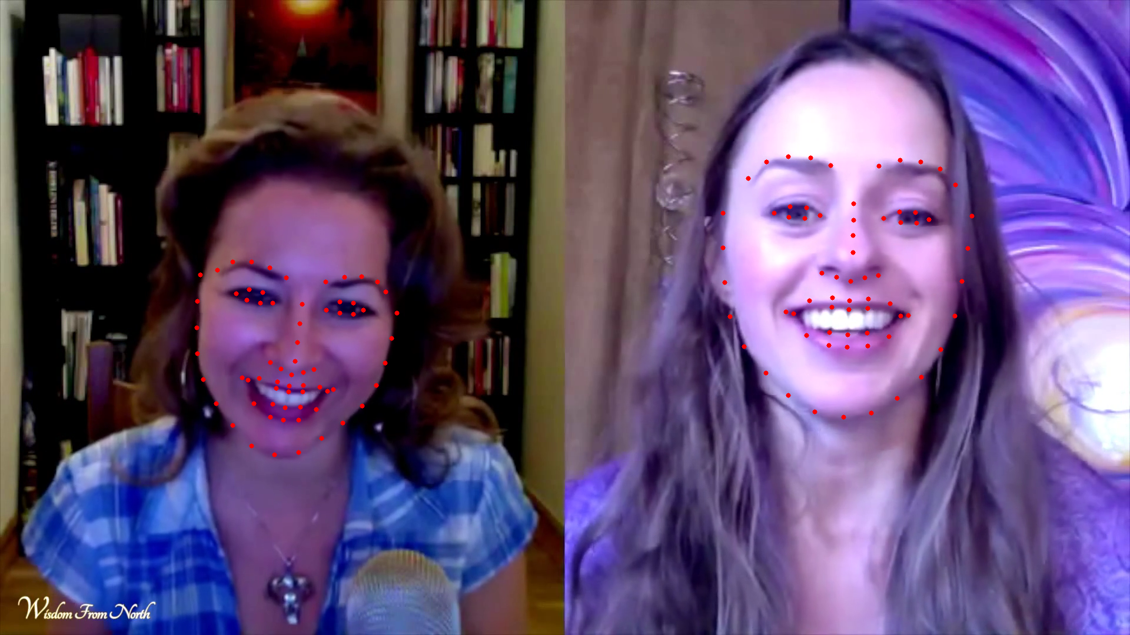
Dataset
Skype chat videos from Youtube
Two people having a conversation
250 videos, 8M frames in total
68 landmark keypoints are tracked for each face
No explicit facial expression labels, only keypoints
At train time, we pick one person as the user input, and the other person as the avatar ground truth

Slide 4
Approach
Encode the facial landmark keypoints using VAE
Predict avatar response in VAE space
Decode the avatar response from VAE space to landmark keypoint space

Slide 5
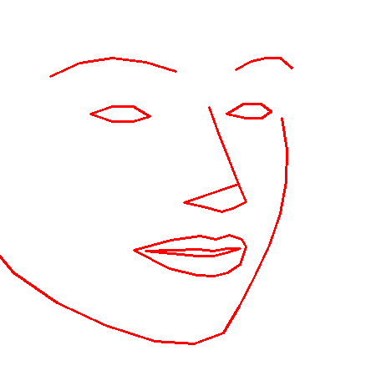
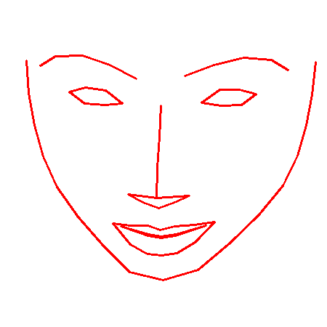


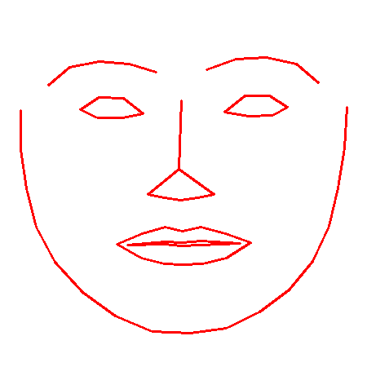
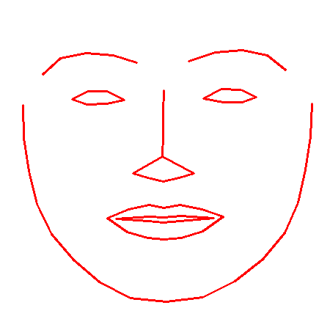
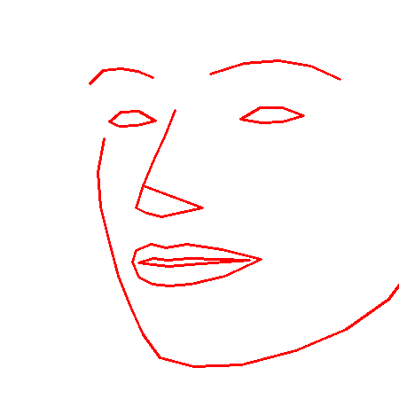
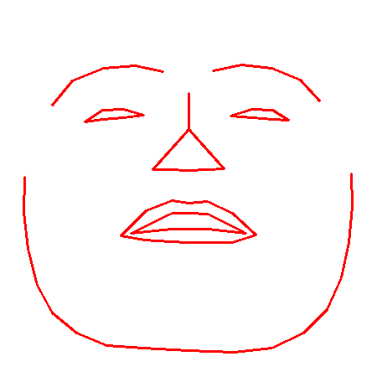

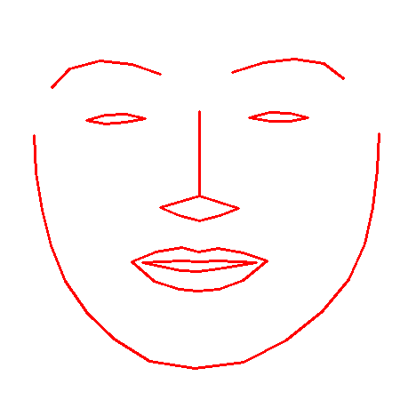

Approach
Encode the facial landmark keypoints using VAE
Dimensionality reduction (from 68 2D keypoints to 20-dim vector)
Disentanglement of facial features
VAE dimensions
-4
0
4
Shaking head
Nodding head
Rotating head
Smile / Laugh
Eye blink

Slide 6
Approach
Predict avatar response in VAE space
For each VAE dimension, we cluster temporal 15-frame segments into clusters
We train a model that takes the user’s and the avatar’s history as input, and predict the cluster ID for the next avatar segment for each VAE dimension
We then combine the predictions for each of the VAE dimensions into one 20-dim vector, and then decode it with the pre-trained VAE decoder

Slide 7
Metrics
We use the following metrics in 68 2D keypoint space to measure how close the prediction is to ground truth:
L2 distance from avatar ground truth
L2 distance of closest match within temporal window
Allowing delay in facial expression response
Difference in variation

Slide 8
Metrics
Model | L2 Error | L2 Error w/ Shift | Δσ
Mirror | 3.31 | 12.19 | 3.08
Avg. mirror | 3.25 | 12.07 | 2.59
Random | 2.47 | 9.24 | 2.89
Nearest neighbor | 3.40 | 12.22 | 3.14
Ours | 1.60 | 6.09 | 2.09

Slide 9
Human Studies
On Amazon Mechanical Turk
Question: which person (B vs. C) is responding better to A (user ground truth)?
Model | Success rate (Ours vs.) | Success rate (Ground truth vs.)
Ground truth | 52.59% | N/A
Ours | N/A | 47.41%
Mirror | 47.92% | 55.85%
Avg. mirror | 79.24% | 76.1%
Random | 51.15% | 54.01%
Nearest neighbor | 68.72% | 62.27%
Observation: Avatar ground truth doesn’t do significantly better than random sequence, which suggests that the judges are not looking at whether B or C is responding to A. On the other hand, avatar ground truth does better when compared to average mirroring of user input and nearest neighbor in train set, which suggests that the judges are actually looking at whether the sequence looks temporally smooth / consistent. From this perspective, our prediction and the avatar ground truth has similar temporal consistency level.

Slide 10
Human Studies
Conclusions:
Judges on Mechanical Turk confirms that the generated response from our model looks temporally consistent
However, judges were not able to tell whether one face is reacting to another
thus we need to rely on numerical metrics to measure how effective the model is for our task

Slide 11
Examples
Demo 1 (avatar talking): link
Demo 2 (avatar nodding its head when the user is talking): link
Comparing our model with other variants: link
Comparing our model with baselines: link

