Slide 1
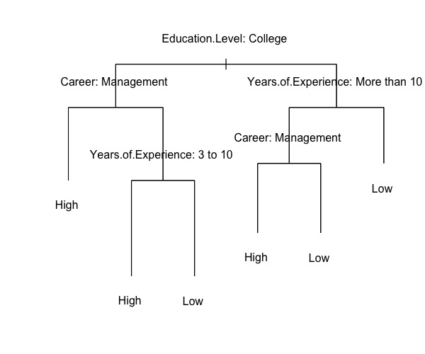
Question 2: Decision Tree
1 Low
1 High
1 Low

Slide 2
Question 2: Decision Tree
Diagram: the number of (High, Low)
Root entropy = 0.971
Education gain = <0.8465>
College (3, 2) entropy = 0.971
Career gain = <0.4202>
Management (2, 0) entropy = 0
Service (1, 2) entropy = 0.918
Experience gain = < 0.918>
3 to 10 (1, 0) entropy = 0
less than 3, more than 3 (0, 2) entropy = 0
High school 1, 4 entropy = 0.722
Experience gain = <0.322>
more than 10 (1, 1) entropy = 1
Career gain = <1>
Management (1, 0) entropy = 0
Service (0, 1) entropy = 0
less than 3, 3 to 10 (0, 3) entropy = 0

Slide 3
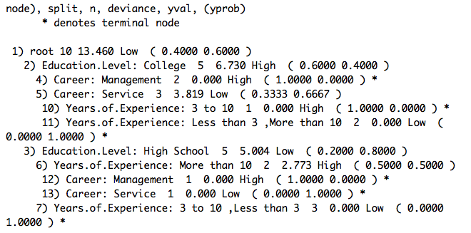
Question 2: Decision Tree
Fit with tree package in R

Slide 4
Question 2: Decision Tree
Before splitting on any attribute: Root
Info([4, 6]) = entropy ([4/10, 6/10]) = -0.4log(0.4)-0.6log(0.6) = 0.971
Education level = “college”:
Info([3, 2]) = entropy([3/5, 2/5]) = 0.971
Education level = “ high school”:
Info([1, 4]) = entropy([1/5, 4/5]) = 0.722
Expected information for Education level:
Info ([3, 2], [1, 4]) = 5/10 * 0.971 + 5/10 * 0.722 = 0.8465 bits

Slide 5
Question 2: Decision Tree
Information gain at the 1st node:
Information gain (education level) = Info([4, 6]) - Info ([3, 2], [1, 4]) = 0.971 - 0.846 = 0.125
Information gain (career) = Info([4, 6]) - Info ([3, 2], [1, 4]) = = 0.125
Information gain (years of experiences) = Info([4, 6]) - Info ([1, 2], [1, 2], [2, 2])
= 0.971 – (3/10 * 0.918 + 3/10 * 0.918 + 4/10 * 1)
= 0.971 – 0.9508 = 0.0202
Continue to split: the 2nd node under college
Career= “management ”: Info([2, 0]) = 0
Career= “service ”: Info([1, 2]) = = 0.918
Information gain (career) = info([3, 2]) - Info ([2, 0], [1, 2]) = 0.971 – 3/5 * 0.918 = 0.4202

Slide 6
Question 2: Decision Tree
Continue to split: 2nd node under high school
Years of experiences = “more than 10 ”: Info([1, 1]) = 1
Years of experiences = “less than 3, 3 to 10”: Info([0, 3]) = 0
Information gain (years of experiences) = info([1, 4]) - Info ([1, 1], [0, 3]) = 0.722 – 2/5 * 1 = 0.322

Slide 7
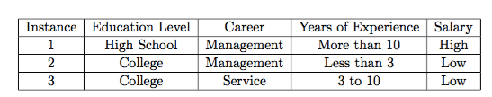
Question 2: Decision Tree - prune
Decision Errors
Keep 2
Prune NA
Prune the tree with validation data:
We don’t have enough validations at each nodes to compare the errors of keeping or pruning the leaves.
If we prune only based on those 3 validations, the tree will become -> see next slide
Decision Errors
Keep NA
Prune 1
Decision Errors
Keep 1
Prune NA
0 High, 1 Low
1 High, 0 Low
0 High, 1 Low

Slide 8
Question 2: Decision Tree - prune
The pruned tree

Slide 9
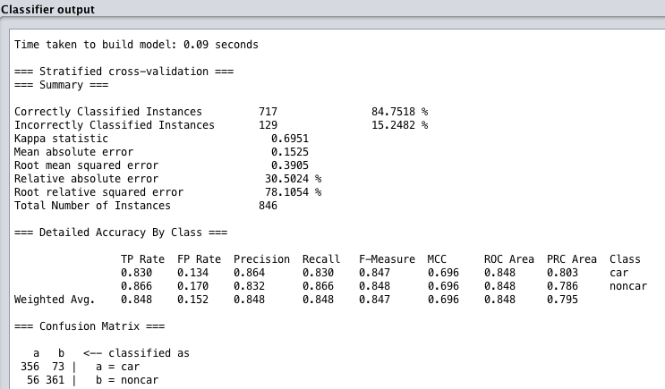
Question 3: SVM using Weka
PolyKernel
Exponent = 1
Correctly classified instances: 717, 84.74118%
Incorrectly classified instances: 129,

Slide 10
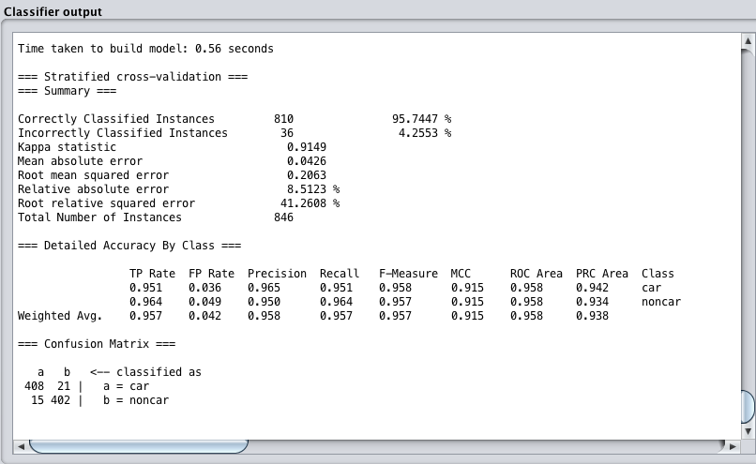
Question 3: SVM using Weka
PolyKernel
Exponent = 2
Correctly classified instances: 810, 95.7447%
Incorrectly classified instances: 36, 4.2553%

Slide 11
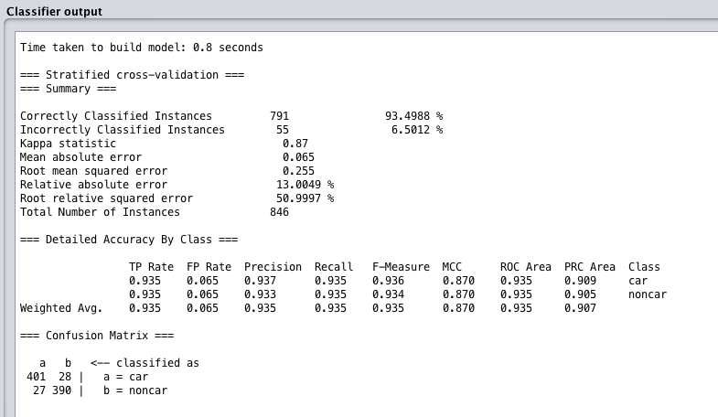
Question 3: SVM using Weka
PolyKernel
Exponent = 4
Correctly classified instances: 791, 93.4988%
Incorrectly classified instances: 55, 6.5012%

Slide 12
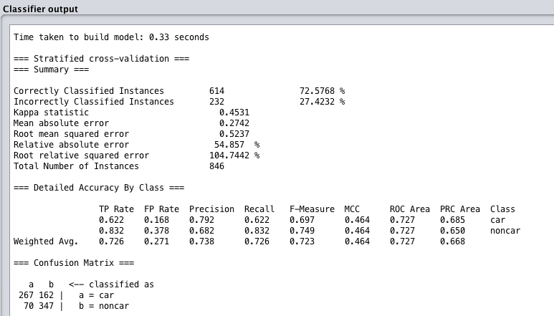
Question 3: SVM using Weka
RBFKernel
Gamma = 0.01
Correctly classified instances: 614, 72.5768%
Incorrectly classified instances: 232, 27.4232%

Slide 13
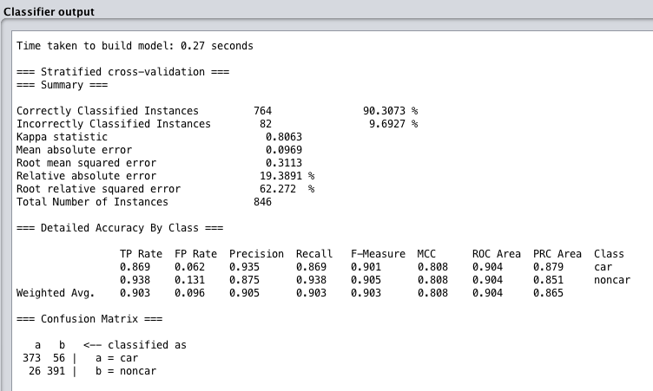
Question 3: SVM using Weka
RBFKernel
Gamma = 1.0
Correctly classified instances: 764, 90.3073%
Incorrectly classified instances: 82, 9.6927%

Slide 14
Question 3: SVM using Weka
Question: why some of the choices do not work well?
Answer:
For the PolyKernel, the degree of exponent controls the flexibility of the decision boundary. Higher degree kernels yield a more flexible decision boundary. For RBFKernel, gamma defines how far the influence of a single training example reaches. When gamma is small (eg. 0.01), we have a large standard deviation, the training example could reach more far and the decision boundary is more smooth. When gamma is large (eg. 1.0), we have a small standard deviation, and will get more wiggly and flexible decision boundaries, the training example could reach more close.
In our five tests, we get more correctly classified instances when the degree of exponent or the gamma are relatively larger (gamma = 1.0).
This could be because more flexible models are able to capture the complexity and the shape of the data, so the models learned features correctly and have higher correctly classified instances. While when polynomials and gamma are small, the model are too constrained and cannot capture the complexity of the data.
Notes:
http://scikit-learn.org/stable/auto_examples/svm/plot_rbf_parameters.html

Slide 15

Question 4: Kernels
Notes:
http://crsouza.com/2010/03/17/kernel-functions-for-machine-learning-applications/

