Slide 1
CISC6930 Data Mining Assignment 4
Youfei Zhang
(yzhang737)

Slide 2
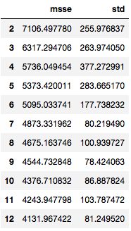
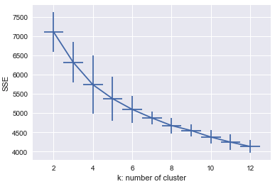
Question 1: K-means Clustering
Mean and sample standard deviation of SSE for k = 1, 2, …, 12

Slide 3
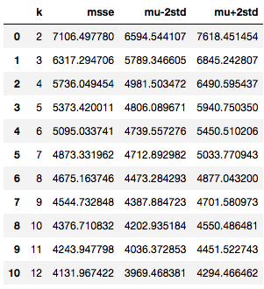
Question 1: K-means Clustering
(b) A table containing the 4 columns: k, μk, μk − 2σk and μk + 2σk for each of the values of k = 1,2,...,12.

Slide 4
Question 1: K-means Clustering
(c) As k increases and approaches the total number of examples N, what value does the SSE approach? What problems does this cause in terms of using SSE to choose an optimal k?
Answer:
As k increases and approaches N, SSE would approach 0.
In the extreme case, when the number of clusters k equals the total number of examples N, the SSE will be 0, since there will be no differences/distance between the centroid of the clusters to each data point.
This leads to the problem that if we choose k based on the goal of minimizing SSE, we will eventually get a very large k value that may not best represent the clusters within the data.

Slide 5

Question 1: K-means Clustering
(d) Can you suggest another measure of cluster compactness and separation that might be more useful than SSE?
Answer:
Another measure that might be more useful than SSE is sihouette analysis. It measures how close each point in one clusters is to points in the neighboring clusters with a range of [-1, 1]
Silhouette coefficients (as these values are referred to as) near +1 indicate that the sample is far away from the neighboring clusters.
A value of 0 indicates that the sample is on or very close to the decision boundary between two neighboring clusters and negative values indicate that those samples might have been assigned to the wrong cluster.

Slide 6
Question 1: K-means Clustering
(d) Can you suggest another measure of cluster compactness and separation that might be more useful than SSE?
Answer:
We can also use gap statistics.
Gap statistics aims to standardize the comparision of the log of the normalized sum of squares with a null reference distribution of the data.
Optimal K is obtained at when the log of the normalized SSM falls the farthest below the reference curve.

Slide 7

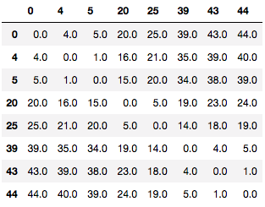
Question 2: Hierarchical Clustering (a) Build a dendrogram using the single-link, bottom-up approach
Answer:
Compute the Euclidean distance between each point
Example:
Euclidean{0, 4} = 4
Euclidean{0, 5} = 5
Euclidean{0, 20} = 20
Euclidean{0, 20} = 20
Euclidean{4, 5} = 1
Euclidean{4, 20} = 16

Slide 8
Question 2: Hierarchical Clustering (a) Build a dendrogram using the single-link, bottom-up approach
Answer:
2) Build clusters with single-link
Level 1:
Cluster{4, 5} = 1
Cluster{20, 25} = 5
Cluster{43, 44} = 1
Level 2:
Cluster{4, 5} vs cluster{0) = 4
Cluster{43,44} vs cluster{39) = 4
Level 3:
Cluster{20, 25} vs cluster{39, 43, 44) = 14
Level 4:
Cluster{20, 25, 39, 43, 44} vs
Cluster{0, 4, 5} = 15
0
4
5
20
25
39
43
44

Slide 9
Question 2: Hierarchical Clustering (b) Suppose we want the two top level clusters. List the data points in each cluster.
1st cluster:
0, 4, 5
2nd cluster:
20, 25, 39, 43, 44
20
25
39
43
44
0
4
5

Slide 10
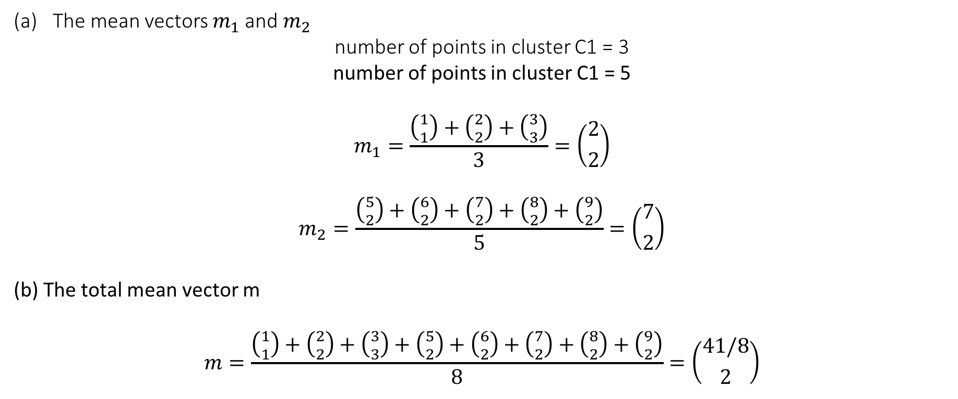
Question 3: Scattering Criteria
The mean vectors $m_{1}$ and $m_{2}$
number of points in cluster C1 = 3
number of points in cluster C1 = 5
$$m_{1}=\frac{\left({1 \atop 1}\right)+\left({2 \atop 2}\right)+\left({3 \atop 3}\right)}{3}=\left({2 \atop 2}\right)$$
$$m_{2}=\frac{\left({5 \atop 2}\right)+\left({6 \atop 2}\right)+\left({7 \atop 2}\right)+\left({8 \atop 2}\right)+\left({9 \atop 2}\right)}{5}=\left({7 \atop 2}\right)$$
(b) The total mean vector m
$$m=\frac{\left({1 \atop 1}\right)+\left({2 \atop 2}\right)+\left({3 \atop 3}\right)+\left({5 \atop 2}\right)+\left({6 \atop 2}\right)+\left({7 \atop 2}\right)+\left({8 \atop 2}\right)+\left({9 \atop 2}\right)}{8}=\left({41/8 \atop 2}\right)$$

Slide 11
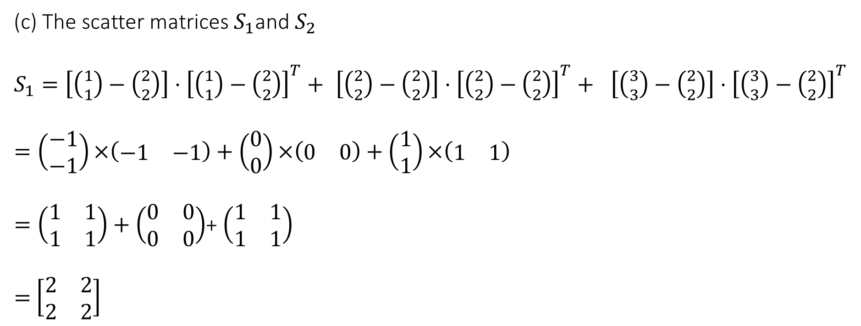
Question 3: Scattering Criteria
(c) The scatter matrices $S_{1}$and $S_{2}$
$S_{1}=\left[\left({1 \atop 1}\right)−\left({2 \atop 2}\right)\right]⋅{\left[\left({1 \atop 1}\right)−\left({2 \atop 2}\right)\right]}^{T}+$ $\left[\left({2 \atop 2}\right)−\left({2 \atop 2}\right)\right]⋅{\left[\left({2 \atop 2}\right)−\left({2 \atop 2}\right)\right]}^{T}+ \left[\left({3 \atop 3}\right)−\left({2 \atop 2}\right)\right]⋅{\left[\left({3 \atop 3}\right)−\left({2 \atop 2}\right)\right]}^{T}$
$$=\left(\begin{matrix}−1 \\ −1\end{matrix}\right)×\left(\begin{matrix}−1 & −1\end{matrix}\right)+\left(\begin{matrix}0 \\ 0\end{matrix}\right)×\left(\begin{matrix}0 & 0\end{matrix}\right)+\left(\begin{matrix}1 \\ 1\end{matrix}\right)×\left(\begin{matrix}1 & 1\end{matrix}\right)$$
$=\left(\begin{matrix}1 & 1 \\ 1 & 1\end{matrix}\right)+\left(\begin{matrix}0 & 0 \\ 0 & 0\end{matrix}\right)$+ $\left(\begin{matrix}1 & 1 \\ 1 & 1\end{matrix}\right)$
$=$ $\left[\begin{matrix}2 & 2 \\ 2 & 2\end{matrix}\right]$

Slide 12
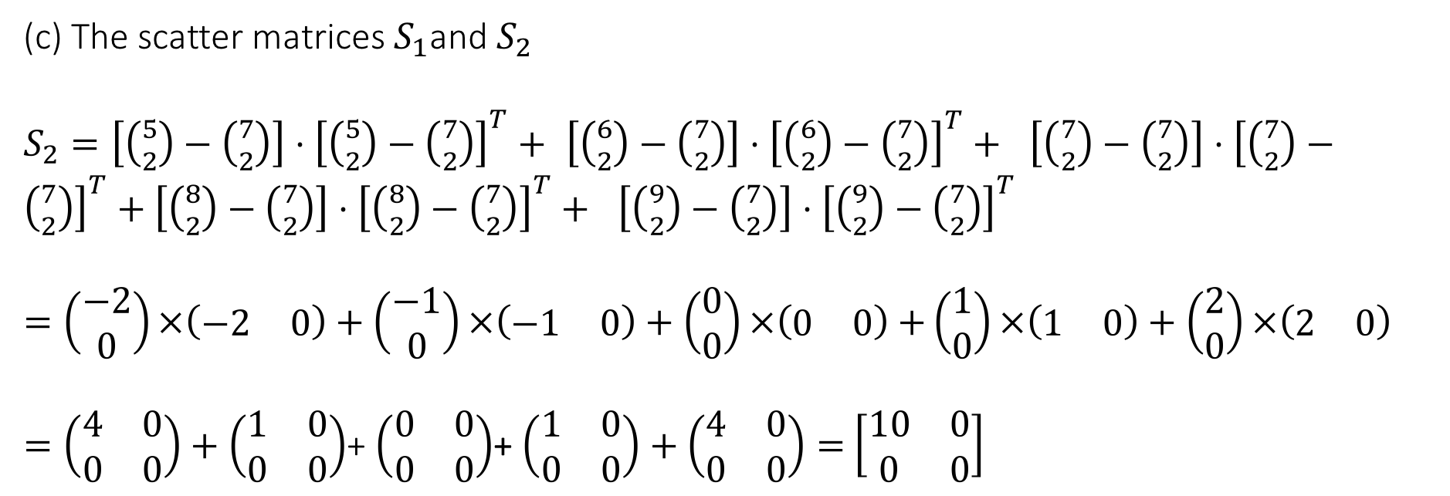
Question 3: Scattering Criteria
(c) The scatter matrices $S_{1}$and $S_{2}$
$S_{2}=\left[\left({5 \atop 2}\right)−\left({7 \atop 2}\right)\right]⋅{\left[\left({5 \atop 2}\right)−\left({7 \atop 2}\right)\right]}^{T}+$ $\left[\left({6 \atop 2}\right)−\left({7 \atop 2}\right)\right]⋅{\left[\left({6 \atop 2}\right)−\left({7 \atop 2}\right)\right]}^{T}+ \left[\left({7 \atop 2}\right)−\left({7 \atop 2}\right)\right]⋅{\left[\left({7 \atop 2}\right)−\left({7 \atop 2}\right)\right]}^{T}+\left[\left({8 \atop 2}\right)−\left({7 \atop 2}\right)\right]⋅{\left[\left({8 \atop 2}\right)−\left({7 \atop 2}\right)\right]}^{T}+ \left[\left({9 \atop 2}\right)−\left({7 \atop 2}\right)\right]⋅{\left[\left({9 \atop 2}\right)−\left({7 \atop 2}\right)\right]}^{T}$
$=\left(\begin{matrix}−2 \\ 0\end{matrix}\right)×\left(\begin{matrix}−2 & 0\end{matrix}\right)+\left(\begin{matrix}−1 \\ 0\end{matrix}\right)×\left(\begin{matrix}−1 & 0\end{matrix}\right)+\left(\begin{matrix}0 \\ 0\end{matrix}\right)×\left(\begin{matrix}0 & 0\end{matrix}\right)$ $+\left(\begin{matrix}1 \\ 0\end{matrix}\right)×\left(\begin{matrix}1 & 0\end{matrix}\right)+\left(\begin{matrix}2 \\ 0\end{matrix}\right)×\left(\begin{matrix}2 & 0\end{matrix}\right)$
$=\left(\begin{matrix}4 & 0 \\ 0 & 0\end{matrix}\right)+\left(\begin{matrix}1 & 0 \\ 0 & 0\end{matrix}\right)$+ $\left(\begin{matrix}0 & 0 \\ 0 & 0\end{matrix}\right)$+ $\left(\begin{matrix}1 & 0 \\ 0 & 0\end{matrix}\right)+\left(\begin{matrix}4 & 0 \\ 0 & 0\end{matrix}\right)=$ $\left[\begin{matrix}10 & 0 \\ 0 & 0\end{matrix}\right]$

Slide 13
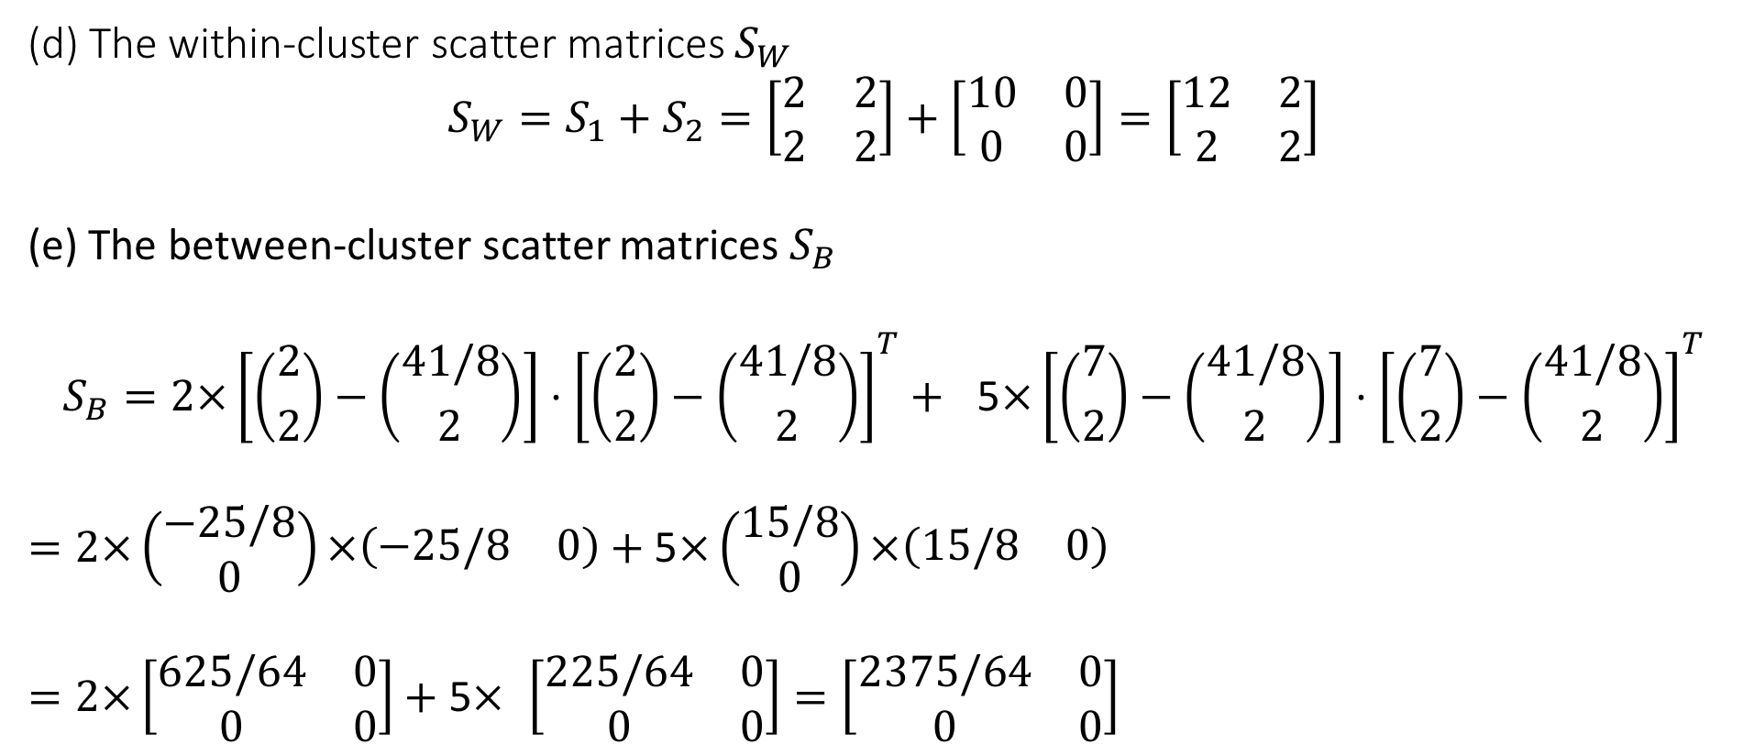
Question 3: Scattering Criteria
(d) The within-cluster scatter matrices $S_{W}$
$$S_{W}=S_{1}+S_{2}=\left[\begin{matrix}2 & 2 \\ 2 & 2\end{matrix}\right]+\left[\begin{matrix}10 & 0 \\ 0 & 0\end{matrix}\right]=\left[\begin{matrix}12 & 2 \\ 2 & 2\end{matrix}\right]$$
(e) The between-cluster scatter matrices $S_{B}$
$$S_{B}=2×\left[\left({2 \atop 2}\right)−\left({41/8 \atop 2}\right)\right]⋅{\left[\left({2 \atop 2}\right)−\left({41/8 \atop 2}\right)\right]}^{T}+ \text{5}×\left[\left({7 \atop 2}\right)−\left({41/8 \atop 2}\right)\right]⋅{\left[\left({7 \atop 2}\right)−\left({41/8 \atop 2}\right)\right]}^{T}$$
$$=2×\left(\begin{matrix}−25/8 \\ 0\end{matrix}\right)×\left(\begin{matrix}−25/8 & 0\end{matrix}\right)+\text{5}×\left(\begin{matrix}15/8 \\ 0\end{matrix}\right)×\left(\begin{matrix}15/8 & 0\end{matrix}\right)$$
$=2×\left[\begin{matrix}625/64 & 0 \\ 0 & 0\end{matrix}\right]+$ $\text{5}×$ $\left[\begin{matrix}225/64 & 0 \\ 0 & 0\end{matrix}\right]=\left[\begin{matrix}2375/64 & 0 \\ 0 & 0\end{matrix}\right]$

Slide 14
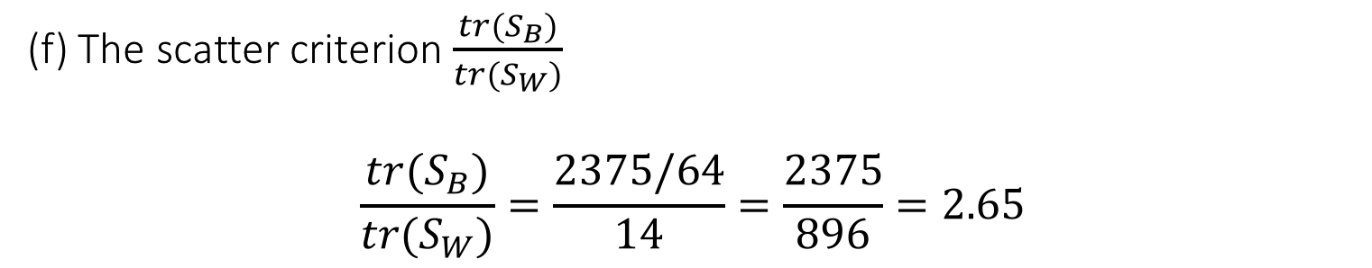
Question 3: Scattering Criteria
(f) The scatter criterion $\frac{tr(S_{B})}{tr(S_{W})}$
$$\frac{tr(S_{B})}{tr(S_{W})}=\frac{2375/64}{14}=\frac{2375}{896}=2.65$$

Slide 15
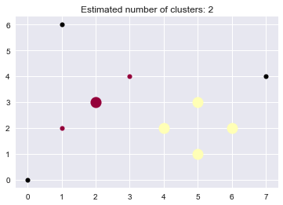
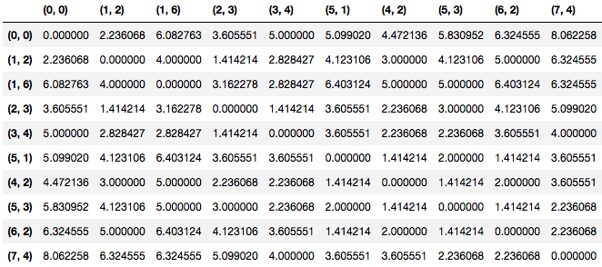
Question 4: DBSCAN:
List the clusters in terms of their points
Cluster 1: {(2, 3), (1, 2), (3, 4)}
Cluster 2: {(5, 1), (4, 2), (6, 2), (5, 3)}

Slide 16
Question 4: DBSCAN
(b) What are the density-connected points?
(3, 4), (2, 3) and (1, 2) are density-connected, since (3, 4), (1, 2) and both density-reachable from (2, 3)
(5, 1), (5, 3), (4, 2), (6, 2) are density-connected, since (5, 1) and (5, 3) are both density-reachable from (4, 2) and (6, 2)

Slide 17
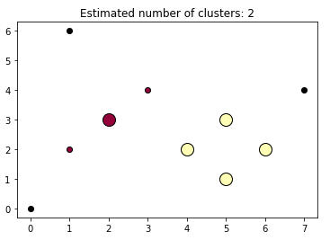
Question 4: DBSCAN
(c) What points (if any) does DBSCAN consider as noise?
Answer:
(0, 0), (1, 6), (7, 4) are considered noise.

Slide 18
Question 5: Evaluation of Classification Algorithm
Instance # | True Class Label | Predicted Probability of Positive Class | Prediction
1 | P | 0.95 | P
2 | N | 0.85 | P
3 | P | 0.78 | P
4 | P | 0.66 | P
5 | N | 0.60 | P
6 | P | 0.55 | P
7 | N | 0.43 | N
8 | N | 0.42 | N
9 | N | 0.41 | N
10 | P | 0.4 | N
Confusion Matrix:
Use 0.5 as the threshold to assign the predicted class label to each data point
N = 10 | Actual: Positive | Actual: Negative
Predicted: Positive | TP = 4 | FP = 2
Predicted: Negative | FN = 1 | TN = 3

Slide 19
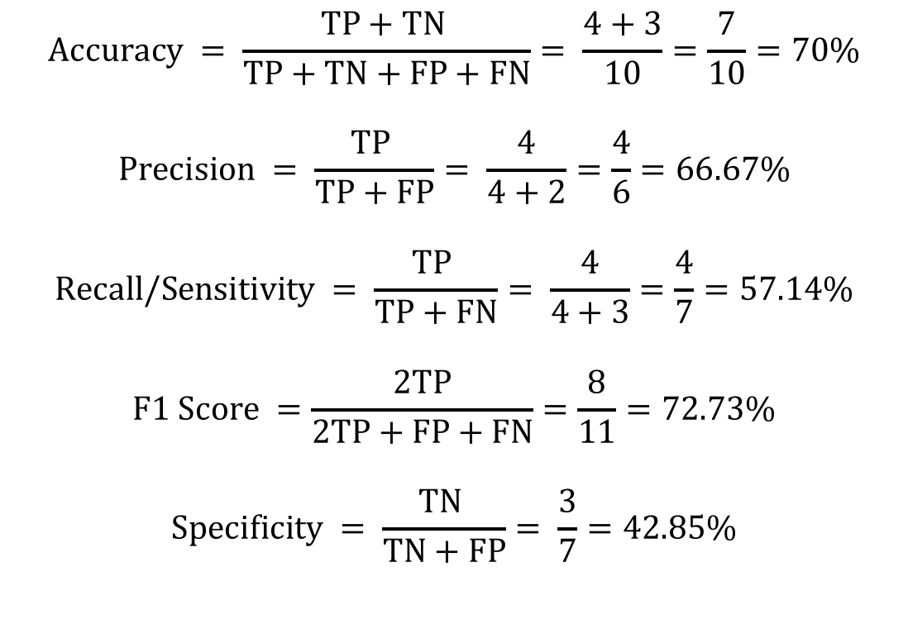
Question 5: Evaluation of Classification Algorithm
$$Accuracy = \frac{TP+TN }{TP+TN+FP+FN}= \frac{4+3}{10}=\frac{7}{10}=70\%$$
$$Precision = \frac{TP }{TP+FP}= \frac{4}{4+2}=\frac{4}{6}=66.67\%$$
$$Recall/Sensitivity = \frac{TP }{TP+FN}= \frac{4}{4+3}=\frac{4}{7}=57.14\%$$
$$F1 Score =\frac{2TP}{2TP+FP+FN}=\frac{8}{11}=72.73\%$$
$$Specificity = \frac{TN }{TN+FP}= \frac{3}{7}=42.85\%$$
N = 10 | Actual: Positive | Actual: Negative
Predicted: Positive | TP = 4 | FP = 2
Predicted: Negative | FN = 1 | TN = 3

