Slide 1
CISC6930 DM Assignment 3
Youfei Zhang
(The code are available on the jupyter notebook)

Slide 2


Question 2: Naïve Bayes
Test set:
Answer:
The classification result of instances 11, 12, 13 is
Low, High, Low
(The pen and paper process are available on the following slides.)

Slide 3
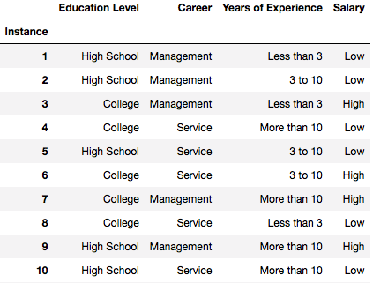
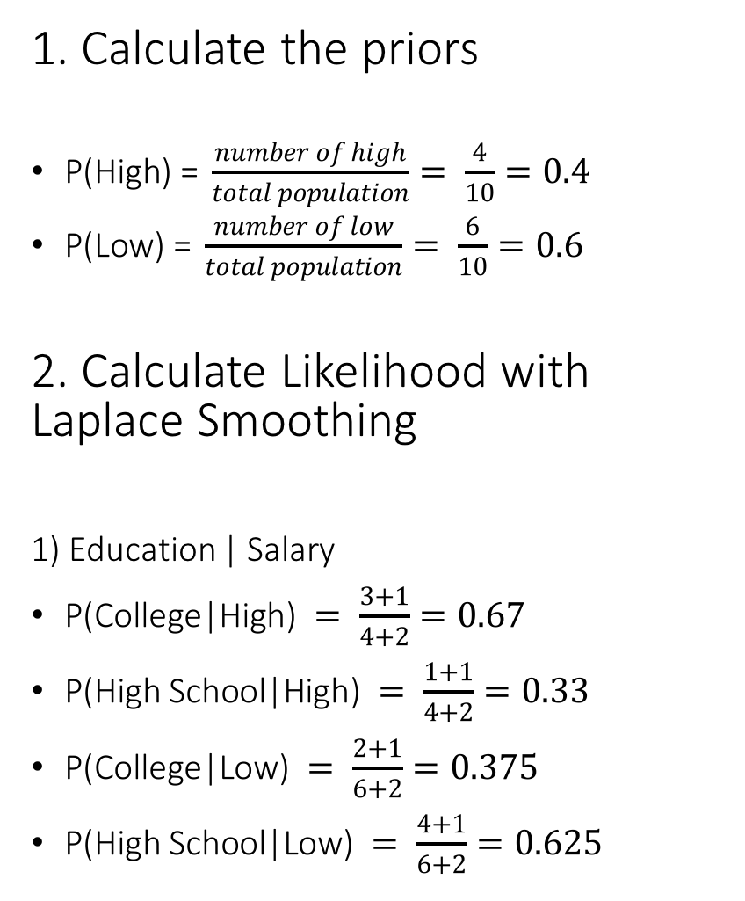
Question 2: Naïve Bayes
1. Calculate the priors
$\text{P}\text{(}\text{High}\text{) =} \frac{number of high}{total population}= \frac{4}{10}=0.4$
$\text{P}\text{(}\text{Low}\text{) =} \frac{number of low}{total population}= \frac{6}{10}=0.6$
2. Calculate Likelihood with Laplace Smoothing
1) Education | Salary
$\text{P}\text{(}\text{College}\text{|}\text{High}\text{) }= \frac{3+1}{4+2}=0.67$
$\text{P}\text{(}\text{High} \text{School}\text{|}\text{High}\text{) }= \frac{1+1}{4+2}=0.33$
$\text{P}\text{(}\text{College}\text{|}\text{Low}\text{) }= \frac{2+1}{6+2}=0.375$
$\text{P}\text{(}\text{High} \text{School}\text{|}\text{Low}\text{) }= \frac{4+1}{6+2}=0.625$

Slide 4
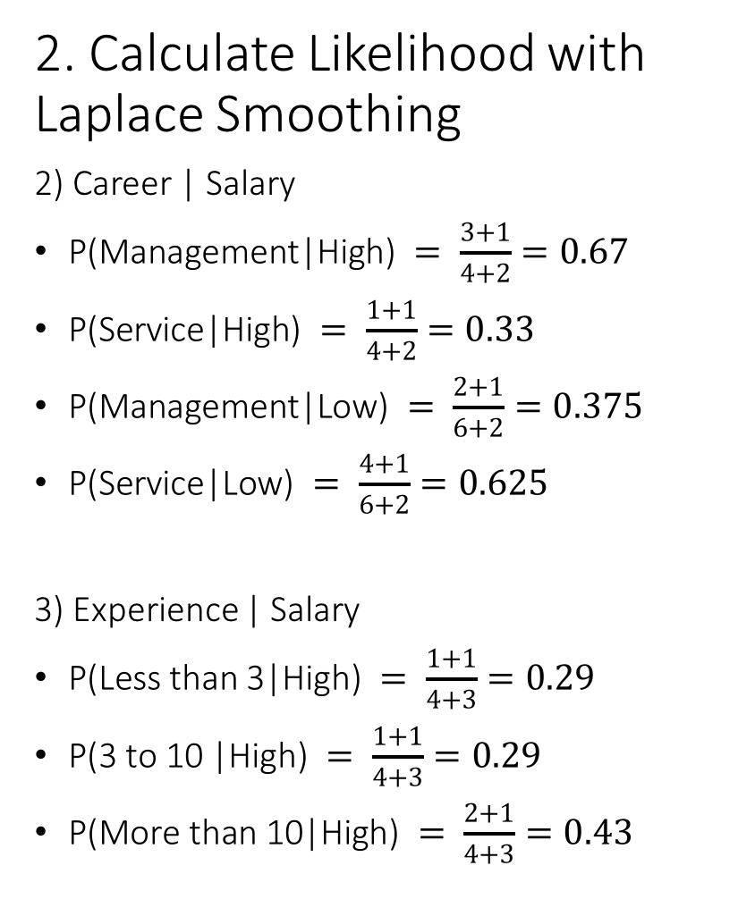
Question 2: Naïve Bayes
2. Calculate Likelihood with Laplace Smoothing
2) Career | Salary
$\text{P}\text{(}\text{Management}\text{|}\text{High}\text{) }= \frac{3+1}{4+2}=0.67$
$\text{P}\text{(}\text{Service}\text{|}\text{High}\text{) }= \frac{1+1}{4+2}=0.33$
$\text{P}\text{(}\text{Management}\text{|}\text{Low}\text{) }= \frac{2+1}{6+2}=0.375$
$\text{P}\text{(}\text{Service}\text{|}\text{Low}\text{) }= \frac{4+1}{6+2}=0.625$
3) Experience | Salary
$\text{P}\text{(}\text{Less} \text{than}\text{ 3|}\text{High}\text{) }= \frac{1+1}{4+3}=0.29$
$\text{P}\text{(3 }\text{to}\text{ 10 |}\text{High}\text{) }= \frac{1+1}{4+3}=0.29$
$\text{P}\text{(}\text{More} \text{than}\text{ 10|}\text{High}\text{) }= \frac{2+1}{4+3}=0.43$

Slide 5
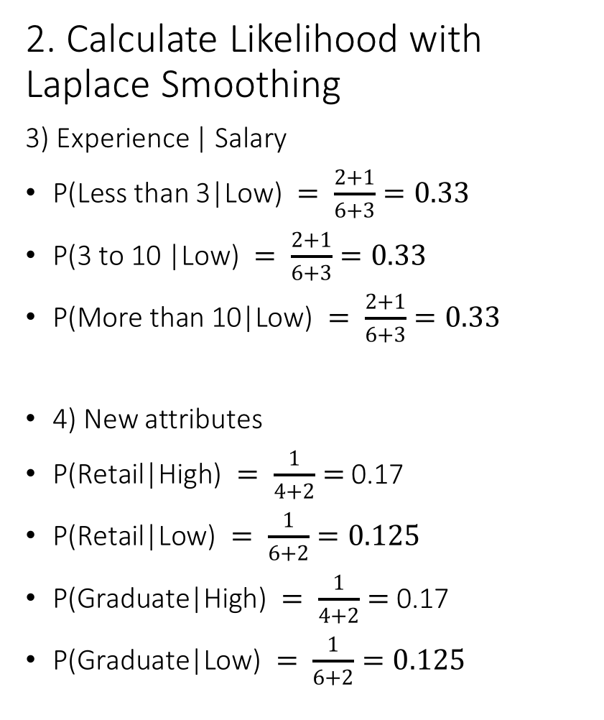
Question 2: Naïve Bayes
2. Calculate Likelihood with Laplace Smoothing
3) Experience | Salary
$\text{P}\text{(}\text{Less} \text{than}\text{ 3|}\text{Low}\text{) }= \frac{2+1}{6+3}=0.33$
$\text{P}\text{(3 }\text{to}\text{ 10 |}\text{Low}\text{) }= \frac{2+1}{6+3}=0.33$
$\text{P}\text{(}\text{More} \text{than}\text{ 10|}\text{Low}\text{) }= \frac{2+1}{6+3}=0.33$
4) New attributes
$\text{P}\text{(}\text{Retail}\text{|}\text{High}\text{) }= \frac{1}{4+2}=$ 0.17
$\text{P}\text{(}\text{Retail}\text{|}\text{Low}\text{) }= \frac{1}{6+2}=0.125$
$\text{P}\text{(}\text{Graduate}\text{|}\text{High}\text{) }= \frac{1}{4+2}=$ 0.17
$\text{P}\text{(}\text{Graduate}\text{|}\text{Low}\text{) }= \frac{1}{6+2}=0.125$

Slide 6
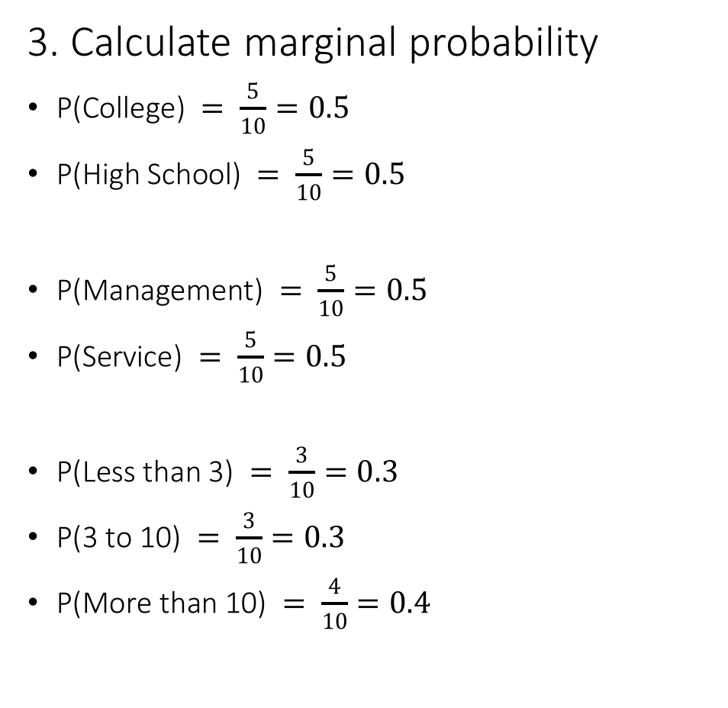
Question 2: Naïve Bayes
3. Calculate marginal probability
$\text{P}\text{(}\text{College}\text{) }= \frac{5}{10}=0.5$
$\text{P}\text{(}\text{High} \text{School}\text{) }= \frac{5}{10}=0.5$
$\text{P}\text{(}\text{Management}\text{) }= \frac{5}{10}=0.5$
$\text{P}\text{(}\text{Service}\text{) }= \frac{5}{10}=0.5$
$\text{P}\text{(}\text{Less} \text{than}\text{ 3) }= \frac{3}{10}=0.3$
$\text{P}\text{(3 }\text{to}\text{ 10) }= \frac{3}{10}=0.3$
$\text{P}\text{(}\text{More} \text{than}\text{ 10) }= \frac{4}{10}=0.4$

Slide 7
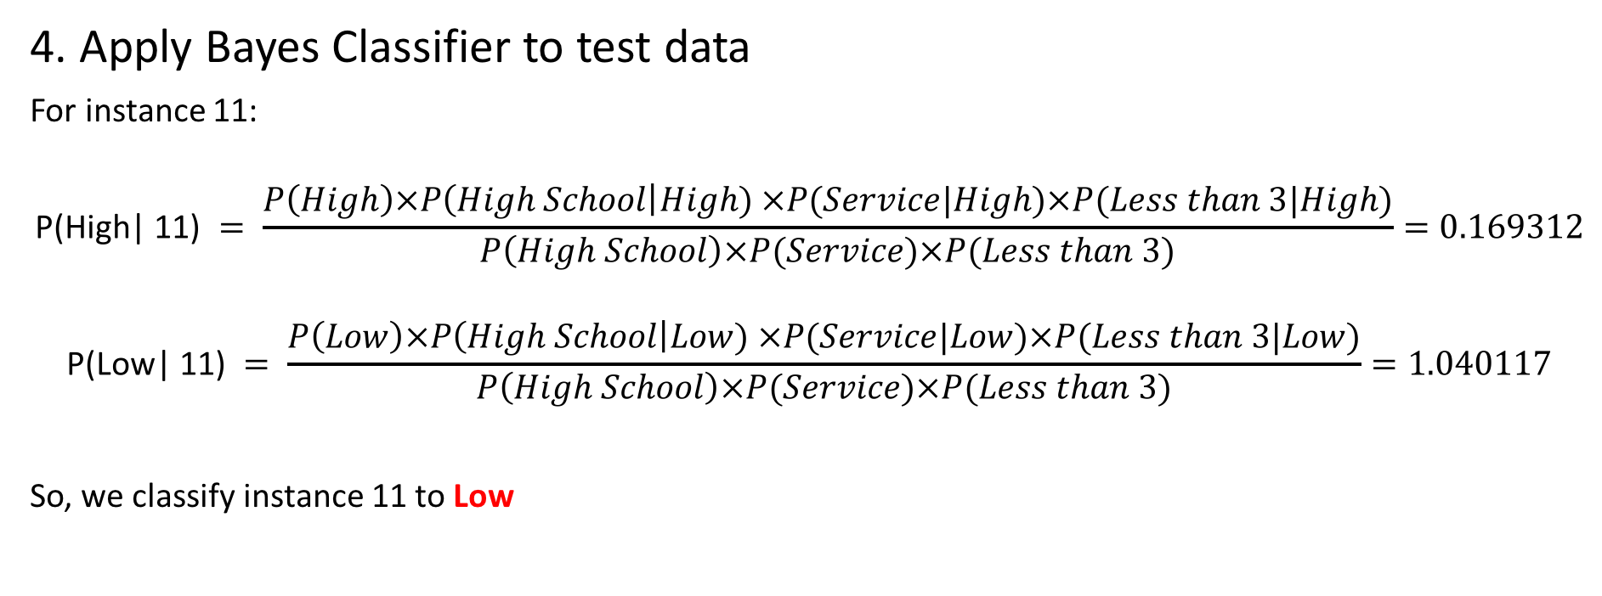
Question 2: Naïve Bayes
4. Apply Bayes Classifier to test data
For instance 11:
$$\text{P}\text{(}\text{High}\text{| 11) }= \frac{P\left(High\right)×P\left(High School\right|High) ×P(Service|High)×P(Less than 3|High)}{P\left(High School\right)×P(Service)×P(Less than 3)}=0.169312$$
$$\text{P}\text{(}\text{Low}\text{| 11) }= \frac{P\left(Low\right)×P\left(High School\right|Low) ×P(Service|Low)×P(Less than 3|Low)}{P\left(High School\right)×P(Service)×P(Less than 3)}=1.040117$$
So, we classify instance 11 to Low

Slide 8
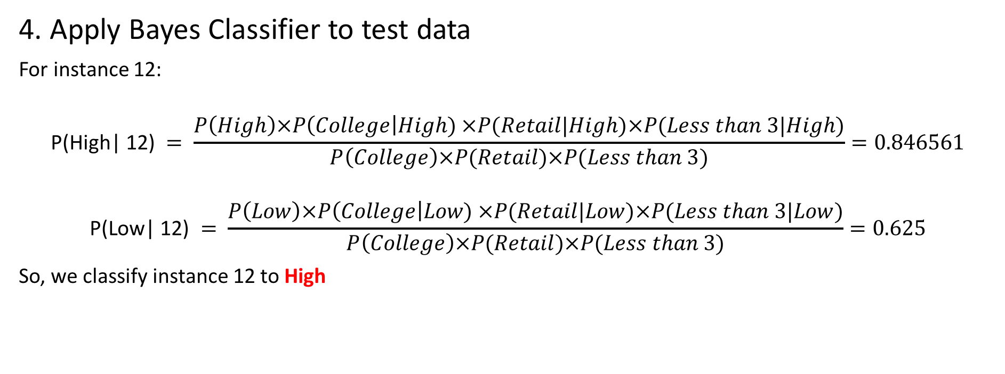
Question 2: Naïve Bayes
4. Apply Bayes Classifier to test data
For instance 12:
$$\text{P}\text{(}\text{High}\text{| 12) }= \frac{P\left(High\right)×P\left(College\right|High) ×P(Retail|High)×P(Less than 3|High)}{P\left(College\right)×P(Retail)×P(Less than 3)}=0.846561$$
$$\text{P}\text{(}\text{Low}\text{| 12) }= \frac{P\left(Low\right)×P\left(College\right|Low) ×P(Retail|Low)×P(Less than 3|Low)}{P\left(College\right)×P(Retail)×P(Less than 3)}=0.625$$
So, we classify instance 12 to High

Slide 9

Question 2: Naïve Bayes
4. Apply Bayes Classifier to test data
For instance 13:
$$\text{P}\text{(}\text{High}\text{| 13) }= \frac{P\left(High\right)×P\left(Graduate\right|High) ×P(Service|High)×P(3 to 10|High)}{P\left(Graduate\right)×P(Service)×P(3 to 10)}=0.42328$$
$$\text{P}\text{(}\text{Low}\text{| 13) }= \frac{P\left(Low\right)×P\left(Graduate\right|Low) ×P(Service|Low)×P(3 to 10|Low)}{P\left(Graduate\right)×P(Service)×P(3 to 10)}=1.041667$$
So, we classify instance 13 to Low

Slide 10
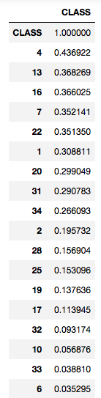
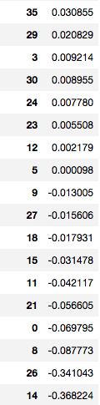
Question 3: Filter Method
(a) List the features from highest |r| (the absolute value of r) to lowest, along with their |r| values. Why would one be interested in the absolute value of r rather than the raw value?
Answer:
The features as ranked as shown on the right graph
We are interested in the absolute value of r rather than the raw value because r measures the correlation between our features and response variable.
The raw value only represent the features themselves without taken consideration of any relationships, so we won't be able to measure the importance and select features purely based on the raw value
.Also r is unitless, which allows us to measure the correlation coefficients calculated on different data sets with different units and compare them on the same bases.

Slide 11
Question 3: Filter Method
(b) Select the features that have the highest m values of |r|, and run LOOCV on the dataset restricted to only those m features. Which value of m gives the highest LOOCV classification accuracy, and what is the value of this optimal accuracy?
Result in python:
Answer:
As we can see from PCC, only the first 20 features in the list have a r score over 0.002.
So, I used LOOCV to evaluate the classification accuracy of m out of th ose 20 features with m = range(1:20), and choose the value of m with the highest LOOCV score.
As a result, the value of m that gives the highest LOOCV classification accuracy is: m = 18
the value of the optimal actuary is: 92.435%

Slide 12
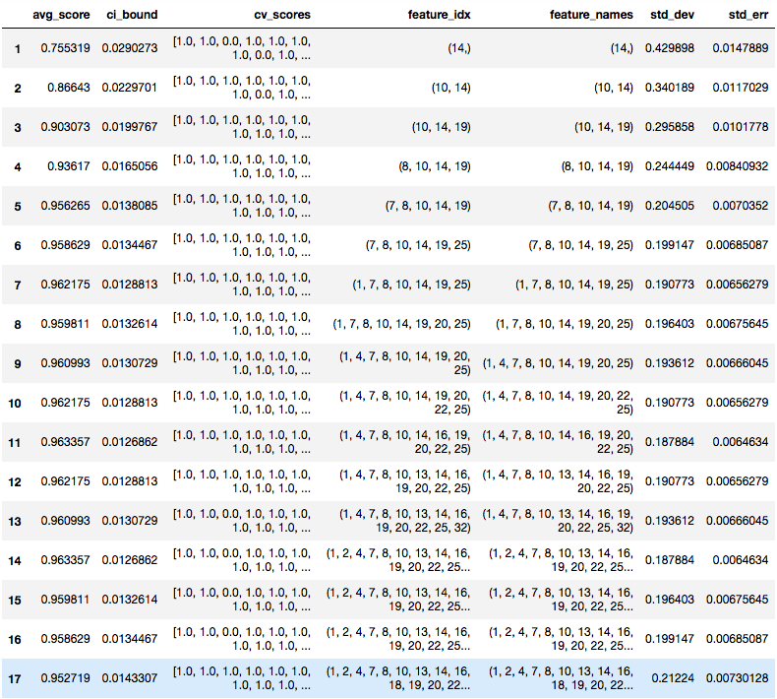
Question 4: Wrapper Method
(a) Show the set of selected features at each step, as it grows from size zero to its final size (increasing in size by exactly one feature at each step).
Answer:
graph on the right side
(b) What is the LOOCV accuracy over the final set of selected features?
Answer:
As we can see, the best subset has a LOOCV accuracy rate of 0.963
The best subset at the step 16 is:
(1, 4, 7, 8, 10, 14, 16, 19, 20, 22, 25)

