Slide 1
CISC6930 Data Mining Assignment 5
Youfei Zhang
(yzhang737)

Slide 2
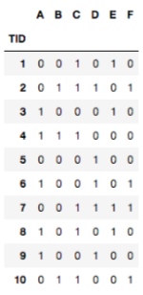
Question 1: Apriori Algorithm
(a) Illustrate the first three levels of the Apriori algorithm (set sizes 1, 2 and 3) for support threshold of 3 transactions, by identifying candidate sets and calculating their support. What are the maximal frequent sets discovered in the first 3 levels?
C 2
Itemset | Sup
A, B | 1
A, C | 2
A, D | 2
A, E | 2
A, F | 1
B, C | 3
B, D | 1
B, E | 0
B, F | 2
C, D | 2
C, E | 3
C, F | 3
D, E | 1
D, F | 3
E, F | 1
Answer:
C1
Level 1
Itemset | Sup
A | 5
B | 3
C | 6
D | 5
E | 4
F | 4
Itemset | Sup
A | 5
B | 3
C | 6
D | 5
E | 4
F | 4
1st scan

Slide 3
Question 1: Apriori Algorithm
(a) Illustrate the first three levels of the Apriori algorithm (set sizes 1, 2 and 3) for support threshold of 3 transactions, by identifying candidate sets and calculating their support. What are the maximal frequent sets discovered in the first 3 levels?
Itemset | Sup
A, B | 1
A, C | 2
A, D | 2
A, E | 2
A, F | 1
B, C | 3
B, D | 1
B, E | 0
B, F | 2
C, D | 2
C, E | 3
C, F | 3
D, E | 1
D, F | 3
E, F | 1
C 2
Level 2
Itemset | Count
B, C | 3
C, E | 3
C, F | 3
D, F | 3
C 3
2nd scan
Itemset | Count
C, E, F | 1
3rd scan
Level 3: non of the items has a support over 3
Itemset | Count
Maximal frequent sets:
{B, C}, {C, E}, {C, F}, {D, F}, {A}

Slide 4
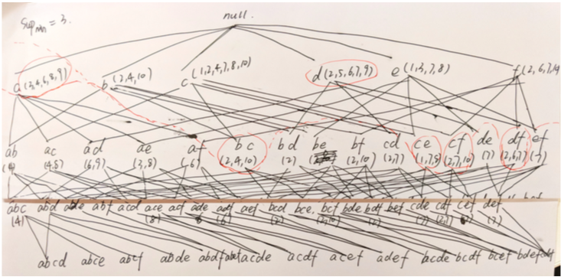
Question 1: Apriori Algorithm
(a) Illustrate the first three levels of the Apriori algorithm (set sizes 1, 2 and 3) for support threshold of 3 transactions, by identifying candidate sets and calculating their support. What are the maximal frequent sets discovered in the first 3 levels?

Slide 5
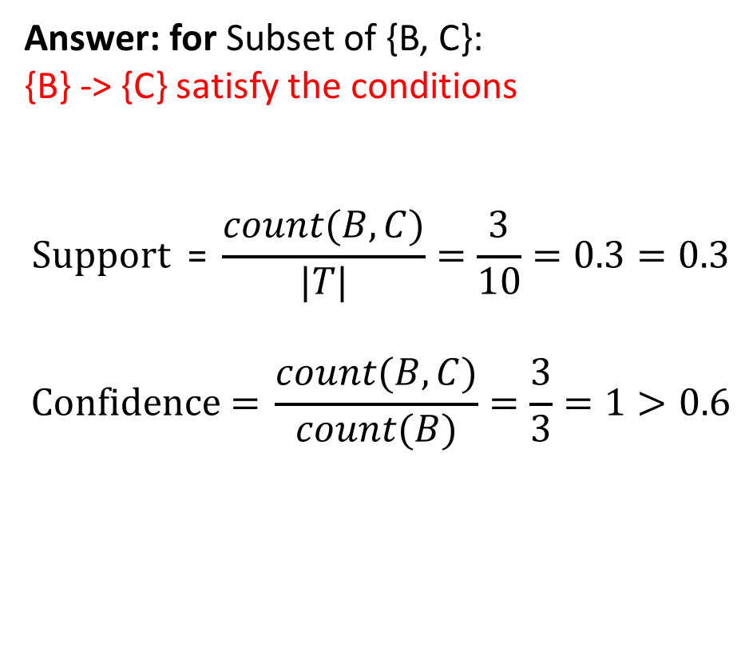
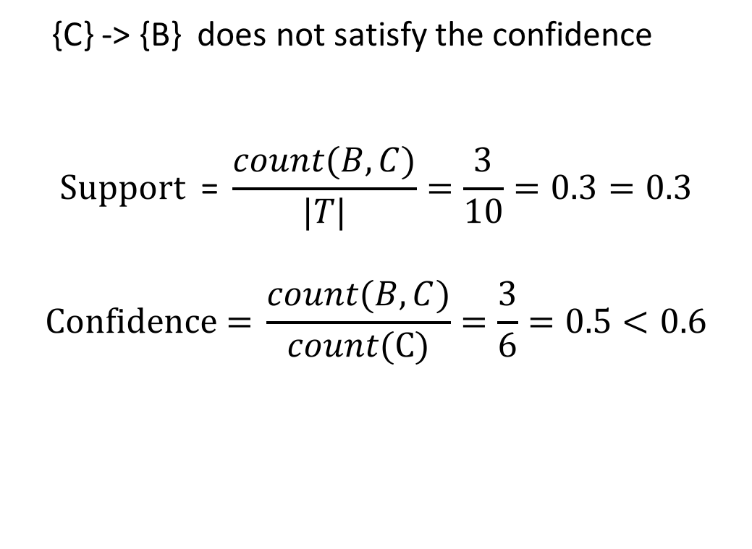
Question 1: Apriori Algorithm
(b) Pick one of the maximal sets and check if any of its subsets are association rules with frequency at least 0.3 and confidence at least 0.6. Pleas explain your answer and show your work.
Answer: for Subset of {B, C}:
{B} -> {C} satisfy the conditions
$$\text{Support} \text{ =} \frac{count(B, C)}{|T|}=\frac{3}{10}=0.3=0.3$$
$$\text{Confidence}\text{ =} \frac{count(B, C)}{count(B)}=\frac{3}{3}=1>0.6$$
{C} -> {B} does not satisfy the confidence
$$\text{Support} \text{ =} \frac{count(B, C)}{|T|}=\frac{3}{10}=0.3=0.3$$
$$\text{Confidence}\text{ =} \frac{count(B, C)}{count(C)}=\frac{3}{6}=0.5<0.6$$

Slide 6
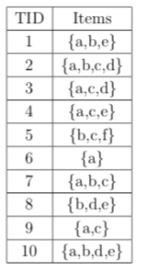
Question 2: FP-tree
(a) Construct FP-tree from the transaction database and draw it here.
Answer:
TID | Items Bought | Frequent Items
1 | {a, b, e} | {a, b, e}
2 | {a, b, c, d} | {a, b, c, d}
3 | {a, c, d} | {a, c, d}
4 | {a, c, e} | {a, c, e}
5 | {b, c, f} | {b, c}
6 | {a} | {a}
7 | {a, b, c} | {a, b, c}
8 | {b, d, e} | {b, d, e}
9 | {a, c} | {a, c}
10 | {a, b, d, e} | {a, b, d, e}
frequent single items | support
a | 8
b | 6
c | 6
d | 4
e | 4

Slide 7
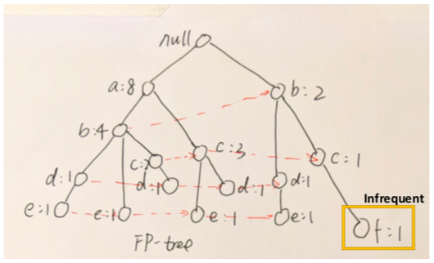
Question 2: FP-tree
(a) Construct FP-tree from the transaction database and draw it here.
TID | Items Bought | Frequent Items
1 | {a, b, e} | {a, b, e}
2 | {a, b, c, d} | {a, b, c, d}
3 | {a, c, d} | {a, c, d}
4 | {a, c, e} | {a, c, e}
5 | {b, c, f} | {b, c}
6 | {a} | {a}
7 | {a, b, c} | {a, b, c}
8 | {b, d, e} | {b, d, e}
9 | {a, c} | {a, c}
10 | {a, b, d, e} | {a, b, d, e}

Slide 8
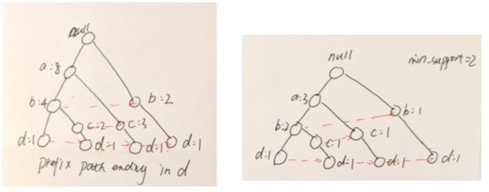
Question 2: FP-tree
(b) Show d’s conditional pattern base (projected database), d’s conditional FP-tree, and find frequent patterns based on d’s conditional FP-tree.
d’s conditional pattern base:
{abc: 1, ab: 1, ac: 1, b: 1﻿﻿﻿﻿﻿}
Prefix path ending in d

Slide 9
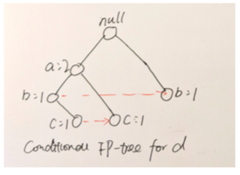
Question 2: FP-tree
(b) Show d’s conditional pattern base (projected database), d’s conditional FP-tree, and find frequent patterns based on d’s conditional FP-tree.
D’s conditional pattern base:
{abc: 1, ab: 1, ac: 1, b: 1﻿﻿﻿﻿﻿}
Frequent patterns:
{d}, {cd}, {bd}, {ad}, {acd},
{abd}
b: 2
d’s conditional FP-tree

Slide 10
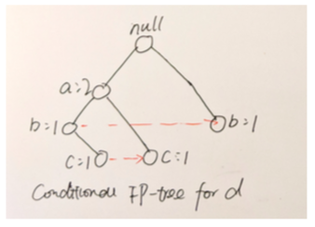
Question 2: FP-tree
(b) Show d’s conditional pattern base (projected database), d’s conditional FP-tree, and find frequent patterns based on d’s conditional FP-tree.
Mining subtrees ends with d
Frequent itemsets:
cd: 2
bd: 2
ad: 2
Frequent patterns:
{d}, {cd}, {bd}, {ad}, {acd},
{abd}
b: 2
d’s conditional FP-tree

Slide 11
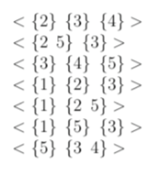
Question 3: GSP Algorithm
In the GSP algorithm, suppose we have the length-3 frequent pattern set L3 as follows:
Generate length-4 candidates set C4 and frequent pattern set L4. Show your work by writing down the details of the join and prune steps.
L3 -> C4:
Step 1: join
<{2} {3} {4} {5}>
<{1} {2} {3} {4}>
<{1} {2 5} {3}>
<{2 5} {3 4}>
<{5} {3 4} {5}>
<{1} {5} {34}
Step 2: pruning
<{2} {3} {4} {5}> prune
<{1} {2} {3} {4}> prune
<{1} {2 5} {3}> keep
<{2 5} {3 4}> prune
<{5} {3 4} {5}> prune
<{1} {5} {34} prune

Slide 12
Question 3: GSP Algorithm
Ck | L(k-1)
<{1} {2 5} {3}> | <{1} {2 5}> | Y
 | <{2 5} {3}> | Y
<{2 5} {3 4}> | <{2 5} {3}> | Y
 | <{5} {3 4}> | N
<{5} {3 4} {5}> | <{5} {3 4} > | Y
 | <{3 4} {5}> | N
<{1} {5} {34} > | <{1} {5} {3}> | Y
 | <{5} {34} > | Y
 | <{1} {34} > | N
Ck | L(k-1)
<{2} {3} {4} {5}> | <{2} {3} {4} > | Y
 | <{3} {4} {5}> | Y
 | <{2} {4} {5}> | N
 | <{2} {3} {5} > | N
<{1} {2} {3} {4}> | <{1} {2} {3} > | Y
 | <{1} {2} {4}> | N
 | <{1} {3} {4}> | N
 | <{2} {3} {4}> | Y
Step 2: pruning
<{2} {3} {4} {5}> prune
<{1} {2} {3} {4}> prune
<{1} {2 5} {3}> keep
<{2 5} {3 4}> prune
<{5} {3 4} {5}> prune
<{1} {5} {34} prune

Slide 13
Question 3: GSP Algorithm
Generate length-4 candidates set C4 and frequent pattern set L4. Show your work by writing down the details of the join and prune steps.
Answer:
C4:
Step 1: join
<{2} {3} {4} {5}>
<{1} {2} {3} {4}>
<{1} {2 5} {3}>
<{2 5} {3 4}>
<{5} {3 4} {5}>
<{1} {5} {34}
Step 2: pruning
<{2} {3} {4} {5}> prune
<{1} {2} {3} {4}> prune
<{1} {2 5} {3}> keep
<{2 5} {3 4}> prune
<{5} {3 4} {5}> prune
<{1} {5} {34} prune
L4: {empty}
L4 is empty because we don’t know the minimum support

Slide 14
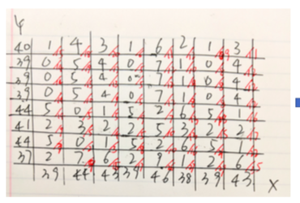
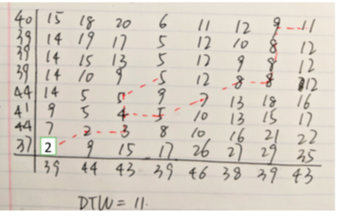
Question 4: DTW
Calculate the DTW distance between X and Y and point out the optimal warping path. (The local cost function is defined as the absolute difference of the two values, e.g., c(x1, y1) = d(39, 37) = 2)
Answer: DTW = 11
2

Slide 15
Question 4: DTW
Calculate the DTW distance between X and Y and point out the optimal warping path. (The local cost function is defined as the absolute difference of the two values, e.g., c(x1, y1) = d(39, 37) = 2)
The final optimal warping path:
Answer: DTW = 11
40 | 15 | 18 | 20 | 6 | 11 | 12 | 9 | 11
39 | 14 | 19 | 17 | 5 | 12 | 10 | 8 | 12
39 | 14 | 15 | 13 | 5 | 12 | 9 | 8 | 12
39 | 14 | 10 | 9 | 5 | 12 | 8 | 8 | 12
44 | 14 | 5 | 5 | 9 | 7 | 13 | 18 | 16
41 | 9 | 5 | 4 | 5 | 10 | 13 | 15 | 17
44 | 7 | 2 | 3 | 8 | 10 | 16 | 21 | 22
37 | 2 | 0 | 15 | 17 | 26 | 27 | 29 | 35
 | 39 | 44 | 43 | 39 | 46 | 38 | 39 | 43
2

