Slide 1
Training samples
Shift data to create comparable sinewaves
Remove 50Hz wave and Denoise samples (signals)
Undersampling
Selected samples
Feature reduction
Feed into Neural Network for prediction

Slide 2
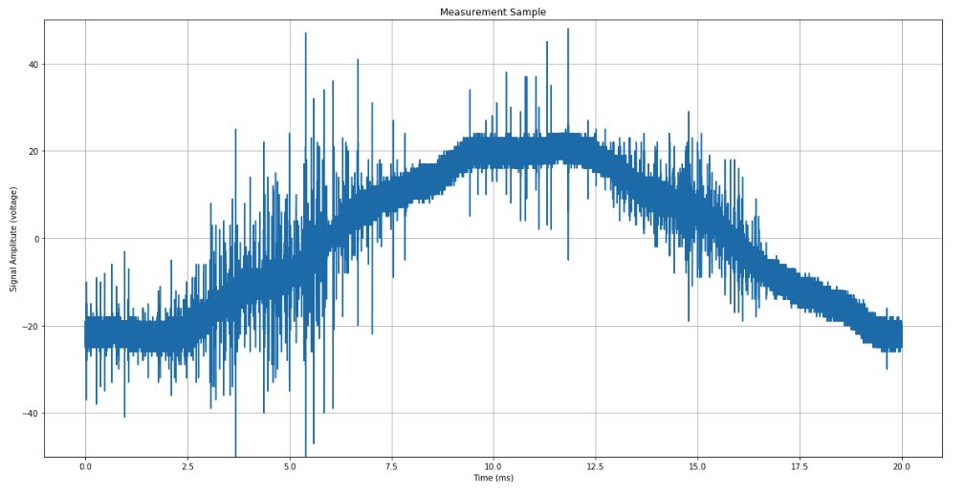
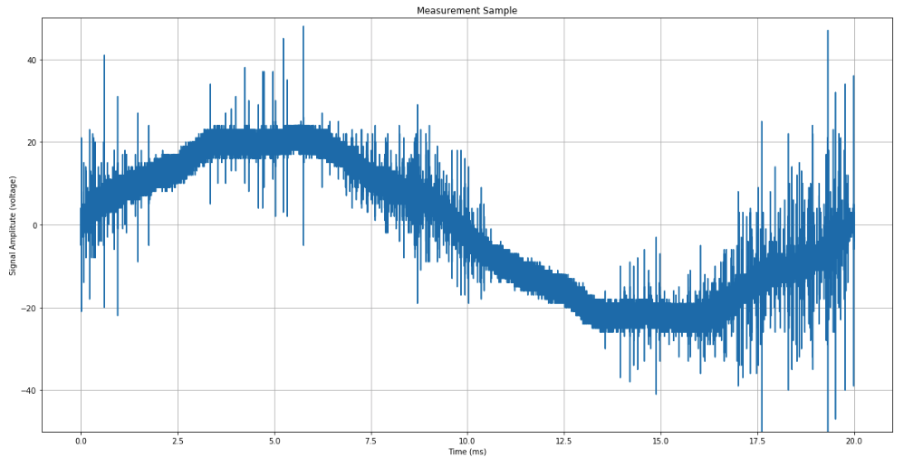
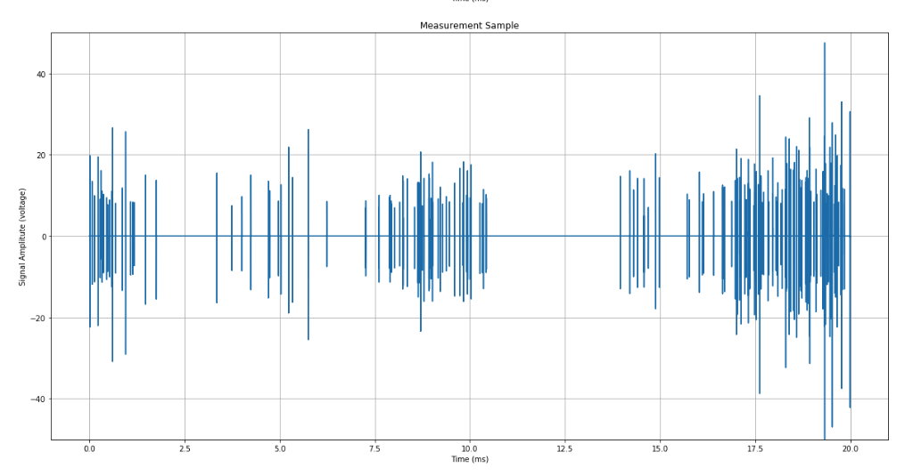
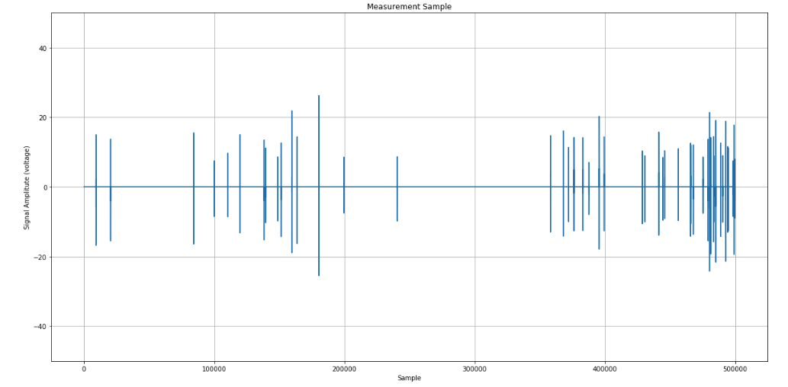
samples
Shift data to create comparable sinewaves
Remove 50Hz wave and denoise samples
Cut away the regions where PD is not expected

Slide 3
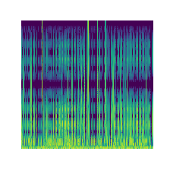

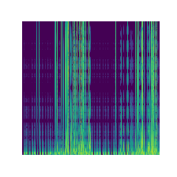
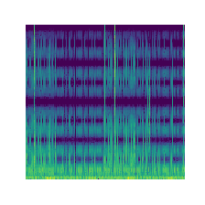
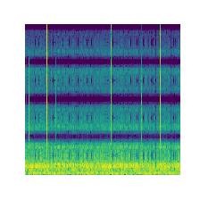
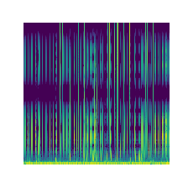
PD positive
signal_id 4
signal_id 201
signal_id 1002
PD negative
signal_id 9
signal_id 205
signal_id 1001

Slide 4
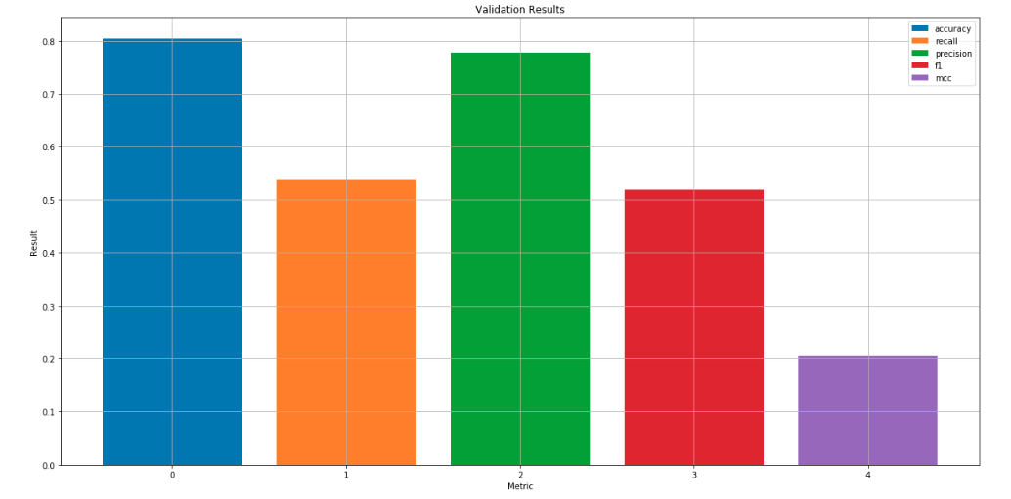
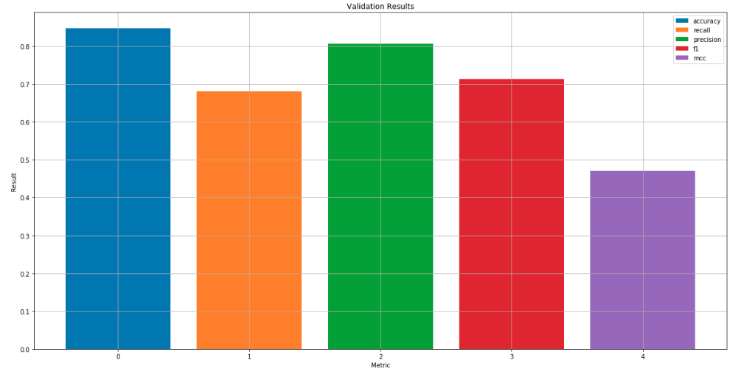
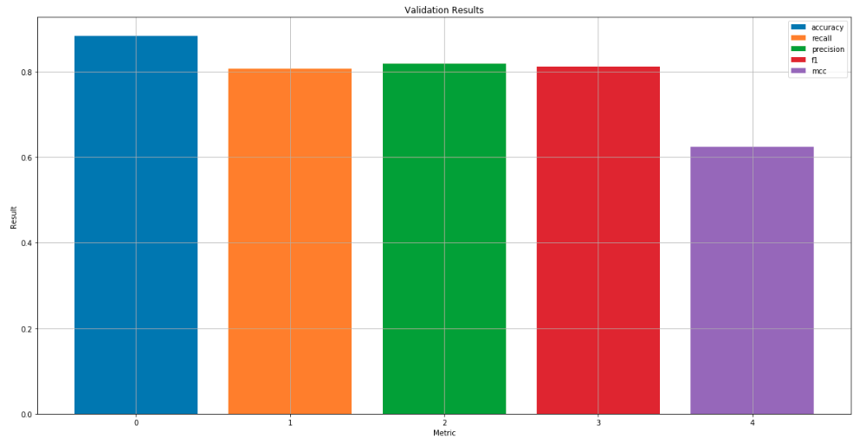
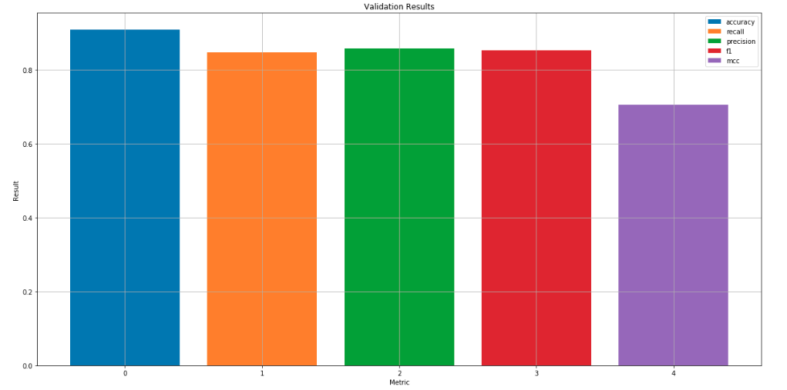
PCA / Dense Net
PCA / 1D CNN
Spectograms / 2D CNN
Spectograms / VGG16
Accuracy
Recall
Precision
F1
MCC

