Slide 1
Version Control
Git
Github
What are these?
Why do we need to use them?
How to use them?

Slide 2
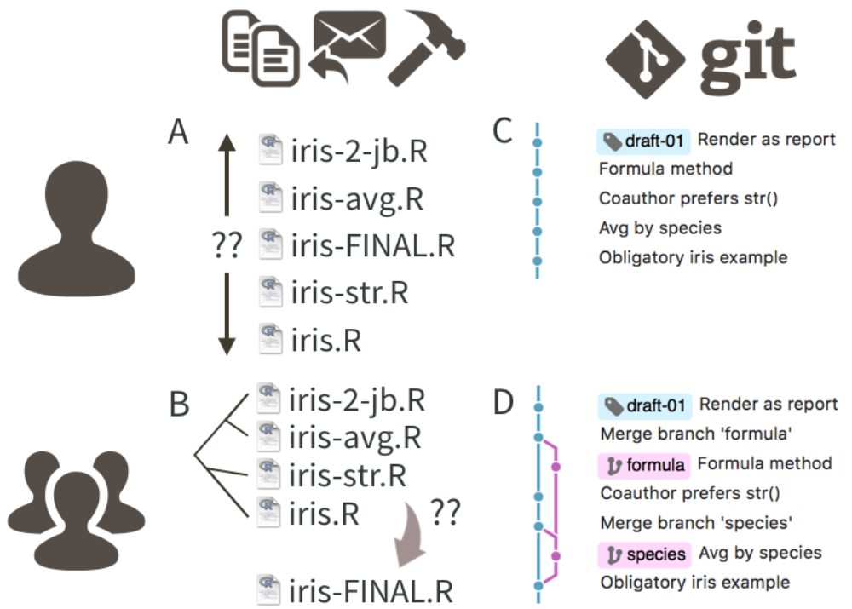
What is Version Control and Git
Git is a version control system
“Track Changes” on steroids
Ensuring reproducibility
Ease of working collaboratively
  With peers
  With past and future self
Bryan J. 2017. Excuse me, do you have a moment to talk about version control? PeerJ Preprints 5:e3159v2 https://doi.org/10.7287/peerj.preprints.3159v2

Slide 3
How to do Version Control
Use a hosting service like GitHub, Bitbucket, and GitLab
Think of these as OneDrive, Google Drive or DropBox
Good even for private solo projects
  Track changes
  Revert when you screw up
  Publication ready
  Personal website or ShinyApp

Slide 4
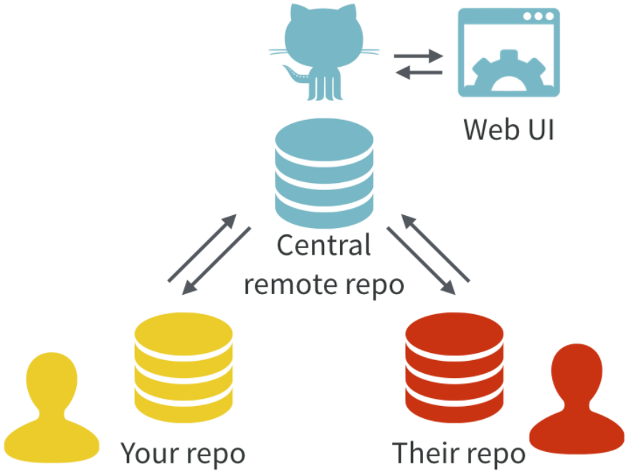
The Pain!
Account
Types of Account
Check and install
Updates (not necessary)
Get your local Git to talk to Github
A Git repository (commonly called a "repo") is a digital container or project folder that tracks and stores the complete history of changes made to files over time

Slide 5
Make the local and the remote talk
Personal Access Token (PAT)
Method 1: GitHub setting
  HTTPS key
Method 2: Rstudio “usethis” package
  HTTPS key
Method 3: Git Bash / Terminal
  SSH key

Slide 6
Project, GitHub first
Method 1: Rstudio “usethis” package
Method 2: Rstudio IDE

Slide 7
Project, GitHub first
Method 1: Rstudio “usethis” package
Method 2: Rstudio IDE

Slide 8
Commit, Push, Pull

Slide 9
A published example

Slide 10
GitHub Co-Pilot

