Slide 1

Syracuse university iSchool course catalog database
IST659
Yibo Feng

Slide 2
Contents
Project goals
ER Diagram
Forms
Major data questions
Reports
Trigger

Slide 3
Project goals – what data to collect?
Available course details
Class details which are subordinate to courses
Instructor data which are assigned to each class
Classroom data where each class is operated
Current or potential student data who take SU iSchool courses
Course registration details of each student
Technical tool data and its description related to each course
Job details related to each course
Available job data
Technical tool data related with each job
Company details which offers each job

Slide 4

Project goals – who can input and query data?
Who can Input the data
Administrative staffs
(students, instructors, and companies can input or update their data through administrative staffs)
Who can query the data
Students
Instructors
Companies
Administrative staffs

Slide 5

Project goals – major data questions?
For students
What are the prerequisite subjects each course requires?
What are the technical skills each job requires?
Whether there are available jobs which matches with student’s job target.
For instructors
How many students enrolled in each class that specific instructor teaches?
Where is the classroom for each class that specific instructor teaches?
For companies
How many and what kind of courses each student has taken?

Slide 6
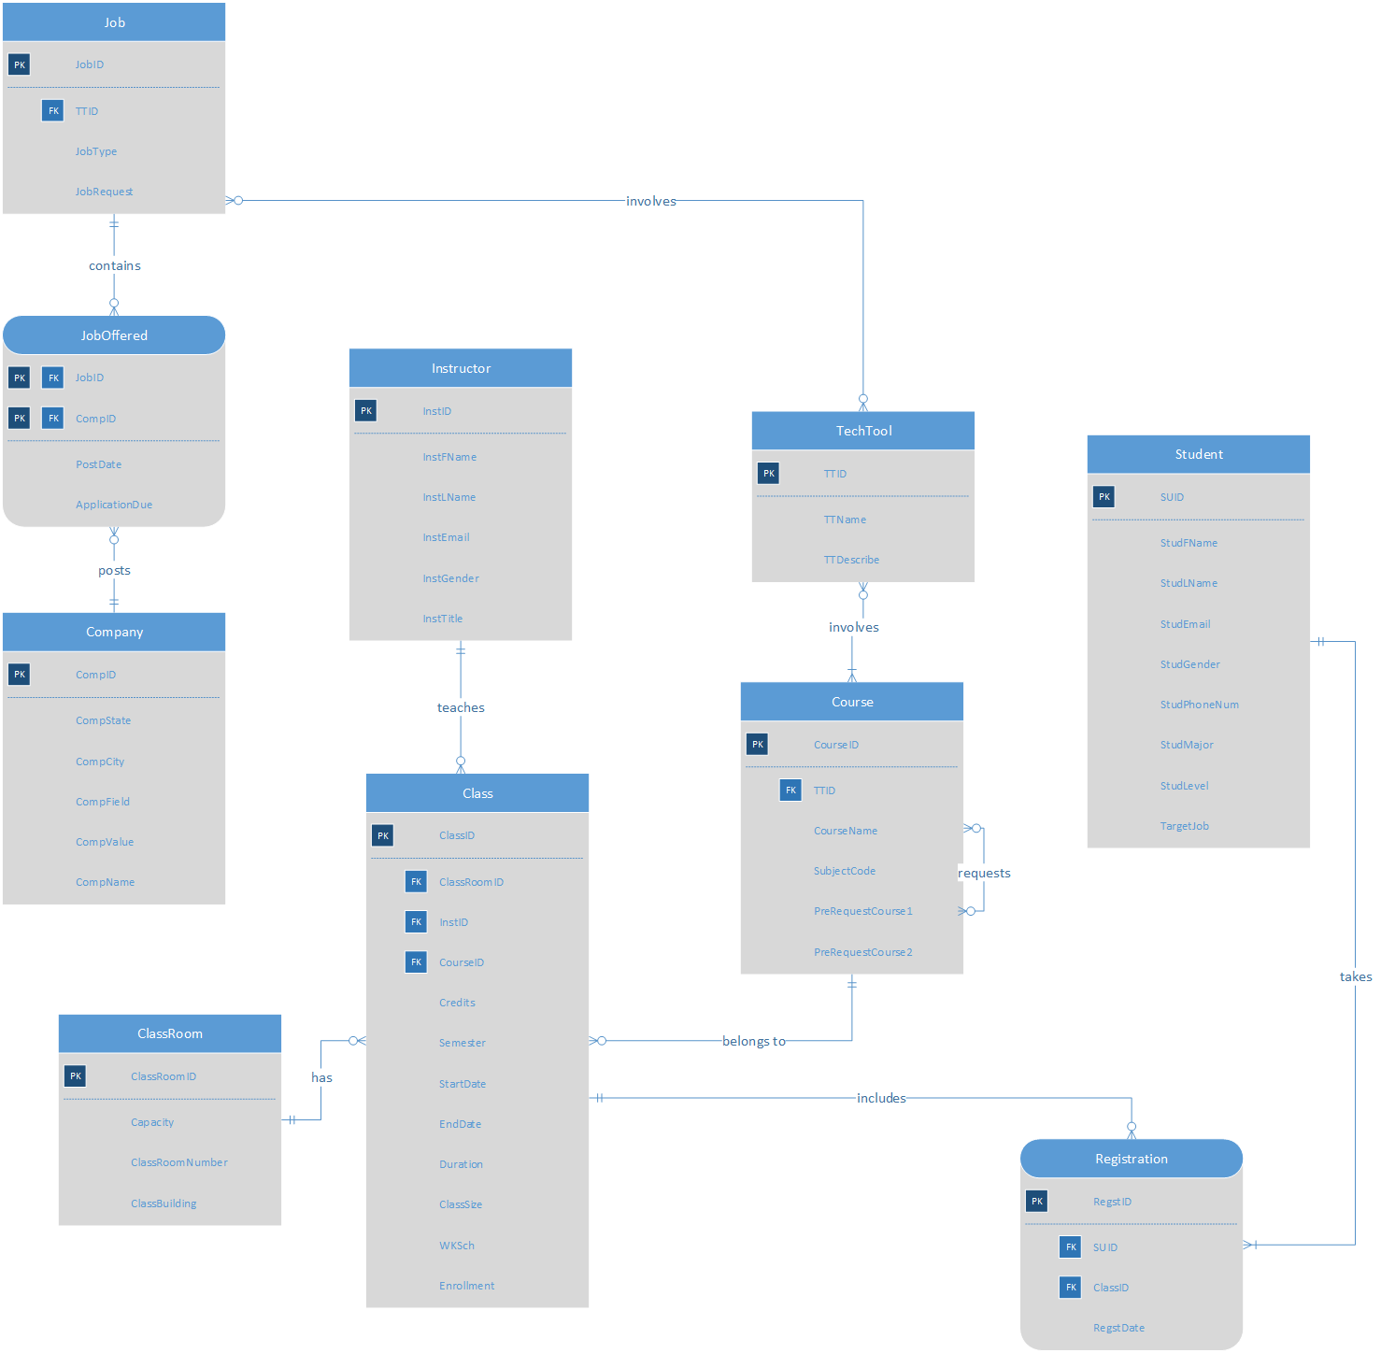
ER Diagram - VISIO

Slide 7
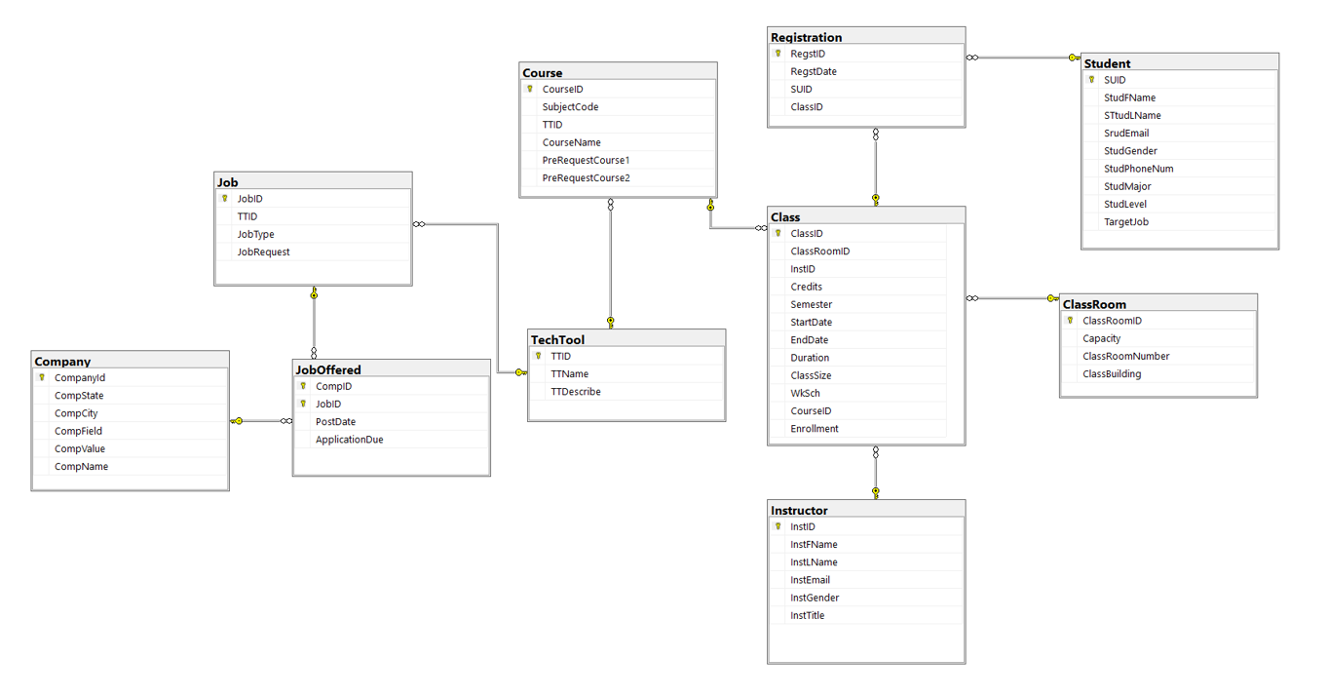
ER Diagram - SQL

Slide 8
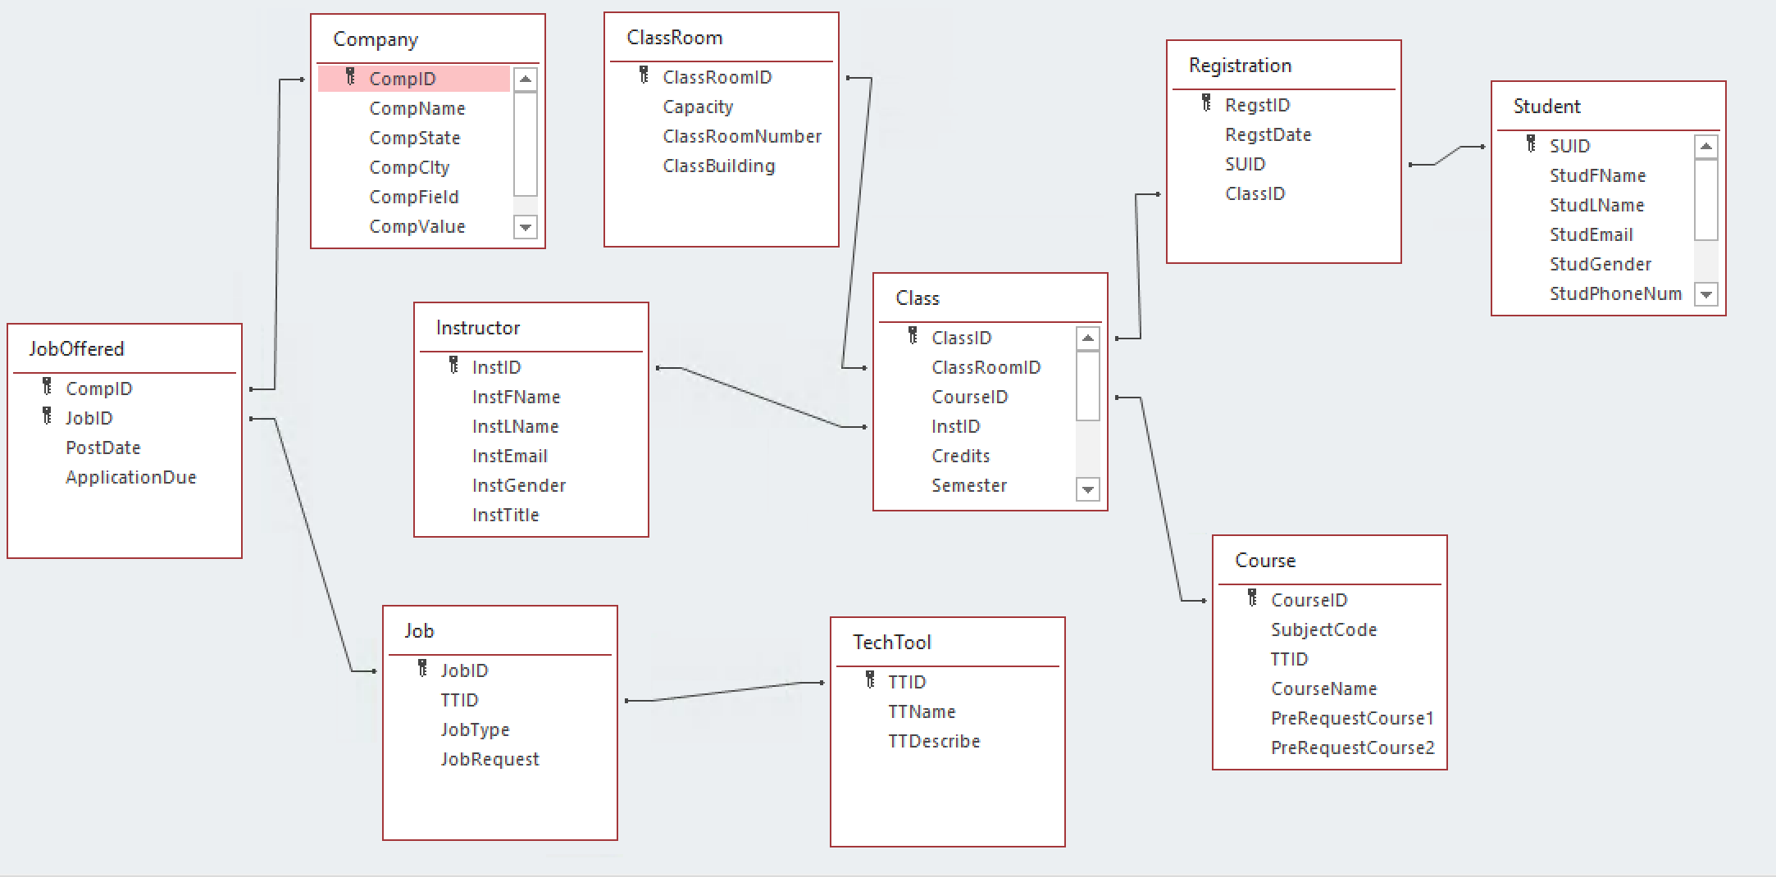
ER Diagram - Access

Slide 9
Forms
Total number of tables : 10
Total number of forms : 10 forms, 4 sub forms
Course search form (Y) : user can search available courses
Course search details form (Y) : allows user to view detailed course information and add instructor, class, classroom data
Class search details form (Y) : allows user to view detailed class data
Course registration details form (Y) : allows user to view each student's course registration information and add course, class, related technical tools and job data
Available job details form (Y) : allows user to view available job offered by specific company and add job offering and related technical tools data
Instructor details from (Y) : allows user to view instructor details
Student details from (Y) : allows user to view student details
Classroom details from (Y) : allows user to view classroom details
Company details from (Y) : allows user to view company details
Registration details from (Y) : allows user to view registration details

Slide 10
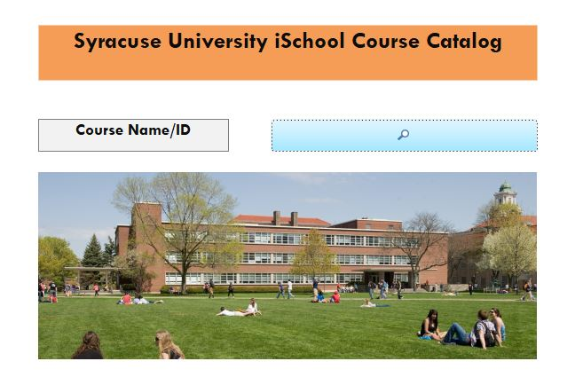
Forms
iSchool course catalog main page

Slide 11
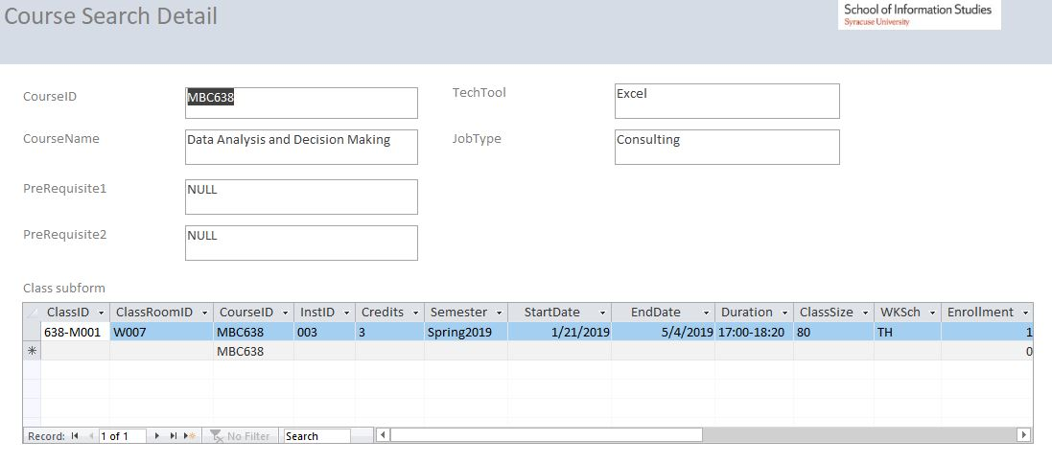
Forms
Display detailed information about available courses

Slide 12
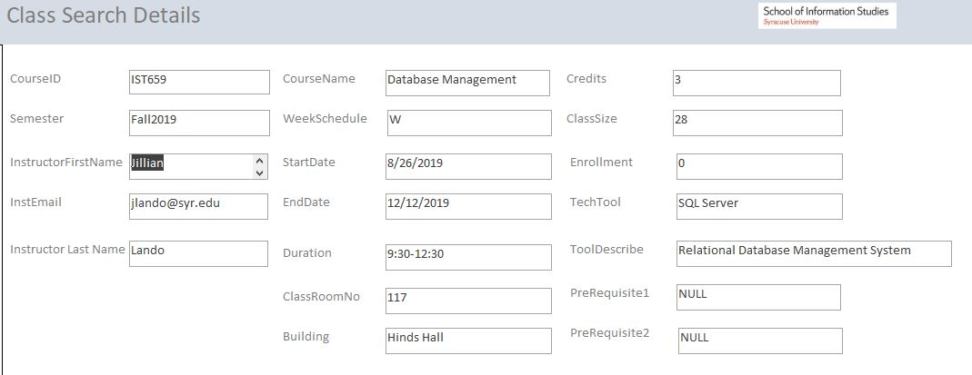
Forms
Display details of classes for a specific course

Slide 13
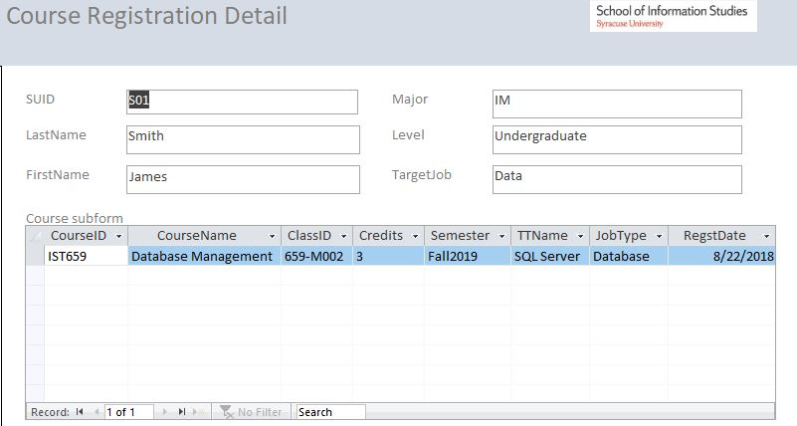
Forms
Display detailed information about courses in which each student enrolled

Slide 14
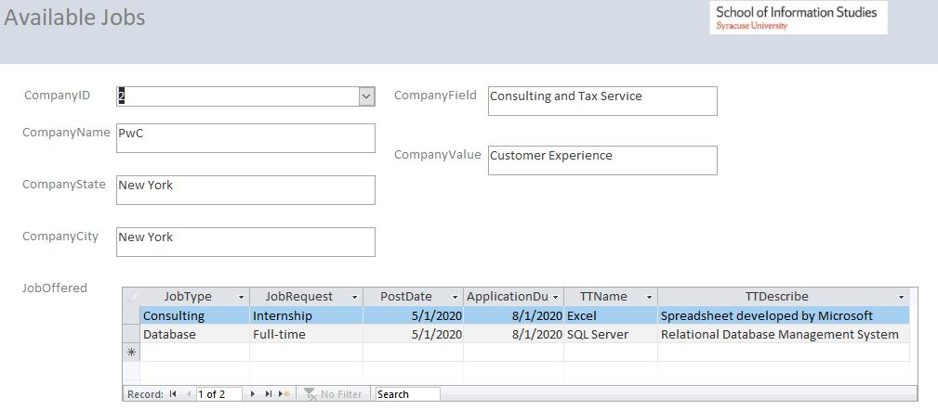
Forms
Display available job information

Slide 15
Major data questions
For students
What are the prerequisite subjects each course requires? (Y)
What are the technical skills each job requires? (Y)
Whether there are available jobs which matches with student’s job target. (Y)
For instructors
How many students enrolled in each class that specific instructor teaches? (Y)
Where is the classroom for each class that specific instructor teaches? (Y)
For companies
How many and what kind of courses each student has taken? (Y)

Slide 16
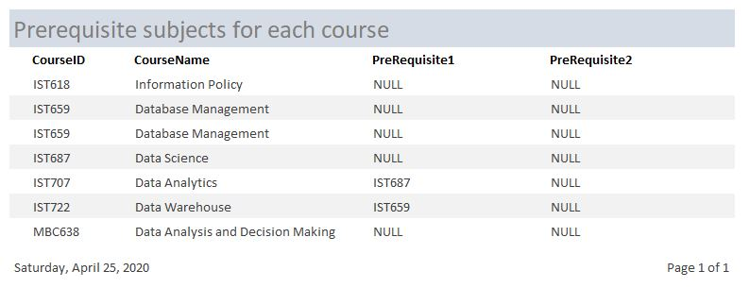
Reports
What are the prerequisite subjects each course requires?​

Slide 17
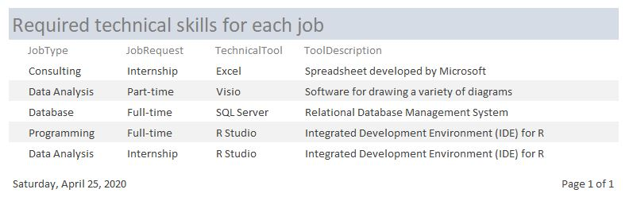
Reports
What are the technical skills each job requires?

Slide 18
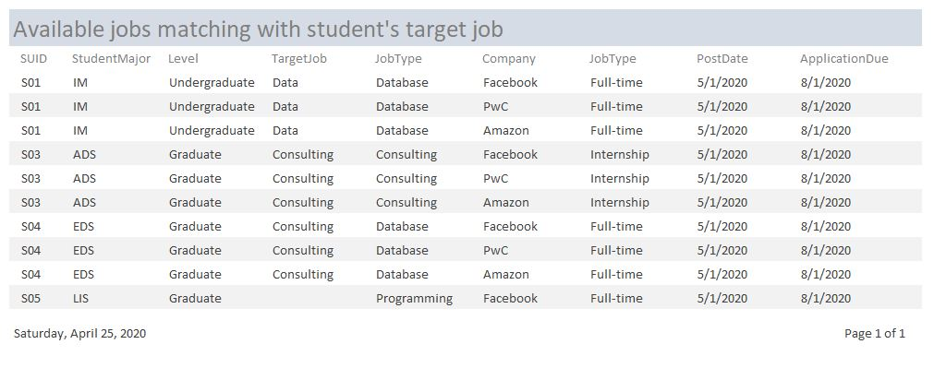
Reports
Whether there are available jobs which matches with student’s job target

Slide 19
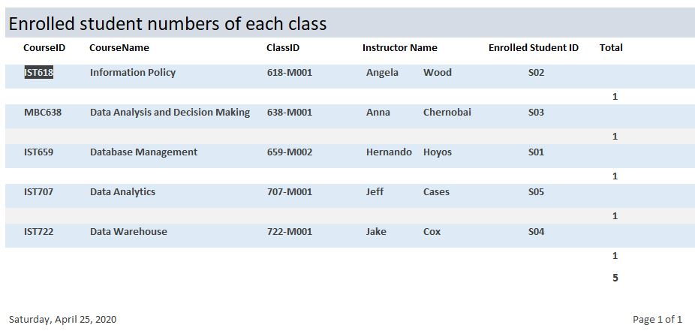
Reports
How many students enrolled in each class that specific instructor teaches?

Slide 20
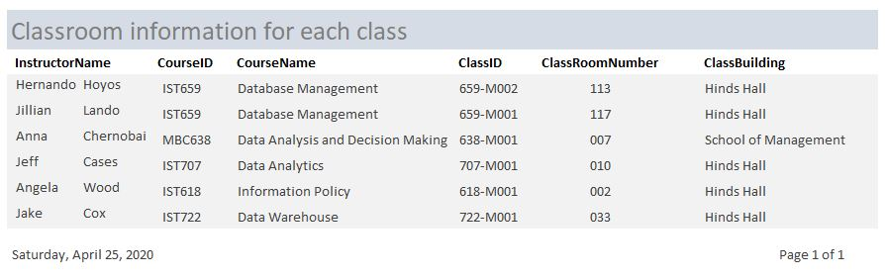
Reports
Where is the classroom for each class that specific instructor teaches?

Slide 21
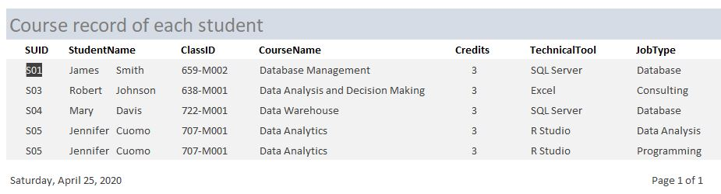
Reports
How many and what kind of courses each student has taken?

Slide 22
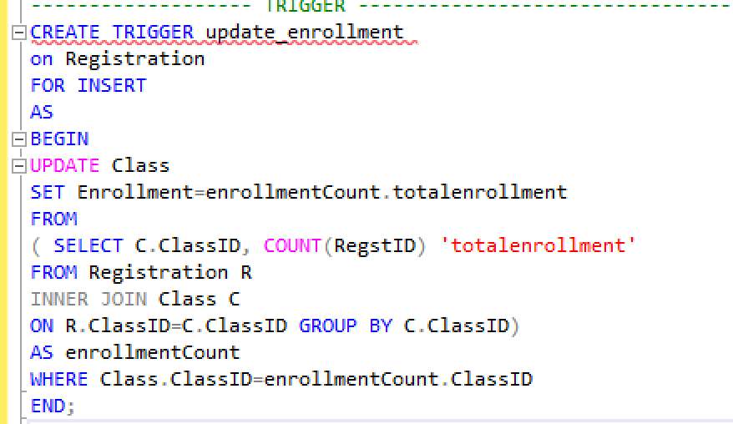
Trigger
This trigger updates the total enrollment when a student registers a new course.

Slide 23
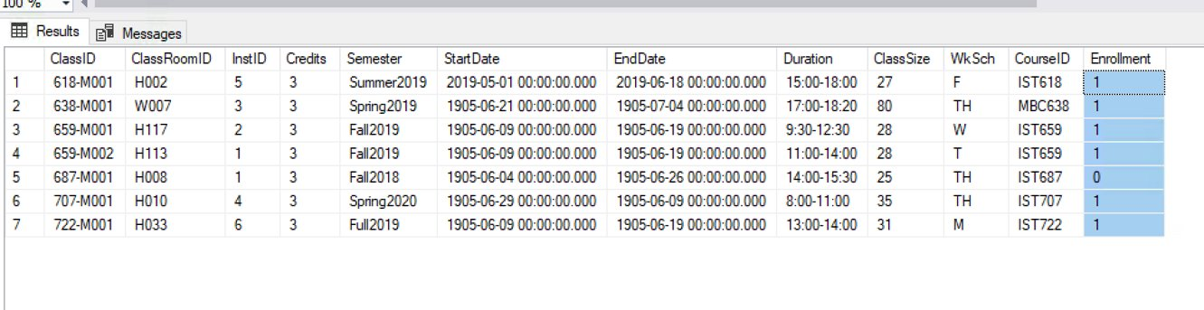
Trigger
Class Table with Actual number of Enrollment before data is updated.
Select * From Class

Slide 24
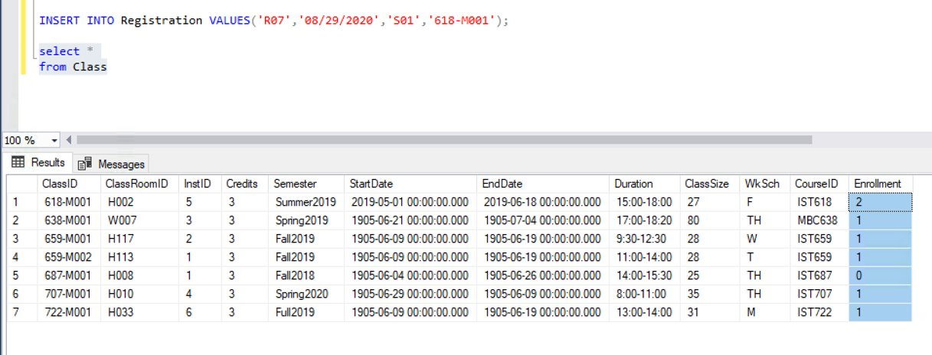
Trigger
Class Table with actual number of Enrollment after data is uploaded
INSERT INTO Registration VALUES('R07','08/29/2020','S01','618-M001');

Slide 25

Thank you! Any questions?

