Slide 1
Analyzing Three Dimensions of Sentence Prosody With FDA
-Structure
Yulan Feng

Slide 2
Overview
Raw Data
  Pre-processing
  Speaker Variability
Smoothing
  B-Spline
  Parameters
Landmark Registration
Functional Principal Component Analysis (FPCA)

Slide 3
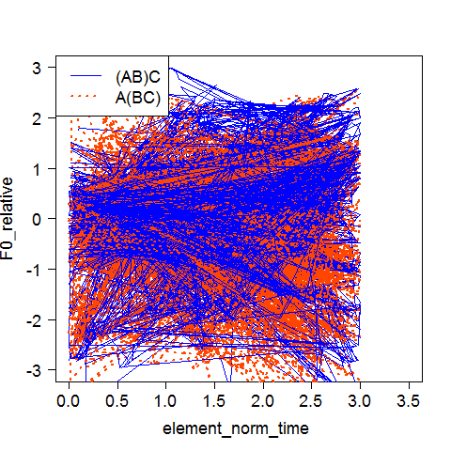
Raw Data
Pre-processing:
  Deleted rows with null F0_relative cells, and filtered out discourses that lack stressed vowels
  Grouped data according to items (group item 1 used)
  Recalculated element norm time to avoid duplicates so that the functions are injective.
Summary:
  351 discourses, classified by structure((AB)C and A(BC))
  Features extracted: discourse name, duration, stressed vowel time points (3), speaker, F0 relative corresponding to time list(element norm time)
Plot with randomly selected 2% of the data

Slide 4
Speaker Variability
Randomly selected two speakers, plot their F0 relatives against element norm time under the same conditions except structure.(Declarative intonation, and First focus)
Plots show that speaker variability in f0 contours is larger than class variability.

Slide 5
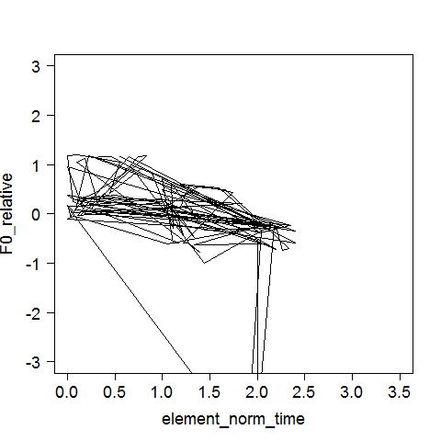
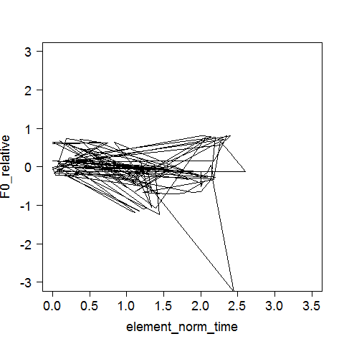
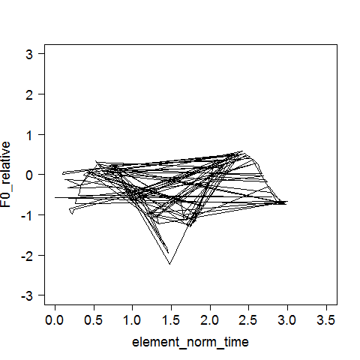
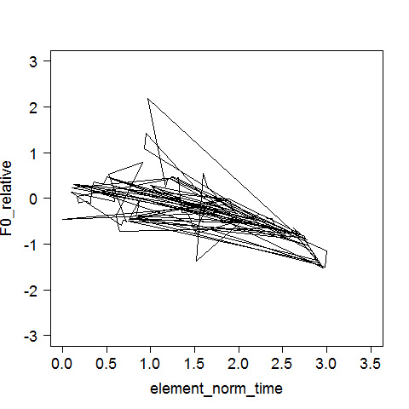
 | Class (AB)C | Class A(BC)
Speaker 1
Speaker 2

Slide 6
Smoothing
Smoothing transforms a sampled contour into a smooth continuous function of time.
In this case , as F0 contours has a wide range of shapes, we adopt B-splines as the function set.
A B-spline is a sequence of polynomial functions that, multiplied by appropriate weights and summed together, approximate a sampled data contour.

Slide 7
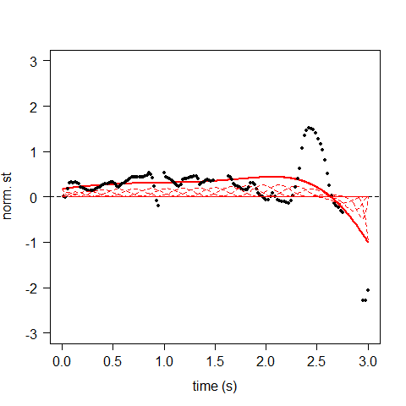
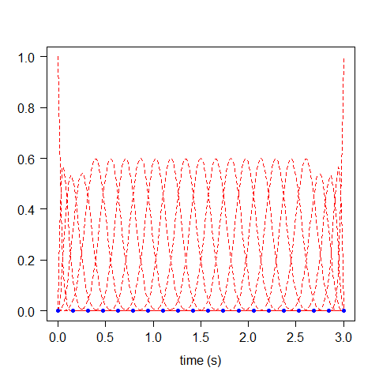
B-spline
A set of B-spline functions, where each 'hill' corresponds to a polynomial function.
B-splines approximation consists of adjusting the position and excursion (positive or negative) of each of the adjacent 'hills' so that their sum is a curve that is close to the original samples
Sample (black dots) approximated by B-spline functions (red line)
B-spline functions

Slide 8
Tuning Parameters
Parameters:
  K: number of connecting points (knots) that are uniformly spaces along the time axis.
    Large k -> keep more detail, higher time resolution, and higher risk of overfitting
  λ: regularization parameter that determines the importance of smoothness relative to fitting error. (10^{λ})
    Large λ -> more smooth line, higher risk of underfitting
Selection:
  Use generalised cross-validation (GCV), find a pair of (k, λ) that minimized GCV error

Slide 9
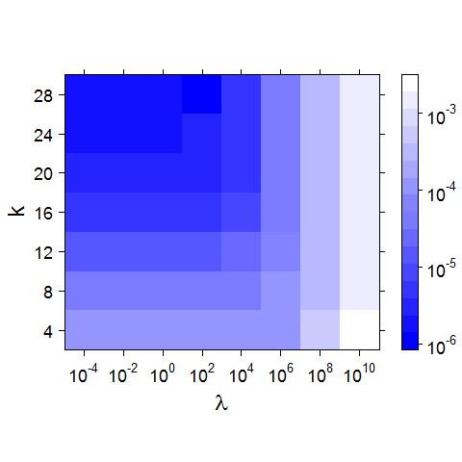
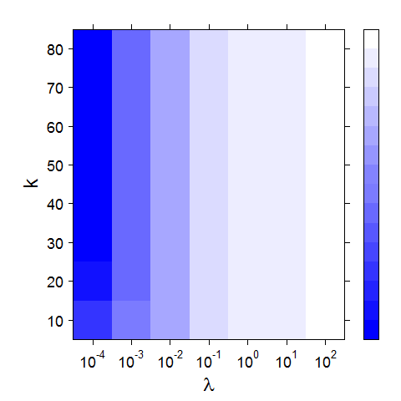
GCV
log GCV errors on a grid
(Gubian’s example)
log GCV errors on a grid
(our case)

Slide 10
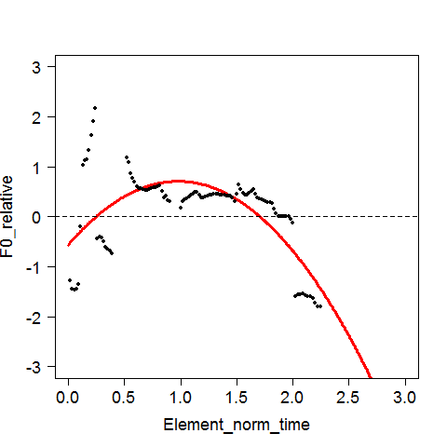
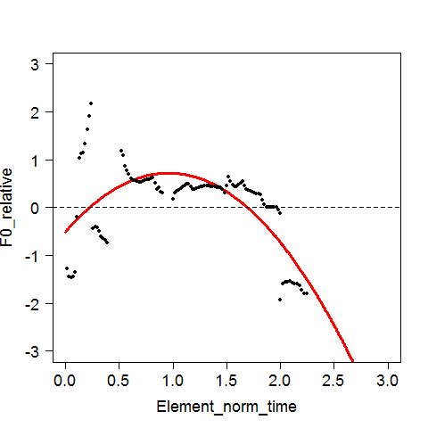
Different effects of (k, λ) pairs
(20,1)
(50,1)

Slide 11
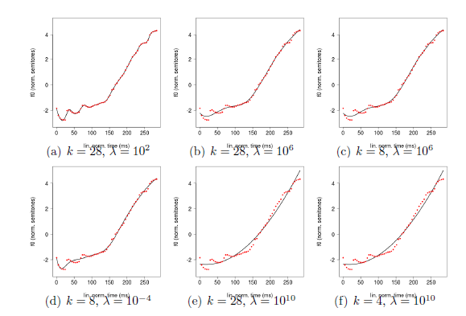
Gubian’s example

Slide 12
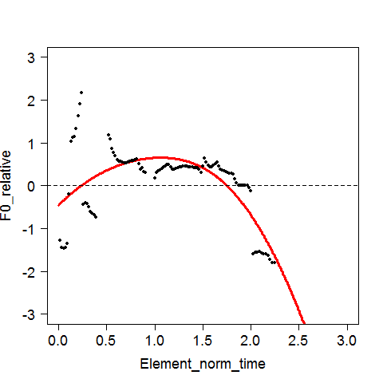
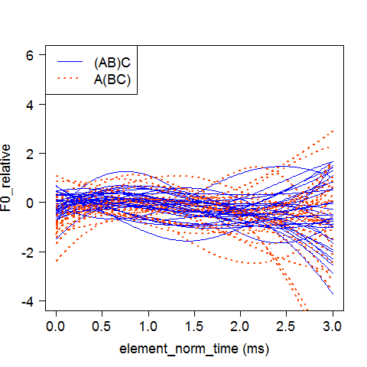
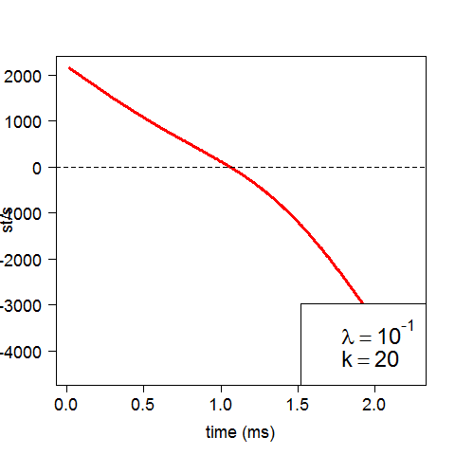
Selected k=20, λ=-1
Smoothed curves
(Raw was like this)
First Derivative

Slide 13
Landmark Registration
Time-align points on different contours that correspond to the same event (Stressed vowels in our case).
As we are using element norm time, where the raw time points were already adjusted relative to 1 within the word and in order (the 4th word of interest has all of its time points between 4 and 5, the 5th word of interest has time points between 5 and 6) , this process is not making a significant change

Slide 14
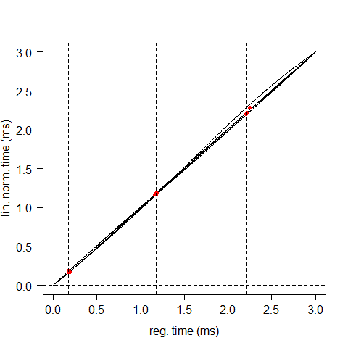
Process
The first stage operates solely on the landmarks provided by the user and produces a time warping curve t = h(τ) that species the mapping between the registered time axis τ and the original time axis t. (This stage is independent of the curves)
The second stage applies the warping functions h(τ) to the corresponding input curves f(t) to obtain the registered curves f(h(τ)).
h(τ) for some curves

Slide 15
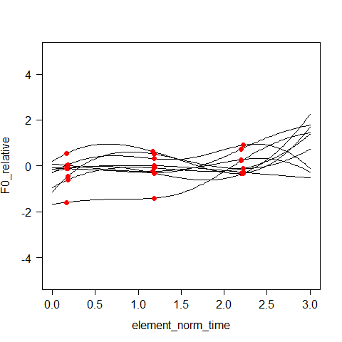
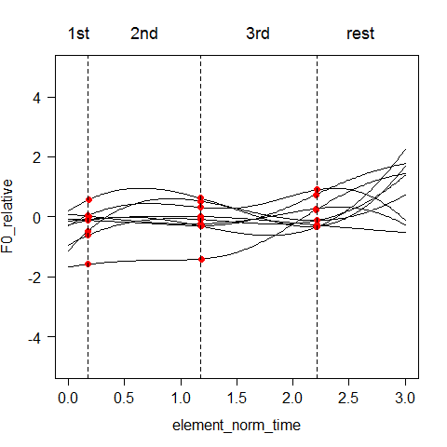
Before landmark registration
After

Slide 16
Functional Principal Component Analysis (FPCA)
FPCA provides a model of the set of input contours in terms of combinations of a small number of curves, namely the mean curve (μ(t)), and the principal component (PC1,PC2…) curves, plus weights (s1,s2..) for the PC curves.
μ(t) is obtained by computing the mean of all smoothed and landmark-registered f0 contours at each instant in time.
The PC curves are numbered from 1 onwards and are computed by the FPCA algorithm based on the same principles as ordinary PCA (Jackson, 1991; Baayen, 2008).
The rank of the PCs reflects the decreasing percentage of variance in the input data that the PCs explain.

Slide 17
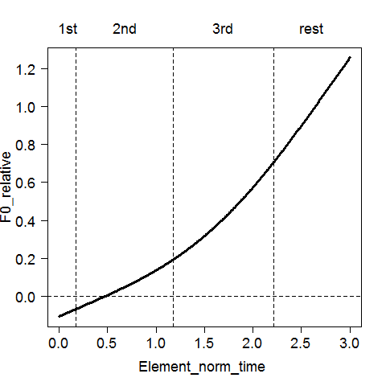
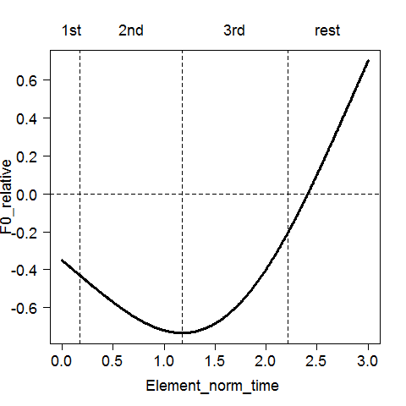
PC1 explains 69.7% of variance
PC2 explains 21.6% of variance
PC3 only explains 7.5% of variance

Slide 18
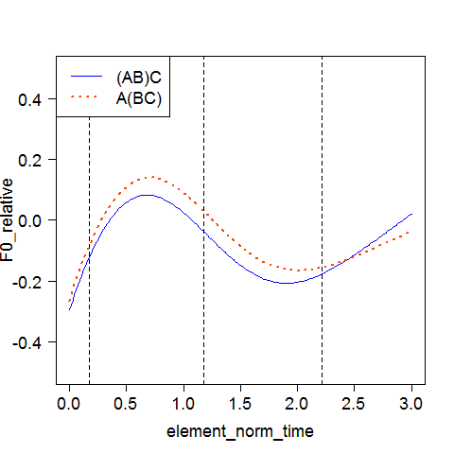
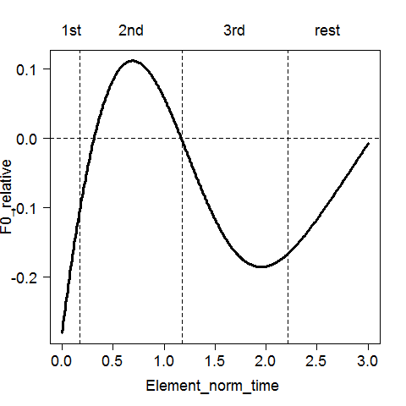
Mean curves for the 2 classes
Mean curve for all contours

Slide 19
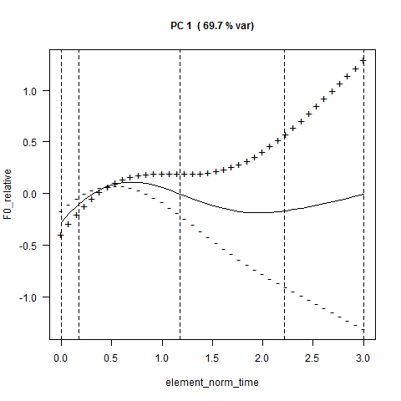
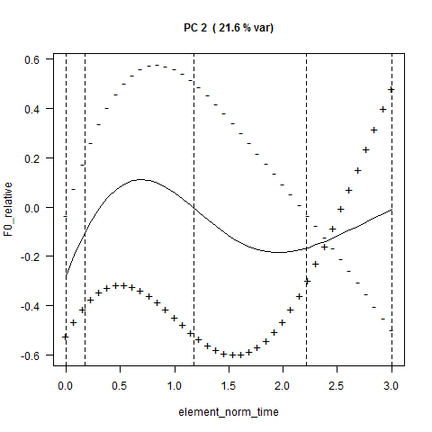
Effects of PCs
solid line: μ(t)
“+” and “-” : the result of adding to or subtracting a PC curve from μ(t)

Slide 20
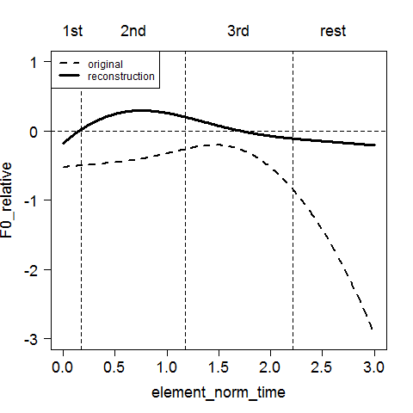
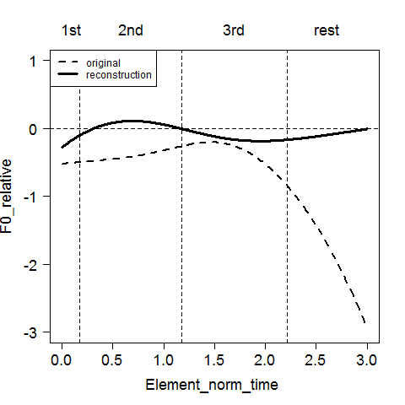
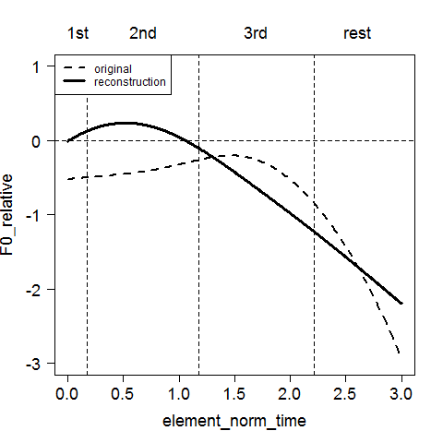

Reconstruction
Mean + PC1+ PC2
Mean + PC1
Mean
Mean + PC2
Weights for PCs: s1= -1.57283, s2= 0.214293
(The weights are overall very small for all samples )

Slide 21
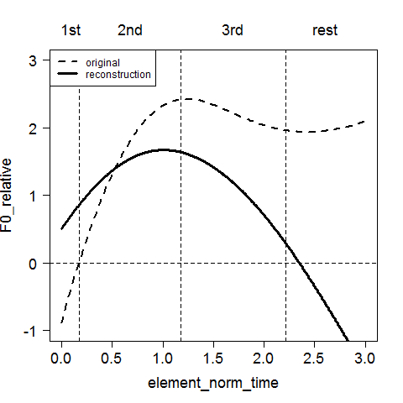
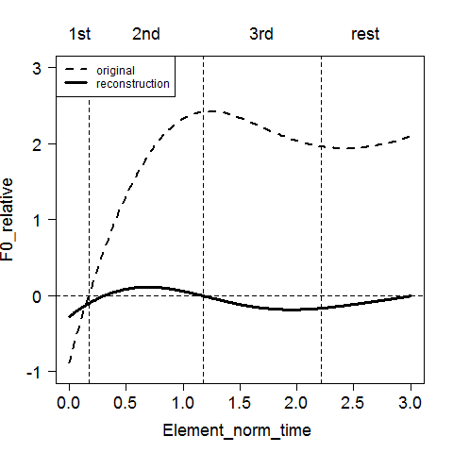
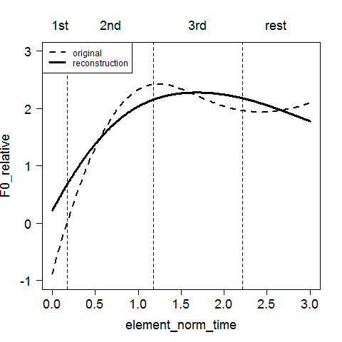
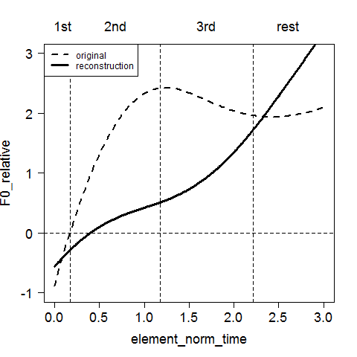
A Better Example
Mean + PC1+ PC2
Mean + PC1
2.241755
Mean
Mean + PC2
Weights for PCs: s1= 2.671368 , s2= 2.241755
(Largest s1&s2 pair )

Slide 22
Why the reconstruction is not so good?
Raw sample too messy
Our sample is part of the sentence instead of a few syllables ([ja] v.s. [i.a] in Gubian’s example) so that smoothing is bad
The contrast between the 2 classes is in fact not so significant
Too many speakers

Slide 23
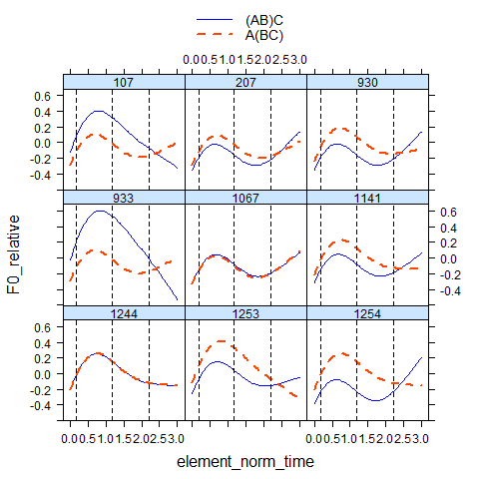
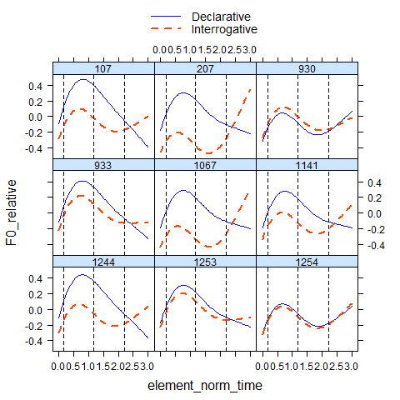
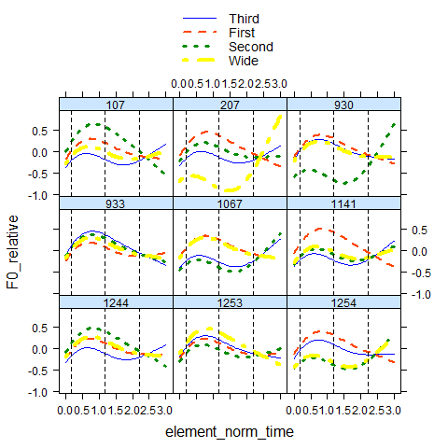
Mean Curves of different classes by different speakers

Slide 24
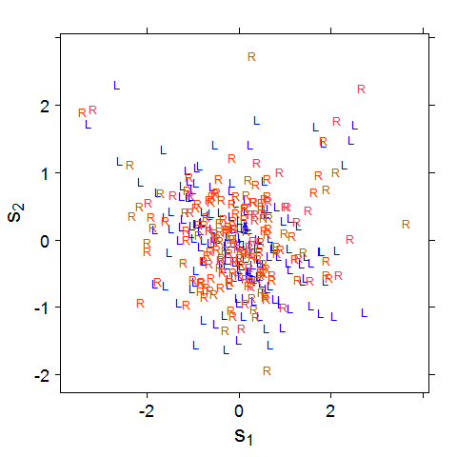
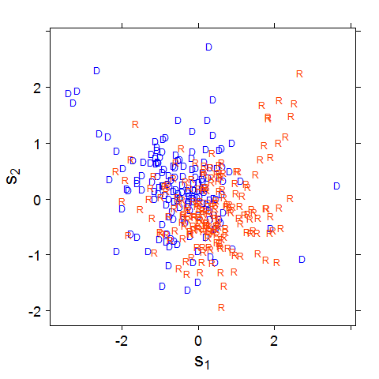
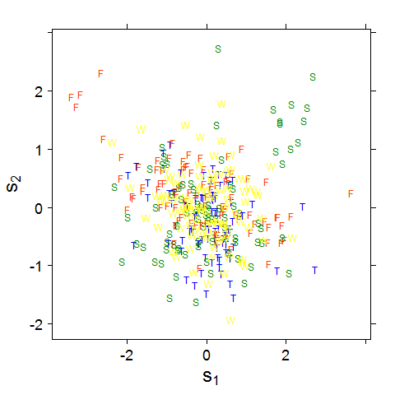
Comparison Among 3 Dimensions
PC scores s1 and s2 labeled corresponding to the class L/R, D/R, and F/S/T/W
L: (AB)C D:Declarative F:First, S:Second
R:A(BC) R:Interrogative T:Third, W:Wide

Slide 25
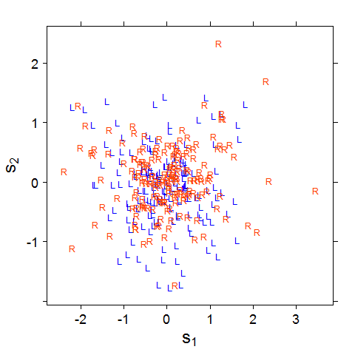
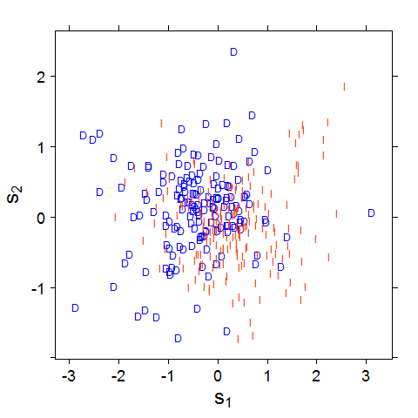
Residualized data
Structure
Intonation

Slide 26
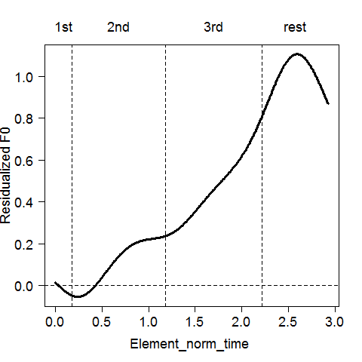
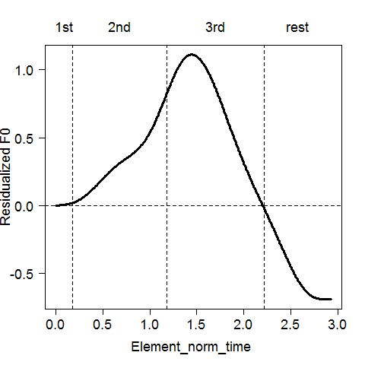
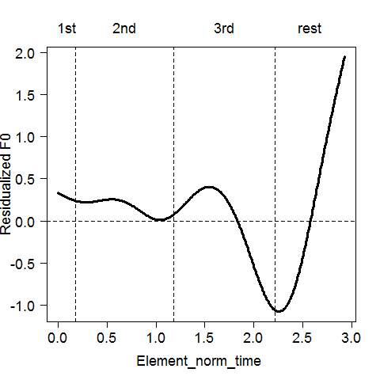
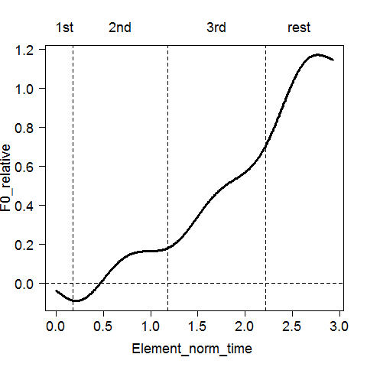
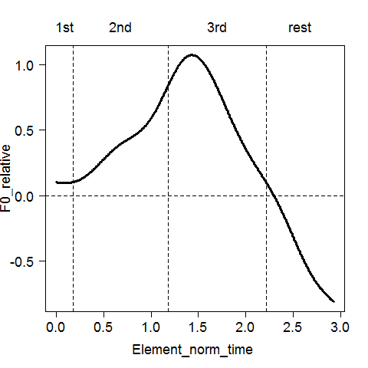
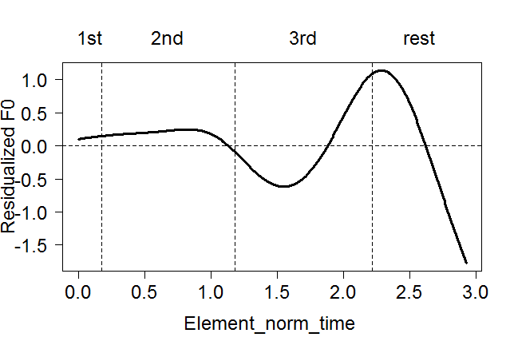
residualsed Structure
37.4%
20.5%
12.8%
residualsed Intonation
42.3%
11.7%
19.6%

Slide 27
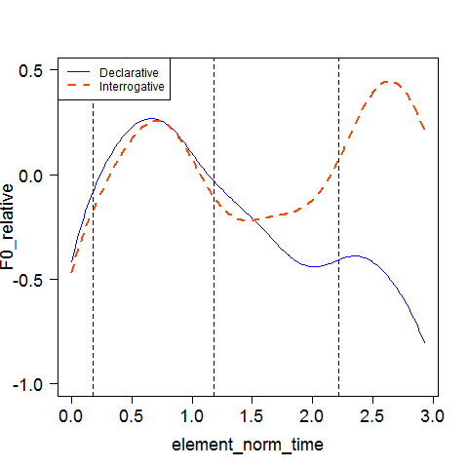
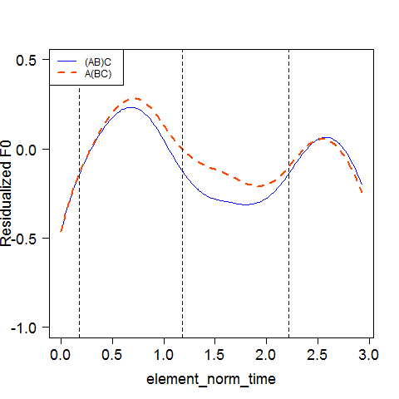
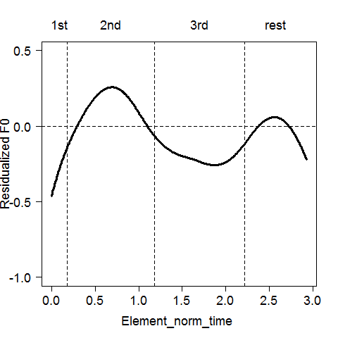
Means for Structure
Means for Intonation
Overall Mean
* “mean” refers to mean function (pcafd$meanfd)

Slide 28
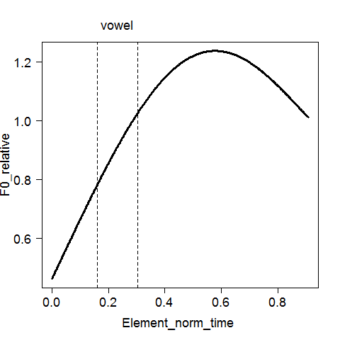
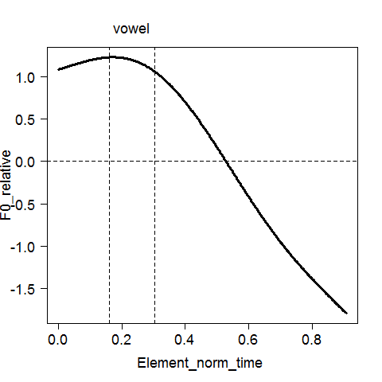
Analysis of the Second Word(Structure)
PC1(65.4%)
PC2(25.7%)

Slide 29

Second word
3 words
Residualization on 3 words

Slide 30

Scatter Plot for Structure Contrast
Second word
3 words
Residualization on 3 words

Slide 31
To Do:
More experiments on the other dimensions and items
Control variables (e.g. make declarative and interrogative 2 separate datasets)
Statistical analysis to test the significance of features (F-statistic, p-value etc.)

