Slide 1
Unit 8 Support Vector Machines
EL-GY 6143: Introduction to machine learning
Prof. Pei liu

Slide 2
Midterm
Midterm
March 29 (Monday), 11:00AM-1:30PM ET via Zoom
Zoom link will be emailed later this week
Exam questions via Google form
https://docs.google.com/forms/d/e/1FAIpQLSe8Ugqv7UhBv2B6zd7nYwhzX78cno7EnPjvfrdHaRKtBnBujQ/viewform?usp=sf_link
Policy
Close-book exam
2 piece of paper cheatsheet, can write on both sides.
Attendance at exams is mandatory
What will be included in the midterm?
All materials taught in Lecture 1 to Lecture 7
Not include Lecture 8: SVM
6-7 questions, very similar to homework

Slide 3
Requirements for Midterm
Please join the meeting on 15 minutes before 11AM, and use your full name when you join.
Each student is required to open Zoom and turn on their video, making sure the camera captures your hands and your computer screen/keyboard. The whole exam will be recorded. To clearly capture the video of exam taking, it is recommended that:
A student can use an external webcam connected to the computer;
Or use another device (smartphone/ipad/laptop with power plugged in);
In both cases, adjust the position/orientation of the camera so that it clearly captures the keyboard, screen and both hands.
During the exam, you should keep your video on all the time. If there is anything wrong with your Zoom connection, please recoonect ASAP. If you cannot reconnect, please email ASAP.

Slide 4
Midterm Submission
Students can read exam questions from computer screen, and write answers on BLANK papers using pen/pencil. If you have a printer, you can also print the questions and answer directly on the question papers.
Use a separate page for each question, and clear mark the questions on the top of the page.
At 1:30PM, submit a single PDF to newclasses.nyu.edu, under the assignment named “Midterm Exam”.
Use Adobe Scan APP/iPhone Notes APP/etc to scan your answers;
Don’t upload several photos;
The DEADLINE for submission is in 10 minutes .If you never used your phone to scan a documents, give it a try before the exam;
Before you leave the exam, it’s your responsibility to make sure all your answers are uploaded.

Slide 5
Learning Objectives
Interpret weights in linear classification of images
Describe why linear classification for images does not work
Define the margin in linear classification
Describe the SVM classification problem.
Write equations for solutions of constrained optimization using the Lagrangian.
Describe a kernel SVM problem for non-linear classification
Implement SVM classifiers in python
Select SVM parameters from cross-validation

Slide 6
Outline
Motivating example: Recognizing handwritten digits
Why logistic regression doesn’t work well.
Maximum margin classifiers
Support vector machines
Kernel trick
Constrained optimization

Slide 7
MNIST Digit Classification
Problem: Recognize hand-written digits
Original problem:
Census forms
Automated processing
Classic machine learning problem
Benchmark
From Patrick J. Grother, NIST Special Database, 1995

Slide 8
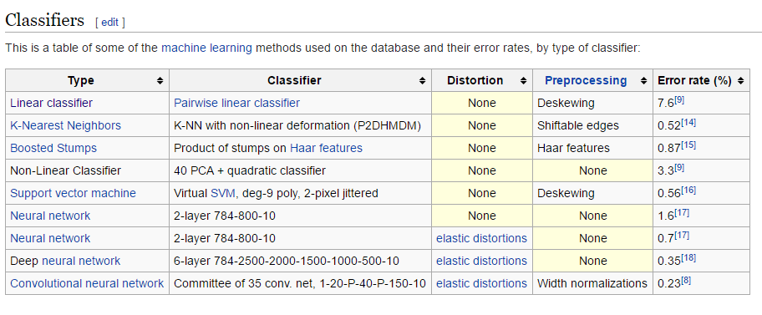
A Widely-Used Benchmark
We will look at SVM today
Not the best algorithm
But quite good
…and illustrates the main points

Slide 9
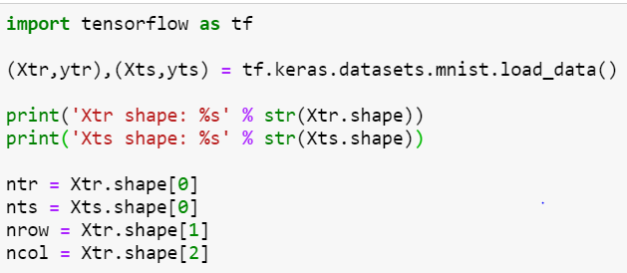

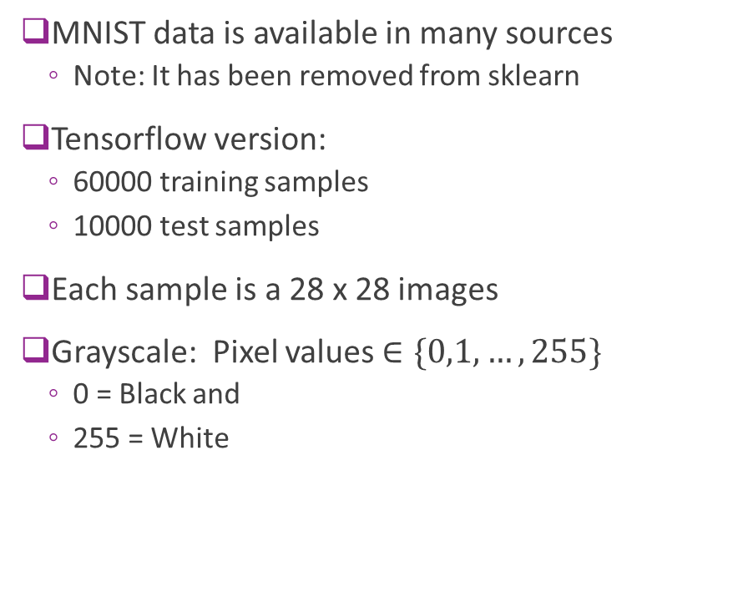
Downloading MNIST
MNIST data is available in many sources
Note: It has been removed from sklearn
Tensorflow version:
60000 training samples
10000 test samples
Each sample is a 28 x 28 images
Grayscale: Pixel values $∈\{0,1,…,255\}$
0 = Black and
255 = White

Slide 10
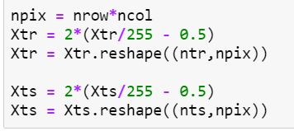

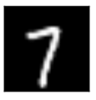


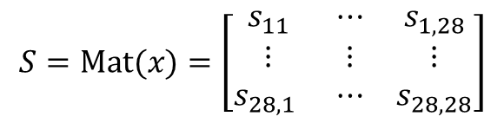


Matrix and Vector Representation
For this demo, we reshape data from $N×28×28$ to $N×784$
But, you can easily go back and forth
Also, scale the pixel values from -1 to 1
28
784 = ${28}^{2}$
28
xsq
$$S=\text{M}\text{at}(x)=\left[\begin{matrix}s_{11} & ⋯ & s_{1,28} \\ ⋮ & ⋮ & ⋮ \\ s_{28,1} & ⋯ & s_{28,28}\end{matrix}\right]$$
$$x=\text{v}\text{ec}(S)=\left[\begin{matrix}x_{1} & ⋯ & x_{784}\end{matrix}\right]$$

Slide 11
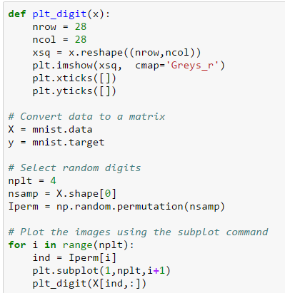
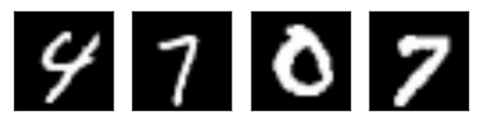
Displaying Images in Python
Key command
Sample permutation is necessary for this dataset, as the original data is ordered by digits
4 random images in the dataset
A human can classify these easily

Slide 12
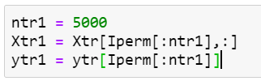
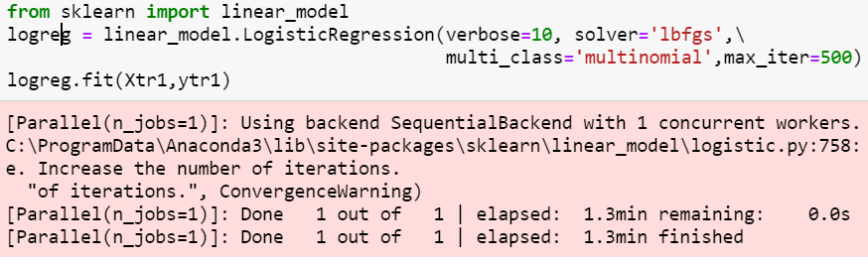
Try a Logistic Classifier
Train on 5000 samples
To reduce training time.
In practice want to train with ~40k
Select correct solver (lbfgs)
Others can be very slow. Even this will take minutes

Slide 13
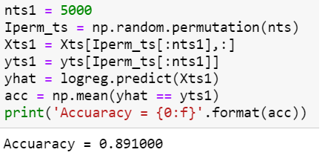
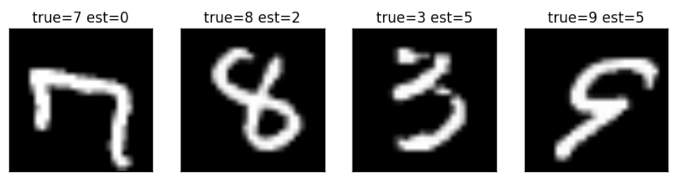
Performance
Accuracy = 89%. Very bad
Some of the errors seem like they should have been easy to spot
What went wrong?

Slide 14




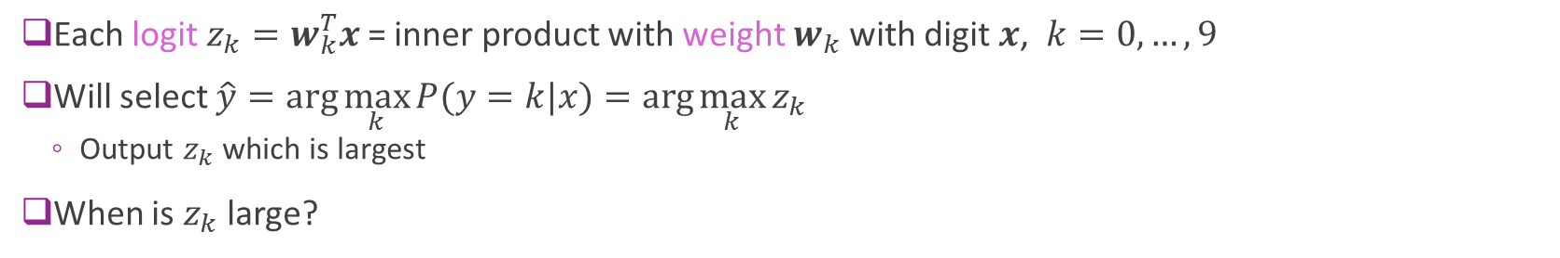
Recap: Logistic Classifier
Logits
Weights
$$x$$
Softmax
$$P(y=k|x)$$
10
$$w_{k}^{T}$$
$$z_{k}$$
Probabilities
Convert 28 x 28 to 784-dim vector
784
Each logit $z_{k}=w_{k}^{T}x$ = inner product with weight $w_{k}$ with digit $x$, $k=0,…,9$
Will select $\hat{y}=\arg{\max_{k}{P(y=k|x)}}=\arg{\max_{k}{z_{k}}}$
Output $z_{k}$ which is largest
When is $z_{k}$ large?

Slide 15
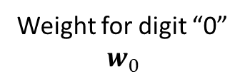
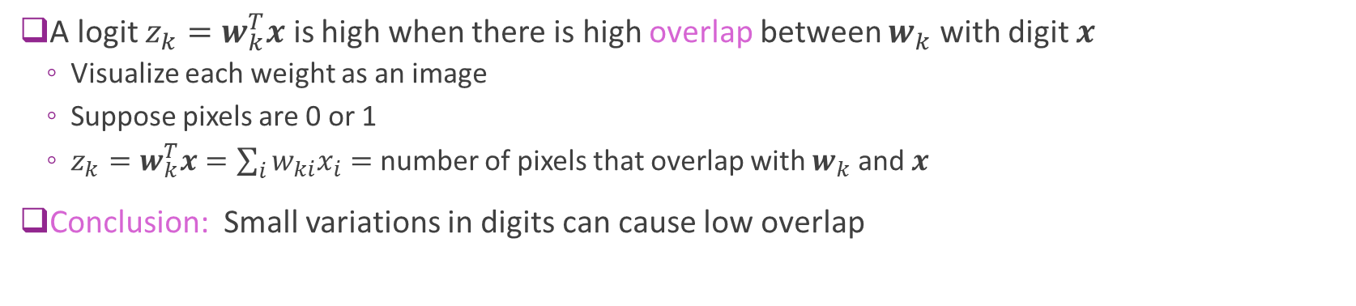

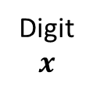

Interpreting the Logistic Classifier Weights
A logit $z_{k}=w_{k}^{T}x$ is high when there is high overlap between $w_{k}$ with digit $x$
Visualize each weight as an image
Suppose pixels are 0 or 1
$z_{k}=w_{k}^{T}x=\sum_{i}{w_{ki}x_{i}}=$ number of pixels that overlap with $w_{k}$ and $x$
Conclusion: Small variations in digits can cause low overlap
Weight for digit “0”
$$w_{0}$$
Digit
$$x$$
Overlap high $⇒x$ is digit 0
Overlap low $⇒x$ not digit 0

Slide 16
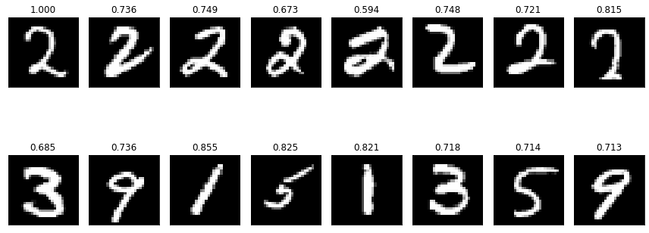

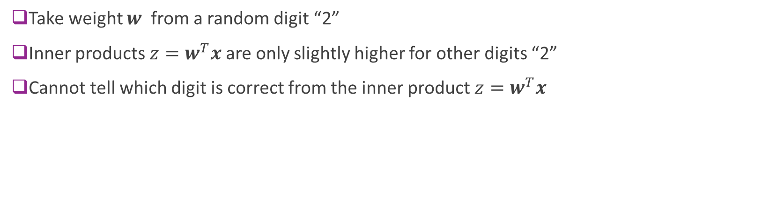


Example with Actual Digits
Take weight $w$ from a random digit “2”
Inner products $z=w^{T}x$ are only slightly higher for other digits “2”
Cannot tell which digit is correct from the inner product $z=w^{T}x$
Digits $x$
$z=w^{T}x$
Weight $w$

Slide 17
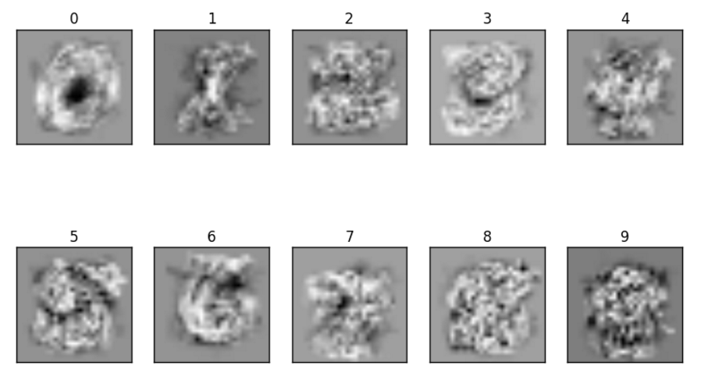
Visualizing the Weights
Optimized weights of the classifier
Blurry versions of image to try to capture rotations, translations, …

Slide 18
Problems with Logistic Classifier
Linear weighting cannot capture many deformities in image
Rotations
Translations
Variations in relative size of digit components
Can be improved with preprocessing
E.g. deskewing, contrast normalization, many methods
Is there a better classifier?

Slide 19
Outline
Motivating example: Recognizing handwritten digits
Why logistic regression doesn’t work well.
Maximum margin classifiers
Support vector machines
Kernel trick
Constrained optimization

Slide 20
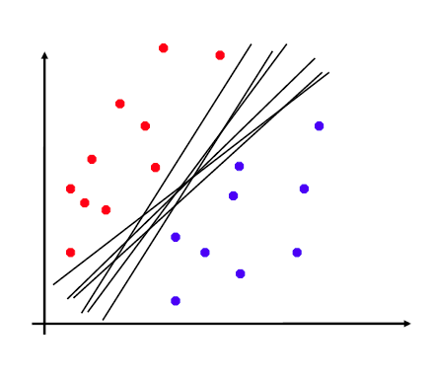
Non-Uniqueness of Separating Plane
Linearly separable data:
Can find a separating hyper-plane as a linear classifier.
Separating hyper-plane is not unique
Fig. on right: Many separating planes
Which one is optimal?

Slide 21
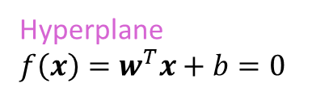
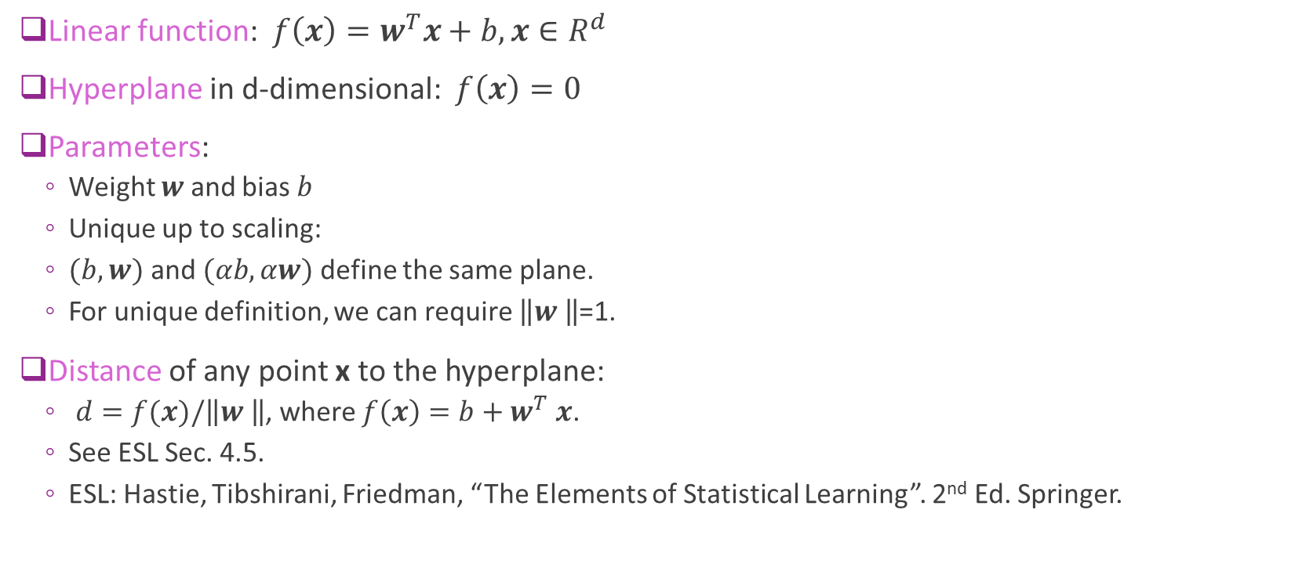


Hyperplane Basics
Linear function: $f\left(x\right)=w^{T}x+b,x∈R^{d}$
Hyperplane in d-dimensional: $f\left(x\right)=0$
Parameters:
Weight $w$ and bias $b$
Unique up to scaling:
$(b,w)$ and $(αb,αw)$ define the same plane.
For unique definition, we can require $\left\|w \right\|$=1.
Distance of any point x to the hyperplane:
$d=f(x)/\left\|w \right\|$, where $f\left(x\right)=b+w^{T}$ $x$.
See ESL Sec. 4.5.
ESL: Hastie, Tibshirani, Friedman, “The Elements of Statistical Learning”. 2nd Ed. Springer.
$$f\left(x\right)$$
$$d=\frac{f\left(x\right)}{\left\|w \right\|}$$
Hyperplane
$f\left(x\right)=w^{T}x+b=0$

Slide 22
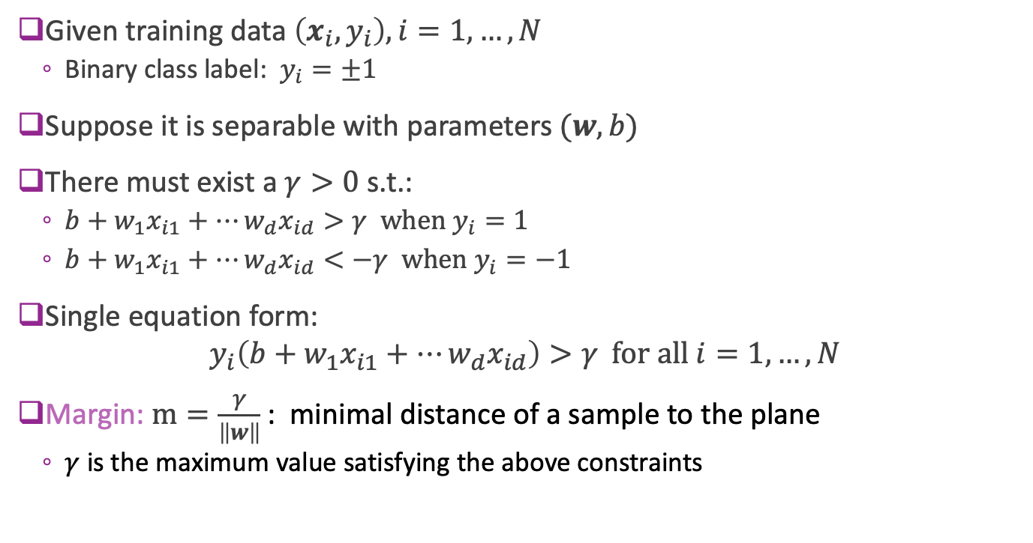


Linear Separability and Margin
Given training data $\left(x_{i},y_{i}\right), i=1,…,N$
Binary class label: $y_{i}=±1$
Suppose it is separable with parameters $(w,b)$
There must exist a $γ>0$s.t.:
$b+w_{1}x_{i1}+⋯w_{d}x_{id}>γ \text{when} y_{i}=1$
$b+w_{1}x_{i1}+⋯w_{d}x_{id}<−γ \text{when} y_{i}=−1$
Single equation form:
$$y_{i}\left(b+w_{1}x_{i1}+⋯w_{d}x_{id}\right)>γ \text{for} \text{all} i=1,…,N$$
Margin: $m=\frac{γ}{\left\|w\right\|}$: minimal distance of a sample to the plane
$γ$ is the maximum value satisfying the above constraints
$$m$$
$$m$$

Slide 23
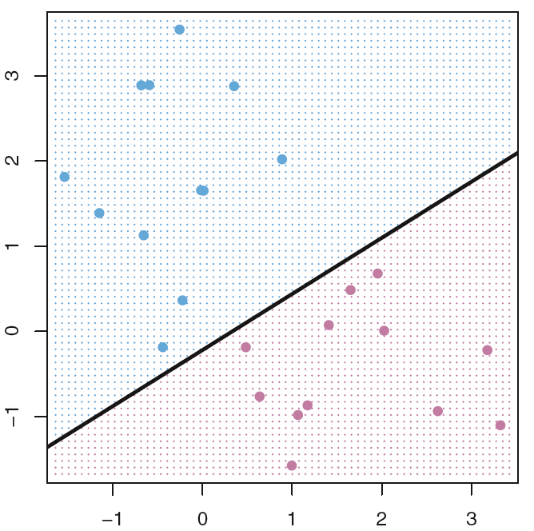
Which separating plane is better ?
From Fig. 9.2 and Fig. 9.3 in ISL.

Slide 24
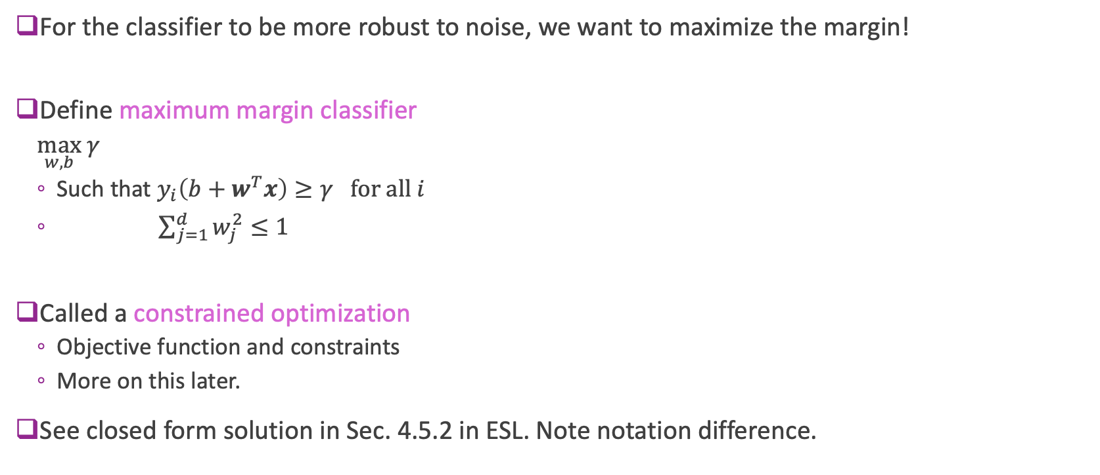
Maximum Margin Classifier
For the classifier to be more robust to noise, we want to maximize the margin!
Define maximum margin classifier
$\max_{w, b} γ$
Such that $y_{i}\left(b+w^{T}x\right)≥γ \text{for} \text{all} i$
$\sum_{j=1}^{d}{w_{j}^{2}}≤1$
Called a constrained optimization
Objective function and constraints
More on this later.
See closed form solution in Sec. 4.5.2 in ESL. Note notation difference.
Maximizes the margin
Ensures all points are correctly classified
Scaling on weights

Slide 25
Visualizing Maximum Margin Classifier
Fig. 9.3 of ISL
Margin determined by closest points to the line
The maximal margin hyperplane represents the mid-line of the widest “slab” that we can insert between two classes
In this figure, there are 3 points at the margin
ISL: James, Witten, Hastie, Tibshirani, An Introduction to Statistical Learning, Springer. 2013.

Slide 26
Problems with MM classifier
Data is often not perfectly separable
Only want to correctly separate most points
MM classifier is not robust
A single sample can radically change line
Fig. 9.4
Fig. 9.5

Slide 27
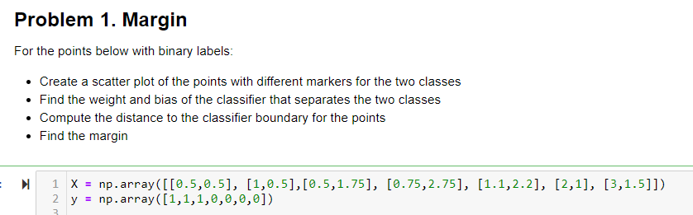
In-Class Exercise
Found in github site: svm_inclass.ipynb

Slide 28
Outline
Motivating example: Recognizing handwritten digits
Why logistic regression doesn’t work well.
Maximum margin classifiers
Support vector machines
Kernel trick
Constrained optimization

Slide 29
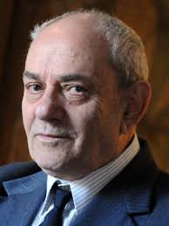
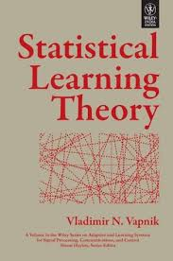
Support Vector Machine
Support Vector Machine (SVM)
Vladimir Vapnik, 1963
But became widely-used with kernel trick, 1993
More on this later
Got best results on character recognition
Key idea: Allow “slack” in the classification
Support vector classifier (SVC): Directly use raw features. Good when the original feature space is roughly linearly separable
Support vector machine (SVM): Map the raw features to some other domain through a kernel function

Slide 30
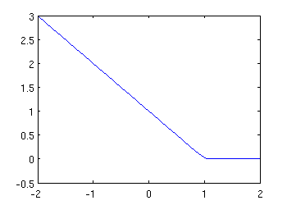
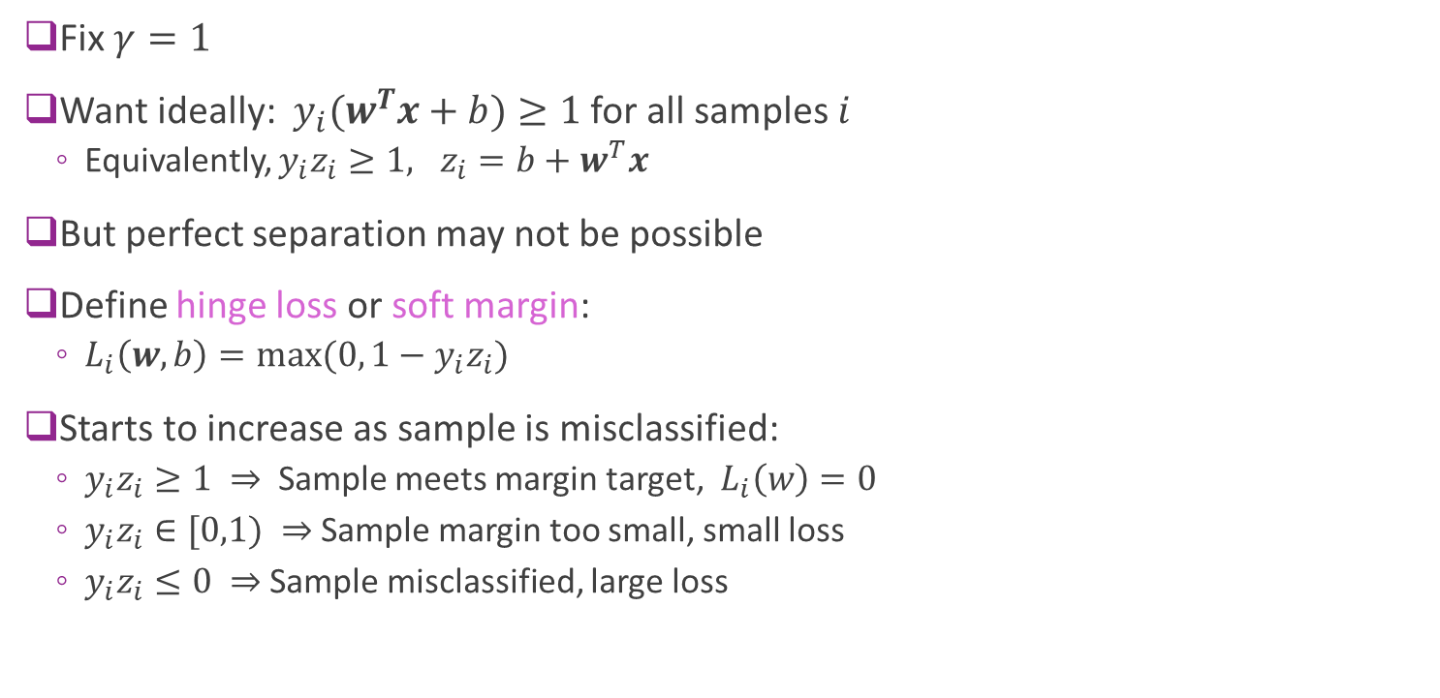


Hinge Loss
Fix $γ=1$
Want ideally: $y_{i}(w^{T}x+b)≥1$ for all samples $i$
Equivalently, $y_{i}z_{i}≥1, z_{i}=b+w^{T}x$
But perfect separation may not be possible
Define hinge loss or soft margin:
$L_{i}\left(w,b\right)=max⁡(0, 1−y_{i}z_{i})$
Starts to increase as sample is misclassified:
$y_{i}z_{i}≥1 ⇒$ Sample meets margin target, $L_{i}\left(w\right)=0$
$y_{i}z_{i}∈[0,1) ⇒$Sample margin too small, small loss
$y_{i}z_{i}≤0 ⇒$Sample misclassified, large loss
$$L_{i}(z_{i})$$
$${y_{i}z}_{i}$$
Misclassifies
Meets margin
Close to margin

Slide 31
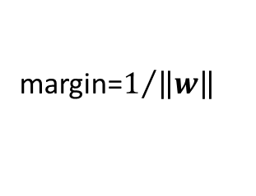
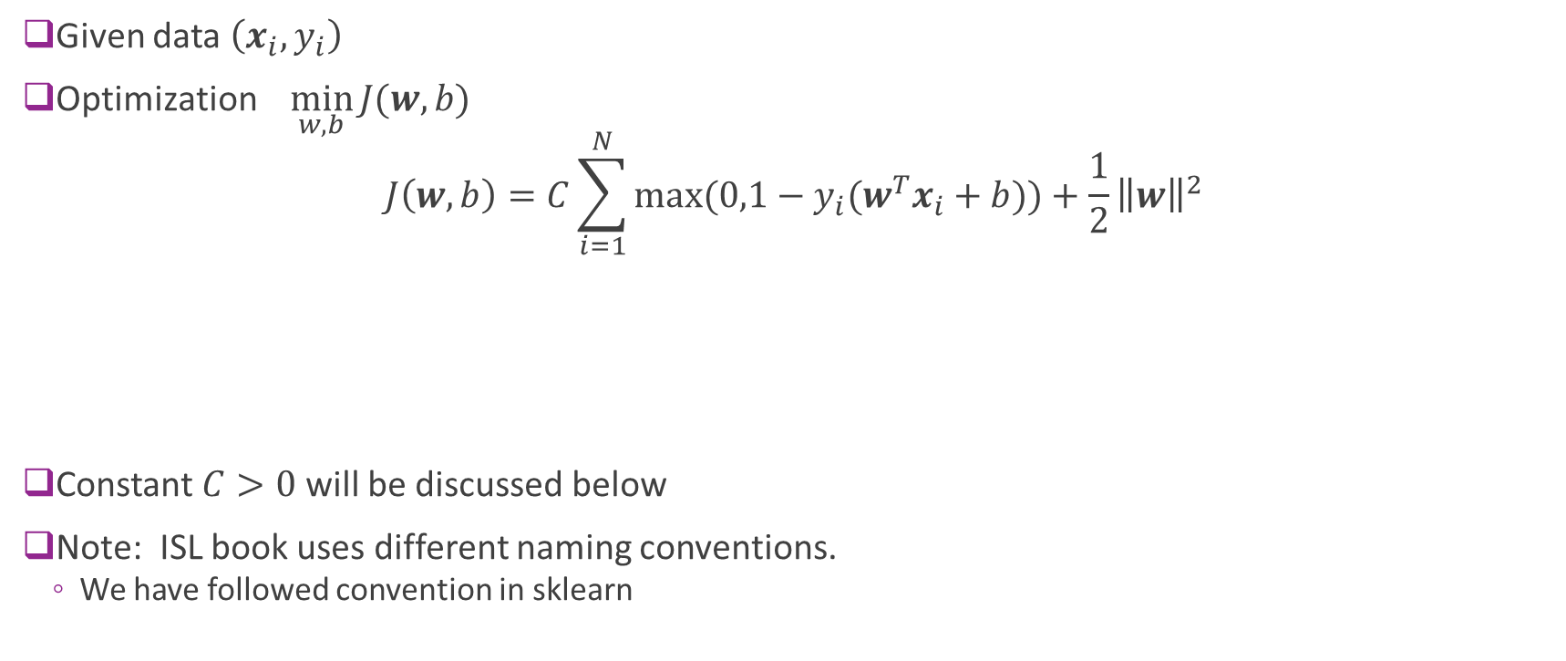
SVM Optimization
Given data $\left(x_{i},y_{i}\right)$
Optimization $\min_{w,b}{J(w,b)}$
$$J\left(w,b\right)=C\sum_{i=1}^{N}{max⁡(0,1−y_{i}(w^{T}x_{i}+b))}+\frac{1}{2}{\left\|w\right\|}^{2}$$
Constant $C>0$ will be discussed below
Note: ISL book uses different naming conventions.
We have followed convention in sklearn
C controls final margin
Hinge loss term
Attempts to reduce
Misclassifications
margin=$1/{\left\|w\right\|}$

Slide 32
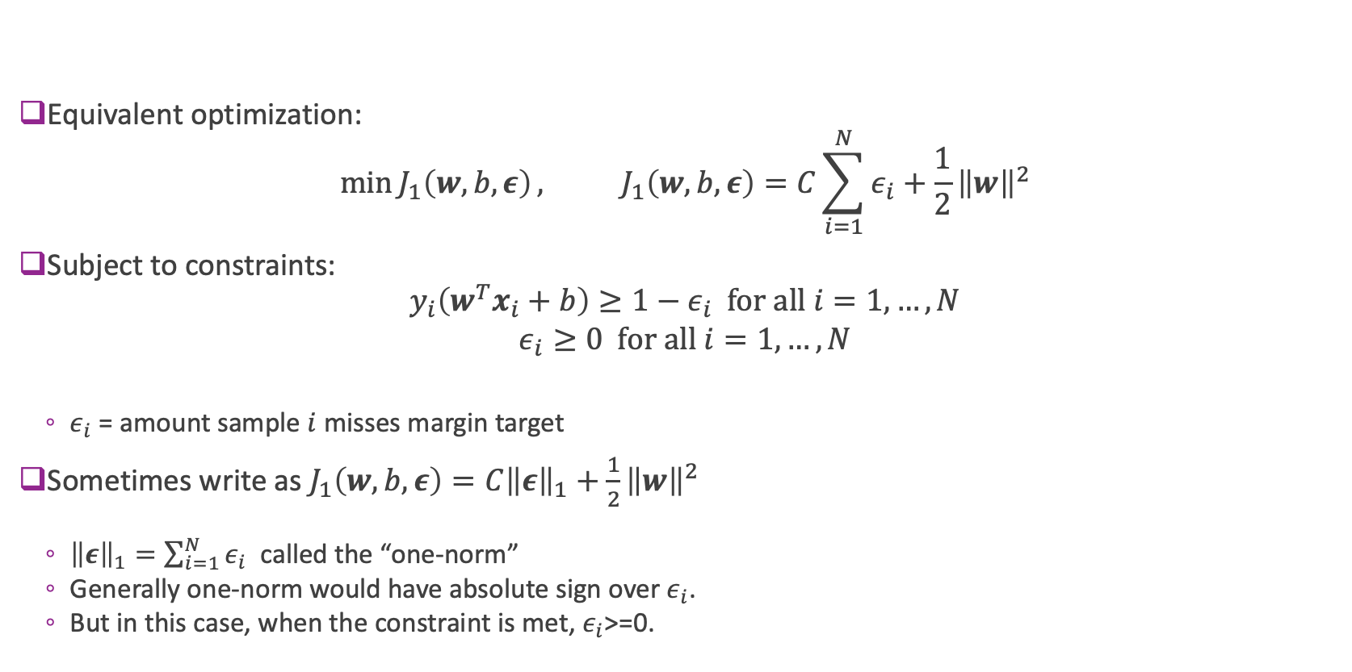
Alternate Form of SVM Optimization
Equivalent optimization:
$$\min{J_{1}\left(w,b,ε\right)}, J_{1}\left(w,b,ε\right)=C\sum_{i=1}^{N}{ε_{i}}+\frac{1}{2}{\left\|w\right\|}^{2}$$
Subject to constraints:
$${y_{i}\left(w^{T}x_{i}+b\right)≥1−ε}_{i} for all i=1,…,N$$
$$ε_{i}≥0 for all i=1,…,N$$
$ε_{i}$ = amount sample $i$ misses margin target
Sometimes write as $J_{1}\left(w,b,ε\right)=C{\left\|ε\right\|}_{1}+\frac{1}{2}{\left\|w\right\|}^{2}$
${\left\|ε\right\|}_{1}=\sum_{i=1}^{N}{ε_{i}}$ called the “one-norm”
Generally one-norm would have absolute sign over $ε_{i}$.
But in this case, when the constraint is met, $ε_{i}$>=0.

Slide 33
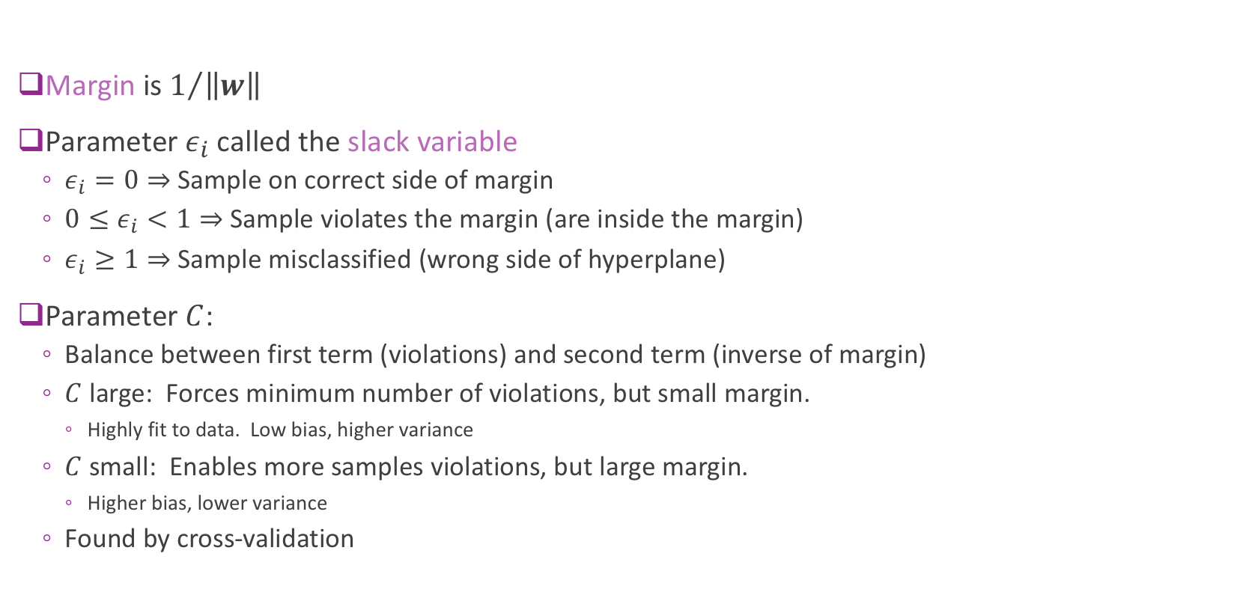
Interpreting Parameters
Margin is $1/{\left\|w\right\|}$
Parameter $ε_{i}$ called the slack variable
$ε_{i}=0⇒$ Sample on correct side of margin
${0≤ε}_{i}<1⇒$ Sample violates the margin (are inside the margin)
$ε_{i}≥1⇒$ Sample misclassified (wrong side of hyperplane)
Parameter $C$:
Balance between first term (violations) and second term (inverse of margin)
$C$ large: Forces minimum number of violations, but small margin.
Highly fit to data. Low bias, higher variance
$C$ small: Enables more samples violations, but large margin.
Higher bias, lower variance
Found by cross-validation

Slide 34
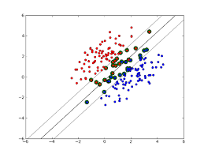

Support Vectors
Support vectors: Samples that either:
Are exactly on margin: $y_{i}(w^{T}x_{i}+b)=1$
Or, on wrong side of margin: $y_{i}\left(w^{T}x_{i}+b\right)≤1$
Changing samples that are not SVs
Does not change solution
Provides robustness

Slide 35

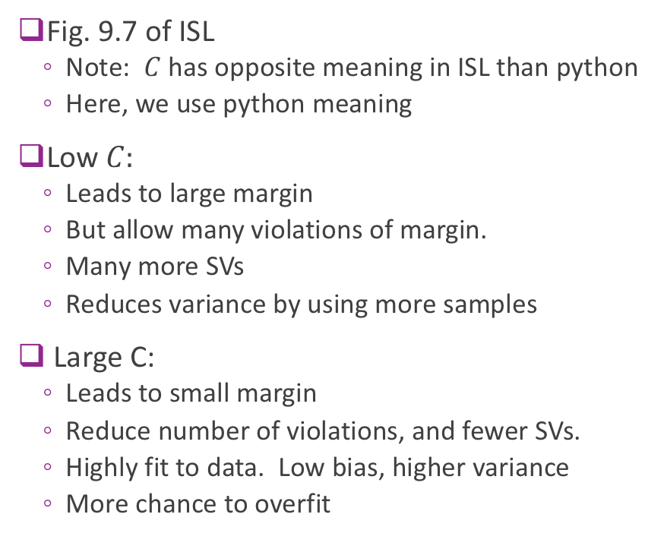




Illustrating Effect of $C$
Low $C=C_{1}$
$$C_{2}$$
Fig. 9.7 of ISL
Note: $C$ has opposite meaning in ISL than python
Here, we use python meaning
Low $C:$
Leads to large margin
But allow many violations of margin.
Many more SVs
Reduces variance by using more samples
Large C:
Leads to small margin
Reduce number of violations, and fewer SVs.
Highly fit to data. Low bias, higher variance
More chance to overfit
$$C_{3}$$
High $C_{4}$

Slide 36
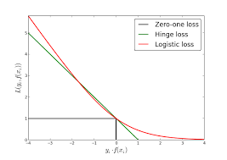
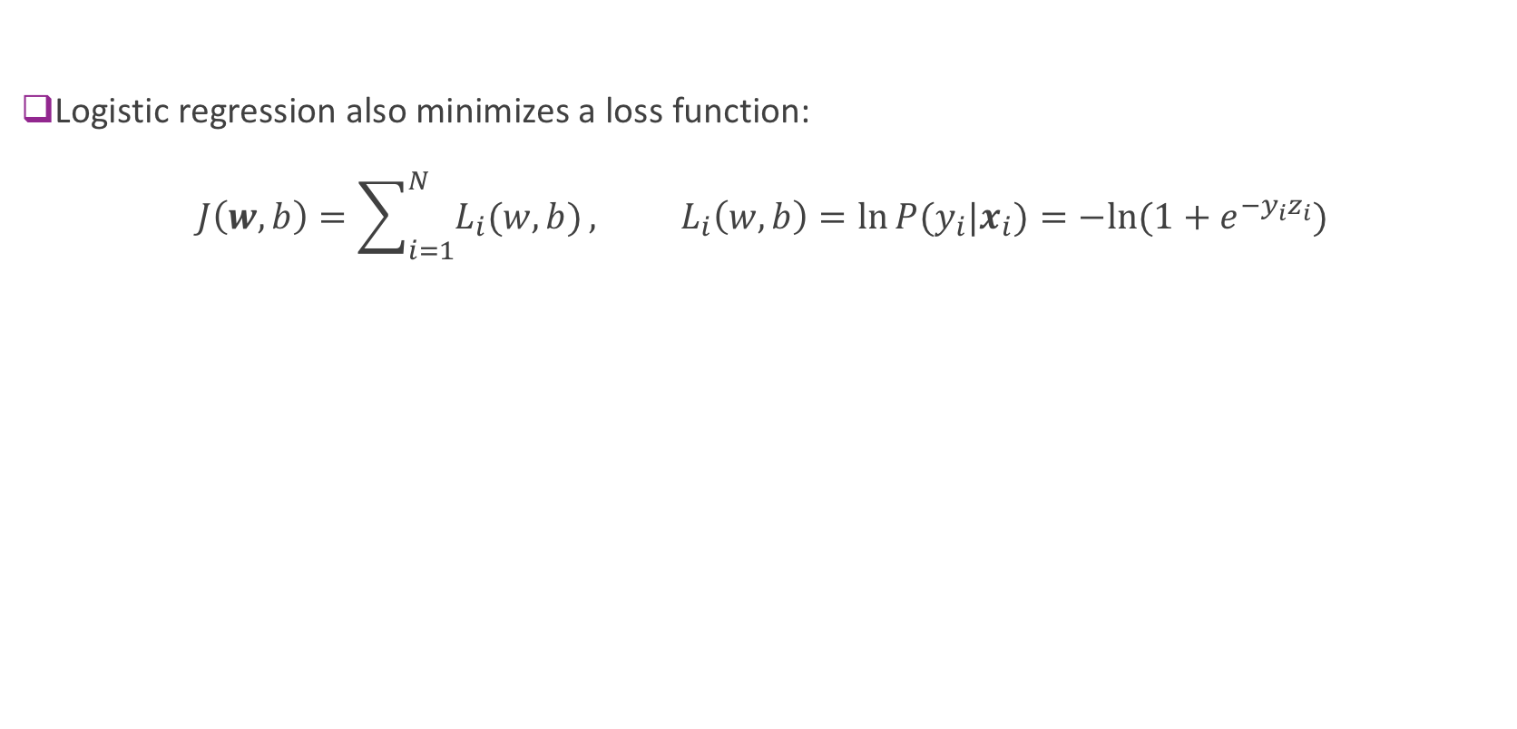
Relation to Logistic Regression
Logistic regression also minimizes a loss function: $J\left(w,b\right)=\sum_{i=1}^{N}{L_{i}(w,b)}, L_{i}\left(w,b\right)=\ln{P(y_{i}|x_{i})}=−ln⁡(1+e^{−{y_{i}z}_{i}})$

Slide 37
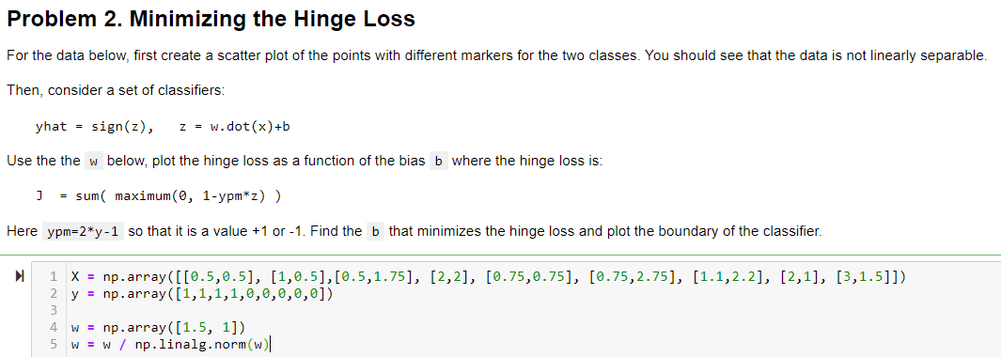
In-Class Exercise

Slide 38
Outline
Motivating example: Recognizing handwritten digits
Why logistic regression doesn’t work well.
Maximum margin classifiers
Support vector machines
Kernel trick
Constrained optimization

Slide 39
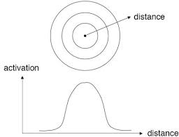
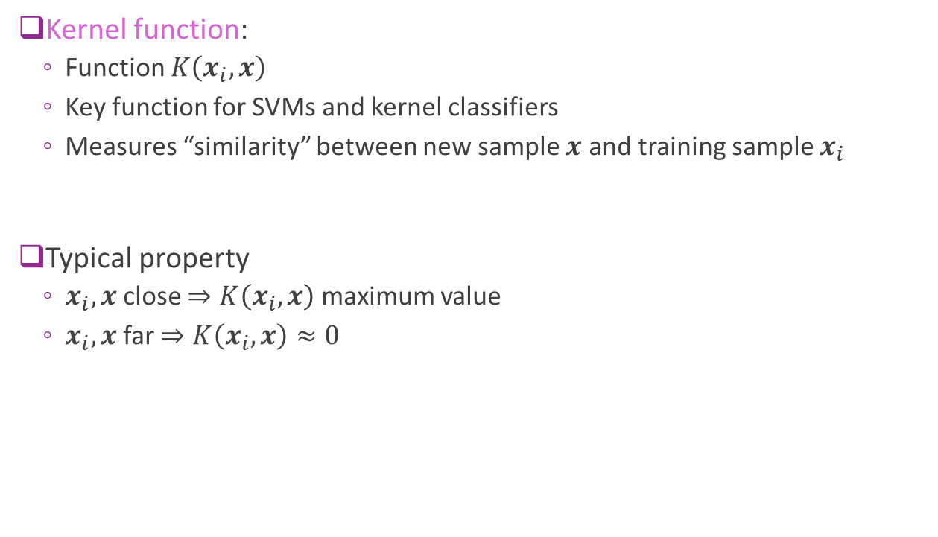
The Kernel Function
Kernel function:
Function $K\left(x_{i},x\right)$
Key function for SVMs and kernel classifiers
Measures “similarity” between new sample $x$ and training sample $x_{i}$
Typical property
$x_{i},x$ close $⇒K\left(x_{i},x\right)$ maximum value
$x_{i},x$ far $⇒K\left(x_{i},x\right)≈0$

Slide 40
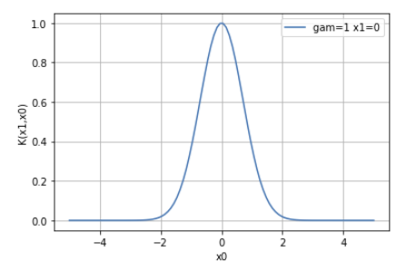

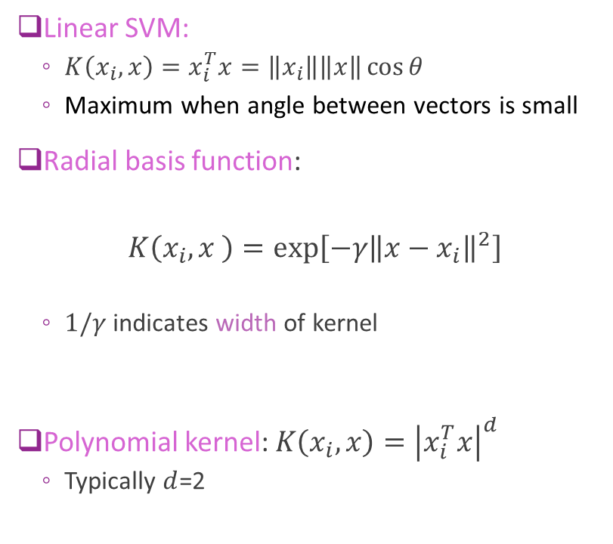


Common Kernels
Linear SVM:
$K\left(x_{i},x\right)=x_{i}^{T}x=\left\|x_{i}\right\|\left\|x\right\|\cos{θ}$
Maximum when angle between vectors is small
Radial basis function:
$$K\left(x_{i},x \right)=\exp\left[−γ{\left\|x−x_{i}\right\|}^{2}\right]$$
$1/γ$ indicates width of kernel
Polynomial kernel: $K\left(x_{i},x\right)={\left|x_{i}^{T}x\right|}^{d}$
Typically $d$=2
$$x_{i}$$
$$θ$$
$$x$$

Slide 41
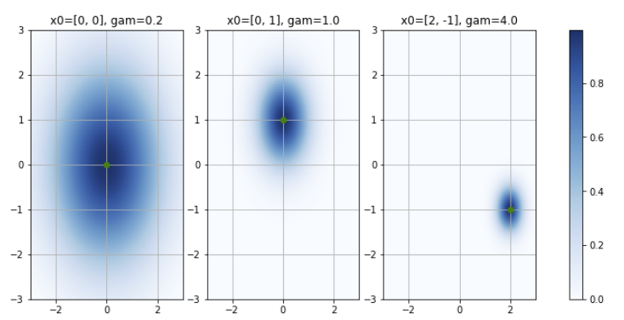
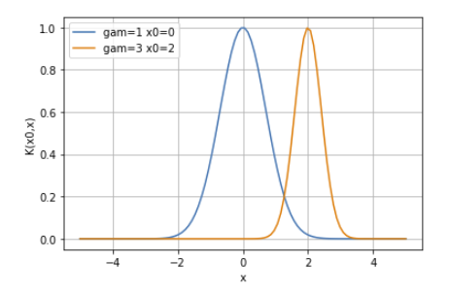
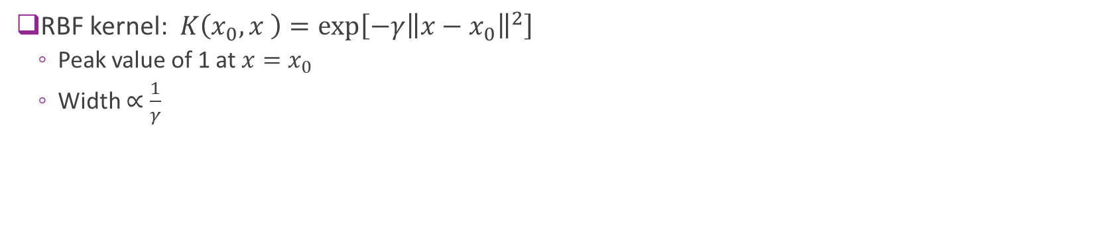
RBF Kernel Examples
RBF kernel: $K\left(x_{0},x \right)=\exp\left[−γ{\left\|x−x_{0}\right\|}^{2}\right]$
Peak value of 1 at $x=x_{0}$
Width $∝\frac{1}{γ}$
RBFs in 1D
RBFs in 2D

Slide 42
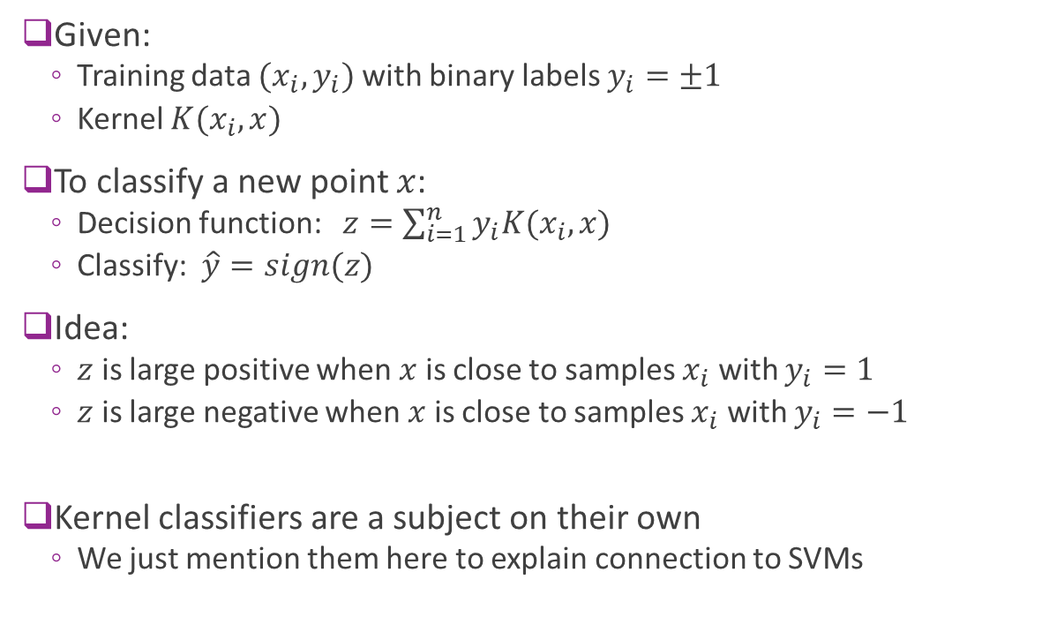
Kernel Classifier
Given:
Training data $(x_{i},y_{i})$ with binary labels $y_{i}=±1$
Kernel $K(x_{i},x)$
To classify a new point $x$:
Decision function: $z=\sum_{i=1}^{n}{y_{i}K(x_{i},x)}$
Classify: $\hat{y}=sign(z)$
Idea:
$z$ is large positive when $x$ is close to samples $x_{i}$ with $y_{i}=1$
$z$ is large negative when $x$ is close to samples $x_{i}$ with $y_{i}=−1$
Kernel classifiers are a subject on their own
We just mention them here to explain connection to SVMs

Slide 43



Example in 1D
Example data with 6 points $(x_{i},y_{i})$
RBF kernel: $K\left(x_{i},x\right)=e^{−γ{\left(x_{i}−x\right)}^{2}}, γ=1$
Decision function:
$z=\sum_{i=1}^{n}{y_{i}K(x_{i},x)}$
Sum of bell curves
Positive when near positive samples
Negative when near negative samples
Classification:
$\hat{y}=sign(z)$
$$i$$ | 1 | 2 | 3 | 4 | 5 | 6
$$x_{i}$$ | -1 | 0 | 1 | 2 | 3 | 5
$$y_{i}$$ | -1 | -1 | 1 | -1 | 1 | 1

Slide 44


Effect of Gamma
Same data as before
RBF kernel: $K\left(x_{i},x\right)=e^{−γ{\left(x_{i}−x\right)}^{2}}$
As $γ$ increases:
Decision function $z≈y_{i}$ when $x=x_{i}$
Classifier fits training data better
Classification region more complex
As a classifier, higher $γ$results in:
Lower bias error
But, higher variance error

Slide 45


SVMs with Non-Linear Transformations
Non-linear transformation:
Replace $x$ with $φ\left(x\right)$
Enables more rich, non-linear classifiers
Examples: polynomial classification $φ\left(x\right)=[1,x,x^{2},…,x^{d−1}]$
Tries to find separation in a feature space
Kernel trick in SVMs:
Makes applying non-linear transformations easy

Slide 46


SVM with the Transformation
Consider SVM model with $x$ replaced by $φ(x)$
Minimize SVM cost function as before (i.e. Hinge loss + inverse margin)
Theorem: The optimal weight is of the form:
$$w=\sum_{i=1}^{N}{α_{i}y_{i}φ(x_{i})}$$
$α_{i}≥0$ for all $i$
$α_{i}>0$ if and only if sample $i$ is a support vector
Will show this fact later using results in constrained optimization
Consequence: The linear discriminant on any other sample $x$ is:
$$z=b+w^{T}φ(x)=b+\sum_{i=1}^{N}{α_{i}y_{i} φ{\left(x_{i}\right)}^{T}φ(x)}$$
$K(x_{i},x)$ = “kernel”

Slide 47

Kernel Form of the SVM Classifier
SVM classifier can be written with the kernel $K\left(x_{i},x\right)$ and values $α_{i}≥0$:
$$z=b+\sum_{i=1}^{N}{α_{i}y_{i}K\left(x_{i},x\right)},$$
$$\hat{y}=\text{sign}\left(z\right)=\left\{\begin{matrix}1 & \text{if} z>0 \\ −1 & \text{if} z<0\end{matrix}\right.$$
Key point: SVM classifier is approximately Kernel classifier
But there are two differences:
Weights $α_{i}≥0$ on the samples (the weights are only non-zero on the SVs)
A bias term $b$ (can be positive or negative)
Decision function
Classification decision

Slide 48

“Kernel Trick” and Dual Parameterization
Kernel form of SVM classifier (previous slide):
$$z=b+\sum_{i=1}^{N}{α_{i}y_{i}K\left(x_{i},x\right)}, \\ \hat{y}=\text{sign}\left(z\right)$$
Dual parameters: $α_{i}≥0,i=1,…,N$
Called the dual parameters due to constrained optimization – see next section
Kernel trick:
Directly solve the parameters $α$ instead of the weights $w$
Can show that the optimization only needs the kernel $K\left(x_{i},x\right)$
Does not need to explicitly use $φ(x)$

Slide 49



SVM Example in 1D
Same data as in the Kernel classifier example
Fit SVM with RBF with different $γ$
Similar trends as kernel classifier: As $γ$ increases
$z$“fits” data $(x_{i},y_{i})$ closer
Leads to more complex decision regions.
Enables nonlinear decision regions
$$i$$ | 1 | 2 | 3 | 4 | 5 | 6
$$x_{i}$$ | -1 | 0 | 1 | 2 | 3 | 5
$$y_{i}$$ | -1 | -1 | 1 | -1 | 1 | 1

Slide 50


Example in 2D
Decision function
Classification
Example:
10 data points with binary labels
Fit SVM with $C=1$ and RBF
$γ=$ 0.3, 3 and 10
Plot:
$z$= linear discriminant
$\hat{y}=sign\left(z\right)=$ classification decision
Observe: As $γ$ increases
Fits training data better
More complex decision region

Slide 51


Parameter Selection
For SVMs with RBFs we need to select:
Parameter $C>0$ in the loss function
Kernel width $γ>0$
Higher $C$ or $γ$
Fewer SVs
Classifiers averages over smaller set
Lower bias, but higher variance
Typically select via cross-validation
Try out different $(C,$ $γ)$ pairs
Find which one provides highest accuracy on test set
Python can automatically do grid search
http://peekaboo-vision.blogspot.com/2010/09/mnist-for-ever.html

Slide 52

Multi-Class SVMs
Suppose there are $K$ classes
One-vs-one:
Train $\left(\begin{matrix}K \\ 2\end{matrix}\right)$ SVMs for each pair of classes
Test sample assigned to class that wins “majority of votes”
Best results but very slow
One-vs-rest:
Train $K$ SVMs: train each class $k$ against all other classes
Pick class with highest $z_{k}$
Sklearn has both options

Slide 53





MNIST Results
Run classifier
Very slow
Several minutes for 40,000 samples
Slow in training and test
Major drawback of SVM
Accuracy $≈0.984$
Much better than logistic regression
Can get better with:
pre-processing
More training data
Optimal parameter selection

Slide 54

MNIST Errors
Some of the error are hard even for a human

Slide 55
Outline
Motivating example: Recognizing handwritten digits
Why logistic regression doesn’t work well.
Maximum margin classifiers
Support vector machines
Kernel trick
Constrained optimization

Slide 56

Constrained Optimization
In many problems, variables are constrained
Constrained optimization formulation:
Objective: Minimize $f(w)$
Constraints: $g_{1}\left(w\right)≤0,…,g_{M}\left(w\right)≤0$
Examples:
Minimize the mpg of a car subject to a cost or meeting some performance
In ML: weight vector may have constraints from physical knowledge
Often write constraints in vector form: Write $g\left(w\right)≤0$ $g\left(w\right)={\left[g_{1}\left(w\right),…,g_{m}\left(w\right)\right]}^{T}$

Slide 57

Lagrangian
Constrained optimization: Min $f\left(w\right) \text{s}\text{.}\text{t}\text{.} g\left(w\right)≤0$
Consider first a single constraint: $g\left(w\right)$ is a scalar
Define Lagrangian: $L\left(w,λ\right)=f\left(w\right)+λg\left(w\right)$
$w$ is called the primal variable
$λ$ is called the dual variable
Dual minimization: Given a dual parameter $λ$, minimize $\hat{w}\left(λ\right)=\arg{\min_{w}{L(w,λ)}}, L^{∗}\left(λ\right)=\min_{w}{L(w,λ)}$
Minimizes a weighted combination of objective and constraint.
Higher $λ⇒$ Weight constraint more (try to make $g\left(w\right)$ smaller)
Lower $λ⇒$ Weight objective more (try to make $f\left(w\right)$ smaller)

Slide 58

KKT Conditions
Given objective $f\left(w\right)$ and constraint $g(w)$
KKT Conditions: $\hat{w},\hat{λ}$ satisfy:
$\hat{w}$ minimizes the Lagrangian: $\hat{w}=\arg{\min_{w}{L(w,\hat{λ})}}$
Either
$g\left(\hat{w}\right)=0$ and $\hat{λ}≥0$ [active constraint]
$g\left(\hat{w}\right)<0$ and $\hat{λ}=0$ [inactive constraint]
Theorem: Under some technical conditions,
if $\hat{w},\hat{λ}$ are local mimima of the constrained optimization, they must satisfy KKT conditions

Slide 59

General Procedure for Single Constraint
Suppose:
$w={\left(w_{1},…,w_{d}\right)}^{T}$: $d$ unknown primal variables
$g\left(w\right)≤0$: scalar constraint
Case 1: Assume constraint is active:
Solve $w$ and $λ$: ${∂L(w,λ)}/{∂w_{j}}=0$ and $g\left(w\right)=0$ (resulting from setting ${∂L(w,λ)}/{∂λ}=0$)
$d+1$ unknowns and $d+1$ equations
Verify that $λ≥0$
Case 2: Assume constraint is inactive
Solve primal objective ${∂f(w)}/{∂w_{j}}=0$ ignoring constraint
$d$ unknowns and $d$ equations
Verify that constraint is satisfied: $g\left(w\right)≤ 0$

Slide 60

KKT Conditions Illustrated
Example 1: Constraint is “active” $\min_{w}{w^{2}} s.t. w+1≤0$
Example 2: Constraint is “inactive” $\min_{w}{w^{2}} s.t. w−1≤0$
Examples worked on board with illustration

Slide 61

Multiple Constraints
Now consider constraint: $g\left(w\right)={\left[g_{1}\left(w\right),…,g_{M}\left(w\right)\right]}^{T}≤0$.
Lagrangian is: $L\left(w,λ\right)=f\left(w\right)+λ^{T}g\left(w\right)=f\left(w\right)+\sum_{m=1}^{M}{λ_{m}}g_{m}\left(w\right)$
Weighted sum of all $M$ constraints
$λ$ is called the dual vector
KKT conditions extend to:
$\hat{w}$ minimizes the Lagrangian: $\hat{w}=\arg{\min_{w}{L(w,\hat{λ})}}$
For each $m=1,…, M$
$g_{m}\left(\hat{w}\right)=0$ and ${\hat{λ}}_{m}≥0$ [active constraint]
$g_{m}\left(\hat{w}\right)<0$ and ${\hat{λ}}_{m}=0$ [inactive constraint]

Slide 62

Multiple Constraints
If there are M constraints, there could be $2^{M}$ cases to discuss
In practice, the number of cases are much smaller
For more information on KKT conditions, check the following lecture on youtube
UAMathCamp Lecture 40(A): Kuhn-Tucker Conditions: Conceptual and geometric insight
https://www.youtube.com/watch?v=HIm3Z0L90Co

Slide 63

SVM Constrained Optimization
Recall: SVM constrained optimization $\min{J_{1}\left(w,b,ε\right)}, J_{1}\left(w,b,ε\right)=C\sum_{i=1}^{N}{ε_{i}}+\frac{1}{2}{\left\|w\right\|}^{2}$
Constraints: ${y_{i}\left(w^{T}x_{i}+b\right)≥1−ε}_{i} and ε_{i}≥0 for all i=1,…,N$
After applying KKT conditions and some algebra [beyond this class], solution is
Optimal weight vector: $w=\sum_{i=1}^{N}{α_{i}y_{i}x_{i}}$ linear combination of instances
Dual parameters $α_{i}$ minimize $\sum_{i=1}^{N}{α_{i}}−\frac{1}{2}\sum_{i=1}^{N}{\sum_{j=1}^{N}{α_{i}α_{j}y_{i}y_{j}x_{i}^{T}x_{j}}} s.t. 0≤α_{i}≤C$
Details can be found on textbook ESLII, section 12.2.1 Computing the Support Vector Classifier

Slide 64

Support Vectors
Classifier weight is: $w=\sum_{i=1}^{N}{α_{i}y_{i}x_{i}}$
Can show that $α_{i}>0$ only when $x_{i}$ is a support vector
On boundary or violating constraint
Otherwise $α_{i}=0$

Slide 65
What you should know
Interpret weights in linear classification of images (logistic regression): Match filters
Understand the margin in linear classification and maximum margin classifier
SVM classifier: Allow violation of margin by introducing slack variables (More robust than linear classifier)
Solve constrained optimization using the Lagrangian.
Understand KKT conditions for a single constraint
Extend to nonlinear classifier by feature transformation: SVM with nonlinear kernels
Select SVM parameters from cross-validation

