Slide 1
Man I 1 (Mangifera indica)
Y.F. Liu, Ph.D.
2017/5/22
(Version: 2017-7-5)

Slide 2
Man i 1 (cDNA)
>KU975060.1 Mangifera indica Man i 1 allergen (Man i 1) mRNA, complete cds
ATGGCCGGAGGCAAGAAGATTAAGATCGGAATCAATGGTTTTGGAAGGATCGGTCGCTTGGTTGCTAGAG
TTGCTCTGCAGAGGAACGATGTTGAGCTTGTGGCTGTTAACGATCCCTTCATCACAACTGATTACATGAC
ATACATGTTTAAGTACGATACTGTTCACGGTCAGTGGAAACACCATGAGGTGAAGATTAAGGACCAAAAG
ACCCTTCTCTTCGATGAGAAGCCAGTCACTGTTTTCGGTATCAGAAACCCTGAGGAGATTCCATGGGCTG
AGACCGGTGCCGAGTTTGTTGTTGAGTCAACTGGAGTGTTCACTGACAAGGAGAAGGCTGCTGCTCACTT
GAAGGGTGGTGCCGAGAAGGTTGTTATTTCGGCCCCAAGCAAAGATGCTCCCATGTTTGTTGTGGGTGTA
AATGAGAAAGAATACAAGCCAGAACTTAACATTGTTTCAAATGCAAGCTGCACAACAAACTGCCTTGCTC
CTCTCGCAAAGGTTATCAATGACAGATTTGGAATTGTTGAGGGTCTTATGACCACTGTCCACTCCATCAC
TGCCACCCAGAAGACTGTTGATGGACCATCAATGAAGGACTGGAGAGGTGGTAGAGCCGCATCCTTCAAC
ATCATCCCCAGCAGCACTGGAGCTGCCAAGGCTGTCGGAAAAGTTCTGCCTTCCCTCAATGGCAAATTGA
CTGGCATGTCTTTCCGTGTTCCTACAGTTGATGTTTCAGTTGTGGACCTTACTGTCAGACTTGAGAAGGA
GGCAACCTATGAGGAAATCAAAGCTGCCATCAAAGAAGAGTCTGAGGGCAAGCTTAAGGGCATTTTGGGA
TACACTGAAGAAGATGTTGTATCCACTGATTTCGTGGGTGACAGCAGGTCAAGCATTTTCGATGCCAAGG
CTGGTATTGCTTTGAACAAGAAATTTGTGAAACTTGTCTCTTGGTATGACAATGAATGGGGATACAGTTC
ACGCGTGATTGACTTGATTGTCCACATGGCATCAACTGCTTAA

Slide 3
Man i 1 (protein)
>ANQ43386.1 Man i 1 allergen [Mangifera indica]
MAGGKKIKIGINGFGRIGRLVARVALQRNDVELVAVNDPFITTDYMTYMFKYDTVHGQWKHHEVKIKDQK
TLLFDEKPVTVFGIRNPEEIPWAETGAEFVVESTGVFTDKEKAAAHLKGGAEKVVISAPSKDAPMFVVGV
NEKEYKPELNIVSNASCTTNCLAPLAKVINDRFGIVEGLMTTVHSITATQKTVDGPSMKDWRGGRAASFN
IIPSSTGAAKAVGKVLPSLNGKLTGMSFRVPTVDVSVVDLTVRLEKEATYEEIKAAIKEESEGKLKGILG
YTEEDVVSTDFVGDSRSSIFDAKAGIALNKKFVKLVSWYDNEWGYSSRVIDLIVHMASTA

Slide 4
Cross-reactive fruits
# | Common name |  | Scientific name | ID | Identity (%) |  | Accession number
1 | celery | 芹菜 | Apium graveolens | 4045 | - | v | KU234489.1
2 | carrot | 胡蘿蔔 | Daucus carota subsp. sativus | 79200 | 84% | v | XM_017371675.1
3 | tomato | 番茄 | Solanum lycopersicum | 4081 | 83% | v | NM_001279325.2
4 | papaya | 番木瓜 | Carica papaya | 3649 | 82% | v | JQ678772.2
5 | banana | 香蕉 | Musa acuminata Musa balbisiana | 4637 | - | v | XM_009385062.2
6 | apple | 蘋果 | Malus domestica | 3750 | 84% | v | XM_008391582.2
7 | watermelon | 西瓜 | Citrullus lanatus | 260674 | - | x | -
8 | pistachio | 開心果 | Pistacia vera | 55513 | - | x | -
9 | Indian dill | 印度蒔蘿 | Anetheum sowa | - | - | x | -
10 | cashew | 腰果 | Anacardium occidentale | 171929 | - | v | JQ659186
11 | almond | 杏仁 | Prunus dulcis | 3755 | - | x | -
12 | wheat | 小麥 | Triticum aestivum | 4565 | - | v | EF592180
13 | ginger | 薑 | Zingiber officinale | 4650 | - | v | JQ085994.1
14 | sweet orange | 柑橘 | Citrus sinensis | 2711 | 88% | v | XM_006483974.2
15 | cacao | 可可 | Theobroma cacao | 3641 | 87% | v | XM_018114458

Slide 5
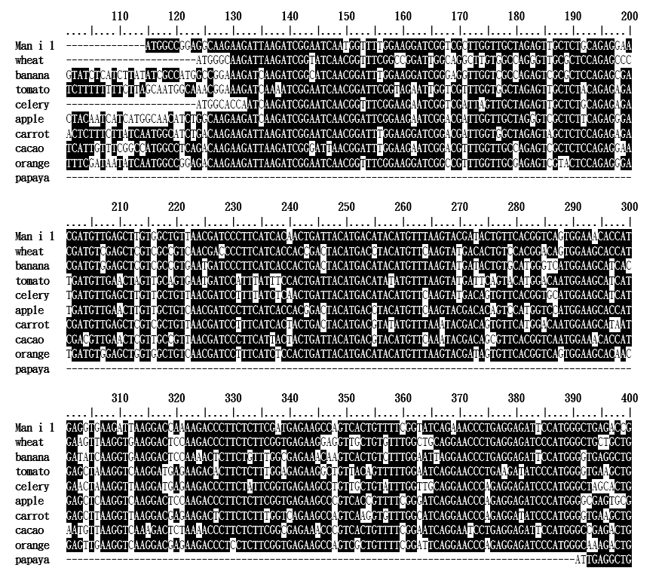
I
II

Slide 6
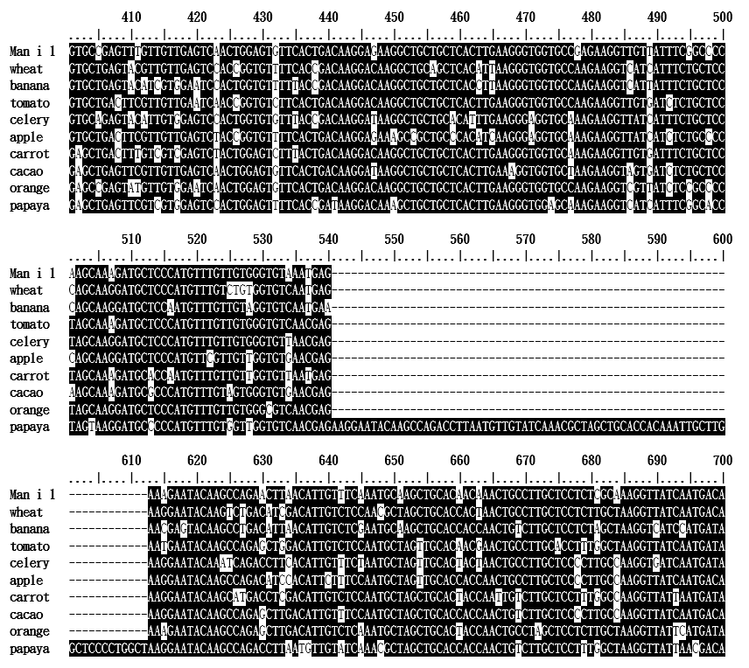
III

Slide 7
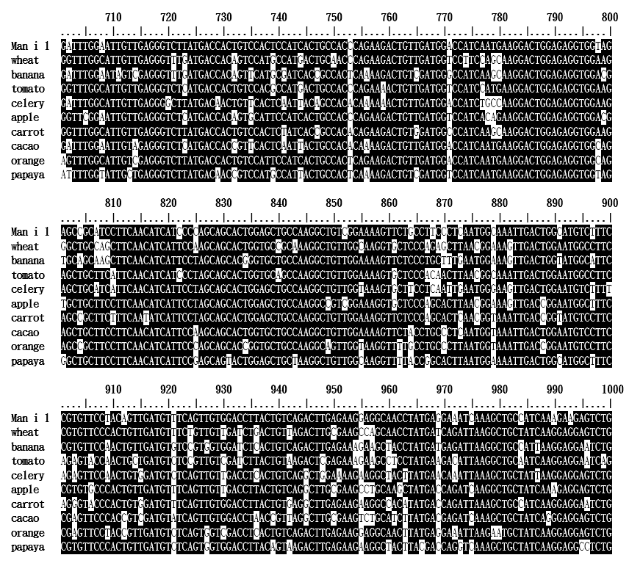
IV

Slide 8
There are four sequence-variant regions in the ten cross-reactive fruits
Region | Variants | Man I 1
I | 18/40 | 39-78
II | 15/33 | 187-219
III | 11/33 | 293-325
IV | 18/32 | 759-790
* Man I 1 : KU975060.1

Slide 9
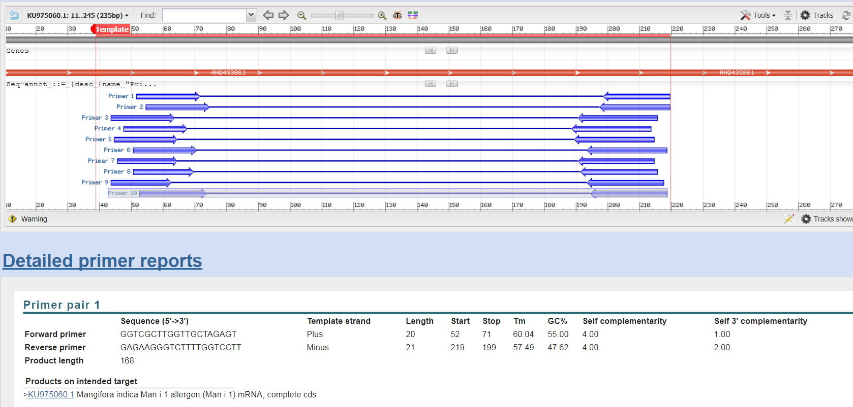
Primers Design #1 (region I and II)

Slide 10
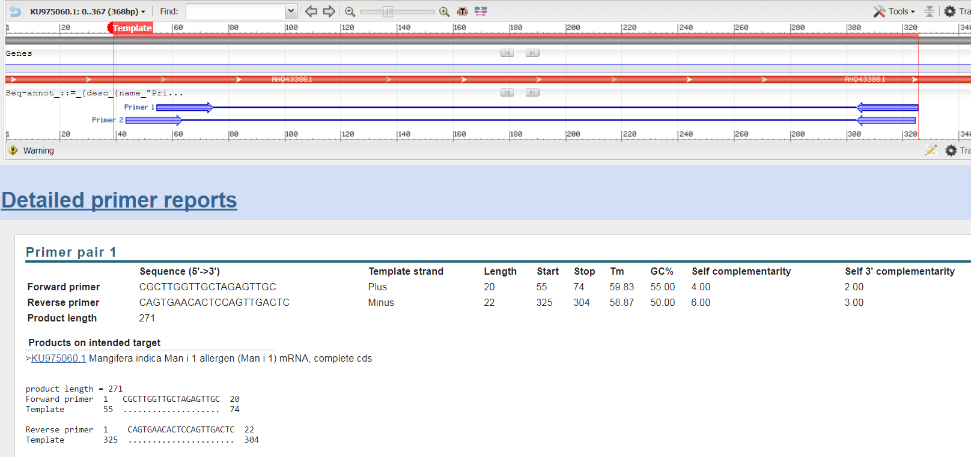
Primers Design #2 (region I and III)

Slide 11
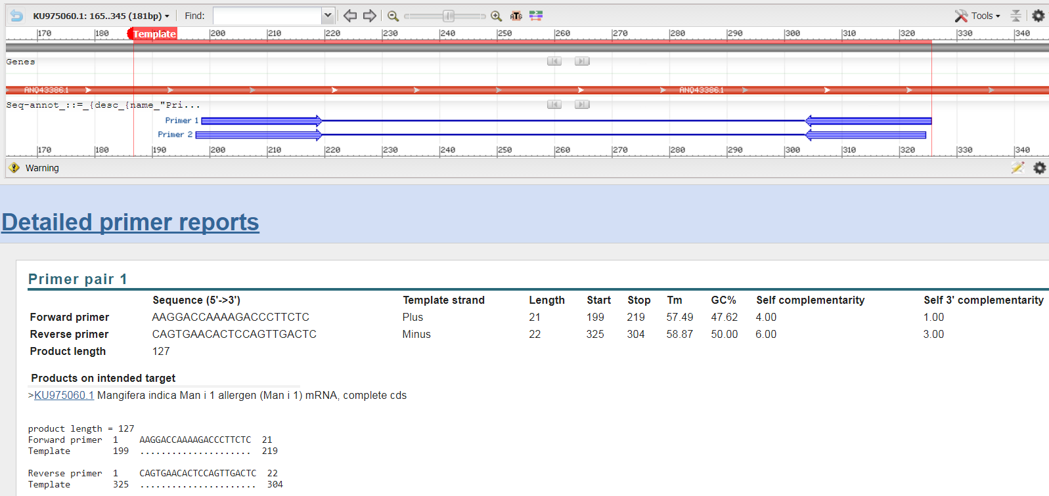
Primers Design #3 (region II and III)

Slide 12
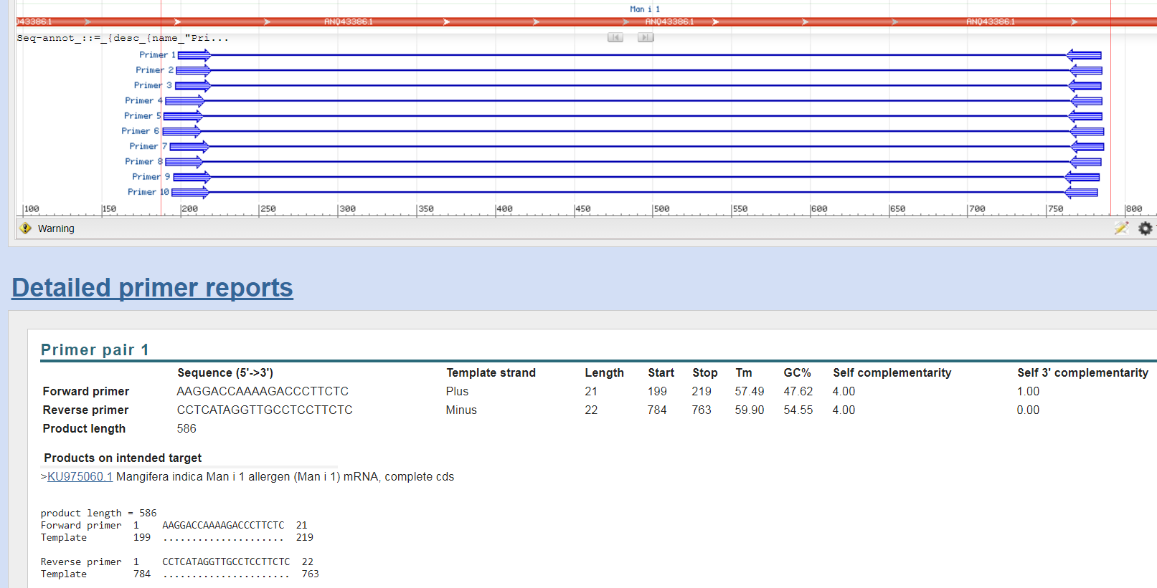
Primers Design #4 (region II and IV)

Slide 13
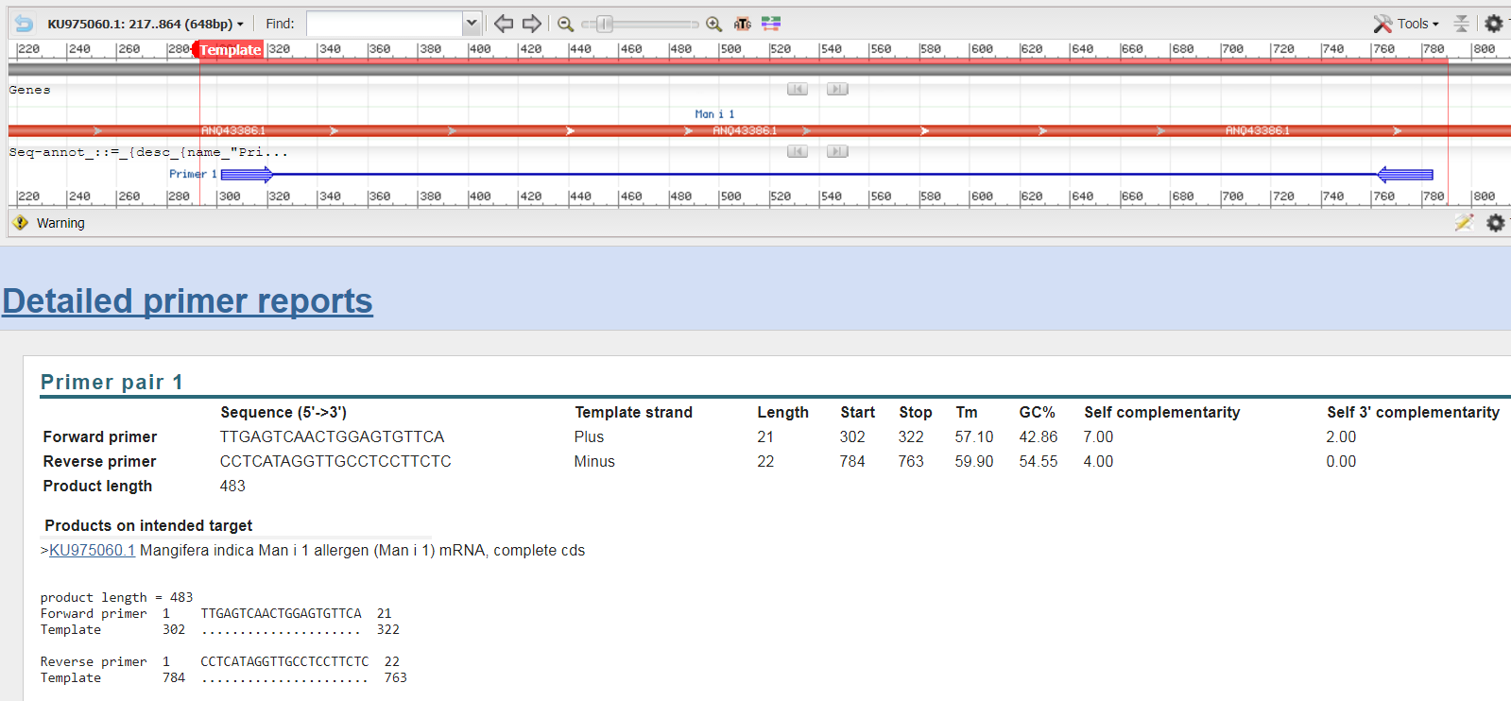
Primers Design #5 (region III and IV)

Slide 14
Mangifera indica L
Mango (Mangifera indica L.) is known as the ‘king of fruits’ for its rich taste, flavor, color, production volume and diverse end usage. It belongs to plant family Anacardiaceae and has a small genome size of 439 Mb (2n = 40). Ancient literature indicates origin of cultivated mango in India. Although wild species of genus Mangifera are distributed throughout South and South-East Asia, recovery of Paleocene mango leaf fossils near Damalgiri, West Garo Hills, Meghalaya point to the origin of genus in peninsular India before joining of the Indian and Asian continental plates. India produces more than fifty percent of the world’s mango and grows more than thousand varieties. Despite its huge economic significance genomic resources for mango are limited and genetics of useful horticultural traits are poorly understood. Here we present a brief account of our recent efforts to generate genomic resources for mango and its use in the analysis of genetic diversity and population structure of mango cultivars. Sequencing of leaf RNA from mango cultivars ‘Neelam’, ‘Dashehari’ and their hybrid ‘Amrapali’ revealed substantially higher level of heterozygosity in ‘Amrapali’ over its parents and helped develop genic simple sequence repeat (SSR) and single nucleotide polymorphism (SNP) markers. Sequencing of double digested restriction-site-associated genomic DNA (ddRAD) of 84 diverse mango cultivars identified 1.67 million high quality SNPs and two major sub-populations. We have assembled 323 Mb of the highly heterozygous ‘Amrapali’ genome using long sequence reads of PacBio single molecule real time (SMRT) sequencing chemistry and predicted 43,247 protein coding genes. We identified in the mango genome 122,332 SSR loci and developed 8,451 Type1 SSR and 835 HSSR markers for high level of polymorphism. Among the published genomes, mango showed highest similarity with sweet orange (Citrus sinensis). These genomic resources will fast track the mango varietal improvement for high productivity, disease resistance and superior end use quality.
Indian Journal of History of Science, 51.2.2 (2016) 355-368

Slide 15
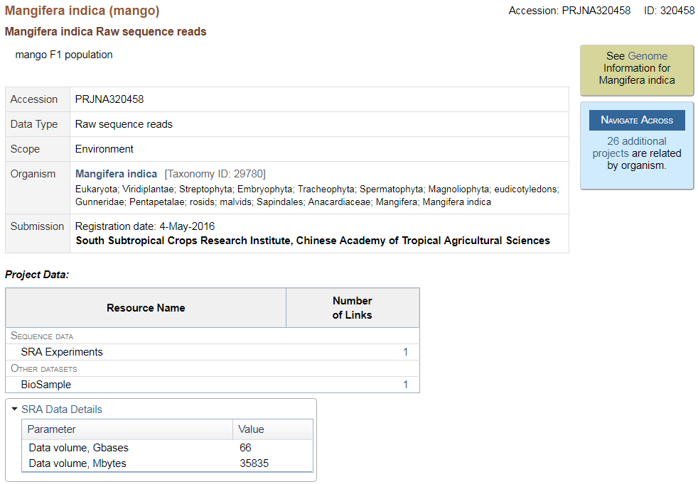
Mangifera indica Raw sequence reads
https://www.ncbi.nlm.nih.gov/bioproject/320458

Slide 16
https://en.wikibooks.org/wiki/Next_Generation_Sequencing_(NGS)/De_novo_assembly
https://en.wikibooks.org/wiki/Next_Generation_Sequencing_(NGS)/De_novo_assembly

Slide 17
Abyss (I)
http://www.bcgsc.ca/platform/bioinfo/software/abyss
http://www.bcgsc.ca/platform/bioinfo/software/abyss/releases/2.0.2/abyss-2.0.2.tar.gz
ABySS requires the Boost C++ libraries, which may be downloaded from here: http://www.boost.org/users/download/
ABySS requires the google sparsehash, which may be downloaded from here: https://github.com/sparsehash/sparsehash
https://en.wikibooks.org/wiki/Next_Generation_Sequencing_(NGS)/ABySS

Slide 18
There are no official best practices, but we (the ABySS team) tend to get good results by doing one or more of the following:
* quality trimming with the abyss-pe `q` option, typically with `q=15` (we do this mostly when we want to reduce memory usage)
* merge overlapping read pairs with `abyss-mergepairs`
* merge non-overlapping read pairs with `konnector`
We don't normally use error correction tools for preprocessing, but IMO ABySS has good internal algorithms for error correction.
For post-processing, we often use `abyss-sealer` for gap filling.
Common gotchas for `abyss-pe` parameter settings:
* minimum alignment length `l` is too high (yielding poor paired-end alignments in the contig and scaffolding stages) -- by default `l` is assigned the same value as `k` which is often too high since `l` specifies the minimum length for a perfect match in both reads of a pair. Typically fixing `l=40` or `l=50` is a good setting.
* minimum sequence length cutoff `s` for contig and scaffolding stages is too low. According to Shaun Jackman (ABySS guru), it should be at least 2*k. I think it is `s=200` by default, whereas I normally set it to `s=1000` to filter out some junk.
https://groups.google.com/forum/#!topic/abyss-users/uAX9MwJMTcc

Slide 19


De novo assembly
Tools: ABySS
abyss-pe -n name=Mongo k=31 q=15 l=40 s=200 S=1000 in='reads1.fastq.gz reads2.fastq.gz'
https://github.com/bcgsc/abyss#optimizing-the-parameter-k
https://github.com/bcgsc/abyss#abyss
Genome Research, 2017 27: 768-777

Slide 20
Abyss (II)
calculate assembly contiguity statistics
abyss-pe -n name=MONGO k=31 in='SRR3476466_1.fastq.gz SRR3476466_2.fastq.gz' > Makefile
chmod 755 Makefile
./Makefile &
abyss-fac MONGO-contigs.fa

Slide 21
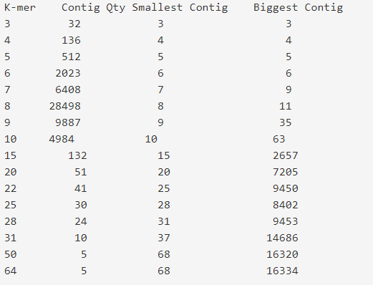
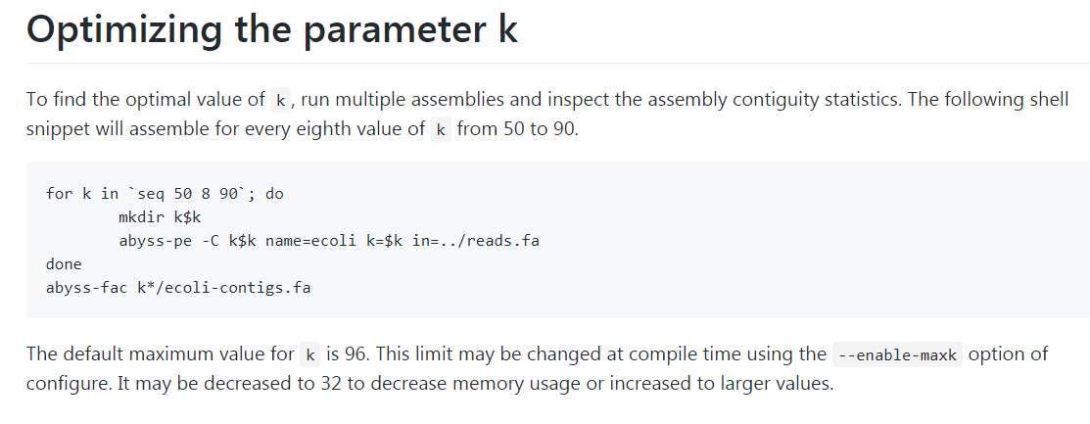
Abyss (III)
K-Mer
https://www.biostars.org/p/46538/

Slide 22
Abyss-Explore
ABySS-Explorer is an interactive Java application that employs a novel graph-based representation to display a sequence assembly and associated meta data.
Konnector: Connecting paired-end reads using a bloom filter de Bruijn graph
http://www.bcgsc.ca/platform/bioinfo/software/abyss-explorer/releases/1.0

Slide 23
NCBI Blast
"ftp://ftp.ncbi.nlm.nih.gov/blast/executables/blast+/LATEST/ncbi-blast-2.7.1+-x64-linux.tar.gz"
./dustmasker -in MONGO-6.fa -infmt fasta -parse_seqids -outfmt maskinfo_asn1_bin -out MONGO-6_mask.asn
./makeblastdb -in MONGO-6.fa -dbtype nucl -mask_data MONGO-6_mask.asn -out MONGO_db -parse_seqids -title "Mongo Genome Assembly" -hash_index
./tblastn -query Man_i_1.pro -out Man_i_1.blast -db MONGO_db

