Slide 1
Secure Cloud and Remote Service Connections for AllJoyn Applications
Art Lancaster
CTO, Affinegy Chair, Gateway Agent Working Group

Slide 2
Agenda
Gateway Agent Working Group
Software components and usage
Consumer Mode
Service Provider Mode
Demonstrations
Affinegy CHARIOT Cloud solutions for AllJoyn and IOT
Gateway Agent developer information
Open Discussion Q&A

Slide 3










Gateway Agent Working Group – AllJoyn meets Cloud / Managed Services
Cloud / Managed
Services
TV: My WiFi video
picture is poor
Fix it?
Dryer:
Laundry is ready
Laundry is ready
AllSeen
Gateway Agent
AllJoyn local applications
TV: Fixing WiFi video quality
DVR: OK playing
My Hawaii vacation
movie
72
72°
OK changing
to away mode
120
80
Car: OK Lights are
now OFF
DVR: play
my Hawaii vacation
movie
Turn off the kitchen lights,
Set away mode.
BeFit: Congratulations goal met!
AllJoyn remote applications
Notes:
AllJoyn enables powerful, distributed IOT applications among devices in a local premise
Prior to the Gateway Agent there was no STANDARD, AllJoyn way to support remote, managed services for AllJoyn
The Gateway Agent working group is about creating standard, open source applications to connect AllJoyn to cloud services and external networks
Since AllJoyn applications and devices talk to each other peer to peer there can be a lot of messages in the local network
The Gateway Agent provides for strong privacy – keeping what belongs at home only at home, while providing a secure and standard AllSeen way to support external and cloud services

Slide 4
AllSeen Gateway Agent Application
Software application ideal for an always on, connected hardware device in the proximal network turning it into an AllJoyn to remote services gateway
Provides a standard and secure method for connecting the local AllJoyn devices and applications to external services
Works with any Internet connection
Supports persistent remote connections without special firewall or port settings

Slide 5
Managed and Secure AllJoyn Remote Routing Node
Filters LAN AllJoyn traffic from remote traffic – only traffic needed for the user’s cloud or remote services are passed
Which AllJoyn applications and traffic are determined by the Gateway Agent’s remote Service Profiles – managed by the Gateway Agent Control API
Enhances the user’s privacy and security
Enables managed service privacy policies
Supports multiple independent cloud services in one device with modular, Connector plug-ins
The Gateway Agent also can support Connector plug-ins to other PAN protocols with AllJoyn (6LowPAN, ZigBee, etc.)

Slide 6
Consumer Mode Operation
User self-manages their AllJoyn connections to external services
Services provisioned via a mobile app with the Gateway Control App component
Connector Plug-in installed
Service Profile managed
Consumer must be at home when configuring their cloud service using Control App
Service profile
Notes:
The Cloud service protocol is determined by the cloud service provider – it must match its Connector Plug-in
Normal case for Consumer Mode
the consumer has a multi-service hub or gateway
They select a mobile app from their mobile app store and install it
The mobile app pairs with its cloud service and includes the control app
This control app tells the Gateway Agent to download and install its connector plug-in in the hub. It also creates a service profile for its service (say all Appliances from Acme Corp.)
Acme corp either runs their own cloud platform or contracts this with a turn-key provider

Slide 7
Service Provider Mode Operation
Ideal for Managed Services Providers
Remote software installation and update management for
Connector Plug-in(s)
Firmware of the hub or gateway
Full remote management of
AllJoyn Services Profile
The overall gateway/hub configuration
Implemented with TR-069a5 enhanced with XMPP
Service profile
Notes:
The Cloud service protocol is determined by the cloud service provider – it must match its Connector Plug-in
In Service Provider mode typical example use case is
Customer signs up for a managed service that includes a managed gateway or hub
The customer is shipped their hub and plugs it into power and connects to Internet (a great use for AllJoyn WiFi On-boarding)
The hub auto registers with the TR-069 ACS server – it receives all configurations automatically and any firmware updates or connectors needed for the cloud service
The remote management server also pre-configures the service profile for the gateway agent. This service profile is remotely manageable as new services/applications are added and removed
The service provider can also choose to allow or prohibit the simultaneous use of Consumer Mode

Slide 8
Remote Connector Plug-In for AllJoyn ⇿ XMPP
An XMPP Cloud Services Connector plug-in for the AllSeen Gateway Agent supporting its APIs and service profiles
Relays local AllJoyn messages, to/from a remote AllJoyn application by wrapping these in XMPP sessions relayed via a standard XMPP server cloud service.
Subscribers authenticate with their cloud service’s XMPP ID – provides secure authentication and an encrypted channel for AllJoyn remote access.
Affinegy is also providing an AllJoyn remote/mobile Android sample application that includes an XMPP client paired with the AllJoyn mobile app.
Normal case provides a remote UX only for the mobile device running this XMPP/AllJoyn mobile connector (non-routing AllJoyn app).
Joining two proximal networks – using two Gateway Agents in two separate locations to securely join the AllJoyn applications

Slide 9
Cloud Services for Gateway Agent available from Affinegy
Affinegy CHARIOT Server Platform
Provides IOT cloud services fully compatible with AllSeen Gateway Agent
XMPP server for high scale, persistent IOT services and management
For Service Provider Mode – Advanced TR-069 ACS remote management server deployed worldwide with millions of devices under management.
Provides full turn-key installation and support management for the hardware device running the Gateway Agent
No cost developer hosted access available from Affinegy
Commercial CHARIOT server licensing available from Affinegy, both hosted and installed options

Slide 10





Affinegy CHARIOT Cloud Services for AllJoyn with AllSeen Gateway Agent
CHARIOT Cloud
AllJoyn Home
AllJoyn Remote
Gateway Agent
with
CHARIOT
Connector Plug-in
AllJoyn Apps
CHARIOT
Mobile Cloud Connector for AllJoyn
AllJoyn Apps
Turn-key enables existing AllJoyn Apps for cloud services
Notes:
We support both Consumer Mode and Service Provider mode for the Gateway Agent
The AllJoyn – XMPP mobile helper app can also be used for at home applications without a hub or gateway, when remote access is not required, but cloud based telemetry and storage are part of the IOT application.
Affinegy’s turn key services include customer on-boarding, and full device management (updates, activation, deactivation, service notifications and analytics reporting)
Full connected home and WiFi home network (Smart Router) user and support experiences
Affinegy is providing no cost hosted access for developers to make it easy to create products with remote services using the Gateway Agent

Slide 11

Affinegy CHARIOT Cloud Services for AllJoyn with AllSeen Gateway Agent
CHARIOT Care, Home & ACS
CHARIOT Cloud
AllJoyn Home
AllJoyn Remote
Gateway Agent
with
CHARIOT
Connector Plug-in + CHARIOT Client
AllJoyn Apps
CHARIOT
Mobile Cloud Connector for AllJoyn
AllJoyn Apps
CHARIOT
Home / Mobile
(Self care)
CHARIOT - One Converged Managed Services Platform
Notes:
We support both Consumer Mode and Service Provider mode for the Gateway Agent
The AllJoyn – XMPP mobile helper app can also be used for at home applications without a hub or gateway, when remote access is not required, but cloud based telemetry and storage are part of the IOT application.
Affinegy’s turn key services include customer on-boarding, and full device management (updates, activation, deactivation, service notifications and analytics reporting)
Full connected home and WiFi home network (Smart Router) user and support experiences
Affinegy is providing no cost hosted access for developers to make it easy to create products with remote services using the Gateway Agent

Slide 12
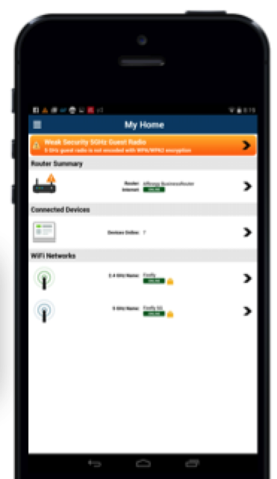
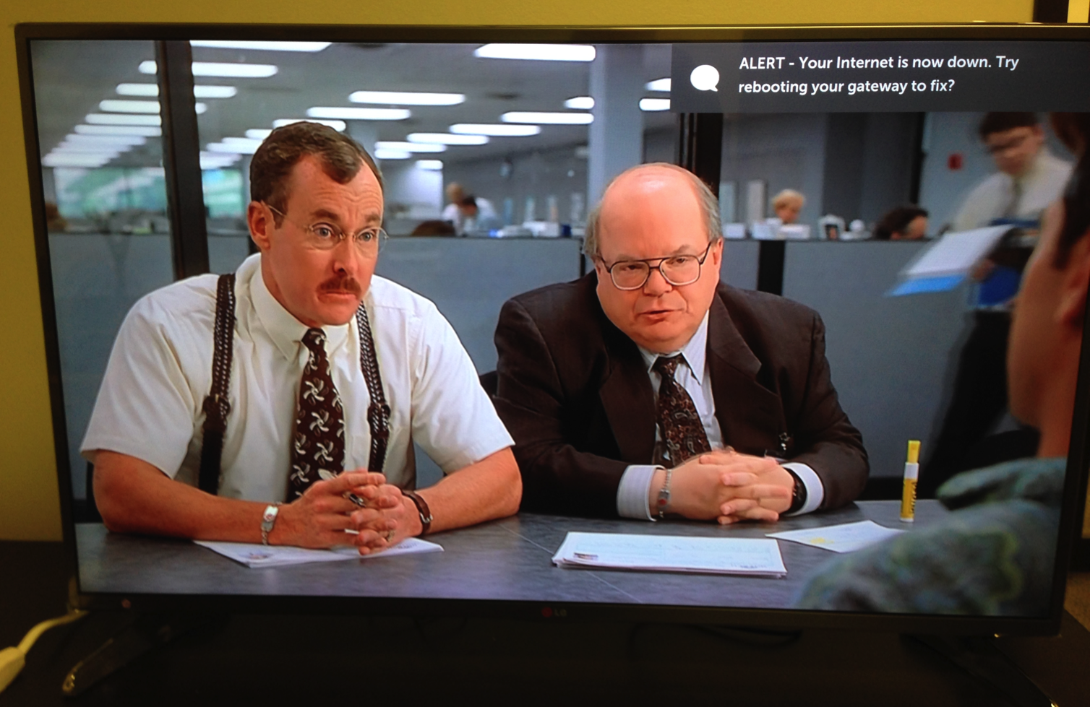
New Self Care: Multiple Screens, Enhanced with Standards-based (AllJoyn) Notifications tied to CHARIOT Alerts
CHARIOT Mobile
Android/IOS notifications with
Local and remote diagnostics
LG Smart TV with AllSeen Messaging Service
Local and remote diagnostics from CHARIOT Server
and Gateway with CHARIOT Client

Slide 13
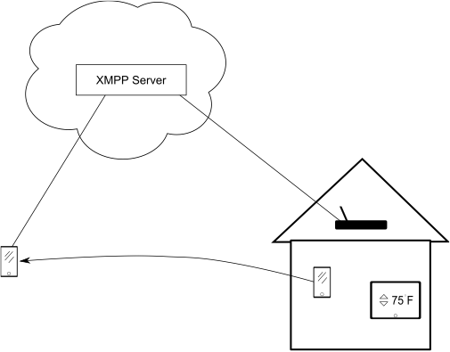
Demo 1 – remoting AllJoyn applications
Demo includes
Gateway Agent embedded in a new generation WiFi router platform – Qualcomm IPQ development system
XMPP connector for AllJoyn from Affinegy
Affinegy’s CHARIOT Cloud platform providing the XMPP support
The AllJoyn ON mobile app

Slide 14
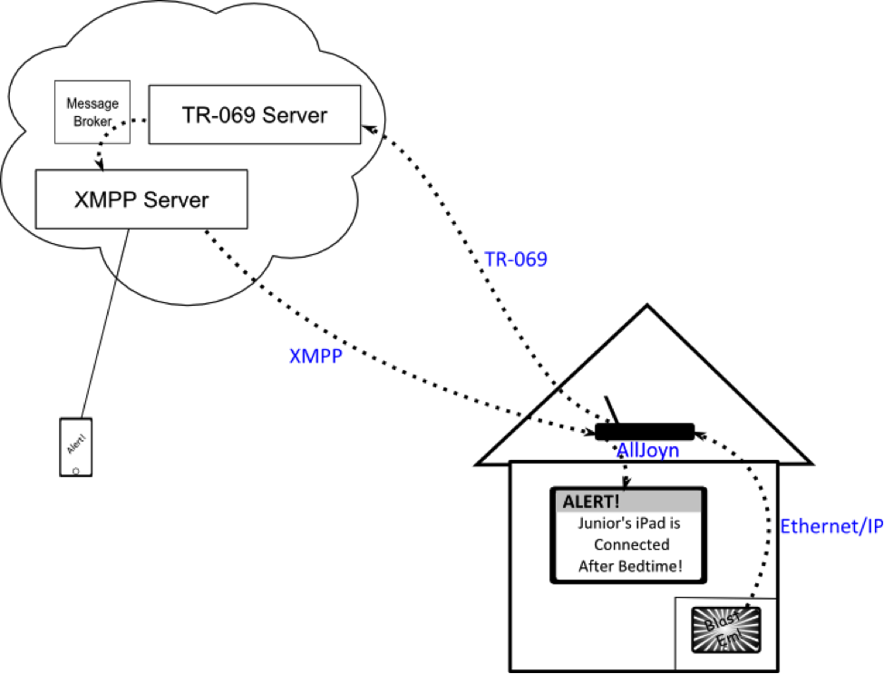
Demo 2 – Integration of Service Provider Mode with AllJoyn notification
Demo includes
Gateway Agent in the IPQ dev system
XMPP connector for AllJoyn from Affinegy
Embedded TR-069 client (Affinegy / AllSeen)
Affinegy’s CHARIOT Cloud platform providing the TR-069 & XMPP support
LG Smart TV with AllJoyn
The AllJoyn ON mobile app

Slide 15
Gateway Agent Developer Information
Gateway Working Group Wiki https://wiki.allseenalliance.org/gateway/gatewayagent
Documentation and presentations
Open source GIT repository
Weekly working group meetings
Inviting contributors now for Connector Plug-ins for remote and PAN protocols
Released code available now in AllSeen GIT:
Gateway Agent management app (embedded for Linux and OpenWRT)
Sample Connector Plug-in
Sample Android Control App for managing connectors and the service profile
Notes:
Plug-ins are invited to support standard remote protocols and PAN protocols. MQTT, Web services, ZigBee, etc.
We are at release 1 now, completed in January
Its based on AllJoyn core 14.06
Working on 14.12 version and for enhancements with Security 2.0 for 15.04
We welcome suggestions and requests

Slide 16
AllSeen Gateway Working Group Contributors
Affinegy
Art Lancaster, CTO – contributor and W.G. chair
Committers: Josh Spain, Kevin Sandifer, Jim Howard
Qualcomm
Shane Dewing, Senior Director Product Management – contributor
Committers: Tsahi Asher, Tali Messing, Benita Gupta, Josh Hershberg

Slide 17
For more information on AllSeen Alliance, visit us at: allseenalliance.org & allseenalliance.org/news/blogs

