Slide 1
Deep Learning Software PyTorch
Department of Computer Science, NYCU
TA 賴佑家
Some slides are from Stanford CS231n

Slide 2








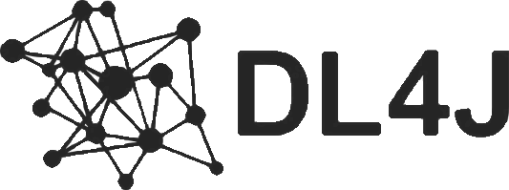


Frameworks
And others……

Slide 3

Frameworks
Most people use these
And others……

Slide 4
Frameworks
We will focus on this
And others……

Slide 5
The advantages of deep learning frameworks
Developing and testing new ideas are quickly
Computing gradients automatically
Running model structures on GPU is efficiently
Please use PyTorch to complete all your assignments !!

Slide 6
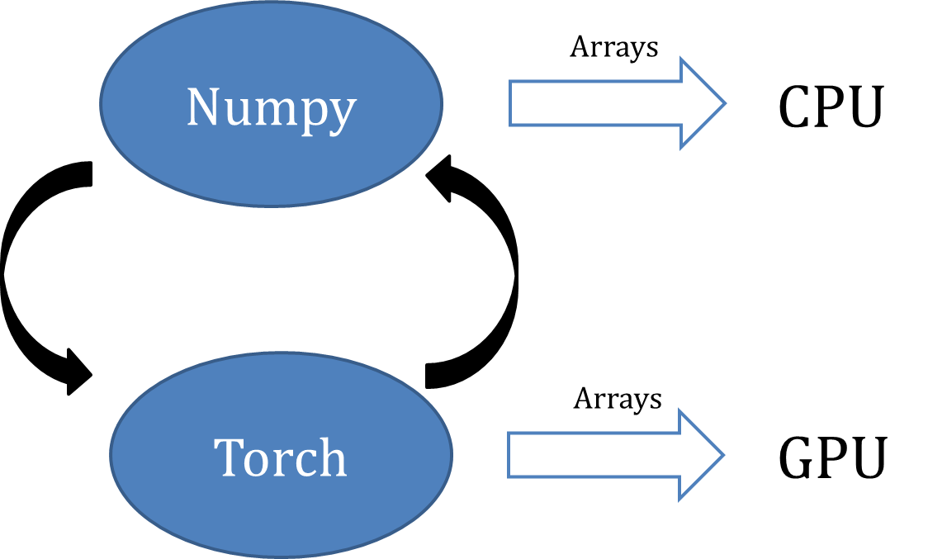
PyTorch Fundamental Concepts
Tensor : torch.Tensor is the central class of the package. It is like a numpy array but can run on GPU.
Autograd : The autograd package provides automatic differentiation for all operations on Tensors.
Module : A neural network layer stores both state and learnable weight.

Slide 7
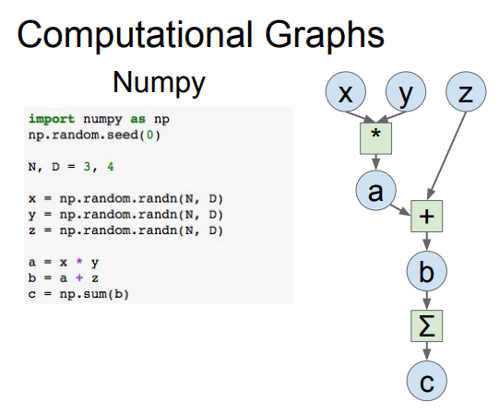

$$x×y+z$$
Neural network can be denoted as a directed acyclic graph

Slide 8
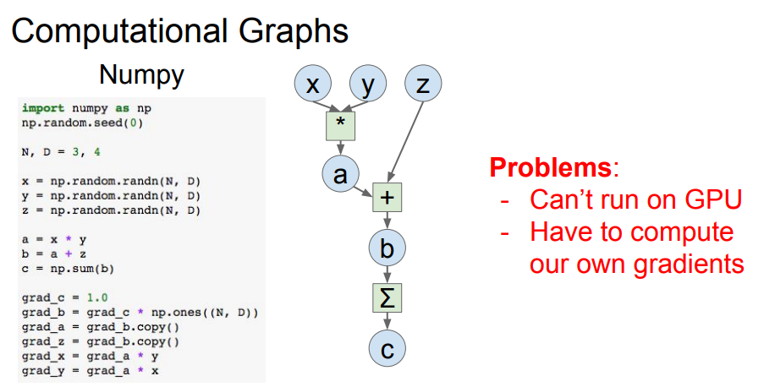
compute gradients

Slide 9
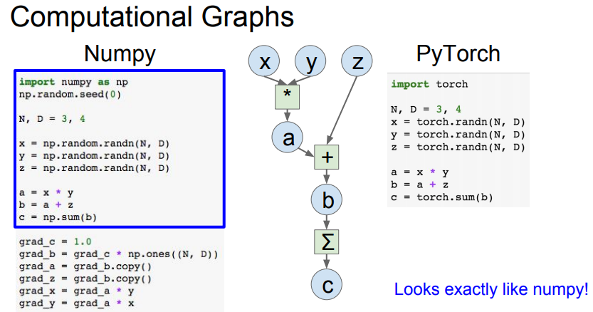

Slide 10
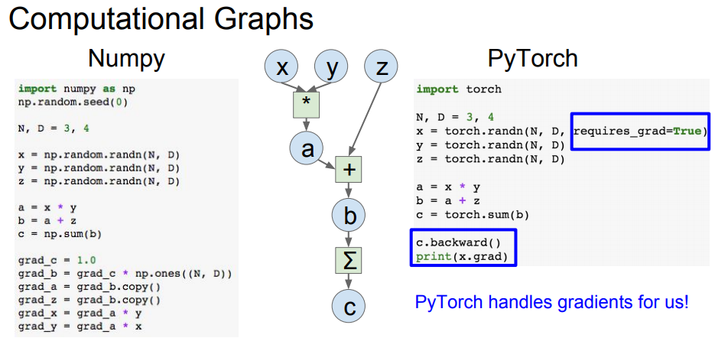
.backward() compute gradient

Slide 11
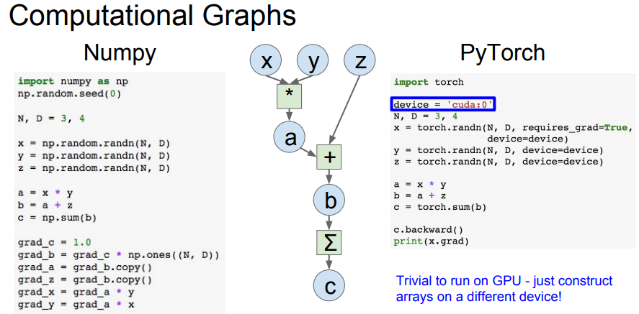

Slide 12
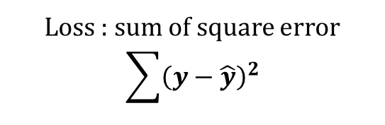

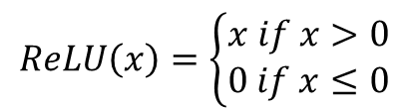



Example
2-layer network
Input: 1000 , batch size = 64
$$x:64×1000$$
Hidden Layer: 100
$$w1:1000×100$$
$$ReLU\left(x\right)=\left\{\begin{aligned}x if x>0 \\ 0 if x≤0\end{aligned}\right.$$
ReLU
Out Layer: 10
$$w2:100×10$$
Loss : sum of square error
$$\sum{{\left(y−\hat{y}\right)}^{2}}$$
$$y :64×10$$

Slide 13
Flow Chart
Prepare data
Create model
Forward pass
Repeat n times or until convergence
Training
Backward pass
Update weights

Slide 14
Easily implement your own deep learning model by using PyTorch

Slide 15
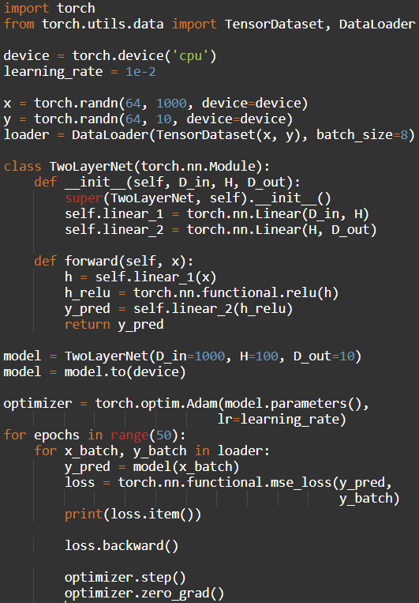
Step1. Prepare Data
PyTorch.utils.data
DataLoader wraps a Dataset and provides minibatches, shuffling, multithreading, for you
When you need to load custom data, just write your own Dataset class
Iterate over loader to form mini-batchs
https://github.com/utkuozbulak/pytorch-custom-dataset-examples

Slide 16
Step2. Create Model
PyTorch.nn
Higher-level wrapper for working with neural nets
Use this ! It will make your life easier
A PyTorch Module is a neural net layer, it can contain weights or other modules
Define your whole model as a single module

Slide 17
Step2. Create Model
PyTorch.nn
Initializer sets up two children (Module can contain Modules)

Slide 18
Step2. Create Model
PyTorch.nn
Define forward pass using child modules
No need to define backward – autograd will handle it

Slide 19
Step3. Forward pass
PyTorch.nn
Define forward pass using child modules
Feed data to model, and compute loss
nn.functional has useful helpers like loss functions

Slide 20
Step4. Backward pass PyTorch.autograd
Forward pass looks exactly the same as before, but we don’t need to track intermediate values
PyTorch keeps track of them for us in the computational graph
Compute gradient of loss with respect to all model weights (they have requires_grad=True)

Slide 21
Step5. Update Weights PyTorch.optim
Use an optimizer for different update rules
After computing gradients, use optimizer to update each model parameters and reset gradients

Slide 22
Flow Chart
Prepare data
Create model
Forward pass
Repeat n times or until convergence
Training
Backward pass
Update weights

Slide 23
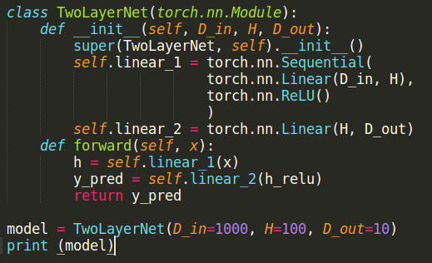
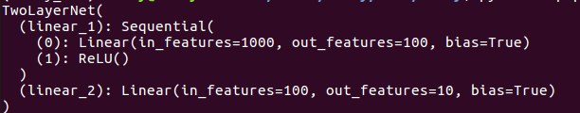
Print model

Slide 24
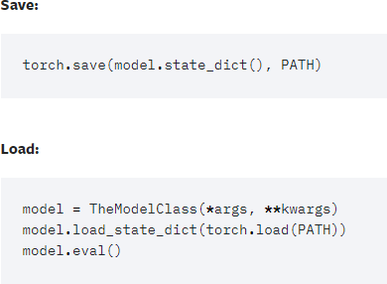
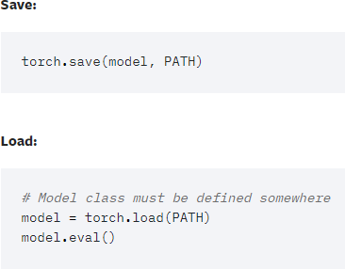
Save and Load model
Saving & Loading Model for Inference
Save/Load Entire Model

Slide 25
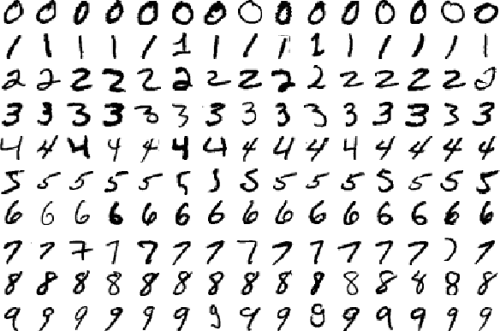
Real Application
MNIST example for PyTorch
https://github.com/pytorch/examples/tree/master/mnist

Slide 26
Build and train a CNN classifier
Data Loader
Define Network
Define Optimizer/Loss function
Learning rate scheduling
Training
Testing
Run and Save model

Slide 27
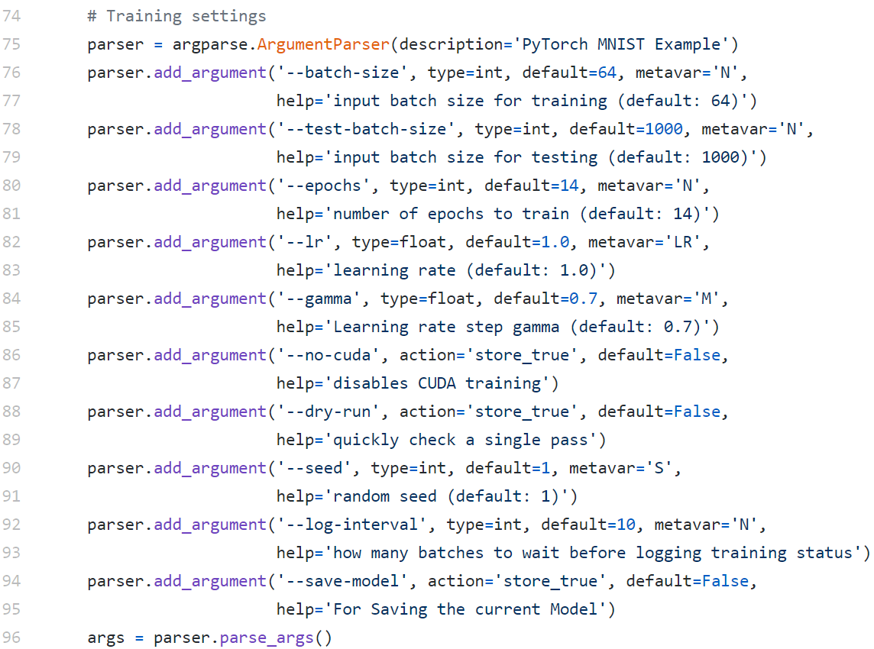
Set hyperparameters

Slide 28
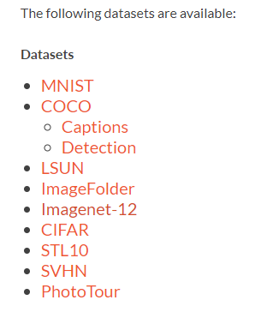
Data Loader
Pytorch offers data loaders for popular dataset

Slide 29
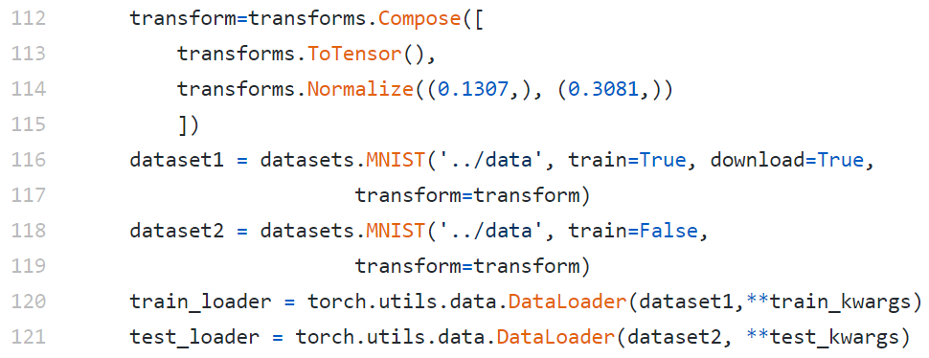
Data Loader

Slide 30
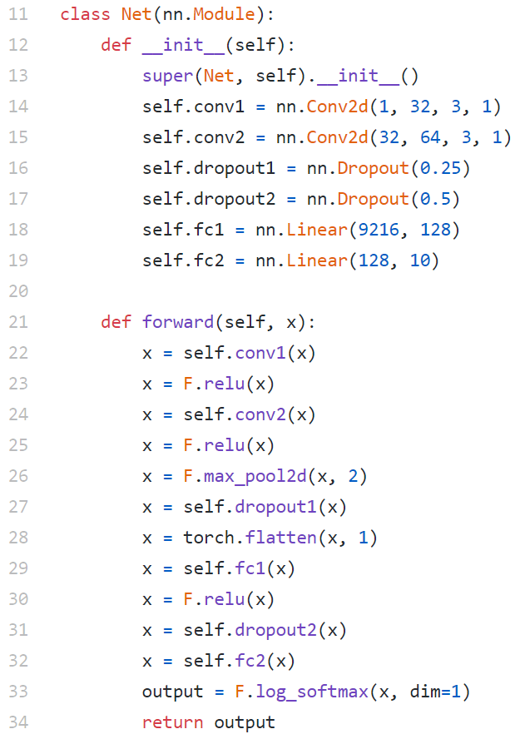
Define Network

Slide 31
Define Optimizer/Loss function
Negative log likelihood loss
Adadelta

Slide 32
Learning rate scheduling

Slide 33
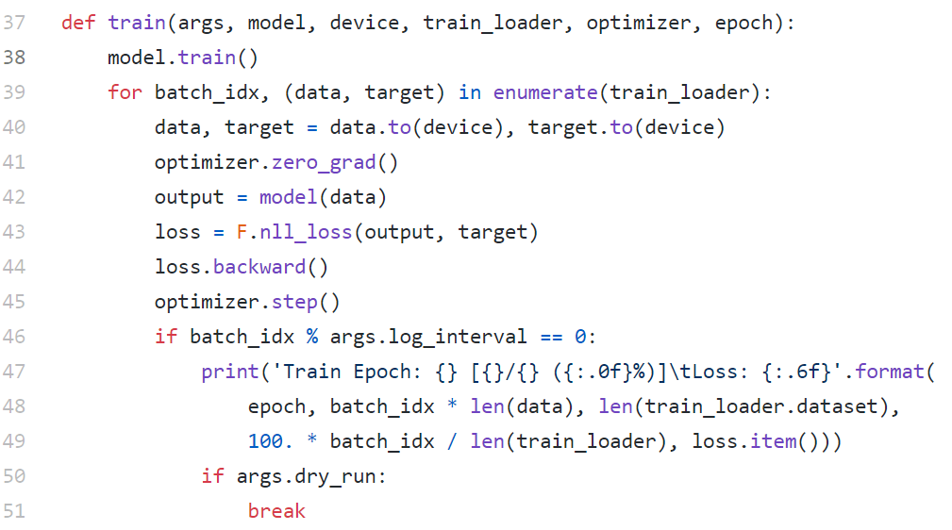
Training

Slide 34
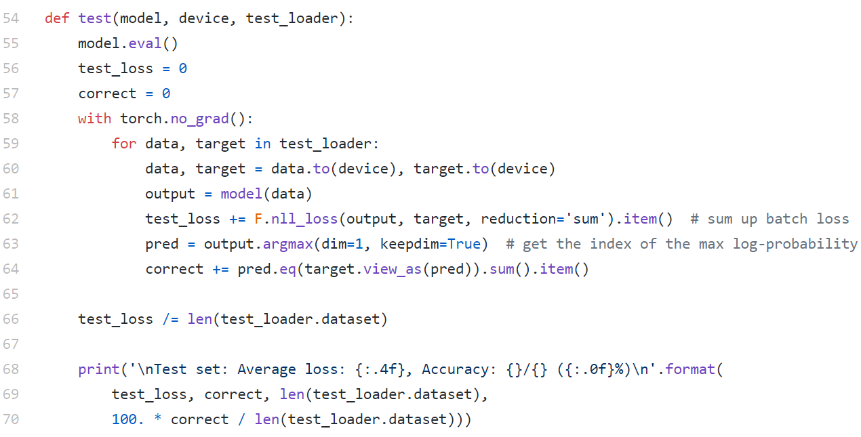
Testing

Slide 35
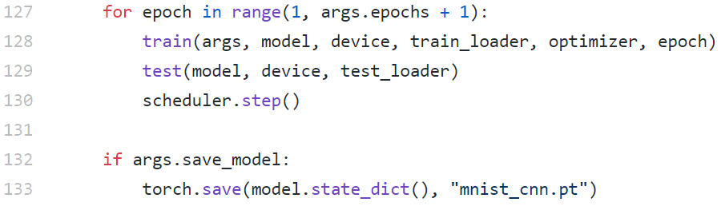
Run and Save model

Slide 36
Q&A

