Slide 1
HW2

Slide 2
Goal
Draw a sphere: Earth
The Earth is rotating.
Add textures on the Earth
*Use GLSL to do this homework, otherwise you’ll get zero points.

Slide 3
Spec
Camera:
Position: (0, 0, 3)
Center: (0, 0, 0)
Up vector: (0, 1, 0)
Earth:
Slice: 360
Stack: 180
Radius: 1
Texture: earth_texture_map.jpg

Slide 4
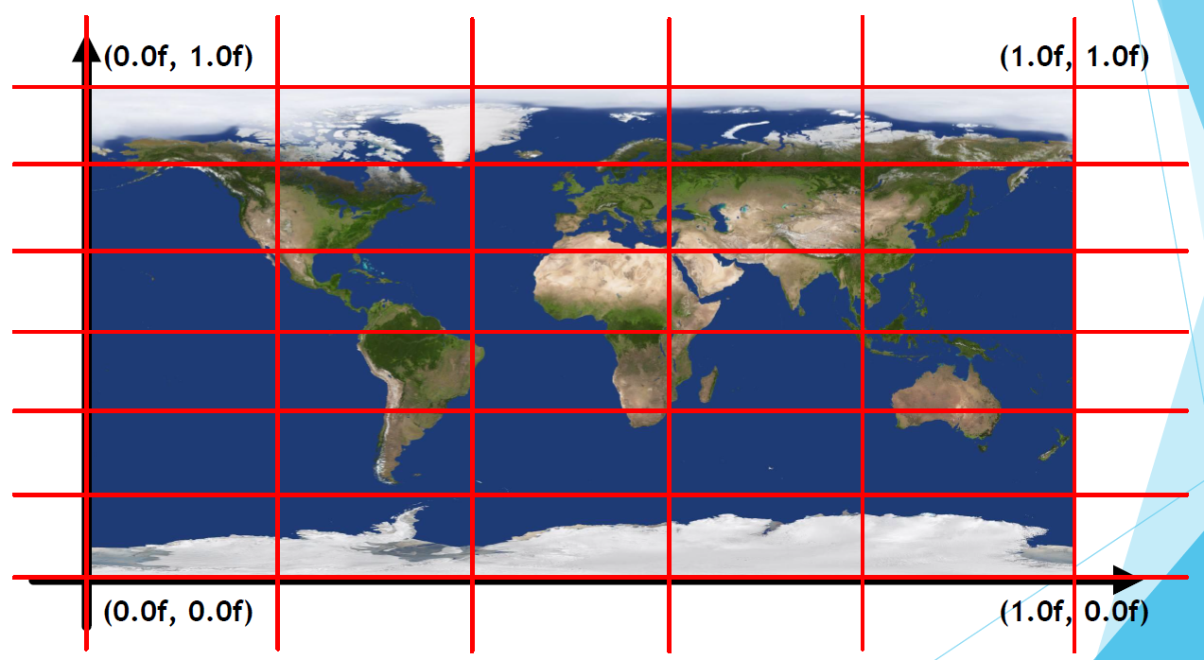
Texture coordinates
stack
slice

Slide 5
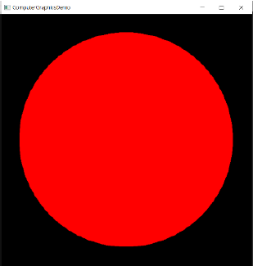
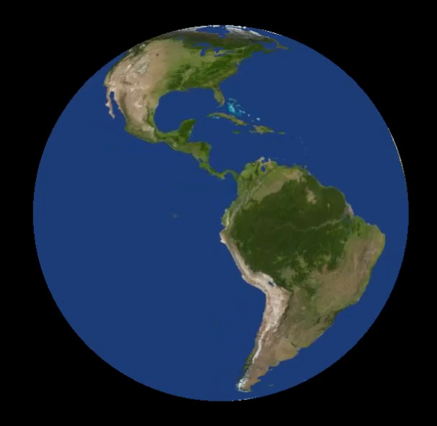
Score
1. Successfully draw a sphere and
show on the window. (65%) Ex:
2. Add the texture on the sphere and rotate it. (25%) Ex:
3. Demo (10%) (We will ask you some questions about this homework)

Slide 6
Others
Use Visual Studio 2017 or 2019 for this homework. (If you use Mac, you should bring your computer to demo.)
You can do this homework from the “HW2Example” project file and follow the instructions in HW2guideline.pdf.
Zip your Visual Studio project into “ StudentID_HW2.zip” , and upload it to New e3.
The deadline is at 11:55 pm on November 25.
If you submit your homework late, the score will be discounted.
submit between (11/26 ̴ 12/2) : Your final score * 0.9
submit between (12/2 ̴ 12/9) : Your final score * 0.8
submit after 12/10 : Your final score * 0.7

Slide 7
How to draw a sphere

Slide 8

Draw a sphere
y
(x, y, z) = (r*sinθ*sin∅, r*cos ∅, r*cosθ*sin ∅)
P
∅
r
O
x
Length of P’O = r*sin∅
Length of P’Z’ = r*sin∅*sinθ -> (x)
Length of OZ’ = r*sin∅*cosθ -> (z)
Length of PP’ = r*cosθ -> (y)
Z’
θ
P’
z

Slide 9
Draw a sphere
Triangle strip – Reuse some vertices to draw the triangles, so we can save the storage space.
According to the picture, we only need 5 vertices to store 3 triangles.
V2
V4
Triangle 3
Triangle 2
Triangle 1
2
1
3
V5
V1
V2
V3
V4
V5
V1
V3

Slide 10
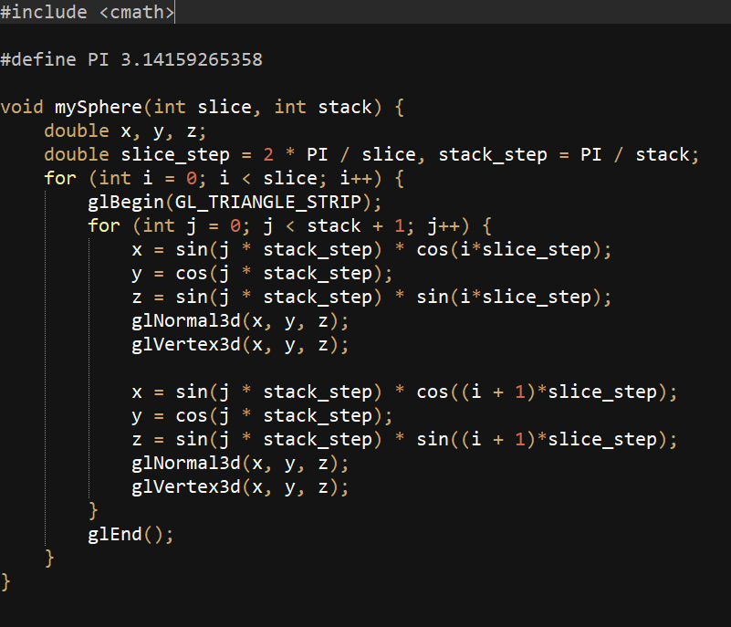
Draw a sphere
We will give you a sample code (sphere.cpp).
If you don’t know how to draw a sphere in HW1, you can take the code as reference.
The code is written in fixed function pipeline, you may need to change it to programmable pipeline in homework 2.

