Slide 1
HW3

Slide 2
Goal
1. Draw a sphere and apply Phong shading or Gouraud shading on it.
2. Use keyboard to control the lighting parameters.
*Use GLSL to do this homework, otherwise you’ll get zero points.

Slide 3
Spec
Camera:
Position: (0, 0, 5.6)
Center: (0, 0, 0)
Up vector: (0, 1, 0)
Sphere:
Slice: 360
Stack: 180
Radius: 1

Slide 4
Spec
Point light source : (draw a small sphere to represent the light source)
Position : (1.1, 1.0 , 1.3)
The color of the sphere : (0.4, 0.5, 0.0)
The radius of the sphere : 0.05
Keyboard control :
“1” : The parameter “Ks” decreases from 1 to 0 (Ks -= 0.1)
“2” : The parameter “Ks” increases from 0 to 1 (Ks += 0.1)
“3” : The parameter “Kd” decreases from 1 to 0 (Kd -= 0.1)
“4” : The parameter “Kd” increases from 0 to 1 (Kd += 0.1)

Slide 5
Spec
Phong Shading :
Ks = 0 (initial value)
Kd = 0 (initial value)
Ka = 0.5
alpha = 3.6
la = (0.2, 0.2, 0.2)
ld = (0.5, 0.5, 0.5)
ls = (0.8, 0.8, 0.8)

Slide 6
Score
1. Successfully draw a sphere and apply Gouraud shading on it. (70%)
2. Switch to Phong shading (Use keyboard “B”). (10%)
3. Use keyboard to control the Kd and Ks parameters. (10%)
4. Demo (10%)
(We will ask you some questions about this homework)
5. Bonus : (10%)
(1).Change to tone mapping (5%) (Use keyboard “B”)
(Set the threshold to map the color into 4 Intensity levels.)
(2).Add border enhancement (5%)
(Use keyboard “E” to enable and disable the border)

Slide 7
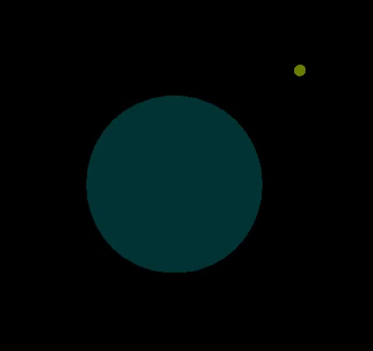
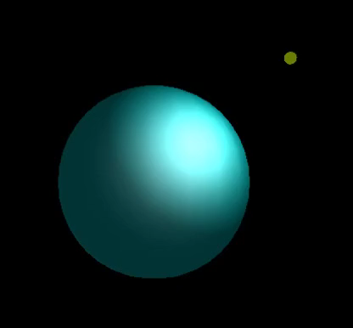
Example video
Phong shading
Control Kd and Ks
Phong shading、Gouraud shading、Tone mapping
Border enhancement
Point light
source
sphere

Slide 8
Others
You can do this homework based on your HW2.
Zip your Visual Studio project into “ StudentID_HW3.zip” , and upload it to New e3.
The deadline is at 11:55 pm on December 23.
If you submit your homework late, the score will be discounted.
submit between (12/24 ̴ 12/30) : Your final score * 0.9
submit between (12/31 ̴ 1/6) : Your final score * 0.8
submit between (1/6~1/10) : Your final score * 0.7

